Slide 1
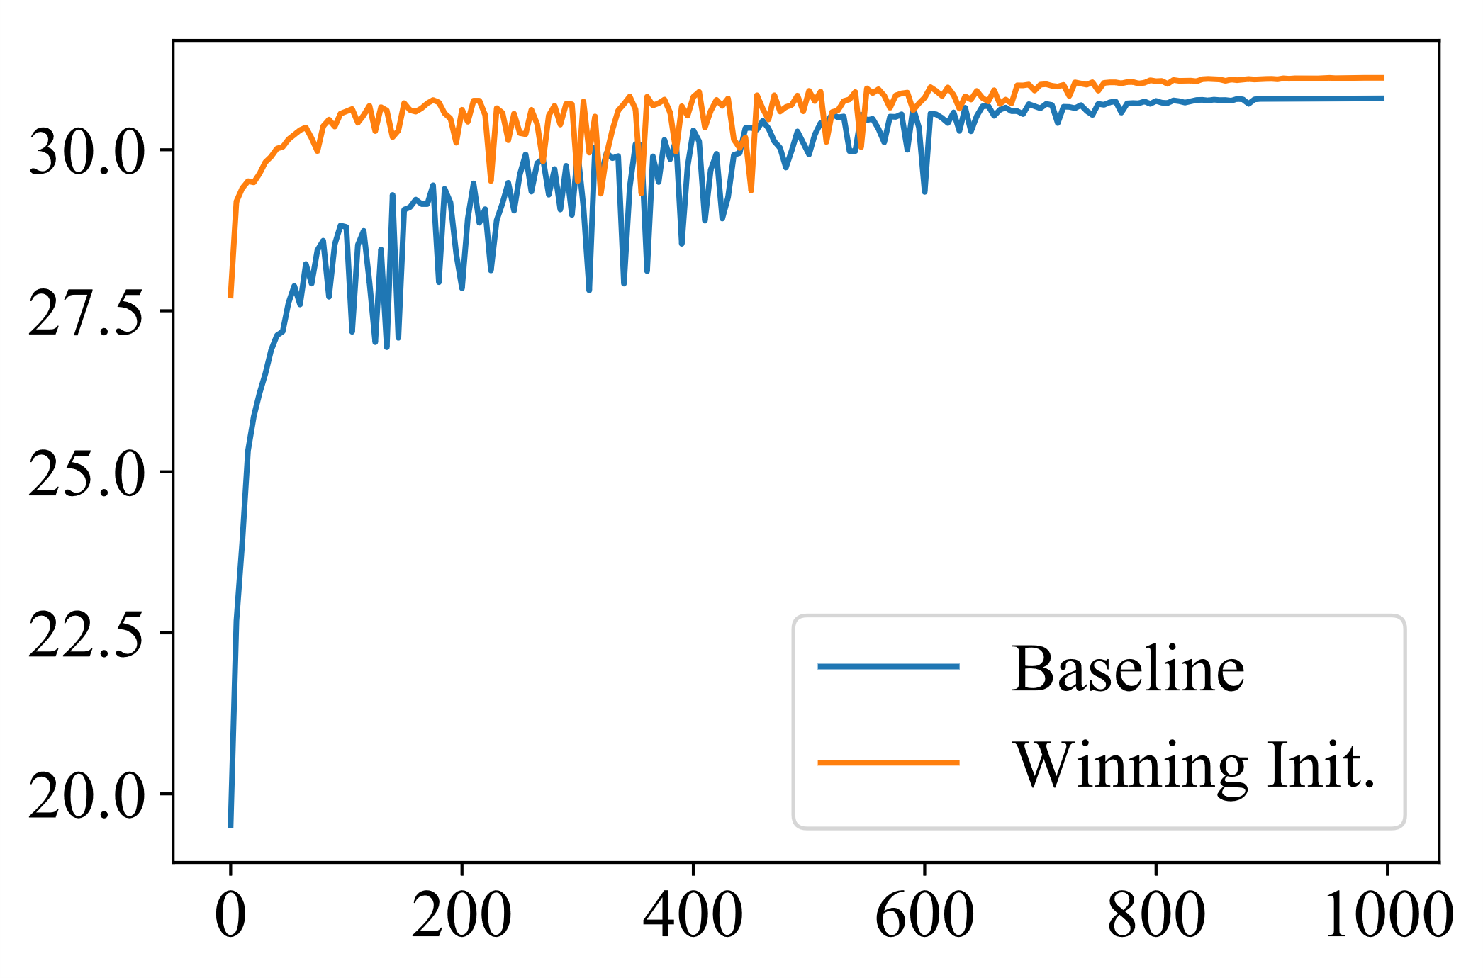
DIV2K Validation PSNR(dB)
Training Iterations(K)

