Slide 1
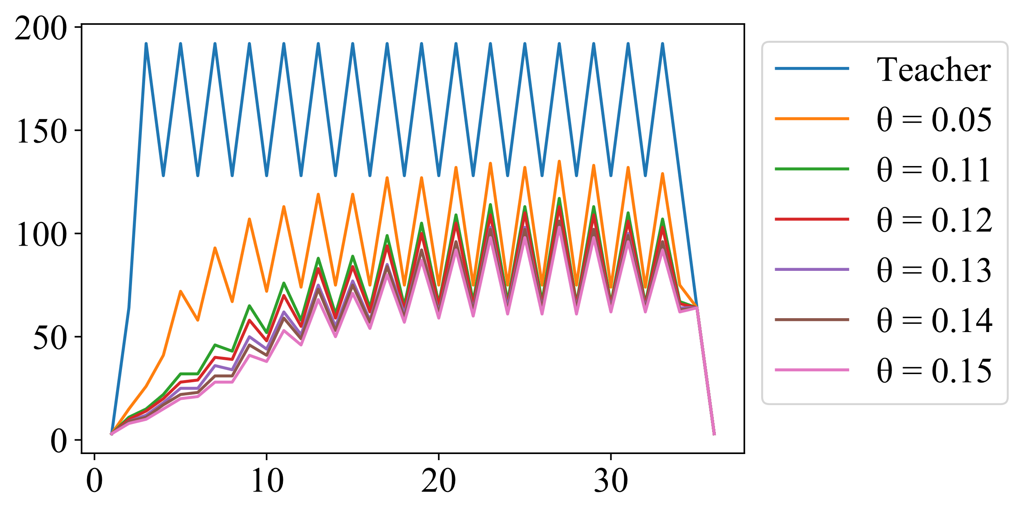
Filter Width
Layer Index

