Slide 1

Protect Your Privacy from Voice Seperation via Adversarial Attack
MMC Final Project
Kailu Wu
Wenjie Li
June 11, 2021

Slide 2

Privacy Disclosure of Voice Information
Smart Speakers like Amazon Echo may record your personal conversation.
Existing voice separation model can separate
your voice from other’s, which can be used to
learn your privacy
Smart Speaker
Figures from web. All copyrights belong to original sources.

Slide 3
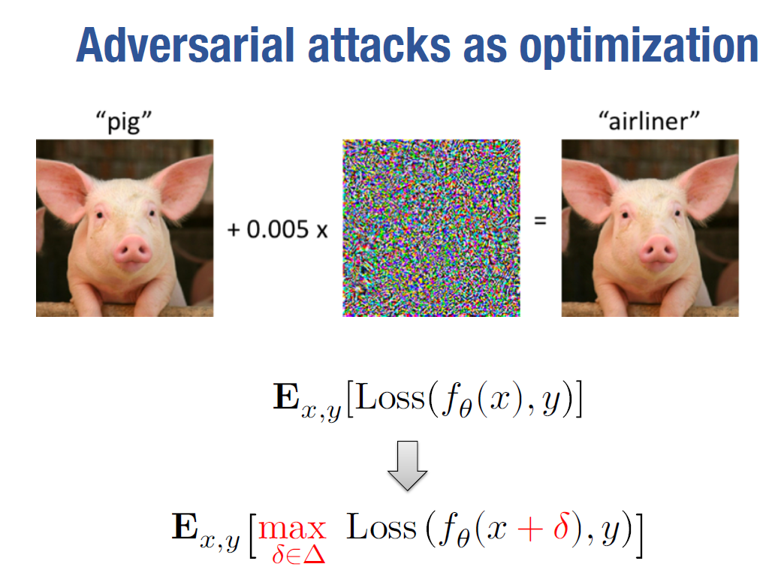
Inspiration from Image Adversarial Attack
Adversariay attaks as optimization like PGD works well on image classification.
For a given length, find a direction with largest loss
Image from MIT CSAIL

Slide 4
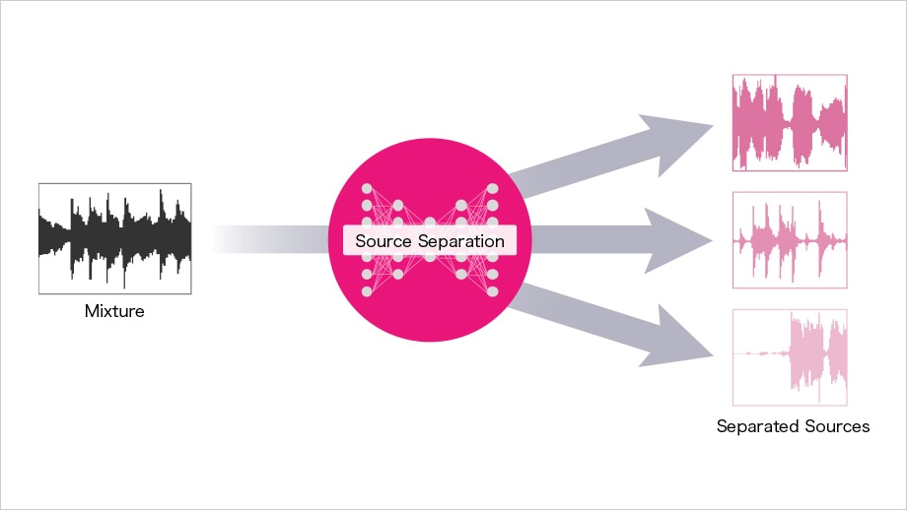
Proposed method
Intuition of proposed method is simple but efficient:
Use adversarial attacks to prevent speakers from voice separation.
Limit the effect of adversarial attacks to make sure the conversation can be understand by human.
Adversarial Attacks on Spectrogram!
*Picture from 'Reviving the Sound of Classic Movies with AI'

Slide 5
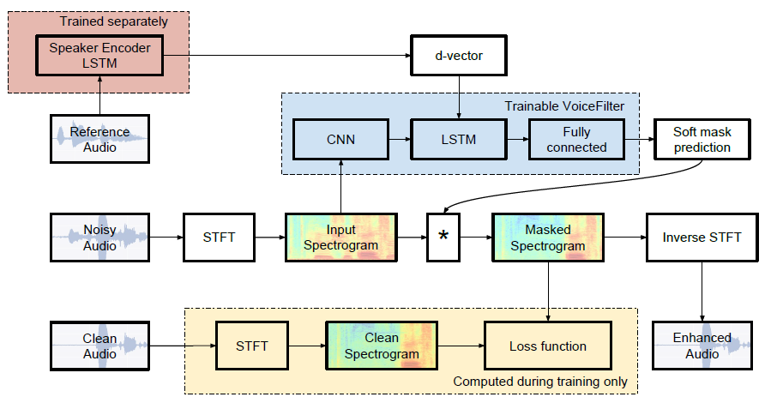
Where the Attack Work on
Adversarial Attacks
*Picture from ‘VoiceFilter’

Slide 6
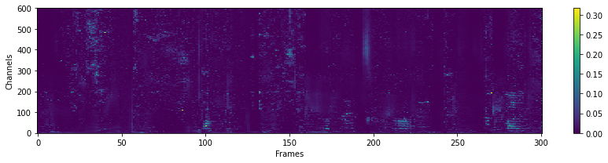
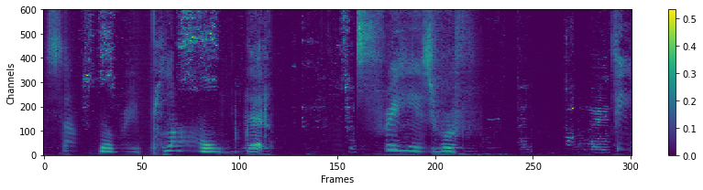
Experimental Results
White Box Attack (Input Spectrogram + Model + d-vector)
 | Test Loss | SDR
Baseline | 0.0078 | 2.77
PGD (0.05) | 0.0489 | -4.44

Slide 7
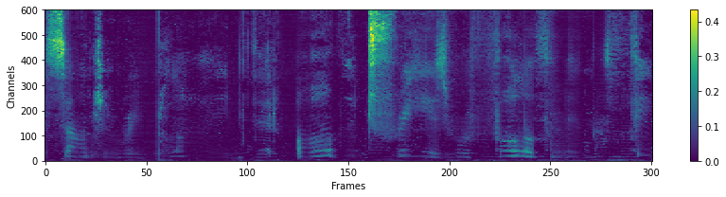
Gray-box Attack
Input Spectrogram + Model + d-vector
Replace d-vector with a Gaussian Noise.
 | Test Loss | SDR
Baseline | 0.0078 | 2.77
PGD (0.05) | 0.049 | -2.95

Slide 8
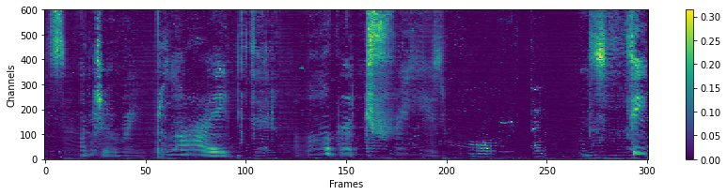
Black-box Attack
Input Spectrogram + Model + d-vector
 | Test Loss | SDR
Baseline | 0.0078 | 2.77
PGD (0.05) | 0.036 | -4.26
Notes:
由于第二个模型没有跑完，所以拿了第一个模型（Baseline是17000 iter版本）的第 12000 iter 版本。

Slide 9

What the attack sounds like?
Mixed
Mixed with Attack
Separated with Attack
Separated without Attack
Ground Truth

Slide 10
Future Works
Black-box attack on both spectrogram and log-spectrogram.
Black-box attack on different type of models.
Weighted black-box attack on spectrogram.
Real-world audio adversarial attacks.

Slide 11
Thanks for Your Attention! Q&A
Kailu Wu
Wenjie Li
June 11, 2021

