Slide 1



X
Sales Dashboard and Data Analysis for Kimia Farma (2020-2023)
Kimia Farma - Big Data Analytics
Presented by
Wulan Indah Chahyani

Slide 2
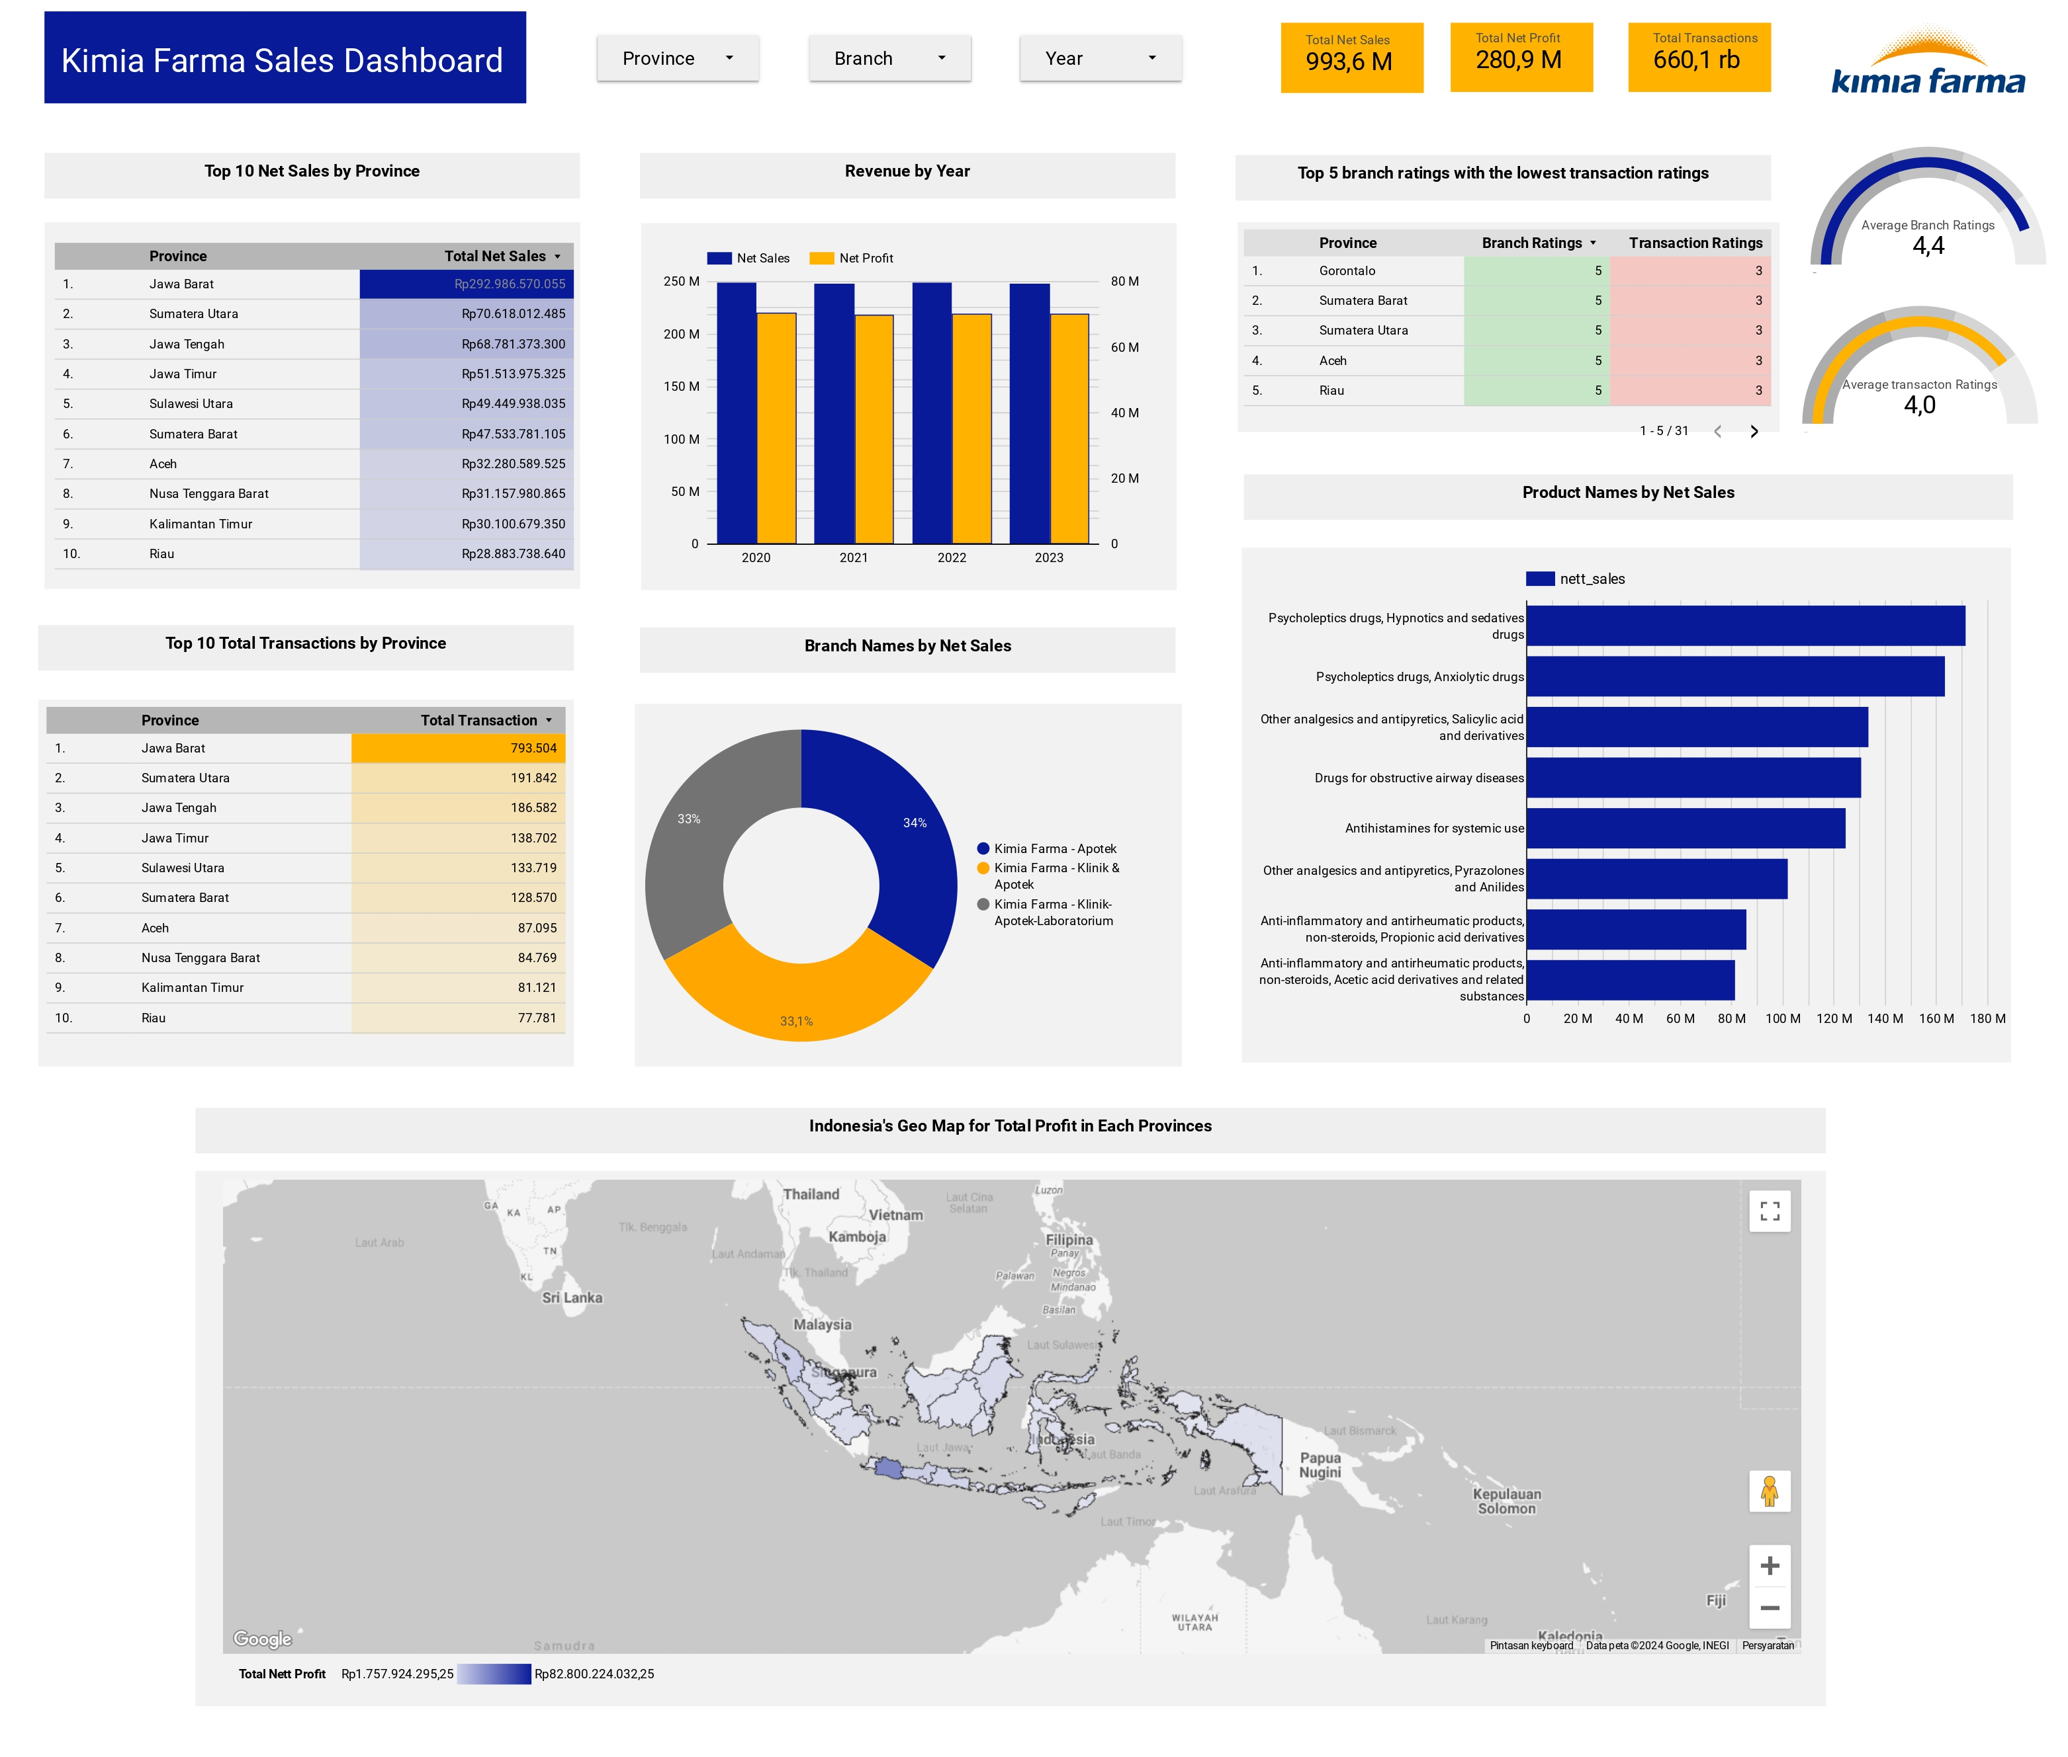


Slide 3
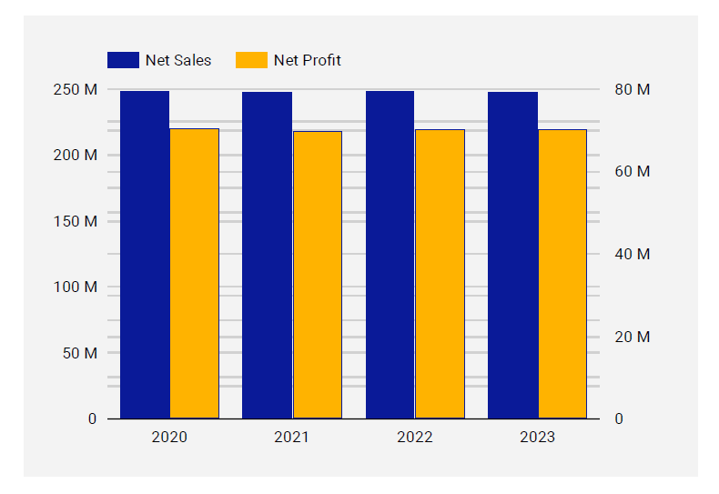
Revenue Trends: 2020-2023
Revenue remains stable from 2020-2023, with notable fluctuations
2020: This year saw the highest net sales, reflecting a strong start
2021: We experienced a significant drop in net sales, indicating potential external or internal challenges
2022: The revenue bounced back, showing resilience and recovery
2023: There was a slight decline compared to 2022

Slide 4
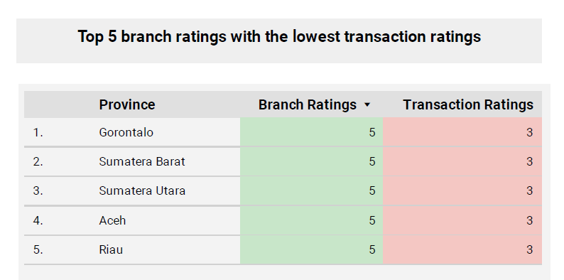
Branch Performance Insights
Gorontalo, Sumatera Barat, Sumatera Utara, Aceh, and Riau - These branches, despite having a significant customer base, are receiving lower ratings for transactions
These branches might need operational improvements to boost transactions

Slide 5
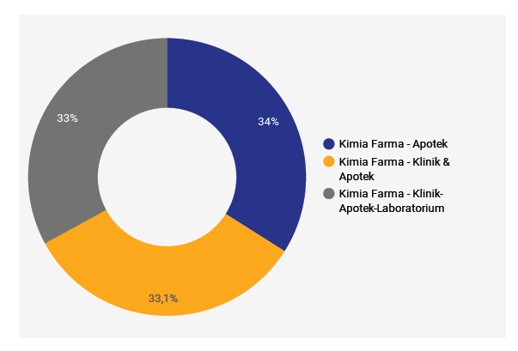
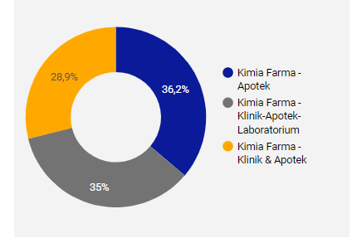
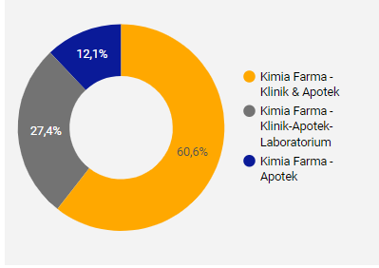
Branch Distribution by Net Sales
Branch Distribution all provinces
Branch Distribution in Jawa Barat
Branch Distribution in NTT
Analyzing the distribution of branches by net sales reveals a balanced presence of different branch types—Apotek (34%), Klinik & Apotek (33.1%), and Klinik-Apotek-Laboratorium (33%)—across various provinces
Each branch type contributes significantly to the overall sales, reflecting a well-balanced strategy
Provinces with the highest net sales, such as Jawa Barat and Sumatera Utara, benefit from this distribution, while provinces with lower sales could potentially improve by adopting a similar model

Slide 6
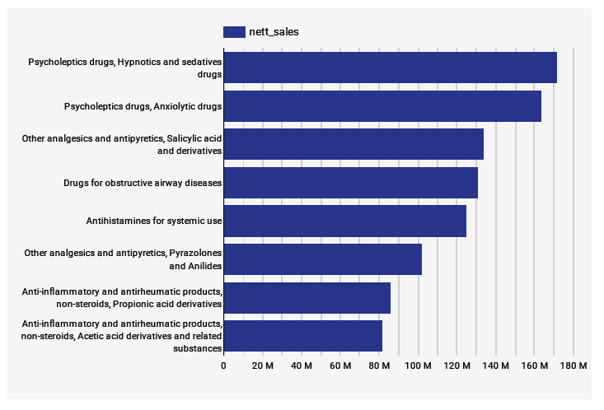
Top-Selling Products
Psycholeptics, hypnotics, and sedatives are the top-selling products, this indicates a strong demand for mental health-related medications.

Slide 7
Recommendations
Boost Marketing in High-Performing Provinces: Focus on Jawa Barat, Sumatera Utara, and Jawa Tengah to maximize sales opportunities
Enhance Operations in Low-Performing Branches: Investigate and improve operations in branches like Aceh and Riau which have high customer satisfaction but low sales
Expand Product Range: Introduce new products in high-demand categories like Psycholeptics and Analgesics to capture more market share
Ensure Equitable Branch Distribution: Maintain a balanced distribution of branch types across all provinces to ensure consistent sales performance
Enhance Underperforming Provinces: Develop targeted strategies to boost revenue in provinces with the lowest net sales, such as increasing marketing efforts, improving branch services, and ensuring product availability

Slide 8
Thank You
X
Logo Company

