Slide 1
Implementation of D/A converters in nano-scale CMOS Technology
Carsten Wulff

Slide 2
Implementation of
the act of implementing − providing a practical means for accomplishing something
D/A converters
digital to analog converters − a electronic circuit that transforms a digital signal into an analog signal
in nano-scale
with transistor lengths less than 100nm
CMOS Technology
complementary metal oxide semiconductor technology − the dominating technology for electronic circuits

Slide 3
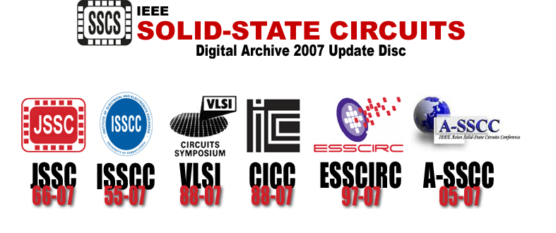
Information source: Institute of Electrical and Electronics Engineers
http://ieeexplore.ieee.org/

Slide 4
Part 1: Introduction
Where are digital to analog converter used?
What is a digital to analog converter?
Why choose nano-scale CMOS?
Part 2: Implementation challenges in nano-scale CMOS
Reduced supply voltage
Well proximity effect
Shallow trench isolation stress

Slide 5
Part 1: Introduction

Slide 6

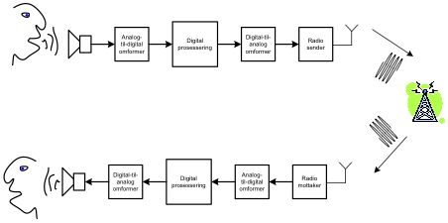
Where are digital to analog converters used?
Inside of a cell phone
ADC
Digital Processor
DAC
TX
DAC
Digital Processor
ADC
RX

Slide 7
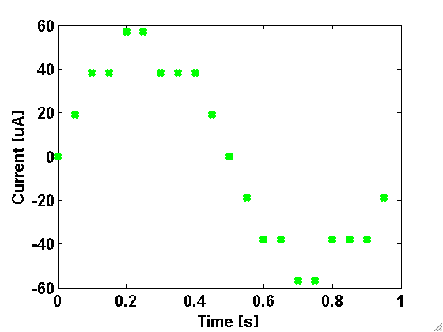
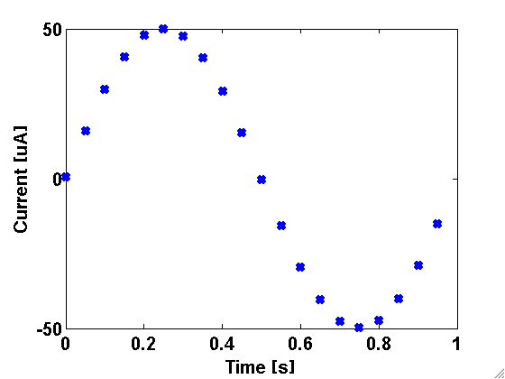
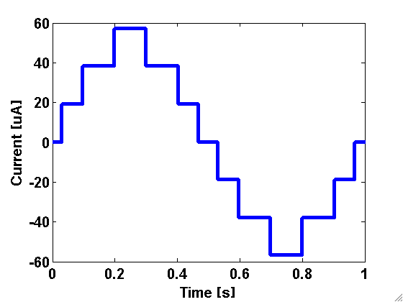
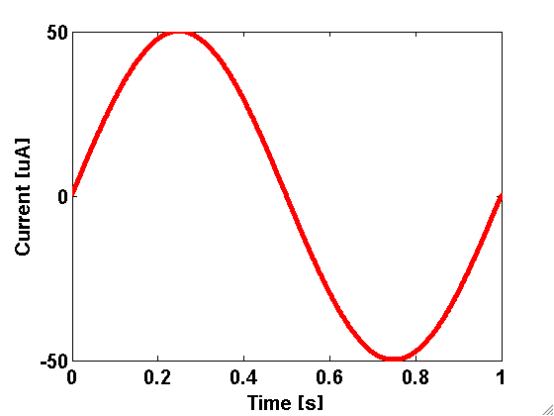
What is a digital to analog converter?
Digital
Discrete time
Discrete value
Discrete time
Continuous value
Continuous time
Discrete value
Continuous time
Continuous value
Analog

Slide 8

Sound examples, how many bits do you need?
2-bit DAC
4 levels
Original
4-bit
DAC
16 levels
8-bit DAC
256 levels

Slide 9
Do you really need that many bits?
1.5-bit DAC
Original
Sigma-delta Modulator
1.5-bit DAC
Low-pass filter
Notes:
15 minutes

Slide 10
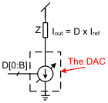
The most common method of digital-to-analog conversion in nano-scale CMOS technology

Slide 11
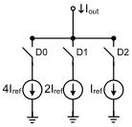
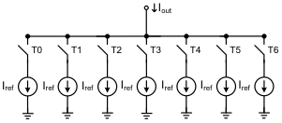
The alternatives
Binary weighted
Low area
Low load on digital inputs
Poor matching
Large glitches
Thermometer weighted
Large area
High load on digital inputs
Good matching
Small glitches
DACs are usually implemented as a combination of the two alternatives

Slide 12
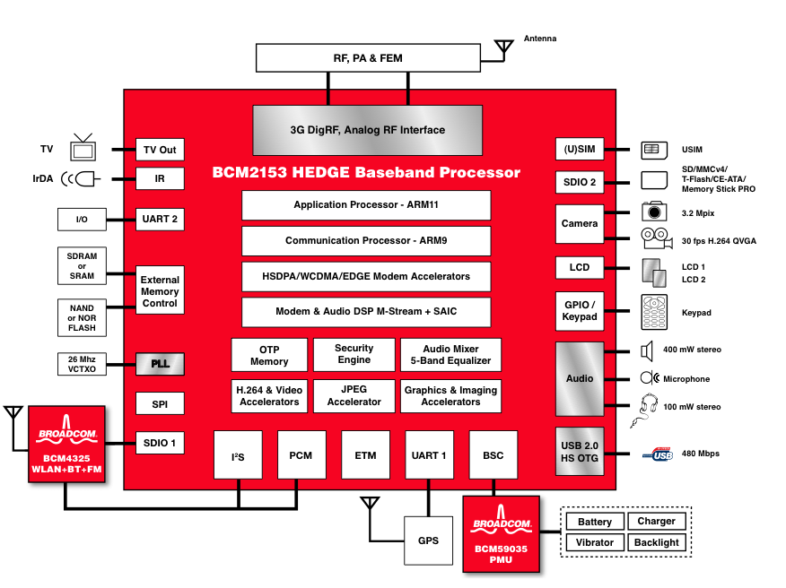
Why choose nano-scale CMOS?
Broadcom: BCM2153 7.2-Mbps HEDGE 65-nm Multimedia Baseband Processor

Slide 13
Part 2: Implementation challenges in nano-scale CMOS

Slide 14
Key papers:
Seo et al, A Low-Spurious Low-Power 12-bit 160-MS/s DAC in 90-nm CMOS for Baseband Wireless Transmitter, JSSC, March, 2007
ISI, timing synchronization and jitter = switching distortion
Source degenerated differential pair to improve switch characteristics
Mismatch caused by Shallow Trench Isolation stress (STI stress)
Mismatch caused by Well Proximity Effect (WPE)
Savoj et al, A 12-GS/s Phase-Calibrated CMOS Digital-to-Analog Converter for Backplane Communications, JSSC, May, 2008 (90nm)
RC delay induced mismatch
Gradient errors
Using higher than maximum power supply

Slide 15
Reduced power supply
From ITRS roadmap [http://www.itrs.net]

Slide 16
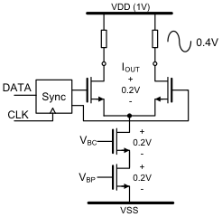
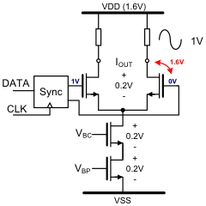
Low headroom

Slide 17
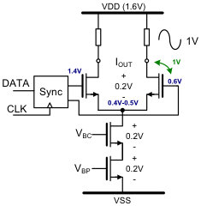
Living outside the rails
Be careful of:
- Voltages during startup
- Reliability, a good idea to run age simulations
[Savoj, JSSC, May 2008]

Slide 18
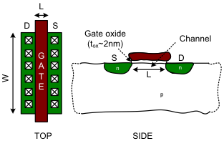
Mismatch of transistors
μ_{n} = mobility, C_{ox} = ε_{ox}ε₀/t_{ox} = Oxide capacitance, V_{GS} = Gate source voltage, V_{T} = threshold voltage
[Razavi,2000]

Slide 19
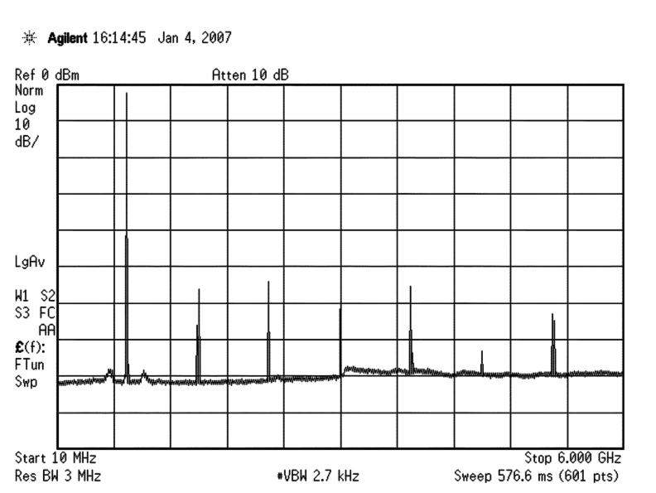
Mismatch leads to decreased linearity
Spurious free dynamic range (SFDR)
[Savoy, JSSC, May 2008]
More mismatch = less SFDR

Slide 20
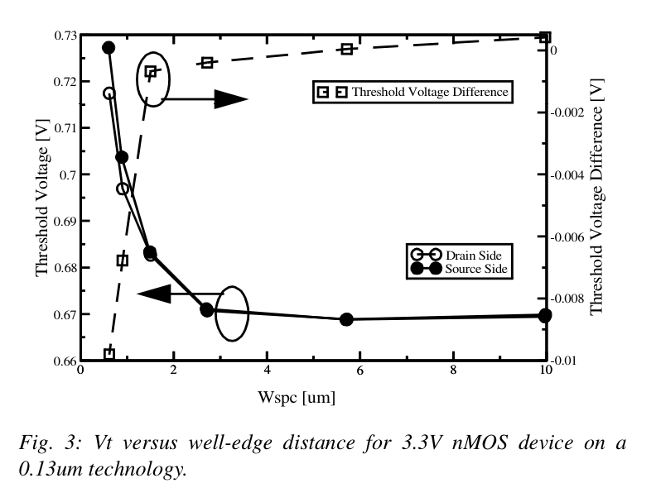
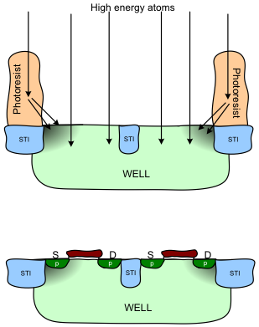
Well Proximity Effect
[Drennan,CICC,2006]

Slide 21
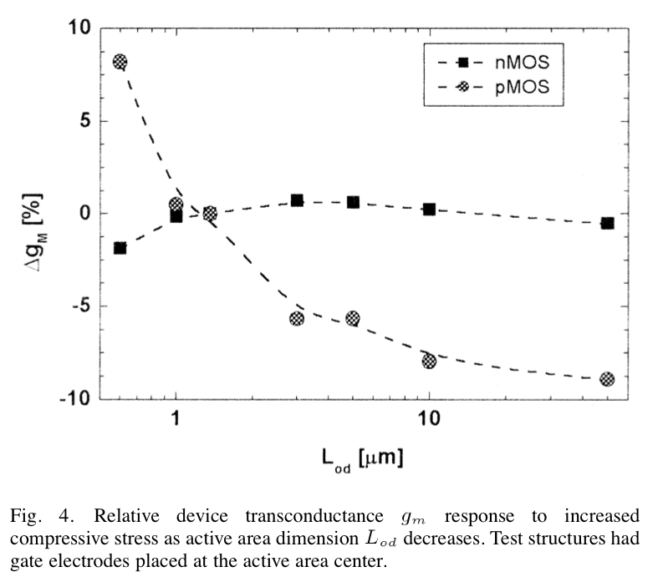
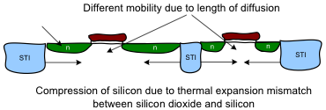
Shallow trench isolation (STI) stress
Modeled by the parameters sa,sb and sd in SPICE
[Diaz, JSSC, March 2003]

Slide 22
Conclusion
Living with low voltage supply
You can use higher than maximum power supply but you need to be careful
Reducing mismatch from WPE and STI stress
Place transistors far from well edge (>3μm)
Simulate on layout early to get the effect of STI stress

Slide 23
List of papers
Fang et al, A 6-b DAC and Analog DRAM for a Maskless Lithography Interface in 90 nm CMOS, A-SSCC 2006
Cao et al, A 10-bit 1GSample/s DAC in 90nm CMOS for Embedded Applications, CICC 2006
Drennan et al, Implications of Proximity Effects for Analog Design, CICC 2006
Evans et al, Deep Submicron Effects on Data Converter Building Blocks, CICC 2008
Seddighard et al, A 3.6GHz, 16mW Σ∆ DAC for a 802.11n / 802.16e transmitter with 30dB digital power control in 90nm CMOS, ESSCIRC 2008
Pozsgay et al, A Fully Digital 65nm CMOS Transmitter for the 2.4- to-2.7GHz WiFi/WiMAX Bands using 5.4GHz AX RF DACs, ISSCC 2008
Schell et al, A Clockless ADC/DSP/DAC System with Activity Dependent Power Dissipation and No Aliasing, ISSCC 2008
Seo et al, A Low-Spurious Low-Power 12-bit 160-MS/s DAC in 90-nm CMOS for Baseband Wireless Transmitter, JSSC March 2007
Savoj et al, A 12-GS/s Phase-Calibrated CMOS Digital-to-Analog Converter for Backplane Communications, JSSC May 2008 & VLSI 2007
Diaz et al, Process and Circuit Design Interlock for Application-Dependent Scaling Tradeoffs and Optimization in the SoC Era, JSSC March 2003
Drennan et al, Understanding MOSFET Mismatch for Analog Design, JSSC March 2003

