Slide 1
Implementation of D/A converters in nano-scale CMOS Technology
Carsten Wulff

Slide 2
Implementation of
the act of implementing − providing a practical means for accomplishing something
D/A converters
digital to analog converters − a electronic circuit that transforms a digital signal into an analog signal
in nano-scale
with transistor lengths less than 100nm
CMOS Technology
complementary metal oxide semiconductor technology − the dominating technology for electronic circuits

Slide 3
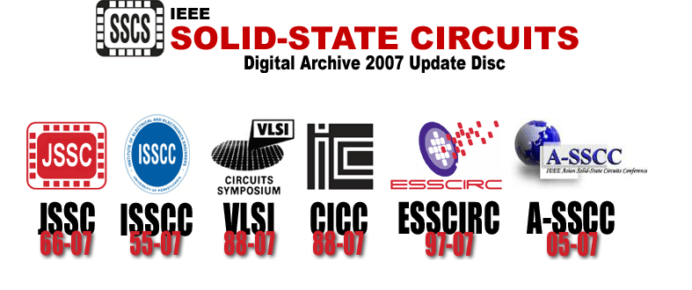
Information source: Institute of Electrical and Electronics Engineers
http://ieeexplore.ieee.org/

Slide 4
Part 1: Introduction
Where are digital to analog converter used?
What is a digital to analog converter?
Why choose nano-scale CMOS?
Part 2: Implementation challenges in nano-scale CMOS
State of the art
Cause, effects and solutions for challenges in nano-scale CMOS

Slide 5
Part 1: Introduction

Slide 6

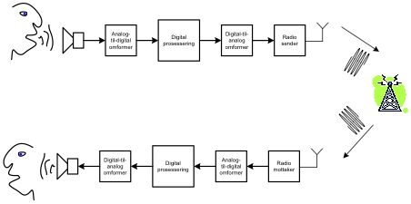
Where are digital to analog converters used?
Inside of a cell phone
ADC
Digital Processor
DAC
TX
DAC
Digital Processor
ADC
RX

Slide 7
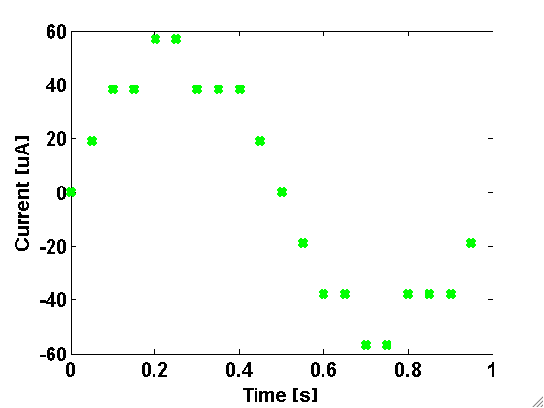
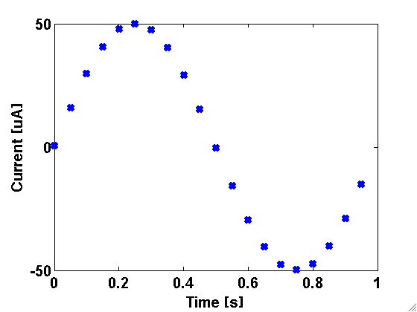
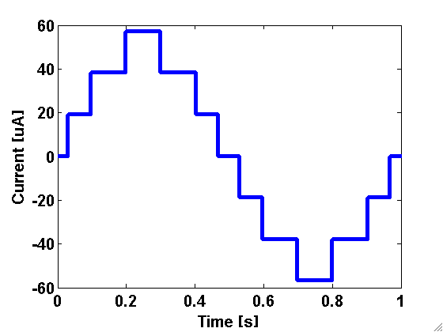
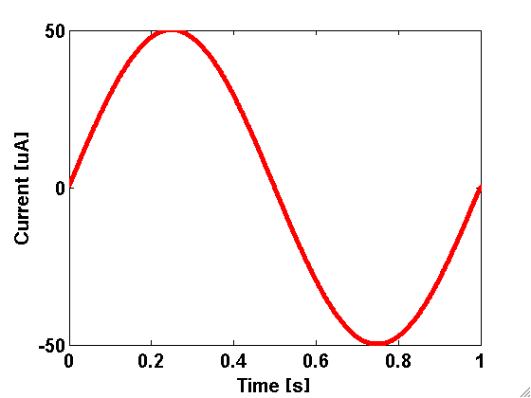
What is a digital to analog converter?
Digital
Discrete time
Discrete value
Discrete time
Continuous value
Continuous time
Discrete value
Continuous time
Continuous value
Analog

Slide 8

Sound examples, how many bits do you need?
2-bit DAC
4 levels
Original
4-bit
DAC
16 levels
8-bit DAC
256 levels

Slide 9
Do you really need that many bits?
1.5-bit DAC
Original
Sigma-delta Modulator
1.5-bit DAC
Low-pass filter

Slide 10
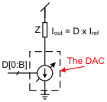
The most common method of digital-to-analog conversion in nano-scale CMOS technology

Slide 11
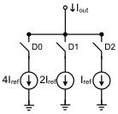
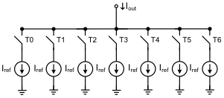
The alternatives
Binary weighted
Low area
Low load on digital inputs
Poor matching
Thermometer weighted
Large area
High load on digital inputs
Good matching
DACs are usually implemented as a combination of the two alternatives

Slide 12
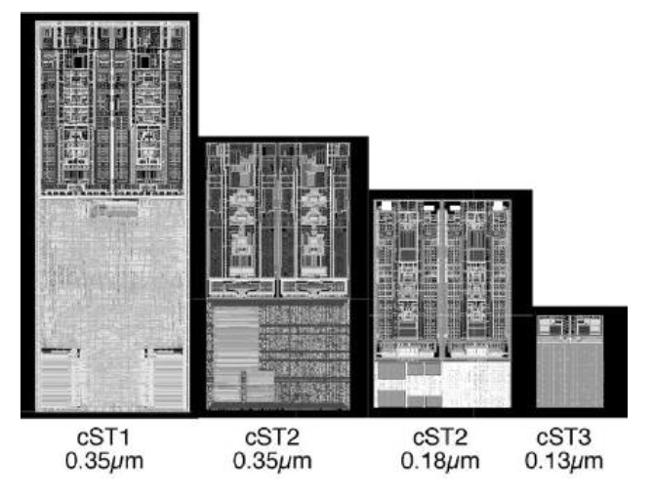
Why choose nano-scale CMOS?
Evolution of a stereo DAC, ST Microelectronics [Colonna05]

Slide 13
Part 2: Implementation challenges in nano-scale CMOS

Slide 14
Key papers:
Cao et al, A 10-bit 1GSample/s DAC in 90nm CMOS for Embedded Applications, CICC 2006
Current source mismatch
Finite output impedance
Zeijl et al, A Digital Envelope Modulator for a WLAN OFDM Polar Transmitter in 90nm CMOS, JSSC, October, 2007
Interconnection induced non-linearity
Mismatch caused by metal tiling
Seo et al, A Low-Spurious Low-Power 12-bit 160-MS/s DAC in 90-nm CMOS for Baseband Wireless Transmitter, JSSC, March, 2007
ISI, timing synchronization and jitter = switching distortion
Degenerated current source to improve switch characteristics
Mismatch caused by Shallow Trench Isolation stress (STI stress)
Mismatch caused by Well Proximity Effect (WPE)
Savoj et al, A 12-GS/s Phase-Calibrated CMOS Digital-to-Analog Converter for Backplane Communications, JSSC, May, 2008
RC delay induced mismatch
Gradient errors
Using higher than maximum power supply

Slide 15
Cause: Reduced power supply
From ITRS roadmap [1]

Slide 16
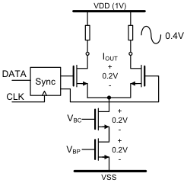
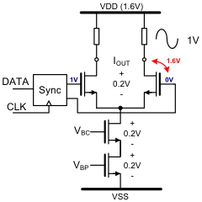
Effect: Low headroom

Slide 17
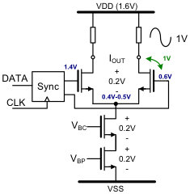
Solution: Living outside the rails
Be careful of:
- Voltages during startup
- Reliability, a good idea to run age simulations
[Savoy, JSSC, May 2008]

Slide 18
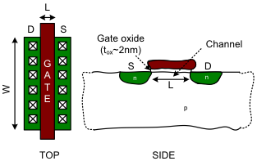
Cause: Mismatch
μ_{n} = mobility, C_{ox} = ε_{ox}ε₀/t_{ox} = Oxide capacitance, V_{GS} = Gate source voltage, V_{T} = threshold voltage

Slide 19
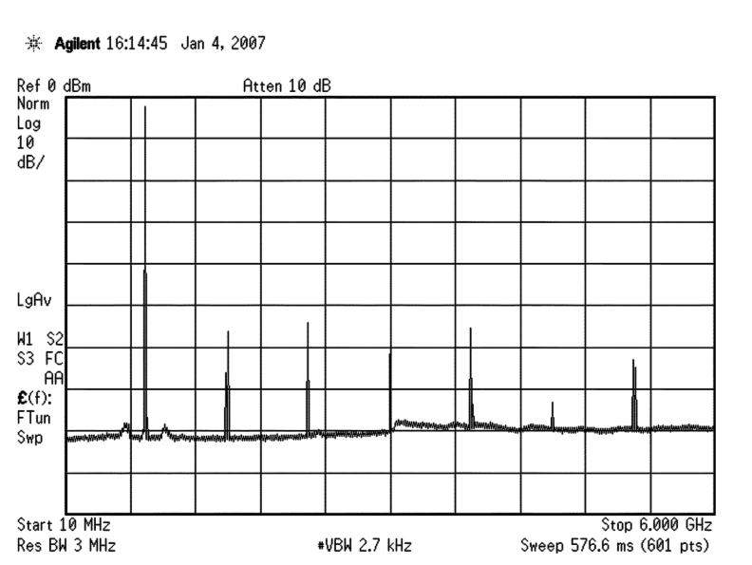
Effect: decreased linearity
Spurious free dynamic range (SFDR)
[Savoy, JSSC, May 2008]
More mismatch = less SFDR

Slide 20
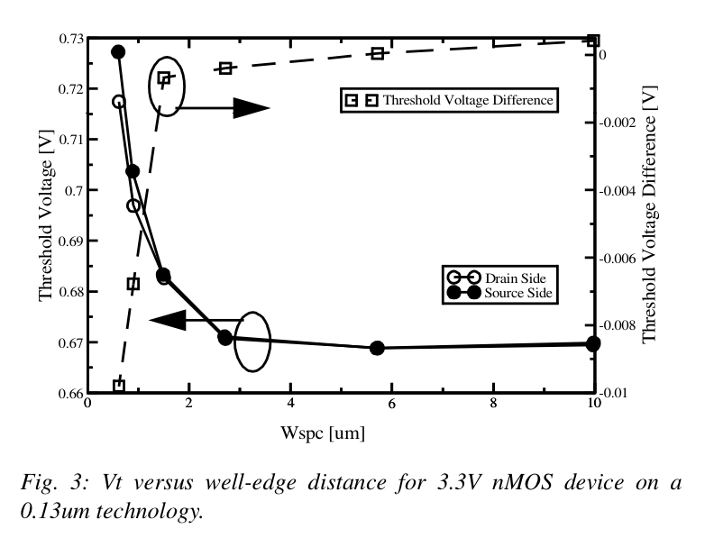
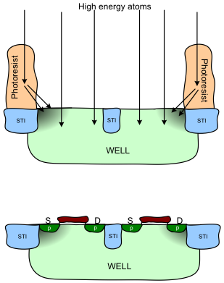
Well Proximity Effect
[Drennan,CICC,2006]

Slide 21
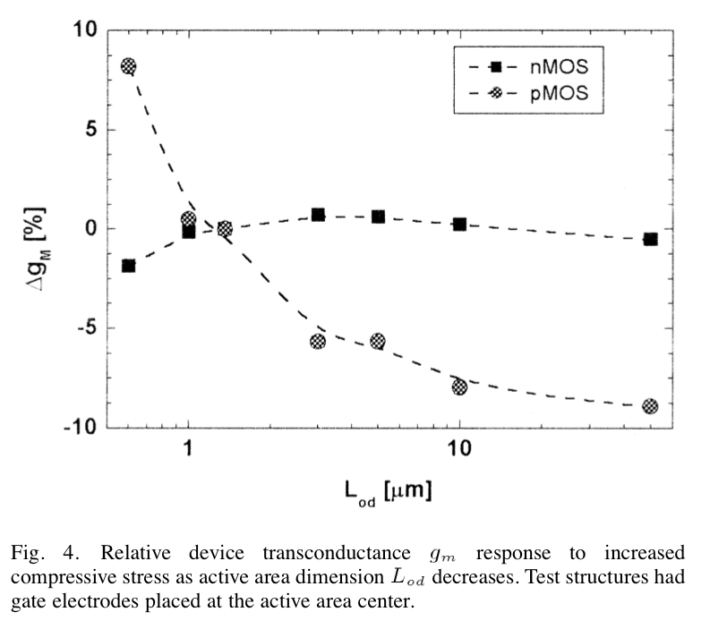
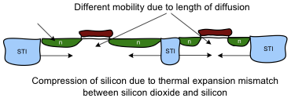
Shallow trench isolation (STI) stress
Modeled by the parameters Sa and Sb in SPICE
[Diaz, JSSC, March 2003]

Slide 22
Conclusion
Living with low voltage supply
You can use higher than maximum power supply but you need to be careful
Reducing mismatch
Place transistors far from well edge (>3μm)
Simulate on layout early to get the effect of STI stress

