Slide 1
Analog Modulo Integrator For Use In Open-Loop Sigma-Delta Modulators
Carsten Wulff, Øystein Knauserud, Trond Ytterdal
Department of Electronics and Telecommunication
Norwegian University of Science and Technology

Slide 2
Outline
Motivation for Open-Loop Sigma Delta Modulation (OLSDM)
Analog Modulo Integrator
Simulations of Analog Modulo Integrator
Simulations of OLSDM
Future Work
Notes:
The outline for todays talk is as follows. First we’ll look into what OLSDM is and why we want to do OLSDM. Then we’ll look at the “analog modulo integrator” which is a block necessary to do amplitude modulation OLSDM. The “analog modulo integrator” we believe to be a new circuit not previously published. After a detailed look at the operation of the “analog modulo integrator” we’ll se some simulations of the circuit and the OLSDM.

Slide 3
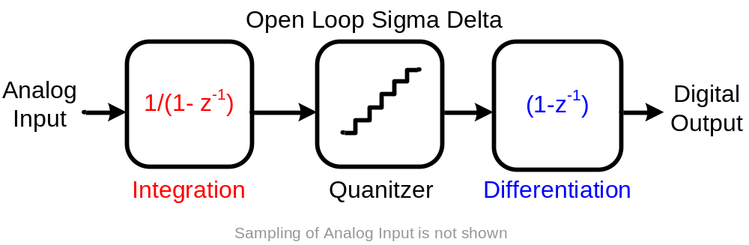
Motivation
What is Open-Loop Sigma Delta Modulation?
  It is Sigma Delta Modulation without global feedback, for low pass Sigma Delta it will be an integrator followed by a quantizer and a differentiator
Why do Open-Loop Sigma Delta?
  Removes feedback DAC, may potentially alleviate linearity problems in Sigma Delta modulators with multi bit quantizers
Notes:
Open-Loop Sigma Delta modulation is basically Sigma Delta modulation without global feedback. For the low pass case it can be seen as a integrator followed by a quantizer and a differentiator. Notice there is ideally no feedback from the digital side. This is of course quite difficult since an ideal integrator has infinite DC gain, thus we have to limit the output of the integrator in some way to do a real implementation. The potential advantage of this approach is that for multi bit quantizers we do not need multi bit DACs, so there is a potential for linearity improvement. We will not discuss the tradeoffs between open loop and closed loop since this paper is just to show that amplitude modulation OLSDM is possible.

Slide 4
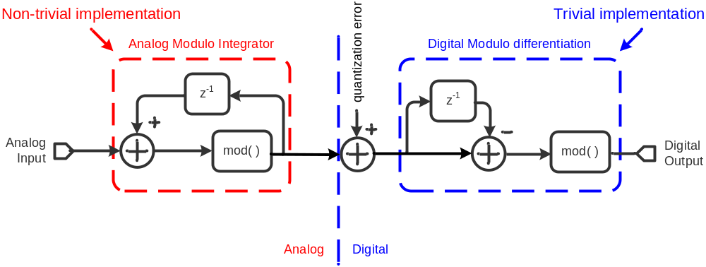
Analog-to-Digital OLSDM
Do an operation on analog side to limit signal swing (modulo integration), and do the inverse operation on the digital side (modulo differentiation)
  STF(Signal Transfer Function): digital output = analog input
  NTF(Noise Transfer Function) : digital output = (1-z⁻¹) quantization error
Need to implement analog modulo integration:
  Frequency-to-digital Sigma-Delta Modulator [1]
  Our approach: Make an analog modulo integrator
Notes:
The modulo operation can be used to limit the output swing of the analog integrator. By doing modulo integration followed by modulo differentiation we get a conventional low pass sigma delta signal transfer function, this has previously been shown in [1]. Digital modulo differentiation is very simple to implement, analog modulo integration is also conceptually simple, but doing it without wasting signal swing is a challenge. The analog modulo integration has previously been implemented using a Frequency-to-Digital operation [1]. We will show that it is also possible to do in the amplitude domain without wasting signal swing.

Slide 5
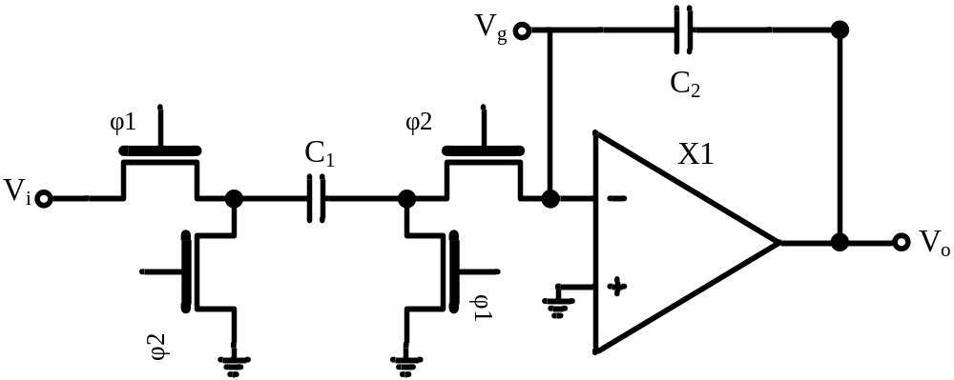
Conventional SC Integrator
Charge C₁ during phi1
Q₁(n) = C₁ x V_{i}(n) , Q₂(n) = C₂ x V_{o}(n)
Transfer charge from C₁ to C₂ during phi2
Q₂(n+1)= C₂ x V_{o}(n+1) = Q₁(n) + Q₂(n) = C₁ x V_{i}(n) + C₂ x V_{o}(n)
Define : -V_{ref} < V_{o} < V_{ref} and C₁=C₂
V_{o}(n+1) = V_{i}(n) + V_{o}(n)
If V_{i}(n)=V_{ref}-Δ and V_{o}(n)=V_{ref}-Δ, where Δ is a small value, then charge transfer will be incomplete because opamp will saturate
But the total charge: Q_{total}(n+1) = Q₁(n) + Q₂(n) ≈ C x 2V_{ref} is preserved
Analog Modulo Circuit connected here
Notes:
In a conventional SC (Switched Capacitor) integrator we charge the input capacitor, C1, to the input voltage Vi, this happens during phi1. In phi2 we transfer the charge stored on C1 to C2, this results in a voltage output that is the sum of the previous output and current input. BUT, if the current input and previous output is close to our maximum swing, Vref. Where Vref as close to Vdd as we can make it and still get a linear opamp. The next output voltage should ideally be 2xVref, but this might be higher than Vdd, thus the opamp will saturate and we will not have complete charge transfer. In other words, integration will not work. BUT, the total charge is on C1 and C2 is still C x 2Vref. Notice the Vg node where we will add our modulo circuit.

Slide 6
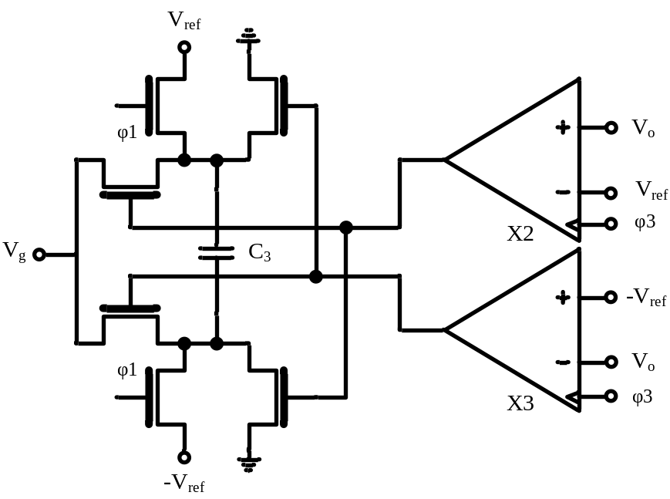
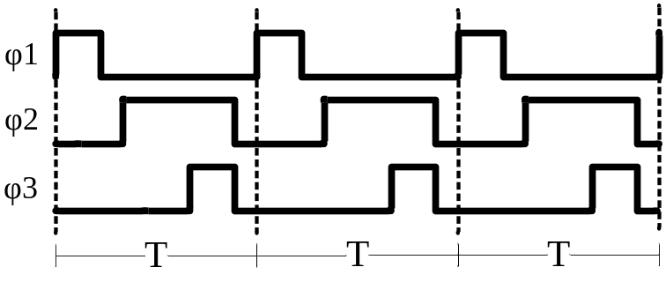
Analog Modulo SC Integrator (1)
Phi1 and Phi2 stay the same
In Phi3 the circuit detects whether V_{o} exceeds V_{ref} or –V_{ref}
  If V_{o} ≥ V_{ref} it subtracts 2xV_{ref}
  If –V_{ref} < V_{o} < V_{ref} it does nothing
  If V_{o} ≤ -V_{ref} it adds 2xV_{ref}
Pseudo Code:
Add the previous output to the current input
If the new output exceeds the reference voltages
Subtract/Add the range of the integrator, V_{r} = 2xV_{ref}
Set the new output to the remainder
Notes:
To make an Analog Modulo SC Integrator we add the circuit seen here. phi1 and phi2 are unchanged, but we add a third phase phi3 where we detect whether Vo exceeds references Vref or –Vref. If it exceeds Vref we subtract a charge from the Vg node equal to Cx2Vref. If Vo is below –Vref we add a charge equal to Cx2Vref and if it is in between we do nothing. This will make the output voltage of our integrator between –Vref< Vo <Vref, thus the charge transfer will then be completed. This implements a modulo integration: 1. add the previous output to the current input, 2. if the new input exceeds the reference voltages, 3. subtract/add the range of the integrator Vr=2xVref, 4. Set the new output the remainder. Let’s look at the circuit during the different phases

Slide 7
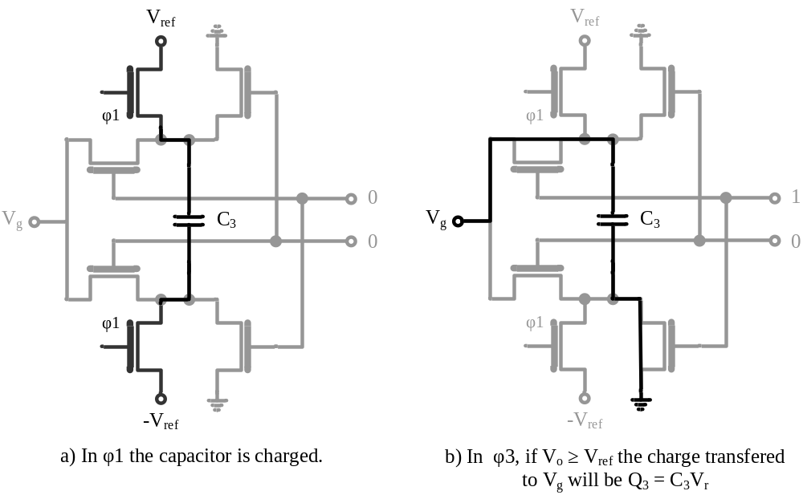
Analog Modulo SC Integrator (2)
V_{o}(n+1) = V_{i}(n) + V_{o}(n) - V_{r}
Notes:
During phi1 we charge the capacitor to a voltage equal to 2xVref = Vr. In phi3, if Vo >= Vref, case b, we effectively subtract the voltage Vr

Slide 8
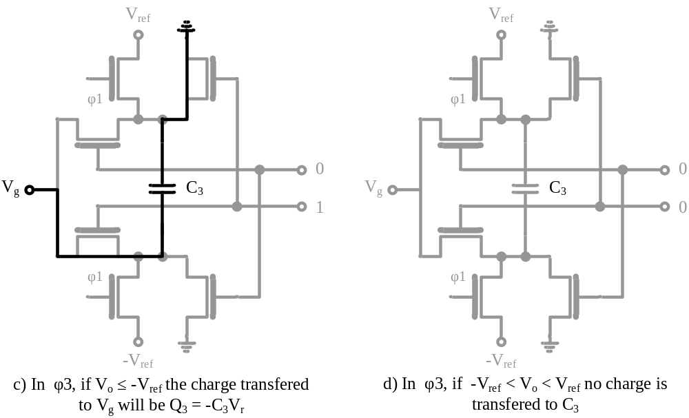
Analog Modulo SC Integrator (3)
V_{o}(n+1) = V_{i}(n) + V_{o}(n) + V_{r}
V_{o}(n+1) = V_{i}(n) + V_{o}(n)
Notes:
In phi3 if Vo <= -Vref, case c, we effectively add the voltage Vr. The difference between b and c is which way we connect the capacitor. In phi3, if –Vref < Vo < Vref, case d, we do nothing.

Slide 9
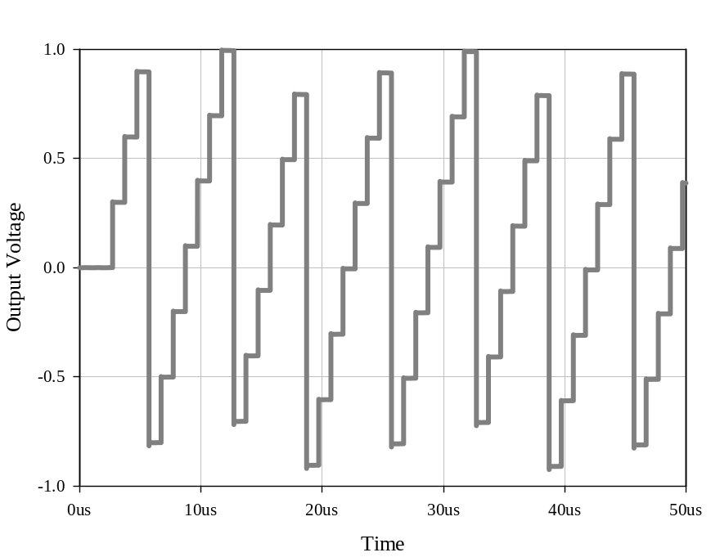
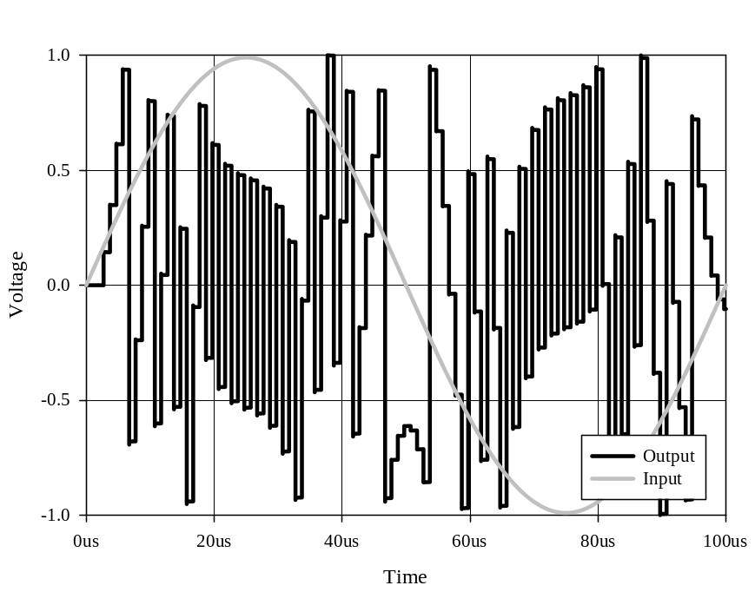
Simulations in AimSPICE[2]
0.3V DC input
Sinusoidal input
The output never exceeds references V_{ref}=1V and –V_{ref}=-1V
Notes:
Here we have shown two simulation results in spice. the one on the left is with a DC input of 0.3V. We can easily see how the integration wraps around and keeps the remainder. For the sinusoidal case we can also see that the output never exceeds the references Vref=1V and –Vref=-1V

Slide 10
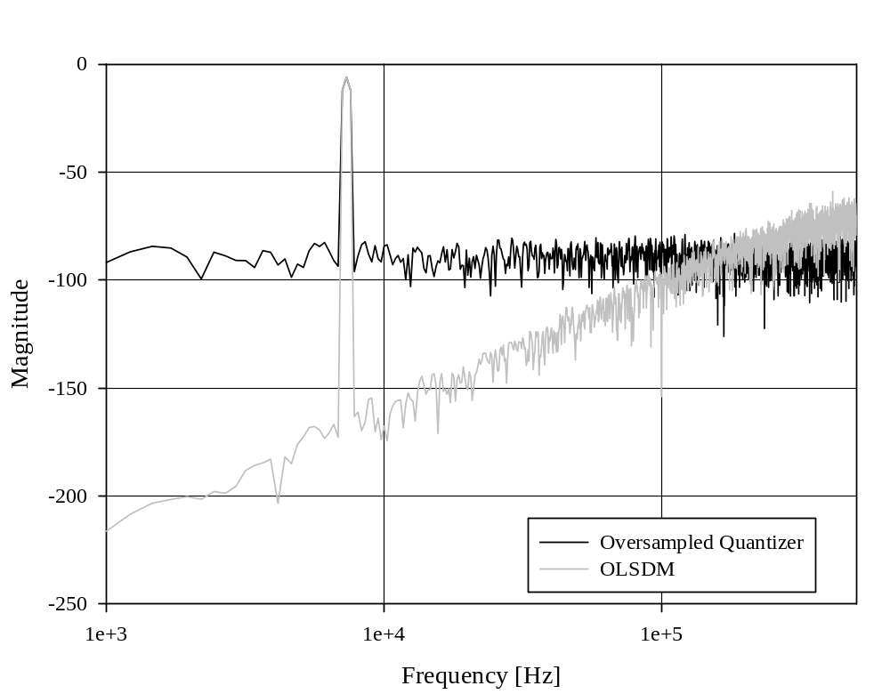
Simulations of OLSDM in SystemDotNet[3]
60dB per decade
Third order OLSDM with 8 bit quantizer with OSR=8
  No noise shaping: ENOB = 9.5 bits
  With noise shaping: ENOB = 15 bits
Notes:
This is a behavioral simulation in the mixed-signal discrete-time event-driven simulator SystemDotNet and not a SPICE simulation.
The plot is an FFT of the output from a simulation of a third order OLSDM with 8 bit quantizer and an OSR of eight. The plot shows both the quantizer without noise shaping and with noise shaping. We can see that the noise shaped one has an slope of around 60dB per decade. With noise shaping we get 15bits and without we get 9.5 bits.

Slide 11
Future Work/Conclusion
Analog Modulo SC Integrator is (to our knowledge) a new circuit
  But as of yet, no show stoppers have been found
The Analog Modulo SC Integrator makes it possible to do OLSDM with conventional SC circuits
Notes:
We believe the Analog Modulo Integrator to be a new circuit. Thus we do not know all the problems with this circuit, but we have started to look into the effects of capacitor mismatch, finite DC gain in opamp and comparator offset, non of these effects are show stoppers. The analog modulo integrator makes it possible to do amplitude modulated open-loop sigma delta modulation.

Slide 12
References
M. Høvin, A. Olsen, T. S. Lande, and C. Toumazou, “Delta-sigma modulators using frequency -modulated intermediate values,” IEEE J.Solid-State Circuits, vol. 32, no. 1, pp. 13–22, 1997.
T. Ytterdal, “Aimspice,” http://www.aimspice.com
C. Wulff, “SystemDotNet,” http://sourceforge.net/projects/systemdotnet

