Slide 1

Design of a 7-bit, 200MS/s, 2mW pipelined ADC with
switched open-loop amplifiers in a 65nm CMOS
technology
Carsten Wulff, Trond Ytterdal
Department of Electronics and Telecommunication
Norwegian University of Science and Technology
Carsten Wulff et al, ”Design of a 7-bit, 200MS/s, 2mW pipelined ADC with switched open-loop amplifiers in a 65nm Technology”

Slide 2
Before we begin
Outline
  Low resolution ADC architectures
  The pipelined ADC architecture
  The open-loop amplifier
  Simulation results
Assumptions
  Simulation is a good indicator of actual performance
  The power dissipation in an ADC should be dominated by thermal noise
Main message of this talk
  Reducing parasitic capacitance is the key to high efficiency low resolution ADCs.
  A pipelined ADC with switched open-loop amplifiers is an efficient architecture for low resolution ADCs
Our contribution
  Turning open-loop amplifiers off during sampling reduces power by 23%
  Using 65nm CMOS technology reduces parasitic capacitance, and allows small sampling capacitors
Carsten Wulff et al, ”Design of a 7-bit, 200MS/s, 2mW pipelined ADC with switched open-loop amplifiers in a 65nm Technology”

Slide 3
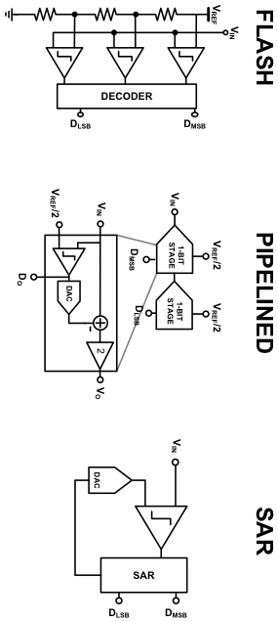


Low resolution ADC architectures
 | Speed | Power | Power/Speed | Input Cap. 6-bit
FLASH | 1 | 2^{N} | 2^{N} | 640fF
PIPELINED | 1/b | c x N | bc x N | d x 10fF
SAR | 1/N | 1 | N | 10fF
Carsten Wulff et al, ”Design of a 7-bit, 200MS/s, 2mW pipelined ADC with switched open-loop amplifiers in a 65nm Technology”

Slide 4
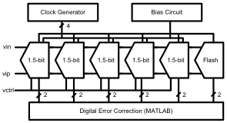
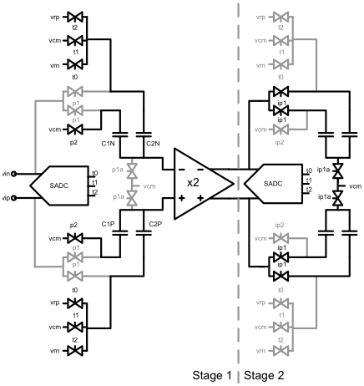
Pipelined Architecture
Highlights:
- 65 nm LP CMOS Technology
- Switched capacitor implementation
- 50fF sampling capacitors
- Six 1.5 bit stages + 1.5 bit Flash
- Four phase clock generator
- Switched open-loop amplifiers
- Transmission gates as switches
- Digital error correction in MATLAB
Not Included:
- Reference buffers
- Input buffers and antialias filter
Multiply
Sample
Carsten Wulff et al, ”Design of a 7-bit, 200MS/s, 2mW pipelined ADC with switched open-loop amplifiers in a 65nm Technology”

Slide 5
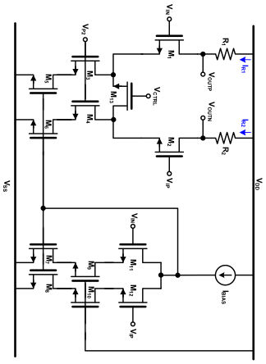

Open-loop amplifier
Based on Shen07 [2]
Resistors and IBIAS set the output common mode
Replica bias keeps IR1 + IR2 = 2 IBIAS
Source degeneration (M13) provide gain control
Switches turn off amplifier when it is not needed
< 7 bit linearity without calibration
VCM = VDD - ITOT(R1+R2)/2
Carsten Wulff et al, ”Design of a 7-bit, 200MS/s, 2mW pipelined ADC with switched open-loop amplifiers in a 65nm Technology”

Slide 6
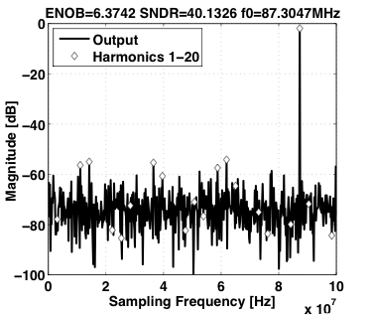
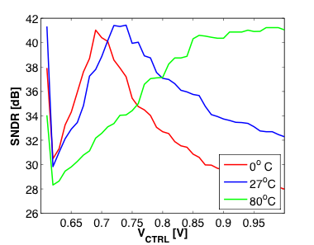
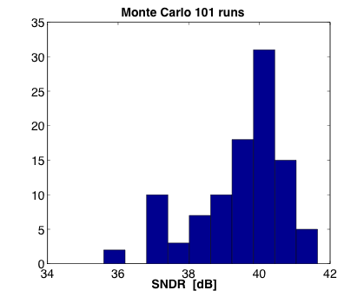

Results
 | Arch. | Tech. [nm] | TI | Power [mW] | ENOB [bits] | Fs [MS/s] | Thermal FOM Smaller is better
This work | Pipelined w/OL | 65 | 1 | 2 | ~ 6.3 | 200 | ~ 1.6 fJ/step
Chen06 [1] | Asynch. SAR | 130 | 2 | 5.3 | 5.3 | 600 | 5.7 fJ/step
Shen07 [2] | Pipelined w/OL | 180 | 2 | 105 | 5.35 | 800 | 59 fJ/step
Carsten Wulff et al, ”Design of a 7-bit, 200MS/s, 2mW pipelined ADC with switched open-loop amplifiers in a 65nm Technology”

Slide 7
Conclusion
Reducing parasitic capacitance is the key to high efficiency low resolution ADCs. Use technologies with low parasitic capacitance, like 65 nm CMOS technologies
A pipelined ADC with switched open-loop amplifiers is an efficient architecture for low resolution ADCs
Turning open-loop amplifiers off during sampling reduces power dissipation
Carsten Wulff et al, ”Design of a 7-bit, 200MS/s, 2mW pipelined ADC with switched open-loop amplifiers in a 65nm Technology”

Slide 8
References
S.-W. M. Chen and R. W. Brodersen, “A 6-bit 600ms/s 5.3mw asynchronous adc in 0.13-μm cmos,” IEEE J. Solid-State Circuits, vol. 41, no. 12, pp. 2669–2679, 2006.
D.-L. Shen and T.-C. Lee, “A 6-bit 800ms/s pipelined a/d converter with open-loop amplifiers,” IEEE J. Solid-State Circuits, vol. 42, no. 2, pp.258–268, 2007.
Carsten Wulff et al, ”Design of a 7-bit, 200MS/s, 2mW pipelined ADC with switched open-loop amplifiers in a 65nm Technology”

Slide 9
Carsten Wulff et al, ”Design of a 7-bit, 200MS/s, 2mW pipelined ADC with switched open-loop amplifiers in a 65nm Technology”

Slide 10
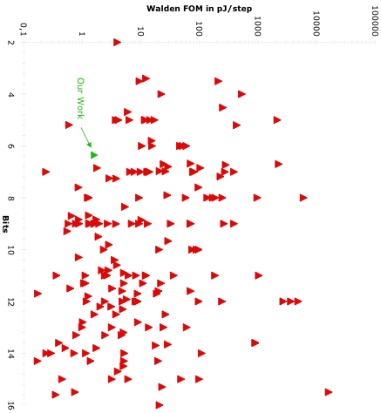
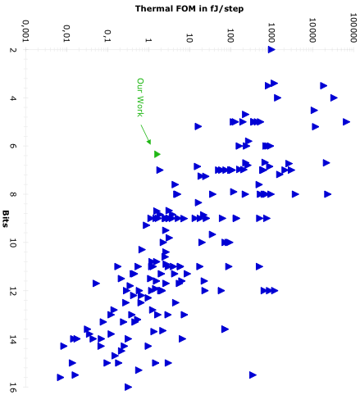

ADC Figure of Merit
Walden FOM
Thermal FOM
1 bit → double the power
1 bit → four times the power
Carsten Wulff et al, ”Design of a 7-bit, 200MS/s, 2mW pipelined ADC with switched open-loop amplifiers in a 65nm Technology”

Slide 11
Thermal noise power
Thermal noise power in switched-capacitor circuits is given by
Sampling capacitor needed to achieve thermal noise power of one fourth of the quantization noise power is given by
Thermal noise limited: Double the accuracy → Four times the power
Carsten Wulff et al, ”Design of a 7-bit, 200MS/s, 2mW pipelined ADC with switched open-loop amplifiers in a 65nm Technology”

Slide 12
Parasitic Capacitance
Parasitic Capacitance: Any capacitance not required by the operation of the circuit.
Parasitic capacitance in current nanoscale technology can exceed 10fF per node
Required input capacitance for thermal noise power at one fourth the quantization noise power at 6-bit level
 | 0^{O}C | 80^{O}C
VMAX = 0.4 V | 4.6fF | 6fF
Difficult to get input capacitance down minimum required at 6-bit level
Use technologies with low parasitic capacitance like 65nm CMOS
Carsten Wulff et al, ”Design of a 7-bit, 200MS/s, 2mW pipelined ADC with switched open-loop amplifiers in a 65nm Technology”

