Slide 1
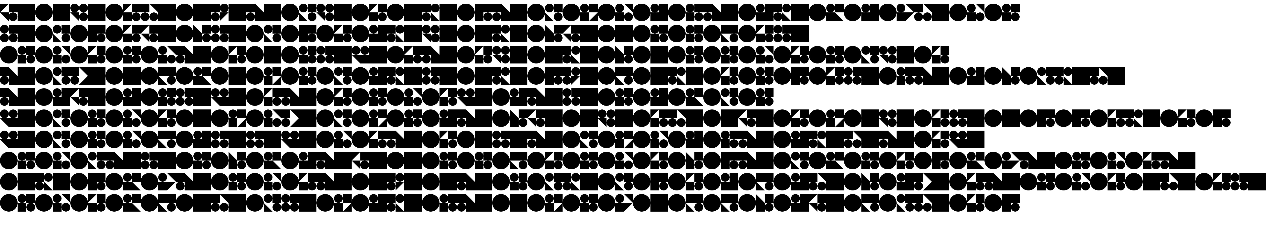

AncientRunes.jpg

Slide 2
Observations
Monolithic
  No delimiters
Monospaced
Monoalphabetic

Slide 3


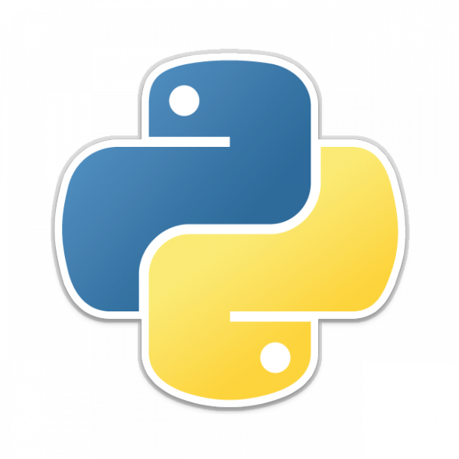
Stack

Slide 4
OpenCV
Template matching
  Source I, template T
  Slide T over I
    LR-UD
  Match using algo
    TM_CCORR_NORMED

Slide 5
1. find_unknown_glyphs
Identify unknown glyphs (iterative)
“known” glyph map
  21 unique glyphs
    Result: known_glyphs.jpg

Slide 6
2. process_each_glyph
Match all known 1..21 glyphs
  Record statistics
  Calculate frequency distribution
    Result: statistics.out

Slide 7
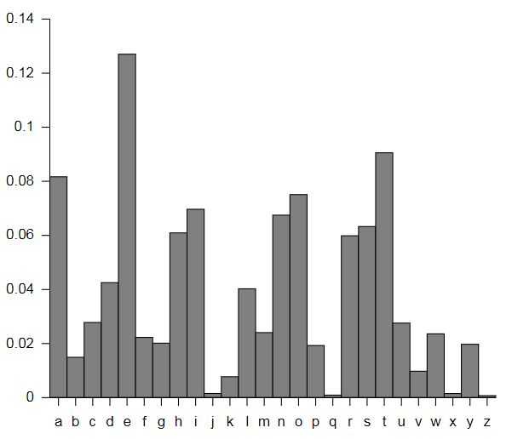
3. reveal_message
Correlate statistics
Print characters at known positions
  Result: solution.jpg

Slide 8
Demo

Slide 9
BAMEGA PRIME AND RICHOTRON FOUGHT
SIDE BY SIDE ON MANY BATTLES
THE THREATS WERE MANY AT THE TIME
RIVAL FACTIONS AND PLANET DESTROYING
ROBOTS WERE THE WORST OF IT
WITH EACH VICTORY BAMEGA BECAME SADDENDED
WITH LOSS WHERE AS RICHOTRON GREW
THIRSTY FOR BATTLE THEY DRIFTED FUTHER
AND FUTHER APART IN IDEOLOGY OVER THE AGES
THE FLAG IS CONTRACTUALLY OBLIGED

Slide 10
Ongoing / Future Work
Assisted analysis
  e.g. CyberChef “Magic”
Support for other (harder) ciphers
  Polyalphabetic, polygraphic, more.
Error reduction...
Polish
  Future CTFs

