Slide 1


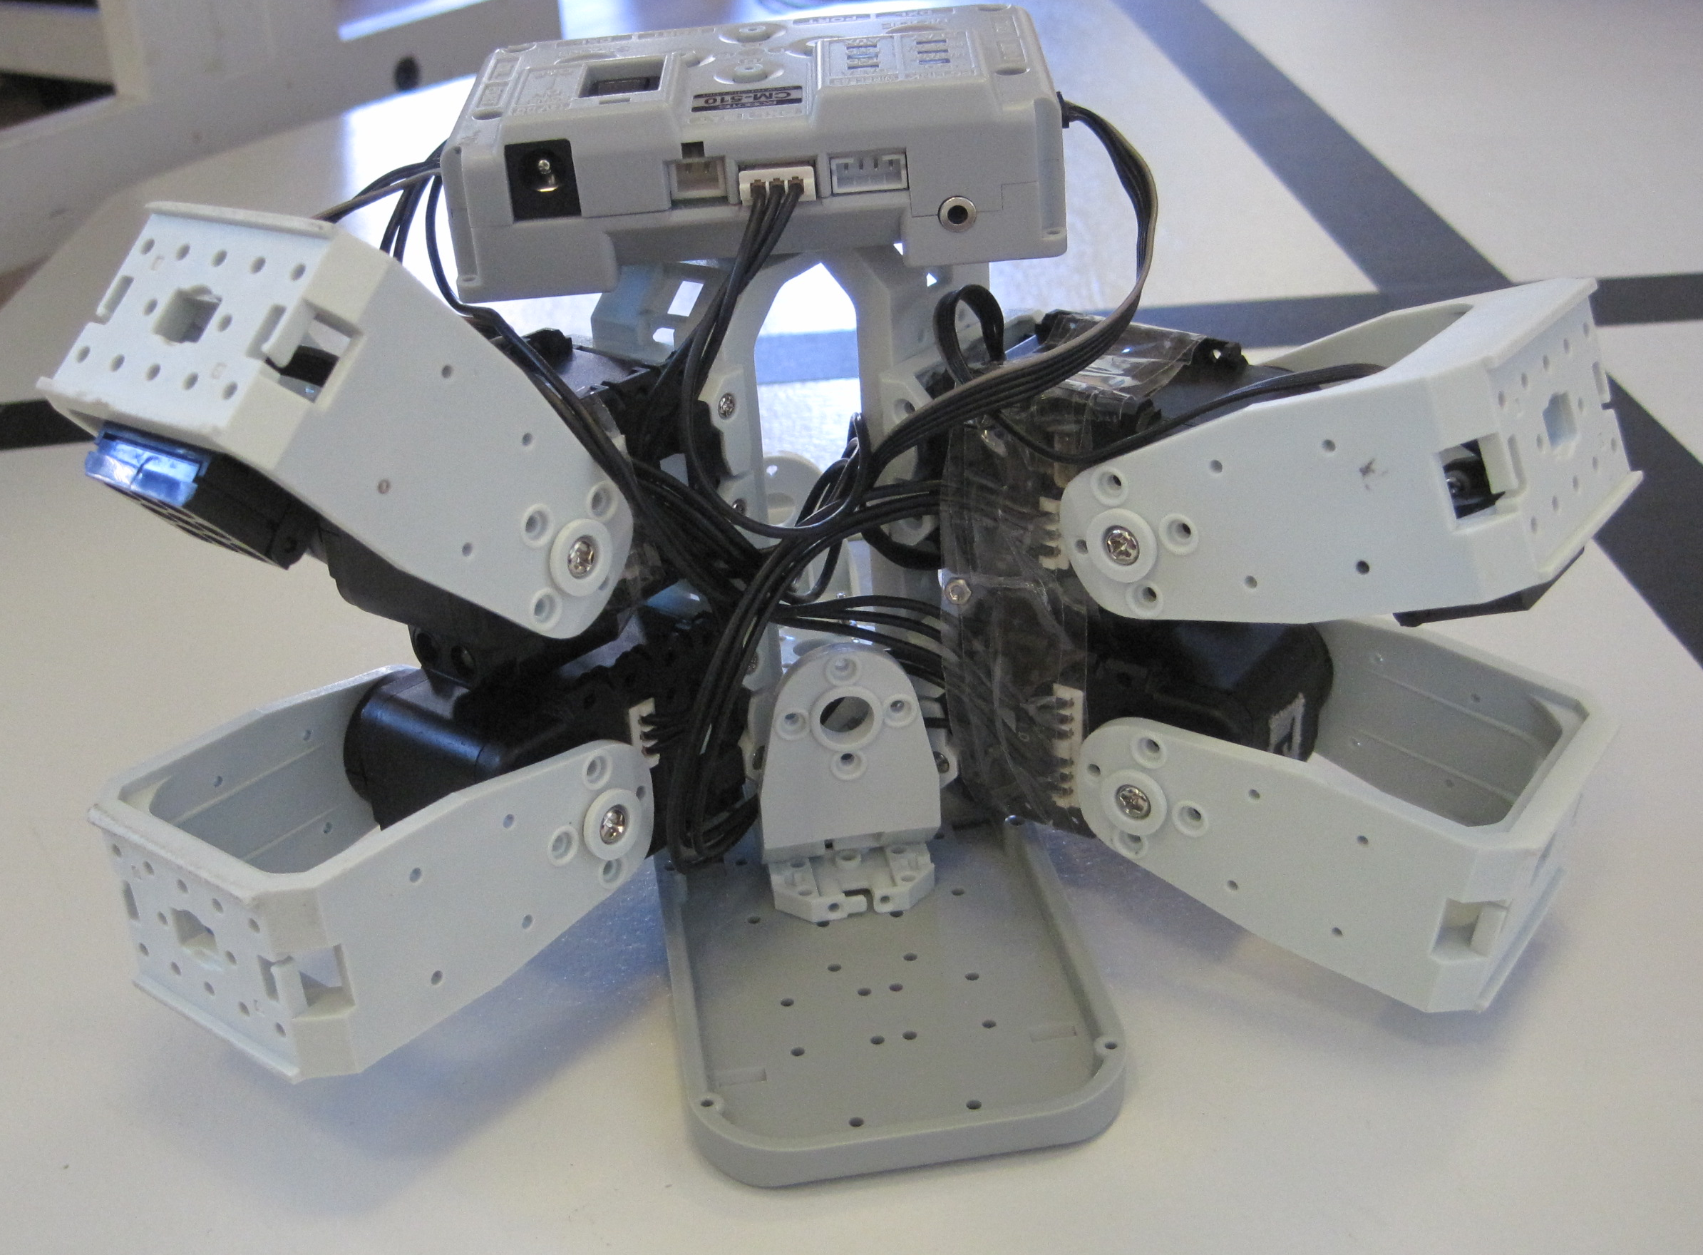
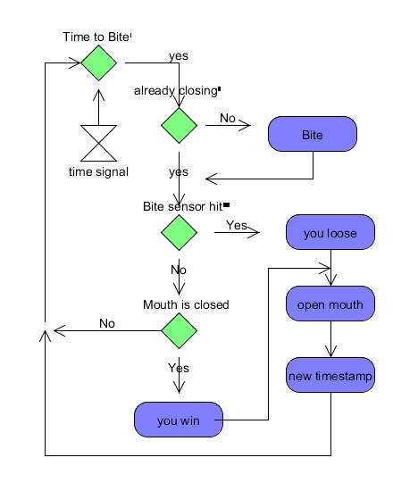
The shark – biting game Developed as part of 31384 - Modular Robotics, 2012
Author: Rune Pagter, Team Kick-Ass
Abstract
This task is to develop a playful interaktiv toy, with the opputunities in the Robottis kit.
Introduction
The shark game, is a simpel playful game, where you put you finger in the sharks, mouth, and fast need to remove it, before you will get bidden. The game have a dual function, so you can use 2 hands. This will no get a bit harder, to focus on 2 sharks, and not remove both hands, if the one shark bite.
Mechanics
The 2 shark are bould with 2 motor each, so it can close the mouth. Inside the mouth i a distance sensor, to se the finger. It is able to read the motor position and if a finger i blocking for total close of the mouth. It i all controlled by a atmel microcontroler in the box.
Constuction.
Implementation
The robot, have to modes of snapping the bite. The first I af distance sensor in the mouth, that sense the finger is in there, and it snaps. The other I a advanced random generator, that calculates, when it is time to snap again. This is individual for each shark bite. In the front of the mouth there is a contact sensor, witch is pressed when there are something between the teeth
The software also write to the command prompt, of how It is going in the game. It tells you if you win or loose a round, and a over all winner.
Results
The toy is playful, but a little predicable, which maybe could be better. It is a challenge only to react on the one hand, there arte bitten and not both
Related Work
Theres have Been built, 2 other robots, of the same kit. One driven autonomes with Wheels. And One that could walk, like a Sea star. Most of sensor, and servo models where used in these previus projekts, and easy to implement again in this projekt.
31384 – Modular Robotics
3-weeks course in June, 5 ECTS
Contact: David Johan Christensen, djchr@elektro.dtu.dk

