Slide 1
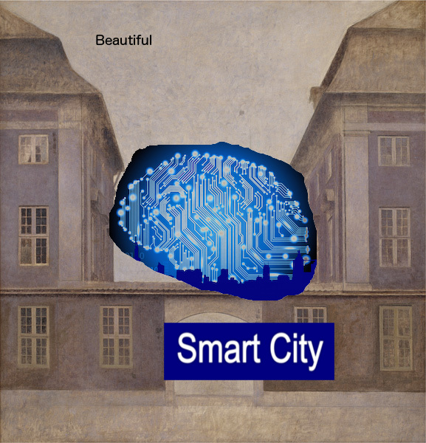
Smart Beautiful City

Slide 2
What
Insert paintings in design dynamically
Why
How
Populate design elements with artobjects picked by user-specific data (location, weather)
Reach new audience
Boost company brand
Generate value to static data
Inject forgotten aesthetics to moderne design

Slide 3
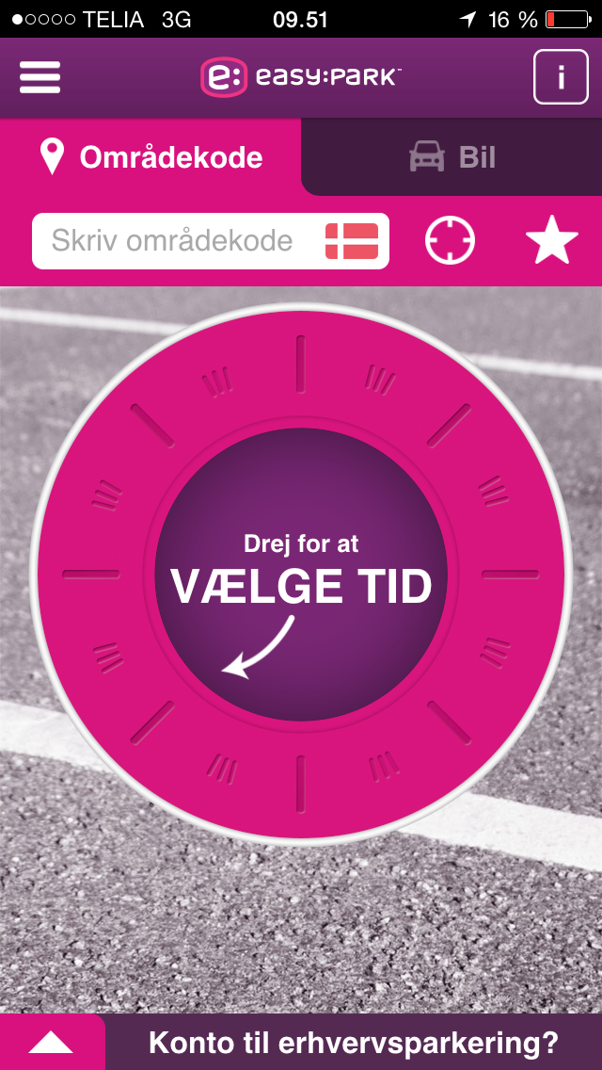
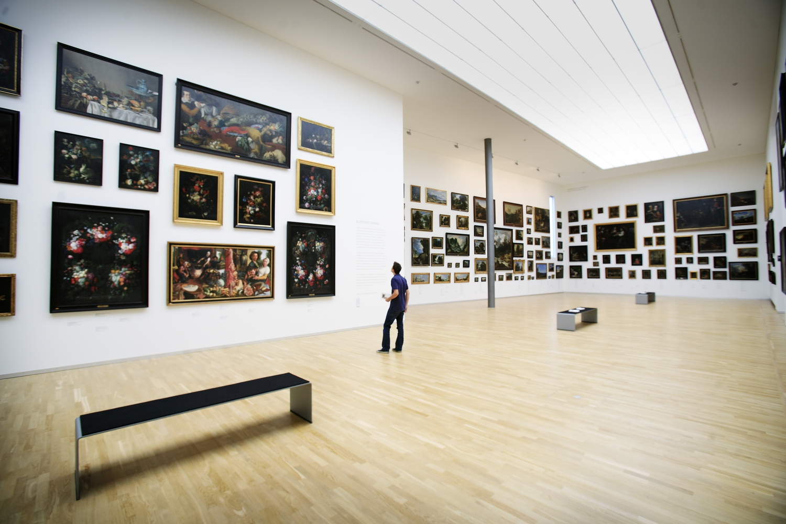
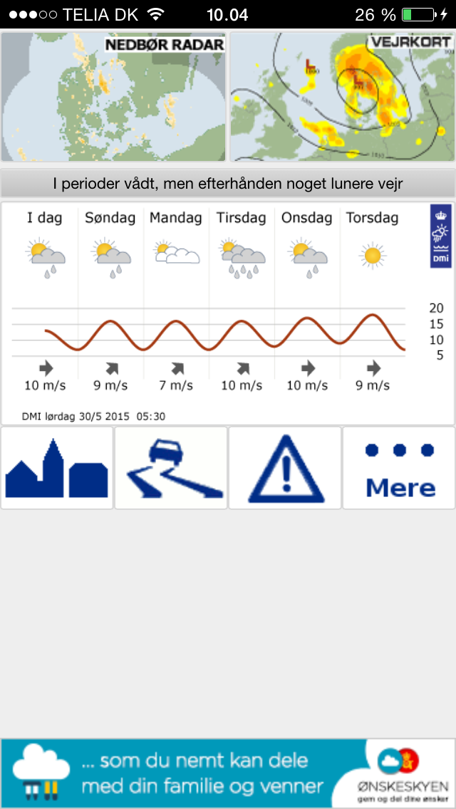

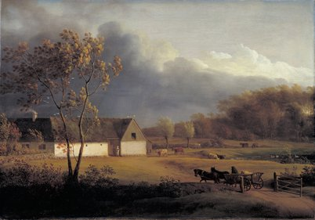
How: SMK to DMI

Slide 4
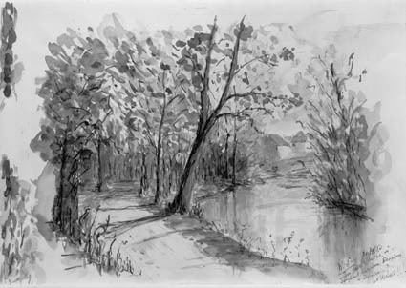
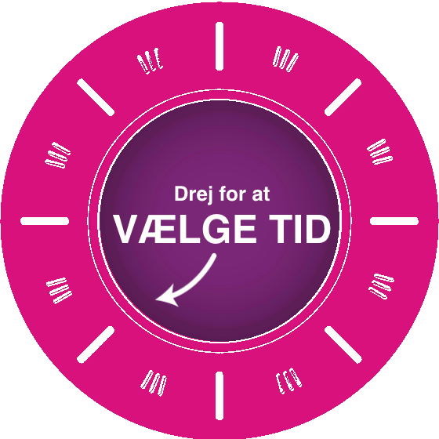
How 2: Live demo ”vej”

Slide 5

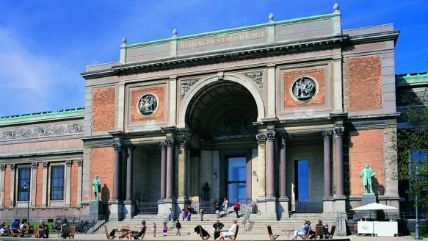

How II: Sharing is caring (+70)

Slide 6
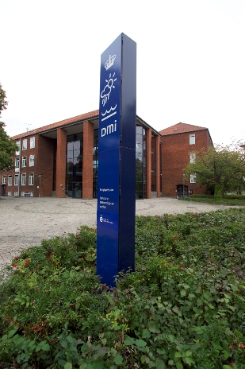
Why: The value chain
Company Brand - Supporting culture
Adding to the customer experience
Injecting forgotten aesthetics into modern life
Land-scape: man & nature
Ethics
Exposing art to nonSMK segment
onsite visitors
online visitors
online contributors

