Slide 1
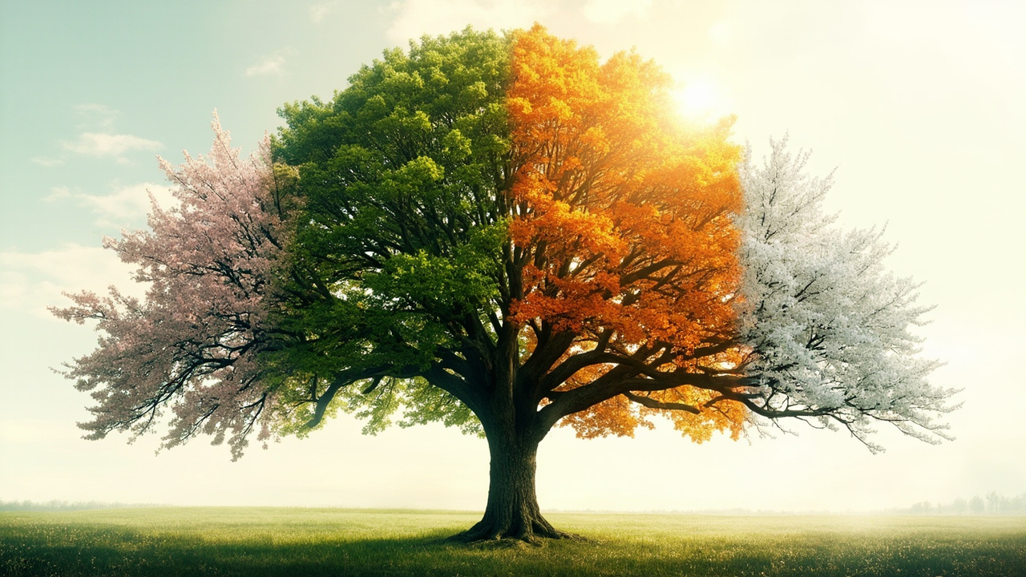
ENGLISH · UNIT 6
The Four
Seasons
Talking about seasons, weather, clothes and activities
SPEAKING · VOCABULARY · READING · 45 MIN

Slide 2
LESSON MAP
What we will learn today
Warm-up & Goals
Sing, guess and set our learning targets
Grammar Focus
What's the weather like? / What do you do in…?
Vocabulary
Seasons, weather words, clothes and activities
Speaking & Writing
Talk about your favourite season and write about it
Reading
A short passage: “My Favourite Season”
02

Slide 3
Can you name all four seasons in English?
Spring · Summer · Autumn (Fall) · Winter — let's explore each one!

Slide 4
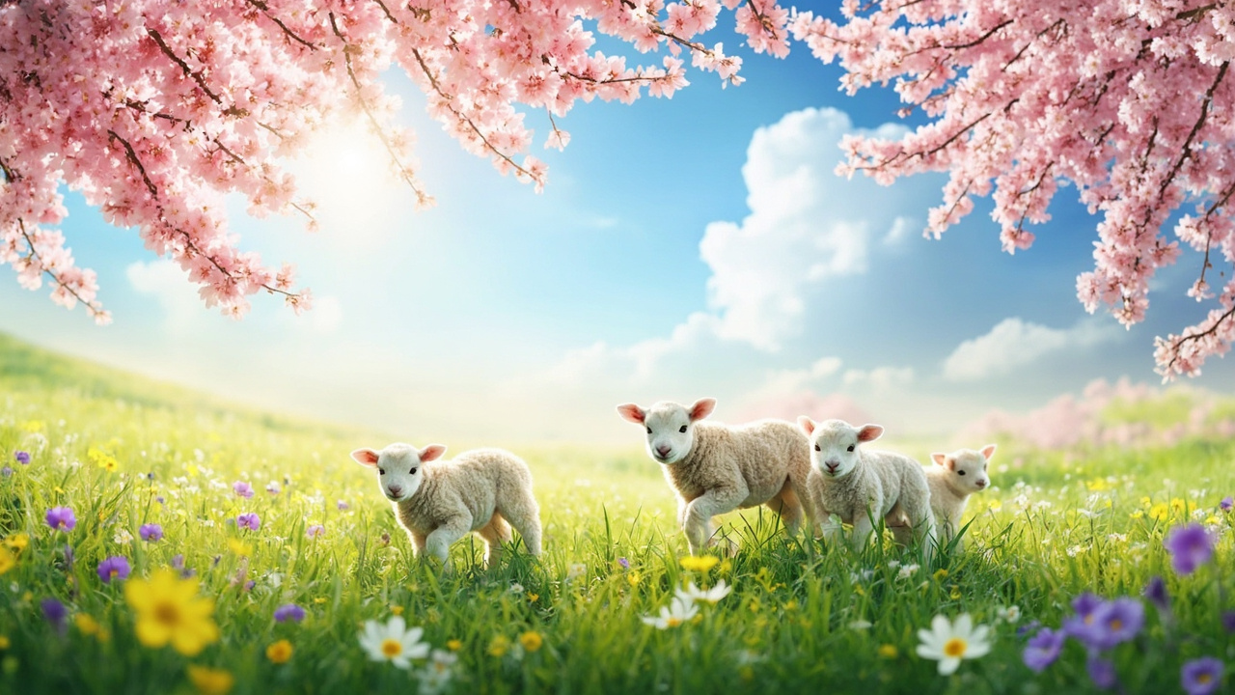
01
Seasons Vocabulary
Four seasons, four colours, four moods

Slide 5
SPRING
warm · green · flowers bloom · it gets warmer
03

Slide 6
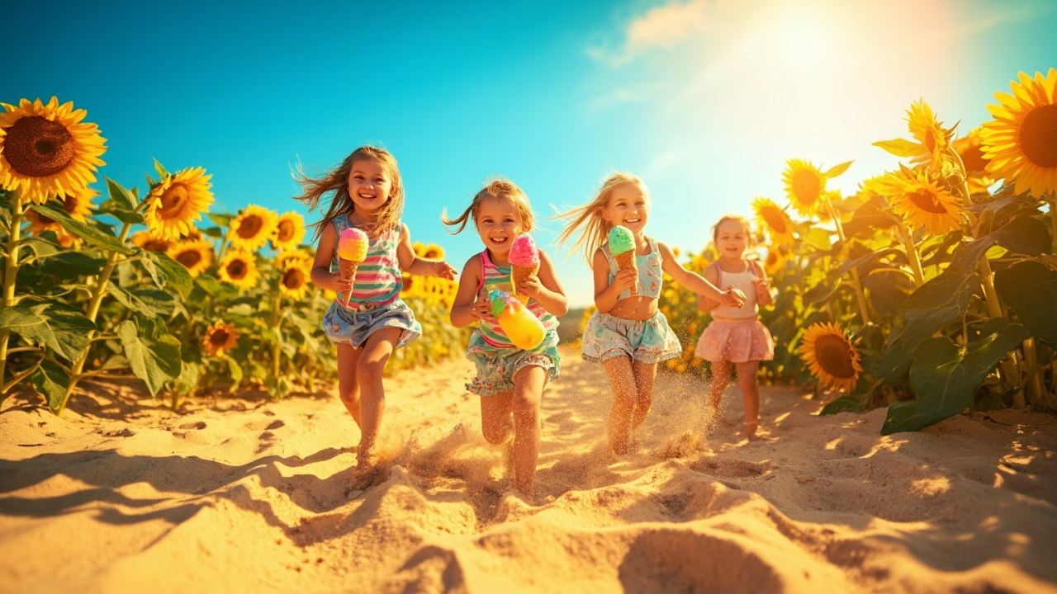
SUMMER
hot · sunny · long days · we go to the beach
04

Slide 7
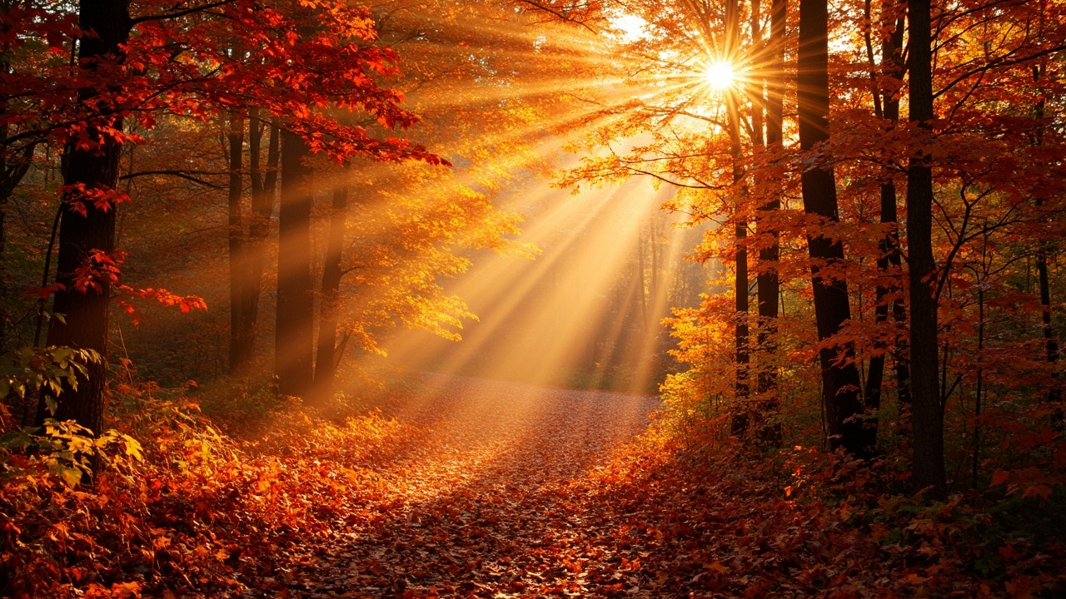
AUTUMN / FALL
cool · windy · leaves fall · golden colours
05

Slide 8
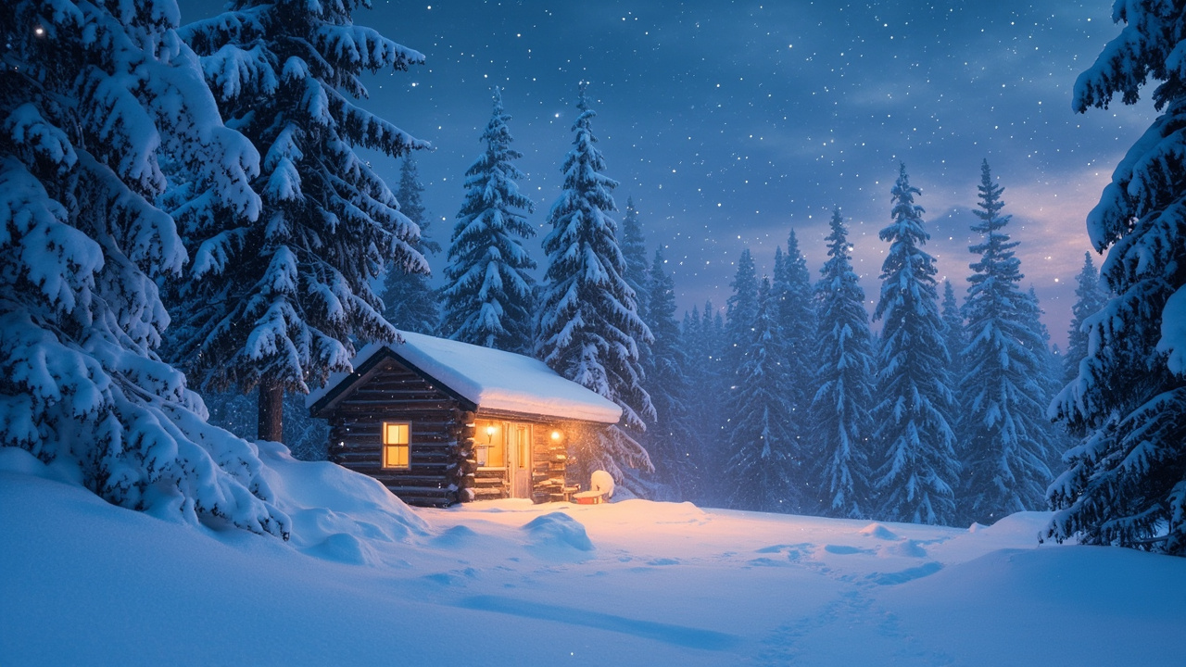
WINTER
cold · snowy · short days · we wear warm coats
06

Slide 9

02
Weather Words
What's the weather like today?

Slide 10
VOCABULARY
Key weather adjectives
sunny ☀
rainy 🌧
windy 🌬
The sky is clear and the sun is shining. “It's sunny today.”
Water falls from the clouds. Don't forget your umbrella!
The wind blows strongly. Good for flying a kite!
snowy ❄
cloudy ☁
foggy 🌫
Soft white snow falls. Let's build a snowman!
The sky is grey and full of clouds.
It's hard to see far. Drive carefully!
07

Slide 11
GRAMMAR FOCUS
Two questions you can always use
Ask about weather
Ask about activities
What's the weather like?
What do you do in winter?
→ It's sunny and warm.
→ I make a snowman.
What's the weather like in summer?
What do you do in spring?
→ It's hot and sunny.
→ I plant flowers and fly kites.
08

Slide 12
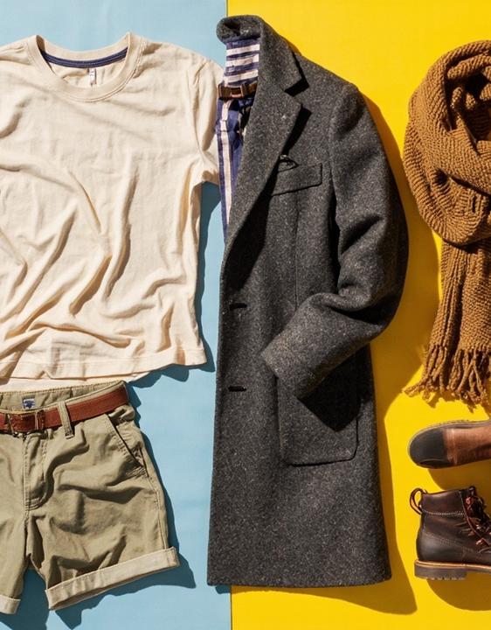
VOCABULARY
What do we wear?
In spring and autumn: a light jacket, a sweater, jeans.
In summer: a T-shirt, shorts, sandals, sunglasses, a hat.
In winter: a warm coat, a scarf, gloves, boots.
Try it: “When it's cold, I wear ______.”
09

Slide 13
03
Reading Time
“My Favourite Season”

Slide 14
READING
My Favourite Season
My favourite season is autumn. The weather is cool and the leaves turn red and gold.
I like to walk in the park and jump in the leaves with my friends.
We wear warm sweaters and drink hot tea. Autumn is quiet and beautiful.
What is YOUR favourite season, and why?
10

Slide 15
COMPREHENSION
Answer these questions
1. What is the writer's favourite season?
Look at the first sentence.
2. What is the weather like?
Find two weather words in the text.
3. What does the writer do?
Name one activity from the passage.
4. What do they wear and drink?
Two things to find.
11

Slide 16
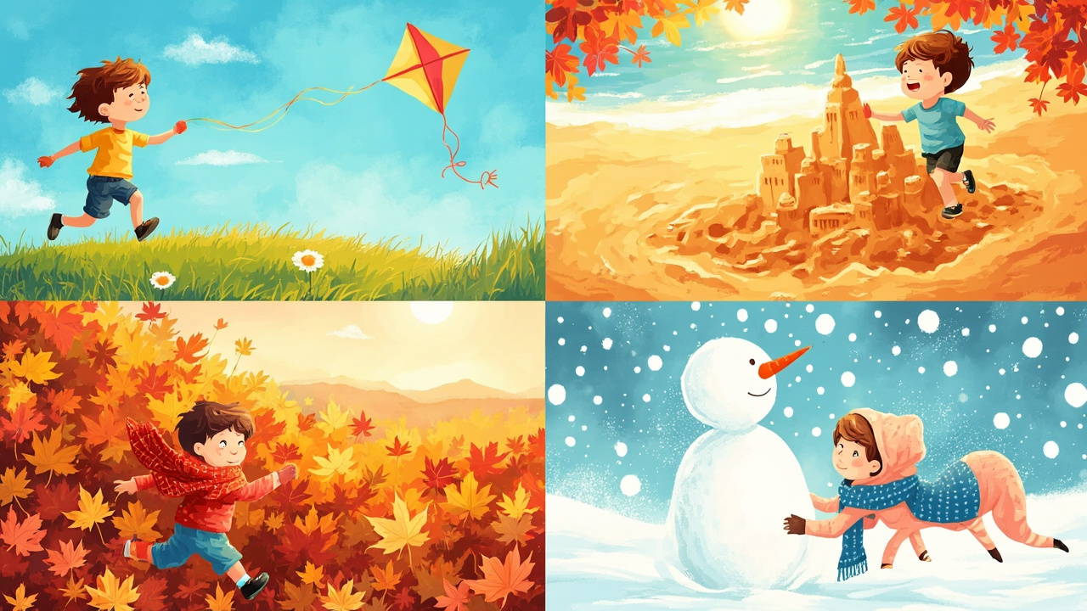
04
Let's Speak
Tell us about YOUR season

Slide 17
SPEAKING FRAME
Use this frame to talk (2 minutes)
① Name it
② Describe weather
“My favourite season is ______.”
“The weather is ______ and ______.”
③ Say activities
④ Say why
“I like to ______ and ______.”
“I love it because ______.”
12

Slide 18
ACTIVITY
Pair & group work
Pair talk (6 min)
Interview your partner: “What's your favourite season? Why?”
Weather report (8 min)
In groups, present a fun weather forecast for four seasons
Writing (8 min)
Write 4–5 sentences about your favourite season using the frame
13

Slide 19
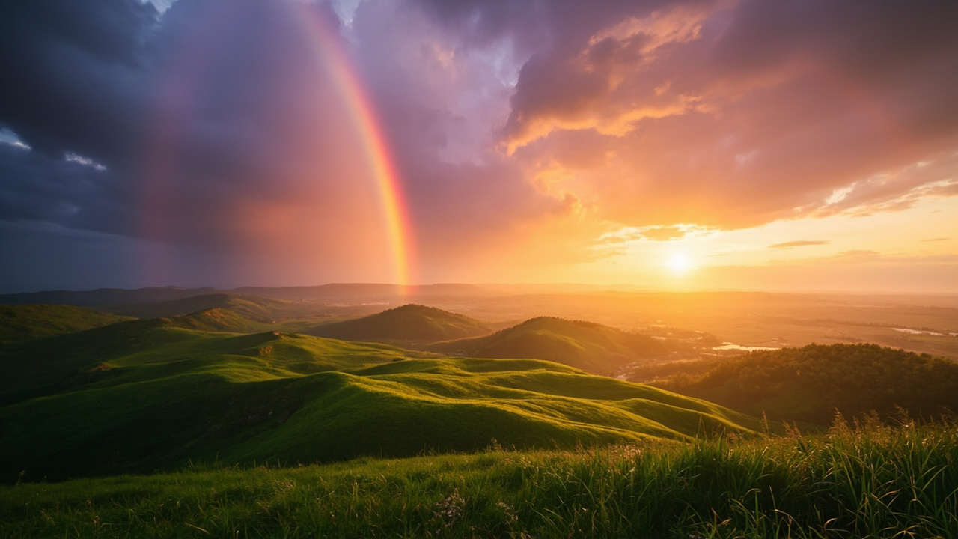
Every season has its own magic
Spring brings flowers, summer brings sunshine,
autumn brings colours, and winter brings snow.
Homework: Write a short paragraph about your favourite season with a drawing.
ENGLISH · THE FOUR SEASONS · UNIT 6

