Slide 1
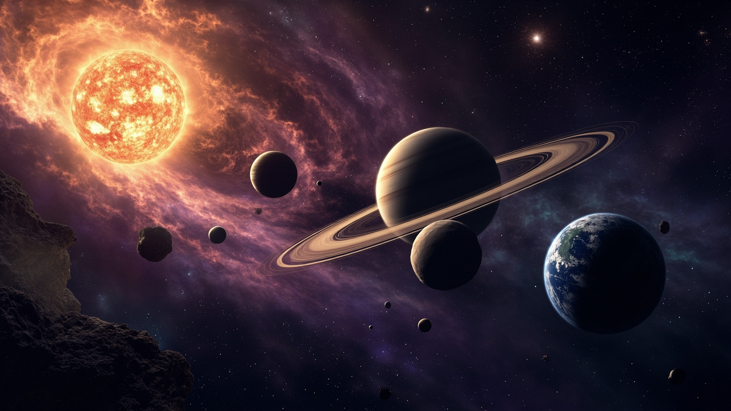
ENGLISH · SCIENCE UNIT
Journey Through
the Solar System
Explore the planets and learn to describe our universe
READING · VOCABULARY · SPEAKING · 45 MIN

Slide 2
MISSION MAP
Today's space mission
Blast Off
Warm-up quiz: how much do you know about space?
Reading & Facts
Amazing facts and comparing planets
The Sun & 8 Planets
Meet every member of our solar system
Speak & Create
Design your own planet and present it
Planet Vocabulary
Words to describe size, distance and features
02

Slide 3
How many planets are there in our solar system?
The answer is EIGHT — let's meet them one by one!

Slide 4
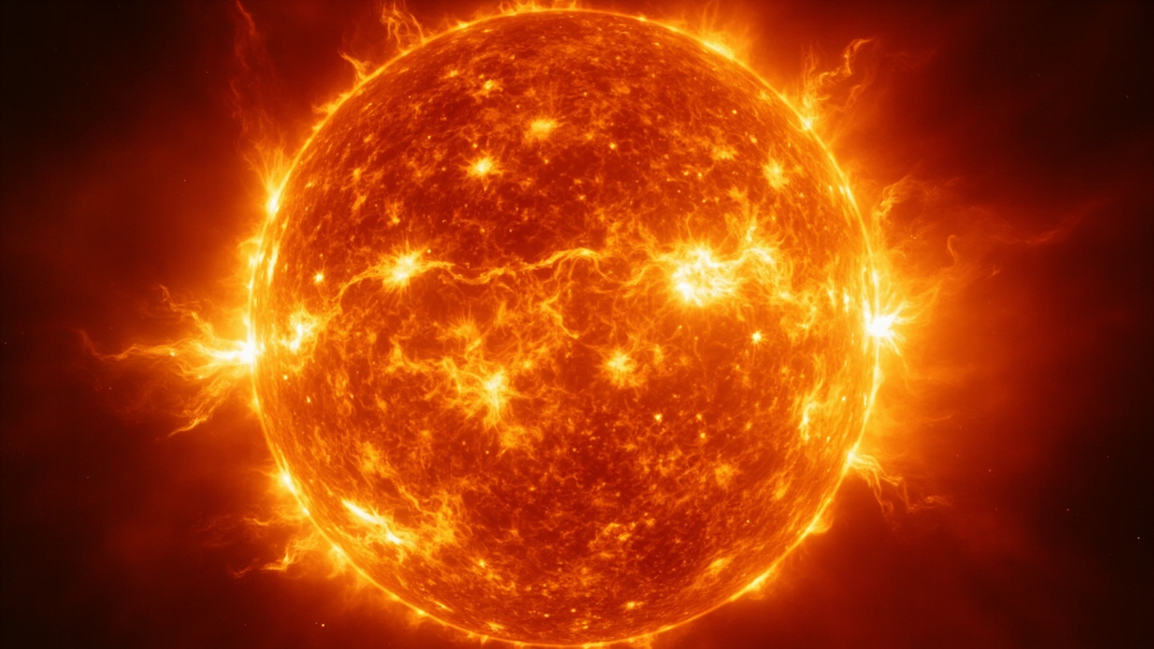
01
The Sun
The star at the centre of everything

Slide 5
THE SUN
Our nearest star
The Sun is a huge ball of hot burning gas at the centre of the solar system.
It is about 1.3 million times bigger than Earth!
The Sun gives us light and heat. Without it, there would be no life.
Word bank: star · gas · heat · light · centre · gravity
03

Slide 6
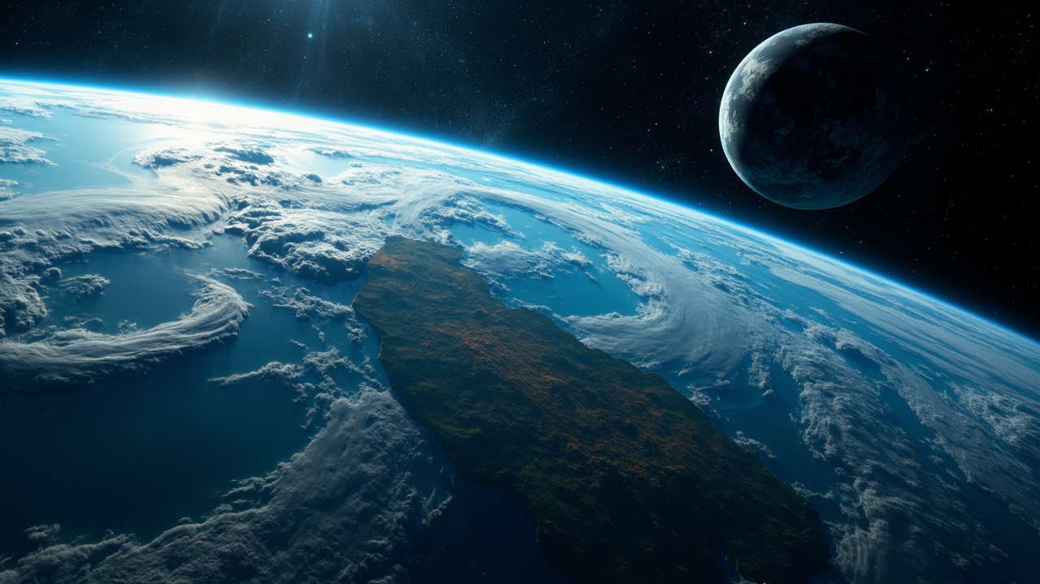
02
The Eight Planets
From tiny Mercury to giant Jupiter

Slide 7
EARTH — our home planet
The only planet with life, liquid water and air we can breathe. It has one moon.
04

Slide 8
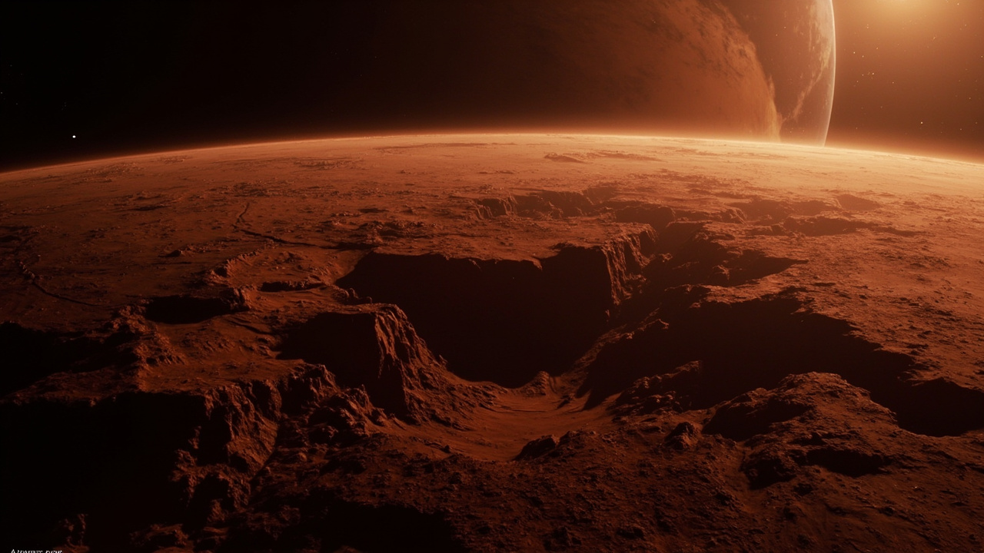
MARS — the red planet
Cold and dusty with rusty red soil. Robots called rovers explore it today.
05

Slide 9
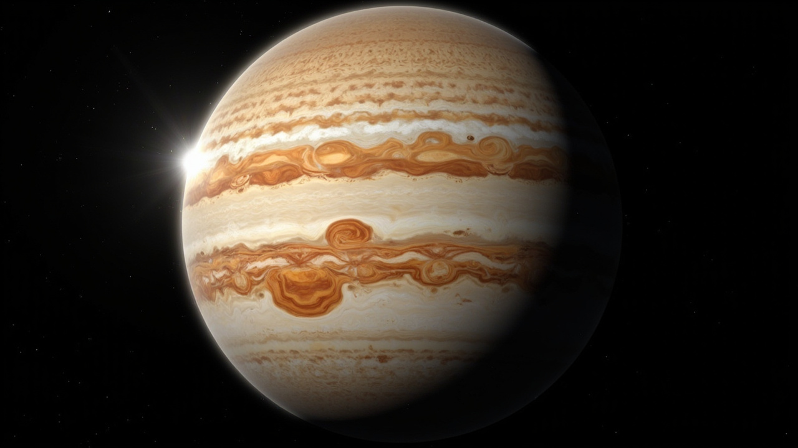
JUPITER — the biggest planet
A giant made of gas, with a huge storm called the Great Red Spot.
06

Slide 10
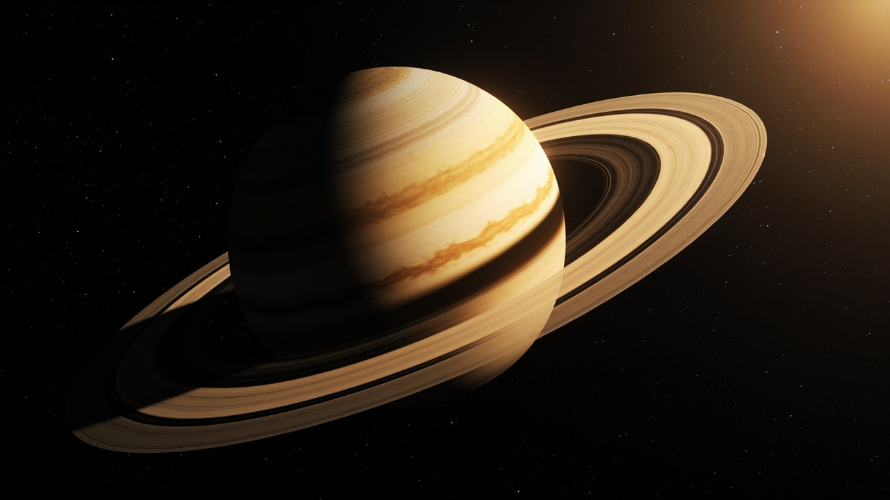
SATURN — the ringed planet
Famous for its beautiful rings made of ice and rock. It has over 140 moons!
07

Slide 11
VOCABULARY
Words to describe planets
size
distance
temperature
huge · giant · tiny · small — “Jupiter is the biggest planet.”
near · far · closest · farthest — “Mercury is closest to the Sun.”
hot · cold · freezing · burning — “Mars is very cold.”
surface
features
compare
rocky · icy · dusty · gassy — “Mars has a dusty surface.”
rings · moons · craters · storms — “Saturn has rings.”
bigger · smaller · hotter · colder than…
08

Slide 12
GRAMMAR FOCUS
Comparing the planets
Comparatives
Superlatives
Jupiter is bigger than Earth.
Jupiter is the biggest planet.
Mars is colder than Earth.
Mercury is the closest to the Sun.
Mercury is closer to the Sun than Venus.
Venus is the hottest planet.
09

Slide 13
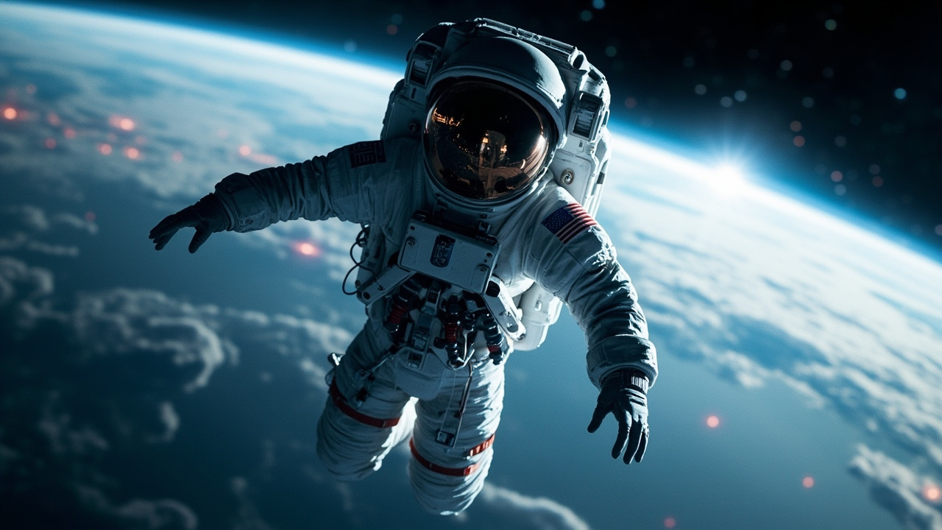
03
Amazing Space Facts
Did you know…?

Slide 14
READING
Five out-of-this-world facts
A day on Venus is longer than its year
Venus spins very, very slowly.
You could fit 1,300 Earths inside Jupiter
It is truly a giant.
Mars has the tallest volcano in the solar system
Olympus Mons is 3× taller than Mount Everest.
Saturn would float on water
It is lighter than water for its size.
Space is completely silent
There is no air to carry sound.
10

Slide 15
READING
Life as an astronaut
Astronauts float in space because there is very little gravity.
They wear special suits to breathe and stay warm — space is freezing!
They eat food from packets and even sleep floating, tied to a wall.
Question: Would you like to be an astronaut? Why or why not?
11

Slide 16
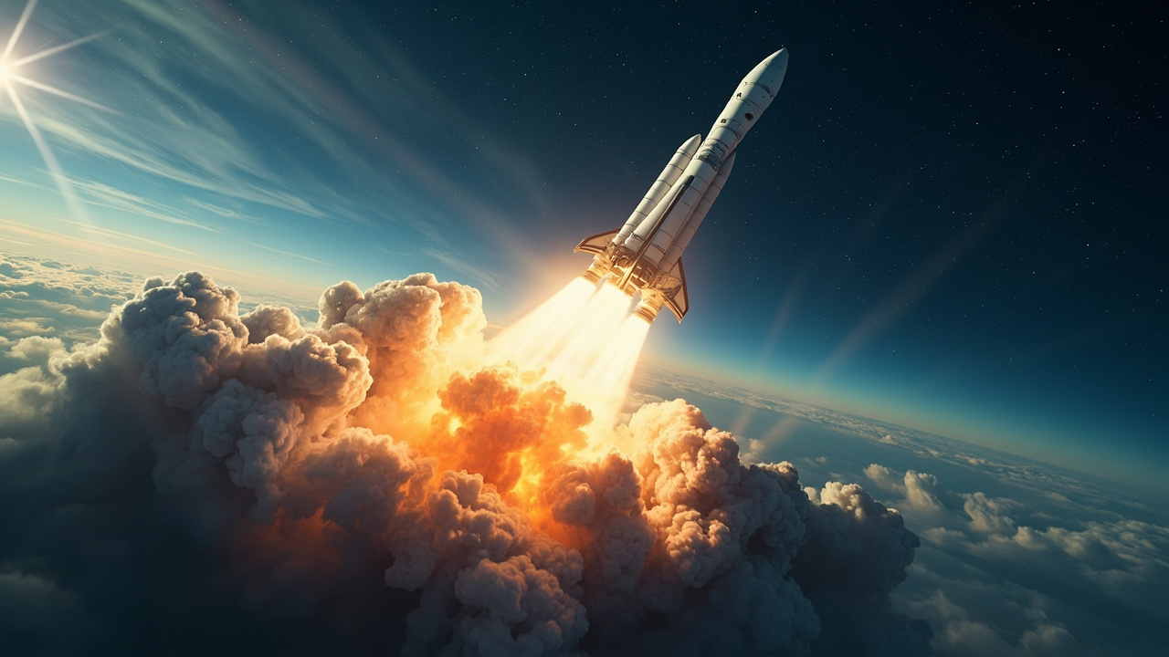
04
Your Mission
Design a planet, present to the crew

Slide 17
PROJECT FRAME
Invent your own planet (use these prompts)
① Name
② Size & distance
“My planet is called ______.”
“It is ______ than Earth and very ______ from the Sun.”
③ Weather & surface
④ Special feature
“It is ______ and has a ______ surface.”
“It has ______ and ______ moons.”
12

Slide 18
ACTIVITY
Explore, speak and create
Fact race (6 min)
In teams, match planets to their descriptions
Design time (8 min)
Draw and name your own planet using the frame
Presentation (10 min)
Present your planet to the class in 4–5 sentences
13

Slide 19
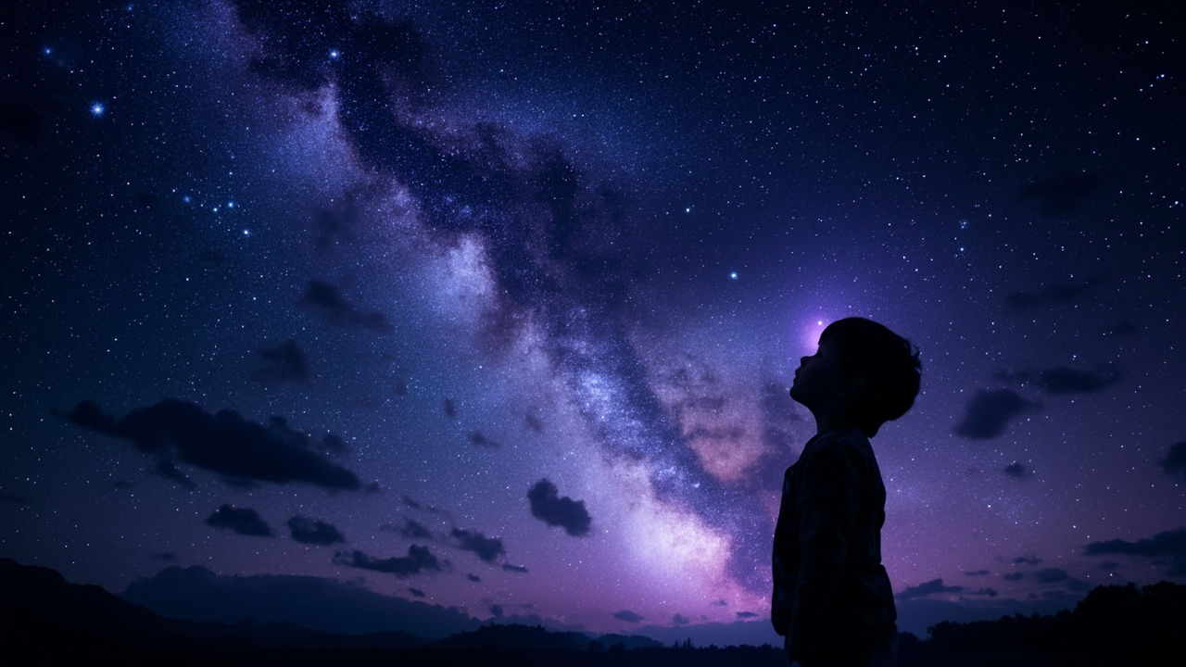
Keep looking up
Our solar system is vast, beautiful and full of mysteries.
The more we learn, the more amazing questions we can ask.
Homework: Write 5 sentences about your favourite planet and draw it.
ENGLISH · JOURNEY THROUGH THE SOLAR SYSTEM

