Slide 1
2、开发环境
Android智能手机开发

Slide 2
建立Android开发环境
软件：
  ①JDK 5 or JDK 6 以上(一定要JDK，光JRE不够)
  ②Eclipse 3.3 以上
  ③Android SDK
  ④ADT 0.8.0
  ⑤相应手机连接驱动

Slide 3
Android可视化环境配置
JDK1.6
  下载网址：http://java.sun.com/javase/downloads/
Eclipse
  下载网址：http://www.eclipse.org/downloads/
ADT
  下载网址： http://developer.android.com
Android SDK 2.x
  下载网址： http://developer.android.com
手机驱动
  各手机厂家网站，或随机光盘
  操作系统自动搜索安装

Slide 4
Quick Start
1. 准备
  安装JDK (最新版)
    设置环境变量：JAVA_HOME、CLASSPATH
  Eclipse (最新版，只有当需要用ADT开发时才用)
2. 下载安装Android SDK
  安装Android SDK，并在Eclipse中进行相应设置。
3. 为Eclipse安装ADT插件
4. 安装手机驱动(真机调试)
  模拟机调试时，可先不装。安装也可由操作系统自动安装。
SDK Setup Done!

Slide 5
安装Eclipse
Eclipse 3.3 以上
Eclipse JDT plugin (included in most Eclipse IDE packages)
  If you need to install or update Eclipse, you can download it from http://www.eclipse.org/downloads/.
Several types of Eclipse packages are available for each platform. For developing Android applications, we recommend that you install one of these packages:
  Eclipse IDE for Java EE Developers
  Eclipse IDE for Java Developers
  Eclipse for RCP/Plug-in Developers
  Eclipse Classic (versions 3.5.1 and higher)

Slide 6
Android的SDK版本
Android 2.1 Platform(new!)
Android 1.6 Platform
Android 1.5 Platform
Older Platforms
  Android 2.0.1 Platform
  Android 2.0 Platform
  Android 1.1 Platform

Slide 7
操作系统
Windows XP (32-bit) or Vista (32- or 64-bit)
Mac OS X 10.5.8 or later (x86 only)
Linux (tested on Linux Ubuntu Hardy Heron)
  64-bit distributions must be capable of running 32-bit applications. For information about how to add support for 32-bit applications.

Slide 8
硬件环境
不包括JAVA、Eclipse。
Component type | Approximate size | Comments
SDK Tools | 50 MB | 必须
Android platform (each) | 150 MB | 至少一个
SDK Add-on (each) | 100 MB | 可选
USB Driver for Windows | 10 MB | 可选，但Windows必须
Samples (per platform) | 10 MB | 可选
Offline documentation | 250 MB | 可选

Slide 9
Constants
int | BASE | Oct. 2008 | The original, first, version of Android.
int | BASE_1_1 | Feb. 2009 | First Android update, officially called 1.1.
int | CUPCAKE | May 2009 | Android 1.5.
int | CUR_DEVELOPMENT |  | Magic version number for a current development build, which has not yet turned into an official release.
int | DONUT | Sep. 2009 | Android 1.6.
int | ECLAIR | Nov. 2009 | Android 2.0: Applications targeting this or a later release will get these new changes in behavior: The Service.onStartCommand function will return the new START_STICKY behavior instead of the old compatibility START_STICKY_COMPATIBILITY.
int | ECLAIR_0_1 | Dec. 2009 | Android 2.0.1
int | ECLAIR_MR1 | Jan. 2010 | Android 2.1

Slide 10
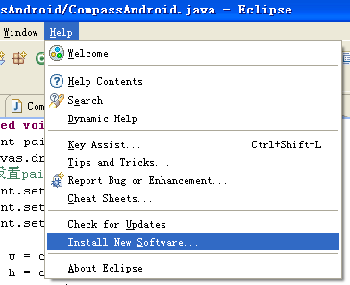
安装Android
解压，在Eclipse中Install New Software…

Slide 11
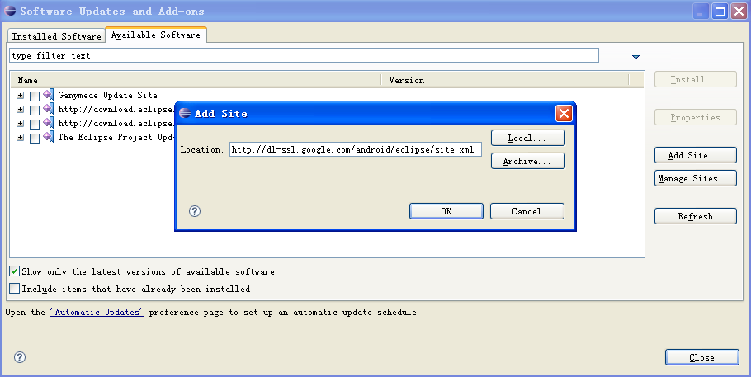
添加ADT(Android开发工具)
ADT

Slide 12
Android学习方法
①了解什么是Android
②建立开发环境
③阅读SDK 文档
④背景知识
  Java
  面向对象
  设计模式
  Eclipse使用
  J2ME等其它手机编程(选)

Slide 13
参考网站
http://androidappdocs.appspot.com/index.html
http://www.android.com/
http://www.android123.com.cn/
http://www.androidcn.org/index.php
https://sites.google.com/site/androidappcourse/home（翻墙）
。。。。。。

Slide 14

Thank you!

