Slide 1

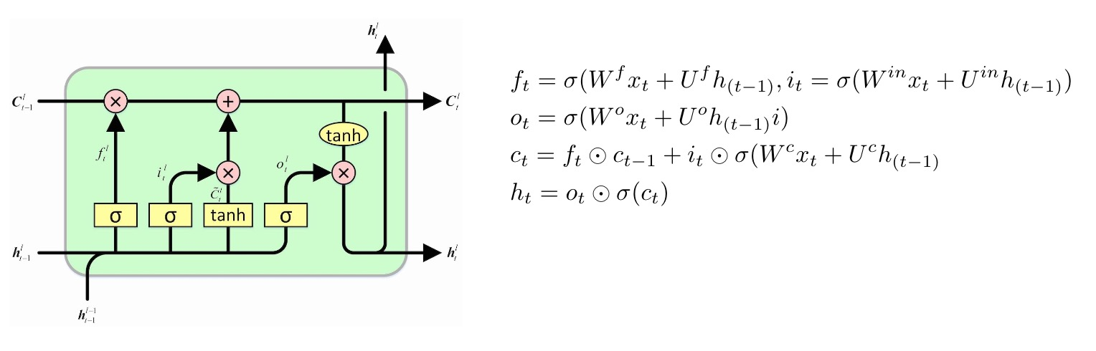
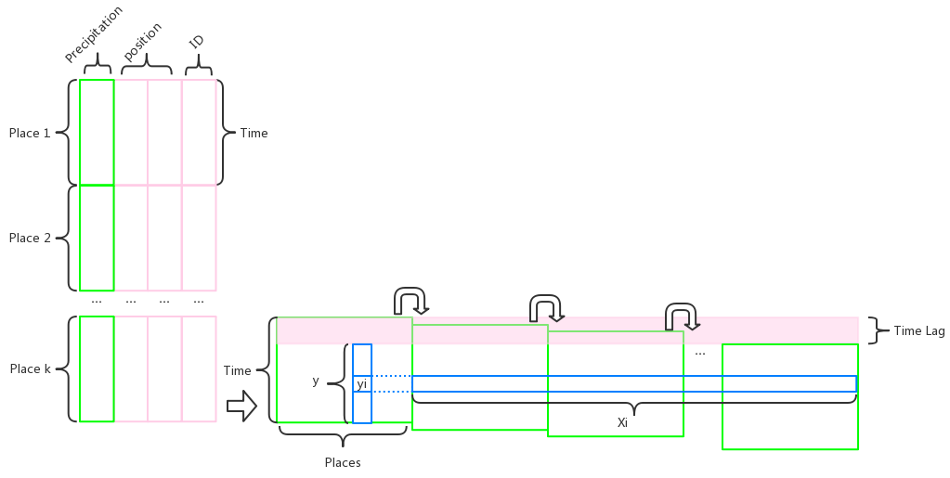
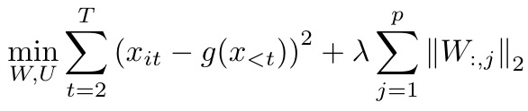
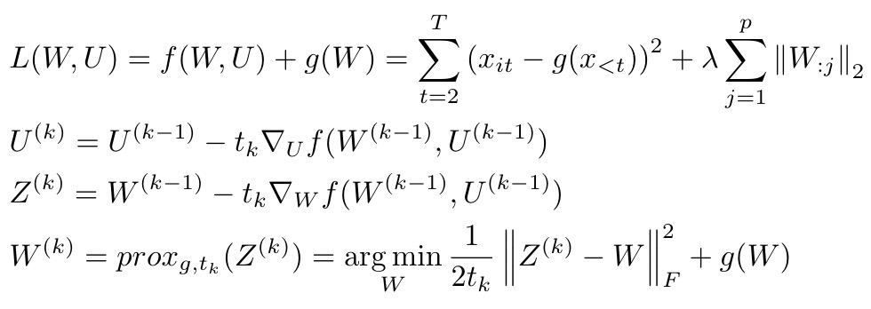
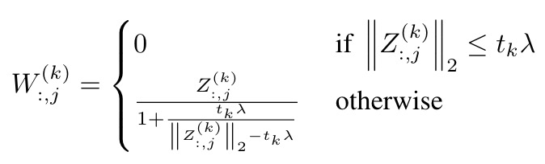
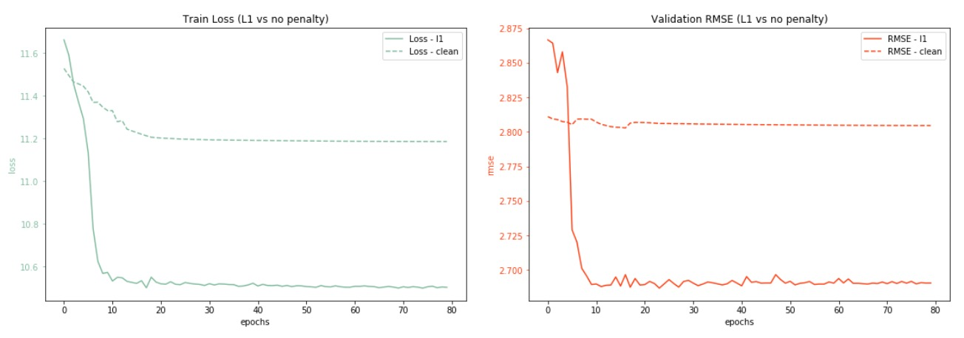
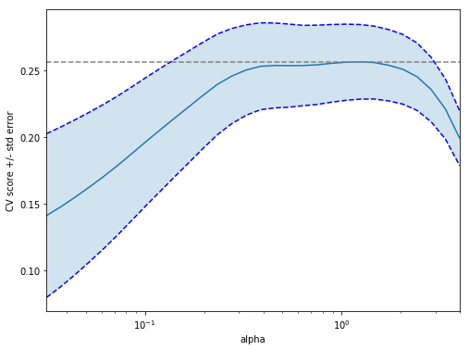
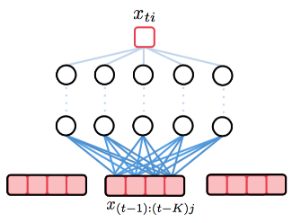
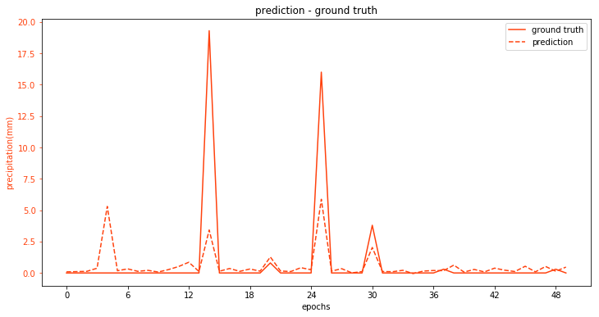


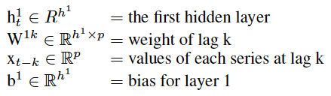


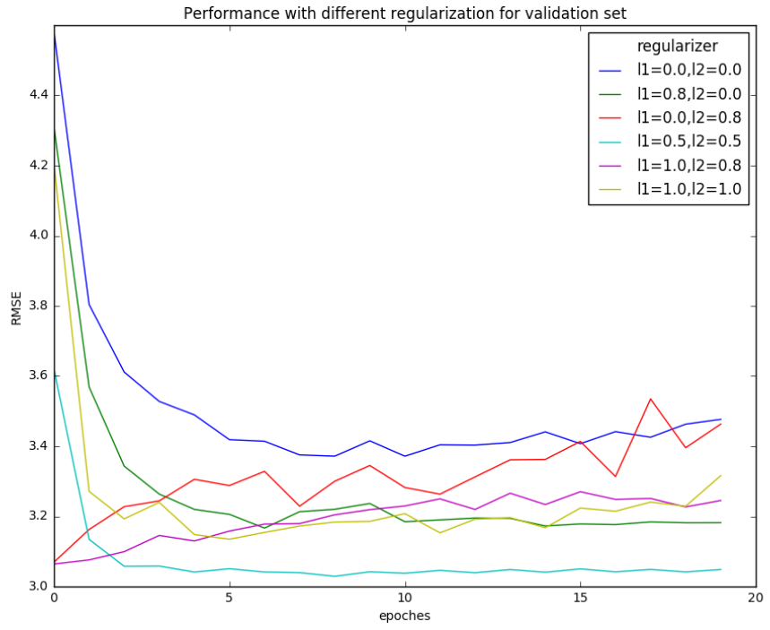
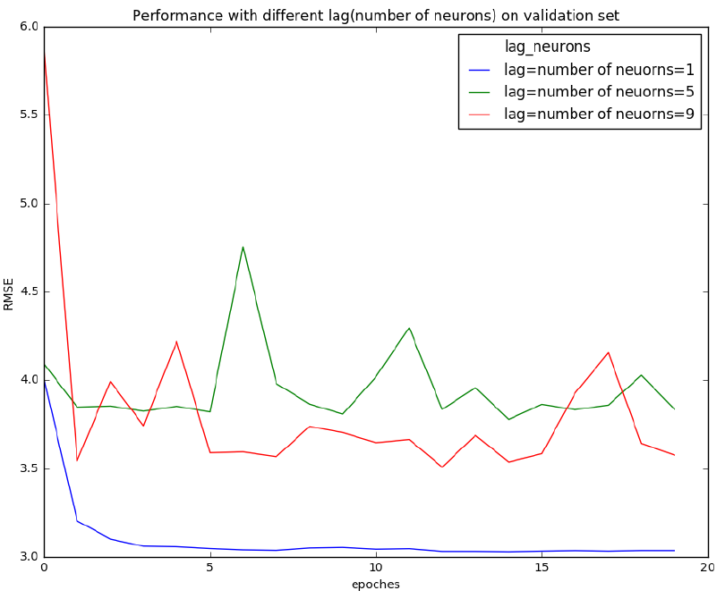
Precipitation Prediction With Multiple models
Sailun Xu, Dongshunyi Li, Jingwei Li
Introduction
Methods: cLSTM
Precipitation predictions are usually based on satellite cloud picture. We are trying to predict precipitation of one city with only historical precipitation data from other cities. We try to:
Fit precipitation data into multiple models
Predict precipitation of some specific city
Interpret the relationship between different cities
Recurrent neural network(RNN), especially Long short-term memory has shown to be well suited for modeling time series data, as they are able compress long-term dependency by updating its hidden state. A LSTM cell is defined by the following rule:
Data Set
Raw data comes with GIS information which is of no use in model training, so we drop them and meanwhile, we transfer precipitation data into matric with columns of places and rows of times.
Same data was assembled multiple times with a difference of one row to represent time lag.
However, just as in the autoregression and MLP case, we would like to add sparsity constraint and retain only significant factors, therefore we introduce the l1-penalization term upon the weight matrix that operators on the input, which lead to the component-wise LSTM (cLSTM) objective:
While naively optimize this objective using (sub)gradient descent would not lead to exact zeroes in most cases, we instead apply proximal stochastic (sub)gradient descent, which enjoys the same convergence rate as (sub)gradient method, yet would have exact zeroes if ground-truth is so. Luckily we have the closed form solution for proximal operator, known as the soft group threshold
Methods: Autoregression
The feature selection is based on LASSO, we use K-fold cross validation to find the best lambda which will lead the R square to reach the highest. Then with a higher level of validation, we find the best day lag for each model. Here, we consider the day lag from 1 to 7 days.
With the features selected by two-level LASSO, we build linear model and calculate P-value of each feature.
Finally, with the R square and coefficients of each feature, we can find the precipitation correlation between different places.
Results
The linear model of precipitation of Alaska has a R-square of 0.35 for test set. Meanwhile, 14 of 19 places selected by LASSO have P-value less than 0.05.
For this selected city in Alaska, we plot most related places. The graph on the right shows the correlation, with line width proportional to the absolute value of coefficient.
On the test dataset, we predict the precipitation of last 48 days based on the history, with ground truth in solid line and prediction in dotted line.
Methods: cMLP
Previous study [2] proposed componentwise MLP(cMLP) to enable the inference of Granger causality from the learned weights of MLP. Figure on the left shows the schematic the cMLP. Particularly, we model the value of series i at time t as:
For cMLP of a particular series i at time t , g() has the form of MLP. The first layer is given as left. The subsequent layers are fully connected and the output is given by the linear output decoder of the last hidden layer output. To select for Granger causality, we applied grouped penalty to the weight in the following equation. For large lambda, many weight penalized to 0.
Conclusion
We proposed multiple models for precipitation forecasting, including autoregression, cMLP and cLSTM. We built models for each location and we found the one for a place at Alaska has the best prediction accuracy. We find that the precipitation of California and Hawaii within 3 days will have the best prediction effect for Alaska.
It turns out that for small dataset with less information and more noise as in our case, sophisticated models such as MLP and LSTM would not necessarily work well. Instead, traditional methods such as auto-regression is not only more performant ( in terms of testing RMSE), but also has better interpretability coming from the lagging hyper-parmeter and coefficient matrix sparsity.
In practice, we use a penalization similar to elastic net, particularly, we tune lambda1 for l1 regularization
and lambda2 for l2 regularization. The best performance achieved when lambda1 = lambda2 = 0.5. We change the lag the same as the number of neurons. Best achieved when lag = 1 .
Reference
[1] Hameed S Leonardo N. Impact of the Hawaiian High on Inter annual Variations of Winter Precipitation over California. 2015.
[2] Alex Tank, Ali Shojaie, Ian Covert, Nicholas J. Foti, and Emily B. Fox. Neural Granger Causality for Nonlinear Time Series. 2018.
[3] Ryan Tibshirani. Proximal Gradient Descent. 2018.

