Slide 1
Distributed Systems and Consistency
Because everything else is easy.

Slide 2
What we're talking about
What are distributed systems?
Why are they good, why are they bad?
CAP theorem
Possible CAP configurations
Strategies for consistency, including:
  Point-in-time consistency with LSS
  Vector clocks for distributed consistency
  CRDTs for consistency from the data structure
  Bloom, a natively consistent distributed language

Slide 3
What's a distributed system?
Short answer: big data systems
  Lots of machines, geographically distributed
Technical answer:
  Any system where events are not global
  Where events can happen simultaneously
Notes:
- What's a distributed system?
- Short answer: "big data"
- Lots of machines, geographically distributed
- Actual answer: any system where events are not global
- Can a read and write happen at the same time? == Distributed
- Mostly things are queued
- Or in database systems, it's fudged -- no lock, so no problem

Slide 4
Why are they good?
Centralized systems scale poorly & expensively
  More locks, more contention
  Expensive hardware
  Vertical scaling
Distributed systems scale well & cheaply
  No locks, no contention
  (Lots of) cheap hardware
  Linear scaling
Notes:
- Why are they good?
- Centralized systems scale poorly & expensively
- More locks, more contention
- Really fast hardware
- Vertical scaling
- Diminishing returns -- will always eventually fail
- Distributed systems scale well & cheaply
- Lots of cheap hardware
- No locks, no contention
- Linear scaling -- can theoretically scale indefinitely

Slide 5
So what's the catch?
Consistency
  “Easy” in centralized systems
  Hard in distributed systems
Notes:
- So what's the catch?
- Consistency
- In a centralized system consistency is simple: single source of truth
- The problem is writing to it performantly
- In a distributed system writes are really fast
- But the definition of "truth" is much, much harder

Slide 6
CAP Theorem
Consistency
  All nodes see the same data at the same time
Availability
  Every request definitely succeeds or fails
Partition tolerance
  System operates despite message loss, failure
Pick two!
Notes:
- CAP theorem
- Consistency (all nodes see the same data at the same time)
- Availability (a guarantee that every request receives a response about whether it was successful or failed)
- Partition tolerance (the system continues to operate despite arbitrary message loss or failure of part of the system)
- Pick 2
- But actually it's usually a sliding scale

Slide 7
No P
No partition tolerance = centralized
  Writes can't reach the store? Broken.
  Reads can't find the data? Broken.
The most common database type
  MySQL
  Postgres
  Oracle
Notes:
- P: No partition tolerance = centralized database
- Can't connect to read or write? You're broken.
- Replication log got corrupted? You're broken.
<img: welcome to our ool>

Slide 8
No A
An unavailable database = a crappy database
  Read or write didn't work? Try again.
  Everything sacrifices A to some degree
Has some use-cases
  High-volume logs & statistics
  Google BigTable
  Mars orbiters!
Notes:
- A: No availability guarantee = guessing
- Read or write didn't work: try again
- Cost/benefit calculation -- everything is unavailable *sometimes*
- High-volume logs, statistics
- Google BigTable locks data on write, will throw errors if you try to read it
- Mars orbiters! Not all the data makes it back, and that's okay.

Slide 9
No C
Lower consistency = distributed systems
  “Eventual consistency”
  Writes will work, or definitely fail
  Reads will work, but might not be entirely true
The new hotness
  Amazon S3, Riak, Google Spanner
Notes:
- C: Lower consistency = Amazon S3, Riak, other distributed systems
- "Eventual" consistency
- Write will work, or definitely fail
- Reads will work, but might not be "true"
- Keep retrying for the truth

Slide 10
Why is this suddenly cool?
The economics of computing have changed
Networking was rare and expensive
  Now cheap and ubiquitous – lots more P
Storage was expensive
  Now ridiculously cheap – allows new approaches
Partition happens
  Deliberately sacrifice Consistency
  Instead of accidentally sacrificing Availability
Notes:
- Why is this a big deal now?
- The last 10 years have been about systems getting so big that P has become a bigger and bigger problem
- Network was expensive, now it's cheap
- And everything is networked
- Storage was expensive, now it's cheap
- Sacrificing A has been the accidental solution
- Instead we can deliberately dial down C to get bigger

Slide 11
Ways to get to eventual consistency
App level:
  Write locking
  Last write wins
Infrastructure level
  Log structured storage
  Multiversion concurrency control
  Vector clocks and siblings
New: language level!
  Bloom
Notes:
- Ways to get to eventual consistency
- There are a ton!
- App level:
- Write locking
- Last write wins
- Infrastructure level:
- Log structured storage, multiversion concurrency control
- Vector clocks and siblings
- New: language level!
- Bloom

Slide 12
Write-time consistency 1
Write-time locking
  Distributed reads
  (Semi)-centralized writes
  Cheap, fast reads (but can be stale)
  Slower writes, potential points of failure
In the wild:
  Clipboard.com
  Awe.sm!
Notes:
- Eventual consistency at write time: 1
- Write-time locking
- Like a centralized database, except reads are okay with stale data
- Slower writes, potential points of failure
- Cheap, fast reads

Slide 13
Write-time consistency 2
Last write wins
  Cheap reads
  Cheap writes
  Can silently lose data!
    A sacrifice of Availability
In the wild:
  Amazon S3
Notes:
- Eventual consistency at write time: 2
- Last write wins
- This is Amazon S3.
- Relies on accurate clocks
- Cheap reads and writes
- Can lose data!
- Okay for image files, bad for payment processing

Slide 14
Side note: Twitter
Twitter is eventually consistent!
Your timeline isn't guaranteed correct
Older tweets can appear or disappear
Twitter sacrifices C for A and P
  But doesn't get a lot of A
Notes:
- Side note: twitter is eventually consistent
- Your timeline doesn't always turn up exactly in order
- Older tweets can slot themselves in
- Tweets can disappear
- Two new tweets can never collide
- This is a form of eventual consistency, last write wins, but no conflicts

Slide 15
Infrastructure level consistency 1
Log structured storage
  Also called append-only databases
  A new angle on consistency: external consistency
  a.k.a. Point-in-time consistency
In the wild:
  BigTable
  Spanner
Notes:
- A consistency approach: log-structured storage
- Also called append-only databases
- Eventual consistency where *consistency* is important, but *currency* is not
<diagram>

Slide 16
How LSS Works
Every write is appended
Indexes are built and appended
Reads work backwards through the log
Challenges
  Index-building can get chunky
    Build them in memory, easily rebuilt
  Garbage collection
    But storage is cheap now!
Notes:
- How LSS works
- Each write is appended
- Indexes are also appended
- To get a value, consult the index
- As the data grows, throw away older values
- Index doesn't need to be updated as often
- If you find operations before the index, rebuild an index from them
- Relies of lots of really cheap storage
- But it turns out we have that!

Slide 17
Why is LSS so cool?
Easier to manage big data
  Size, schema, allocation of storage simplified
Indexes are impossible to corrupt
Reads and writes are cheap
Point-in-time consistency is free!
  Called Multiversion Concurrency Control
Notes:
- Why is this good?
- Don't have to care about the size or schema of the object
- Deleting old objects is automatic
- Can't corrupt the index
- Reads and writes are cheap
- Point-in-time consistency is automatic: just read values older than the one you started with
- BUT: you still could be behind reality

Slide 18
Infrastructure level consistency 2
Vector clocks
  Vectors as in math
  Basically an array
Notes:
- Another consistency approach: vector clocks
- Eventual consistency where consistency and currency both matter
- Vector, as in math
- It means an array, but mathematicians are annoying
<diagram>
- Simultaneous writes produce siblings - never any data lost

Slide 19
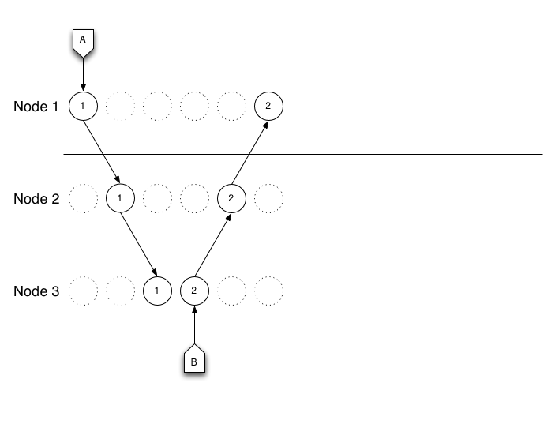

Slide 20
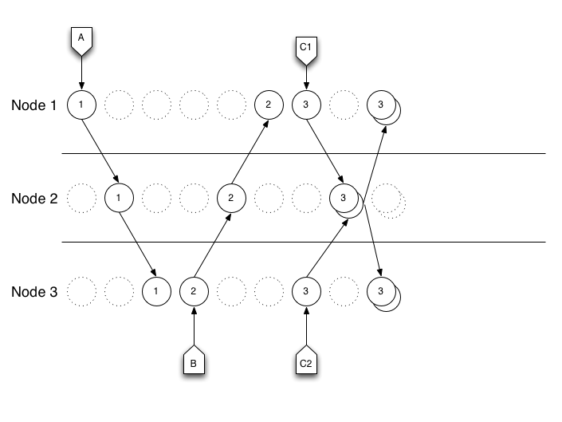

Slide 21
Not enough for consistency
Different nodes know different things!
Quorum reads
  N or more nodes must agree
Quorum writes
  N or more nodes must receive new value
Can tune N for your application
Notes:
- Not good enough!
- Read consistency: quorum reads
- N or more sources must return the same value
- Write consistency: quorum writes
- N or more nodes must receive the new value

Slide 22

But siblings suck!
Notes:
- Pretty good
- But man do siblings suck!
http://3.bp.blogspot.com/-h60iS4_uwfg/T2B4rntiV4I/AAAAAAAAK9M/Wc_jaXLRowg/s400/istock_brothers-fighting-300x198.jpg

Slide 23
Dealing with siblings
1: Consistency at read time
  Slower reads
  Pay every time
2: Consistency at write time
  Slower writes
  Pay once
3: Consistency at infrastructure level
  CRDTs: Commutative Replicated Data Types
  Monotonic lattices of commutative operations
Notes:
- Dealing with siblings
- 1: Consistency at read time through clever resolution
- Cheap, fast writes
- Potentially slower reads, duplicated dispute resolution logic
- Pay on every read
- 2: Avoid creating them in the first place
- Put a sharded lock in front of your writes
- Potentially slower writes
- Pay once on write
- 3: CRDTs: Commutative Replicated Data Types
- monotonic lattices of commutative operations
- Don't panic

Slide 24
Don't Panic
We're going to go slowly
There's no math

Slide 25
Monotonicity
Operations only affect the data in one way
  e.g. increment vs. set
Instead of storing values, store operations
Notes:
- Monotonicity
- Means operations only affect the data in one way
- Simplest example: setter vs. incrementer
- Bad: http://en.wikipedia.org/wiki/File:Monotonicity_example3.png
- Good: http://en.wikipedia.org/wiki/File:Monotonicity_example1.png
- The setter can get it wrong, destroy information
- The incrementer doesn't need to know the exact value, just that it goes up by one
( Also good: http://en.wikipedia.org/wiki/File:Monotonicity_example2.png )
- Instead of storing values, store operations

Slide 26
Commutativity
Means the order of operations isn't important
  1 + 5 + 10 == 10 + 5 + 1
  Also: (1+5) + 10 == (10+5) + 1
You don't need to know when stuff happened
Just what happened
Notes:
- Commutativity
- Means the order of operations isn't important
- 1 + 5 + 10 == 10 + 5 + 1
- Also: (1+5) + 10 == 1 + (5+10)
- Means you don't need to know what order the operations happened in
- Just that they happened

Slide 27
Lattices
A data structure of operations
  Like a vector clock, sets of operations
“Partially” ordered
  Means you can throw away oldest operations
Notes:
- Lattices
- A data structure consisting of a set of operatios
- Like vector clocks, a (partial) order of operations
- Doesn't have to be exact
- Just enough to able to avoid having to re-run every operation every time

Slide 28
Put it all together: CRDTs
Commutative Replicated Data Types
  Each node stores every entry as a lattice
  Lattices are distributed and merged
  Operations are commutative
    So collisions don't break stuff
Notes:
- Put it all together: CRDTs
- Commutative Replicated Data Types
- Each node stores operations in a lattice
- As data is distributed, lattices are merged
- Because operations are commutative, collisions are okay
- Because the exact order is irrelevant

Slide 29
CRDTs are monotonic
Each new operation adds information
Data is never deleted or destroyed
Applications don't need to know
Everything is in the store
Notes:
- CRDTs are a monotonic data structure
- Each new operation only adds information
- It's never taken away or destroyed
- This is really exciting!
- It means we don't have to build application logic to handle it
- Just get your data types right, and the database will sort it out
- Enables radically distributed systems

Slide 30
CRDTs are pretty awesome
But
  use a lot more space
  garbage collection is non-trivial
In the wild:
  The data processor!

Slide 31
Language level consistency
Bloom
  A natively distributed-safe language
  All operations are monotonic and commutative
  Allows compiler-level analysis
  Flag where unsafe things are happening
    And suggest fixes and coordination
  Crazy future stuff
Notes:
- Crazy future shit: Bloom
- A language where all the operations available are monotonic, commutative
- Calls to non-monotonic operations are special
- Allows for compiler-level analysis of distributed code
- Flag in advance whether or not you are safe, where you need coordination, and what type
- Crazy shit

Slide 32
In Summary
Big data is easy
  Just use distributed systems!
Consistency is hard
  The solution may be in data structures
  Making use of radically cheaper storage
Store operations, not values
  And make operations commutative
Data is so cool!
Notes:
- In summary:
- Big data is easy
- Distributed systems are the answer
- Distribution makes consistency harder in exchange for better partition
- The solution may be changing the way data is stored
- Don't store a value, store a sequence of operations
- Make the operations commutative, the structure monotonic
- Pretty cool stuff

Slide 33
More reading
Log Structured Storage:
  http://blog.notdot.net/2009/12/Damn-Cool-Algorithms-Log-structured-storage
Lattice data structures and CALM theorem:
  http://db.cs.berkeley.edu/papers/UCB-lattice-tr.pdf
Bloom:
  http://www.bloom-lang.net/
Ops: Riak in the Cloud
  https://speakerdeck.com/u/randommood/p/getting-starte
Notes:
Log Structured Storage:
http://blog.notdot.net/2009/12/Damn-Cool-Algorithms-Log-structured-storage
Lattice data structures and CALM theorem:
http://db.cs.berkeley.edu/papers/UCB-lattice-tr.pdf
Bloom:
http://www.bloom-lang.net/
Ops: Riak in the Cloud
https://speakerdeck.com/u/randommood/p/getting-starte

Slide 34
Even more reading
http://en.wikipedia.org/wiki/Multiversion_concurrency_control
http://en.wikipedia.org/wiki/Monotonic_function
http://en.wikipedia.org/wiki/Commutative_property
http://en.wikipedia.org/wiki/CAP_theorem
http://en.wikipedia.org/wiki/Fallacies_of_Distributed_Computing
http://pagesperso-systeme.lip6.fr/Marc.Shapiro/papers/RR-6956.pdf
http://en.wikipedia.org/wiki/Vector_clock
Notes:
Other sources:
http://en.wikipedia.org/wiki/Multiversion_concurrency_control
http://en.wikipedia.org/wiki/Monotonic_function
http://en.wikipedia.org/wiki/Commutative_property
http://en.wikipedia.org/wiki/CAP_theorem
http://en.wikipedia.org/wiki/Fallacies_of_Distributed_Computing
http://pagesperso-systeme.lip6.fr/Marc.Shapiro/papers/RR-6956.pdf
http://en.wikipedia.org/wiki/Vector_clock

