Slide 1
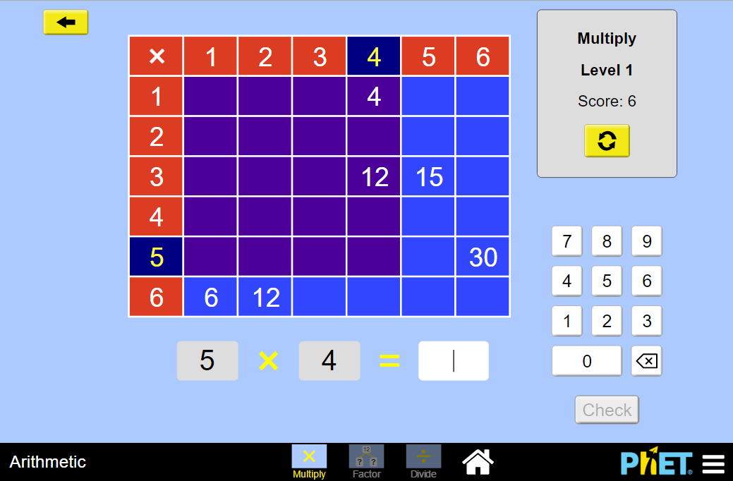


Tips for Teachers
Arithmetic
In the Arithmetic sim, students will practice multiplying, dividing and factoring by using a multiplication table. Each screen (Multiply, Factor, Divide) opens with a level selection that allows you to choose your level. The “back” arrow on the upper left returns the user to the level selection.
SELECT more difficult levels with larger multiplication tables.
CHOOSE to multiply,
factor,
or divide.
REWARD users get +1 point for each answer correct on the first try!
Suggestions for Use
Sample Challenge Prompts
Why can two numbers be multiplied in either order?
Which numbers form a purple square on the arithmetic board?
After you complete a board, what patterns do you notice? Are the patterns similar or different for boards on different levels?
On the multiply screen, how can you use the purple squares to help you answer a multiplication problem?
On the division screen, there is no division sign! How is this a division problem? Re-write one of the problems as a division statement.
Insights into Student Use
Students may not immediately notice the connection between the answer in each cell and the number of cells in the displayed purple shaded area. In addition, the division screen is framed in the form of “what number do you have to multiply the first number by to get the product?” which may be a slightly different context than they have seen division before. However, this multiplicative approach to division can be very powerful for increasing the student’s conceptual understanding.
See all activities for Arithmetic here.
For more tips on using PhET sims with your students, see Tips for Using PhET.
Dalton, Hanson, McGarry, February 2016
Notes:
Use this screen to orient the viewer to the layout, controls, and features of each screen. If you have multiple screens, the screenshots may need to be smaller and you might not be able to point out every control- so focus on the less obvious ones (i.e., do not point out the refresh button). If you have only one screen, do not feel the need to fill the entire page. The content on the second page can move up to the first page.
To modify the callouts:
Drag up and down to change the height
Drag the tip of the pointer to adjust where it points
CTRL+SHIFT+drag up/down to make a copy (CMD+SHIFT on mac)
Choose a new color theme by clicking a callout > Format > Fill > More Colors > Magnifying Glass/Dropper > Click on a color in the sim that you like!
Content Screen(s)
One screenshot in a useful configuration
One-sentence description of the goal of the screen or distinguishing between two similar screens.
Callouts highlighting features and tools (If applicable, include a screenshot within the callout to help describe what a control will do).
Game Screen(s)
One screenshot with the level selection buttons
One-sentence description of the design of the game, the levels, or how the levels are scaffolded.
Callouts with details of each level/game, types of challenges

