Slide 1

Chapter 1
Introduction System and Network Administration
By Dr. Samuel Asferaw
2025/2026

Slide 2
Topics
What is system administration?
What do sysadmins do?
Administration Challenges
Principles and First Steps
Organizations and Certifications
Maturity and Complexity
SAGE Code of Ethics
X-Windows Operating Systems

Slide 3
What is a Computer Network system?
Computer Network System: An organized collection of computers interacting with a group of users looking for services to accomplish work.
Servers
PCs
Network
run on
Use
Services
Users
help to accomplish work

Slide 4
System State
System policy: specification of a system’s configuration and its acceptable usage.
System state S(t): the current configuration (files, kernel, memory or CPU usage) of a system.
Ideal states S*(t): states of the system that match the system policy. Over time, the system state shifts away from the ideal state.
System administration: modifying the system to bring it closer to S*(t).

Slide 5
What do sysadmins do?
Small org: sysadmin can be entire IT staff
  Phone support
  Order and install software and hardware
  Fix anything that breaks from phones to servers
  Develop software
Large org: sysadmin is one of many IT staff
  Specialists instead of “jack of all trades”
  Database admin, Network admin, Fileserver admin, Help desk worker, Programmers, Logistics

Slide 6
What do sysadmins do? …
Add and remove users
Add and remove hardware
Perform backups
Install new software systems
Troubleshooting
System monitoring
Auditing security
Help users
Communicate
All are common activities for sysadmin.

Slide 7

User Account Management
Creating user accounts
  Consistency requires automation
  Startup (dot) files
Removing user accounts
  Consistency requires automation
  Many accounts across different systems
Namespace management
  Usernames and UIDs
  Multiple namespaces or SSI?

Slide 8
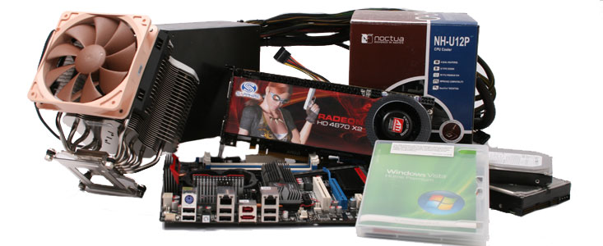
Hardware Management
Adding and removing hardware
  Configuration, cabling, etc.
Purchase
  Evaluate and purchase servers + other hardware
Capacity planning
  How many servers? How much bandwidth, storage?
Data Center management
  Power, environment (cooling, fire alarm)
Virtualization
  When can virtual servers be used vs. physical?

Slide 9
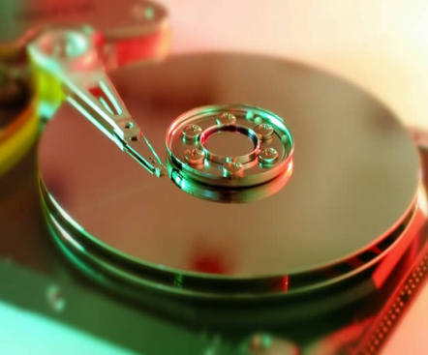
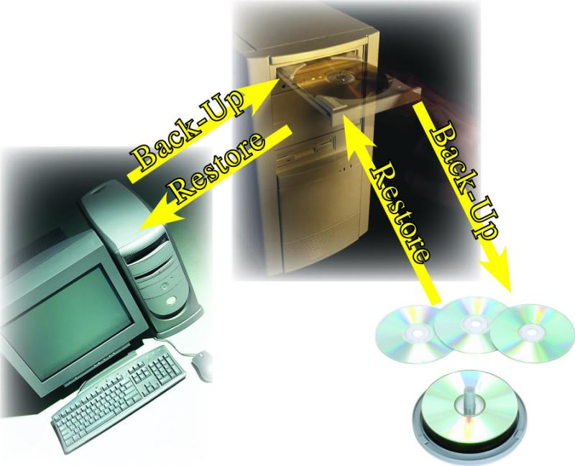
Data Backups
Backup strategy and policies
  Scheduling: when and how often?
  Capacity planning
  Location: on-site vs. off-site.
Monitoring backups
  Checking logs
  Verifying media
Performing restores when requested

Slide 10
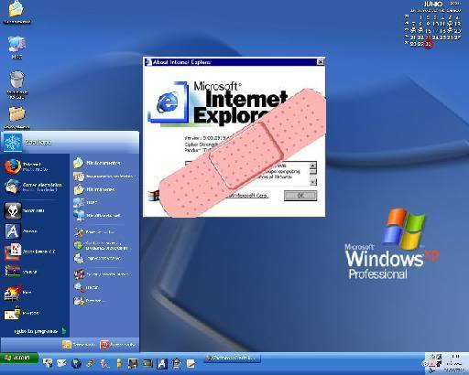
Software Installation
Evaluation of software
Automated consistent OS installs
  Desktop vs. server OS image needs.
Installation of software
  Purchase, find, or
  build custom software.
Managing software installations
  Distributing software to multiple hosts.
  Managing multiple versions of a software pkg.
Patching and updating software

Slide 11
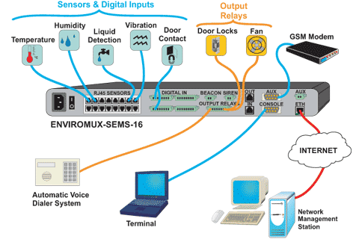
System Monitoring
Automatically monitor systems for
  Problems (disk full, error logs, security)
  Performance (CPU, mem, disk, network)
Security
  Passwords
  Break-ins
Capacity
  Disk, RAM, CPU, network
System logs
  Examination
  Periodic rotation and truncation
  Archival storage (at least
  summaries)
Provides data for capacity planning
  Determine need for resources
  Establish case to bring to management

Slide 12
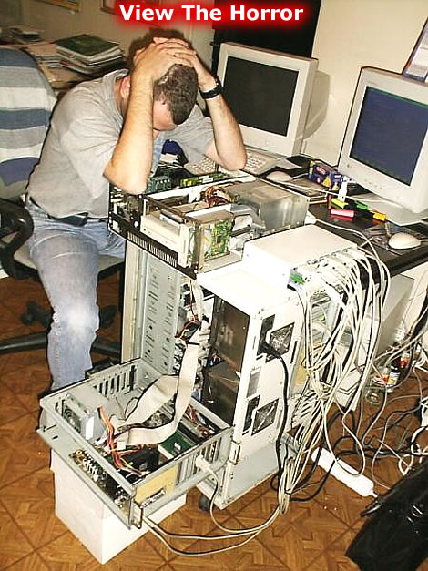
Troubleshooting
Problem identification, diagnosis, and resolution
  By user notification
  By log files or monitoring programs
Finding the root cause of problems
  Provide temporary solution if necessary
  Solve the root problem to permanently eliminate
    Often quite difficult!
  Often requires
  Broad and thorough
  system knowledge
  Outside experts
  Luck

Slide 13
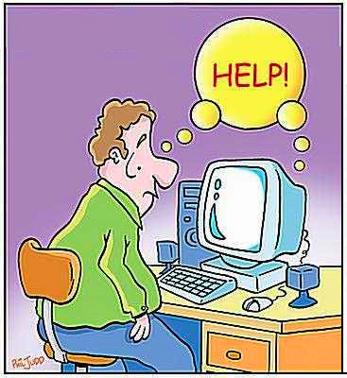
User Assistance
Time intensive!
Techniques
  Help desks
  Trouble-ticket systems
Software availability and usage
Software configuration settings
Hardware usage, maintenance, and troubleshooting
User documentation and training
  Policies and procedures
Schedule and communicate downtimes

Slide 14
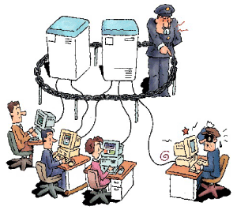
Security Concerns
System logging and audit facilities
  Evaluation and implementation
  Monitoring and analysis
  Traps, auditing and monitoring programs
Unexpected or unauthorized user detection
Monitoring of security advisories
  Security holes and weaknesses
  Live exploits

Slide 15
Communicate
Customers
  Keep customer appraised of process
    When you’ve started working on a request
    When you make progress, need feedback
    When you’ve finished
  Communicate system status
    Uptime, scheduled downtimes, failures
  Meet regularly with customer managers
Managers
  Meet regularly with your manager
  Write weekly status reports

Slide 16
Specialized Skills
Heterogeneous Environments
  Integrating multiple-OSes, hardware types, or network protocols, distributed sites.
Databases
  SQL RDMS
Networking
  Complex routing, high speed networks, voice.
Security
  Firewalls, authentication, biometrics, cryptography.
Storage
  Network Attached Storage (NAS), Storage Area Networks (SANs), cloud storage.
Virtualization and Cloud Computing
  VMware, cloud architectures.

Slide 17
Practice of sysadmin
Common practice may not be good practice
  There are three reasons for common practice:
    Someone did it and others followed blindly;
    Believe it is good after careful thought;
    An arbitrary choice had to be made;
  Think for yourself
  Pay attention to experts but don’t automatically believe anyone
  Every choice needs a reason

Slide 18
Practice of sysadmin ...
Good practices
  Look for answers in manuals, newsgroups, and archive of mailing lists
    Usually “google” helps for most common problems
  Use controlled trial and error for diagnosis
  Listen to people who tell us there is a problem. It might be true
  Write down problems and solutions in a log book, and write down experiences
  Take responsibilities for our actions
  Remember to tidy things up regularly
  After learning something new, ask yourself “How does this apply to my work?”

Slide 19
System administrator (sysadmin)
Successful System Administrators
  No stereotypes, “White/black Cats Theory”
  Normally if one can keep the users happy she is successful (which is very difficult)
  Life-long learning skills. One’s proud knowledge and expertise today may be obsolete tomorrow (Be prepared to be jobless if you do not keep learning)
Some myths for new sysadmin
  There exists a right answer for every problem
  Things should always work in the way we expect
  Every problem should have a happy end

Slide 20
Challenges of System Administration
Not only just installing system/software, also about planning and designing an efficient community of computers
Design a logical and efficient network
Easy upgrade for a large number of computers
Decide what and where services are installed
Plan and implement security
Provide a comfortable environment for users
Develop ways of fixing problems and errors
Keep track of new technology and software

Slide 21
Challenges of System Administration ...
Need
  Broad knowledge of hardware and software
  To balance conflicting requirements
    Short-term vs. long-term needs
    End-user vs. organizational requirements
    Service provider vs. police model
  To work well and efficiently under pressure
  24x7 availability
  Flexibility, tolerance, and patience
  Good communication skills
People think of sysadmins only when things don't work!

Slide 22
Principles of SA
Simplicity
  Choose the simplest solution that solves the entire problem
  Work towards a predictable system
Clarity
  Choose a straightforward solution that’s easy to change, maintain, debug, and explain to other SAs
Generality
  Choose reusable solutions that scale up; use open protocols
Automation
  Use software to replace human effort
Communication
  Be sure that you’re solving the right problems and that people know what you’re doing
Basics First
  Solve basic infrastructure problems before advanced ones

Slide 23
Qualities of a Successful Sysadmin
Customer oriented
  Ability to deal with interrupts, time pressure
  Communication skills
  Service provider, not system police
Technical knowledge
  Hardware, network, and software knowledge
  Debugging and troubleshooting skills
Time management
  Automate everything possible
  Ability to prioritize tasks: urgency and importance

Slide 24
First Steps to Better SA
Use a request system
  Customers know what you’re doing
  You know what you’re doing
Manage quick requests right
  Handle emergencies quickly
  Use request system to avoid interruptions
Policies
  How do people get help?
  What is the scope of responsibility for SA team?
  What is our definition of emergency?
Start every host in a known state.

Slide 25
Types of Sites
Small
  2-10 computers, 1 OS, 2-20 users.
  Small staff size requires outsourcing to obtain most specialized skills.
Midsized
  11-100 computers, 1-3 OSes, 21-100 users.
Large
  100+ computers, multiples OSes, 100+ users
  Outsources to reduce costs, some specializations.

Slide 26
Organizations Working on SA
USENIX: Advanced Computing Systems Association
LISA: Large Installation System Administration
SAGE: System Administration Guild
LOPSA: League of Professional System Administrators

Slide 27
Certifications for SA
CCNA, CCNP, CCIE (Cisco)
cSAGE (SAGE)
MCSA (Microsoft)
RHCE (Red Hat)
SCSA (Sun)
VCP (VMware)

Slide 28
SAGE Job Descriptions
Novice SA
  OS familiarity, help desk skills
Junior SA
  Can use OS system administration tools
Intermediate SA
  Understanding of distributed computing, common servers, automate small tasks, independent action
Senior SA
  Understanding of scaling issues, including capacity planning, solve problems by addressing root cause, higher level programming abilities, write proposals for purchasing, data center planning, etc.

Slide 29
SA Maturity Model (SAMM)
Ad Hoc
  Ad-hoc non-repeatable solutions, firefighting.
Repeatable
  Some repeatable processes.
Defined
  Documented standard processes
Managed
  Process effectiveness measured, adapted.
Optimized

Slide 30
Maturity and Complexity
Scalable but time lost in process
Low downtime, high efficiency
Maturity
Constant firefighting, high downtime
Works, but hard
to scale up
Complexity: increasing numbers of systems and/or services

Slide 31
Tool Maturity Levels
Ad Hoc
  OS GUI, CLI, or web administration interfaces.
Repeatable
  Version control (RCS, SVN, GIT), request tracker
Defined
  Automatic monitoring (Nagios, monit, god)
Managed
  Configuration management (AutomateIt, cfengine)
Optimized

Slide 32
SAGE Code of Ethics
Professionalism
Personal Integrity
Privacy
Laws and Policies
Communication
System Integrity
Education
Social Responsibility
http://www.sage.org/ethics/

Slide 33
X-Windows
Mac Operating System
Unix Operating System
Linux Operating System
etc

Slide 34
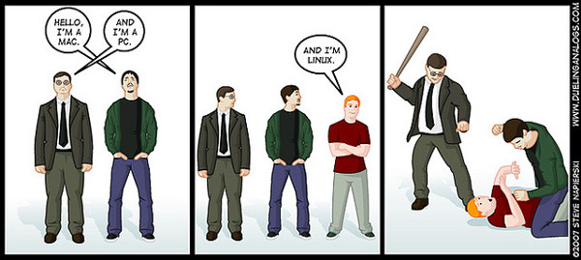
Which OS to learn to admin?

Slide 35
Brief History of UNIX
Originated as a research project in 1969 at AT&T Bell Labs
  Made available to universities (free) in 1976
Berkeley UNIX started in 1977 when UCB licensed code from AT&T.
  Berkeley Software Distribution started in 1977 with 1BSD, and ended in 1993 with 4.4BSD
  Licensing costs from AT&T increased, so Berkeley attempted to remove AT&T code, but ran out of funds before completion.
  Final release of AT&T-free code called 4.4BSD-Lite.
    Most current BSD distributions (FreeBSD, NetBSD, OpenBSD) are derived from 4.4BSD-Lite.
Most commercial versions of UNIX (Solaris, HP-UX) are derived from the AT&T code

Slide 36
What is Linux? much is courtesy of www.kernel.org
Linux is a clone of the operating system Unix, written by a loosely-knit team of hackers across the Net.
Like any modern full-fledged Unix, Linux includes:
  true multitasking
  proper memory management and virtual memory
  shared libraries and shared copy-on-write executables
  TCP/IP networking
Linux really refers to the kernel
  Most commands and apps are really separate programs, not specific to Linux, and often are part of the Free Software Foundation's GNU project.
Linux was first developed for 32-bit x86-based PCs (386 or higher). These days it also runs on dozens of other processors.

Slide 37
What is Linux? Cont…
Linux stands for Linus’ Unix
It is the kernel of an operating system.
Linux is an open-source, UNIX-like operating system created by Linus Torvalds in 1991.
Known for being secure, customizable, and widely used in servers, desktops, and embedded systems.
Key Features: Multitasking, multi-user support, portability, and stability.
Kernel: The core of the Linux OS, managing hardware and system processes.

Slide 38
Brief History of Linux
Created as a personal project (and still controlled) by Linus Torvalds, a Finnish graduate student, in 1991
Conceived as an offshoot of Minix (a model OS)
  Not derived from AT&T or BSD UNIX code
Red Hat (one of many Linux vendors) founded in 1993
Kernel v1.0 released 1994
Most recent (Jan 2016) kernel release is 4.4?

Slide 39
Linux Distributions and UIs
Linux Distribution (Distro): A complete OS package that includes the Linux kernel, GNU utilities, a package manager, and applications.
Popular Distros:
  Ubuntu: User-friendly, great for beginners.
  Fedora: Cutting-edge features, preferred by developers.
  Debian: Stable, extensive package support.
  CentOS/RHEL: Enterprise-grade, popular for servers.
  Arch Linux: Highly customizable, preferred by advanced users.

Slide 40
Besic Benefits of Using Linux
Open Source: Free and open to modification.
Security: Fewer vulnerabilities than other OS.
Flexibility: Highly customizable for any type of use.
Performance: Efficient resource usage, especially for servers

Slide 41
Linux Operations Review
1. File Management Commands (for navigating and manipulating files)
  ls: Lists the files and directories in the current directory.
    Example: ls -l shows a detailed (long) listing with permissions, ownership, and size.
  cd: Changes the current directory to a specified path.
    Example: cd /home/user/Documents changes to the "Documents" directory.
  cp: Copies files or directories from one location to another.
    Example: cp file.txt /home/user/backup/ copies "file.txt" to the "backup" directory.
  mv: Moves files or directories, or renames them.
    Example: mv file.txt /home/user/backup/ moves "file.txt" to the "backup" directory. If in the same directory, it acts as a rename.
  rm: Deletes files or directories.
    Example: rm file.txt deletes "file.txt". Adding -r (recursive) is needed to delete directories and their contents (e.g., rm -r myfolder).

Slide 42
Cont..
2. Process Management Commands (for managing running processes)
  ps: Displays a snapshot of current processes.
    Example: ps aux shows all running processes, their user, CPU, memory usage, etc.
  top: Continuously displays running processes in real-time, allowing you to monitor CPU, memory, and other resource usage.
    You can press q to quit the top interface.
  kill: Terminates a specific process by its Process ID (PID).
    Example: kill 1234 sends a termination signal to the process with PID 1234. kill -9 1234 sends a forceful kill signal.

Slide 43
Cont..
3. Permissions Management Commands (for controlling access to files and directories)
  chmod: Changes file or directory permissions for users, groups, and others.
    Example: chmod 755 script.sh gives read, write, and execute permissions to the owner, and read and execute permissions to group and others.
  chown: Changes the ownership of a file or directory.
    Example: chown user:group file.txt sets "user" as the owner and "group" as the group owner of "file.txt".
  User Groups: Groups in Linux allow permissions to be set for multiple users at once. Commands like usermod -aG groupname username can add a user to a group.

Slide 44
Cont..
4. Package Management Commands (for installing, updating, and managing software)
Debian-based (e.g., Ubuntu)
  apt-get: Used for package management tasks such as installing, upgrading, and removing software.
    Example: sudo apt-get install package-name installs a package.
  apt: A newer, user-friendly command for managing packages, often with simplified syntax.
    Example: sudo apt update updates the package list, and sudo apt upgrade upgrades installed packages.
RedHat-based (e.g., Fedora)
  yum: Used for package management on older RedHat-based systems.
    Example: sudo yum install package-name installs a package.
  dnf: The newer package manager replacing yum, with faster performance and dependency handling.
    Example: sudo dnf install package-name installs a package.
Arch-based (e.g., Arch Linux)
  pacman: The default package manager for Arch-based systems, used for installing, upgrading, and removing packages.
    Example: sudo pacman -S package-name installs a package, and sudo pacman -R package-name removes it.

Slide 45
Where to get answers?
Linux/UNIX documentation can be found in many places
  Manual pages (man pages, using man command)
  Texinfo documents (read with info command)
  HOWTOs – focused descriptions of a topic
  Distribution-specific documentation
  Your favorite Web search engine
    Will typically find online versions of the above

Slide 46
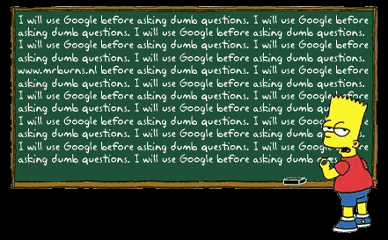
Where to get answers?

Slide 47
End of Chapter 1
Thank you !

