Slide 1

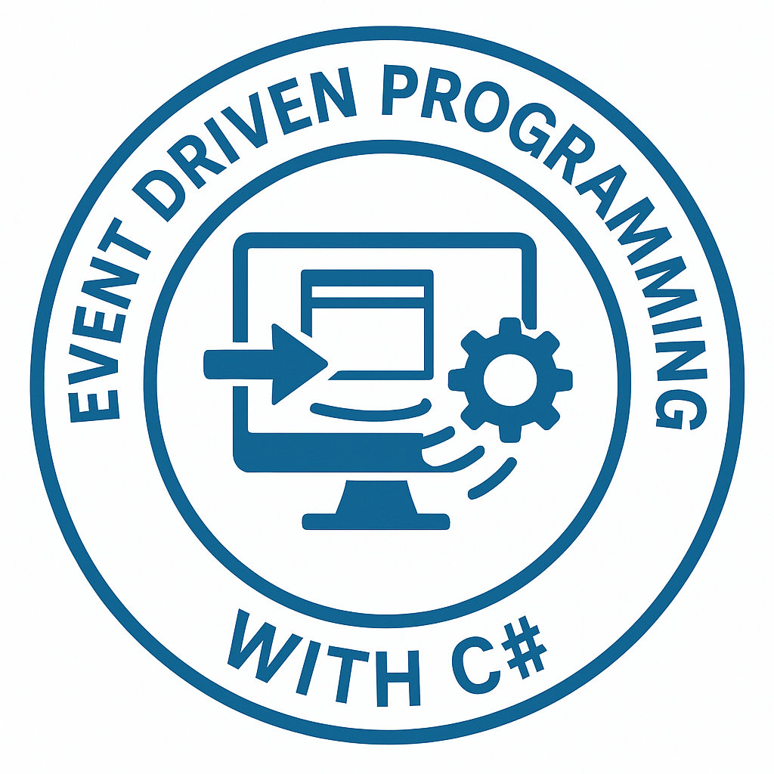
DEBRE BERHAN UNIVERSTITY
College of Computing
Chapter 5: Database Programming
Modern Desktop Development Using API and EF Core (Code-First)
By Binyam Tekalign
May 10, 2026

Slide 2
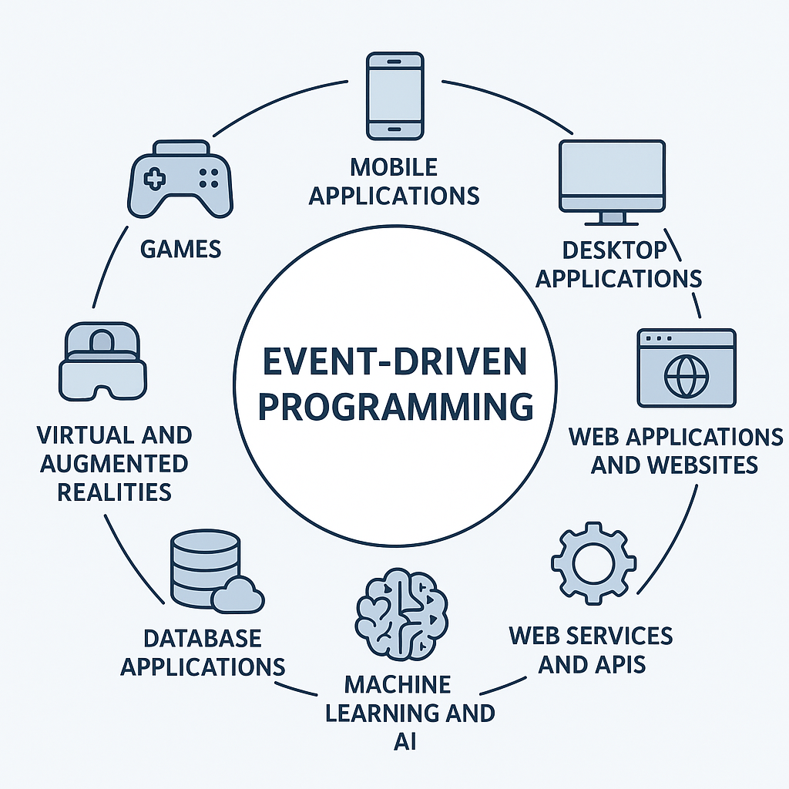

Outline
Introduction to Three-Tier Architecture
  Concepts and benefits and Layer responsibilities
Data Layer Implementation
  Entity Framework Core (Code First),
  Entities, and DbContext
Business/API Layer Implementation
  Services and Interfaces, DTOs and Validation
  Business Logic (User, Product, Sell), Migrations
  Program.cs, appsettings.json,
  Controllers and Dependency Injection
Connecting Desktop Application to API
  HttpClient usage, JSON serialization, and UI integration

Slide 3
What is Three-Tier Architecture?
A software architecture that separates an application into three logical layers:
Presentation Layer
  WinForms Desktop App, Web App
Business/API Layer
  Handles logic + API
Data Layer
  Database interaction
User → Desktop App → Business/API → Data Layer → Database

Slide 4
Three-Tier Architecture
Problem with simple applications:
  UI directly accesses database
  No separation of concerns
  Hard to maintain
  Difficult to scale
Advantage
  Separation of concerns
  Easier maintenance
  Reusability
  Scalability
  Security

Slide 5
Evolution of Architecture
1-Tier:
  Everything in one place
2-Tier:
  UI ↔ Database
3-Tier:
  UI ↔ Business/API ↔ Database
Example 3 –Tier:
  UI → Shopping App
  Business → Order Processing
  Data → Product Database

Slide 6
Responsibilities
Business/API Layer
  Business rules
  Validation
  Processing requests
  Exposing API endpoints
Data Layer
  Database communication
  CRUD operations
  Data models
Examples:
Validate user login
Check product stock
Calculate totals

Slide 7
Our Project in This Chapter
We will build:
User Module
  Register
  Login
  Change Password
Product Module
  Add / Update / Delete / View
Selling Module
  Sell Product
  Generate Report

Slide 8
Next Steeps
Extend existing solution (Desktop App already exists)
Add new projects:
  Data Layer
  Business/API Layer
Setup project references
Install required NuGet packages
Prepare base structure

Slide 9
Add Data Layer Project
Steps:
  Right-click Solution
  Add → New Project
  Select:
  Class Library (.NET)
  Name:
  MyApp.Data

Slide 10
Add Business/API Layer Project
Steps:
  Right-click Solution
  Add → New Project
  Select:
  ASP.NET Core Web API
  Name:
  MyApp.BusinessApi

Slide 11
Setup Project References
Add References:
  BusinessApi → Data
  Desktop → BusinessApi
Steps:
  Right-click BusinessAPI project → Add Data Reference
  Right-click Desktop project → Add BusinessAPI Reference
Important rule
  Never add reference of data to desktop.

Slide 12
Install NuGet Packages (Data Layer)
Install in MyApp.Data:
  Microsoft.EntityFrameworkCore
    EF Core → ORM
  Microsoft.EntityFrameworkCore.SqlServer
    SqlServer → Database provide
  Microsoft.EntityFrameworkCore.Tools
    Tools → Migration support

Slide 13
Install Packages (Business/API Layer)
Install in MyApp.BusinessApi:
  Microsoft.Extensions.DependencyInjection
  Microsoft.EntityFrameworkCore.SqlServer
    So API can use DbContext with SQL Server
  Microsoft.EntityFrameworkCore.Design
  Microsoft.AspNetCore.Identity
    Used for PasswordHasher
    Hashing & verifying passwords
  Swashbuckle.AspNetCore (auto-added)
    Enables Swagger UI
    Allows testing API visually

Slide 14
Create Folder Structure (Data Layer)
Inside MyApp.Data:
  Entities/ → Database models
  Context/ → DbContext
  Repositories/ (optional later)

Slide 15
Create Folder Structure (Business Layer)
Inside MyApp.BusinessApi:
  Services/ → Business logic
  Interfaces/ → Contracts
  DTOs/ → Data transfer objects
  Helpers/ → Utilities (hashing, etc.)
Always build after setup

Slide 16
Naming Conventions
PascalCase for classes
Singular for entities:
  User
  Product
Service naming:
  IUserService
  UserService

Slide 17
What is Data Layer?
The layer responsible for:
  Communicating with database
  Performing CRUD operations
  Managing data models

Slide 18
Responsibilities of Data Layer
Define Entities (Models)
Configure DbContext
Manage Migrations
Provide data access logic

Slide 19
What is Entity Framework Core?
EF Core = ORM (Object Relational Mapper)
Converts:
  C# objects → Database tables
  Queries → SQL
Code First Approach
  Define models in C# → EF creates database
  Models → DbContext → Migration → Database
Opposite is Database First

Slide 20
Our Database Design
We will create:
  User
  Product
  SellProduct

Slide 21
Create User Entity
public class User
{
public int Id { get; set; }
public string Username { get; set; }
public string PasswordHash { get; set; }
public DateTime CreatedAt { get; set; }
}
Do NOT store plain password
Use PasswordHash

Slide 22
Create Product Entity
public class Product
{
public int Id { get; set; }
public string Name { get; set; }
public decimal Price { get; set; }
public int Quantity { get; set; }
}

Slide 23
Create SellProduct Entity
public class SellProduct
{
public int Id { get; set; }
public int ProductId { get; set; }
public Product Product { get; set; }
public int Quantity { get; set; }
public DateTime SoldAt { get; set; }
}
One Product → Many Sales
One-to-Many relationship

Slide 24
Create AppDbContext
using Microsoft.EntityFrameworkCore;
public class AppDbContext : DbContext
{
public DbSet<User> Users { get; set; }
public DbSet<Product> Products { get; set; }
public DbSet<SellProduct> SellProducts { get; set; }
public AppDbContext(DbContextOptions<AppDbContext> options)
: base(options)
{
}
}

Slide 25
What is DbContext?
Central class for EF Core
Manages:
  Database connection
  Queries
Tracking changes

Slide 26
Data Annotations vs Fluent API in EF Core
Configuring Models and Database Rules
Two ways to configure EF Core models
Both are widely used in real systems
Used for:
  Validation
  Database schema configuration
Fluent API overrides annotations
Feature | Data Annotations | Fluent API
Location | Inside model | DbContext
Simplicity | Easy | More flexible
Complex rules | Limited | Powerful

Slide 27
Required Field
Data Annotation
  [Required]
  public string Name { get; set; }
  [MaxLength(100)]
  public string Name { get; set; }
  [Column(TypeName = "decimal(18,2)")]
  public decimal Price { get; set; }
  [EmailAddress]
  public string Email { get; set; }
  [Range(1, 100)]
  public int Quantity { get; set; }
  [StringLength(50, MinimumLength = 5)]
  public string Username { get; set; }
Fluent API
  modelBuilder.Entity<Product>()
  .Property(p => p.Name)
  .IsRequired();
  modelBuilder.Entity<Product>()
  .Property(p => p.Name)
  .HasMaxLength(100);
  modelBuilder.Entity<Product>()
  .Property(p => p.Price)
  .HasColumnType("decimal(18,2)");
  Not directly supported
  Not built-in → use business logic)
  modelBuilder.Entity<User>()
  .Property(u => u.Username)
  .HasMaxLength(50);

Slide 28
Required Field
Data Annotation
  [Key]
  public int Id { get; set; }
Fluent API
  modelBuilder.Entity<User>()
  .HasKey(u => u.Id);
  modelBuilder.Entity<User>()
  .Property(u => u.CreatedAt)
  .HasDefaultValueSql("GETDATE()");
  modelBuilder.Entity<User>()
  .HasIndex(u => u.Username)
  .IsUnique();

Slide 29
Data Annotations Example
public class Product
{
public int Id { get; set; }
[Required]
[MaxLength(100)]
public string Name { get; set; }
[Range(1, 10000)]
public int Quantity { get; set; }
[Column(TypeName = "decimal(18,2)")]
public decimal Price { get; set; }
}

Slide 30
Fluent API Full Example
protected override void OnModelCreating(ModelBuilder modelBuilder)
{
modelBuilder.Entity<Product>(entity =>
{
entity.Property(p => p.Name)
.IsRequired()
.HasMaxLength(100);
entity.Property(p => p.Price)
.HasColumnType("decimal(18,2)");
entity.HasIndex(p => p.Name)
.IsUnique();
});
}

Slide 31
Business/API Layer Implementation
Responsibilities
  Validate input
  Apply business rules
  Communicate with Data Layer
  Return structured data (DTOs)

Slide 32
Create DTOs
DTO = Data Transfer Object
User DTOs
public class UserRegisterDto
{
public string Username { get; set; }
public string Password { get; set; }
}
public class UserLoginDto
{
public string Username { get; set; }
public string Password { get; set; }
}
Control data exposure
Avoid sending full entity
Improve security
Product DTO
public class ProductDto
{
public string Name { get; set; }
public decimal Price { get; set; }
public int Quantity { get; set; }
}

Slide 33
Interfaces
Enforcing Contracts:
  An interface guarantees that any class implementing it will have specific, publicly accessible members.
Achieving Abstraction:
  Interfaces allow developers to hide implementation specifics from the client code.
Supporting Multiple Inheritance of Behavior:
  C# does not support multiple inheritance of classes, but a class can implement multiple interfaces.
Facilitating Unit Testing and Dependency Injection (DI):
  Interfaces are essential for the Dependency Injection design pattern.

Slide 34
Create Interfaces
public interface IProductService
{
Task<ActionResult<IEnumerable<ProductDto>>> AddProduct(ProductDto dto);
Task<ActionResult<IEnumerable<ProductDto>>> GetAll();
Task<ActionResult<ProductDto>> UpdateProduct(int id, ProductDto dto);
Task<ActionResult<IEnumerable<ProductDto>>> DeleteProduct(int id);
}

Slide 35
Create Interfaces
public interface IUserService
{
void Register(UserRegisterDto dto);
bool Login(UserLoginDto dto);
void ChangePassword(int userId, string oldPassword, string newPassword);
User GetById(int id);
List<User> GetAll();
void Delete(int id);
}

Slide 36
Create Interfaces
public interface ISellProductService
{
void SellProduct(int productId, int quantity);
List<SellProduct> GetAllSales();
List<SellProduct> GetSalesByProduct(int productId);
List<SalesReportDto> GetSalesReport();
List<SellProduct> GetSalesByDate(DateTime start, DateTime end);
}

Slide 37
Implement Services
Create:
  UserService.cs
  ProductService.cs
  SellProductService.cs
Inject DbContext
private readonly AppDbContext _context;
private readonly IPasswordHasher<User> _passwordHasher;
public UserService(AppDbContext context, IPasswordHasher<User> passwordHasher)
{
_context = context;
}

Slide 38
What is Dependency Injection (DI)?
Technique to provide dependencies
Improves flexibility and testability

Slide 39
What is appsettings.json?
Configuration file
Used for:
  Connection strings
  App settings
  API keys
{
"ConnectionStrings": {
"DefaultConnection": "Server=.;Database=MyAppDb;Trusted_Connection=True;"
}
}
"ConnectionStrings": {
"DefaultConnection": "Server=.;Database=TestDb;User Id=sa;Password=12345678;MultipleActiveResultSets=true;
TrustServerCertificate=True"
},

Slide 40
What is Program.cs?
Entry point of the application
  First file executed when API starts
Configures services
Builds application
Defines middleware pipeline

Slide 41
Basic Structure of Program.cs
var builder = WebApplication.CreateBuilder(args);
// Configure services
//e.g.
builder.Services.AddControllers();
//Enables controller support
var app = builder.Build();
// Configure middleware
app.Run();

Slide 42
Register DbContext
builder.Services.AddDbContext<AppDbContext>(options =>
options.UseSqlServer(
builder.Configuration.GetConnectionString("DefaultConnection")));
Connects app to database
Register Business Services (DI)
builder.Services.AddScoped<IUserService, UserService>();
builder.Services.AddScoped<IProductService, ProductService>();
DI connects interface → implementation

Slide 43
What is AddScoped?
Creates instance per request
Other lifetimes:
AddSingleton → one instance
AddTransient → new instance each time

Slide 44
Enable Swagger
builder.Services.AddEndpointsApiExplorer();
builder.Services.AddSwaggerGen();
Lecture Notes:
Used for API testing

Slide 45
Middleware Pipeline
var app = builder.Build();
app.UseHttpsRedirection();
app.UseAuthorization();
app.MapControllers();
Middleware are Components that handle requests
Flow:Request → Middleware → Controller → Response

Slide 46
Complete Program.cs Example
var builder = WebApplication.CreateBuilder(args);
builder.Services.AddControllers();
builder.Services.AddDbContext<AppDbContext>(options =>
options.UseSqlServer(
builder.Configuration.GetConnectionString("DefaultConnection")));
builder.Services.AddScoped<IPasswordHasher<User>, PasswordHasher<User>>();
builder.Services.AddScoped<IUserService, UserService>();
builder.Services.AddEndpointsApiExplorer();
builder.Services.AddSwaggerGen();
var app = builder.Build();
app.UseHttpsRedirection();
app.UseAuthorization();
app.MapControllers();
app.Run();

Slide 47
User Registration Logic
public async Task<AuthResponse> Register(UserRegisterDto dto)
{ if (await _context.Users.AnyAsync(u => u.Username == dto.Username))
return new AuthResponse { Seccess = false, Message = "User exists" };
var user = new User
{
Username = dto.Username,
CreatedAt = DateTime.Now
};
user.PasswordHash = _passwordHasher.HashPassword(user, dto.Password);
_context.Users.Add(user);
_context.SaveChanges();
return new AuthResponse { Seccess = true, Message = "Registred" };
}

Slide 48
Login Logic
public async Task<AuthResponse> Login(UserLoginDto dto)
{
var user = await _context.Users.FirstOrDefaultAsync(u => u.Username == dto.Username);
if (user == null)
return new AuthResponse { Seccess = false, Message = "Authentication failed" };
var result = _passwordHasher.VerifyHashedPassword(user, user.PasswordHash, dto.Password);
if (result == PasswordVerificationResult.Failed)
return new AuthResponse { Seccess = false, Message = "Authentication failed"};
else
return new AuthResponse { Seccess = true, Message = "Authenticated" };
}

Slide 49
Product Service — Add
public async Task<ActionResult<IEnumerable<ProductDto>>> AddProduct(ProductDto dto)
{
var product = new Product
{
Name = dto.Name,
Price = dto.Price,
Quantity = dto.Quantity
};
_context.Products.Add(product);
_context.SaveChanges();
return await GetAll();
}

Slide 50
Get Products (LINQ)
public async Task<ActionResult<IEnumerable<ProductDto>>> GetAll()
{
List<Product> products = await _context.Products.ToListAsync();
List<ProductDto> productDtos = new List<ProductDto>();
foreach (Product product in products)
{
ProductDto productDto = new ProductDto();
productDto.Name = product.Name;
productDto.Price = product.Price;
productDto.Quantity = product.Quantity;
productDto.Id = product.Id;
productDtos.Add(productDto);
}
return productDtos;
}

Slide 51
Update Product
public async Task<ActionResult<ProductDto>> UpdateProduct(int id, ProductDto dto)
{
var product = _context.Products.Find(id);
if (product == null)
throw new Exception("Not found");
product.Name = dto.Name;
product.Price = dto.Price;
product.Quantity = dto.Quantity;
_context.SaveChanges();
return dto;
}

Slide 52
Delete Product
public async Task<ActionResult<IEnumerable<ProductDto>>> DeleteProduct(int id)
{
var product = _context.Products.Find(id);
if (product != null)
{
_context.Products.Remove(product);
_context.SaveChanges();
return await GetAll();
}
return await GetAll();
}

Slide 53
Selling Logic
public void Sell(int productId, int quantity)
{
var product = _context.Products.Find(productId);
if (product.Quantity < quantity)
throw new Exception("Insufficient stock");
product.Quantity -= quantity;
var sale = new SellProduct
{
ProductId = productId,
Quantity = quantity,
SoldAt = DateTime.Now
};
_context.SellProducts.Add(sale);
_context.SaveChanges();
}

Slide 54
Report Using LINQ
var report = _context.SellProducts
.GroupBy(s => s.ProductId)
.Select(g => new
{
ProductId = g.Key,
TotalSold = g.Sum(x => x.Quantity)
})
.ToList();

Slide 55
What is Controller?
Handles HTTP requests
GET
POST
PUT
DELETE

Slide 56
Basic Controller Example
[ApiController]
[Route("api/[controller]")]
public class UsersController : ControllerBase
{
private readonly IUserService _service;
public UsersController(IUserService service)
{
_service = service;
}
}

Slide 57
Action Example
[HttpPost("register")]
public async Task<ActionResult<AuthResponse>> Register(UserRegisterDto dto)
{
return Ok(await _service.Register(dto));
}
[HttpPost("login")]
public async Task<ActionResult<AuthResponse>> Login(UserLoginDto dto)
{
return Ok(await _service.Login(dto));
}

Slide 58
Connecting Desktop App to API Layer
Goal of This Section
  How Desktop App communicates with API
  How to use HttpClient
  How to send/receive JSON
  How to integrate UI with backend

Slide 59
Why Use API?
Desktop → Database (Bad Practice)
Desktop → API → Database (Correct)
Advantages:
  Security
  Scalability
  Reusability
  Centralized logic
User → Desktop UI → API → Business Logic → Data → DB
⬅ Response (JSON)

Slide 60
What is HttpClient?
.NET class used to send HTTP requests
GET
POST
PUT
DELETE
Works like a browser internally
Create ApiClient Class
  Inside Desktop project:
  Create Services folder
  Create ApiClient.cs class.
Method | Purpose
GET | Retrieve data
POST | Create data
PUT | Update data
DELETE | Remove data

Slide 61
Basic ApiClient Setup
public class ApiClient
{
private readonly HttpClient _httpClient;
public ApiClient()
{
_httpClient = new HttpClient();
_httpClient.BaseAddress = new Uri("https://localhost:5001/api/");
}
}
We get the port number from API Properties/launchSettings.josn

Slide 62
Register and Login http client
public async Task<AuthResponse?> Register(UserRegisterDto request)
{
var response = await _http.PostAsJsonAsync("api/Users/Register", request);
response.EnsureSuccessStatusCode();
return await response.Content.ReadFromJsonAsync<AuthResponse>();
}
public async Task<AuthResponse?> Login(UserLoginDto request)
{
var response = await _http.PostAsJsonAsync("api/Users/Login", request);
response.EnsureSuccessStatusCode();
return await response.Content.ReadFromJsonAsync<AuthResponse>();
}

Slide 63
Desktop App
Register form code example
var registerRequest = new UserRegisterDto
{
Username = txtUsername.Text,
Password = txtPassword.Text
};
var created = await _apiClient.Register(registerRequest);
LoginFrm login = new LoginFrm();
login.Show();
this.Hide();

Slide 64
Desktop Login
Login form code example
var loginRequest = new UserLoginDto
{
Username = txtUserName.Text,
Password = txtPassword.Text
};
var result = await _apiClient.Login(loginRequest);
if (result.Seccess)
{
MainForm f3 = new MainForm();
f3.Show();
this.Hide();
}
return;

Slide 65
What Is LINQ?
LINQ stands for: Language-Integrated Query
It allows querying:
  Objects
  Collections
  Lists
  Databases (via EF Core)
  XML
  JSON
Using C# syntax, instead of SQL or loops.

Slide 66
Why LINQ Matters
LINQ is powerful because:
  Replaces loops with clean expressions
  Works with lists, arrays, DbSet, JSON
  Integrates smoothly with EF Core
  Avoids manual SQL writing
  Enables functional programming concepts
  Makes code readable and shorter

Slide 67
Traditional Way vs LINQ
Traditional:
LINQ:
List<Product> results = new List<Product>();
foreach (var p in products)
{
if (p.UnitPrice > 100)
results.Add(p);
}
var results = products.Where(p => p.UnitPrice > 100).ToList();

Slide 68
LINQ Query Syntax vs Method Syntax
Query Syntax:
Method Syntax (most popular):
EF Core internally uses method syntax.
var q = from p in products
where p.UnitPrice > 100
select p;
var q = products.Where(p => p.UnitPrice > 100);

Slide 69
Important LINQ Methods
Most commonly used:
  Where()
  Select()
  OrderBy()
  OrderByDescending()
  FirstOrDefault()
  SingleOrDefault()
  Any()
  Take()
  Skip()
  ToList()

Slide 70
Using Where()
Filters items based on a condition.
Equivalent to SQL:
var expensive = products
.Where(p => p.UnitPrice > 100)
.ToList();
SELECT * FROM Products WHERE UnitPrice > 100;

Slide 71
Using Select()
Selects specific fields or transforms data.
Or create new objects:
var names = products
.Select(p => p.Name)
.ToList();
var info = products.Select(p => new {
p.Name,
p.UnitPrice
}).ToList();

Slide 72
Using OrderBy()
Ascending:
Descending:
var sorted = products
.OrderBy(p => p.UnitPrice)
.ToList();
sorted = products
.OrderByDescending(p => p.UnitPrice)
.ToList();

Slide 73
FirstOrDefault()
Gets the first item or returns null.
Used frequently with EF Core:
var product = products
.FirstOrDefault(p => p.Name == "Laptop");
var user = _context.Users
.FirstOrDefault(u => u.UserName == request.UserName);

Slide 74
SingleOrDefault()
Ensures only one item exists.
Throws exception if more than one exists.
var p = products.SingleOrDefault(p => p.Id == 3);

Slide 75
Any()
Checks if something exists.
Very useful for:
  Validation
  Existence check
  Authentication logic
bool hasCheapItems = products.Any(p => p.UnitPrice < 50);

Slide 76
Take() and Skip() (Paging)
Take 5
Skip 10
Used in paging APIs.
var top5 = products.Take(5).ToList();
var next = products.Skip(10).Take(5).ToList();

Slide 77
Combining LINQ Methods
Chaining operations = clean logic.
var filtered = products
.Where(p => p.UnitPrice >= 100)
.OrderBy(p => p.Name)
.Select(p => new { p.Name, p.UnitPrice })
.ToList();

Slide 78
LINQ with EF Core
EF Core converts LINQ into SQL.
EF generates SQL like:
var items = await _context.Products
.Where(p => p.QuantityInStock < 10)
.OrderBy(p => p.Name)
.ToListAsync();
SELECT * FROM Products
WHERE QuantityInStock < 10
ORDER BY Name ASC;

Slide 79
Example in Controller
[HttpGet("low-stock")]
public async Task<IEnumerable<Product>> GetLowStock()
{
return await _context.Products
.Where(p => p.QuantityInStock < 5)
.ToListAsync();
}

Slide 80
LINQ GroupBy
Useful for:
  Reporting
  Charts
  Statistics in dashboard
var groups = products
.GroupBy(p => p.Category)
.Select(g => new { Category = g.Key, Count = g.Count() })
.ToList();

Slide 81
Entity Relationships in Code First (C# / EF Core)
Understanding:
  One-to-One
  One-to-Many
  Many-to-Many

Slide 82
Why Relationships Matter
If relationships are wrong:
  Data duplication occurs
  Queries become complex
  System becomes incorrect
If relationships are correct:
  Clean database design
  Easy querying (LINQ)
  Scalable system

Slide 83
What Is a Relationship
How classes are connected
Type | Meaning
One-to-One | One object ↔ one object
One-to-Many | One object → many objects
Many-to-Many | Many objects ↔ many objects
Type | Structure | Key Feature
One-to-One | A → B | Single reference
One-to-Many | A → List | Collection
Many-to-Many | A ↔ B via bridge | Extra table

Slide 84
Core Concepts
Primary Key
  public int Id { get; set; }
Foreign Key
  public int StudentId { get; set; }
Navigation Property
  public Student Student { get; set; }
Collection
  public ICollection<Course> Courses { get; set; }

Slide 85
Example Classes (Part 1)
public class Student
{
public int Id { get; set; }
public string Name { get; set; }
public StudentProfile Profile { get; set; }
public ICollection<Enrollment> Enrollments { get; set; } = new List<Enrollment>();
}
public class StudentProfile
{
public int Id { get; set; }
public string Address { get; set; }
public string Phone { get; set; }
public int StudentId { get; set; }
public Student Student { get; set; }
}

Slide 86
Example Classes (Part 2)
public class Department
{
public int Id { get; set; }
public string Name { get; set; }
public ICollection<Course> Courses { get; set; }= new List<Course>();
}
public class Course
{
public int Id { get; set; }
public string Title { get; set; }
public int DepartmentId { get; set; }
public Department Department { get; set; }
public ICollection<Enrollment> Enrollments { get; set; } = new List<Enrollment>();
}

Slide 87
Example Classes (Part 3)
public class Enrollment
{
public int Id { get; set; }
public int StudentId { get; set; }
public int CourseId { get; set; }
public double Grade { get; set; }
public Student Student { get; set; }
public Course Course { get; set; }
}

Slide 88
ONE TO ONE
One object is linked to exactly one object
Uses single object reference
Has Foreign Key in one side
No collection
Example
  Student → Profile
  Person → Passport
In student class we used
  public StudentProfile Profile { get; set; }
In Student Profile class we used
  public int StudentId { get; set; }
  public Student Student { get; set; }

Slide 89
ONE TO MANY
One object is linked to many objects.
Uses Collection (ICollection)
Foreign key is in child table
Example
  Department → Courses
  Customer → Orders
In Department class we use collection
  public ICollection<Course> Courses { get; set; }= new List<Course>();
In Course class we use foreign key
  public int DepartmentId { get; set; }
  public Department Department { get; set; }

Slide 90
MANY TO MANY
Many objects relate to many objects.
A Student takes many courses
A course could be taken by many students
So, it requires bridge class (Enrollment)
Without Enrollment:
Can not store Grade, Date, Status, etc.
With Enrollment: Flexible design and Real-world modeling
Contains two foreign keys

Slide 91
MANY TO MANY
Both Student and Course Class need ICollection of Enrollment class
  public ICollection<Enrollment> Enrollments { get; set; } = new List<Enrollment>();
Enrollment class should have foreign key of Student and Course classes.
  public int StudentId { get; set; }
  public Student Student { get; set; }
  public int CourseId { get; set; }
  public Course Course { get; set; }

Slide 92
Summary
Type | Code Pattern | Use
One-to-One | ClassA → ClassB | Reference
One-to-Many | ClassA → ICollection<ClassB> | ICollection
Many-to-Many | ClassA → Bridge → ClassB | Bridge class

Slide 93
Understanding Include
What is Include()?
Include() is used in Entity Framework Core to load related data together with the main entity.
Without Include(), only the main table data is loaded.
Example:
  var students = _context.Students.ToList();
  Loads only students.
With Include
  var students = _context.Students
  .Include(s => s.Profile)
  .ToList();
  It loads Students + StudentProfile

Slide 94
Include
Use When
  One-to-One
  One-to-Many
  Need related data immediately
Examples:
  .Include(s => s.Profile)
  .Include(d => d.Courses)
  .Include(c => c.Enrollments)

Slide 95
Understanding ThenInclude()
Used after Include() to load the next level relationship.
It means:
  Main Table → Child Table → Grandchild Table
Example
  var students = _context.Students
  .Include(s => s.Enrollments)
  .ThenInclude(e => e.Course)
  .ToList();
Loads:
Students
→ Enrollments
→ Course

Slide 96
Practical Home work.
Design classes for:
Library System
  Member
  MemberProfile
  Book
  Category
  Borrow
Identify:
  One-to-One
  One-to-Many
  Many-to-Many

Slide 97
Thank You!
?

