Slide 1
Event Driven Programming
Elements of Event Driven Programming

Slide 2
Objectives
At the end of the lesson students should be able to:
  Understand events and delegates
  Create an event handler for a control
  Work with windows controls
  Work with properties and events of controls
  Design and build windows based application

Slide 3
Contents
Working on events and delegates
Creating an Event Handler for a Control
Using Windows Forms
Working with Windows Forms Controls
Using Dialog Boxes in a Windows Forms Application
Creating Menus
Adding Controls at Run Time

Slide 4
Elements of Event Driven Programming
Event Source
  Who are the users of the system? Human users, other system, the environment, time, …
Event
  How the user interact to the system? By click, touch, speak, ticking time, sending message, …
Delegates
  Who will receive the events and wire/connect to the event handler?
Event Handler
  Who will define the logic, what will be done when receiving an event?
User Interface to accept/Listen for the event and respond/display the result
  Forms and Controls
  Message/Text
  Network
  Other form of interfaces

Slide 5
Event
An event is a message sent by an object to signal the occurrence of an action that is either invoked by a user or programmatically.
Each event has
  a sender that raises the event and
  a receiver that handles the event.
An event is used to signal the occurrence of an action.
  For example, this action could be user invoked, such as the
    Click event of a Button control, or
    the event could be raised programmatically to signal the end of a long computation.
The object that raises (triggers) the event is referred to as the event sender.
The procedure that handles the event is referred to as the event receiver.
In either case, the sender does not know which object or method will respond to the events that it raises.

Slide 6
Event …
Therefore, it is necessary to have a component that links the event sender with the event receiver.
The .NET Framework uses a delegate type to work as a function pointer between the sender and the event receiver.
In most cases, the .NET Framework creates the delegate and takes care of the details for you.
However, you can create your own delegates for cases when you want an event to use different event handlers under different circumstances.

Slide 7
Event …
Delegates are objects that you can use to call the methods of other objects.
You can use the Delegate keyword in a declaration statement to create your own delegate that derives from the MulticastDelegate class.
Creating your own delegates can be useful in situations where you need an intermediary between a calling procedure and the procedure being called.

Slide 8
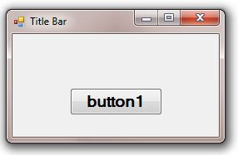
Event Model in the .NET Framework
Click Event
this.button1.Click += new System.EventHandler(this.button1_Click);
_________________________________________
private void button1_Click(object sender, EventArgs e)
{
//... the code goes here ...
}
Invoke the Delegate
Delegate calls the associated procedures
Delegate

Slide 9
Delegates
Delegate
  Binds events to methods
  Can be bound to single or multiple methods
When an event is recorded by an application
  The control raises the event by invoking the delegate for the event
  The delegate in turn calls the bound method
public delegate void EventHandler(object sender, EventArgs e);

Slide 10
Delegate …
Delegates are used to hold a reference to the method that will handle an event.
For example, an event occurs when a user clicks a button.
  The button raises a click event but does not know what behavior you, the programmer, want to occur when the button is clicked,
  so the button has a delegate member to which you assign your own method for handling the event.
You can use the same infrastructure that is used by the .NET Framework to create your own delegates.

Slide 11
Delegate …
A delegate is a data structure, derived from the Delegate Class, which refers
  to a static method or
  to a class instance and an instance method of that class.
Delegates are useful when
  your application must perform an action by calling a method but
  you do not know what that action will be.
Delegates allow you to specify at run time the method to be invoked.
Delegates are object-oriented, type-safe, and secure.

Slide 12
Delegate …
By convention, event delegates in the .NET Framework have two parameters,
  the source that raised the event and
  the data for the event.
The following example shows an event delegate declaration:
  public delegate void EventHandler(object sender, EventArgs e);
Event delegates are multicast,
  which means that they can hold references to more than one event handling method.
Delegates allow for flexibility and fine-grain control in event handling.
A delegate acts as an event dispatcher for the class that raises the event by maintaining a list of registered event handlers for the event.

Slide 13
Event Handler
Event Handlers
  Methods bound to an event
  When the event is raised, the code within the event handler is executed
Two Event Arguments with Event Handlers
  An object representing the object that raised the event
  An event object containing any event-specific information
    private void CalculateGpag_Click(object sender, EventArgs e)
    {
    }

Slide 14
Event handler …
You can use the same event handler to handle more than one event.
  For example, you can create a single event handler to handle events of
    a button and
    a menu item that are used for the same purpose.
The following code example is an event handler for the Click event of a button.
    private void CalculateGpag_Click(object sender, EventArgs e)
    {
    }

Slide 15
Event handler …
The following code example shows how you can use a single event handler to handle events for multiple controls.
    // inside the Windows Form Designer generated code region
    …
    this.button1.Click += new
    System.EventHandler(this.button1_Click);
    // add the button2.click event to button1_click handler
    this.button2.Click += new
    System.EventHandler(this.button1_Click);
    private void button1_Click(object sender, System.EventArgs e)
    {
    }

Slide 16
Event handler …
Each event handler provides two parameters that allow you to handle the event properly.
  The first parameter (Sender in the previous code example) provides a reference to the object that raised the event.
  It specifies the source that raised the event.
  The second parameter (e in the previous code example) passes an object specific to the event being handled.
  This parameter contains all of the data that is required to handle the event.

Slide 17
Developing Event Driven App
Steps to develop a Windows based Event Driven System
  Design the GUI
    Drag/drop controls or using code
    Set properties of controls at design time/ using code
      At least some basic properties of Forms and Controls
  Select Event(s) for forms and controls
    Select appropriate events for the forms and controls
  Create delegate for the event
    The IDE does it automatically or you can specify by yourself if you want
  Create event handler for controls
    The IDE does it automatically or you can specify by yourself if you want
  Write the event handler
    Write the business logic code here

Slide 18
Design the GUI
Windows Form Controls
Controls
  Textbox
  Label
  Button
  RichText Box
  RadioButton
  Check Box
  Link Label
  List View
  Grid View
  …

Slide 19
Windows Form Controls
Windows Forms controls are reusable components that
  encapsulate user interface functionality and
  are used in a Windows Forms application.
Not only does the .NET Framework Class Library
  provide many ready-to-use controls,
  also provides the infrastructure for developing your own controls.

Slide 20
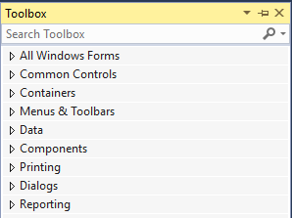
Windows Form Controls …
Depending on the functionality that you want to provide in the user interface of your application,
  you will select a control from one of the following categories:

Slide 21
Windows Form Controls …
Command controls
  Button
  LinkLabel
  NotifyIcon
  ToolTip
Text controls enable users to enter text and edit the text contained in these controls at run time:
  Textbox
  Rich Textbox
The following additional text controls can be used to display text but do not allow application users to directly edit the text content that they display:
  Label
  StatusBar

Slide 22
Windows Form Controls …
The following selection controls allow users to select a value from a list:
  CheckedListBox
  ComboBox
  DomainUpDown
  ListBox
  ListView
  NumericUpDown
  TreeView
The following are the categories of menu controls:
  MenuStrip
  ContextMenu

Slide 23
Windows Form Controls …
Container controls can be used to group other controls on a form
  Panel
  GroupBox
  TabControl
The following are the categories of graphic controls:
  ImageList
  PictureBox
Visual Studio .NET provides a set of common dialog boxes. These include
  ColorDialog
  FontDialog
  PageSetupDialog
  PrintDialog
  OpenFileDialog
  SaveFileDialog
  FolderBrowtherDialog

Slide 24
Working with Windows Forms
Creating a Form
Adding controls to a Form
Organizing controls on a Form
Creating MDI Applications

Slide 25
Windows Forms
Forms are the basic element of the user interface (UI) in applications created for the Microsoft Windows operating system.
They provide a framework that you can use throughout your application to give it a consistent look and feel.
A form in Windows-based applications is used to present information to the user and to accept input from the user.
Forms expose properties that define their appearance, methods that define their behavior, and events that define their interaction with the user.

Slide 26
Windows Forms …
By
  setting the properties of the form and
  writing code to respond to its events,
  customizing the form to meet the requirements of your application.
A form is a control derived from the Form class,
  which in turn derives from the Control class.
The framework also allows you to inherit from existing forms to add functionality or modify existing behavior.
When you add a form to your project,
  you can choose whether it inherits from the Form class provided by the .NET Framework or from a form you created previously.

Slide 27
How to create a Form
A base Form is created when you create a new project
To add another new Form
  Right-click the project on the solution explorer
  Click Add
  Then click Windows Forms

Slide 28
Windows Forms …
In a Windows-based application, the form is the primary element for user interaction.
By combining controls and your own actions, you can request information from the user and respond to it.
In Visual Studio .NET, a form is a window used in your application.
When you create a new Windows Application project, Visual Studio .NET provides a Designer view that contains a form.
The default form contains the minimum elements used by most forms:
  a title bar,
  a control box, and
  Minimize, Maximize, and Close buttons.

Slide 29
Windows Forms …
Most applications require more than one window.
You must add a form to your project for every window that your application requires.
To add additional forms to your project:
  If Solution Explorer is not open, on the View menu, click Solution Explorer .
  In Solution Explorer, right-click the project name, point to Add , and then click Windows Form.
  In the Add New Item dialog box, in the Name box, type an appropriate name for the form, and then click Open.

Slide 30
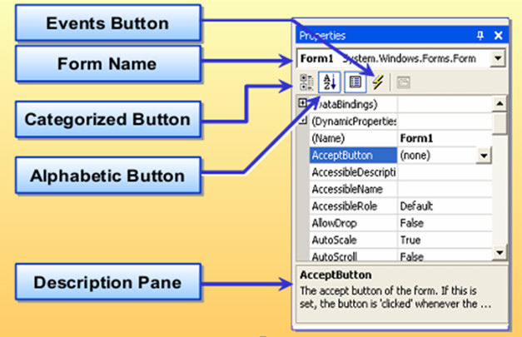
Forms Properties

Slide 31
Form Properties …
Name:-
  Sets the name of the form in your project.
  This is not the name that is displayed to the user in the caption bar but rather the name that you will use in your code to reference the form.
AcceptButton:
  Sets which button is clicked when the user presses the ENTER key.
  Note: You must have at least one button on your form to use this property.
CancelButton:
  Sets which button is clicked when the user presses the ESC key.
  Note: You must have at least one button on your form to use this property.

Slide 32
Form Properties …
ControlBox:
  Determines whether a form displays a control box in the caption bar.
  The control box can contain the Minimize button, Maximize button, Help button, and the Close button.
FormBorderStyle:
  Controls the appearance of the border for the form.
  This will also affect how the caption bar appears and what buttons appear on it.
MaximizeBox:
  Determines whether a form has a Maximizebutton in the upper right corner of its caption bar.

Slide 33
Form Properties …
MinimizeBox:
  Determines whether a form has a Minimize button in the upper right corner of its caption bar.
StartPosition:
  Determines the position of a form on the screen when it first appears.
Text;
  Sets the text displayed in the caption bar of the control.
You can set form properties either by writing code or by using the Properties window.
Any property settings that you establish at design time are used as the initial settings each time your application runs.

Slide 34
Form events and methods
After adding the necessary forms to your project and setting the startup form,
you must determine which events and methods to use.
The entire life cycle of a form uses several methods and events.
When the Show() method is called, the form events and methods are generally triggered in the following order:
  Load
  GotFocus
  Activated
  Closing
  Closed
  Deactivate
  LostFocus
  Dispose

Slide 35
Form events and methods …
The Initialize event is typically used to prepare an application for use.
Variables are assigned to initial values, and controls may be moved or resized to accommodate initialization data.
In .NET, initialization code must be added to the form constructor after the call to InitializeComponent() as shown in the following example:
    public ConstructorName()
    {
    // Required for Windows Form Designer support
    InitializeComponent();
    // Add your initialization code here
    }

Slide 36
Form Methods …
Modal vs Modeless Forms
  Modal
    A form the one where you have to deal with it before you can continue.
  Modeless
    You can continue to use other without giving a response
Show
  The Show method includes an implied Load;
    this means that if the specified form is not already loaded when the Show method is called,
      the application automatically loads the form into memory and then
      displays it to the user.
  The Show method can display forms as modal or modeless.
    example: formInstanceName.Show();
  You can use the ShowDialog() method to show a form as a dialog box.

Slide 37
Form Methods …
Load
  The Load event is used to perform actions that must occur before the form displays.
  It is also used to assign default values to the form and its controls.
  The Load event occurs each time that a form is loaded into memory.
  A form’s Load event can run multiple times during an application’s life.
  Load fires when a form starts as the result of the
    Load statement,
    Show statement, or
    when a reference is made to an unloaded form’s properties, methods, or controls.

Slide 38
Form Methods …
Activated and Deactivate
  When the user moves among two or more forms,
    you can use the Activated and Deactivate events to define the forms’ behaviors.
  The Activated event occurs when the form is activated in code or by the user.
  To activate a form at run time by using code, call the Activate method.
  You can use this event for tasks such as updating the contents of the form based on changes made to the form’s data when the form was not activated.
  The Activated event fires when the form receives focus from another form in the same project.

Slide 39
Form Methods …
The Activated event fires only when the form is visible.
  For example, a form loaded by using the Load statement isn’t visible unless you use the Show method, or set the form’s Visible property to True.
The Activated event fires before the GotFocus event.
Use the following code to set the focus to a form.
      formInstanceName.Focus();
Deactivate fires when the form loses focus to another form. This event fires after the LostFocus event.
Both the Activated and Deactivate events fire only when focus is changing within the same application.
If you switch to a different application and then return to the program, neither event fires.

Slide 40
Form Methods …
Closing
  The Closing event is useful when you need to know how the user is closing the form.
  The Closing event occurs when the form receives a request to close.
  Data validation can occur at this time.
  If there is a need to keep the form open (for example, if data validation fails), the closing event can be canceled.
Note
  If you need to add code that executes either when
    the form being displayed or
    the form is being hidden
      add the code to the Activated and Deactivated event handlers instead of to the GotFocus and LostFocus event handlers

Slide 41
Form Methods …
Closed
  The Closed event occurs when the form is closed and before the Dispose event.
  Use the Closed event procedure to verify that the form should be closed or to specify actions that take place when closing the form.
  You can also include form-level validation code for closing the form or saving data to a file

Slide 42
Form Methods …
Dispose
  The .NET framework does not support the Terminate event.
  Termination code must execute inside the Dispose method, before the call to base.Dispose().
    protected override void Dispose( bool disposing )
    {
    // Termination code goes here.
    if( disposing )
    {
    if (components != null)
    {
    components.Dispose();
    }
    }
    base.Dispose( disposing );
    }
  The Dispose method is called automatically for the main form in an application;
  you must call it explicitly for any other form.

Slide 43
Form Methods …
Hide
  The Hide method removes a form from the screen without removing it from memory.
  A hidden form’s controls are not accessible to the user, but they are available to the running application.
  When a form is hidden , the user cannot interact with the application until all code in the event procedure that caused the form to be hidden has finished executing.
  If the form is not already loaded into memory when the Hide method is called,
    the Hide method loads the form but doesn’t display it.
    formInstanceName.Hide();

Slide 44
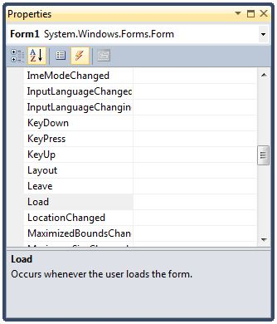
How to Handle Form Events
Properties
Events

Slide 45
Form Events …
An event handler is a segment of code that is called when a corresponding event occurs.
  For example,
    you can write code in an event handler for the Activated event of a form
      to perform operations such as updating the data displayed in the controls of the form when the form is activated.
The .NET Framework uses a standard naming convention for event handlers.
The convention is to combine
  the name of the object that sends the event,
  an underscore, and
  the name of the event.
For example, the Click event of a form named Form1 would be named Form1_Click .

Slide 46
Form Events …
Open the Properties windows for the form for which you want to add an event handler.
Click the Event icon in the Properties window to view the events.
Double-click the event to add an event handler.
  When you create a form by using Windows Forms Designer,
    the Designer generates a lot of code that you would have to write if you were creating a form on your own.
Note:
  Avoid modifying or deleting the Windows Forms Designer generated code.
  If you do, can end up with errors in your project

Slide 47
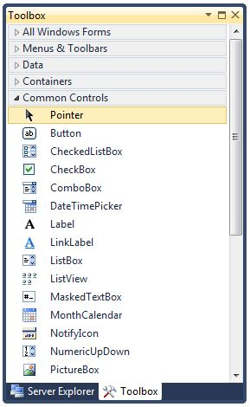
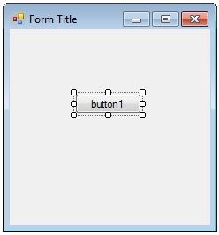
Add Controls to a Form

Slide 48
Controls to a Form …
Controls are objects that are contained in form objects.
  Buttons, TextBoxes, and Labels are examples of controls.
There are two ways to add controls to a form.
  The first way allows you to add several controls quickly and then size and position them individually.
  The second way gives you more initial control over the size and position of the control.

Slide 49
Controls to a Form …
To add controls to a form and then size and position them:
If the Toolbox is not open, on the View menu, click Toolbox.
In the Toolbox, double-click the control that you want to add.
  This places an instance of the control at the default size in the upper left corner of the active object.
  When adding multiple controls in this manner, they are placed on top of each other.
After the controls are added, you can reposition and resize them:
  To reposition the control, click the control to select it, and then drag the control to the correct position.
  To resize the control, click the control to select it, drag one of the eight sizing handles until the control is properly sized.

Slide 50
Controls to a Form …
To size and position controls while you add them to a form:
If the Toolbox is not open, on the View menu, click Toolbox.
In the Toolbox, click the control that you want to add.
Move the mouse pointer over the form.
  The pointer symbol changes to a crosshair.
Position the crosshair where you want the upper left corner of the control.
Click and drag the crosshair where you want the lower right corner.
  A rectangle that indicates the control’s size and location is drawn on the screen.

Slide 51
Controls to a Form …
When the control is correctly sized, release the mouse button.
  The sized control appears in the correct location on the form.
You can reposition or resize the control after you have released the mouse button:
  To reposition the control, click the control to select it, and then drag the control to the correct position.
  To resize the control, click the control to select it, and drag one of the eight sizing handles until the control is properly sized.

Slide 52
How to Add Menus to a Form
Menus provide a structured way for users to access the commands and tools contained in an application.
Proper planning and design of menus and toolbars
  is essential and
  ensures proper functionality and
  accessibility of your application to users.

Slide 53
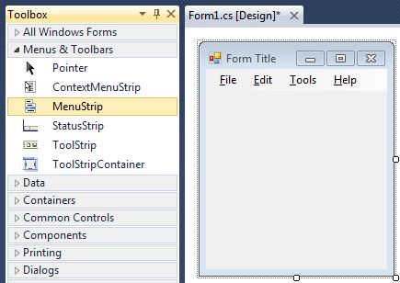
Menu to a form …

Slide 54
Menu to a form …
A menu control properties
  Name
    identifies the menu control in code.
  Text
    the text that appears on the menu bar at run time.
  Items
    collection of items to display on the Toolstrips
  To add menus to a form:
    If the Toolbox is not open, on the View menu, click Toolbox.
    In the Toolbox, double-click the MenuStrip control.
    In the Text box, on the newly created menu, type the text for the first menu’s title. This title will appear on the menu bar.
    In the Name box, in the Properties window, type the name that you will use to refer to the menu control in code.

Slide 55
Customize the Controls Toolbox
How to Customize the Controls Toolbox
  Right-click the Toolbox
  Click-Choose Items
  Click the .NET Framework Components tab or the COM Components tab, and
  select the required controls.

Slide 56
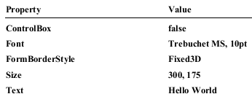
Creating a Form and Adding Controls
Set the properties of a form
  Create a new project with name- CreatingForms
  Open the CreatingForms.cs file in Design view.
  If the Properties window is not visible, on the View menu, click Properties Window.
  Set the remaining form properties to the indicated values.

Slide 57
Controls to a form
Add controls to the form
  If the Toolbox is not visible, on the View menu, click Toolbox.
  In the Toolbox, double-click the Label control to add it to the form.
  Double-click the Button control to add it to the form.
  Double-click the Button control again to add a second button to the form.
  Position the Label control near the top center of the form.
  Position the buttons next to each other near the bottom of the form—with button1 on the left and button2 on the right.

Slide 58
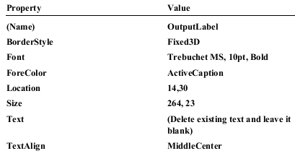
Controls Properties
Set the properties of the controls
  Click the Label1 control.
  Set the following properties for the Label1 control to the values provided.

Slide 59
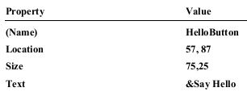
Controls Properties …
  Click Button1.
  Set the following properties for the Button1 control to the values provided in the following table.

Slide 60
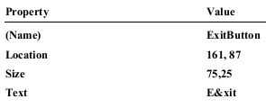
Controls Properties
  Click Button2.
  Set the following properties for the Button2 control to the values provided in the following table.

Slide 61
Controls Properties
  Double-click the Say Hello button to create the Click event handler.
  In the Click event handler for HelloButton, add the following line of code:
    OutputLabel.Text = "Hello, World!";
  Switch back to Design view of the form.
  Double click the Exit button to create the Click event handler.
  In the Click event handler for ExitButton , add the following line of code:
    this.Close();
  Switch back to Design view of the form.
  Set the AcceptButton property to HelloButton and the CancelButton property to ExitButton .

Slide 62
Build App
Build and run the application
  1. To build the application, click the Build menu, and then click Build Solution .
  2. Run the application by pressing F5.

Slide 63
Creating an Inherited Form
Creating new Windows Forms by inheriting from base forms is an efficient way to
  duplicate your best efforts without going through the process of entirely recreating a form every time you require it.
The process of inheriting a form from an existing one is called Visual Inheritance.
Access Modifiers
  Private:- Read-only to a child form, all of its property values in the property browser are disabled
  Protected:- Accessible within the class and from any class that inherits from the class that declared this member
  Public:-Most permissive level.
    Public controls have full accessibility

Slide 64
Inherited Forms …
There are two ways of implementing Visual Inheritance in a Visual Studio .NET project.
  To create an inherited form programmatically:
  Create a new project in Visual Studio .NET.
  Add another form, or view the code of Form1, which is created by default.
  In the class definition, add a reference to the form to inherit from.
    The reference should include the namespace that contains the form, followed by a period, and then the name of the base form itself.
      public class Form2 : Namespace1.Form1
    The form now takes on the characteristics of the inherited form.
    It contains the controls that were on the inherited form, the code, and the properties.

Slide 65
Inherited Forms …
To create an inherited form by using the Inheritance Picker dialog box:
  On the Project menu, click Add Windows Form .
  In the Categories pane, click Windows Form Items, and in the Templates pane, click Inherited Form .
    In the Name box, type a name, and then click Open.
    This will open the Inheritance Picker dialog box.
  Click Browse, and locate the compiled executable of the project that contains your form.
    Click OK.
    The new form should now be added into the project and be based on your inherited form.
    It contains the controls on the base form.

Slide 66
Organizing Controls on a Form
How to Arrange Controls on a Form by Using the Format Menu
How to Set the Tab Order for Controls
How to Anchor a Control in Windows Forms
How to Dock a Control in Windows Forms
How to resize and position controls

Slide 67
Organizing Controls …
Often you want to change the position and dimensions of controls at run time.
  Currently, you handle the resize event
    calculate the new position, width, and height, and
    call some methods like Move or SetWindowPos.
The Windows Forms library offers two very helpful concepts to simplify these proceedings:
  anchoring and
  docking.
In addition, Visual Studio .NET provides the Format menu,
  which allows you to arrange controls on a form.

Slide 68
Organizing Controls …
Using the Format Menu
You can use the Format menu or the Layout Toolbar
  to align, layer, and lock controls on a form.
The Format menu provides many options for organizing controls.
When you use the Format menu options for organizing controls,
  select controls so that the last control that you select is the primary control to which the others are aligned.
  The primary control has dark sizing handles whereas other controls have light sizing handles around them.

Slide 69
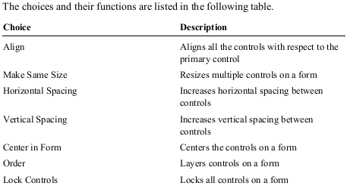
Organizing Controls …

Slide 70
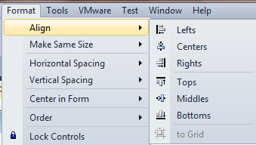
Organizing Controls …
In the Windows Forms Designer,
  open the form that contains the controls that you want to position.
Select the controls that you want to align
  so that the last control that you select is the primary control to which the others are aligned.
  On the Format menu, point to Align, and then click any of the seven choices available.

Slide 71
Organizing Controls …
When creating complex user interfaces, you may want to layer controls on a form.
  To layer controls on a form:
    1. Select a control.
    2. On the Format menu, point to Order, and then click Bring To Front or Send To Back .
  You can lock all controls on a form.
    This prevents any accidental moving or resizing of controls if you are setting other properties for controls.
  To lock all controls on a form,
    on the Format menu, click Lock Controls.

Slide 72
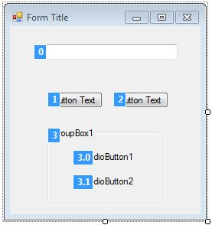
Organizing Controls …
How to Set the Tab Order for Controls
  On the View menu, select Tab Order
  Click a control to change its tab order
  Or
  Set the TabIndex property
  Set the TabStop property to True

Slide 73
Organizing Controls …
The tab order is the order in which a user moves focus from one control to another by pressing the TAB key.
Each form has its own tab order.
By default, the tab order is the same as the order in which you created the controls.
Tab order numbering begins with zero.
You can set tab order in the Properties window by using the TabIndex property.
The TabIndex property of a control determines where it is positioned in the tab order.
By default, the first control drawn has a TabIndex value of 0 , the second has a TabIndex of 1 , and so on.

Slide 74
Organizing Controls …
To set the tab order by using the View menu:
  On the View menu, click Tab Order.
  Click the controls sequentially to establish the tab order that you want.
  When you are finished, on the View menu, click Tab Order.
To set the tab order by using the TabIndex property:
  Select the control.
  Set the TabIndex property to the required value.
  Set the TabStop property to True.
By turning off the TabStop property,
  you enable a control be passed over in the tab order of the form.
A control in which the TabStop property has been set to False
  still maintains its position in the tab order,
  even though the control is skipped when you cycle through the controls with the TAB key.

Slide 75
Organizing Controls …
Anchoring
  Ensures that the edges of the control remain in the same position with respect to the parent container
To anchor a control to the form
  Set its Anchor property
  Default value: Top, Left
  Other Styles: Bottom, Right

Slide 76
Organizing Controls …
If you are designing a form that the user can resize at run time,
  the controls on the form should resize and reposition properly.
When a control is anchored to a form (or another container) and the form is resized,
  the control maintains the distance between the control and the anchor positions (which is the initial position).
You use the Anchor property editor to anchor.

Slide 77
Organizing Controls …
To anchor a control on a form:
  Select the control that you want to anchor.
  In the Properties window,
    click the Anchor property, and then
    click the Anchor arrow.
    The Anchor property editor is displayed; it contains a top bar, left bar, right bar, and bottom bar.
  To set an anchor, click the top, left, right, or bottom bar in the Anchor property editor.
Controls are anchored to the top and left by default.
To clear a side of the control that has been anchored, click the bar on that side.

Slide 78
Organizing Controls …
Docking
  Enables you to glue the edges of a control to the edges of its parent control
  To dock a control
  Set the Dock property

Slide 79
Organizing Controls …
You can dock controls to the edges of your form.
For example,
  Windows Explorer docks
    the TreeView control to the left side of the window and
    the ListView control to the right side of the window.
Use the Dock property for all visible Windows Forms controls to define the docking mode.
If you use the Dock property, a control is coupled with two edges of the container.
Then, the control is horizontally or vertically resized when the container is resized.

Slide 80
Organizing Controls …
In real life, you do not indicate the edges, you indicate a border.
If you dock a control to the left border,
  it is connected with the top left and bottom left edge.
The value of the Dock property is one of the DockStyle values.
A special case is DockStyle.Fill.
  This value docks the control to all edges.
  The control fills in the complete client area of the container.

Slide 81
Organizing Controls …
To dock a control on a form:
  Select the control that you want to dock.
  In the Properties window, click the arrow to the right of the Dock property.
    The Dock property editor is displayed; it contains a series of buttons that represent the edges and the center of the form.
  Click the button that represents the edge of the form where you want to dock the control.
    To fill the contents of the control’s form or container control, click the Fill (center) button.
    Click None to disable docking.
  The control is automatically resized to fit the boundaries of the docked edge.

Slide 82
MDI Applications
When creating Windows-based applications,
  you can use different styles for the user interface.
Your application can have
  a single-document interface (SDI) or
  a multiple-document interface (MDI), or
  you can create an explorer-style interface.
For more information about different types of application interfaces, see the .NET Framework software development kit (SDK).

Slide 83
SDI Vs MDI
SDI
MDI
Only one document is visible at a time.
Must close one document before opening another.
Example:
  Microsoft WordPad
Several documents are visible at the same time.
Each document is displayed in its own window.
Example:
  Microsoft Excel

Slide 84
Creating MDI Applications
To create a parent form
  Create a new project
  Set the IsMdiContainer property to True
  Add a menu item to invoke the child form
To create a child form
  Add a new form to the project
To call a child form from a parent form
  protected void MenuItem1_onClick(object sender, EventArgs e)
  {
    Form2 newChildForm = new Form2();
    //set parent Form
    newChildForm.MdiParen = this;
    //display the child form
    newChildForm.Show();
  }

Slide 85
Creating MDI Application ...
There are three main steps involved in creating an MDI application:
  creating a parent form,
  creating a child form, and
  calling the child form from a parent form.
To create the parent form at design time:
  The Parent form in an MDI application is the form that contains the MDI child windows.
  Child windows are used for interacting with users in an MDI application.
Create a new project.
Select the default Form, In the Properties window, set the IsMdiContainer of the Form property to True.
  This designates the form as an MDI container for child windows.

Slide 86
Creating MDI Application ...
  From the Toolbox, drag a MainMenu component to the form.
    You need a menu to invoke the child forms from the parent form.
  Set the MdiList property of the Windows menu item to True.
MDI child forms are critical for MDI applications because users interact with the application through child forms.
To create the child form at design time:
  In the same project that contains the parent form, create a new form.
You can also create an MDI form by
  Click Project Menu/Right click on Project
    Add => Add Windows Form
  Select MDI Parent Form
  Set the MDI Form as a startup Form

Slide 87
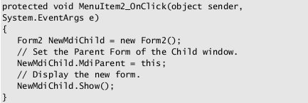
Creating MDI Application ...
To call the child form from the parent form:
  Create a Click event handler for the New menu item on the parent form.
  Insert code similar to the following code to create a new MDI child form when the user clicks the New menu item.

Slide 88
Creating MDI Application ...
How Parent and Child Forms Interact
  To list the available child windows that are owned by the parent
    Create a menu item (Windows) and set its MdiList property to True
  To determine the active MDI child
    Use the ActiveMdiChild property
  To arrange child windows on the parent form
    Call the LayoutMdimethod

Slide 89
Creating MDI Application ...
In an MDI application,
  a parent form has several child forms, and
  each of the child forms interacts with the parent form.
  Visual Studio .NET includes several properties that allow parent and child forms in an MDI application to interact.
An easy way to keep track of the different MDI child windows an application has open is to use a Window list.
The functionality to keep track of all
  the open MDI child forms as well as which child form has focus is part of Visual Studio .NET and is set with the MdiList property of a menu item.

Slide 90
Creating MDI Application ...
To list the child windows of a parent form by using the Window list:
  Add a MainMenu component to the parent form.
  Add the following top-level menu items to the MainMenu component by using the Menu Designer.
  MenuItem Text___
  menuItem1 &File
  menuItem2 &Windows
  Set the MdiList property of the Windows menu item to True.

Slide 91
Creating MDI Application ...
When you are completing certain procedures in an application,
  it is important to determine the active form.
Because an MDI application can have many instances of the same child form,
  the procedure must know which form to use.
To specify the correct form,
  use the ActiveMdiChild property,
    which returns the child form that has the focus or that was most recently active.
Use the following code to determine the active child form.
    Form activeChild = this.ActiveMdiChild;

Slide 92
Creating MDI Application ...
Arranging child windows on the parent form
  To arrange child windows on a parent form,
    you can use the LayoutMdi method with the MdiLayout enumeration to rearrange the child forms in an MDI parent form.
  There are four different MdiLayout enumeration values that can be used by the LayoutMdi method.
  These values help you display the form as
    cascading,
    horizontally or
    vertically tiled, or
    as child form icons arranged along the lower portion of the MDI form.
  To arrange child forms, in an event,
    use the LayoutMdi method to set the MdiLayout enumeration for the MDI parent form.

Slide 93
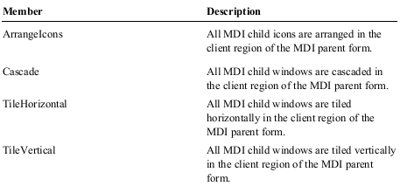
Creating MDI Application ...
You can use the following members of the MdiLayout enumeration when calling the LayoutMdi method of the Form class.

Slide 94
Creating MDI Application ...
The following example uses the Cascade setting of the MdiLayout enumeration for the child windows of the MDI parent form (Form1).
  protected void CascadeWindows_Click(object sender, System.EventArgs e)
  {
    Form1.LayoutMdi(MdiLayout.Cascade);
  }

Slide 95
More information on
John Sharp. Microsoft Visual C# 2013 Step by Step, 2015 Microsoft Press USA
Joel Murach, Anne Boehm. Murach C# 2012, Mike Murach & Associates Inc USA, 2013
Microsoft Corporation. Microsoft Visual Studio 2012 Product Guide, 2012

Slide 96
QUESTions
?

