Slide 1

LINUX System and Network Administration
Chapter 3
By Dr. Samuel Asferaw
2025/2026

Slide 2
Outlines
Introduction
Linux Systems and Network Concepts
Linux User Administration
Linux Service/Server Administration
Supporting a Windows Network - through SAMBA
Mail Server
'

Slide 3
Unix Operating system
It is a multi-user, multi-tasking operating system.
That means, many users logged into a system simultaneously, each running many programs
It's the kernel’s job to keep each process and user separate and to regulate access to system hardware, including CPU, memory, disk and other I/O devices

Slide 4
Linux Operating System
What is Linux?
    It is a free and open source Unix-type operating system
    It provides programming interface as well as user interface compatible with Unix
    Developed under GNU General Public License, the source code for Linux is freely available to everyone
    Linux was first released in the year 1991.
    Debian, Fedora, and Ubuntu are the popular Linux distributions. Which one we have in the lab installed?
    RedHat Enterprise Linux and SUSE Linux Enterprise Server (SLES) that are available as commercial distributions of Linuxss

Slide 5
Linux Architecture
As it is freely redistributable, anyone can modify and create variations of source code.
Two layers of Linux are User space and Kernel space.
Within these layers, there are four main components i,e. Hardware, Kernel, System call interface (aka Shell) and User applications
Hardware is comprised of all the peripheral devices which are attached to the computer such us terminals, printer, CPU, RAM, mother board
14

Slide 6
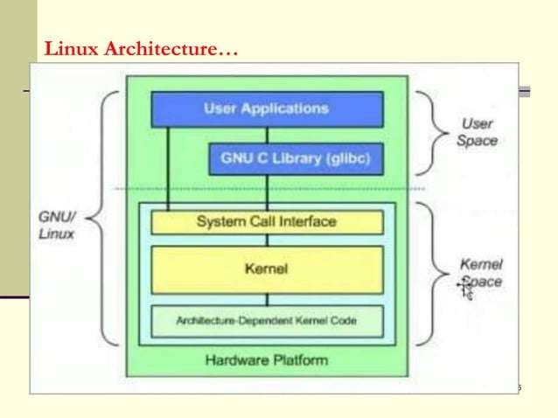

Slide 7
Linux Architecture....
Kernel: It is responsible for a lot of critical tasks like:
Process control,
Networking management,
Accessing peripherals and file system,
Security management and
Memory management.

Slide 8
Distinction between Linux and Windows OS
Linux is completely freed from price whereas windows is marketable package and is expensive

Slide 9
Linux Systems and Network Concepts
Linux systems support a wide range of network concepts and technologies, making a popular choice for network
IP Addressing
  Support both IPv4 and IPv6 addressing used to identify devices and communicate over a network
Network Interfaces: physical or virtual devices used to connect a Linux system to a network
Routing: is the process of forwarding data between networks.
Firewalls: used to protect Linux systems from unauthorized access and can be configured to filter incoming and outgoing network traffic

Slide 10
Linux Systems and Network Concepts …
Seven OSI layers
Four DoD layers: the four DoD (Department of Defense) layers, also known as the TCP/IP model,
Wireshark sniffer: network protocol analyzer and sniffer tool that is used to monitor and analyze network traffic
Sniffing for ntp (Network Time Protocol) packets
Sniffing an ARP (Address Resolution Protocol) broadcast can capture and display information about the ARP requests and responses, including the MAC addresses of the devices on the network and corresponding IP addresses

Slide 11
Linux Systems and Network Concepts …
Unicast: originates from one computer and is destined for exactly one other computer
Multicast is destined for a group of computers
A broadcast is meant for everyone.
An anycast signal goes the geographically nearest of a well defined group

Slide 12
Linux File System
The Linux file system organizes data on a storage device into files and directories.
Files can contain data or programs
Directories organize files into a hierarchical structure.
File System Hierarchy
Linux file system hierarchy is organized like a tree, with the root directory at the top and sub-directories branching out from there.
Some of the main directories in the Linux file system include:
/: The root directory of the file system.
/bin: Contains essential user binaries, such as 1s and cp commands.

Slide 13
Linux File System …
File System Hierarchy …
/sbin: Contains essential system binaries, such as those used to manage the system network.
/etc: Contains system configuration files, such as those used to configure the network or set up user accounts.
/usr: Contains user programs and files, such as documentation and libraries.
/var: Contains variable data files, such as log files and mail spools
/tmp: Contains temporary files that are deleted when the system is rebooted.
/home: Contains user home directories

Slide 14
Linux File System …
File System Types
Linux supports several file system types, including:
ext4: the default file system for most modern Linux distributions.
XFS: a high-performance file system designed for large-scale environment
btrfs: a modern file systcm that supports features such us snapshots and compression.
NTFS: a file system used by Windows that can be mounted on Linux systems.

Slide 15
Linux File System …
Mounting File System
To access data on a storage device, the file system must be mounted
This involves attaching the file system to a directory in the existing file system hierarchy
The mount command is used to mount a file system, and umount command is used to unmount it.

Slide 16
Permissions and Ownership
Linux uses a permission system to control access to files and directories.
Each file and directory has an owner and a group, and three sets of permissions: read, write, and execute.
These permissions can be set for the owner, the group, and all other users

Slide 17
Permissions and Groups
Permissions are divided into three user-based groups:
1. Owner: apply only to the user who owns the file or directory
  Owner can read, write, and execute the file or directory; and can also change its permissions.
2. Group: apply only to the group assigned to the file or directory
Group can read, write, and execute the file or directory but other users who are not part of the group cannot
3. All users: apply to all other users on the system who are not owner or part of the group assigned to the file or directory
These users can read, write, and executc the file or directory if the other permissions allow it

Slide 18
Permission Types
There are three types of permissions in Linux
Read (r): Allows a user to read the contents of a file or list the contents of a directory.
Write (w): Allows a user to modify the contents of a file or create, rename or delete files in a directory:
Execute (x). Allows a user to execute a file or enter a directnry
No permission (-): user may not have any permission for reading, writing or execution

Slide 19
Permission Types …
In general, access permissions specify who can access a particular file or resource and what actions they can perform on it such as reading, writing or executing
To change permissions in Linux, we can use chmod command
syntax for the chmod command:
chmod [permissions] [file/directory]
or
chmod [user] [operation][permissions] [file/directory]

Slide 20
Permission Types …
Example 1:
If you are the owner of a file called account and want to change the permissions or modes so that:
  User can read, write and execute,
  Group members can read and execute only and
  Others can only read, you will run the commands bellow:
sudo chmod u=rwx, g=rx, o=r account
endetx@Ubuntu:~/Desktop$ chmod u=rwx, g=rx, o=r account
endetx@Ubuntu:~/Desktop$ ls –l
drwxr-xr-- endex 4096 Jan 22 06:54 account
d = directory

Slide 21
Permission Types …
Examples 2:
On the other hand if you permit read, write and execute for type of user permissions for a file account
User, group and other users can rend, write and execute the chmod will be as follows:
sudo chmod u=rwx, g=rwx, o=rwx account
Exercise 1:
If you change permission mode for a file exam as follows what chmod command you used? For user read and write only for group read only and for other write and execute; what chmod command used?
Answer: sudo chmod u=rw, g=r, o=wx exam

Slide 22
About chmod command:
The chmod command changes the permission of the other file called confidential with permission that user can read (r), write (w) and execute (x) it
Group members can only read (r) and execute (x) and
Others can only read (r) its content...
The same command above can be written as shown below using its octal permission notation chmod 754 confidential
Permission Types …

Slide 23
Modifications of Permission
About chmod command:
The same command on previous slide can be written as shown below using its octal permission notation.
sudo chmod 754 confidential
The digit 7 is equal to read, write and execute. The digit 5 is equal to read and execute, the digit 4 is equal read.
  7= read, write, execute
  5= read, execute
  4 = Read
  2 = Write
  1 = Execute
  0 = no permission
So, 7 = 4 + 2 + 1 (rwx);
5= 4 + 1 (rx);
4 (r)

Slide 24
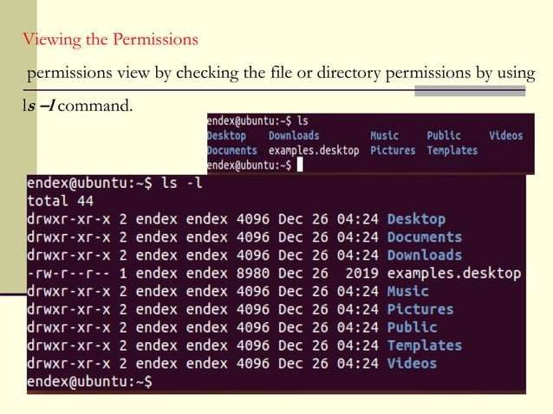

Slide 25
Linux Commands for System Administrators
Commands are used in Linux for different advantages:
It can save time
Used when unable to use GU I
Some commands used in Linux:
ls Used to list files and folders in the current working directories
ls –l Used to Sort file as per last modified time and permission type for file or directory
cd Used to change directory from the current you are working on to other
cd/ Take you to the root directory
  Example: root/d1/d2/d4$ cd … Becomes root$

Slide 26
Linux Commands for System Administrators …
Some commands used in Linux: …
cd .. Used to return back one directory from the current directory
Example: root/dl/d2/d4$ cd .. Becomes root/d1/d2>
apt -get Used to install, upgrade and update software
Example:: root/d1/d2/d4$ apt —get install sw1
pwd Used to print the full path of current working directory (print working directory)
Example:: admin/Desktop/d2/d4$ pwd will display
./home/admin/Desktop/d2/d4$

Slide 27
Linux Commands for System Administrators …
Some common commands used in Linux...
cp Used to copy file. You should to specify both a file you copy and location where you going to copy
Example: cp /home/admin/Desktop/sata$file.odt
/home/admin/Desktop/new$
This example copies a file called file.odt from sata directory to new directory

Slide 28
Some common commands used in Linux ...
Linux Commands for System Administrators …
mkdir/ Used to create new directories (also known as folders in the current directory)
Exemple: /admin/Desktop$ mkdir folder1
rmdir/ Used to remove or delete directory from the system Example: /admin/Desktop$ rmdir folder1
This syntax is used to remove folder folderl from Desktop
rm Used to remove files from folder
Example: /admin/Desktop/folder1$ rm file1
This syntax is used to remove a file called file1 from folder called folder1

Slide 29
Linux Commands for System Administrators ...
Some common commands used in Linux . . .
W Used to display users currently logged in and their process along with shows load averages
Also shows the login name, tty name, remote host, login time, idle time.
An options that used with this commands:
-h : displays no header entries.
-s : without JCPU and PCPU.
-f: Removes from field.
-V : (upper letts) Shows versions

Slide 30
Linux Commands for System Administrators ...
users Used to display currently logged in users
  This command don't have other parameters other than help and version.
who Used to display user name, date, time and host information.
These are an options for this command
-b : Displays last system reboot date and time.
-r : Shows current runlet.
-a, -all: Displays all information in cumulatively.
mv Used to rename file or folder
Example: mv old new (to rename folder old to new)

Slide 31
mv Also used to move files or folder to other
Example: /home/endex/Desktop/old$ mv file1.odt
/home/endex/Desktop$ new
This is file1.odt is moved from current folder to folder called new
Less It allows quickly to view file.
Also can page up and down.
Press ‘q' to quit from less window.
For more commands (Please, read)
Linux Commands for System Administrators ...

Slide 32
Linux Commands and Tools for System Administrators
Some common Network commands used in Linux
Ping
Route
Traceroute
Ifconfig
Nslookup
Hostname
Vmstat
Tcpdump
Netstat

Slide 33
Linux Commands and Tools for System Administrators…
IoStat: Input / Output Statistics
It is a tool used to collect and show system input and output storage device statistics
This tool is often used to trace storage device performance
But it should be installed first to use it

Slide 34

Linux Commands and Tools for System Administrators…
VmStat: Virtual Memory Statistics
This command used to display Statistics of the following:
virtual memory,
kernel threads,
interrupts,
disks,
System processes
I/O blocks,
CPU activity and much more.
By default vmstat command is not available under Linux systems you need to install a package called sysstat

Slide 35
Linux Commands and Tools for System Administrators…
Lsof : List Open Files
Used to display list of the open files and the processes
The open files included are:
  Disk files,
  Network sockets,
  List of devices and processes.
netstat : Network Statistics
Used to display network connection, routing tables, and network interface statistics
Tcpdump: allows you to capture and analyze network traffic in real-time
.

Slide 36
Linux Commands and Tools for System Administrators…
ifconfig (interface configurator):
To initialize an interface,
To assign IP Address to interface and enable or
To disable interface on demand.
To view IP Address and Hardware / MAC Address
To view MTU ( Maximum transmission unit) size
Example to assign IP address for interface eth0
/home/endex/$ ifconfig eth0 192.168.50.5 netmask 255.255.255.0
/home/endex /$ ifconfig eth0 (initialize interface)
/home/endex/$ ifup eth0 (enable eth0 interface}
/home/endex/$ ifdown eth0 (disable eth0 interface}

Slide 37
Linux Commands and Tools for System Administrators…
traceroute Used to trace the path that packets take from the local system to
a remote host
Example: below let tracing route to global DNS
endex/ubuntu$ traceroute 4.2.2.2
nslookup : use to find out DNS related query
The following examples shows A Record (IP Address of www.google.com
Example: endex/ubuntu$ www.google.com

Slide 38
Linux Commands and Tools for System Administrators…
route: is used to display and modify the system's network routing table
Example endex/ubuntu$ route
ARP is useful to view / add the contents of the kernel's ARP tables
Example to see default table use the command as
endex/ubuntu$ arp — e
Ping (Packet INternet Groper)
Used to test network connectivity to a remote host by sending packets to the host and waiting for response.
Example: erndex/ubutitu$ ping 4.2.2.2 OR
endex/ubuntu$ www.goog1e.com

Slide 39
Linux Commands and Tools for System Administrators…
Host
Used to find name to IP or IP to name in 1Pv4 or IPv6 and
.Example: endex/ubuntu$ host www.google.com OR
endex/ubuntu$ www.google.com
iwconfig command
use to configure a wireless network interface.
set the basic Wi-Fi details like: SSID channel and encryption.
endex/ubuntu$ iwconfig [interface]

Slide 40
Linux User Administration
Involves managing user accounts and their associated permissions.
Common tasks involved in Linux user administration:
Creating User Accounts: used useradd [options] username
Managing User Groups: Users can be organized into groups to simplify permissions management.
To create a new group, you can use groupadd command.
  groupadd groupname
To add a user to a group, you can use the usermod command.
usermod –a-G groupname username
The -a flag (append) ensures that the user is added to the new group without being removed from any other groups they are already in, while -G specifies the secondary group(s) to modify.

Slide 41
Linux User Administration …
Setting User Permissions: to set permissions for a file or directory, you can use the chmod command
chmod [permissions] filename
Setting User Quotas: you can set disk quotas to limit the amount of disk spsce that each user can use.
To set a quota for a user, you can use the edquota command
edquota –u username
Removing User Accounts: you can use the userdel coonmand
  userdel username
yon can also use -r option to remove the user’s home directory and mail spool

Slide 42
Linux Service/Server Administration
Linux Server/Service Administration: Involves managing and maintaining various services and servers running on Linux-based operating systems
Some of the key areas:
System administration: involves the setup configuration and maintenance of Linux-based systems
Responsibilities of Linux System Administrator
Installing and configuring the operating system, managing user accounts, configuring network interfaces, and managing system resources
File and Print Services : involve sharing of files and printers across a network
Provide file and print services using various protocols, such as NFS and Samba

Slide 43
Linux Service/Server Administration …
Web Services: involve hosting and serving web content, such as web pages, web applications using various web servers e.g. Apache server
Database Services: storing and managing data using a database management system (DBMS) e.g MySQL and PostgreSQL.
Mail Services: sending and receiving email messages using mail servers, such as Postfix and Exim
Virtualization: running multiple virtual machines on a single physical machine e.g. KVM and Xen.
Security and monitoring: protecting systems and data from unauthorized access and monitoring system performance and health e.g. firewalls and intrusion detection systems (IDS).

Slide 44
Supporting a Windows Network - through SAMBA
Samba is a free and open-source software allows Linux and Unix
systems to share files and printers with windows computers .
Provides file and print services to windows clients using SMB/CIFS
protocol.
System Administrators use Samba to integrate Linux/Unix systems with Windows networks, manage access controls and permissions.
To configure Samba for file and printer sharing, the administrator
needs:
Install Samba on the Linux/Unix system
Configure Samba to share directories and printers
Set up user authentication and access controls
‘

Slide 45
Supporting a Windows Network - through SAMBA...
Samba security considerations
Samba has several security features to restrict access to shared resources
These include:
User authenticetiton: use several authentication methods, including local user accounts, Active Directory, and LDAP.
Access Control: use access control lists (ACLs) to restrict access to shared resources based on user/group membership and permissions.
Encryption: use encryption to secure data transmissions between the Linux/Unix system and Windows clients.

Slide 46
Mail Server
Email systems consist of mail servers and mail clients.
Mail servers are responsible for storing and forwarding mail messages
Mail clicnts are used to read and compose email messages.
To set up and configure a mail server, administrator needs to:
  Install a MTA (Mail Transfer Agent) to handle incoming and outgoing mail e.g. Postfix or Sendmail
  Configure MTA to handle mail delivery, including DNS configuration and mail routing
  Install a MDA (Mail Delivery Agent), to handle mail storage and retrieval e.g. Dovecot or Courier
  Configure the MDA to handle user authentication and access controls.

Slide 47
End of Chapter 3
Thank You!
Any Question ?

