Slide 1
Introducing Golang Project

Slide 2
Tools of Trade
Compiler
Go Language Compiler (Main Compiler for Go Language)
Protocol Buffer Compiler (Main Compiler for serializing data using Protocol Buffers)
LLVM (Compiler used for VSCode Protobuf Plugin [Optional])
GCC (Compiler used by some of Golang 3rd party library package [Must Have])
IDE
VS Code (Free)
Goland (Commercial [30 day free trial]
Others
Docker

Slide 3
Tools of Trade – Tips and Tricky Part
GOROOT
Install on non administrator folder (Windows)
Make sure the $GOROOT/bin exists in System Environment Variables
GOPATH
Set on non administrator folder (Windows)
Make sure the $GOPATH/bin exists in System Environment Variables
Create src, pkg, and bin folder under $GOPATH
src folder is where you put all your project codes
[Optional] src folder structure: src/[scm]/[scm username or group]/project name e.g. src/github.com/developerserasiautoraya/fms-om-journey
PROTOC
Set on non administrator folder (Windows)
Make sure the $PROTOC/bin exists in System Environment Variables

Slide 4
Tools of Trade – Tips and Tricky Part
VSCode Plugins
Go for Visual Studio Code (ms-vscode.go by Microsoft)
Go Outliner (766b.go-outliner by 766b)
vscode-proto3 (zxh404.vscode-proto3 by zxh404)
Clang-Format (xaver.clang-format by Xaver)
[Optional] Docker (ms-azuretools.vscode-docker by Microsoft)
[Optional] Settings Sync (shan.code-settings-sync by Shan Khan)
Goland Settings (File - Settings)
Go - GOROOT
Go - GOPATH - Project GOPATH
Go - Go Modules - Enable Go Modules (vgo) Integration
Tools - Filewatcher - Add - gofmt
Tools - Terminal - Shell Path

Slide 5
Project Structure
Golang (Unofficial) Standard Project Layout
Clean Architecture

Slide 6
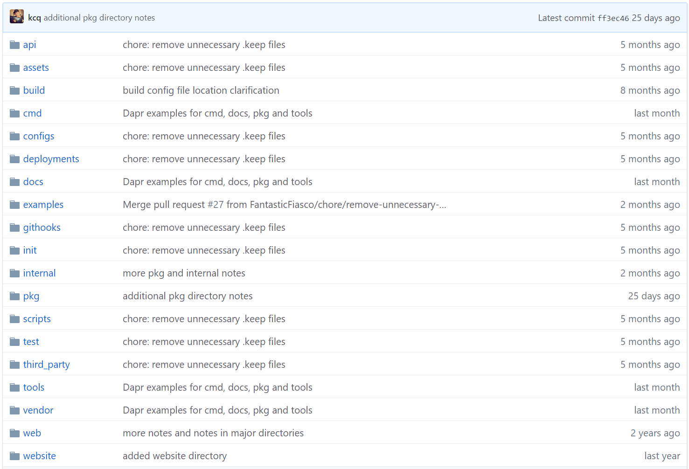

Slide 7
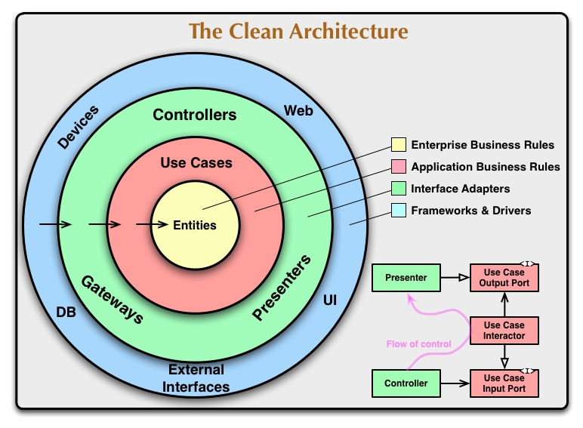
Clean Architecture

Slide 8
CQRS (Command Query Responsibility Segregation)
Command = Create, Update, and Delete operation (the actions that manipulate data on database).
Query = Retrieve (the action that retrieve/read data from database)
Entity model used for Command operation.
Domain model used for Query operation.

Slide 9
3rd Party Library
Viper, for Go configurations.
go-mssqldb, MS SQL Driver written in pure Go language.
gORM, ORM.
gRPC, RPC framework from Google.
gRPC Gateway, translate gRPC to REST API.
gRPC Protoc Gen Go, protocol buffer helper library to generate Go file from Protobuf.
gRPC Swagger Generator, generate Open API from protobuf file.

Slide 10
Thank You

