Slide 1
Forest Park Southeast, Botanical Heights, Central West End
Monthly Crime Report: March 2021
Washington University Medical Center

Slide 2
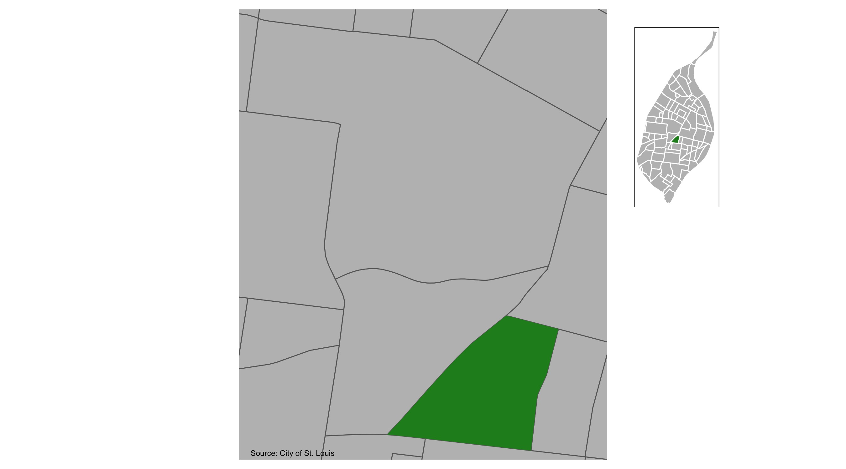
Botanical Heights

Slide 3
Botanical Heights : Summary Notes
10 total crimes in March 2021
0 crime(s) against persons
8 crime(s) against property
1 crime(s) against society
1 unspecified crimes

Slide 4
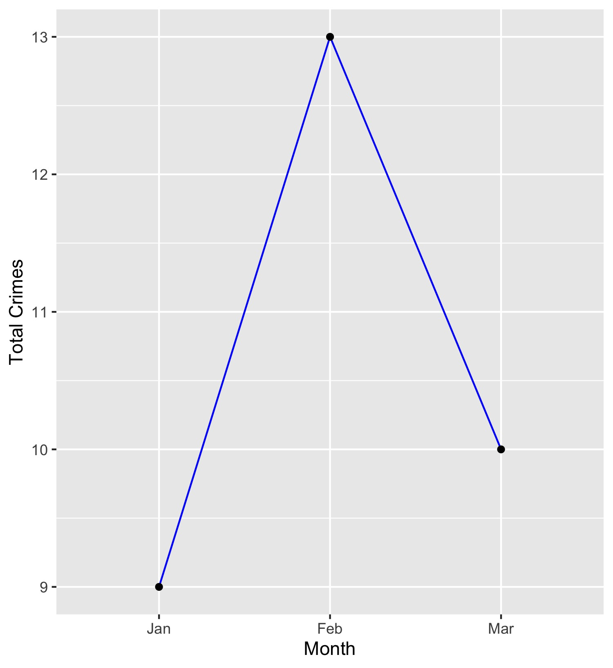
Botanical Heights
Type of Crime | Jan | Feb | Mar
Person | 1 | 2 | 0
Property | 4 | 9 | 8
Society | 1 | 2 | 1
Unspecified | 3 | 0 | 1
Total | 9 | 13 | 10

Slide 5
Botanical Heights : Property Crimes
Crime | Jan | Feb | Mar | Total
Robbery | 0 | 0 | 0 | 0
Arson | 0 | 0 | 0 | 0
Extortion/Blackmail | 0 | 0 | 0 | 0
Burglary/Breaking and Entering | 0 | 0 | 0 | 0
Pocket-picking | 0 | 0 | 0 | 0
Purse-snatching | 0 | 0 | 0 | 0
Shoplifting | 1 | 0 | 0 | 1
Theft From Building | 0 | 0 | 0 | 0
Theft From Coin-Operated Machine or Device | 0 | 0 | 0 | 0
Theft From Motor Vehicle | 0 | 3 | 3 | 6
Theft From Motor Vehicle Parts/Accessories | 0 | 2 | 0 | 2
All Other Larceny | 1 | 0 | 0 | 1
Motor Vehicle Theft | 1 | 0 | 1 | 2
Counterfeiting/Forgery | 0 | 0 | 0 | 0
False Pretense/Swindle/Confidence Game | 0 | 0 | 1 | 1
Credit Card/Automatic Teller Machine Fraud | 0 | 0 | 0 | 0
Impersonation | 0 | 0 | 0 | 0
Welfare Fraud | 0 | 0 | 0 | 0
Wire Fraud | 0 | 0 | 0 | 0
Identity Theft | 0 | 0 | 0 | 0

Slide 6
Botanical Heights : Property Crimes
Crime | Jan | Feb | Mar | Total
Hacking/Computer Invasion | 0 | 0 | 0 | 0
Embezzlement | 0 | 0 | 0 | 0
Stolen Property Offenses | 0 | 0 | 0 | 0
Destruction/Damage/Vandalism of Property | 1 | 4 | 3 | 8
Bribery | 0 | 0 | 0 | 0
Bad Checks | 0 | 0 | 0 | 0
Total | 4 | 9 | 8 | 21

Slide 7
Botanical Heights : Society Crimes
Crime | Jan | Feb | Mar | Total
Drug/Narcotic Violations | 0 | 0 | 1 | 1
Drug Equipment Violations | 0 | 0 | 0 | 0
Pornography/Obscene Material | 0 | 0 | 0 | 0
Betting/Wagering | 0 | 0 | 0 | 0
Operating/Promoting/Assisting Gambling | 0 | 0 | 0 | 0
Gambling Equipment Violations | 0 | 0 | 0 | 0
Sports Tampering | 0 | 0 | 0 | 0
Prostitution | 0 | 0 | 0 | 0
Assisting or Promoting Prostitution | 0 | 0 | 0 | 0
Purchasing Prostitution | 0 | 0 | 0 | 0
Weapons Law Violations | 0 | 2 | 0 | 2
Animal Cruelty | 0 | 0 | 0 | 0
Curfew/Loitering/Vagrancy Violations | 0 | 0 | 0 | 0
Disorderly Conduct | 1 | 0 | 0 | 1
Driving Under the Influence | 0 | 0 | 0 | 0
Drunkeness | 0 | 0 | 0 | 0
Family Offenses, Nonviolent | 0 | 0 | 0 | 0
Liquor Law Violations | 0 | 0 | 0 | 0
Peeping Tom | 0 | 0 | 0 | 0
Trespass of Real Property | 0 | 0 | 0 | 0
Total | 1 | 2 | 1 | 4

Slide 8
Botanical Heights : Person Crimes
Crime | Jan | Feb | Mar | Total
Murder and Nonnegligent Manslaughter | 0 | 0 | 0 | 0
Negligent Manslaughter | 0 | 0 | 0 | 0
Justifiable Homicide | 0 | 0 | 0 | 0
Suicide | 0 | 0 | 0 | 0
Kidnapping/Abduction | 0 | 0 | 0 | 0
Rape | 0 | 0 | 0 | 0
Sodomy | 0 | 0 | 0 | 0
Sexual Assault with an Object | 0 | 0 | 0 | 0
Fondling | 0 | 0 | 0 | 0
Aggravated Assault | 0 | 1 | 0 | 1
Simple Assault | 1 | 1 | 0 | 2
Intimidation | 0 | 0 | 0 | 0
Incest | 0 | 0 | 0 | 0
Statutory Rape | 0 | 0 | 0 | 0
Human Trafficking, Commercial Sex Acts | 0 | 0 | 0 | 0
Human Trafficking, Involuntary Servitude | 0 | 0 | 0 | 0
Total | 1 | 2 | 0 | 3

Slide 9
Botanical Heights : Unspecified Crimes
Crime | Jan | Feb | Mar | Total
Runaway | 0 | 0 | 0 | 0
All Other Offenses | 3 | 0 | 1 | 4
Total | 3 | 0 | 1 | 4

Slide 10
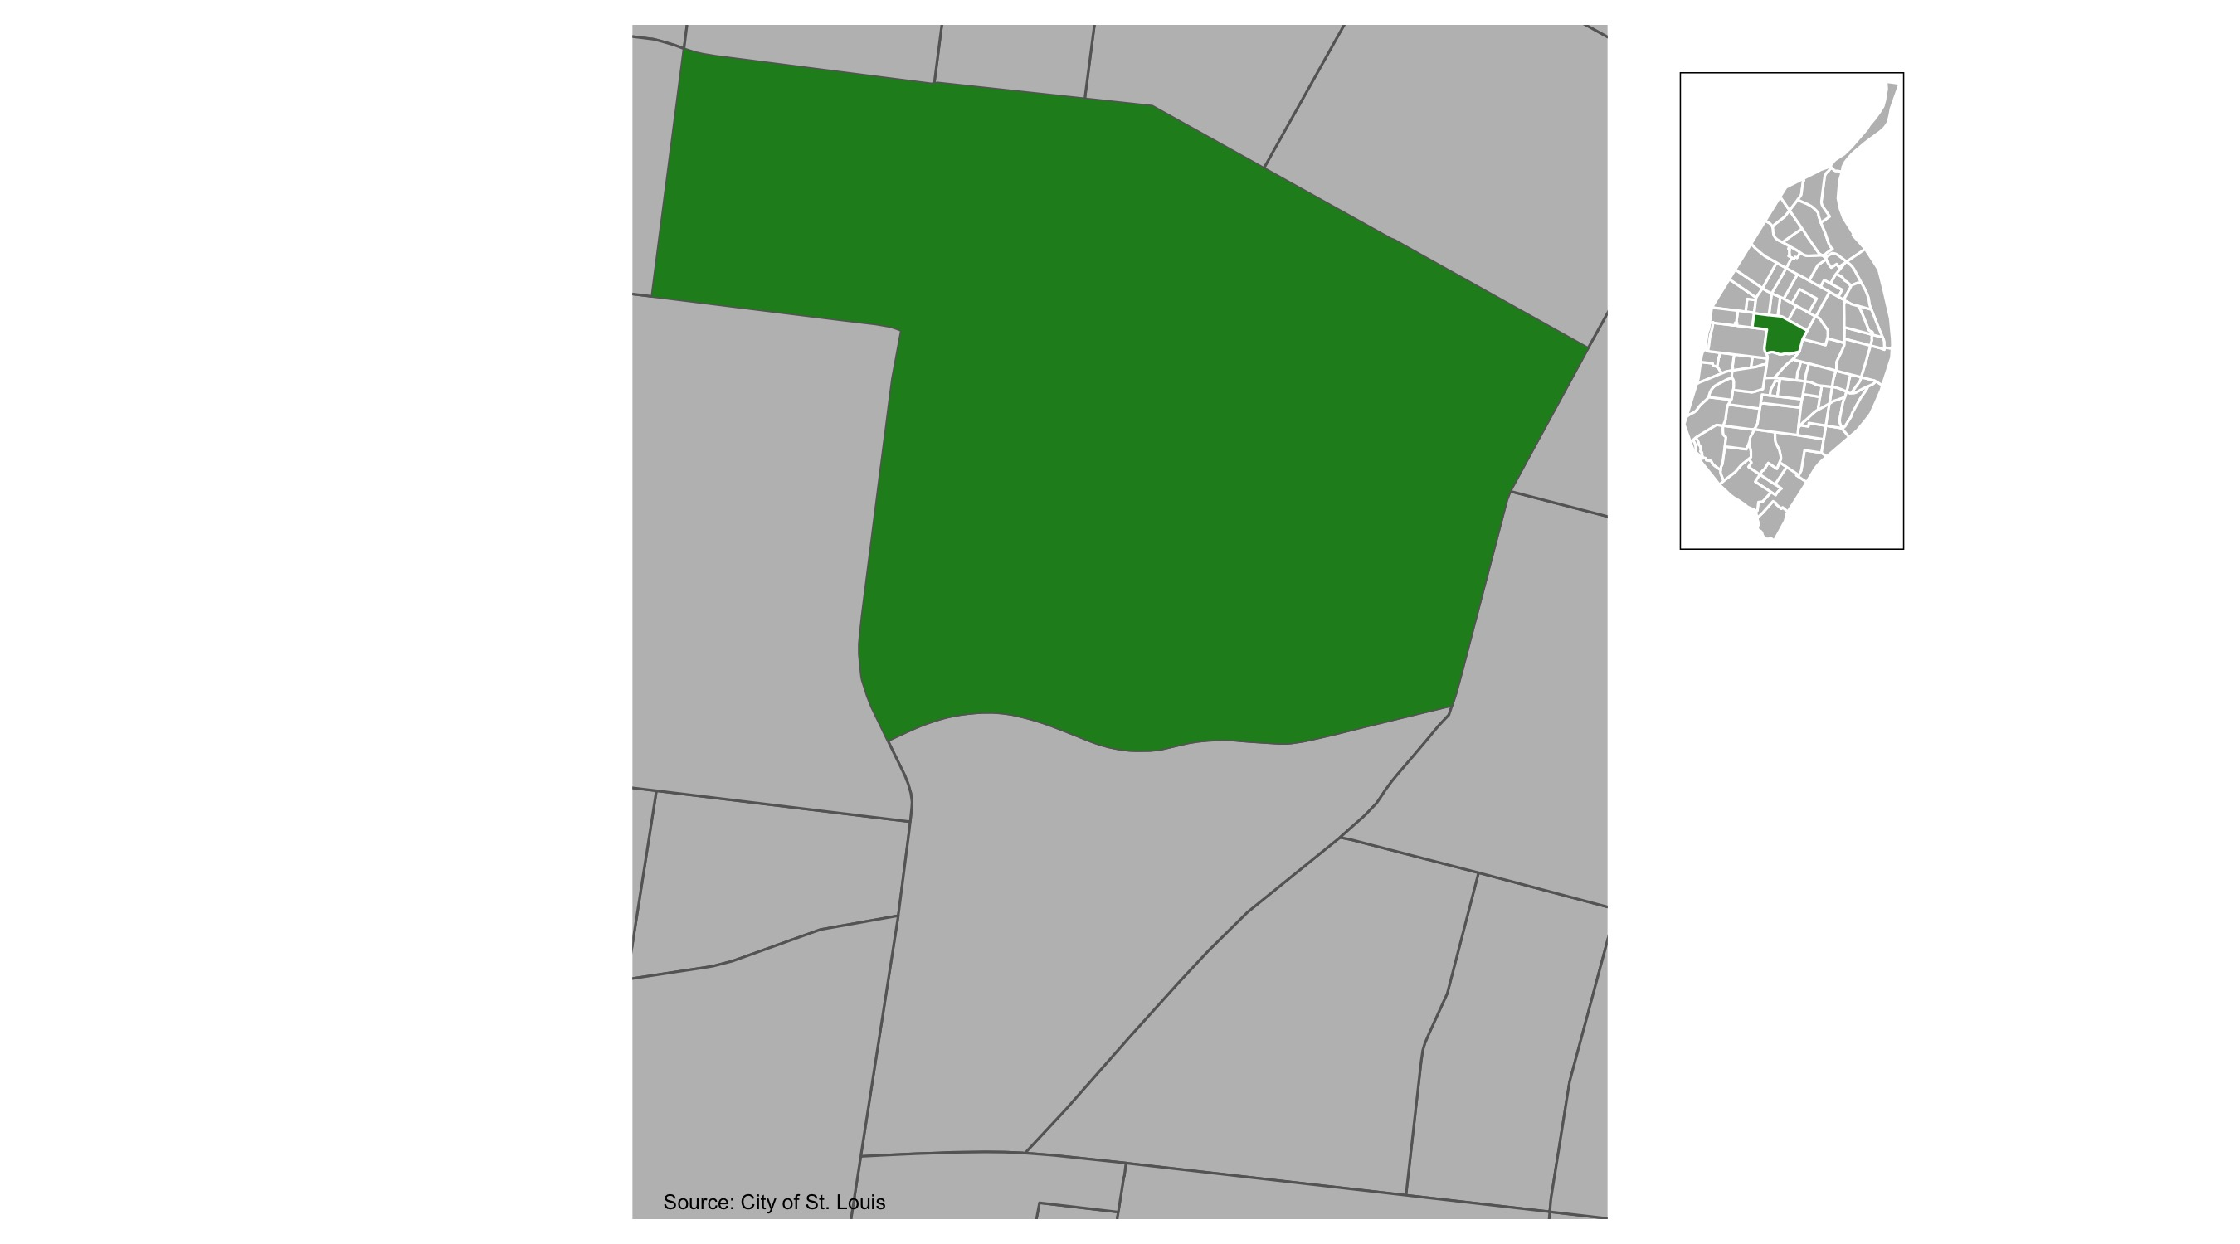
Central West End

Slide 11
Central West End : Summary Notes
122 total crimes in March 2021
3 crime(s) against persons
83 crime(s) against property
15 crime(s) against society
21 unspecified crimes

Slide 12
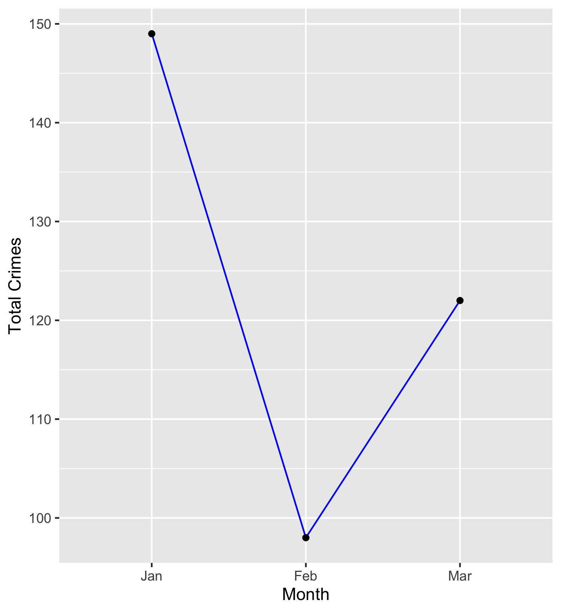
Central West End
Type of Crime | Jan | Feb | Mar
Person | 14 | 7 | 3
Property | 92 | 61 | 83
Society | 23 | 22 | 15
Unspecified | 20 | 8 | 21
Total | 149 | 98 | 122

Slide 13
Central West End : Property Crimes
Crime | Jan | Feb | Mar | Total
Robbery | 6 | 3 | 1 | 10
Arson | 0 | 1 | 0 | 1
Extortion/Blackmail | 0 | 0 | 0 | 0
Burglary/Breaking and Entering | 7 | 2 | 5 | 14
Pocket-picking | 1 | 0 | 0 | 1
Purse-snatching | 0 | 0 | 0 | 0
Shoplifting | 3 | 4 | 14 | 21
Theft From Building | 7 | 2 | 6 | 15
Theft From Coin-Operated Machine or Device | 0 | 0 | 1 | 1
Theft From Motor Vehicle | 15 | 15 | 12 | 42
Theft From Motor Vehicle Parts/Accessories | 18 | 8 | 6 | 32
All Other Larceny | 11 | 8 | 10 | 29
Motor Vehicle Theft | 4 | 8 | 9 | 21
Counterfeiting/Forgery | 0 | 0 | 1 | 1
False Pretense/Swindle/Confidence Game | 0 | 0 | 0 | 0
Credit Card/Automatic Teller Machine Fraud | 0 | 0 | 0 | 0
Impersonation | 0 | 1 | 0 | 1
Welfare Fraud | 0 | 0 | 0 | 0
Wire Fraud | 0 | 0 | 0 | 0
Identity Theft | 1 | 1 | 0 | 2

Slide 14
Central West End : Property Crimes
Crime | Jan | Feb | Mar | Total
Hacking/Computer Invasion | 0 | 0 | 0 | 0
Embezzlement | 0 | 0 | 0 | 0
Stolen Property Offenses | 3 | 0 | 0 | 3
Destruction/Damage/Vandalism of Property | 16 | 8 | 18 | 42
Bribery | 0 | 0 | 0 | 0
Bad Checks | 0 | 0 | 0 | 0
Total | 92 | 61 | 83 | 236

Slide 15
Central West End : Society Crimes
Crime | Jan | Feb | Mar | Total
Drug/Narcotic Violations | 4 | 8 | 3 | 15
Drug Equipment Violations | 2 | 4 | 1 | 7
Pornography/Obscene Material | 0 | 0 | 1 | 1
Betting/Wagering | 0 | 0 | 0 | 0
Operating/Promoting/Assisting Gambling | 0 | 0 | 0 | 0
Gambling Equipment Violations | 0 | 0 | 0 | 0
Sports Tampering | 0 | 0 | 0 | 0
Prostitution | 0 | 0 | 0 | 0
Assisting or Promoting Prostitution | 0 | 0 | 0 | 0
Purchasing Prostitution | 0 | 0 | 0 | 0
Weapons Law Violations | 6 | 4 | 1 | 11
Animal Cruelty | 0 | 0 | 0 | 0
Curfew/Loitering/Vagrancy Violations | 0 | 0 | 0 | 0
Disorderly Conduct | 4 | 2 | 5 | 11
Driving Under the Influence | 0 | 1 | 1 | 2
Drunkeness | 0 | 0 | 0 | 0
Family Offenses, Nonviolent | 2 | 0 | 0 | 2
Liquor Law Violations | 0 | 0 | 0 | 0
Peeping Tom | 0 | 0 | 0 | 0
Trespass of Real Property | 5 | 3 | 3 | 11
Total | 23 | 22 | 15 | 60

Slide 16
Central West End : Person Crimes
Crime | Jan | Feb | Mar | Total
Murder and Nonnegligent Manslaughter | 1 | 0 | 0 | 1
Negligent Manslaughter | 0 | 0 | 0 | 0
Justifiable Homicide | 0 | 0 | 0 | 0
Suicide | 0 | 0 | 0 | 0
Kidnapping/Abduction | 0 | 1 | 0 | 1
Rape | 0 | 0 | 0 | 0
Sodomy | 0 | 0 | 0 | 0
Sexual Assault with an Object | 0 | 0 | 0 | 0
Fondling | 0 | 0 | 0 | 0
Aggravated Assault | 7 | 2 | 3 | 12
Simple Assault | 4 | 4 | 0 | 8
Intimidation | 1 | 0 | 0 | 1
Incest | 0 | 0 | 0 | 0
Statutory Rape | 1 | 0 | 0 | 1
Human Trafficking, Commercial Sex Acts | 0 | 0 | 0 | 0
Human Trafficking, Involuntary Servitude | 0 | 0 | 0 | 0
Total | 14 | 7 | 3 | 24

Slide 17
Central West End : Unspecified Crimes
Crime | Jan | Feb | Mar | Total
Runaway | 0 | 0 | 0 | 0
All Other Offenses | 20 | 8 | 21 | 49
Total | 20 | 8 | 21 | 49

Slide 18
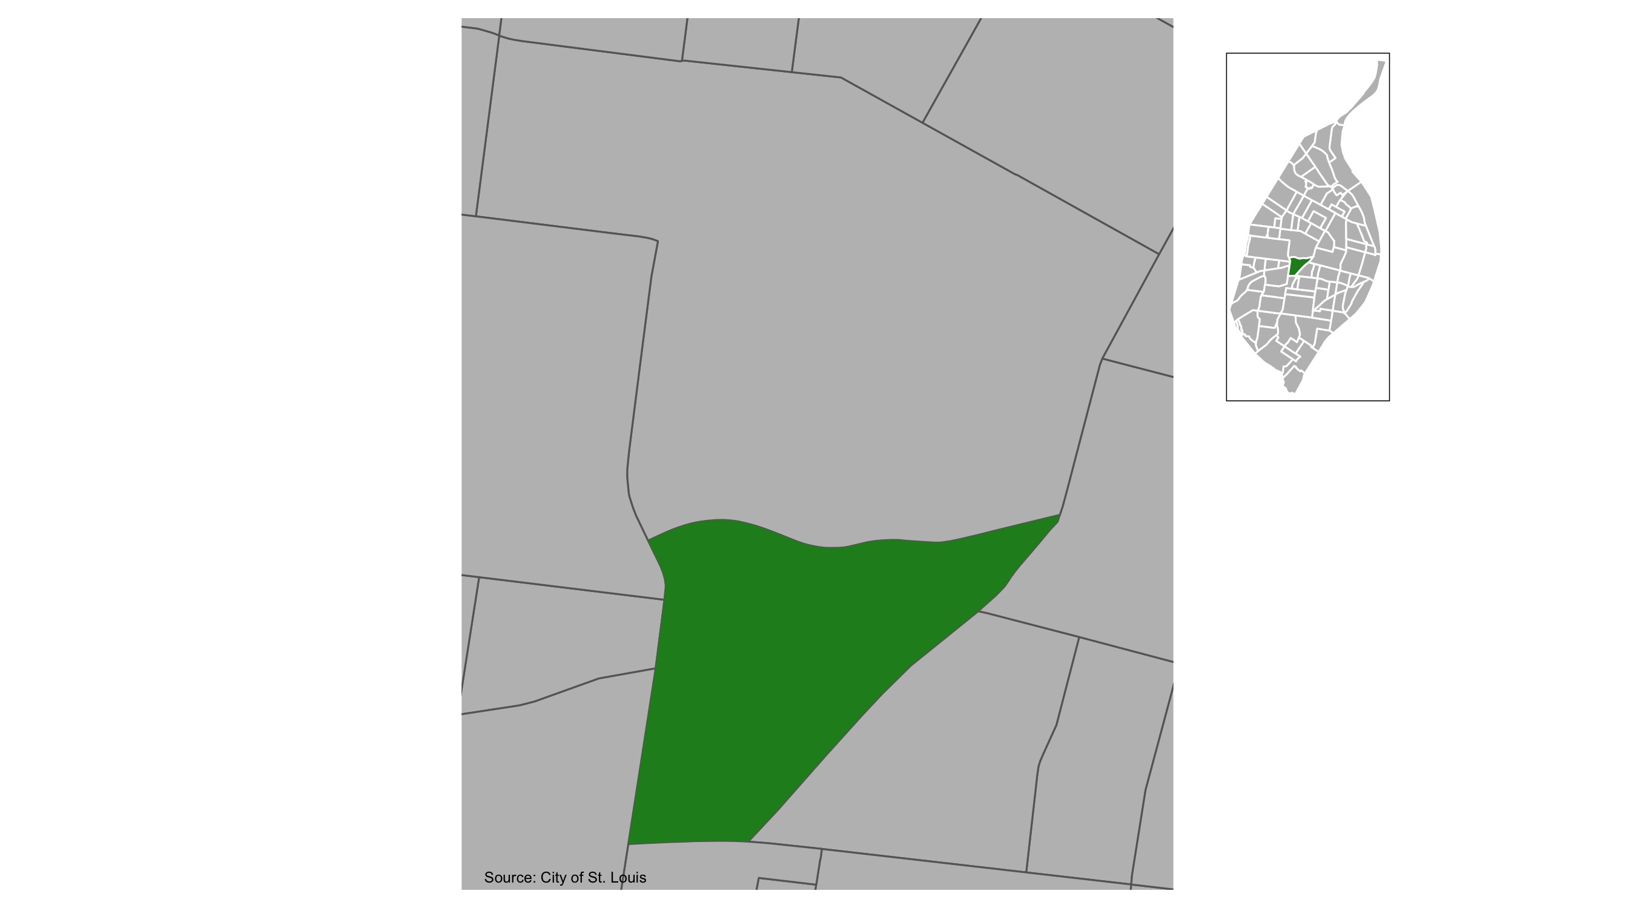
Forest Park Southeast

Slide 19
Forest Park Southeast : Summary Notes
19 total crimes in March 2021
1 crime(s) against persons
14 crime(s) against property
1 crime(s) against society
3 unspecified crimes

Slide 20
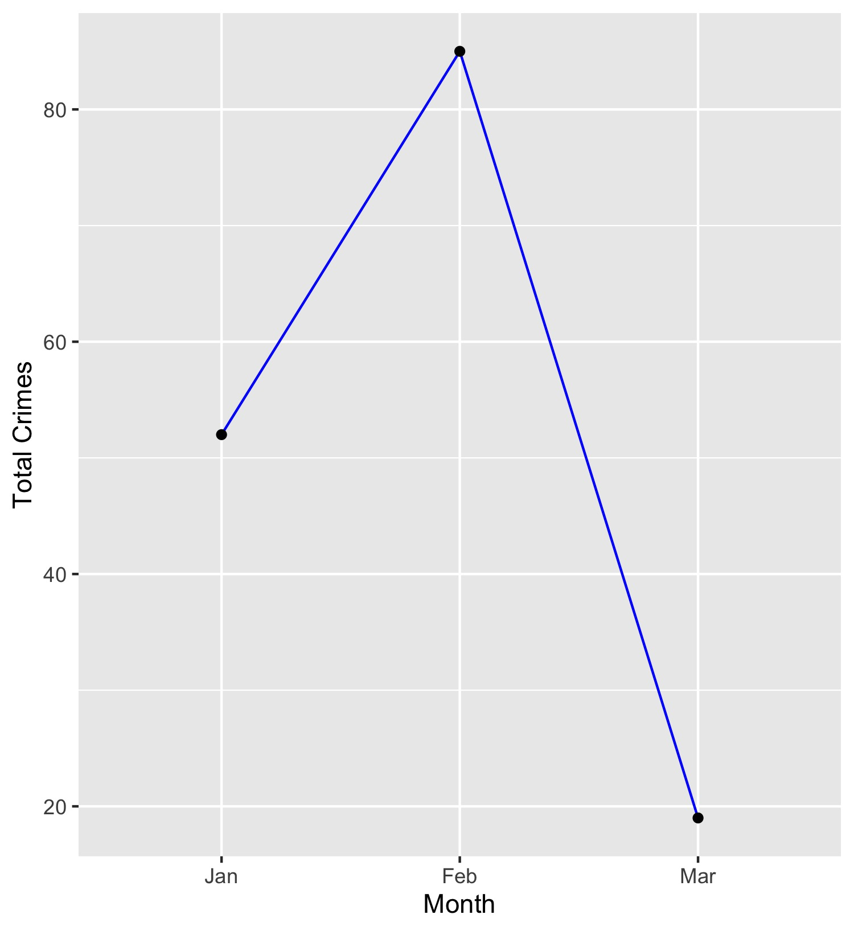
Forest Park Southeast
Type of Crime | Jan | Feb | Mar
Person | 3 | 1 | 1
Property | 35 | 83 | 14
Society | 5 | 0 | 1
Unspecified | 9 | 1 | 3
Total | 52 | 85 | 19

Slide 21
Forest Park Southeast : Property Crimes
Crime | Jan | Feb | Mar | Total
Robbery | 0 | 0 | 0 | 0
Arson | 0 | 1 | 0 | 1
Extortion/Blackmail | 0 | 0 | 0 | 0
Burglary/Breaking and Entering | 0 | 0 | 0 | 0
Pocket-picking | 0 | 0 | 0 | 0
Purse-snatching | 0 | 0 | 0 | 0
Shoplifting | 0 | 0 | 0 | 0
Theft From Building | 0 | 1 | 1 | 2
Theft From Coin-Operated Machine or Device | 0 | 0 | 0 | 0
Theft From Motor Vehicle | 9 | 31 | 5 | 45
Theft From Motor Vehicle Parts/Accessories | 5 | 3 | 1 | 9
All Other Larceny | 3 | 1 | 1 | 5
Motor Vehicle Theft | 7 | 9 | 1 | 17
Counterfeiting/Forgery | 0 | 0 | 0 | 0
False Pretense/Swindle/Confidence Game | 1 | 0 | 0 | 1
Credit Card/Automatic Teller Machine Fraud | 0 | 0 | 0 | 0
Impersonation | 0 | 0 | 1 | 1
Welfare Fraud | 0 | 0 | 0 | 0
Wire Fraud | 0 | 0 | 0 | 0
Identity Theft | 0 | 0 | 0 | 0

Slide 22
Forest Park Southeast : Property Crimes
Crime | Jan | Feb | Mar | Total
Hacking/Computer Invasion | 0 | 0 | 0 | 0
Embezzlement | 0 | 0 | 0 | 0
Stolen Property Offenses | 0 | 0 | 0 | 0
Destruction/Damage/Vandalism of Property | 10 | 37 | 4 | 51
Bribery | 0 | 0 | 0 | 0
Bad Checks | 0 | 0 | 0 | 0
Total | 35 | 83 | 14 | 132

Slide 23
Forest Park Southeast : Society Crimes
Crime | Jan | Feb | Mar | Total
Drug/Narcotic Violations | 1 | 0 | 0 | 1
Drug Equipment Violations | 1 | 0 | 0 | 1
Pornography/Obscene Material | 0 | 0 | 0 | 0
Betting/Wagering | 0 | 0 | 0 | 0
Operating/Promoting/Assisting Gambling | 0 | 0 | 0 | 0
Gambling Equipment Violations | 0 | 0 | 0 | 0
Sports Tampering | 0 | 0 | 0 | 0
Prostitution | 0 | 0 | 0 | 0
Assisting or Promoting Prostitution | 0 | 0 | 0 | 0
Purchasing Prostitution | 0 | 0 | 0 | 0
Weapons Law Violations | 1 | 0 | 1 | 2
Animal Cruelty | 0 | 0 | 0 | 0
Curfew/Loitering/Vagrancy Violations | 0 | 0 | 0 | 0
Disorderly Conduct | 1 | 0 | 0 | 1
Driving Under the Influence | 1 | 0 | 0 | 1
Drunkeness | 0 | 0 | 0 | 0
Family Offenses, Nonviolent | 0 | 0 | 0 | 0
Liquor Law Violations | 0 | 0 | 0 | 0
Peeping Tom | 0 | 0 | 0 | 0
Trespass of Real Property | 0 | 0 | 0 | 0
Total | 5 | 0 | 1 | 6

Slide 24
Forest Park Southeast : Person Crimes
Crime | Jan | Feb | Mar | Total
Murder and Nonnegligent Manslaughter | 0 | 0 | 0 | 0
Negligent Manslaughter | 0 | 0 | 0 | 0
Justifiable Homicide | 0 | 0 | 0 | 0
Suicide | 0 | 0 | 0 | 0
Kidnapping/Abduction | 0 | 0 | 0 | 0
Rape | 0 | 0 | 0 | 0
Sodomy | 0 | 0 | 0 | 0
Sexual Assault with an Object | 0 | 0 | 0 | 0
Fondling | 0 | 0 | 0 | 0
Aggravated Assault | 2 | 1 | 0 | 3
Simple Assault | 1 | 0 | 1 | 2
Intimidation | 0 | 0 | 0 | 0
Incest | 0 | 0 | 0 | 0
Statutory Rape | 0 | 0 | 0 | 0
Human Trafficking, Commercial Sex Acts | 0 | 0 | 0 | 0
Human Trafficking, Involuntary Servitude | 0 | 0 | 0 | 0
Total | 3 | 1 | 1 | 5

Slide 25
Forest Park Southeast : Unspecified Crimes
Crime | Jan | Feb | Mar | Total
Runaway | 0 | 0 | 0 | 0
All Other Offenses | 9 | 1 | 3 | 13
Total | 9 | 1 | 3 | 13

