Slide 1
Forest Park Southeast, Botanical Heights, Central West End
Monthly Crime Report: January 2021
Washington University Medical Center

Slide 2
Forest Park Southeast : Summary Notes
52 total crimes in January 2021
3 crime(s) against persons in January 2021
35 crime(s) against property in January 2021
5 crime(s) against society in January 2021
9 unspecified crimes in January 2021

Slide 3
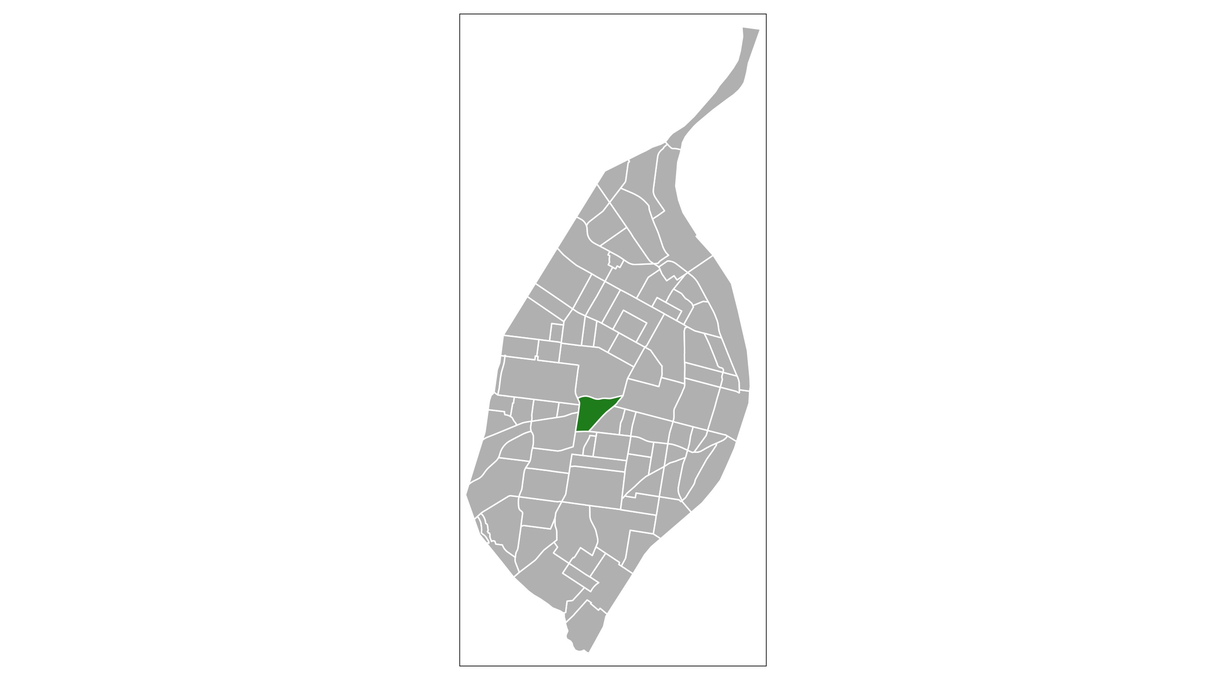
Forest Park Southeast
Type of Crime | Jan
Person | 3
Property | 35
Society | 5
Unspecified | 9
Total | 52

Slide 4
Forest Park Southeast : January Property Crimes
Robbery | Arson | Extortion/Blackmail | Burglary/Breaking and Entering | Pocket-picking | Purse-snatching | Shoplifting | Theft From Building | Theft From Coin-Operated Machine or Device | Theft From Motor Vehicle | Theft From Motor Vehicle Parts/Accessories | All Other Larceny | Motor Vehicle Theft | Counterfeiting/Forgery | False Pretense/Swindle/Confidence Game | Credit Card/Automatic Teller Machine Fraud | Impersonation | Welfare Fraud | Wire Fraud | Identity Theft | Hacking/Computer Invasion | Embezzlement | Stolen Property Offenses | Destruction/Damage/Vandalism of Property | Bribery | Bad Checks
0 | 0 | 0 | 0 | 0 | 0 | 0 | 0 | 0 | 9 | 5 | 3 | 7 | 0 | 1 | 0 | 0 | 0 | 0 | 0 | 0 | 0 | 0 | 10 | 0 | 0

Slide 5
Forest Park Southeast : January Society Crimes
Drug/Narcotic Violations | Drug Equipment Violations | Pornography/Obscene Material | Betting/Wagering | Operating/Promoting/Assisting Gambling | Gambling Equipment Violations | Sports Tampering | Prostitution | Assisting or Promoting Prostitution | Purchasing Prostitution | Weapons Law Violations | Animal Cruelty | Curfew/Loitering/Vagrancy Violations | Disorderly Conduct | Driving Under the Influence | Drunkeness | Family Offenses, Nonviolent | Liquor Law Violations | Peeping Tom | Trespass of Real Property
1 | 1 | 0 | 0 | 0 | 0 | 0 | 0 | 0 | 0 | 1 | 0 | 0 | 1 | 1 | 0 | 0 | 0 | 0 | 0

Slide 6
Forest Park Southeast : January Person Crimes
Murder and Nonnegligent Manslaughter | Negligent Manslaughter | Justifiable Homicide | Suicide | Kidnapping/Abduction | Rape | Sodomy | Sexual Assault with an Object | Fondling | Aggravated Assault | Simple Assault | Intimidation | Incest | Statutory Rape | Human Trafficking, Commercial Sex Acts | Human Trafficking, Involuntary Servitude
0 | 0 | 0 | 0 | 0 | 0 | 0 | 0 | 0 | 2 | 1 | 0 | 0 | 0 | 0 | 0

Slide 7
Forest Park Southeast : January Unspecified Crimes
Runaway | All Other Offenses
0 | 9

Slide 8
Botanical Heights : Summary Notes
9 total crimes in January 2021
1 crime(s) against persons in January 2021
4 crime(s) against property in January 2021
1 crime(s) against society in January 2021
3 unspecified crimes in January 2021

Slide 9
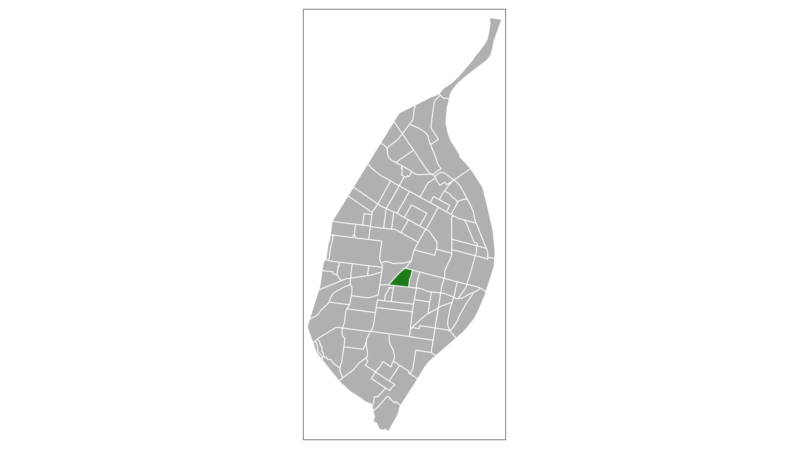
Botanical Heights
Type of Crime | Jan
Person | 1
Property | 4
Society | 1
Unspecified | 3
Total | 9

Slide 10
Botanical Heights : January Property Crimes
Robbery | Arson | Extortion/Blackmail | Burglary/Breaking and Entering | Pocket-picking | Purse-snatching | Shoplifting | Theft From Building | Theft From Coin-Operated Machine or Device | Theft From Motor Vehicle | Theft From Motor Vehicle Parts/Accessories | All Other Larceny | Motor Vehicle Theft | Counterfeiting/Forgery | False Pretense/Swindle/Confidence Game | Credit Card/Automatic Teller Machine Fraud | Impersonation | Welfare Fraud | Wire Fraud | Identity Theft | Hacking/Computer Invasion | Embezzlement | Stolen Property Offenses | Destruction/Damage/Vandalism of Property | Bribery | Bad Checks
0 | 0 | 0 | 0 | 0 | 0 | 1 | 0 | 0 | 0 | 0 | 1 | 1 | 0 | 0 | 0 | 0 | 0 | 0 | 0 | 0 | 0 | 0 | 1 | 0 | 0

Slide 11
Botanical Heights : January Society Crimes
Drug/Narcotic Violations | Drug Equipment Violations | Pornography/Obscene Material | Betting/Wagering | Operating/Promoting/Assisting Gambling | Gambling Equipment Violations | Sports Tampering | Prostitution | Assisting or Promoting Prostitution | Purchasing Prostitution | Weapons Law Violations | Animal Cruelty | Curfew/Loitering/Vagrancy Violations | Disorderly Conduct | Driving Under the Influence | Drunkeness | Family Offenses, Nonviolent | Liquor Law Violations | Peeping Tom | Trespass of Real Property
0 | 0 | 0 | 0 | 0 | 0 | 0 | 0 | 0 | 0 | 0 | 0 | 0 | 1 | 0 | 0 | 0 | 0 | 0 | 0

Slide 12
Botanical Heights : January Person Crimes
Murder and Nonnegligent Manslaughter | Negligent Manslaughter | Justifiable Homicide | Suicide | Kidnapping/Abduction | Rape | Sodomy | Sexual Assault with an Object | Fondling | Aggravated Assault | Simple Assault | Intimidation | Incest | Statutory Rape | Human Trafficking, Commercial Sex Acts | Human Trafficking, Involuntary Servitude
0 | 0 | 0 | 0 | 0 | 0 | 0 | 0 | 0 | 0 | 1 | 0 | 0 | 0 | 0 | 0

Slide 13
Botanical Heights : January Unspecified Crimes
Runaway | All Other Offenses
0 | 3

Slide 14
Central West End : Summary Notes
149 total crimes in January 2021
14 crime(s) against persons in January 2021
92 crime(s) against property in January 2021
23 crime(s) against society in January 2021
20 unspecified crimes in January 2021

Slide 15
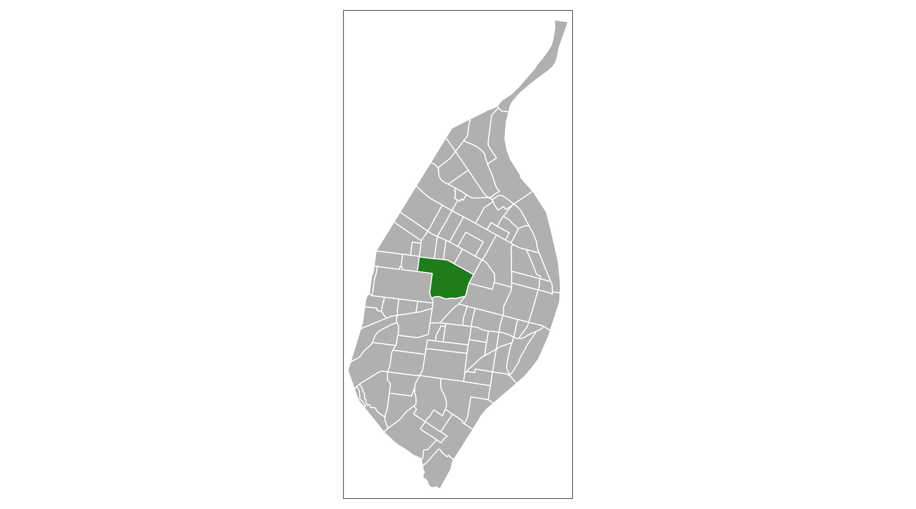
Central West End
Type of Crime | Jan
Person | 14
Property | 92
Society | 23
Unspecified | 20
Total | 149

Slide 16
Central West End : January Property Crimes
Robbery | Arson | Extortion/Blackmail | Burglary/Breaking and Entering | Pocket-picking | Purse-snatching | Shoplifting | Theft From Building | Theft From Coin-Operated Machine or Device | Theft From Motor Vehicle | Theft From Motor Vehicle Parts/Accessories | All Other Larceny | Motor Vehicle Theft | Counterfeiting/Forgery | False Pretense/Swindle/Confidence Game | Credit Card/Automatic Teller Machine Fraud | Impersonation | Welfare Fraud | Wire Fraud | Identity Theft | Hacking/Computer Invasion | Embezzlement | Stolen Property Offenses | Destruction/Damage/Vandalism of Property | Bribery | Bad Checks
6 | 0 | 0 | 7 | 1 | 0 | 3 | 7 | 0 | 15 | 18 | 11 | 4 | 0 | 0 | 0 | 0 | 0 | 0 | 1 | 0 | 0 | 3 | 16 | 0 | 0

Slide 17
Central West End : January Society Crimes
Drug/Narcotic Violations | Drug Equipment Violations | Pornography/Obscene Material | Betting/Wagering | Operating/Promoting/Assisting Gambling | Gambling Equipment Violations | Sports Tampering | Prostitution | Assisting or Promoting Prostitution | Purchasing Prostitution | Weapons Law Violations | Animal Cruelty | Curfew/Loitering/Vagrancy Violations | Disorderly Conduct | Driving Under the Influence | Drunkeness | Family Offenses, Nonviolent | Liquor Law Violations | Peeping Tom | Trespass of Real Property
4 | 2 | 0 | 0 | 0 | 0 | 0 | 0 | 0 | 0 | 6 | 0 | 0 | 4 | 0 | 0 | 2 | 0 | 0 | 5

Slide 18
Central West End : January Person Crimes
Murder and Nonnegligent Manslaughter | Negligent Manslaughter | Justifiable Homicide | Suicide | Kidnapping/Abduction | Rape | Sodomy | Sexual Assault with an Object | Fondling | Aggravated Assault | Simple Assault | Intimidation | Incest | Statutory Rape | Human Trafficking, Commercial Sex Acts | Human Trafficking, Involuntary Servitude
1 | 0 | 0 | 0 | 0 | 0 | 0 | 0 | 0 | 7 | 4 | 1 | 0 | 1 | 0 | 0

Slide 19
Central West End : January Unspecified Crimes
Runaway | All Other Offenses
0 | 20

