Slide 1
Academy, Fountain Park, Lewis Place, Vandeventer
Monthly Crime Report: December 2021
Washington University Medical Center

Slide 2
History of Crime Reporting
Since the 1929 the Uniform Crime Report (UCR) has used a Summary Reporting System (SRS) to collect monthly counts of the number of crimes
In 1982 the Bureau of Justice Statistics and the FBI sponsored a study with the objective of revising the existing form of reporting crime. Through this, the National Incident Based Reporting System (NIBRS) was created
The FBI UCR Program transitioned to a NIBRS only data collection by January 1, 2021. Other states have followed suit and SLMPD has been working to make this same transition

Slide 3
NIBRS vs SRS
NIBRS captures details on each single crime incident—as well as on separate offenses within the same incident—including information on victims, known offenders, relationships between victims and offenders, arrestees, and property involved in crimes
Standardizes crime reporting across all local, state, and tribal law enforcement agencies
SRS only counted the most serious offense (i.e. if a murder and robbery occurred, only the murder is counted) while NIBRS counts up to 10 crimes per incident
Current NIBRS reporting are not directly comparable to the previous UCR “hierarchy” numbers. With this change, you will likely see increases in crime statistics. This increase does not mean that crime is necessarily increasing, but rather that crime is being reported in a non-hierarchical format, with more detail and counting each individual crime

Slide 4
NIBRS and SLMPD
Unforeseen technology delays and the incompatibility in comparing crime (NIRBS V. UCR) has caused delays in making the crime information available
The City of St Louis Information Technology Division (I.T.) has created a series of internal 2021 NIBRS reports
Because of this transition information is limited to counts of each crime by neighborhood

Slide 5
Expanded Service Area

Slide 6
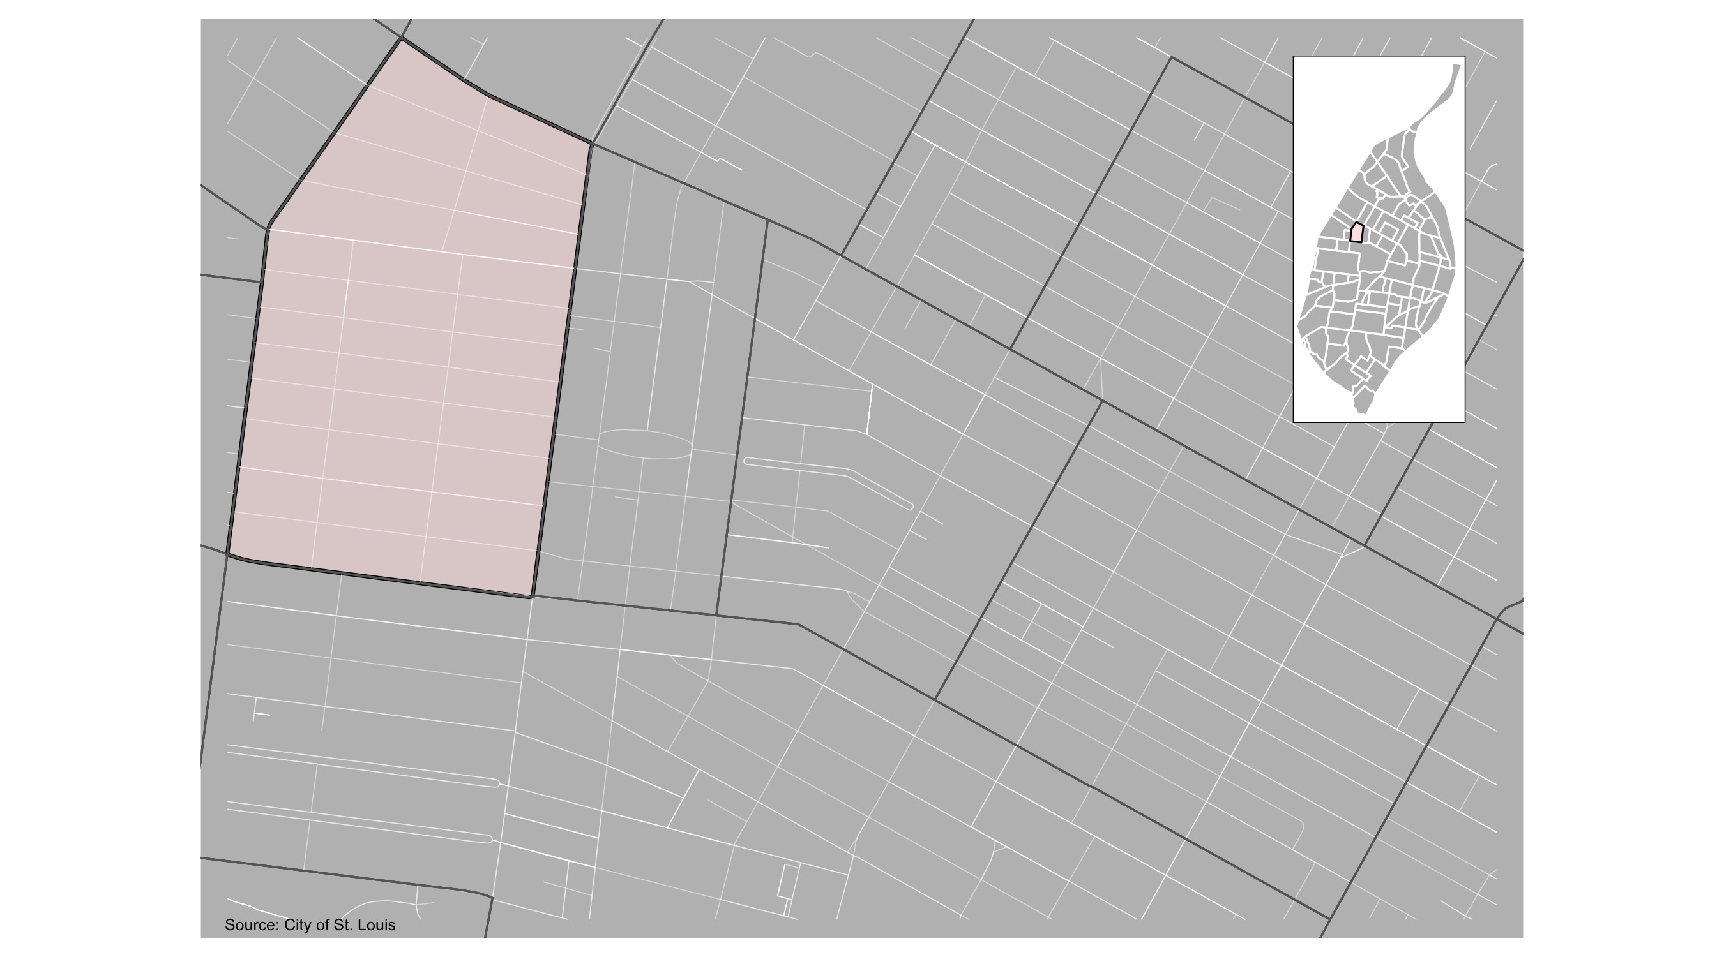
Academy

Slide 7
Academy: Summary Notes
35 total crimes in December 2021
10 crime(s) against persons
19 crime(s) against property
6 crime(s) against society
0 unspecified crimes

Slide 8
Academy
Type of Crime | Jan | Feb | Mar | Apr | May | Jun | Jul | Aug | Sep | Oct | Nov | Dec
Person | 8 | 4 | 6 | 8 | 7 | 6 | 11 | 16 | 12 | 9 | 10 | 9
Property | 11 | 21 | 22 | 10 | 20 | 12 | 20 | 17 | 20 | 20 | 19 | 12
Society | 11 | 8 | 14 | 15 | 14 | 8 | 11 | 4 | 7 | 5 | 6 | 6
Unspecified | 0 | 0 | 0 | 0 | 0 | 0 | 0 | 0 | 0 | 0 | 0 | 0
Total | 30 | 33 | 42 | 33 | 41 | 26 | 42 | 37 | 39 | 34 | 35 | 27

Slide 9
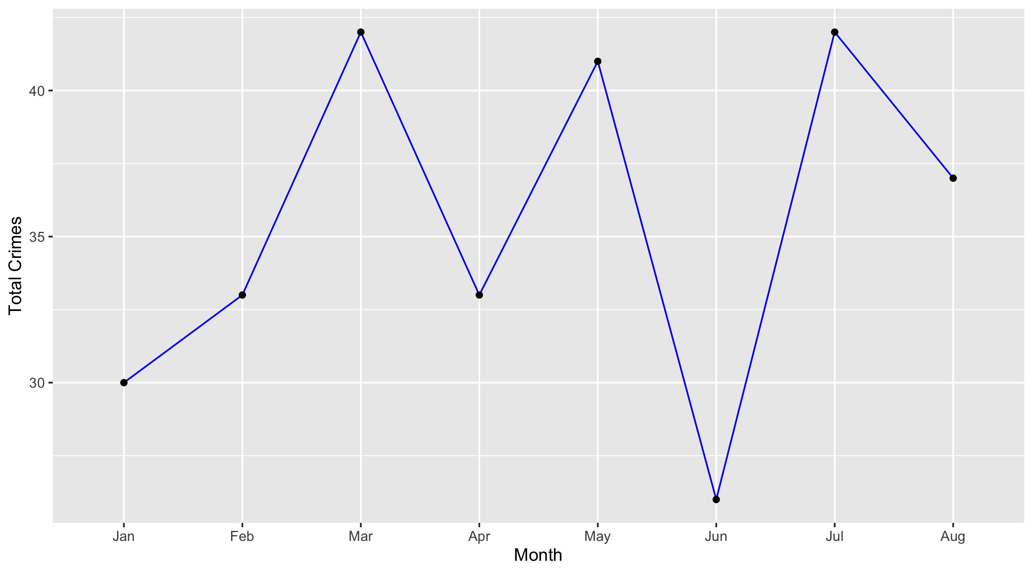
Academy

Slide 10
Academy: Property Crimes
Crime | Jan | Feb | Mar | Apr | May | Jun | Jul | Aug | Sep | Oct | Nov | Dec | Total
Robbery | 2 | 1 | 2 | 1 | 1 | 0 | 0 | 1 | 1 | 1 | 1 | 1 | 12
Arson | 0 | 0 | 1 | 0 | 0 | 0 | 0 | 0 | 0 | 0 | 1 | 1 | 3
Extortion/Blackmail | 0 | 0 | 0 | 0 | 0 | 0 | 0 | 0 | 0 | 0 | 0 | 0 | 0
Burglary/Breaking and Entering | 2 | 1 | 0 | 0 | 0 | 0 | 1 | 1 | 4 | 3 | 0 | 3 | 15
Pocket-picking | 0 | 0 | 0 | 1 | 0 | 0 | 0 | 0 | 0 | 0 | 0 | 0 | 1
Purse-snatching | 0 | 0 | 0 | 0 | 0 | 0 | 0 | 0 | 0 | 0 | 0 | 0 | 0
Shoplifting | 1 | 0 | 1 | 0 | 0 | 0 | 0 | 3 | 0 | 0 | 0 | 0 | 5
Theft From Building | 0 | 1 | 0 | 0 | 1 | 2 | 1 | 0 | 1 | 1 | 0 | 0 | 7
Theft From Coin-Operated Machine or Device | 0 | 0 | 0 | 0 | 0 | 0 | 0 | 0 | 0 | 0 | 0 | 0 | 0
Theft From MV | 0 | 1 | 1 | 1 | 3 | 3 | 0 | 2 | 1 | 2 | 3 | 0 | 17
Theft From MV Parts/Accessories | 1 | 3 | 1 | 1 | 3 | 2 | 1 | 1 | 0 | 1 | 2 | 1 | 17
All Other Larceny | 1 | 3 | 2 | 1 | 1 | 1 | 5 | 0 | 1 | 0 | 0 | 1 | 16
MV Theft | 2 | 6 | 6 | 1 | 3 | 1 | 3 | 3 | 1 | 3 | 4 | 3 | 36
Counterfeiting/Forgery | 0 | 0 | 0 | 0 | 0 | 0 | 0 | 0 | 0 | 0 | 0 | 0 | 0
False Pretense/Swindle/Confidence Game | 0 | 0 | 1 | 0 | 0 | 0 | 0 | 0 | 0 | 1 | 0 | 0 | 2
Credit Card/ATM Fraud | 0 | 0 | 0 | 0 | 0 | 0 | 0 | 0 | 0 | 1 | 1 | 0 | 2
Impersonation | 0 | 0 | 0 | 0 | 0 | 0 | 0 | 0 | 0 | 0 | 0 | 0 | 0
Welfare Fraud | 0 | 0 | 0 | 0 | 0 | 0 | 0 | 0 | 0 | 0 | 0 | 0 | 0
Wire Fraud | 0 | 0 | 0 | 0 | 0 | 0 | 0 | 0 | 0 | 0 | 0 | 0 | 0

Slide 11
Academy: Property Crimes
Crime | Jan | Feb | Mar | Apr | May | Jun | Jul | Aug | Sep | Oct | Nov | Dec | Total
Identity Theft | 0 | 0 | 0 | 0 | 0 | 0 | 0 | 0 | 0 | 0 | 0 | 0 | 0
Hacking/Computer Invasion | 0 | 0 | 0 | 0 | 0 | 0 | 0 | 0 | 0 | 0 | 0 | 0 | 0
Embezzlement | 0 | 0 | 0 | 0 | 0 | 0 | 0 | 0 | 0 | 0 | 0 | 0 | 0
Stolen Property Offenses | 0 | 0 | 0 | 0 | 0 | 0 | 0 | 0 | 3 | 2 | 3 | 0 | 8
Destruction/Damage/Vandalism of Property | 2 | 5 | 7 | 4 | 8 | 3 | 9 | 6 | 8 | 5 | 4 | 2 | 63
Bribery | 0 | 0 | 0 | 0 | 0 | 0 | 0 | 0 | 0 | 0 | 0 | 0 | 0
Total | 11 | 21 | 22 | 10 | 20 | 12 | 20 | 17 | 20 | 20 | 19 | 12 | 204

Slide 12
Academy: Society Crimes
Crime | Jan | Feb | Mar | Apr | May | Jun | Jul | Aug | Sep | Oct | Nov | Dec | Total
Drug/Narcotic Violations | 4 | 3 | 5 | 8 | 6 | 1 | 1 | 1 | 2 | 2 | 2 | 2 | 37
Drug Equipment Violations | 2 | 2 | 2 | 2 | 2 | 0 | 2 | 2 | 1 | 0 | 1 | 0 | 16
Pornography/Obscene Material | 0 | 0 | 0 | 0 | 0 | 0 | 0 | 0 | 0 | 0 | 0 | 0 | 0
Betting/Wagering | 0 | 0 | 0 | 0 | 0 | 0 | 0 | 0 | 0 | 0 | 0 | 0 | 0
Operating/Promoting/Assisting Gambling | 0 | 0 | 0 | 0 | 0 | 0 | 0 | 0 | 0 | 0 | 0 | 0 | 0
Gambling Equipment Violations | 0 | 0 | 0 | 0 | 0 | 0 | 0 | 0 | 0 | 0 | 0 | 0 | 0
Sports Tampering | 0 | 0 | 0 | 0 | 0 | 0 | 0 | 0 | 0 | 0 | 0 | 0 | 0
Prostitution | 0 | 0 | 0 | 0 | 0 | 0 | 4 | 0 | 0 | 0 | 0 | 0 | 4
Assisting or Promoting Prostitution | 0 | 0 | 0 | 0 | 0 | 0 | 0 | 0 | 0 | 0 | 0 | 0 | 0
Purchasing Prostitution | 0 | 0 | 0 | 0 | 0 | 0 | 0 | 0 | 0 | 0 | 0 | 0 | 0
Weapons Law Violations | 2 | 1 | 6 | 3 | 5 | 3 | 2 | 1 | 4 | 2 | 2 | 3 | 34
Animal Cruelty | 0 | 0 | 0 | 0 | 0 | 0 | 0 | 0 | 0 | 0 | 0 | 0 | 0
Curfew/Loitering/Vagrancy Violations | 0 | 0 | 0 | 0 | 0 | 0 | 0 | 0 | 0 | 0 | 0 | 0 | 0
Disorderly Conduct | 3 | 1 | 1 | 2 | 1 | 1 | 0 | 0 | 0 | 1 | 1 | 1 | 12
Driving Under the Influence | 0 | 0 | 0 | 0 | 0 | 1 | 0 | 0 | 0 | 0 | 0 | 0 | 1
Drunkeness | 0 | 0 | 0 | 0 | 0 | 0 | 0 | 0 | 0 | 0 | 0 | 0 | 0
Family Offenses, Nonviolent | 0 | 1 | 0 | 0 | 0 | 2 | 0 | 0 | 0 | 0 | 0 | 0 | 3
Liquor Law Violations | 0 | 0 | 0 | 0 | 0 | 0 | 2 | 0 | 0 | 0 | 0 | 0 | 2
Peeping Tom | 0 | 0 | 0 | 0 | 0 | 0 | 0 | 0 | 0 | 0 | 0 | 0 | 0
Total | 11 | 8 | 14 | 15 | 14 | 8 | 11 | 4 | 7 | 5 | 6 | 6 | 109

Slide 13
Academy: Person Crimes
Crime | Jan | Feb | Mar | Apr | May | Jun | Jul | Aug | Sep | Oct | Nov | Dec | Total
Murder and Nonnegligent Manslaughter | 1 | 0 | 0 | 0 | 0 | 0 | 0 | 0 | 0 | 0 | 0 | 1 | 2
Negligent Manslaughter | 0 | 0 | 0 | 0 | 0 | 0 | 0 | 0 | 0 | 0 | 0 | 0 | 0
Justifiable Homicide | 0 | 0 | 0 | 0 | 0 | 0 | 0 | 0 | 0 | 0 | 0 | 0 | 0
Suicide | 0 | 0 | 0 | 0 | 0 | 0 | 0 | 0 | 0 | 0 | 0 | 0 | 0
Kidnapping/Abduction | 0 | 0 | 1 | 1 | 0 | 1 | 1 | 0 | 0 | 0 | 0 | 0 | 4
Rape | 0 | 0 | 0 | 1 | 0 | 0 | 0 | 0 | 1 | 0 | 0 | 0 | 2
Sodomy | 0 | 0 | 0 | 1 | 0 | 0 | 0 | 0 | 0 | 0 | 0 | 0 | 1
Sexual Assault with an Object | 0 | 0 | 0 | 0 | 0 | 0 | 0 | 0 | 0 | 0 | 0 | 0 | 0
Fondling | 0 | 0 | 0 | 0 | 0 | 0 | 0 | 0 | 0 | 0 | 0 | 0 | 0
Aggravated Assault | 3 | 2 | 3 | 2 | 4 | 3 | 6 | 14 | 6 | 5 | 4 | 1 | 53
Simple Assault | 3 | 2 | 2 | 2 | 3 | 2 | 3 | 1 | 2 | 4 | 5 | 5 | 34
Intimidation | 1 | 0 | 0 | 1 | 0 | 0 | 1 | 1 | 3 | 0 | 1 | 2 | 10
Incest | 0 | 0 | 0 | 0 | 0 | 0 | 0 | 0 | 0 | 0 | 0 | 0 | 0
Statutory Rape | 0 | 0 | 0 | 0 | 0 | 0 | 0 | 0 | 0 | 0 | 0 | 0 | 0
Human Trafficking, Commercial Sex Acts | 0 | 0 | 0 | 0 | 0 | 0 | 0 | 0 | 0 | 0 | 0 | 0 | 0
Total | 8 | 4 | 6 | 8 | 7 | 6 | 11 | 16 | 12 | 9 | 10 | 9 | 106

Slide 14
Academy: Unspecified Crimes
Crime | Jan | Feb | Mar | Apr | May | Jun | Jul | Aug | Sep | Oct | Nov | Dec | Total
Runaway | 0 | 0 | 0 | 0 | 0 | 0 | 0 | 0 | 0 | 0 | 0 | 0 | 0
Total | 0 | 0 | 0 | 0 | 0 | 0 | 0 | 0 | 0 | 0 | 0 | 0 | 0

Slide 15
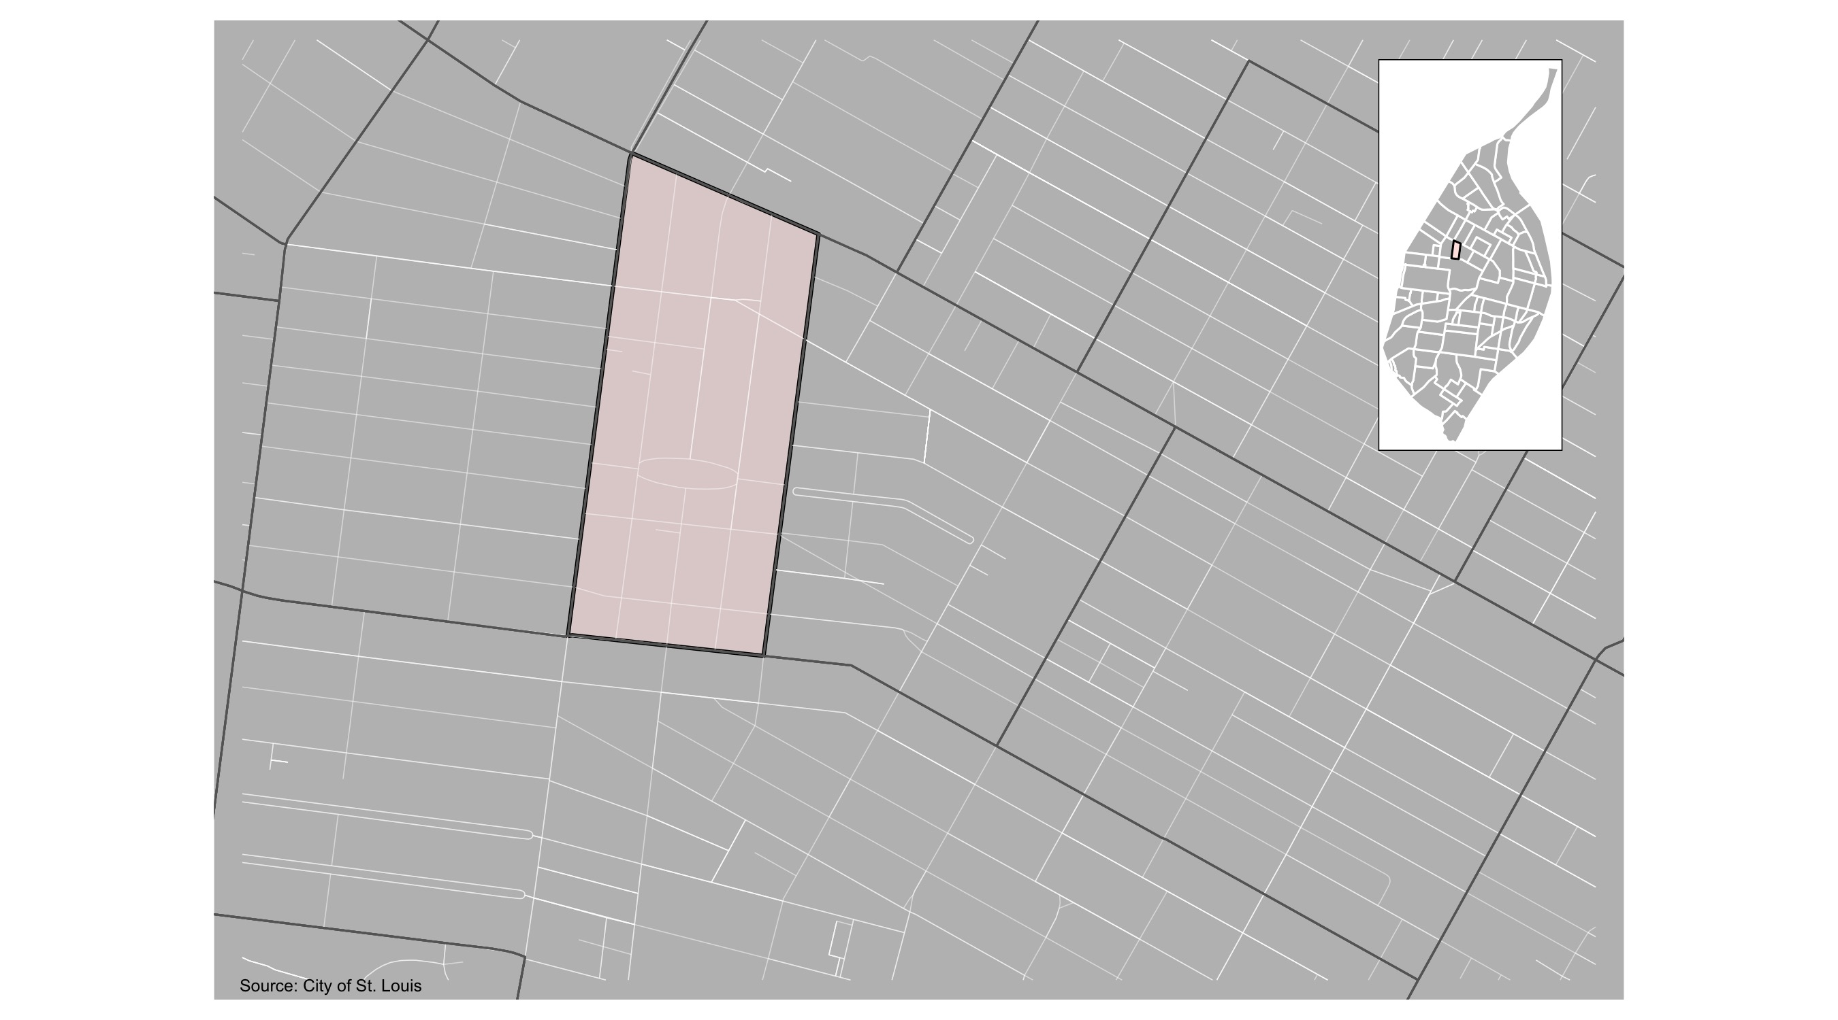
Fountain Park

Slide 16
Fountain Park: Summary Notes
23 total crimes in December 2021
6 crime(s) against persons
12 crime(s) against property
5 crime(s) against society
0 unspecified crimes

Slide 17
Fountain Park
Type of Crime | Jan | Feb | Mar | Apr | May | Jun | Jul | Aug | Sep | Oct | Nov | Dec
Person | 1 | 3 | 4 | 8 | 2 | 6 | 13 | 2 | 3 | 6 | 6 | 5
Property | 3 | 10 | 5 | 10 | 10 | 18 | 11 | 12 | 16 | 13 | 12 | 7
Society | 6 | 9 | 12 | 12 | 6 | 5 | 8 | 8 | 4 | 6 | 5 | 2
Unspecified | 0 | 0 | 0 | 0 | 0 | 0 | 0 | 0 | 0 | 0 | 0 | 0
Total | 10 | 22 | 21 | 30 | 18 | 29 | 32 | 22 | 23 | 25 | 23 | 14

Slide 18
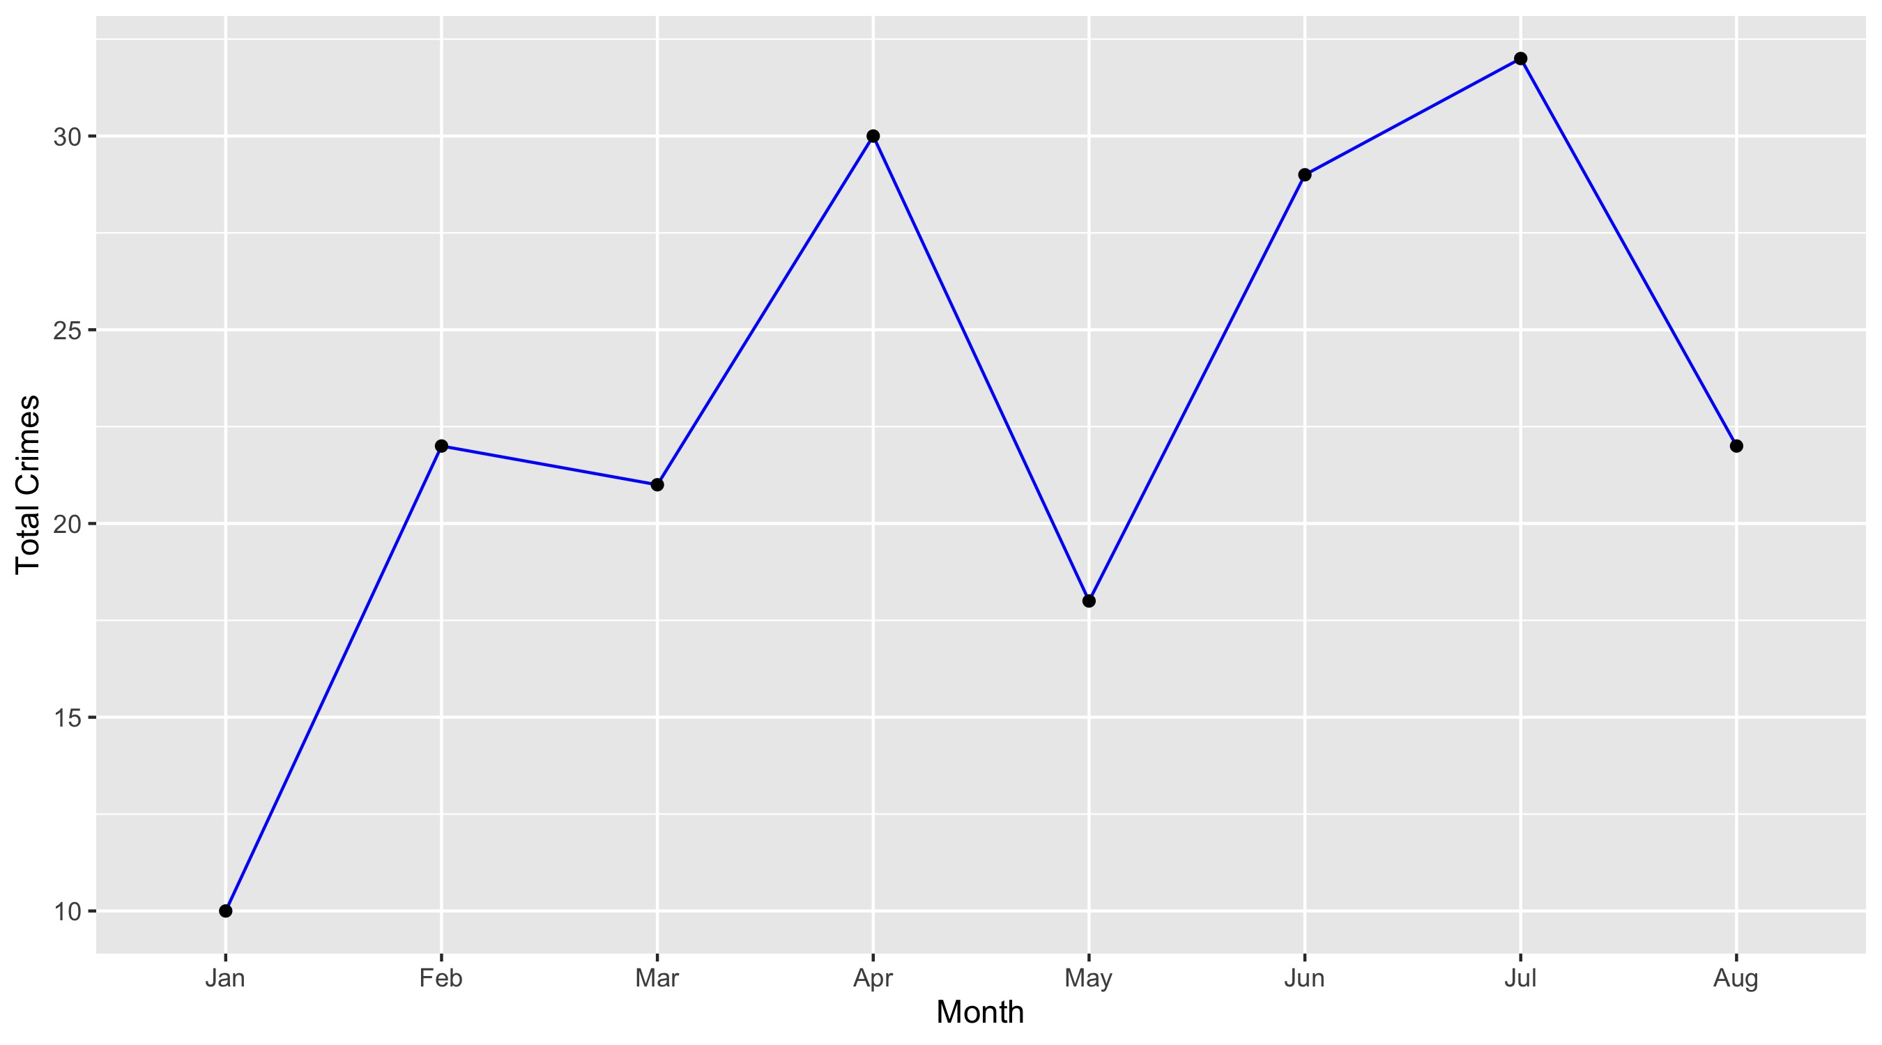
Fountain Park

Slide 19
Fountain Park: Property Crimes
Crime | Jan | Feb | Mar | Apr | May | Jun | Jul | Aug | Sep | Oct | Nov | Dec | Total
Robbery | 0 | 0 | 1 | 0 | 1 | 0 | 1 | 2 | 0 | 2 | 0 | 1 | 8
Arson | 0 | 0 | 0 | 0 | 0 | 0 | 0 | 0 | 0 | 1 | 1 | 0 | 2
Extortion/Blackmail | 0 | 0 | 0 | 0 | 0 | 0 | 0 | 0 | 0 | 0 | 0 | 0 | 0
Burglary/Breaking and Entering | 0 | 4 | 0 | 0 | 1 | 2 | 0 | 1 | 1 | 3 | 1 | 3 | 16
Pocket-picking | 0 | 0 | 0 | 0 | 0 | 0 | 0 | 0 | 0 | 0 | 0 | 0 | 0
Purse-snatching | 0 | 0 | 0 | 0 | 0 | 0 | 0 | 0 | 0 | 0 | 0 | 0 | 0
Shoplifting | 0 | 0 | 0 | 0 | 0 | 0 | 0 | 0 | 0 | 0 | 0 | 0 | 0
Theft From Building | 1 | 0 | 0 | 1 | 0 | 3 | 2 | 0 | 0 | 3 | 2 | 1 | 13
Theft From Coin-Operated Machine or Device | 0 | 0 | 0 | 0 | 0 | 0 | 0 | 0 | 0 | 0 | 0 | 0 | 0
Theft From MV | 1 | 1 | 1 | 0 | 1 | 1 | 1 | 0 | 2 | 0 | 1 | 0 | 9
Theft From MV Parts/Accessories | 1 | 0 | 0 | 2 | 0 | 0 | 0 | 0 | 4 | 0 | 0 | 0 | 7
All Other Larceny | 0 | 0 | 0 | 1 | 0 | 1 | 0 | 4 | 1 | 0 | 2 | 0 | 9
MV Theft | 0 | 3 | 1 | 2 | 2 | 5 | 1 | 2 | 1 | 0 | 2 | 0 | 19
Counterfeiting/Forgery | 0 | 0 | 0 | 0 | 0 | 0 | 0 | 0 | 0 | 0 | 0 | 0 | 0
False Pretense/Swindle/Confidence Game | 0 | 0 | 0 | 0 | 0 | 0 | 0 | 0 | 0 | 0 | 0 | 0 | 0
Credit Card/ATM Fraud | 0 | 0 | 2 | 0 | 0 | 0 | 0 | 0 | 0 | 0 | 0 | 0 | 2
Impersonation | 0 | 0 | 0 | 0 | 0 | 0 | 0 | 0 | 0 | 0 | 0 | 0 | 0
Welfare Fraud | 0 | 0 | 0 | 0 | 0 | 0 | 0 | 0 | 0 | 0 | 0 | 0 | 0
Wire Fraud | 0 | 0 | 0 | 0 | 0 | 0 | 0 | 0 | 0 | 0 | 0 | 0 | 0

Slide 20
Fountain Park: Property Crimes
Crime | Jan | Feb | Mar | Apr | May | Jun | Jul | Aug | Sep | Oct | Nov | Dec | Total
Identity Theft | 0 | 0 | 0 | 0 | 0 | 0 | 0 | 0 | 0 | 0 | 1 | 0 | 1
Hacking/Computer Invasion | 0 | 0 | 0 | 0 | 0 | 0 | 0 | 0 | 0 | 0 | 0 | 0 | 0
Embezzlement | 0 | 0 | 0 | 0 | 0 | 0 | 0 | 0 | 0 | 0 | 0 | 0 | 0
Stolen Property Offenses | 0 | 0 | 0 | 0 | 0 | 0 | 0 | 1 | 1 | 1 | 1 | 0 | 4
Destruction/Damage/Vandalism of Property | 0 | 2 | 0 | 4 | 5 | 6 | 6 | 2 | 6 | 3 | 1 | 2 | 37
Bribery | 0 | 0 | 0 | 0 | 0 | 0 | 0 | 0 | 0 | 0 | 0 | 0 | 0
Total | 3 | 10 | 5 | 10 | 10 | 18 | 11 | 12 | 16 | 13 | 12 | 7 | 127

Slide 21
Fountain Park: Society Crimes
Crime | Jan | Feb | Mar | Apr | May | Jun | Jul | Aug | Sep | Oct | Nov | Dec | Total
Drug/Narcotic Violations | 3 | 3 | 4 | 5 | 0 | 1 | 3 | 4 | 0 | 3 | 2 | 2 | 30
Drug Equipment Violations | 2 | 1 | 3 | 2 | 0 | 1 | 1 | 1 | 0 | 1 | 1 | 0 | 13
Pornography/Obscene Material | 0 | 0 | 0 | 0 | 0 | 0 | 0 | 0 | 0 | 0 | 0 | 0 | 0
Betting/Wagering | 0 | 0 | 0 | 0 | 0 | 0 | 0 | 0 | 0 | 0 | 0 | 0 | 0
Operating/Promoting/Assisting Gambling | 0 | 0 | 0 | 0 | 0 | 0 | 0 | 0 | 0 | 0 | 0 | 0 | 0
Gambling Equipment Violations | 0 | 0 | 0 | 0 | 0 | 0 | 0 | 0 | 0 | 0 | 0 | 0 | 0
Sports Tampering | 0 | 0 | 0 | 0 | 0 | 0 | 0 | 0 | 0 | 0 | 0 | 0 | 0
Prostitution | 0 | 0 | 0 | 0 | 0 | 0 | 0 | 0 | 0 | 0 | 0 | 0 | 0
Assisting or Promoting Prostitution | 0 | 0 | 0 | 0 | 0 | 0 | 0 | 0 | 0 | 0 | 0 | 0 | 0
Purchasing Prostitution | 0 | 0 | 0 | 0 | 0 | 0 | 0 | 0 | 0 | 0 | 0 | 0 | 0
Weapons Law Violations | 1 | 3 | 3 | 5 | 4 | 2 | 3 | 3 | 3 | 1 | 2 | 0 | 30
Animal Cruelty | 0 | 0 | 0 | 0 | 0 | 0 | 0 | 0 | 0 | 0 | 0 | 0 | 0
Curfew/Loitering/Vagrancy Violations | 0 | 0 | 0 | 0 | 0 | 0 | 0 | 0 | 0 | 0 | 0 | 0 | 0
Disorderly Conduct | 0 | 2 | 2 | 0 | 2 | 1 | 1 | 0 | 1 | 0 | 0 | 0 | 9
Driving Under the Influence | 0 | 0 | 0 | 0 | 0 | 0 | 0 | 0 | 0 | 0 | 0 | 0 | 0
Drunkeness | 0 | 0 | 0 | 0 | 0 | 0 | 0 | 0 | 0 | 0 | 0 | 0 | 0
Family Offenses, Nonviolent | 0 | 0 | 0 | 0 | 0 | 0 | 0 | 0 | 0 | 1 | 0 | 0 | 1
Liquor Law Violations | 0 | 0 | 0 | 0 | 0 | 0 | 0 | 0 | 0 | 0 | 0 | 0 | 0
Peeping Tom | 0 | 0 | 0 | 0 | 0 | 0 | 0 | 0 | 0 | 0 | 0 | 0 | 0
Total | 6 | 9 | 12 | 12 | 6 | 5 | 8 | 8 | 4 | 6 | 5 | 2 | 83

Slide 22
Fountain Park: Person Crimes
Crime | Jan | Feb | Mar | Apr | May | Jun | Jul | Aug | Sep | Oct | Nov | Dec | Total
Murder and Nonnegligent Manslaughter | 0 | 0 | 0 | 0 | 0 | 0 | 0 | 1 | 0 | 1 | 0 | 1 | 3
Negligent Manslaughter | 0 | 0 | 0 | 0 | 0 | 0 | 0 | 0 | 0 | 0 | 0 | 0 | 0
Justifiable Homicide | 0 | 0 | 0 | 0 | 0 | 0 | 0 | 0 | 0 | 0 | 0 | 0 | 0
Suicide | 0 | 0 | 0 | 0 | 0 | 0 | 0 | 0 | 0 | 0 | 0 | 0 | 0
Kidnapping/Abduction | 0 | 0 | 0 | 0 | 0 | 0 | 2 | 0 | 0 | 0 | 0 | 0 | 2
Rape | 0 | 0 | 0 | 0 | 0 | 0 | 0 | 0 | 0 | 0 | 0 | 0 | 0
Sodomy | 0 | 0 | 0 | 0 | 0 | 0 | 0 | 0 | 0 | 0 | 0 | 0 | 0
Sexual Assault with an Object | 0 | 0 | 0 | 0 | 0 | 0 | 0 | 0 | 0 | 0 | 0 | 0 | 0
Fondling | 0 | 0 | 0 | 0 | 0 | 0 | 0 | 0 | 0 | 0 | 0 | 0 | 0
Aggravated Assault | 1 | 1 | 0 | 3 | 1 | 4 | 7 | 0 | 1 | 3 | 3 | 3 | 27
Simple Assault | 0 | 2 | 4 | 5 | 1 | 2 | 3 | 1 | 2 | 2 | 2 | 1 | 25
Intimidation | 0 | 0 | 0 | 0 | 0 | 0 | 1 | 0 | 0 | 0 | 1 | 0 | 2
Incest | 0 | 0 | 0 | 0 | 0 | 0 | 0 | 0 | 0 | 0 | 0 | 0 | 0
Statutory Rape | 0 | 0 | 0 | 0 | 0 | 0 | 0 | 0 | 0 | 0 | 0 | 0 | 0
Human Trafficking, Commercial Sex Acts | 0 | 0 | 0 | 0 | 0 | 0 | 0 | 0 | 0 | 0 | 0 | 0 | 0
Total | 1 | 3 | 4 | 8 | 2 | 6 | 13 | 2 | 3 | 6 | 6 | 5 | 59

Slide 23
Fountain Park: Unspecified Crimes
Crime | Jan | Feb | Mar | Apr | May | Jun | Jul | Aug | Sep | Oct | Nov | Dec | Total
Runaway | 0 | 0 | 0 | 0 | 0 | 0 | 0 | 0 | 0 | 0 | 0 | 0 | 0
Total | 0 | 0 | 0 | 0 | 0 | 0 | 0 | 0 | 0 | 0 | 0 | 0 | 0

Slide 24
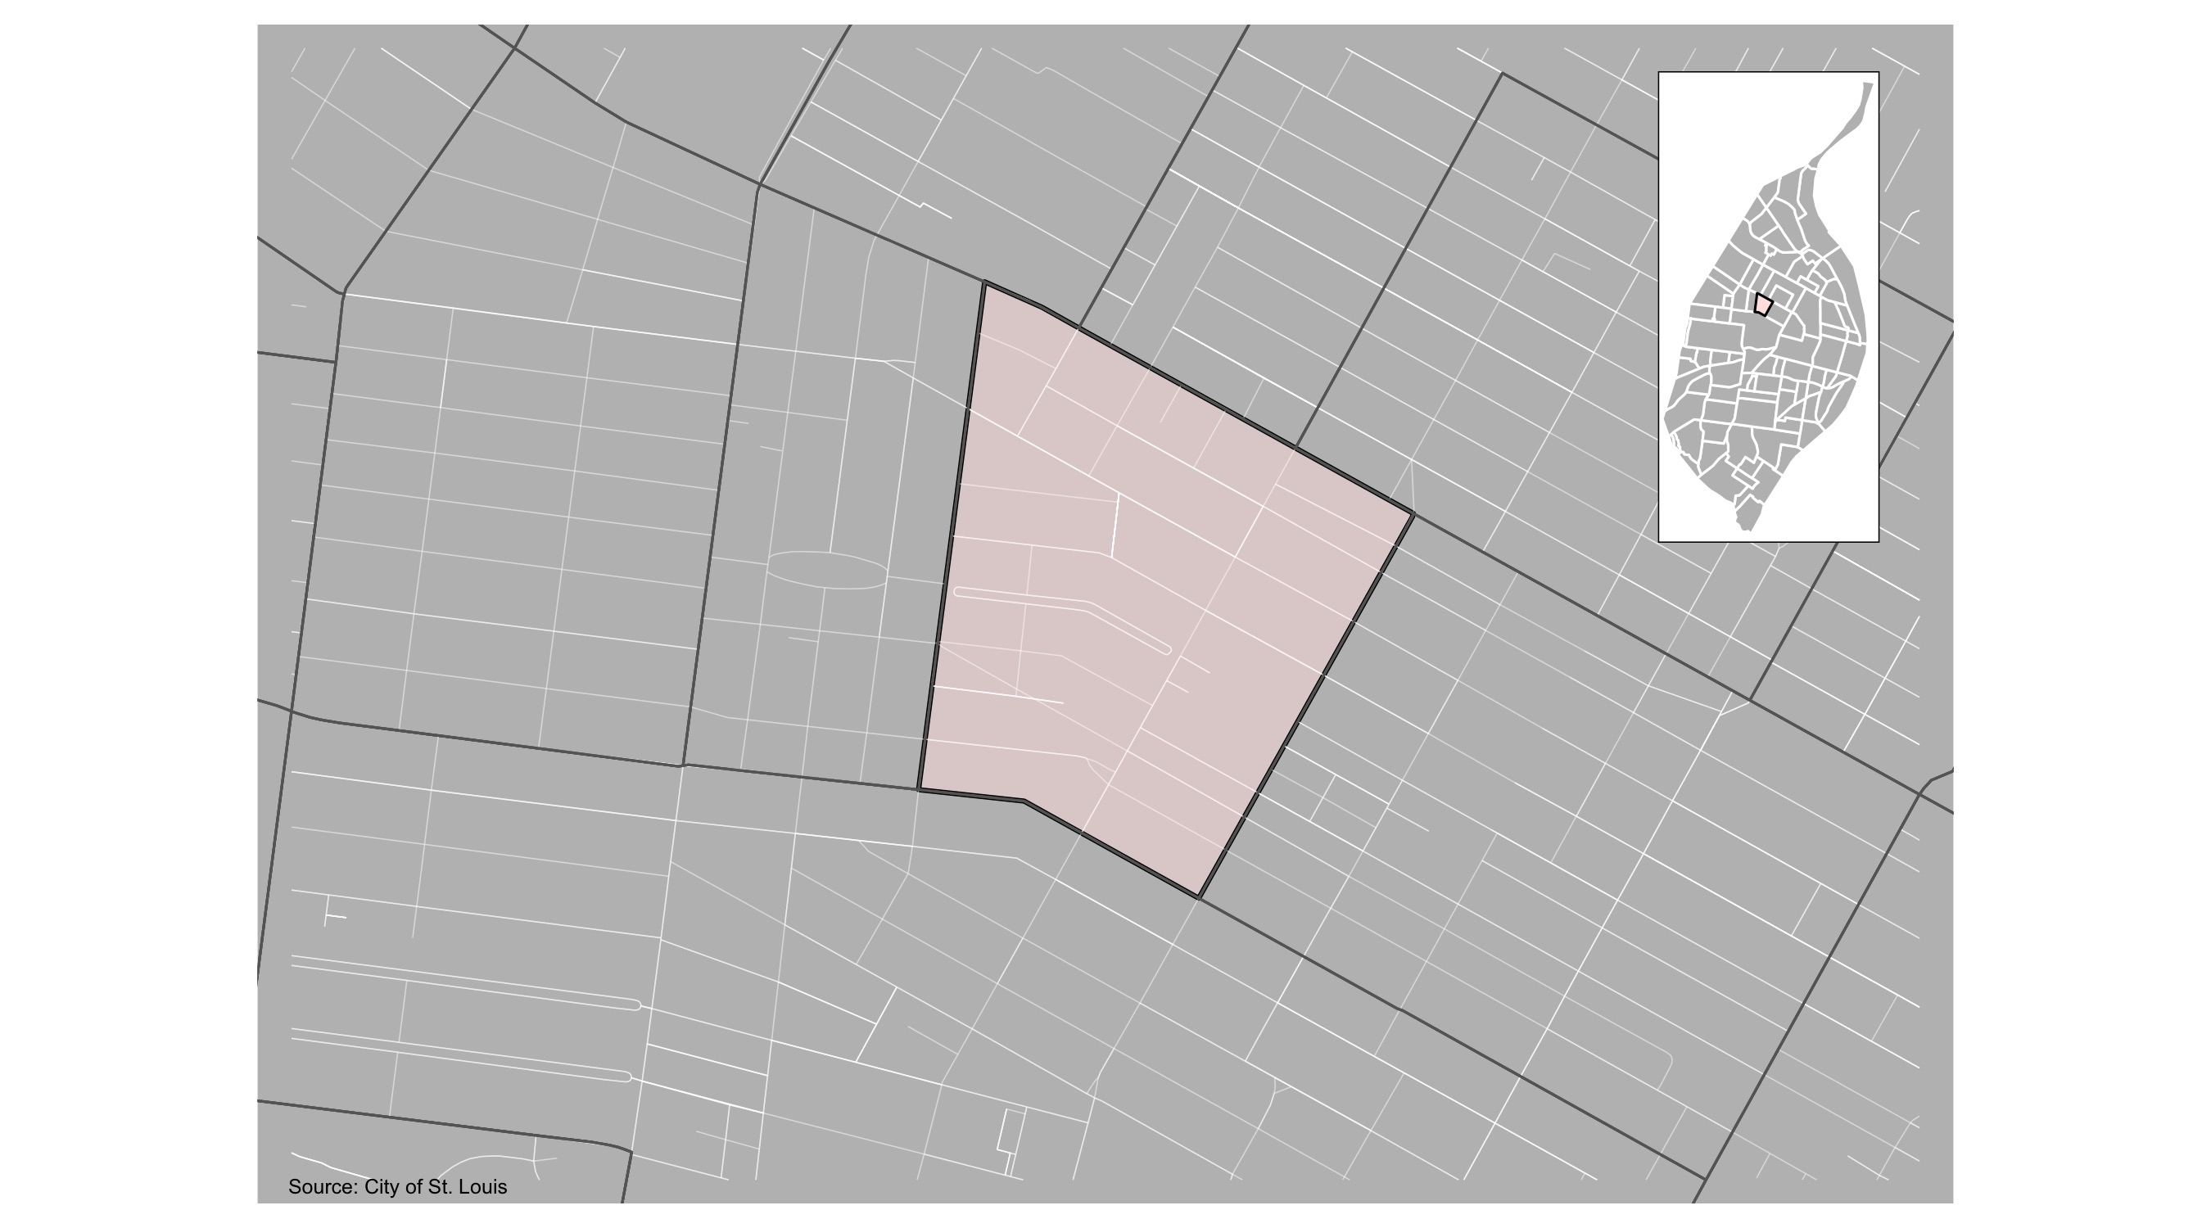
Lewis Place

Slide 25
Lewis Place: Summary Notes
11 total crimes in December 2021
3 crime(s) against persons
6 crime(s) against property
2 crime(s) against society
0 unspecified crimes

Slide 26
Lewis Place
Type of Crime | Jan | Feb | Mar | Apr | May | Jun | Jul | Aug | Sep | Oct | Nov | Dec
Person | 1 | 1 | 0 | 2 | 3 | 1 | 3 | 2 | 4 | 1 | 3 | 6
Property | 7 | 10 | 5 | 8 | 9 | 8 | 6 | 13 | 7 | 8 | 6 | 6
Society | 2 | 0 | 3 | 2 | 4 | 3 | 2 | 5 | 6 | 1 | 2 | 5
Unspecified | 0 | 0 | 0 | 0 | 0 | 0 | 0 | 0 | 0 | 0 | 0 | 0
Total | 10 | 11 | 8 | 12 | 16 | 12 | 11 | 20 | 17 | 10 | 11 | 17

Slide 27
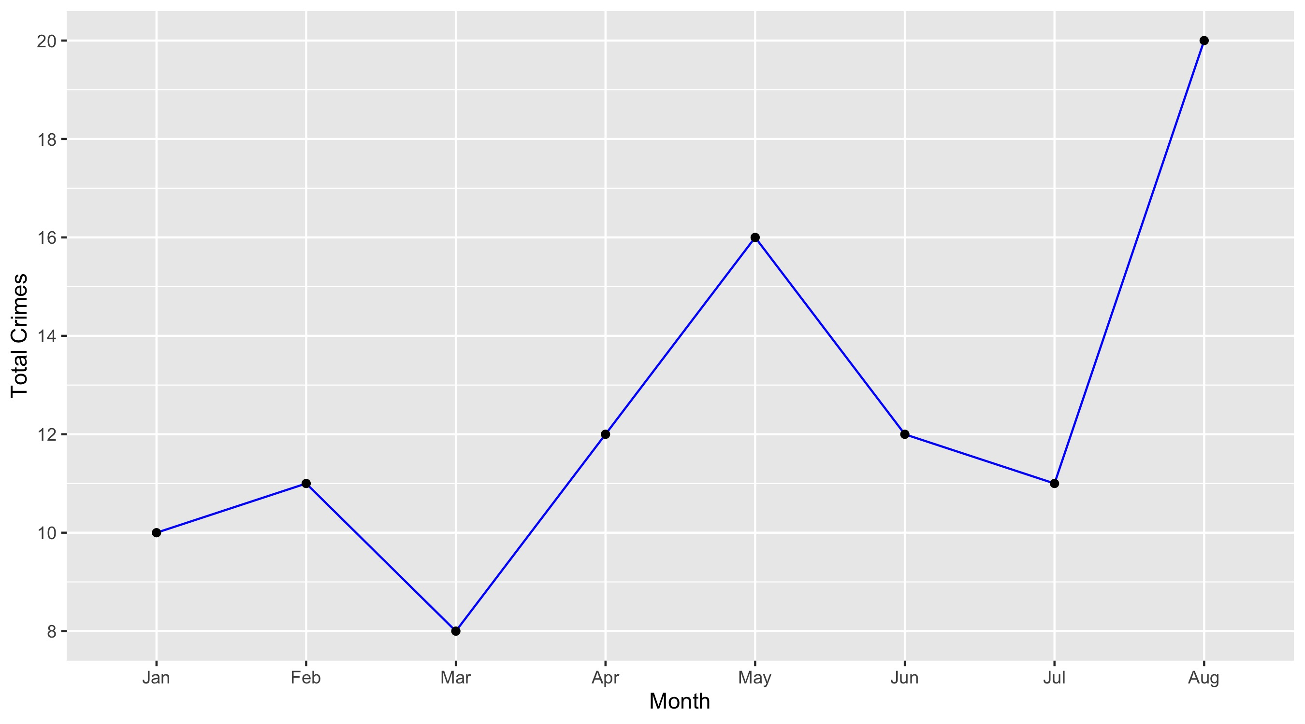
Lewis Place

Slide 28
Lewis Place: Property Crimes
Crime | Jan | Feb | Mar | Apr | May | Jun | Jul | Aug | Sep | Oct | Nov | Dec | Total
Robbery | 0 | 1 | 0 | 0 | 0 | 0 | 0 | 1 | 0 | 0 | 0 | 1 | 3
Arson | 0 | 0 | 0 | 0 | 0 | 0 | 1 | 0 | 1 | 0 | 0 | 0 | 2
Extortion/Blackmail | 0 | 0 | 0 | 0 | 0 | 0 | 0 | 0 | 0 | 0 | 0 | 0 | 0
Burglary/Breaking and Entering | 1 | 1 | 0 | 2 | 1 | 1 | 1 | 2 | 2 | 1 | 1 | 0 | 13
Pocket-picking | 0 | 0 | 0 | 0 | 0 | 0 | 0 | 0 | 0 | 0 | 0 | 0 | 0
Purse-snatching | 0 | 0 | 0 | 0 | 0 | 0 | 0 | 0 | 0 | 0 | 0 | 0 | 0
Shoplifting | 0 | 0 | 0 | 0 | 0 | 0 | 0 | 0 | 0 | 0 | 0 | 0 | 0
Theft From Building | 1 | 1 | 0 | 0 | 1 | 1 | 1 | 2 | 0 | 0 | 0 | 1 | 8
Theft From Coin-Operated Machine or Device | 0 | 0 | 0 | 0 | 0 | 0 | 0 | 0 | 0 | 0 | 0 | 0 | 0
Theft From MV | 0 | 0 | 0 | 0 | 0 | 0 | 0 | 0 | 0 | 0 | 1 | 0 | 1
Theft From MV Parts/Accessories | 0 | 2 | 0 | 3 | 1 | 1 | 0 | 2 | 1 | 0 | 2 | 0 | 12
All Other Larceny | 1 | 1 | 2 | 0 | 1 | 1 | 0 | 0 | 0 | 0 | 0 | 1 | 7
MV Theft | 2 | 1 | 0 | 0 | 2 | 1 | 0 | 1 | 1 | 2 | 0 | 0 | 10
Counterfeiting/Forgery | 0 | 0 | 0 | 0 | 0 | 0 | 0 | 0 | 1 | 0 | 0 | 0 | 1
False Pretense/Swindle/Confidence Game | 0 | 0 | 0 | 0 | 0 | 0 | 0 | 0 | 0 | 0 | 0 | 0 | 0
Credit Card/ATM Fraud | 0 | 0 | 0 | 0 | 0 | 1 | 0 | 0 | 0 | 0 | 0 | 0 | 1
Impersonation | 0 | 0 | 0 | 0 | 0 | 0 | 0 | 0 | 0 | 0 | 0 | 0 | 0
Welfare Fraud | 0 | 0 | 0 | 0 | 0 | 0 | 0 | 0 | 0 | 0 | 0 | 0 | 0
Wire Fraud | 0 | 0 | 0 | 0 | 0 | 0 | 0 | 0 | 0 | 0 | 0 | 0 | 0

Slide 29
Lewis Place: Property Crimes
Crime | Jan | Feb | Mar | Apr | May | Jun | Jul | Aug | Sep | Oct | Nov | Dec | Total
Identity Theft | 0 | 0 | 0 | 0 | 0 | 0 | 0 | 0 | 0 | 0 | 0 | 0 | 0
Hacking/Computer Invasion | 0 | 0 | 0 | 0 | 0 | 0 | 0 | 0 | 0 | 0 | 0 | 0 | 0
Embezzlement | 0 | 0 | 0 | 0 | 0 | 0 | 0 | 0 | 0 | 0 | 0 | 0 | 0
Stolen Property Offenses | 1 | 0 | 0 | 0 | 0 | 0 | 0 | 2 | 0 | 0 | 0 | 0 | 3
Destruction/Damage/Vandalism of Property | 1 | 3 | 3 | 3 | 3 | 2 | 3 | 3 | 1 | 5 | 2 | 3 | 32
Bribery | 0 | 0 | 0 | 0 | 0 | 0 | 0 | 0 | 0 | 0 | 0 | 0 | 0
Total | 7 | 10 | 5 | 8 | 9 | 8 | 6 | 13 | 7 | 8 | 6 | 6 | 93

Slide 30
Lewis Place: Society Crimes
Crime | Jan | Feb | Mar | Apr | May | Jun | Jul | Aug | Sep | Oct | Nov | Dec | Total
Drug/Narcotic Violations | 2 | 0 | 1 | 1 | 1 | 1 | 0 | 1 | 2 | 0 | 0 | 0 | 9
Drug Equipment Violations | 0 | 0 | 0 | 1 | 0 | 0 | 0 | 1 | 1 | 0 | 0 | 0 | 3
Pornography/Obscene Material | 0 | 0 | 0 | 0 | 0 | 0 | 0 | 0 | 0 | 0 | 0 | 0 | 0
Betting/Wagering | 0 | 0 | 0 | 0 | 0 | 0 | 0 | 0 | 0 | 0 | 0 | 0 | 0
Operating/Promoting/Assisting Gambling | 0 | 0 | 0 | 0 | 0 | 0 | 0 | 0 | 0 | 0 | 0 | 0 | 0
Gambling Equipment Violations | 0 | 0 | 0 | 0 | 0 | 0 | 0 | 0 | 0 | 0 | 0 | 0 | 0
Sports Tampering | 0 | 0 | 0 | 0 | 0 | 0 | 0 | 0 | 0 | 0 | 0 | 0 | 0
Prostitution | 0 | 0 | 0 | 0 | 0 | 0 | 0 | 0 | 0 | 0 | 0 | 0 | 0
Assisting or Promoting Prostitution | 0 | 0 | 0 | 0 | 0 | 0 | 0 | 0 | 0 | 0 | 0 | 0 | 0
Purchasing Prostitution | 0 | 0 | 0 | 0 | 0 | 0 | 0 | 0 | 0 | 0 | 0 | 0 | 0
Weapons Law Violations | 0 | 0 | 2 | 0 | 3 | 1 | 2 | 1 | 3 | 1 | 2 | 4 | 19
Animal Cruelty | 0 | 0 | 0 | 0 | 0 | 0 | 0 | 0 | 0 | 0 | 0 | 0 | 0
Curfew/Loitering/Vagrancy Violations | 0 | 0 | 0 | 0 | 0 | 0 | 0 | 0 | 0 | 0 | 0 | 0 | 0
Disorderly Conduct | 0 | 0 | 0 | 0 | 0 | 1 | 0 | 1 | 0 | 0 | 0 | 1 | 3
Driving Under the Influence | 0 | 0 | 0 | 0 | 0 | 0 | 0 | 0 | 0 | 0 | 0 | 0 | 0
Drunkeness | 0 | 0 | 0 | 0 | 0 | 0 | 0 | 0 | 0 | 0 | 0 | 0 | 0
Family Offenses, Nonviolent | 0 | 0 | 0 | 0 | 0 | 0 | 0 | 1 | 0 | 0 | 0 | 0 | 1
Liquor Law Violations | 0 | 0 | 0 | 0 | 0 | 0 | 0 | 0 | 0 | 0 | 0 | 0 | 0
Peeping Tom | 0 | 0 | 0 | 0 | 0 | 0 | 0 | 0 | 0 | 0 | 0 | 0 | 0
Total | 2 | 0 | 3 | 2 | 4 | 3 | 2 | 5 | 6 | 1 | 2 | 5 | 35

Slide 31
Lewis Place: Person Crimes
Crime | Jan | Feb | Mar | Apr | May | Jun | Jul | Aug | Sep | Oct | Nov | Dec | Total
Murder and Nonnegligent Manslaughter | 0 | 0 | 0 | 1 | 1 | 0 | 0 | 0 | 0 | 0 | 0 | 1 | 3
Negligent Manslaughter | 0 | 0 | 0 | 0 | 0 | 0 | 0 | 0 | 0 | 0 | 0 | 0 | 0
Justifiable Homicide | 0 | 0 | 0 | 0 | 0 | 0 | 0 | 0 | 0 | 0 | 0 | 0 | 0
Suicide | 0 | 0 | 0 | 0 | 0 | 0 | 0 | 0 | 0 | 0 | 0 | 0 | 0
Kidnapping/Abduction | 0 | 0 | 0 | 0 | 0 | 0 | 0 | 0 | 0 | 0 | 0 | 0 | 0
Rape | 0 | 0 | 0 | 0 | 0 | 0 | 0 | 0 | 0 | 0 | 0 | 1 | 1
Sodomy | 0 | 0 | 0 | 0 | 0 | 0 | 0 | 0 | 0 | 0 | 0 | 0 | 0
Sexual Assault with an Object | 0 | 0 | 0 | 0 | 0 | 0 | 0 | 0 | 0 | 0 | 0 | 0 | 0
Fondling | 0 | 0 | 0 | 0 | 0 | 0 | 0 | 0 | 0 | 0 | 0 | 0 | 0
Aggravated Assault | 0 | 1 | 0 | 1 | 1 | 0 | 1 | 0 | 1 | 1 | 0 | 1 | 7
Simple Assault | 1 | 0 | 0 | 0 | 1 | 1 | 2 | 1 | 3 | 0 | 3 | 3 | 15
Intimidation | 0 | 0 | 0 | 0 | 0 | 0 | 0 | 1 | 0 | 0 | 0 | 0 | 1
Incest | 0 | 0 | 0 | 0 | 0 | 0 | 0 | 0 | 0 | 0 | 0 | 0 | 0
Statutory Rape | 0 | 0 | 0 | 0 | 0 | 0 | 0 | 0 | 0 | 0 | 0 | 0 | 0
Human Trafficking, Commercial Sex Acts | 0 | 0 | 0 | 0 | 0 | 0 | 0 | 0 | 0 | 0 | 0 | 0 | 0
Total | 1 | 1 | 0 | 2 | 3 | 1 | 3 | 2 | 4 | 1 | 3 | 6 | 27

Slide 32
Lewis Place: Unspecified Crimes
Crime | Jan | Feb | Mar | Apr | May | Jun | Jul | Aug | Sep | Oct | Nov | Dec | Total
Runaway | 0 | 0 | 0 | 0 | 0 | 0 | 0 | 0 | 0 | 0 | 0 | 0 | 0
Total | 0 | 0 | 0 | 0 | 0 | 0 | 0 | 0 | 0 | 0 | 0 | 0 | 0

Slide 33
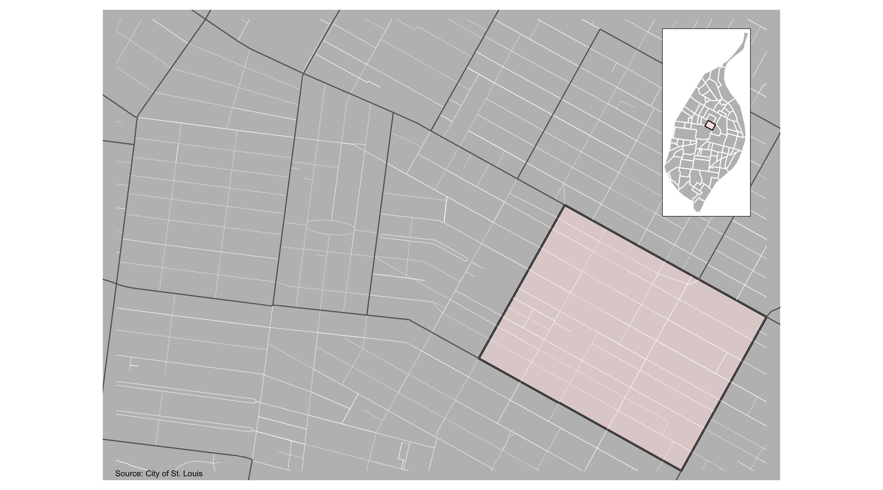
Vandeventer

Slide 34
Vandeventer: Summary Notes
20 total crimes in December 2021
10 crime(s) against persons
6 crime(s) against property
4 crime(s) against society
0 unspecified crimes

Slide 35
Vandeventer
Type of Crime | Jan | Feb | Mar | Apr | May | Jun | Jul | Aug | Sep | Oct | Nov | Dec
Person | 6 | 4 | 4 | 4 | 5 | 7 | 6 | 4 | 9 | 5 | 10 | 21
Property | 19 | 11 | 24 | 16 | 18 | 20 | 17 | 16 | 18 | 8 | 6 | 12
Society | 7 | 6 | 3 | 4 | 5 | 1 | 8 | 11 | 5 | 1 | 4 | 8
Unspecified | 0 | 0 | 0 | 0 | 0 | 0 | 0 | 0 | 0 | 0 | 0 | 0
Total | 32 | 21 | 31 | 24 | 28 | 28 | 31 | 31 | 32 | 14 | 20 | 41

Slide 36
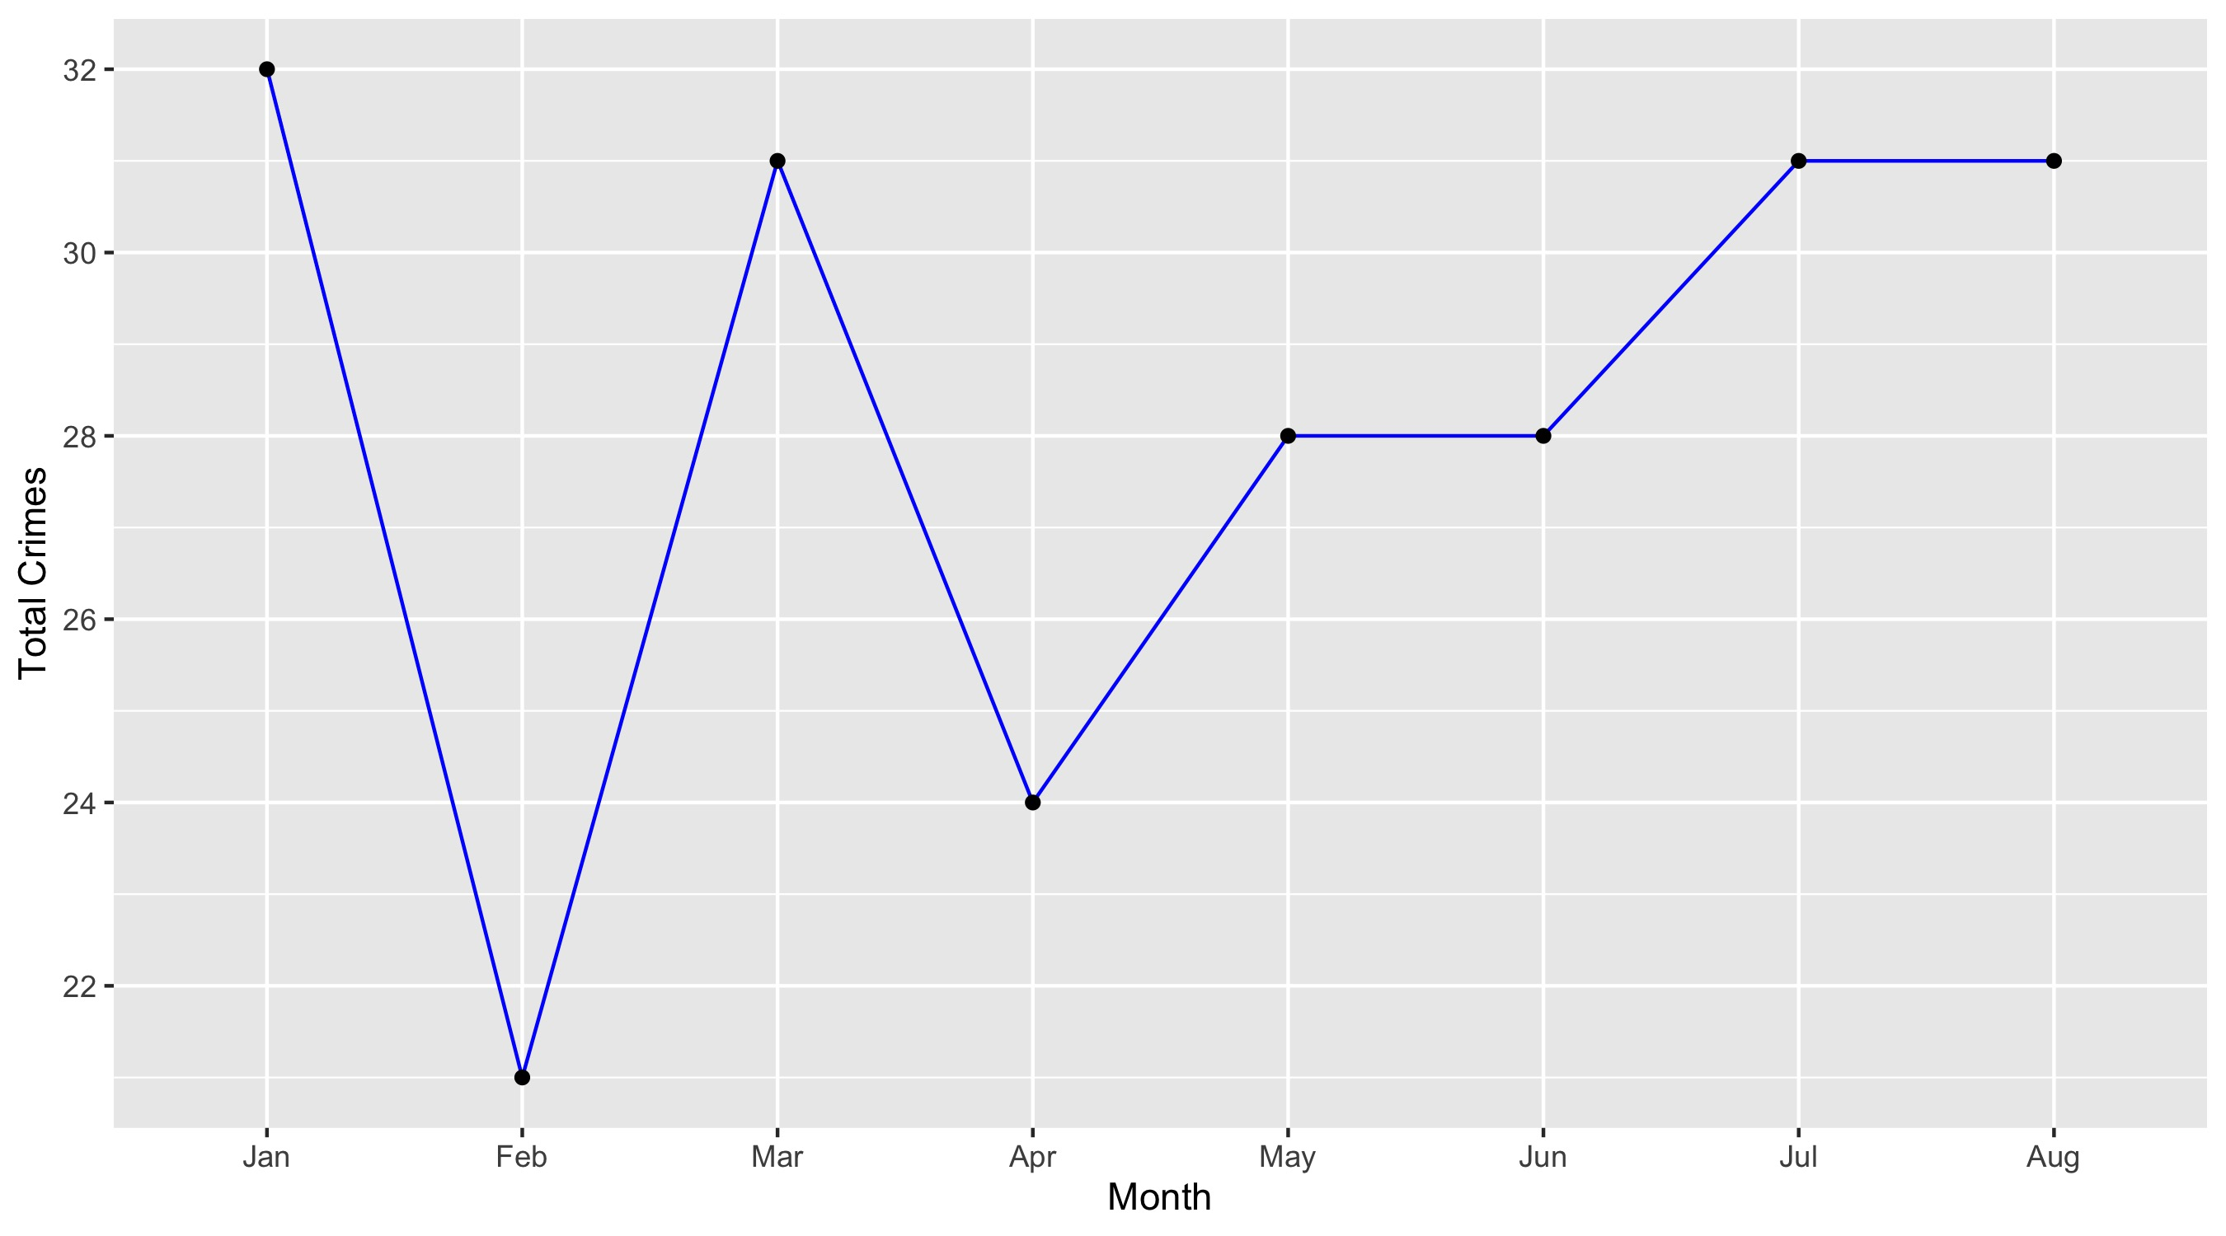
Vandeventer

Slide 37
Vandeventer: Property Crimes
Crime | Jan | Feb | Mar | Apr | May | Jun | Jul | Aug | Sep | Oct | Nov | Dec | Total
Robbery | 0 | 1 | 0 | 0 | 0 | 0 | 0 | 1 | 2 | 0 | 1 | 1 | 6
Arson | 1 | 0 | 0 | 0 | 1 | 1 | 0 | 0 | 0 | 0 | 1 | 0 | 4
Extortion/Blackmail | 0 | 0 | 0 | 0 | 0 | 0 | 0 | 0 | 0 | 0 | 0 | 0 | 0
Burglary/Breaking and Entering | 2 | 0 | 3 | 3 | 1 | 4 | 1 | 2 | 2 | 0 | 0 | 0 | 18
Pocket-picking | 1 | 0 | 0 | 0 | 1 | 0 | 0 | 0 | 0 | 0 | 0 | 0 | 2
Purse-snatching | 0 | 0 | 0 | 0 | 0 | 0 | 0 | 0 | 0 | 0 | 0 | 0 | 0
Shoplifting | 0 | 0 | 0 | 1 | 0 | 0 | 0 | 0 | 0 | 0 | 0 | 0 | 1
Theft From Building | 2 | 1 | 1 | 2 | 2 | 0 | 0 | 1 | 2 | 1 | 0 | 0 | 12
Theft From Coin-Operated Machine or Device | 0 | 0 | 0 | 0 | 0 | 0 | 0 | 0 | 0 | 0 | 0 | 0 | 0
Theft From MV | 3 | 0 | 3 | 2 | 1 | 1 | 0 | 0 | 1 | 1 | 1 | 0 | 13
Theft From MV Parts/Accessories | 0 | 2 | 4 | 4 | 3 | 2 | 2 | 0 | 1 | 0 | 0 | 0 | 18
All Other Larceny | 4 | 3 | 4 | 0 | 1 | 5 | 4 | 1 | 2 | 2 | 0 | 2 | 28
MV Theft | 3 | 2 | 1 | 1 | 0 | 1 | 3 | 2 | 2 | 1 | 0 | 1 | 17
Counterfeiting/Forgery | 0 | 0 | 0 | 0 | 0 | 0 | 0 | 0 | 0 | 0 | 0 | 1 | 1
False Pretense/Swindle/Confidence Game | 0 | 0 | 0 | 0 | 0 | 0 | 0 | 0 | 0 | 0 | 0 | 0 | 0
Credit Card/ATM Fraud | 1 | 0 | 0 | 0 | 0 | 0 | 0 | 1 | 0 | 0 | 0 | 0 | 2
Impersonation | 0 | 0 | 0 | 0 | 0 | 0 | 0 | 0 | 0 | 0 | 0 | 0 | 0
Welfare Fraud | 0 | 0 | 0 | 0 | 0 | 0 | 0 | 0 | 0 | 0 | 0 | 0 | 0
Wire Fraud | 0 | 0 | 0 | 0 | 0 | 0 | 0 | 0 | 0 | 0 | 0 | 0 | 0

Slide 38
Vandeventer: Property Crimes
Crime | Jan | Feb | Mar | Apr | May | Jun | Jul | Aug | Sep | Oct | Nov | Dec | Total
Identity Theft | 0 | 0 | 0 | 0 | 0 | 0 | 0 | 0 | 0 | 0 | 0 | 0 | 0
Hacking/Computer Invasion | 0 | 0 | 0 | 0 | 0 | 0 | 0 | 0 | 0 | 0 | 0 | 0 | 0
Embezzlement | 0 | 0 | 0 | 0 | 0 | 0 | 0 | 0 | 0 | 0 | 0 | 0 | 0
Stolen Property Offenses | 0 | 0 | 0 | 0 | 1 | 0 | 2 | 1 | 1 | 0 | 0 | 2 | 7
Destruction/Damage/Vandalism of Property | 2 | 2 | 8 | 3 | 7 | 6 | 5 | 7 | 5 | 3 | 3 | 5 | 56
Bribery | 0 | 0 | 0 | 0 | 0 | 0 | 0 | 0 | 0 | 0 | 0 | 0 | 0
Total | 19 | 11 | 24 | 16 | 18 | 20 | 17 | 16 | 18 | 8 | 6 | 12 | 185

Slide 39
Vandeventer: Society Crimes
Crime | Jan | Feb | Mar | Apr | May | Jun | Jul | Aug | Sep | Oct | Nov | Dec | Total
Drug/Narcotic Violations | 3 | 2 | 1 | 1 | 1 | 0 | 2 | 4 | 3 | 0 | 1 | 4 | 22
Drug Equipment Violations | 0 | 0 | 0 | 1 | 0 | 0 | 1 | 0 | 1 | 0 | 1 | 0 | 4
Pornography/Obscene Material | 0 | 0 | 0 | 0 | 0 | 0 | 0 | 0 | 0 | 0 | 0 | 0 | 0
Betting/Wagering | 0 | 0 | 0 | 0 | 0 | 0 | 0 | 0 | 0 | 0 | 0 | 0 | 0
Operating/Promoting/Assisting Gambling | 0 | 0 | 0 | 0 | 0 | 0 | 0 | 0 | 0 | 0 | 0 | 0 | 0
Gambling Equipment Violations | 0 | 0 | 0 | 0 | 0 | 0 | 0 | 0 | 0 | 0 | 0 | 0 | 0
Sports Tampering | 0 | 0 | 0 | 0 | 0 | 0 | 0 | 0 | 0 | 0 | 0 | 0 | 0
Prostitution | 0 | 0 | 0 | 0 | 0 | 0 | 0 | 0 | 0 | 0 | 0 | 0 | 0
Assisting or Promoting Prostitution | 0 | 0 | 0 | 0 | 0 | 0 | 0 | 0 | 0 | 0 | 0 | 0 | 0
Purchasing Prostitution | 0 | 0 | 0 | 0 | 0 | 0 | 0 | 0 | 0 | 0 | 0 | 0 | 0
Weapons Law Violations | 4 | 2 | 2 | 1 | 1 | 1 | 4 | 4 | 0 | 1 | 2 | 4 | 26
Animal Cruelty | 0 | 0 | 0 | 0 | 0 | 0 | 0 | 0 | 0 | 0 | 0 | 0 | 0
Curfew/Loitering/Vagrancy Violations | 0 | 0 | 0 | 0 | 0 | 0 | 0 | 0 | 0 | 0 | 0 | 0 | 0
Disorderly Conduct | 0 | 1 | 0 | 1 | 3 | 0 | 1 | 3 | 0 | 0 | 0 | 0 | 9
Driving Under the Influence | 0 | 1 | 0 | 0 | 0 | 0 | 0 | 0 | 1 | 0 | 0 | 0 | 2
Drunkeness | 0 | 0 | 0 | 0 | 0 | 0 | 0 | 0 | 0 | 0 | 0 | 0 | 0
Family Offenses, Nonviolent | 0 | 0 | 0 | 0 | 0 | 0 | 0 | 0 | 0 | 0 | 0 | 0 | 0
Liquor Law Violations | 0 | 0 | 0 | 0 | 0 | 0 | 0 | 0 | 0 | 0 | 0 | 0 | 0
Peeping Tom | 0 | 0 | 0 | 0 | 0 | 0 | 0 | 0 | 0 | 0 | 0 | 0 | 0
Total | 7 | 6 | 3 | 4 | 5 | 1 | 8 | 11 | 5 | 1 | 4 | 8 | 63

Slide 40
Vandeventer: Person Crimes
Crime | Jan | Feb | Mar | Apr | May | Jun | Jul | Aug | Sep | Oct | Nov | Dec | Total
Murder and Nonnegligent Manslaughter | 0 | 0 | 0 | 1 | 0 | 0 | 0 | 0 | 1 | 0 | 1 | 0 | 3
Negligent Manslaughter | 0 | 0 | 0 | 0 | 0 | 0 | 0 | 0 | 0 | 0 | 0 | 0 | 0
Justifiable Homicide | 0 | 0 | 0 | 0 | 0 | 0 | 0 | 0 | 0 | 0 | 0 | 0 | 0
Suicide | 0 | 0 | 0 | 0 | 0 | 0 | 0 | 0 | 0 | 0 | 0 | 0 | 0
Kidnapping/Abduction | 0 | 0 | 0 | 0 | 0 | 0 | 0 | 0 | 0 | 0 | 0 | 0 | 0
Rape | 0 | 0 | 0 | 0 | 0 | 0 | 0 | 0 | 0 | 0 | 0 | 0 | 0
Sodomy | 0 | 0 | 0 | 0 | 0 | 0 | 0 | 0 | 0 | 0 | 0 | 1 | 1
Sexual Assault with an Object | 0 | 0 | 0 | 0 | 0 | 0 | 0 | 0 | 0 | 0 | 0 | 0 | 0
Fondling | 0 | 0 | 0 | 0 | 0 | 0 | 0 | 0 | 0 | 0 | 0 | 0 | 0
Aggravated Assault | 4 | 3 | 2 | 2 | 1 | 4 | 4 | 4 | 5 | 3 | 6 | 15 | 53
Simple Assault | 2 | 1 | 2 | 1 | 4 | 3 | 2 | 0 | 1 | 2 | 2 | 4 | 24
Intimidation | 0 | 0 | 0 | 0 | 0 | 0 | 0 | 0 | 2 | 0 | 1 | 0 | 3
Incest | 0 | 0 | 0 | 0 | 0 | 0 | 0 | 0 | 0 | 0 | 0 | 0 | 0
Statutory Rape | 0 | 0 | 0 | 0 | 0 | 0 | 0 | 0 | 0 | 0 | 0 | 1 | 1
Human Trafficking, Commercial Sex Acts | 0 | 0 | 0 | 0 | 0 | 0 | 0 | 0 | 0 | 0 | 0 | 0 | 0
Total | 6 | 4 | 4 | 4 | 5 | 7 | 6 | 4 | 9 | 5 | 10 | 21 | 85

Slide 41
Vandeventer: Unspecified Crimes
Crime | Jan | Feb | Mar | Apr | May | Jun | Jul | Aug | Sep | Oct | Nov | Dec | Total
Runaway | 0 | 0 | 0 | 0 | 0 | 0 | 0 | 0 | 0 | 0 | 0 | 0 | 0
Total | 0 | 0 | 0 | 0 | 0 | 0 | 0 | 0 | 0 | 0 | 0 | 0 | 0

