Slide 1
Academy, Fountain Park, Lewis Place, Vandeventer
Monthly Crime Report: February 2022
Washington University Medical Center

Slide 2
History of Crime Reporting
Since the 1929 the Uniform Crime Report (UCR) has used a Summary Reporting System (SRS) to collect monthly counts of the number of crimes
In 1982 the Bureau of Justice Statistics and the FBI sponsored a study with the objective of revising the existing form of reporting crime. Through this, the National Incident Based Reporting System (NIBRS) was created
The FBI UCR Program transitioned to a NIBRS only data collection by January 1, 2021. Other states have followed suit and SLMPD has been working to make this same transition

Slide 3
NIBRS vs SRS
NIBRS captures details on each single crime incident—as well as on separate offenses within the same incident—including information on victims, known offenders, relationships between victims and offenders, arrestees, and property involved in crimes
Standardizes crime reporting across all local, state, and tribal law enforcement agencies
SRS only counted the most serious offense (i.e. if a murder and robbery occurred, only the murder is counted) while NIBRS counts up to 10 crimes per incident
Current NIBRS reporting are not directly comparable to the previous UCR “hierarchy” numbers. With this change, you will likely see increases in crime statistics. This increase does not mean that crime is necessarily increasing, but rather that crime is being reported in a non-hierarchical format, with more detail and counting each individual crime

Slide 4
NIBRS and SLMPD
Unforeseen technology delays and the incompatibility in comparing crime (NIRBS V. UCR) has caused delays in making the crime information available
The City of St Louis Information Technology Division (I.T.) has created a series of internal 2021 NIBRS reports
Because of this transition information is limited to counts of each crime by neighborhood

Slide 5
Expanded Service Area

Slide 6
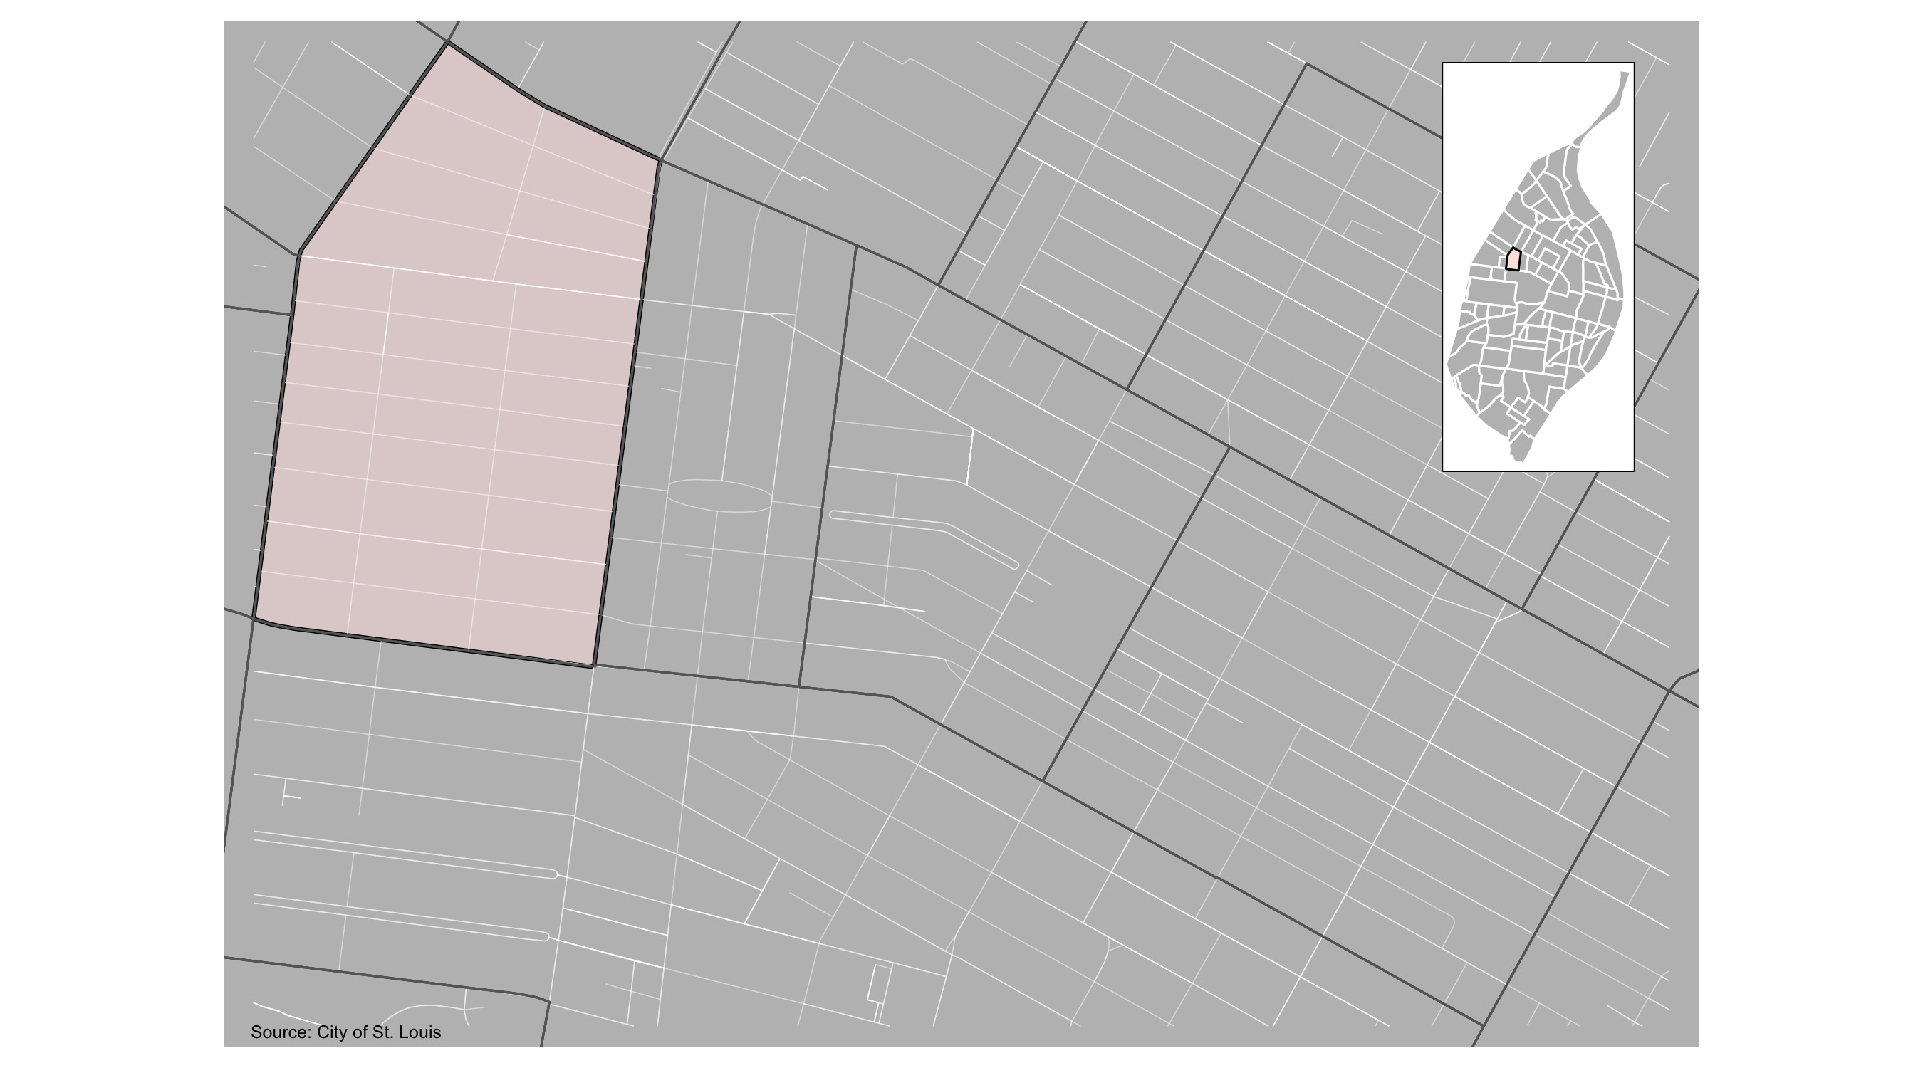
Academy

Slide 7
Academy: Month Summary Notes
38 total crimes in February 2022
171% change compared to February 2021 (14 total crimes)
5 crime(s) against persons in February 2022
67% change compared to February 2021 (3 crimes against persons)
6 crime(s) against society in February 2022
200% change compared to February 2021 (2 crimes against society)
20 crime(s) against propety in February 2022
122% change compared to February 2021 (9 crimes against property)
7 unspecified crime(s) in February 2022
Infinite change compared to February 2021 (0 unspecified crimes)

Slide 8
Academy: Year to Date Summary Notes
68 total crimes in 2022
196% change compared to this time in 2021 (23 total crimes)
14 crime(s) against persons in 2022
250% change compared to this time in 2021 (4 crimes against persons)
9 crime(s) against society in 2022
200% change compared to this time in 2021 (3 crimes against society)
33 crime(s) against property in 2022
154% change compared to this time in 2021 (13 crimes against property)
12 unspecified crime(s) in 2022
300% change compared to this time in 2021 (4 unspecified crimes)

Slide 9
Academy
2022 | 2022 | 2022 | 2022
Type of Crime | Jan | Feb | Total
Person | 9 | 5 | 14
Property | 13 | 20 | 33
Society | 3 | 6 | 9
Unspecified | 5 | 7 | 12
Total | 30 | 38 | 68
Type of Crime | Jan | Feb | Total
Person | 1 | 3 | 4
Property | 4 | 9 | 13
Society | 1 | 2 | 3
Unspecified | 3 | 0 | 3
Total | 9 | 14 | 23

Slide 10
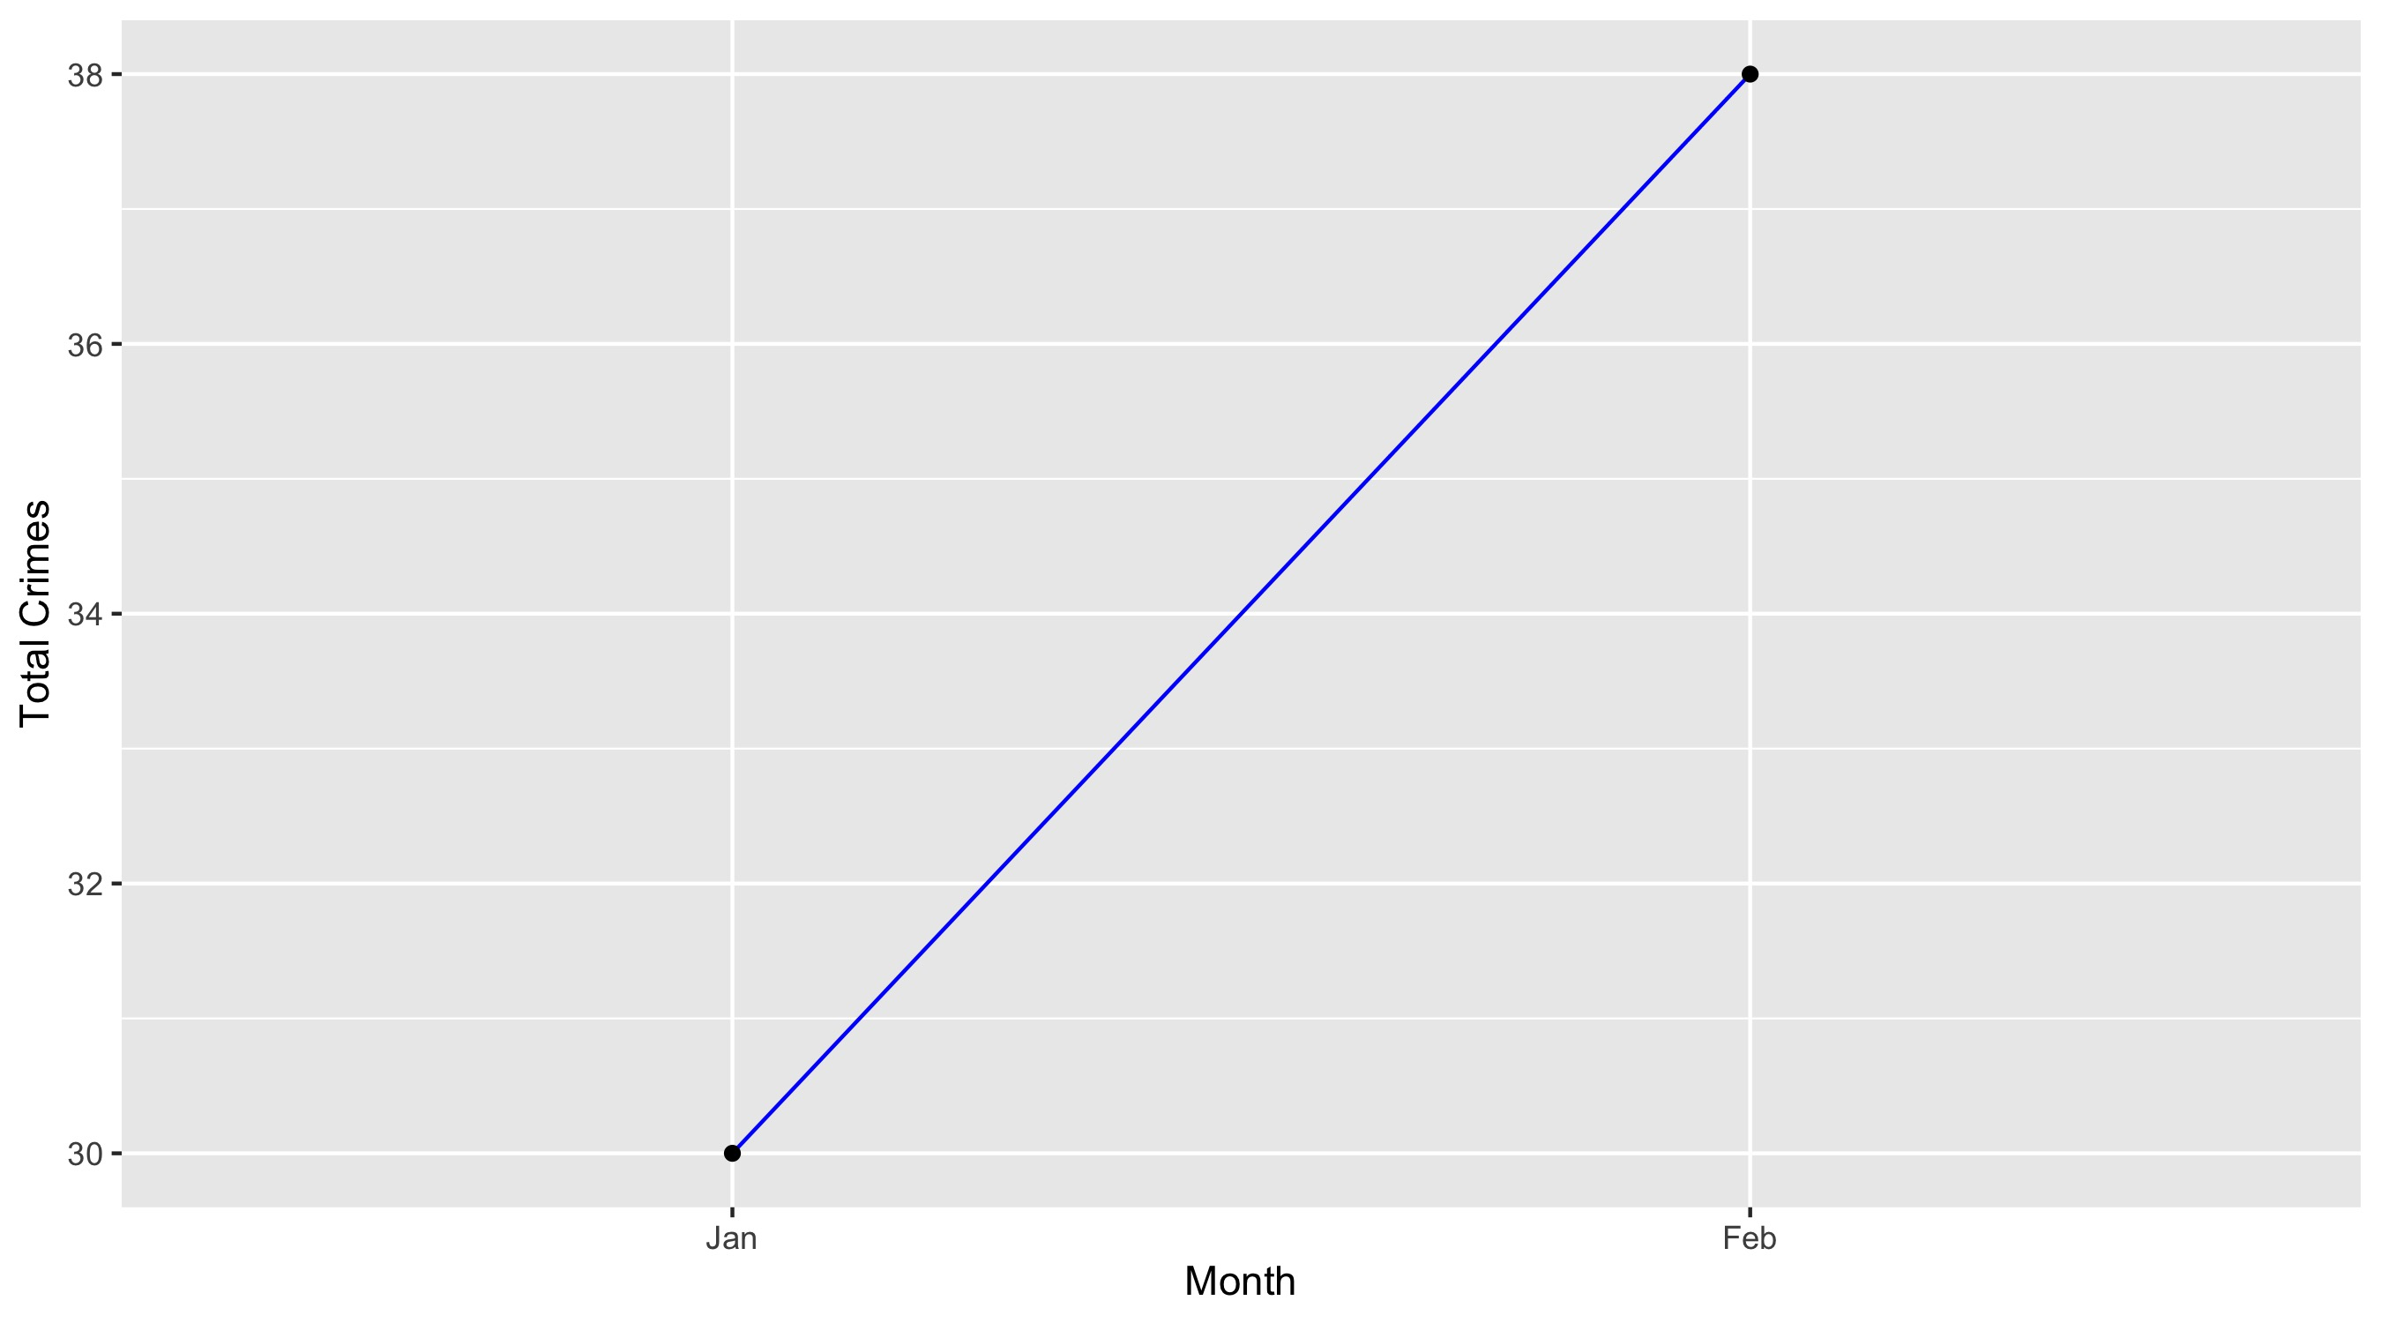
Academy

Slide 11
Academy: Property Crimes
Crime | Jan | Feb | Total
Robbery | 2 | 4 | 6
Arson | 1 | 0 | 1
Extortion/Blackmail | 0 | 0 | 0
Burglary/Breaking and Entering | 2 | 2 | 4
Pocket-picking | 0 | 0 | 0
Purse-snatching | 0 | 0 | 0
Shoplifting | 0 | 1 | 1
Theft From Building | 1 | 0 | 1
Theft From Coin-Operated Machine or Device | 0 | 0 | 0
Theft From MV | 1 | 0 | 1
Theft From MV Parts/Accessories | 0 | 2 | 2
All Other Larceny | 1 | 1 | 2
MV Theft | 1 | 3 | 4
Counterfeiting/Forgery | 0 | 0 | 0
False Pretense/Swindle/Confidence Game | 0 | 0 | 0
Credit Card/ATM Fraud | 0 | 0 | 0
Impersonation | 0 | 0 | 0
Welfare Fraud | 0 | 0 | 0
Wire Fraud | 0 | 0 | 0

Slide 12
Academy: Property Crimes
Crime | Jan | Feb | Total
Identity Theft | 0 | 0 | 0
Hacking/Computer Invasion | 0 | 0 | 0
Embezzlement | 0 | 0 | 0
Stolen Property Offenses | 1 | 0 | 1
Destruction/Damage/Vandalism of Property | 2 | 7 | 9
Bribery | 0 | 0 | 0
Bad Checks | 1 | 0 | 1
Total | 13 | 20 | 33

Slide 13
Academy: Society Crimes
Crime | Jan | Feb | Total
Drug/Narcotic Violations | 1 | 1 | 2
Drug Equipment Violations | 0 | 0 | 0
Pornography/Obscene Material | 0 | 0 | 0
Betting/Wagering | 0 | 0 | 0
Operating/Promoting/Assisting Gambling | 0 | 0 | 0
Gambling Equipment Violations | 0 | 0 | 0
Sports Tampering | 0 | 0 | 0
Prostitution | 0 | 0 | 0
Assisting or Promoting Prostitution | 0 | 0 | 0
Purchasing Prostitution | 0 | 0 | 0
Weapons Law Violations | 2 | 4 | 6
Animal Cruelty | 0 | 0 | 0
Curfew/Loitering/Vagrancy Violations | 0 | 0 | 0
Disorderly Conduct | 0 | 1 | 1
Driving Under the Influence | 0 | 0 | 0
Drunkeness | 0 | 0 | 0
Family Offenses, Nonviolent | 0 | 0 | 0
Liquor Law Violations | 0 | 0 | 0
Peeping Tom | 0 | 0 | 0
Trespass of Real Property | 0 | 0 | 0
Total | 3 | 6 | 9

Slide 14
Academy: Person Crimes
Crime | Jan | Feb | Total
Murder and Nonnegligent Manslaughter | 0 | 0 | 0
Negligent Manslaughter | 0 | 0 | 0
Justifiable Homicide | 0 | 0 | 0
Suicide | 0 | 0 | 0
Kidnapping/Abduction | 0 | 0 | 0
Rape | 0 | 0 | 0
Sodomy | 0 | 0 | 0
Sexual Assault with an Object | 0 | 0 | 0
Fondling | 0 | 0 | 0
Aggravated Assault | 4 | 2 | 6
*Aggravated Assault with Firearm | 4 | 2 | 6
Simple Assault | 1 | 1 | 2
Intimidation | 0 | 0 | 0
Incest | 0 | 0 | 0
Statutory Rape | 0 | 0 | 0
Human Trafficking, Commercial Sex Acts | 0 | 0 | 0
Human Trafficking, Involuntary Servitude | 0 | 0 | 0
Total | 9 | 5 | 14

Slide 15
Academy: Unspecified Crimes
Crime | Jan | Feb | Total
Runaway | 0 | 0 | 0
All Other Offenses | 5 | 7 | 12
Total | 5 | 7 | 12

Slide 16
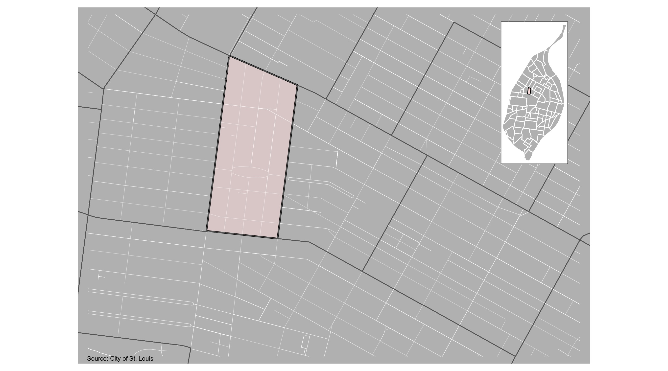
Fountain Park

Slide 17
Fountain Park: Month Summary Notes
32 total crimes in February 2022
129% change compared to February 2021 (14 total crimes)
10 crime(s) against persons in February 2022
233% change compared to February 2021 (3 crimes against persons)
10 crime(s) against society in February 2022
400% change compared to February 2021 (2 crimes against society)
10 crime(s) against propety in February 2022
11% change compared to February 2021 (9 crimes against property)
2 unspecified crime(s) in February 2022
Infinite change compared to February 2021 (0 unspecified crimes)

Slide 18
Fountain Park: Year to Date Summary Notes
70 total crimes in 2022
204% change compared to this time in 2021 (23 total crimes)
27 crime(s) against persons in 2022
575% change compared to this time in 2021 (4 crimes against persons)
18 crime(s) against society in 2022
500% change compared to this time in 2021 (3 crimes against society)
21 crime(s) against property in 2022
62% change compared to this time in 2021 (13 crimes against property)
4 unspecified crime(s) in 2022
33% change compared to this time in 2021 (4 unspecified crimes)

Slide 19
Fountain Park
2022 | 2022 | 2022 | 2022
Type of Crime | Jan | Feb | Total
Person | 17 | 10 | 27
Property | 11 | 10 | 21
Society | 8 | 10 | 18
Unspecified | 2 | 2 | 4
Total | 38 | 32 | 70
Type of Crime | Jan | Feb | Total
Person | 1 | 3 | 4
Property | 4 | 9 | 13
Society | 1 | 2 | 3
Unspecified | 3 | 0 | 3
Total | 9 | 14 | 23

Slide 20
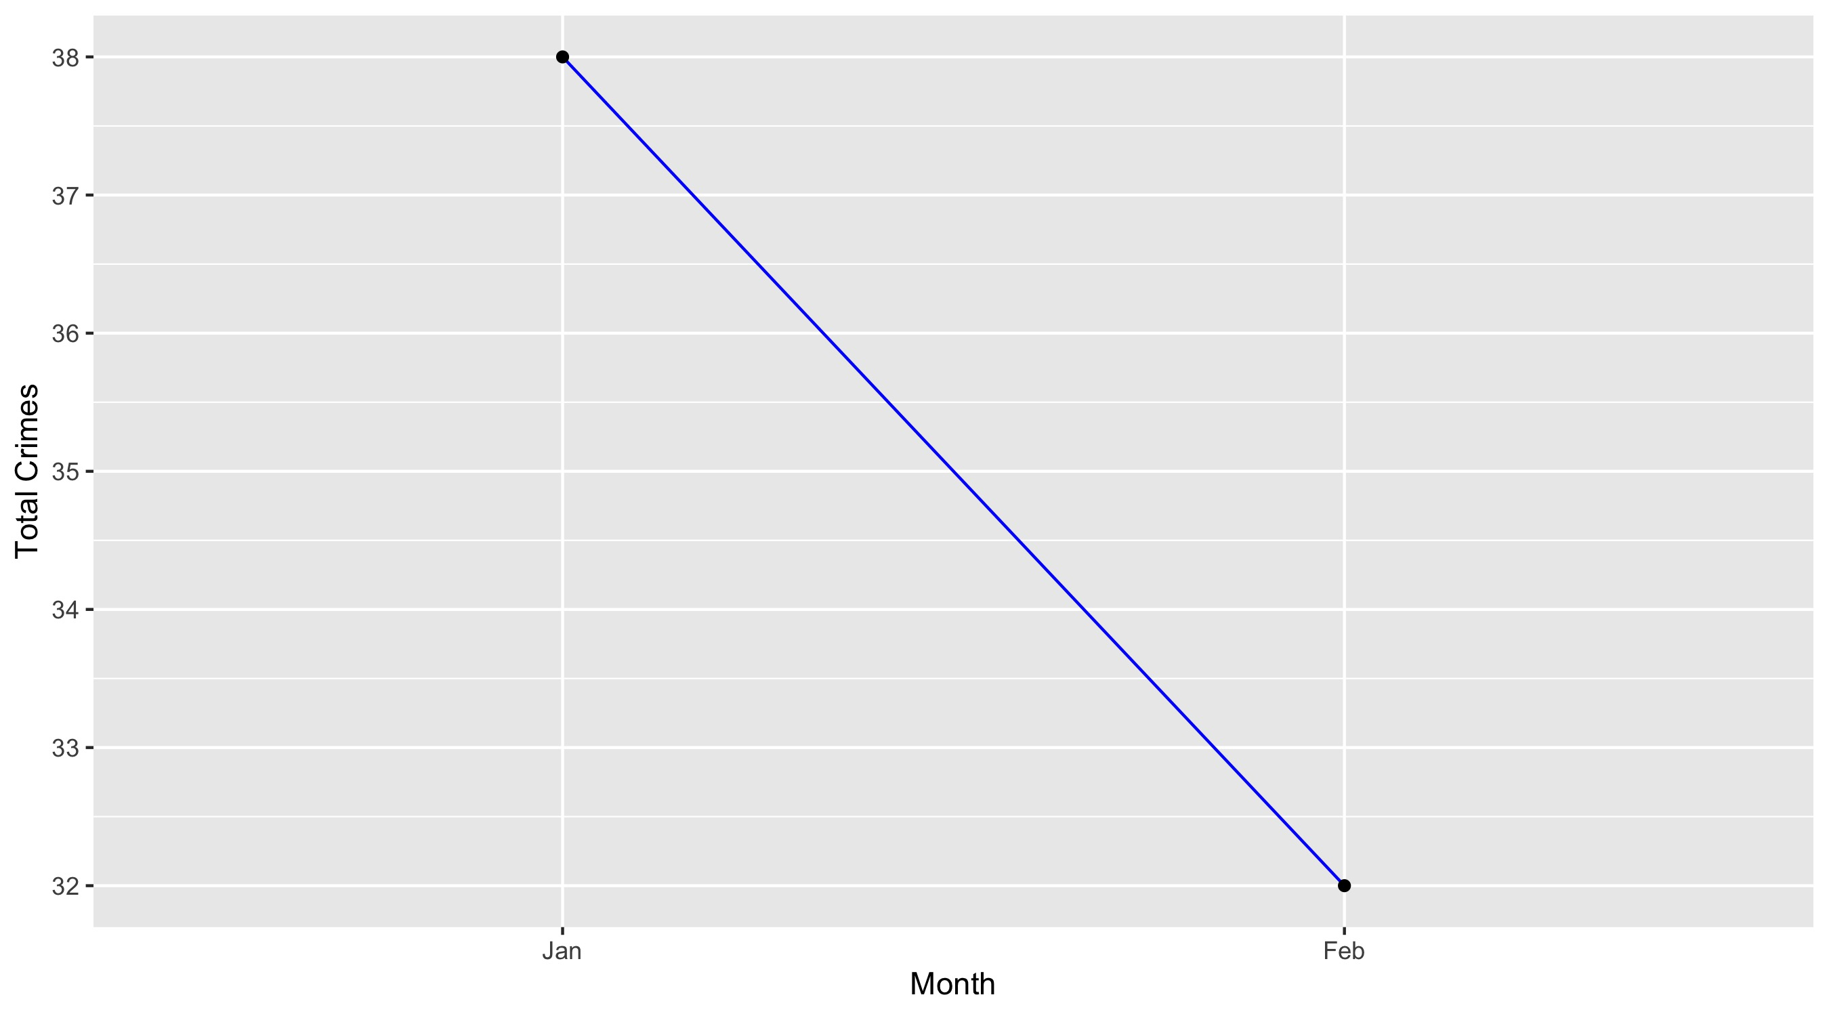
Fountain Park

Slide 21
Fountain Park: Property Crimes
Crime | Jan | Feb | Total
Robbery | 1 | 0 | 1
Arson | 0 | 0 | 0
Extortion/Blackmail | 0 | 0 | 0
Burglary/Breaking and Entering | 1 | 2 | 3
Pocket-picking | 0 | 0 | 0
Purse-snatching | 0 | 0 | 0
Shoplifting | 1 | 0 | 1
Theft From Building | 0 | 0 | 0
Theft From Coin-Operated Machine or Device | 0 | 0 | 0
Theft From MV | 1 | 1 | 2
Theft From MV Parts/Accessories | 0 | 0 | 0
All Other Larceny | 1 | 0 | 1
MV Theft | 1 | 2 | 3
Counterfeiting/Forgery | 0 | 0 | 0
False Pretense/Swindle/Confidence Game | 0 | 0 | 0
Credit Card/ATM Fraud | 0 | 0 | 0
Impersonation | 0 | 0 | 0
Welfare Fraud | 0 | 0 | 0
Wire Fraud | 0 | 0 | 0

Slide 22
Fountain Park: Property Crimes
Crime | Jan | Feb | Total
Identity Theft | 0 | 0 | 0
Hacking/Computer Invasion | 0 | 0 | 0
Embezzlement | 0 | 0 | 0
Stolen Property Offenses | 1 | 1 | 2
Destruction/Damage/Vandalism of Property | 4 | 4 | 8
Bribery | 0 | 0 | 0
Bad Checks | 0 | 0 | 0
Total | 11 | 10 | 21

Slide 23
Fountain Park: Society Crimes
Crime | Jan | Feb | Total
Drug/Narcotic Violations | 1 | 4 | 5
Drug Equipment Violations | 0 | 0 | 0
Pornography/Obscene Material | 0 | 0 | 0
Betting/Wagering | 0 | 0 | 0
Operating/Promoting/Assisting Gambling | 0 | 0 | 0
Gambling Equipment Violations | 0 | 0 | 0
Sports Tampering | 0 | 0 | 0
Prostitution | 0 | 0 | 0
Assisting or Promoting Prostitution | 0 | 0 | 0
Purchasing Prostitution | 0 | 0 | 0
Weapons Law Violations | 3 | 3 | 6
Animal Cruelty | 0 | 0 | 0
Curfew/Loitering/Vagrancy Violations | 0 | 0 | 0
Disorderly Conduct | 0 | 1 | 1
Driving Under the Influence | 0 | 0 | 0
Drunkeness | 0 | 0 | 0
Family Offenses, Nonviolent | 0 | 0 | 0
Liquor Law Violations | 0 | 0 | 0
Peeping Tom | 0 | 0 | 0
Trespass of Real Property | 4 | 2 | 6
Total | 8 | 10 | 18

Slide 24
Fountain Park: Person Crimes
Crime | Jan | Feb | Total
Murder and Nonnegligent Manslaughter | 0 | 0 | 0
Negligent Manslaughter | 0 | 0 | 0
Justifiable Homicide | 0 | 0 | 0
Suicide | 0 | 0 | 0
Kidnapping/Abduction | 0 | 0 | 0
Rape | 0 | 0 | 0
Sodomy | 0 | 0 | 0
Sexual Assault with an Object | 0 | 0 | 0
Fondling | 0 | 0 | 0
Aggravated Assault | 6 | 5 | 11
*Aggravated Assault with Firearm | 5 | 4 | 9
Simple Assault | 3 | 1 | 4
Intimidation | 3 | 0 | 3
Incest | 0 | 0 | 0
Statutory Rape | 0 | 0 | 0
Human Trafficking, Commercial Sex Acts | 0 | 0 | 0
Human Trafficking, Involuntary Servitude | 0 | 0 | 0
Total | 17 | 10 | 27

Slide 25
Fountain Park: Unspecified Crimes
Crime | Jan | Feb | Total
Runaway | 0 | 0 | 0
All Other Offenses | 2 | 2 | 4
Total | 2 | 2 | 4

Slide 26
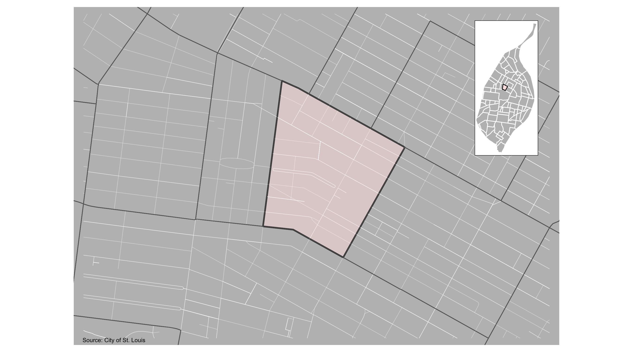
Lewis Place

Slide 27
Lewis Place: Month Summary Notes
11 total crimes in February 2022
-21% change compared to February 2021 (14 total crimes)
4 crime(s) against persons in February 2022
33% change compared to February 2021 (3 crimes against persons)
1 crime(s) against society in February 2022
-50% change compared to February 2021 (2 crimes against society)
3 crime(s) against propety in February 2022
-67% change compared to February 2021 (9 crimes against property)
3 unspecified crime(s) in February 2022
Infinite change compared to February 2021 (0 unspecified crimes)

Slide 28
Lewis Place: Year to Date Summary Notes
34 total crimes in 2022
48% change compared to this time in 2021 (23 total crimes)
8 crime(s) against persons in 2022
100% change compared to this time in 2021 (4 crimes against persons)
3 crime(s) against society in 2022
0% change compared to this time in 2021 (3 crimes against society)
14 crime(s) against property in 2022
8% change compared to this time in 2021 (13 crimes against property)
9 unspecified crime(s) in 2022
200% change compared to this time in 2021 (4 unspecified crimes)

Slide 29
Lewis Place
2022 | 2022 | 2022 | 2022
Type of Crime | Jan | Feb | Total
Person | 4 | 4 | 8
Property | 11 | 3 | 14
Society | 2 | 1 | 3
Unspecified | 6 | 3 | 9
Total | 23 | 11 | 34
Type of Crime | Jan | Feb | Total
Person | 1 | 3 | 4
Property | 4 | 9 | 13
Society | 1 | 2 | 3
Unspecified | 3 | 0 | 3
Total | 9 | 14 | 23

Slide 30
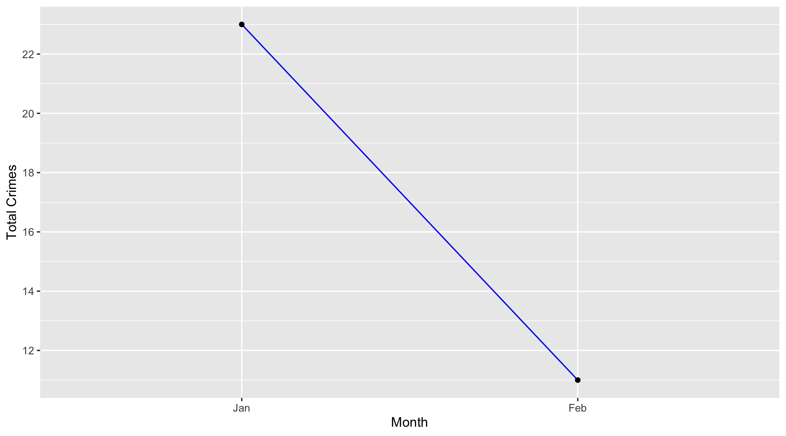
Lewis Place

Slide 31
Lewis Place: Property Crimes
Crime | Jan | Feb | Total
Robbery | 1 | 1 | 2
Arson | 0 | 0 | 0
Extortion/Blackmail | 0 | 0 | 0
Burglary/Breaking and Entering | 0 | 0 | 0
Pocket-picking | 0 | 0 | 0
Purse-snatching | 0 | 0 | 0
Shoplifting | 0 | 0 | 0
Theft From Building | 3 | 0 | 3
Theft From Coin-Operated Machine or Device | 0 | 0 | 0
Theft From MV | 1 | 1 | 2
Theft From MV Parts/Accessories | 0 | 0 | 0
All Other Larceny | 1 | 0 | 1
MV Theft | 3 | 0 | 3
Counterfeiting/Forgery | 0 | 0 | 0
False Pretense/Swindle/Confidence Game | 0 | 0 | 0
Credit Card/ATM Fraud | 0 | 0 | 0
Impersonation | 0 | 0 | 0
Welfare Fraud | 0 | 0 | 0
Wire Fraud | 0 | 0 | 0

Slide 32
Lewis Place: Property Crimes
Crime | Jan | Feb | Total
Identity Theft | 0 | 0 | 0
Hacking/Computer Invasion | 0 | 0 | 0
Embezzlement | 0 | 0 | 0
Stolen Property Offenses | 1 | 0 | 1
Destruction/Damage/Vandalism of Property | 1 | 1 | 2
Bribery | 0 | 0 | 0
Bad Checks | 0 | 0 | 0
Total | 11 | 3 | 14

Slide 33
Lewis Place: Society Crimes
Crime | Jan | Feb | Total
Drug/Narcotic Violations | 0 | 0 | 0
Drug Equipment Violations | 0 | 0 | 0
Pornography/Obscene Material | 0 | 0 | 0
Betting/Wagering | 0 | 0 | 0
Operating/Promoting/Assisting Gambling | 0 | 0 | 0
Gambling Equipment Violations | 0 | 0 | 0
Sports Tampering | 0 | 0 | 0
Prostitution | 0 | 0 | 0
Assisting or Promoting Prostitution | 0 | 0 | 0
Purchasing Prostitution | 0 | 0 | 0
Weapons Law Violations | 1 | 1 | 2
Animal Cruelty | 0 | 0 | 0
Curfew/Loitering/Vagrancy Violations | 0 | 0 | 0
Disorderly Conduct | 0 | 0 | 0
Driving Under the Influence | 0 | 0 | 0
Drunkeness | 0 | 0 | 0
Family Offenses, Nonviolent | 0 | 0 | 0
Liquor Law Violations | 0 | 0 | 0
Peeping Tom | 0 | 0 | 0
Trespass of Real Property | 1 | 0 | 1
Total | 2 | 1 | 3

Slide 34
Lewis Place: Person Crimes
Crime | Jan | Feb | Total
Murder and Nonnegligent Manslaughter | 0 | 0 | 0
Negligent Manslaughter | 0 | 0 | 0
Justifiable Homicide | 0 | 0 | 0
Suicide | 0 | 0 | 0
Kidnapping/Abduction | 0 | 0 | 0
Rape | 1 | 1 | 2
Sodomy | 1 | 0 | 1
Sexual Assault with an Object | 0 | 0 | 0
Fondling | 0 | 0 | 0
Aggravated Assault | 1 | 2 | 3
*Aggravated Assault with Firearm | 1 | 1 | 2
Simple Assault | 0 | 0 | 0
Intimidation | 0 | 0 | 0
Incest | 0 | 0 | 0
Statutory Rape | 0 | 0 | 0
Human Trafficking, Commercial Sex Acts | 0 | 0 | 0
Human Trafficking, Involuntary Servitude | 0 | 0 | 0
Total | 4 | 4 | 8

Slide 35
Lewis Place: Unspecified Crimes
Crime | Jan | Feb | Total
Runaway | 0 | 0 | 0
All Other Offenses | 6 | 3 | 9
Total | 6 | 3 | 9

Slide 36
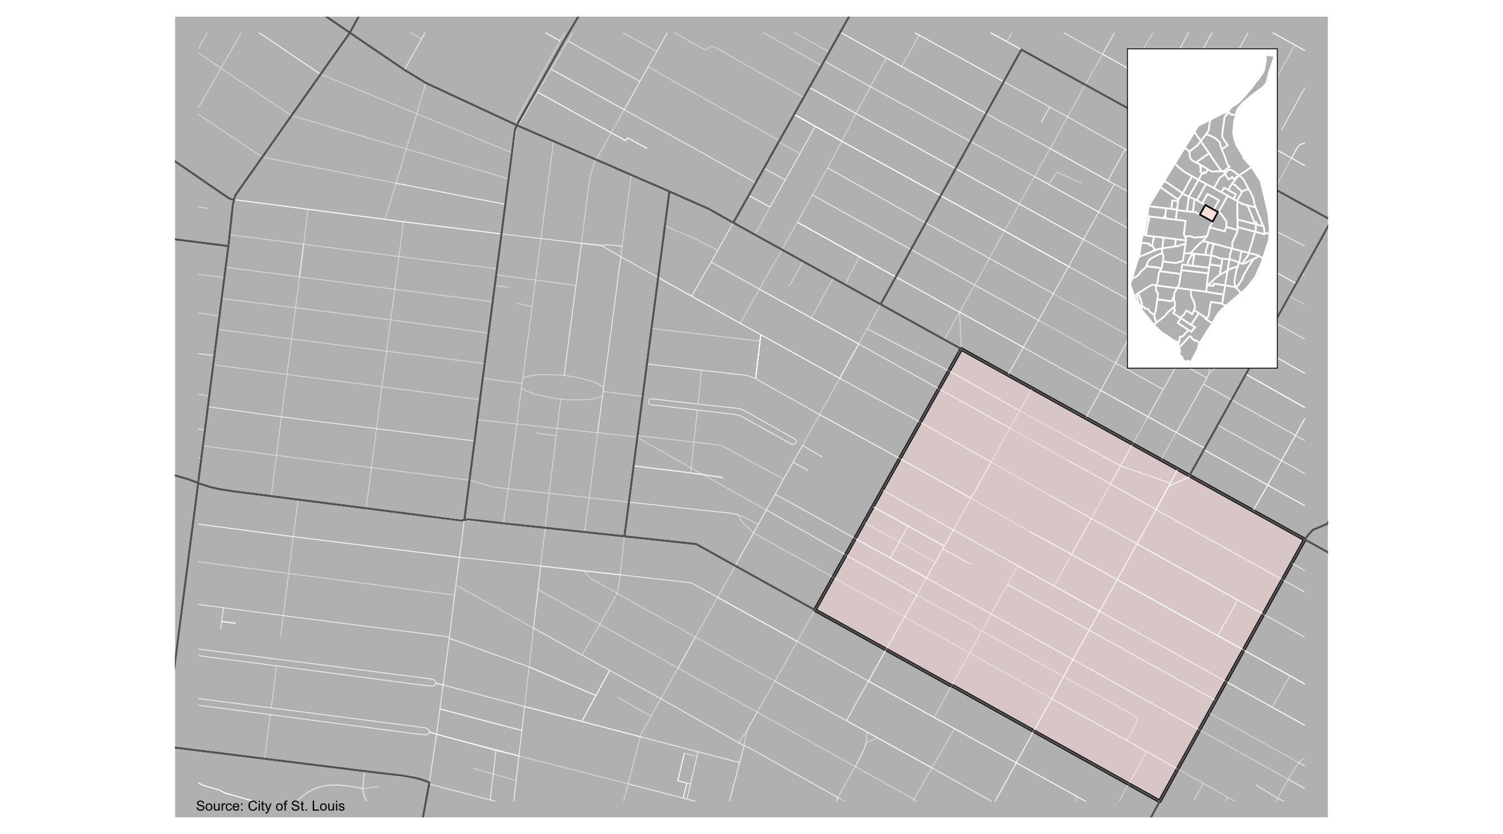
Vandeventer

Slide 37
Vandeventer: Month Summary Notes
13 total crimes in February 2022
-7% change compared to February 2021 (14 total crimes)
0 crime(s) against persons in February 2022
-100% change compared to February 2021 (3 crimes against persons)
0 crime(s) against society in February 2022
-100% change compared to February 2021 (2 crimes against society)
8 crime(s) against propety in February 2022
-11% change compared to February 2021 (9 crimes against property)
5 unspecified crime(s) in February 2022
Infinite change compared to February 2021 (0 unspecified crimes)

Slide 38
Vandeventer: Year to Date Summary Notes
31 total crimes in 2022
35% change compared to this time in 2021 (23 total crimes)
5 crime(s) against persons in 2022
25% change compared to this time in 2021 (4 crimes against persons)
4 crime(s) against society in 2022
33% change compared to this time in 2021 (3 crimes against society)
17 crime(s) against property in 2022
31% change compared to this time in 2021 (13 crimes against property)
5 unspecified crime(s) in 2022
67% change compared to this time in 2021 (4 unspecified crimes)

Slide 39
Vandeventer
2022 | 2022 | 2022 | 2022
Type of Crime | Jan | Feb | Total
Person | 5 | 0 | 5
Property | 9 | 8 | 17
Society | 4 | 0 | 4
Unspecified | 0 | 5 | 5
Total | 18 | 13 | 31
Type of Crime | Jan | Feb | Total
Person | 1 | 3 | 4
Property | 4 | 9 | 13
Society | 1 | 2 | 3
Unspecified | 3 | 0 | 3
Total | 9 | 14 | 23

Slide 40

Vandeventer

Slide 41
Vandeventer: Property Crimes
Crime | Jan | Feb | Total
Robbery | 1 | 2 | 3
Arson | 0 | 0 | 0
Extortion/Blackmail | 0 | 0 | 0
Burglary/Breaking and Entering | 2 | 0 | 2
Pocket-picking | 0 | 0 | 0
Purse-snatching | 0 | 0 | 0
Shoplifting | 0 | 1 | 1
Theft From Building | 1 | 0 | 1
Theft From Coin-Operated Machine or Device | 0 | 0 | 0
Theft From MV | 0 | 0 | 0
Theft From MV Parts/Accessories | 2 | 1 | 3
All Other Larceny | 1 | 0 | 1
MV Theft | 2 | 2 | 4
Counterfeiting/Forgery | 0 | 0 | 0
False Pretense/Swindle/Confidence Game | 0 | 0 | 0
Credit Card/ATM Fraud | 0 | 0 | 0
Impersonation | 0 | 0 | 0
Welfare Fraud | 0 | 0 | 0
Wire Fraud | 0 | 0 | 0

Slide 42
Vandeventer: Property Crimes
Crime | Jan | Feb | Total
Identity Theft | 0 | 0 | 0
Hacking/Computer Invasion | 0 | 0 | 0
Embezzlement | 0 | 0 | 0
Stolen Property Offenses | 0 | 0 | 0
Destruction/Damage/Vandalism of Property | 0 | 2 | 2
Bribery | 0 | 0 | 0
Bad Checks | 0 | 0 | 0
Total | 9 | 8 | 17

Slide 43
Vandeventer: Society Crimes
Crime | Jan | Feb | Total
Drug/Narcotic Violations | 1 | 0 | 1
Drug Equipment Violations | 0 | 0 | 0
Pornography/Obscene Material | 0 | 0 | 0
Betting/Wagering | 0 | 0 | 0
Operating/Promoting/Assisting Gambling | 0 | 0 | 0
Gambling Equipment Violations | 0 | 0 | 0
Sports Tampering | 0 | 0 | 0
Prostitution | 0 | 0 | 0
Assisting or Promoting Prostitution | 0 | 0 | 0
Purchasing Prostitution | 0 | 0 | 0
Weapons Law Violations | 2 | 0 | 2
Animal Cruelty | 0 | 0 | 0
Curfew/Loitering/Vagrancy Violations | 0 | 0 | 0
Disorderly Conduct | 0 | 0 | 0
Driving Under the Influence | 0 | 0 | 0
Drunkeness | 0 | 0 | 0
Family Offenses, Nonviolent | 0 | 0 | 0
Liquor Law Violations | 0 | 0 | 0
Peeping Tom | 0 | 0 | 0
Trespass of Real Property | 1 | 0 | 1
Total | 4 | 0 | 4

Slide 44
Vandeventer: Person Crimes
Crime | Jan | Feb | Total
Murder and Nonnegligent Manslaughter | 0 | 0 | 0
Negligent Manslaughter | 0 | 0 | 0
Justifiable Homicide | 0 | 0 | 0
Suicide | 0 | 0 | 0
Kidnapping/Abduction | 0 | 0 | 0
Rape | 0 | 0 | 0
Sodomy | 0 | 0 | 0
Sexual Assault with an Object | 0 | 0 | 0
Fondling | 0 | 0 | 0
Aggravated Assault | 0 | 0 | 0
*Aggravated Assault with Firearm | 0 | 0 | 0
Simple Assault | 3 | 0 | 3
Intimidation | 2 | 0 | 2
Incest | 0 | 0 | 0
Statutory Rape | 0 | 0 | 0
Human Trafficking, Commercial Sex Acts | 0 | 0 | 0
Human Trafficking, Involuntary Servitude | 0 | 0 | 0
Total | 5 | 0 | 5

Slide 45
Vandeventer: Unspecified Crimes
Crime | Jan | Feb | Total
Runaway | 0 | 0 | 0
All Other Offenses | 0 | 5 | 5
Total | 0 | 5 | 5

