Slide 1
Forest Park Southeast, Central West End, Botanical Heights,
Monthly Crime Report: February 2022
Washington University Medical Center

Slide 2
History of Crime Reporting
Since the 1929 the Uniform Crime Report (UCR) has used a Summary Reporting System (SRS) to collect monthly counts of the number of crimes
In 1982 the Bureau of Justice Statistics and the FBI sponsored a study with the objective of revising the existing form of reporting crime. Through this, the National Incident Based Reporting System (NIBRS) was created
The FBI UCR Program transitioned to a NIBRS only data collection by January 1, 2021. Other states have followed suit and SLMPD has been working to make this same transition

Slide 3
NIBRS vs SRS
NIBRS captures details on each single crime incident—as well as on separate offenses within the same incident—including information on victims, known offenders, relationships between victims and offenders, arrestees, and property involved in crimes
Standardizes crime reporting across all local, state, and tribal law enforcement agencies
SRS only counted the most serious offense (i.e. if a murder and robbery occurred, only the murder is counted) while NIBRS counts up to 10 crimes per incident
Current NIBRS reporting are not directly comparable to the previous UCR “hierarchy” numbers. With this change, you will likely see increases in crime statistics. This increase does not mean that crime is necessarily increasing, but rather that crime is being reported in a non-hierarchical format, with more detail and counting each individual crime

Slide 4
NIBRS and SLMPD
Unforeseen technology delays and the incompatibility in comparing crime (NIRBS V. UCR) has caused delays in making the crime information available
The City of St Louis Information Technology Division (I.T.) has created a series of internal 2021 NIBRS reports
Because of this transition information is limited to counts of each crime by neighborhood

Slide 5
Core Neighborhoods

Slide 6
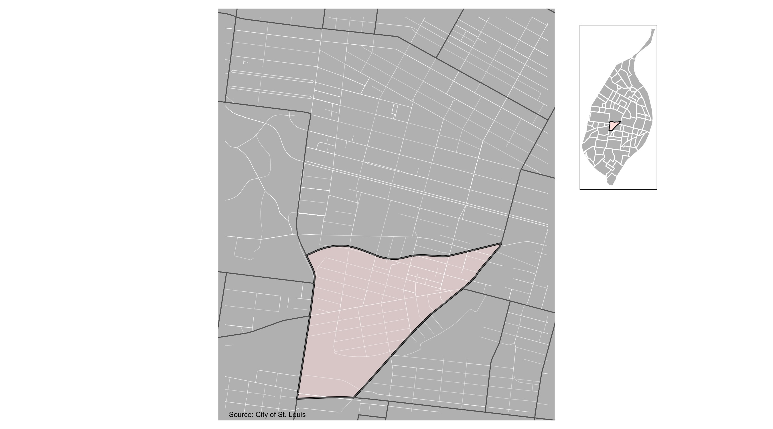
Forest Park Southeast

Slide 7
Forest Park Southeast: Month Summary Notes
54 total crimes in February 2022
-41% change compared to February 2021 (91 total crimes)
3 crime(s) against persons in February 2022
200% change compared to February 2021 (1 crimes against persons)
2 crime(s) against society in February 2022
Infinite change compared to February 2021 (0 crimes against society)
43 crime(s) against propety in February 2022
-52% change compared to February 2021 (89 crimes against property)
6 unspecified crime(s) in February 2022
500% change compared to February 2021 (1 unspecified crimes)

Slide 8
Forest Park Southeast: Year to Date Summary Notes
93 total crimes in 2022
-35% change compared to this time in 2021 (144 total crimes)
6 crime(s) against persons in 2022
20% change compared to this time in 2021 (5 crimes against persons)
3 crime(s) against society in 2022
-40% change compared to this time in 2021 (5 crimes against society)
72 crime(s) against property in 2022
-42% change compared to this time in 2021 (124 crimes against property)
12 unspecified crime(s) in 2022
20% change compared to this time in 2021 (5 unspecified crimes)

Slide 9
Forest Park Southeast
2022 | 2022 | 2022 | 2022
Type of Crime | Jan | Feb | Total
Person | 3 | 3 | 6
Property | 29 | 43 | 72
Society | 1 | 2 | 3
Unspecified | 6 | 6 | 12
Total | 39 | 54 | 93
2021 | 2021 | 2021 | 2021
Type of Crime | Jan | Feb | Total
Person | 4 | 1 | 5
Property | 35 | 89 | 124
Society | 5 | 0 | 5
Unspecified | 9 | 1 | 10
Total | 53 | 91 | 144

Slide 10
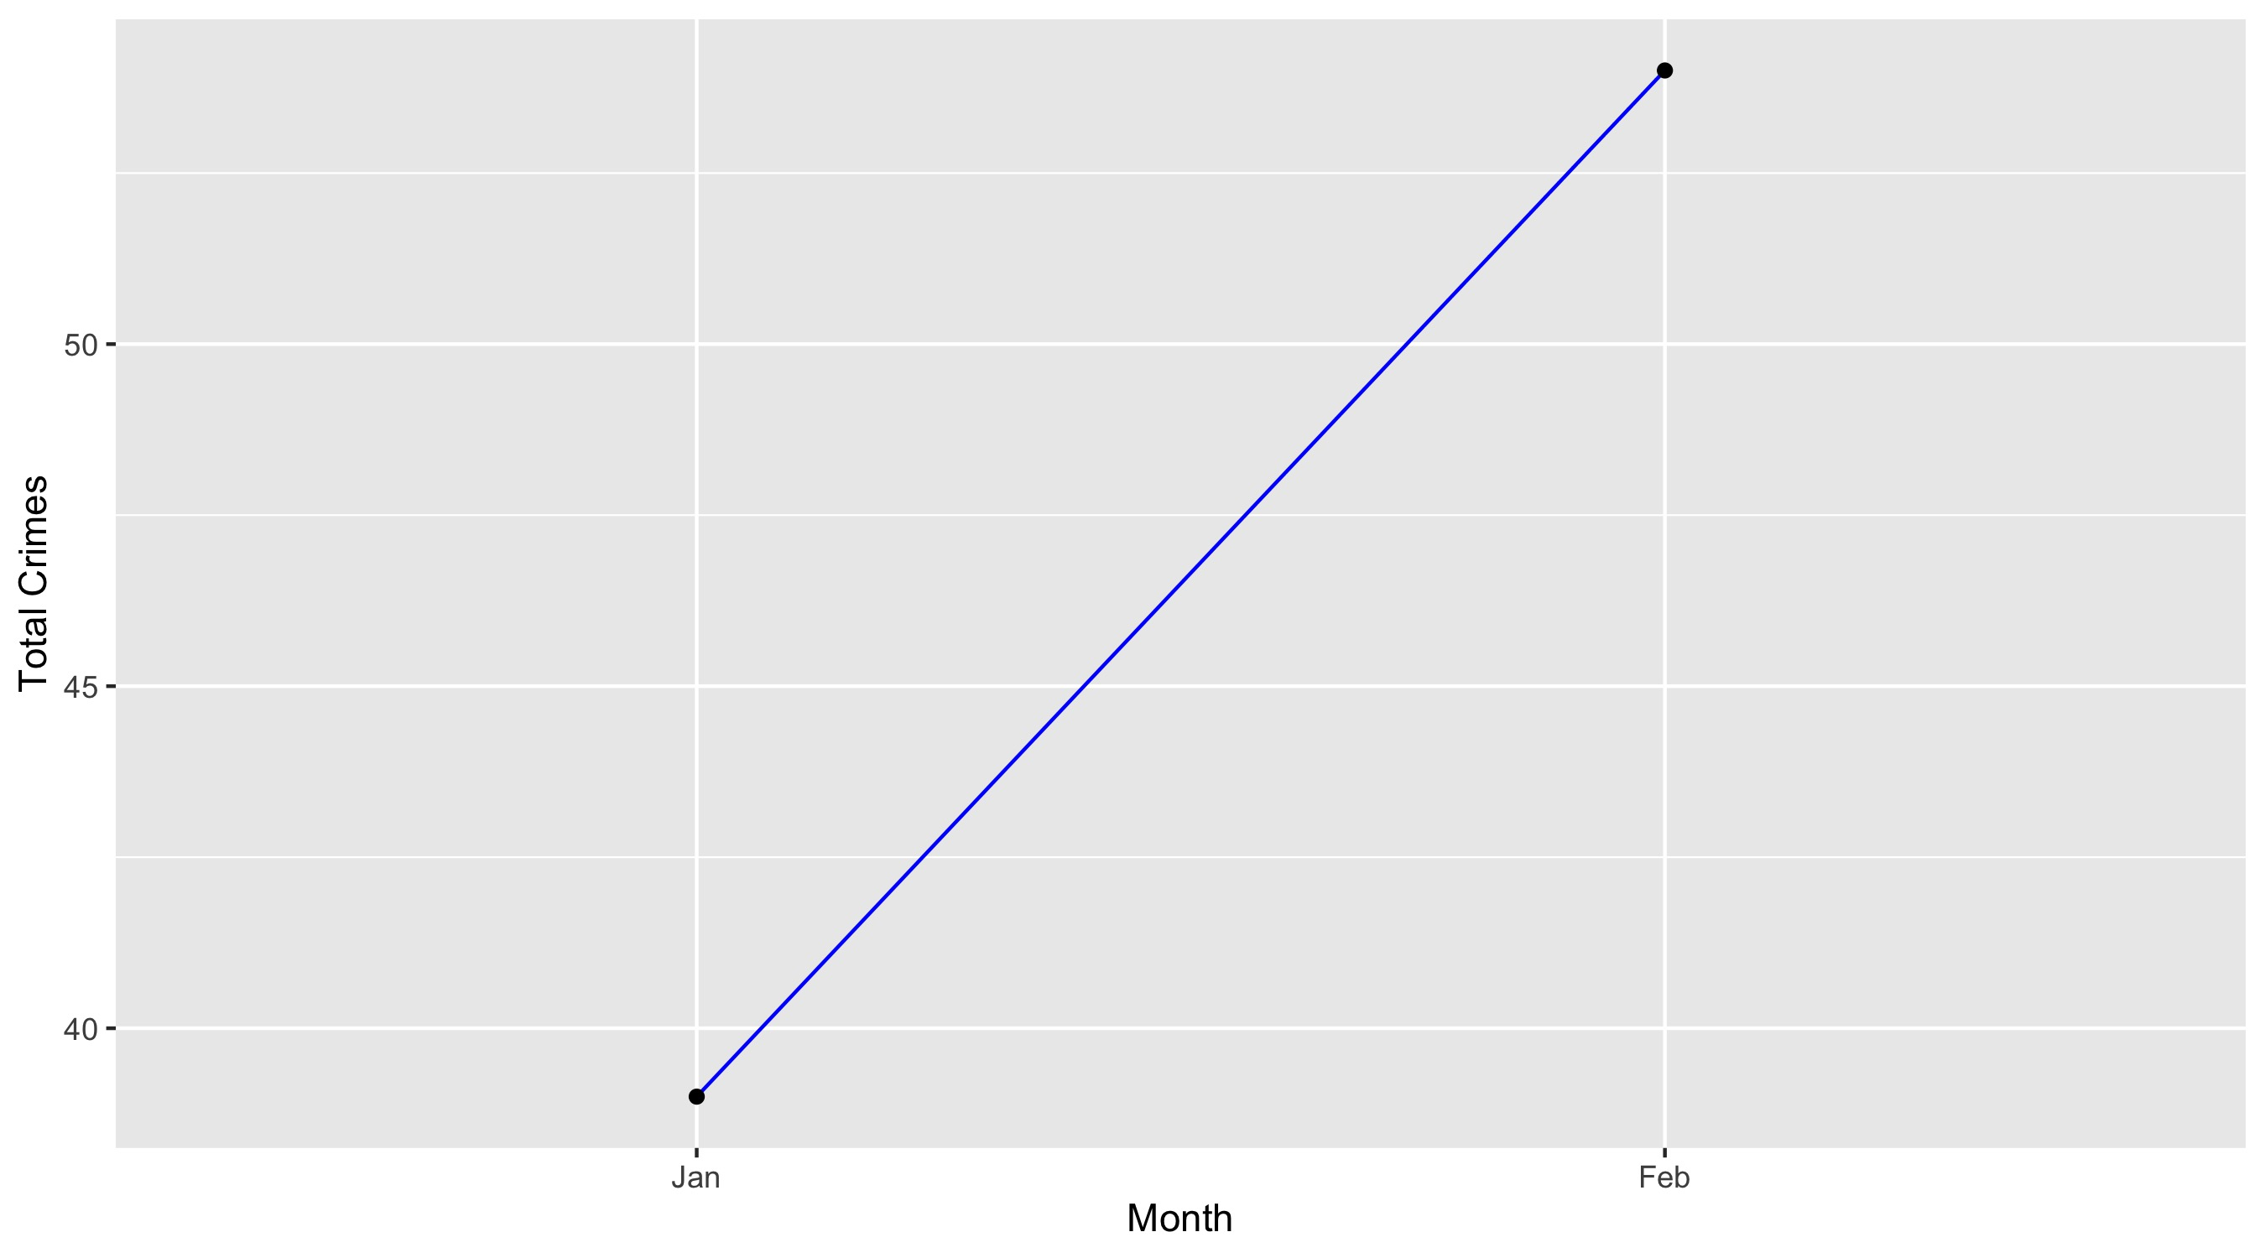
Forest Park Southeast

Slide 11
Forest Park Southeast: Property Crimes
Crime | Jan | Feb | Total
Robbery | 0 | 0 | 0
Arson | 0 | 0 | 0
Extortion/Blackmail | 0 | 0 | 0
Burglary/Breaking and Entering | 0 | 1 | 1
Pocket-picking | 0 | 0 | 0
Purse-snatching | 0 | 0 | 0
Shoplifting | 1 | 0 | 1
Theft From Building | 3 | 2 | 5
Theft From Coin-Operated Machine or Device | 0 | 0 | 0
Theft From MV | 7 | 12 | 19
Theft From MV Parts/Accessories | 2 | 2 | 4
All Other Larceny | 1 | 3 | 4
MV Theft | 4 | 3 | 7
Counterfeiting/Forgery | 0 | 0 | 0
False Pretense/Swindle/Confidence Game | 0 | 0 | 0
Credit Card/ATM Fraud | 0 | 0 | 0
Impersonation | 0 | 0 | 0
Welfare Fraud | 0 | 0 | 0
Wire Fraud | 0 | 0 | 0

Slide 12
Forest Park Southeast: Property Crimes
Crime | Jan | Feb | Total
Identity Theft | 0 | 0 | 0
Hacking/Computer Invasion | 0 | 0 | 0
Embezzlement | 0 | 0 | 0
Stolen Property Offenses | 0 | 0 | 0
Destruction/Damage/Vandalism of Property | 11 | 20 | 31
Bribery | 0 | 0 | 0
Bad Checks | 0 | 0 | 0
Total | 29 | 43 | 72

Slide 13
Forest Park Southeast: Society Crimes
Crime | Jan | Feb | Total
Drug/Narcotic Violations | 0 | 1 | 1
Drug Equipment Violations | 0 | 0 | 0
Pornography/Obscene Material | 0 | 0 | 0
Betting/Wagering | 0 | 0 | 0
Operating/Promoting/Assisting Gambling | 0 | 0 | 0
Gambling Equipment Violations | 0 | 0 | 0
Sports Tampering | 0 | 0 | 0
Prostitution | 0 | 0 | 0
Assisting or Promoting Prostitution | 0 | 0 | 0
Purchasing Prostitution | 0 | 0 | 0
Weapons Law Violations | 0 | 1 | 1
Animal Cruelty | 0 | 0 | 0
Curfew/Loitering/Vagrancy Violations | 0 | 0 | 0
Disorderly Conduct | 1 | 0 | 1
Driving Under the Influence | 0 | 0 | 0
Drunkeness | 0 | 0 | 0
Family Offenses, Nonviolent | 0 | 0 | 0
Liquor Law Violations | 0 | 0 | 0
Peeping Tom | 0 | 0 | 0
Trespass of Real Property | 0 | 0 | 0
Total | 1 | 2 | 3

Slide 14
Forest Park Southeast: Person Crimes
Crime | Jan | Feb | Total
Murder and Nonnegligent Manslaughter | 0 | 0 | 0
Negligent Manslaughter | 0 | 0 | 0
Justifiable Homicide | 0 | 0 | 0
Suicide | 0 | 0 | 0
Kidnapping/Abduction | 0 | 0 | 0
Rape | 0 | 0 | 0
Sodomy | 0 | 0 | 0
Sexual Assault with an Object | 0 | 0 | 0
Fondling | 0 | 0 | 0
Aggravated Assault | 0 | 1 | 1
*Aggravated Assault with Firearm | 0 | 0 | 0
Simple Assault | 3 | 1 | 4
Intimidation | 0 | 1 | 1
Incest | 0 | 0 | 0
Statutory Rape | 0 | 0 | 0
Human Trafficking, Commercial Sex Acts | 0 | 0 | 0
Human Trafficking, Involuntary Servitude | 0 | 0 | 0
Total | 3 | 3 | 6

Slide 15
Forest Park Southeast: Unspecified Crimes
Crime | Jan | Feb | Total
Runaway | 0 | 0 | 0
All Other Offenses | 6 | 6 | 12
Total | 6 | 6 | 12

Slide 16
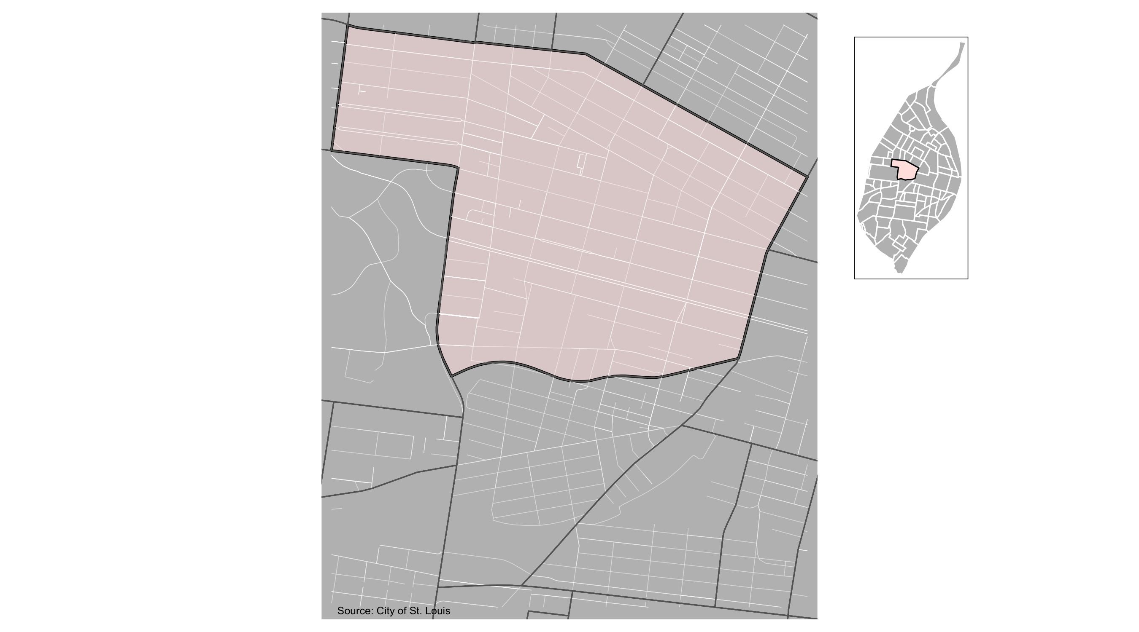
Central West End

Slide 17
Central West End: Month Summary Notes
190 total crimes in February 2022
62% change compared to February 2021 (117 total crimes)
30 crime(s) against persons in February 2022
88% change compared to February 2021 (16 crimes against persons)
16 crime(s) against society in February 2022
-33% change compared to February 2021 (24 crimes against society)
131 crime(s) against propety in February 2022
93% change compared to February 2021 (68 crimes against property)
13 unspecified crime(s) in February 2022
44% change compared to February 2021 (9 unspecified crimes)

Slide 18
Central West End: Year to Date Summary Notes
332 total crimes in 2022
20% change compared to this time in 2021 (277 total crimes)
42 crime(s) against persons in 2022
14% change compared to this time in 2021 (37 crimes against persons)
25 crime(s) against society in 2022
-48% change compared to this time in 2021 (48 crimes against society)
232 crime(s) against property in 2022
42% change compared to this time in 2021 (163 crimes against property)
33 unspecified crime(s) in 2022
14% change compared to this time in 2021 (37 unspecified crimes)

Slide 19
Central West End
2022 | 2022 | 2022 | 2022
Type of Crime | Jan | Feb | Total
Person | 12 | 30 | 42
Property | 101 | 131 | 232
Society | 9 | 16 | 25
Unspecified | 20 | 13 | 33
Total | 142 | 190 | 332
2021 | 2021 | 2021 | 2021
Type of Crime | Jan | Feb | Total
Person | 21 | 16 | 37
Property | 95 | 68 | 163
Society | 24 | 24 | 48
Unspecified | 20 | 9 | 29
Total | 160 | 117 | 277

Slide 20
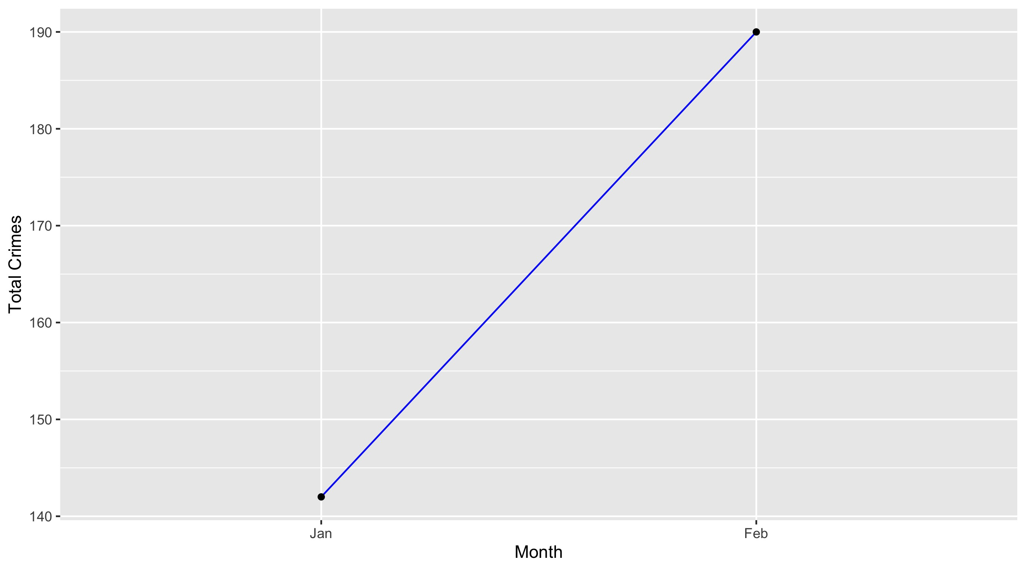
Central West End

Slide 21
Central West End: Property Crimes
Crime | Jan | Feb | Total
Robbery | 3 | 1 | 4
Arson | 0 | 0 | 0
Extortion/Blackmail | 0 | 0 | 0
Burglary/Breaking and Entering | 6 | 6 | 12
Pocket-picking | 0 | 0 | 0
Purse-snatching | 0 | 0 | 0
Shoplifting | 1 | 3 | 4
Theft From Building | 16 | 10 | 26
Theft From Coin-Operated Machine or Device | 0 | 0 | 0
Theft From MV | 24 | 27 | 51
Theft From MV Parts/Accessories | 6 | 20 | 26
All Other Larceny | 5 | 4 | 9
MV Theft | 9 | 15 | 24
Counterfeiting/Forgery | 1 | 2 | 3
False Pretense/Swindle/Confidence Game | 0 | 0 | 0
Credit Card/ATM Fraud | 2 | 0 | 2
Impersonation | 0 | 0 | 0
Welfare Fraud | 0 | 0 | 0
Wire Fraud | 0 | 0 | 0

Slide 22
Central West End: Property Crimes
Crime | Jan | Feb | Total
Identity Theft | 0 | 0 | 0
Hacking/Computer Invasion | 0 | 0 | 0
Embezzlement | 0 | 0 | 0
Stolen Property Offenses | 0 | 0 | 0
Destruction/Damage/Vandalism of Property | 28 | 43 | 71
Bribery | 0 | 0 | 0
Bad Checks | 0 | 0 | 0
Total | 101 | 131 | 232

Slide 23
Central West End: Society Crimes
Crime | Jan | Feb | Total
Drug/Narcotic Violations | 0 | 2 | 2
Drug Equipment Violations | 0 | 0 | 0
Pornography/Obscene Material | 0 | 0 | 0
Betting/Wagering | 0 | 0 | 0
Operating/Promoting/Assisting Gambling | 0 | 0 | 0
Gambling Equipment Violations | 0 | 0 | 0
Sports Tampering | 0 | 0 | 0
Prostitution | 0 | 0 | 0
Assisting or Promoting Prostitution | 0 | 0 | 0
Purchasing Prostitution | 0 | 0 | 0
Weapons Law Violations | 5 | 6 | 11
Animal Cruelty | 0 | 0 | 0
Curfew/Loitering/Vagrancy Violations | 0 | 0 | 0
Disorderly Conduct | 2 | 4 | 6
Driving Under the Influence | 0 | 1 | 1
Drunkeness | 0 | 0 | 0
Family Offenses, Nonviolent | 0 | 0 | 0
Liquor Law Violations | 0 | 0 | 0
Peeping Tom | 0 | 0 | 0
Trespass of Real Property | 2 | 3 | 5
Total | 9 | 16 | 25

Slide 24
Central West End: Person Crimes
Crime | Jan | Feb | Total
Murder and Nonnegligent Manslaughter | 0 | 0 | 0
Negligent Manslaughter | 0 | 0 | 0
Justifiable Homicide | 0 | 0 | 0
Suicide | 0 | 0 | 0
Kidnapping/Abduction | 0 | 0 | 0
Rape | 0 | 0 | 0
Sodomy | 0 | 1 | 1
Sexual Assault with an Object | 0 | 0 | 0
Fondling | 0 | 0 | 0
Aggravated Assault | 3 | 7 | 10
*Aggravated Assault with Firearm | 1 | 6 | 7
Simple Assault | 5 | 16 | 21
Intimidation | 3 | 0 | 3
Incest | 0 | 0 | 0
Statutory Rape | 0 | 0 | 0
Human Trafficking, Commercial Sex Acts | 0 | 0 | 0
Human Trafficking, Involuntary Servitude | 0 | 0 | 0
Total | 12 | 30 | 42

Slide 25
Central West End: Unspecified Crimes
Crime | Jan | Feb | Total
Runaway | 0 | 0 | 0
All Other Offenses | 20 | 13 | 33
Total | 20 | 13 | 33

Slide 26
Neighboring Geographies

Slide 27
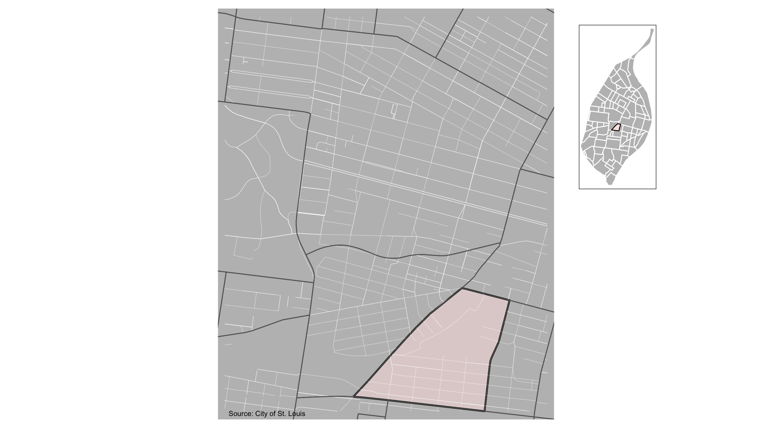
Botanical Heights

Slide 28
Botanical Heights: Month Summary Notes
18 total crimes in February 2022
29% change compared to February 2021 (14 total crimes)
1 crime(s) against persons in February 2022
-67% change compared to February 2021 (3 crimes against persons)
0 crime(s) against society in February 2022
-100% change compared to February 2021 (2 crimes against society)
14 crime(s) against propety in February 2022
56% change compared to February 2021 (9 crimes against property)
3 unspecified crime(s) in February 2022
Infinite change compared to February 2021 (0 unspecified crimes)

Slide 29
Botanical Heights: Year to Date Summary Notes
38 total crimes in 2022
65% change compared to this time in 2021 (23 total crimes)
5 crime(s) against persons in 2022
25% change compared to this time in 2021 (4 crimes against persons)
2 crime(s) against society in 2022
-33% change compared to this time in 2021 (3 crimes against society)
28 crime(s) against property in 2022
115% change compared to this time in 2021 (13 crimes against property)
3 unspecified crime(s) in 2022
0% change compared to this time in 2021 (4 unspecified crimes)

Slide 30
Botanical Heights
2022 | 2022 | 2022 | 2022
Type of Crime | Jan | Feb | Total
Person | 4 | 1 | 5
Property | 14 | 14 | 28
Society | 2 | 0 | 2
Unspecified | 0 | 3 | 3
Total | 20 | 18 | 38
2021 | 2021 | 2021 | 2021
Type of Crime | Jan | Feb | Total
Person | 1 | 3 | 4
Property | 4 | 9 | 13
Society | 1 | 2 | 3
Unspecified | 3 | 0 | 3
Total | 9 | 14 | 23

Slide 31
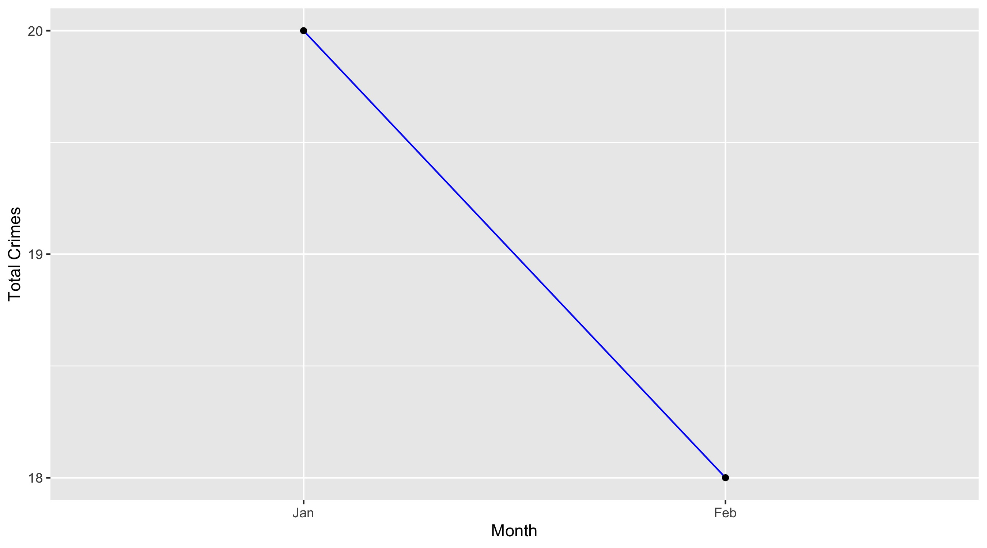
Botanical Heights

Slide 32
Botanical Heights: Property Crimes
Crime | Jan | Feb | Total
Robbery | 0 | 0 | 0
Arson | 0 | 0 | 0
Extortion/Blackmail | 0 | 0 | 0
Burglary/Breaking and Entering | 1 | 1 | 2
Pocket-picking | 0 | 0 | 0
Purse-snatching | 0 | 0 | 0
Shoplifting | 1 | 0 | 1
Theft From Building | 0 | 0 | 0
Theft From Coin-Operated Machine or Device | 0 | 0 | 0
Theft From MV | 5 | 5 | 10
Theft From MV Parts/Accessories | 1 | 1 | 2
All Other Larceny | 1 | 1 | 2
MV Theft | 1 | 2 | 3
Counterfeiting/Forgery | 0 | 0 | 0
False Pretense/Swindle/Confidence Game | 0 | 0 | 0
Credit Card/ATM Fraud | 0 | 0 | 0
Impersonation | 0 | 0 | 0
Welfare Fraud | 0 | 0 | 0
Wire Fraud | 0 | 0 | 0

Slide 33
Botanical Heights: Property Crimes
Crime | Jan | Feb | Total
Identity Theft | 0 | 0 | 0
Hacking/Computer Invasion | 0 | 0 | 0
Embezzlement | 0 | 0 | 0
Stolen Property Offenses | 0 | 0 | 0
Destruction/Damage/Vandalism of Property | 4 | 4 | 8
Bribery | 0 | 0 | 0
Bad Checks | 0 | 0 | 0
Total | 14 | 14 | 28

Slide 34
Botanical Heights: Society Crimes
Crime | Jan | Feb | Total
Drug/Narcotic Violations | 0 | 0 | 0
Drug Equipment Violations | 0 | 0 | 0
Pornography/Obscene Material | 0 | 0 | 0
Betting/Wagering | 0 | 0 | 0
Operating/Promoting/Assisting Gambling | 0 | 0 | 0
Gambling Equipment Violations | 0 | 0 | 0
Sports Tampering | 0 | 0 | 0
Prostitution | 0 | 0 | 0
Assisting or Promoting Prostitution | 0 | 0 | 0
Purchasing Prostitution | 0 | 0 | 0
Weapons Law Violations | 0 | 0 | 0
Animal Cruelty | 0 | 0 | 0
Curfew/Loitering/Vagrancy Violations | 0 | 0 | 0
Disorderly Conduct | 1 | 0 | 1
Driving Under the Influence | 0 | 0 | 0
Drunkeness | 0 | 0 | 0
Family Offenses, Nonviolent | 0 | 0 | 0
Liquor Law Violations | 0 | 0 | 0
Peeping Tom | 0 | 0 | 0
Trespass of Real Property | 1 | 0 | 1
Total | 2 | 0 | 2

Slide 35
Botanical Heights: Person Crimes
Crime | Jan | Feb | Total
Murder and Nonnegligent Manslaughter | 0 | 0 | 0
Negligent Manslaughter | 0 | 0 | 0
Justifiable Homicide | 0 | 0 | 0
Suicide | 0 | 0 | 0
Kidnapping/Abduction | 0 | 0 | 0
Rape | 0 | 0 | 0
Sodomy | 0 | 0 | 0
Sexual Assault with an Object | 0 | 0 | 0
Fondling | 0 | 0 | 0
Aggravated Assault | 2 | 0 | 2
*Aggravated Assault with Firearm | 2 | 0 | 2
Simple Assault | 0 | 1 | 1
Intimidation | 0 | 0 | 0
Incest | 0 | 0 | 0
Statutory Rape | 0 | 0 | 0
Human Trafficking, Commercial Sex Acts | 0 | 0 | 0
Human Trafficking, Involuntary Servitude | 0 | 0 | 0
Total | 4 | 1 | 5

Slide 36
Botanical Heights: Unspecified Crimes
Crime | Jan | Feb | Total
Runaway | 0 | 0 | 0
All Other Offenses | 0 | 3 | 3
Total | 0 | 3 | 3

