Slide 1
Forest Park Southeast, Botanical Heights, Central West End, Medical Campus
Monthly Crime Report: April 2020
Washington University Medical Center

Slide 2
Forest Park Southeast: Summary Notes
14 total crimes in April 2020
-22% change compared to April 2019 (18 total crimes)
0 crime(s) against persons in April 2020
-100% change compared to April 2019 (3 crimes against persons)
102 total crimes in 2020
50% change compared to this time in 2019 (68 total crimes)
17 crime(s) against persons in 2020
89% change compared to this time in 2019 (9 crimes against persons)

Slide 3
Forest Park Southeast: Year to Year Comparison
Part 1 Crimes | Jan | Feb | Mar | Apr | May | Jun | Jul | Aug | Sep | Oct | Nov | Dec | Total
Aggravated Assault | 0 | 3 | 1 | 2 | 2 | 4 | 2 | 0 | 2 | 5 | 0 | 5 | 26
Arson | 0 | 0 | 1 | 0 | 0 | 1 | 0 | 0 | 0 | 0 | 0 | 0 | 2
Burgalry | 0 | 0 | 1 | 1 | 0 | 0 | 3 | 1 | 4 | 8 | 3 | 1 | 22
Homicide | 0 | 0 | 0 | 0 | 0 | 0 | 0 | 0 | 1 | 0 | 0 | 0 | 1
Larceny | 7 | 10 | 15 | 12 | 9 | 21 | 17 | 19 | 24 | 35 | 17 | 32 | 218
Motor Vehicle Theft | 3 | 6 | 1 | 2 | 0 | 4 | 6 | 1 | 8 | 3 | 3 | 0 | 37
Robbery | 1 | 0 | 1 | 1 | 2 | 5 | 2 | 1 | 2 | 3 | 1 | 2 | 21
Total | 11 | 19 | 20 | 18 | 13 | 35 | 30 | 22 | 41 | 54 | 24 | 40 | 327
Part 1 Crimes | Jan | Feb | Mar | Apr | Total
Aggravated Assault | 1 | 5 | 3 | 0 | 9
Arson | 0 | 0 | 0 | 0 | 0
Burgalry | 3 | 1 | 4 | 1 | 9
Homicide | 0 | 0 | 0 | 0 | 0
Larceny | 25 | 15 | 14 | 10 | 64
Motor Vehicle Theft | 2 | 5 | 2 | 3 | 12
Robbery | 1 | 6 | 1 | 0 | 8
Total | 32 | 32 | 24 | 14 | 102

Slide 4
Forest Park Southeast: Summary Tables
Day of the Week | Number of Crimes
Sun | 2
Mon | 0
Tue | 0
Wed | 0
Thu | 4
Fri | 4
Sat | 4
Total | 14
Part 1 Crimes | Number of Crimes
Burgalry | 1
Larceny | 10
Motor Vehicle Theft | 3
Total | 14
Crimes Against Persons | Number of Crimes
FALSE | 14
Total | 14
Time of Day | Number of Crimes
Day | 14
Total | 14

Slide 5
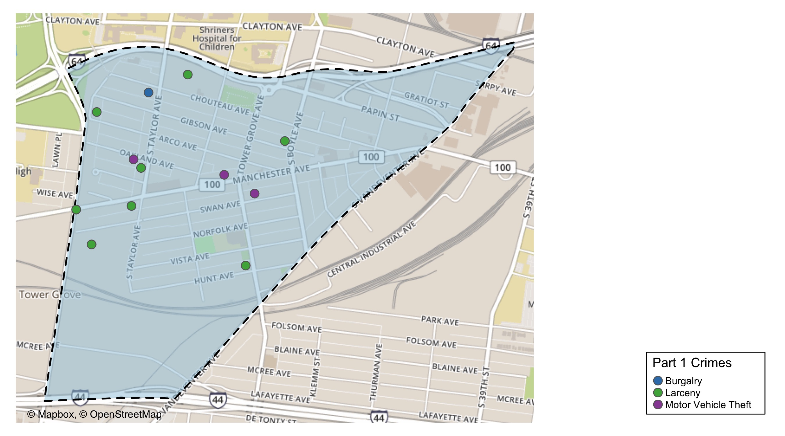
Forest Park Southeast: Total Crime Map

