Slide 1
West End, Visitation Park, Skinker DeBaliviere, DeBaliviere Place
Monthly Crime Report: March 2022
Washington University Medical Center

Slide 2
History of Crime Reporting
Since the 1929 the Uniform Crime Report (UCR) has used a Summary Reporting System (SRS) to collect monthly counts of the number of crimes
In 1982 the Bureau of Justice Statistics and the FBI sponsored a study with the objective of revising the existing form of reporting crime. Through this, the National Incident Based Reporting System (NIBRS) was created
The FBI UCR Program transitioned to a NIBRS only data collection by January 1, 2021. Other states have followed suit and SLMPD has been working to make this same transition

Slide 3
NIBRS vs SRS
NIBRS captures details on each single crime incident—as well as on separate offenses within the same incident—including information on victims, known offenders, relationships between victims and offenders, arrestees, and property involved in crimes
Standardizes crime reporting across all local, state, and tribal law enforcement agencies
SRS only counted the most serious offense (i.e. if a murder and robbery occurred, only the murder is counted) while NIBRS counts up to 10 crimes per incident
Current NIBRS reporting are not directly comparable to the previous UCR “hierarchy” numbers. With this change, you will likely see increases in crime statistics. This increase does not mean that crime is necessarily increasing, but rather that crime is being reported in a non-hierarchical format, with more detail and counting each individual crime

Slide 4
NIBRS and SLMPD
Unforeseen technology delays and the incompatibility in comparing crime (NIRBS V. UCR) has caused delays in making the crime information available
The City of St Louis Information Technology Division (I.T.) has created a series of internal 2021 NIBRS reports
Because of this transition information is limited to counts of each crime by neighborhood

Slide 5
Expanded Service Area

Slide 6
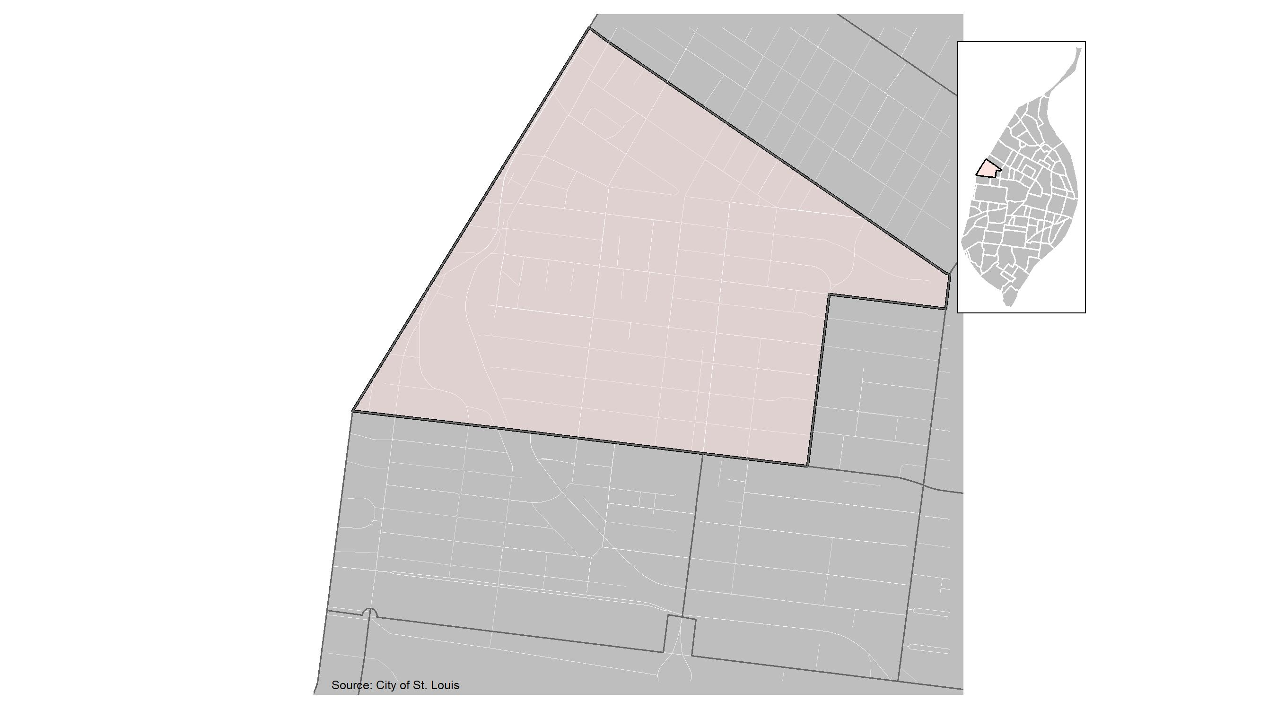
West End

Slide 7
West End: Month Summary Notes
83 total crimes in March 2022
-18% change compared to March 2021 (101 total crimes)
22 crime(s) against persons in March 2022
47% change compared to March 2021 (15 crimes against persons)
9 crime(s) against society in March 2022
-64% change compared to March 2021 (25 crimes against society)
40 crime(s) against propety in March 2022
-11% change compared to March 2021 (45 crimes against property)
12 unspecified crime(s) in March 2022
-25% change compared to March 2021 (16 unspecified crimes)

Slide 8
West End: Year to Date Summary Notes
180 total crimes in 2022
-27% change compared to this time in 2021 (247 total crimes)
37 crime(s) against persons in 2022
-29% change compared to this time in 2021 (52 crimes against persons)
24 crime(s) against society in 2022
-61% change compared to this time in 2021 (61 crimes against society)
97 crime(s) against property in 2022
7% change compared to this time in 2021 (91 crimes against property)
22 unspecified crime(s) in 2022
-49% change compared to this time in 2021 (52 unspecified crimes)

Slide 9
West End
2022 | 2022 | 2022 | 2022 | 2022
Type of Crime | Jan | Feb | Mar | Total
Person | 3 | 12 | 22 | 37
Property | 33 | 24 | 40 | 97
Society | 6 | 9 | 9 | 24
Unspecified | 3 | 7 | 12 | 22
Total | 45 | 52 | 83 | 180
2021 | 2021 | 2021 | 2021 | 2021
Type of Crime | Jan | Feb | Mar | Total
Person | 10 | 27 | 15 | 52
Property | 23 | 23 | 45 | 91
Society | 18 | 18 | 25 | 61
Unspecified | 16 | 11 | 16 | 43
Total | 67 | 79 | 101 | 247

Slide 10
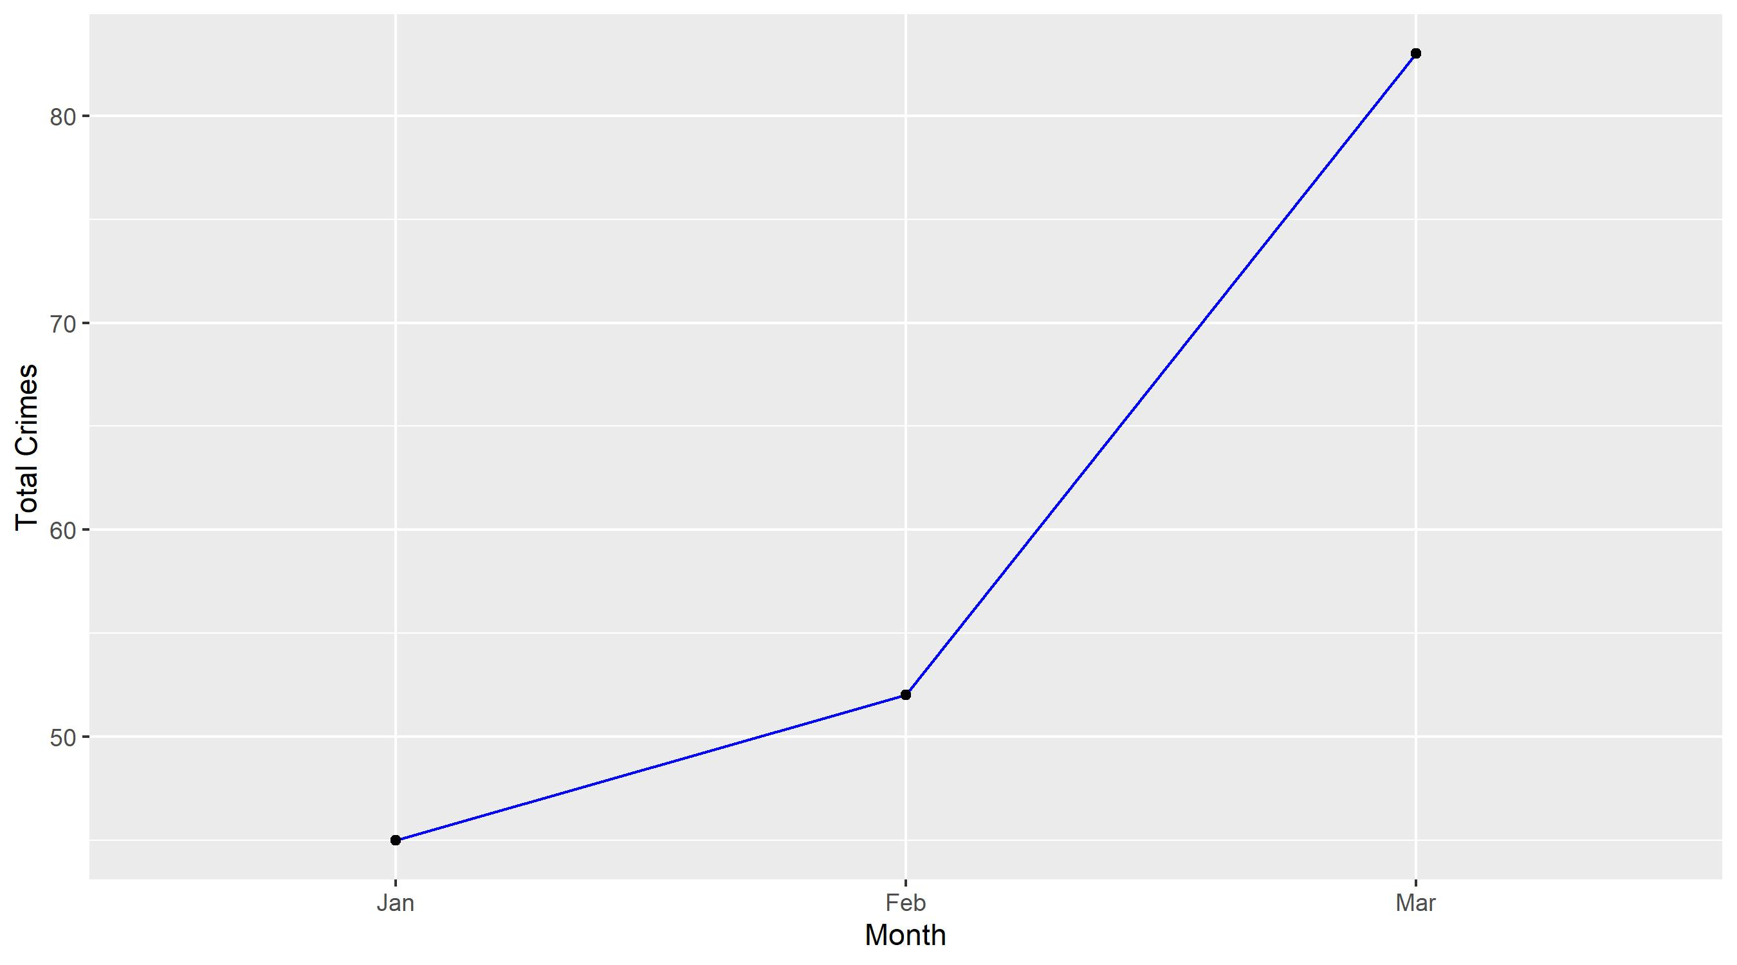
West End

Slide 11
West End: Property Crimes
Crime | Jan | Feb | Mar | Total
Robbery | 2 | 0 | 0 | 2
Arson | 0 | 0 | 0 | 0
Extortion/Blackmail | 0 | 0 | 0 | 0
Burglary/Breaking and Entering | 8 | 6 | 3 | 17
Pocket-picking | 0 | 0 | 1 | 1
Purse-snatching | 0 | 0 | 0 | 0
Shoplifting | 4 | 1 | 1 | 6
Theft From Building | 1 | 0 | 0 | 1
Theft From Coin-Operated Machine or Device | 0 | 0 | 0 | 0
Theft From MV | 3 | 0 | 10 | 13
Theft From MV Parts/Accessories | 2 | 2 | 2 | 6
All Other Larceny | 3 | 6 | 3 | 12
MV Theft | 5 | 2 | 5 | 12
Counterfeiting/Forgery | 0 | 0 | 1 | 1
False Pretense/Swindle/Confidence Game | 0 | 0 | 0 | 0
Credit Card/ATM Fraud | 0 | 0 | 0 | 0
Impersonation | 0 | 0 | 0 | 0
Welfare Fraud | 0 | 0 | 0 | 0
Wire Fraud | 0 | 0 | 0 | 0

Slide 12
West End: Property Crimes
Crime | Jan | Feb | Mar | Total
Identity Theft | 0 | 0 | 0 | 0
Hacking/Computer Invasion | 0 | 0 | 0 | 0
Embezzlement | 0 | 0 | 0 | 0
Stolen Property Offenses | 0 | 1 | 0 | 1
Destruction/Damage/Vandalism of Property | 5 | 6 | 14 | 25
Bribery | 0 | 0 | 0 | 0
Bad Checks | 0 | 0 | 0 | 0
Total | 33 | 24 | 40 | 97

Slide 13
West End: Society Crimes
Crime | Jan | Feb | Mar | Total
Drug/Narcotic Violations | 0 | 2 | 1 | 3
Drug Equipment Violations | 0 | 0 | 0 | 0
Pornography/Obscene Material | 0 | 0 | 0 | 0
Betting/Wagering | 0 | 0 | 0 | 0
Operating/Promoting/Assisting Gambling | 0 | 0 | 0 | 0
Gambling Equipment Violations | 0 | 0 | 0 | 0
Sports Tampering | 0 | 0 | 0 | 0
Prostitution | 0 | 0 | 2 | 2
Assisting or Promoting Prostitution | 0 | 0 | 0 | 0
Purchasing Prostitution | 0 | 0 | 0 | 0
Weapons Law Violations | 2 | 3 | 5 | 10
Animal Cruelty | 0 | 0 | 0 | 0
Curfew/Loitering/Vagrancy Violations | 0 | 0 | 0 | 0
Disorderly Conduct | 1 | 2 | 1 | 4
Driving Under the Influence | 0 | 0 | 0 | 0
Drunkeness | 0 | 0 | 0 | 0
Family Offenses, Nonviolent | 0 | 0 | 0 | 0
Liquor Law Violations | 0 | 0 | 0 | 0
Peeping Tom | 0 | 0 | 0 | 0
Trespass of Real Property | 3 | 2 | 0 | 5
Total | 6 | 9 | 9 | 24

Slide 14
West End: Person Crimes
Crime | Jan | Feb | Mar | Total
Murder and Nonnegligent Manslaughter | 0 | 0 | 1 | 1
Negligent Manslaughter | 0 | 0 | 0 | 0
Justifiable Homicide | 0 | 0 | 0 | 0
Suicide | 0 | 0 | 0 | 0
Kidnapping/Abduction | 0 | 0 | 0 | 0
Rape | 0 | 0 | 0 | 0
Sodomy | 0 | 0 | 0 | 0
Sexual Assault with an Object | 0 | 0 | 0 | 0
Fondling | 0 | 0 | 0 | 0
Aggravated Assault | 1 | 1 | 8 | 10
*Aggravated Assault with Firearm | 0 | 1 | 5 | 6
Simple Assault | 1 | 10 | 6 | 17
Intimidation | 1 | 0 | 2 | 3
Incest | 0 | 0 | 0 | 0
Statutory Rape | 0 | 0 | 0 | 0
Human Trafficking, Commercial Sex Acts | 0 | 0 | 0 | 0
Human Trafficking, Involuntary Servitude | 0 | 0 | 0 | 0
Total | 3 | 12 | 22 | 37

Slide 15
West End: Unspecified Crimes
Crime | Jan | Feb | Mar | Total
All Other Offenses | 3 | 7 | 12 | 22
Total | 3 | 7 | 12 | 22

Slide 16
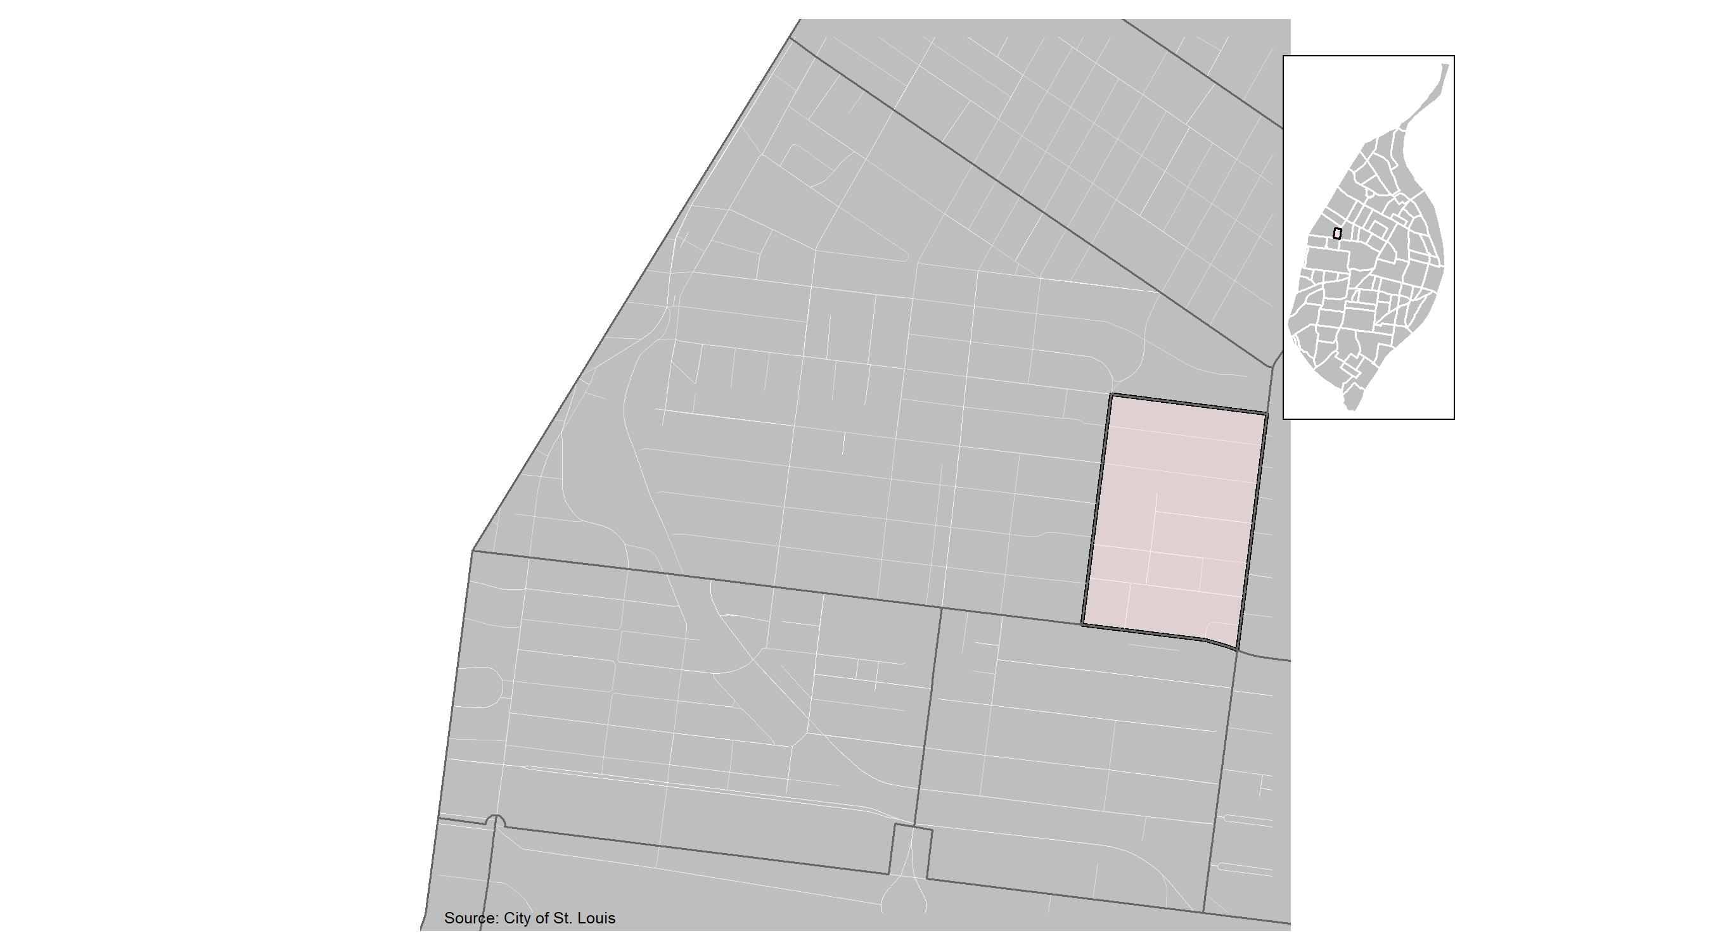
Visitation Park

Slide 17
Visitation Park: Month Summary Notes
7 total crimes in March 2022
-30% change compared to March 2021 (10 total crimes)
0 crime(s) against persons in March 2022
-100% change compared to March 2021 (1 crimes against persons)
1 crime(s) against society in March 2022
0% change compared to March 2021 (1 crimes against society)
6 crime(s) against propety in March 2022
-25% change compared to March 2021 (8 crimes against property)
0 unspecified crime(s) in March 2022
0 change compared to March 2021 (0 unspecified crimes)

Slide 18
Visitation Park: Year to Date Summary Notes
27 total crimes in 2022
-34% change compared to this time in 2021 (41 total crimes)
3 crime(s) against persons in 2022
0% change compared to this time in 2021 (3 crimes against persons)
2 crime(s) against society in 2022
-50% change compared to this time in 2021 (4 crimes against society)
21 crime(s) against property in 2022
-28% change compared to this time in 2021 (29 crimes against property)
1 unspecified crime(s) in 2022
-80% change compared to this time in 2021 (3 unspecified crimes)

Slide 19
Visitation Park
2022 | 2022 | 2022 | 2022 | 2022
Type of Crime | Jan | Feb | Mar | Total
Person | 2 | 1 | 0 | 3
Property | 6 | 9 | 6 | 21
Society | 0 | 1 | 1 | 2
Unspecified | 0 | 1 | 0 | 1
Total | 8 | 12 | 7 | 27
2021 | 2021 | 2021 | 2021 | 2021
Type of Crime | Jan | Feb | Mar | Total
Person | 2 | 0 | 1 | 3
Property | 19 | 2 | 8 | 29
Society | 3 | 0 | 1 | 4
Unspecified | 5 | 0 | 0 | 5
Total | 29 | 2 | 10 | 41

Slide 20
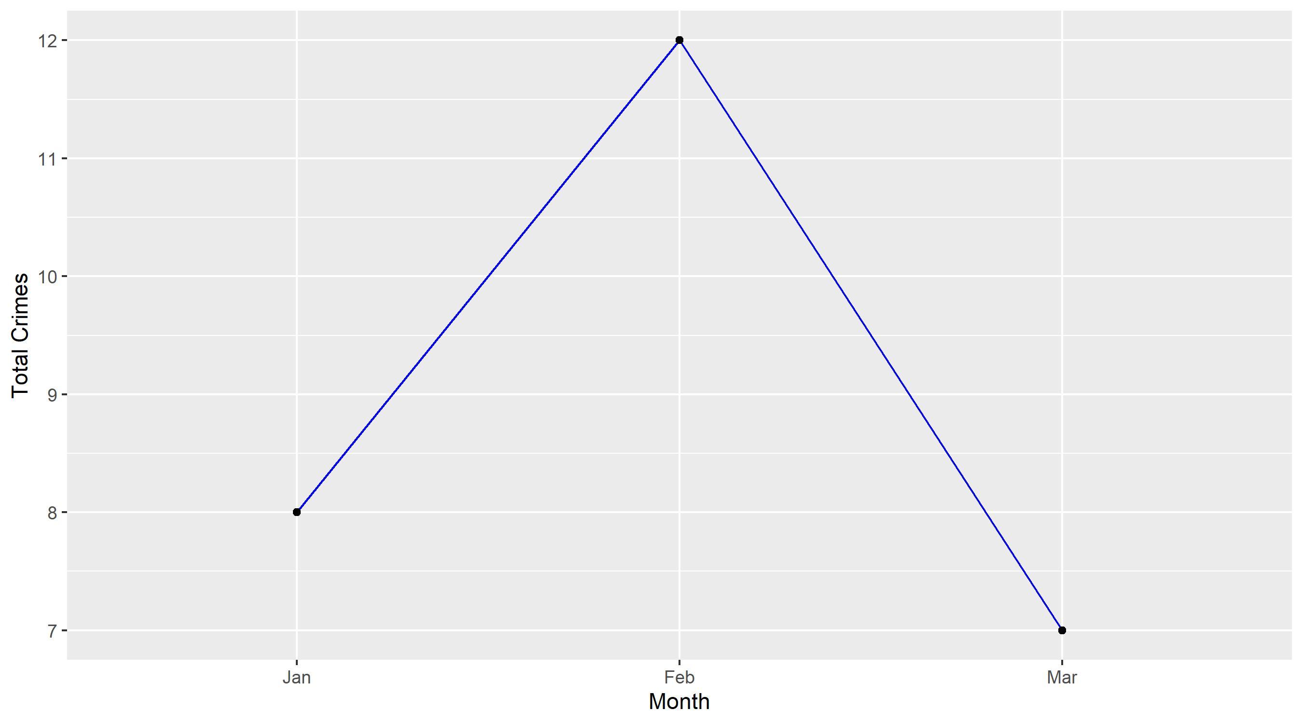
Visitation Park

Slide 21
Visitation Park: Property Crimes
Crime | Jan | Feb | Mar | Total
Robbery | 0 | 1 | 0 | 1
Arson | 0 | 0 | 0 | 0
Extortion/Blackmail | 0 | 0 | 0 | 0
Burglary/Breaking and Entering | 0 | 0 | 0 | 0
Pocket-picking | 0 | 0 | 0 | 0
Purse-snatching | 0 | 0 | 0 | 0
Shoplifting | 0 | 0 | 0 | 0
Theft From Building | 0 | 1 | 0 | 1
Theft From Coin-Operated Machine or Device | 0 | 0 | 0 | 0
Theft From MV | 0 | 1 | 1 | 2
Theft From MV Parts/Accessories | 1 | 2 | 0 | 3
All Other Larceny | 1 | 1 | 0 | 2
MV Theft | 2 | 1 | 1 | 4
Counterfeiting/Forgery | 0 | 0 | 0 | 0
False Pretense/Swindle/Confidence Game | 0 | 0 | 0 | 0
Credit Card/ATM Fraud | 0 | 0 | 1 | 1
Impersonation | 0 | 0 | 0 | 0
Welfare Fraud | 0 | 0 | 0 | 0
Wire Fraud | 0 | 0 | 0 | 0

Slide 22
Visitation Park: Property Crimes
Crime | Jan | Feb | Mar | Total
Identity Theft | 0 | 0 | 0 | 0
Hacking/Computer Invasion | 0 | 0 | 0 | 0
Embezzlement | 0 | 0 | 0 | 0
Stolen Property Offenses | 0 | 0 | 1 | 1
Destruction/Damage/Vandalism of Property | 2 | 2 | 2 | 6
Bribery | 0 | 0 | 0 | 0
Bad Checks | 0 | 0 | 0 | 0
Total | 6 | 9 | 6 | 21

Slide 23
Visitation Park: Society Crimes
Crime | Jan | Feb | Mar | Total
Drug/Narcotic Violations | 0 | 0 | 1 | 1
Drug Equipment Violations | 0 | 0 | 0 | 0
Pornography/Obscene Material | 0 | 0 | 0 | 0
Betting/Wagering | 0 | 0 | 0 | 0
Operating/Promoting/Assisting Gambling | 0 | 0 | 0 | 0
Gambling Equipment Violations | 0 | 0 | 0 | 0
Sports Tampering | 0 | 0 | 0 | 0
Prostitution | 0 | 0 | 0 | 0
Assisting or Promoting Prostitution | 0 | 0 | 0 | 0
Purchasing Prostitution | 0 | 0 | 0 | 0
Weapons Law Violations | 0 | 0 | 0 | 0
Animal Cruelty | 0 | 0 | 0 | 0
Curfew/Loitering/Vagrancy Violations | 0 | 0 | 0 | 0
Disorderly Conduct | 0 | 1 | 0 | 1
Driving Under the Influence | 0 | 0 | 0 | 0
Drunkeness | 0 | 0 | 0 | 0
Family Offenses, Nonviolent | 0 | 0 | 0 | 0
Liquor Law Violations | 0 | 0 | 0 | 0
Peeping Tom | 0 | 0 | 0 | 0
Trespass of Real Property | 0 | 0 | 0 | 0
Total | 0 | 1 | 1 | 2

Slide 24
Visitation Park: Person Crimes
Crime | Jan | Feb | Mar | Total
Murder and Nonnegligent Manslaughter | 0 | 0 | 0 | 0
Negligent Manslaughter | 0 | 0 | 0 | 0
Justifiable Homicide | 0 | 0 | 0 | 0
Suicide | 0 | 0 | 0 | 0
Kidnapping/Abduction | 0 | 0 | 0 | 0
Rape | 0 | 0 | 0 | 0
Sodomy | 0 | 0 | 0 | 0
Sexual Assault with an Object | 0 | 0 | 0 | 0
Fondling | 0 | 0 | 0 | 0
Aggravated Assault | 1 | 0 | 0 | 1
*Aggravated Assault with Firearm | 0 | 0 | 0 | 0
Simple Assault | 1 | 1 | 0 | 2
Intimidation | 0 | 0 | 0 | 0
Incest | 0 | 0 | 0 | 0
Statutory Rape | 0 | 0 | 0 | 0
Human Trafficking, Commercial Sex Acts | 0 | 0 | 0 | 0
Human Trafficking, Involuntary Servitude | 0 | 0 | 0 | 0
Total | 2 | 1 | 0 | 3

Slide 25
Visitation Park: Unspecified Crimes
Crime | Jan | Feb | Mar | Total
All Other Offenses | 0 | 1 | 0 | 1
Total | 0 | 1 | 0 | 1

Slide 26
Neighboring Geographies

Slide 27
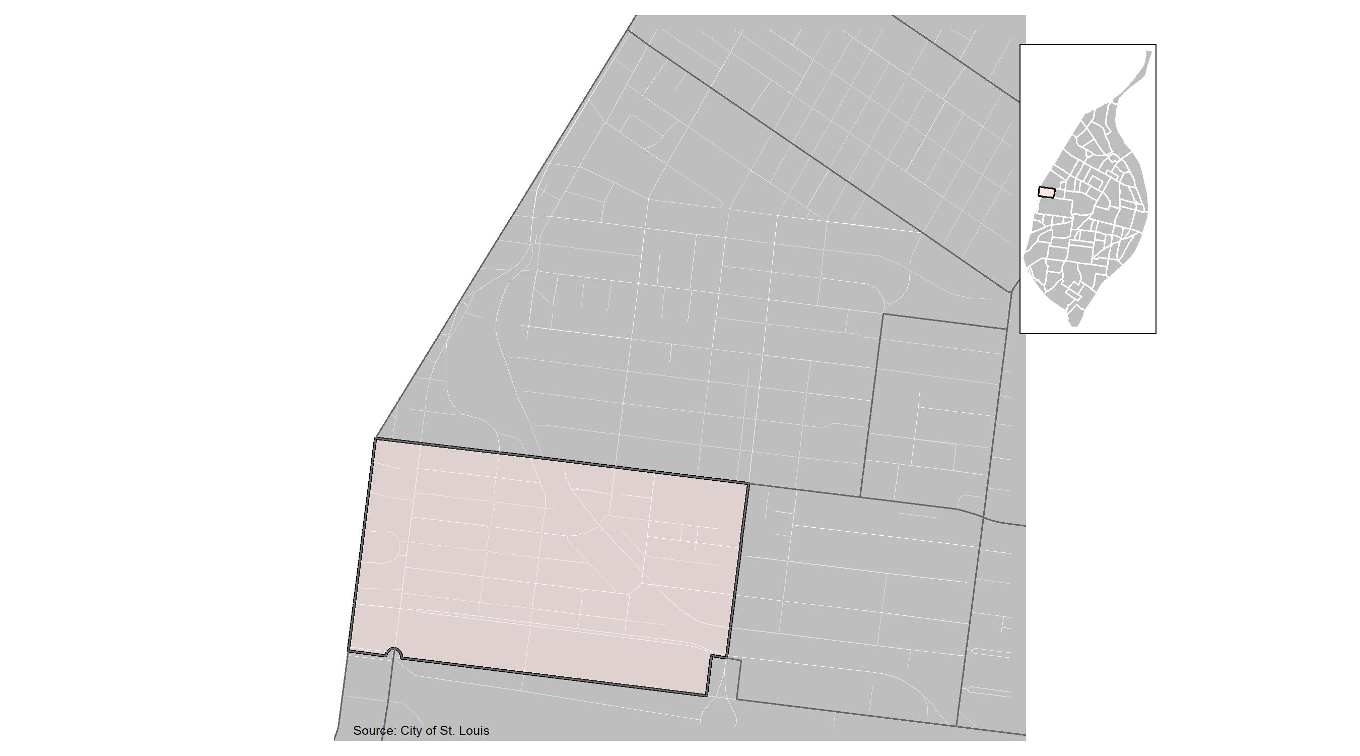
Skinker DeBaliviere

Slide 28
Skinker DeBaliviere: Month Summary Notes
37 total crimes in March 2022
106% change compared to March 2021 (18 total crimes)
2 crime(s) against persons in March 2022
100% change compared to March 2021 (1 crimes against persons)
1 crime(s) against society in March 2022
0% change compared to March 2021 (1 crimes against society)
28 crime(s) against propety in March 2022
115% change compared to March 2021 (13 crimes against property)
6 unspecified crime(s) in March 2022
100% change compared to March 2021 (3 unspecified crimes)

Slide 29
Skinker DeBaliviere: Year to Date Summary Notes
73 total crimes in 2022
28% change compared to this time in 2021 (57 total crimes)
2 crime(s) against persons in 2022
-78% change compared to this time in 2021 (9 crimes against persons)
2 crime(s) against society in 2022
-33% change compared to this time in 2021 (3 crimes against society)
59 crime(s) against property in 2022
40% change compared to this time in 2021 (42 crimes against property)
10 unspecified crime(s) in 2022
233% change compared to this time in 2021 (9 unspecified crimes)

Slide 30
Skinker DeBaliviere
2022 | 2022 | 2022 | 2022 | 2022
Type of Crime | Jan | Feb | Mar | Total
Person | 0 | 0 | 2 | 2
Property | 15 | 16 | 28 | 59
Society | 1 | 0 | 1 | 2
Unspecified | 1 | 3 | 6 | 10
Total | 17 | 19 | 37 | 73
2021 | 2021 | 2021 | 2021 | 2021
Type of Crime | Jan | Feb | Mar | Total
Person | 1 | 7 | 1 | 9
Property | 17 | 12 | 13 | 42
Society | 1 | 1 | 1 | 3
Unspecified | 0 | 0 | 3 | 3
Total | 19 | 20 | 18 | 57

Slide 31
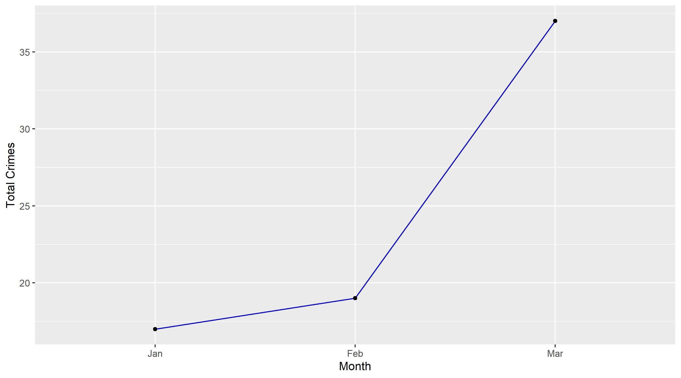
Skinker DeBaliviere

Slide 32
Skinker DeBaliviere: Property Crimes
Crime | Jan | Feb | Mar | Total
Robbery | 0 | 0 | 1 | 1
Arson | 0 | 0 | 0 | 0
Extortion/Blackmail | 0 | 0 | 0 | 0
Burglary/Breaking and Entering | 1 | 0 | 6 | 7
Pocket-picking | 0 | 0 | 0 | 0
Purse-snatching | 0 | 0 | 0 | 0
Shoplifting | 0 | 0 | 0 | 0
Theft From Building | 0 | 0 | 1 | 1
Theft From Coin-Operated Machine or Device | 0 | 0 | 0 | 0
Theft From MV | 2 | 2 | 5 | 9
Theft From MV Parts/Accessories | 3 | 3 | 2 | 8
All Other Larceny | 1 | 3 | 1 | 5
MV Theft | 2 | 2 | 3 | 7
Counterfeiting/Forgery | 0 | 1 | 0 | 1
False Pretense/Swindle/Confidence Game | 0 | 0 | 0 | 0
Credit Card/ATM Fraud | 0 | 0 | 0 | 0
Impersonation | 0 | 0 | 0 | 0
Welfare Fraud | 0 | 0 | 0 | 0
Wire Fraud | 0 | 0 | 0 | 0

Slide 33
Skinker DeBaliviere: Property Crimes
Crime | Jan | Feb | Mar | Total
Identity Theft | 0 | 0 | 0 | 0
Hacking/Computer Invasion | 0 | 0 | 0 | 0
Embezzlement | 0 | 0 | 0 | 0
Stolen Property Offenses | 0 | 0 | 0 | 0
Destruction/Damage/Vandalism of Property | 5 | 4 | 9 | 18
Bribery | 0 | 0 | 0 | 0
Bad Checks | 1 | 1 | 0 | 2
Total | 15 | 16 | 28 | 59

Slide 34
Skinker DeBaliviere: Society Crimes
Crime | Jan | Feb | Mar | Total
Drug/Narcotic Violations | 0 | 0 | 0 | 0
Drug Equipment Violations | 0 | 0 | 0 | 0
Pornography/Obscene Material | 0 | 0 | 0 | 0
Betting/Wagering | 0 | 0 | 0 | 0
Operating/Promoting/Assisting Gambling | 0 | 0 | 0 | 0
Gambling Equipment Violations | 0 | 0 | 0 | 0
Sports Tampering | 0 | 0 | 0 | 0
Prostitution | 0 | 0 | 0 | 0
Assisting or Promoting Prostitution | 0 | 0 | 0 | 0
Purchasing Prostitution | 0 | 0 | 0 | 0
Weapons Law Violations | 0 | 0 | 1 | 1
Animal Cruelty | 0 | 0 | 0 | 0
Curfew/Loitering/Vagrancy Violations | 1 | 0 | 0 | 1
Disorderly Conduct | 0 | 0 | 0 | 0
Driving Under the Influence | 0 | 0 | 0 | 0
Drunkeness | 0 | 0 | 0 | 0
Family Offenses, Nonviolent | 0 | 0 | 0 | 0
Liquor Law Violations | 0 | 0 | 0 | 0
Peeping Tom | 0 | 0 | 0 | 0
Trespass of Real Property | 0 | 0 | 0 | 0
Total | 1 | 0 | 1 | 2

Slide 35
Skinker DeBaliviere: Person Crimes
Crime | Jan | Feb | Mar | Total
Murder and Nonnegligent Manslaughter | 0 | 0 | 0 | 0
Negligent Manslaughter | 0 | 0 | 0 | 0
Justifiable Homicide | 0 | 0 | 0 | 0
Suicide | 0 | 0 | 0 | 0
Kidnapping/Abduction | 0 | 0 | 0 | 0
Rape | 0 | 0 | 0 | 0
Sodomy | 0 | 0 | 0 | 0
Sexual Assault with an Object | 0 | 0 | 0 | 0
Fondling | 0 | 0 | 0 | 0
Aggravated Assault | 0 | 0 | 1 | 1
*Aggravated Assault with Firearm | 0 | 0 | 1 | 1
Simple Assault | 0 | 0 | 0 | 0
Intimidation | 0 | 0 | 0 | 0
Incest | 0 | 0 | 0 | 0
Statutory Rape | 0 | 0 | 0 | 0
Human Trafficking, Commercial Sex Acts | 0 | 0 | 0 | 0
Human Trafficking, Involuntary Servitude | 0 | 0 | 0 | 0
Total | 0 | 0 | 2 | 2

Slide 36
Skinker DeBaliviere: Unspecified Crimes
Crime | Jan | Feb | Mar | Total
All Other Offenses | 1 | 3 | 6 | 10
Total | 1 | 3 | 6 | 10

Slide 37
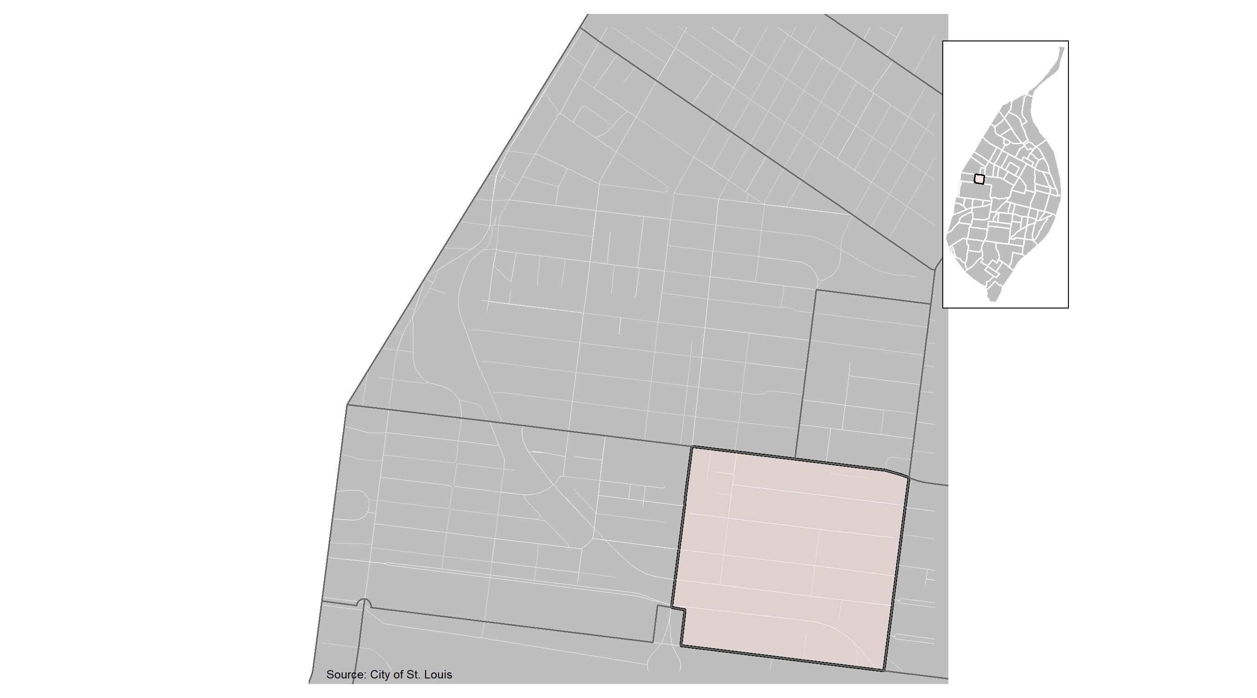
DeBaliviere Place

Slide 38
DeBaliviere Place: Month Summary Notes
42 total crimes in March 2022
133% change compared to March 2021 (18 total crimes)
1 crime(s) against persons in March 2022
-50% change compared to March 2021 (2 crimes against persons)
0 crime(s) against society in March 2022
-100% change compared to March 2021 (3 crimes against society)
38 crime(s) against propety in March 2022
245% change compared to March 2021 (11 crimes against property)
3 unspecified crime(s) in March 2022
50% change compared to March 2021 (2 unspecified crimes)

Slide 39
DeBaliviere Place: Year to Date Summary Notes
98 total crimes in 2022
96% change compared to this time in 2021 (50 total crimes)
9 crime(s) against persons in 2022
80% change compared to this time in 2021 (5 crimes against persons)
5 crime(s) against society in 2022
-38% change compared to this time in 2021 (8 crimes against society)
77 crime(s) against property in 2022
133% change compared to this time in 2021 (33 crimes against property)
7 unspecified crime(s) in 2022
75% change compared to this time in 2021 (5 unspecified crimes)

Slide 40
DeBaliviere Place
2022 | 2022 | 2022 | 2022 | 2022
Type of Crime | Jan | Feb | Mar | Total
Person | 2 | 6 | 1 | 9
Property | 26 | 13 | 38 | 77
Society | 0 | 5 | 0 | 5
Unspecified | 0 | 4 | 3 | 7
Total | 28 | 28 | 42 | 98
2021 | 2021 | 2021 | 2021 | 2021
Type of Crime | Jan | Feb | Mar | Total
Person | 2 | 1 | 2 | 5
Property | 14 | 8 | 11 | 33
Society | 0 | 5 | 3 | 8
Unspecified | 2 | 0 | 2 | 4
Total | 18 | 14 | 18 | 50

Slide 41
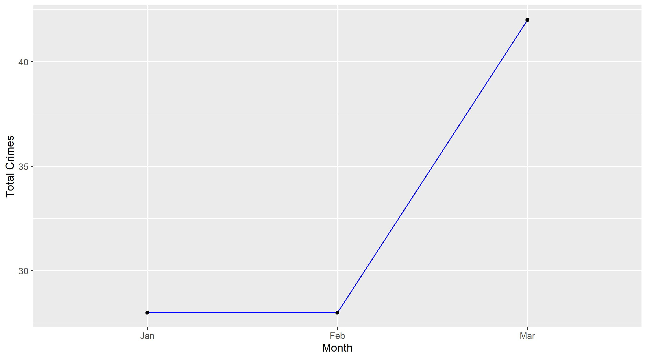
DeBaliviere Place

Slide 42
DeBaliviere Place: Property Crimes
Crime | Jan | Feb | Mar | Total
Robbery | 0 | 0 | 1 | 1
Arson | 0 | 0 | 0 | 0
Extortion/Blackmail | 0 | 0 | 0 | 0
Burglary/Breaking and Entering | 0 | 1 | 3 | 4
Pocket-picking | 0 | 0 | 0 | 0
Purse-snatching | 0 | 0 | 0 | 0
Shoplifting | 0 | 0 | 0 | 0
Theft From Building | 2 | 1 | 7 | 10
Theft From Coin-Operated Machine or Device | 0 | 0 | 0 | 0
Theft From MV | 8 | 6 | 10 | 24
Theft From MV Parts/Accessories | 3 | 1 | 1 | 5
All Other Larceny | 0 | 1 | 2 | 3
MV Theft | 3 | 1 | 3 | 7
Counterfeiting/Forgery | 0 | 1 | 0 | 1
False Pretense/Swindle/Confidence Game | 0 | 0 | 1 | 1
Credit Card/ATM Fraud | 0 | 0 | 0 | 0
Impersonation | 0 | 0 | 0 | 0
Welfare Fraud | 0 | 0 | 0 | 0
Wire Fraud | 0 | 0 | 0 | 0

Slide 43
DeBaliviere Place: Property Crimes
Crime | Jan | Feb | Mar | Total
Identity Theft | 1 | 0 | 0 | 1
Hacking/Computer Invasion | 0 | 0 | 0 | 0
Embezzlement | 0 | 0 | 0 | 0
Stolen Property Offenses | 0 | 0 | 1 | 1
Destruction/Damage/Vandalism of Property | 9 | 1 | 9 | 19
Bribery | 0 | 0 | 0 | 0
Bad Checks | 0 | 0 | 0 | 0
Total | 26 | 13 | 38 | 77

Slide 44
DeBaliviere Place: Society Crimes
Crime | Jan | Feb | Mar | Total
Drug/Narcotic Violations | 0 | 0 | 0 | 0
Drug Equipment Violations | 0 | 0 | 0 | 0
Pornography/Obscene Material | 0 | 0 | 0 | 0
Betting/Wagering | 0 | 0 | 0 | 0
Operating/Promoting/Assisting Gambling | 0 | 0 | 0 | 0
Gambling Equipment Violations | 0 | 0 | 0 | 0
Sports Tampering | 0 | 0 | 0 | 0
Prostitution | 0 | 0 | 0 | 0
Assisting or Promoting Prostitution | 0 | 0 | 0 | 0
Purchasing Prostitution | 0 | 0 | 0 | 0
Weapons Law Violations | 0 | 1 | 0 | 1
Animal Cruelty | 0 | 0 | 0 | 0
Curfew/Loitering/Vagrancy Violations | 0 | 0 | 0 | 0
Disorderly Conduct | 0 | 2 | 0 | 2
Driving Under the Influence | 0 | 0 | 0 | 0
Drunkeness | 0 | 0 | 0 | 0
Family Offenses, Nonviolent | 0 | 0 | 0 | 0
Liquor Law Violations | 0 | 0 | 0 | 0
Peeping Tom | 0 | 0 | 0 | 0
Trespass of Real Property | 0 | 2 | 0 | 2
Total | 0 | 5 | 0 | 5

Slide 45
DeBaliviere Place: Person Crimes
Crime | Jan | Feb | Mar | Total
Murder and Nonnegligent Manslaughter | 0 | 0 | 0 | 0
Negligent Manslaughter | 0 | 0 | 0 | 0
Justifiable Homicide | 0 | 0 | 0 | 0
Suicide | 0 | 0 | 0 | 0
Kidnapping/Abduction | 0 | 0 | 0 | 0
Rape | 0 | 0 | 0 | 0
Sodomy | 0 | 0 | 0 | 0
Sexual Assault with an Object | 0 | 0 | 0 | 0
Fondling | 0 | 1 | 0 | 1
Aggravated Assault | 1 | 2 | 0 | 3
*Aggravated Assault with Firearm | 0 | 1 | 0 | 1
Simple Assault | 1 | 2 | 1 | 4
Intimidation | 0 | 0 | 0 | 0
Incest | 0 | 0 | 0 | 0
Statutory Rape | 0 | 0 | 0 | 0
Human Trafficking, Commercial Sex Acts | 0 | 0 | 0 | 0
Human Trafficking, Involuntary Servitude | 0 | 0 | 0 | 0
Total | 2 | 6 | 1 | 9

Slide 46
DeBaliviere Place: Unspecified Crimes
Crime | Jan | Feb | Mar | Total
All Other Offenses | 0 | 4 | 3 | 7
Total | 0 | 4 | 3 | 7

