Slide 1
Forest Park Southeast, Central West End, Botanical Heights,
Monthly Crime Report: March 2022
Washington University Medical Center

Slide 2
History of Crime Reporting
Since the 1929 the Uniform Crime Report (UCR) has used a Summary Reporting System (SRS) to collect monthly counts of the number of crimes
In 1982 the Bureau of Justice Statistics and the FBI sponsored a study with the objective of revising the existing form of reporting crime. Through this, the National Incident Based Reporting System (NIBRS) was created
The FBI UCR Program transitioned to a NIBRS only data collection by January 1, 2021. Other states have followed suit and SLMPD has been working to make this same transition

Slide 3
NIBRS vs SRS
NIBRS captures details on each single crime incident—as well as on separate offenses within the same incident—including information on victims, known offenders, relationships between victims and offenders, arrestees, and property involved in crimes
Standardizes crime reporting across all local, state, and tribal law enforcement agencies
SRS only counted the most serious offense (i.e. if a murder and robbery occurred, only the murder is counted) while NIBRS counts up to 10 crimes per incident
Current NIBRS reporting are not directly comparable to the previous UCR “hierarchy” numbers. With this change, you will likely see increases in crime statistics. This increase does not mean that crime is necessarily increasing, but rather that crime is being reported in a non-hierarchical format, with more detail and counting each individual crime

Slide 4
NIBRS and SLMPD
Unforeseen technology delays and the incompatibility in comparing crime (NIRBS V. UCR) has caused delays in making the crime information available
The City of St Louis Information Technology Division (I.T.) has created a series of internal 2021 NIBRS reports
Because of this transition information is limited to counts of each crime by neighborhood

Slide 5
Core Neighborhoods

Slide 6
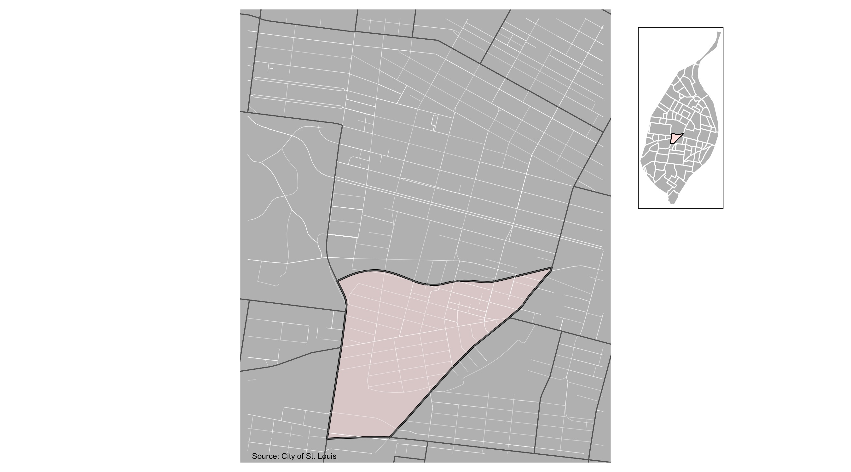
Forest Park Southeast

Slide 7
Forest Park Southeast: Month Summary Notes
63 total crimes in March 2022
232% change compared to March 2021 (19 total crimes)
10 crime(s) against persons in March 2022
900% change compared to March 2021 (1 crimes against persons)
5 crime(s) against society in March 2022
400% change compared to March 2021 (1 crimes against society)
38 crime(s) against propety in March 2022
171% change compared to March 2021 (14 crimes against property)
10 unspecified crime(s) in March 2022
233% change compared to March 2021 (3 unspecified crimes)

Slide 8
Forest Park Southeast: Year to Date Summary Notes
39 total crimes in 2022
-26% change compared to this time in 2021 (53 total crimes)
16 crime(s) against persons in 2022
167% change compared to this time in 2021 (6 crimes against persons)
8 crime(s) against society in 2022
33% change compared to this time in 2021 (6 crimes against society)
110 crime(s) against property in 2022
-20% change compared to this time in 2021 (138 crimes against property)
22 unspecified crime(s) in 2022
69% change compared to this time in 2021 (6 unspecified crimes)

Slide 9
Forest Park Southeast
2022 | 2022 | 2022 | 2022 | 2022
Type of Crime | Jan | Feb | Mar | Total
Person | 3 | 3 | 10 | 16
Property | 29 | 43 | 38 | 110
Society | 1 | 2 | 5 | 8
Unspecified | 6 | 6 | 10 | 22
Total | 39 | 54 | 63 | 156
2021 | 2021 | 2021 | 2021 | 2021
Type of Crime | Jan | Feb | Mar | Total
Person | 4 | 1 | 1 | 6
Property | 35 | 89 | 14 | 138
Society | 5 | 0 | 1 | 6
Unspecified | 9 | 1 | 3 | 13
Total | 53 | 91 | 19 | 163

Slide 10
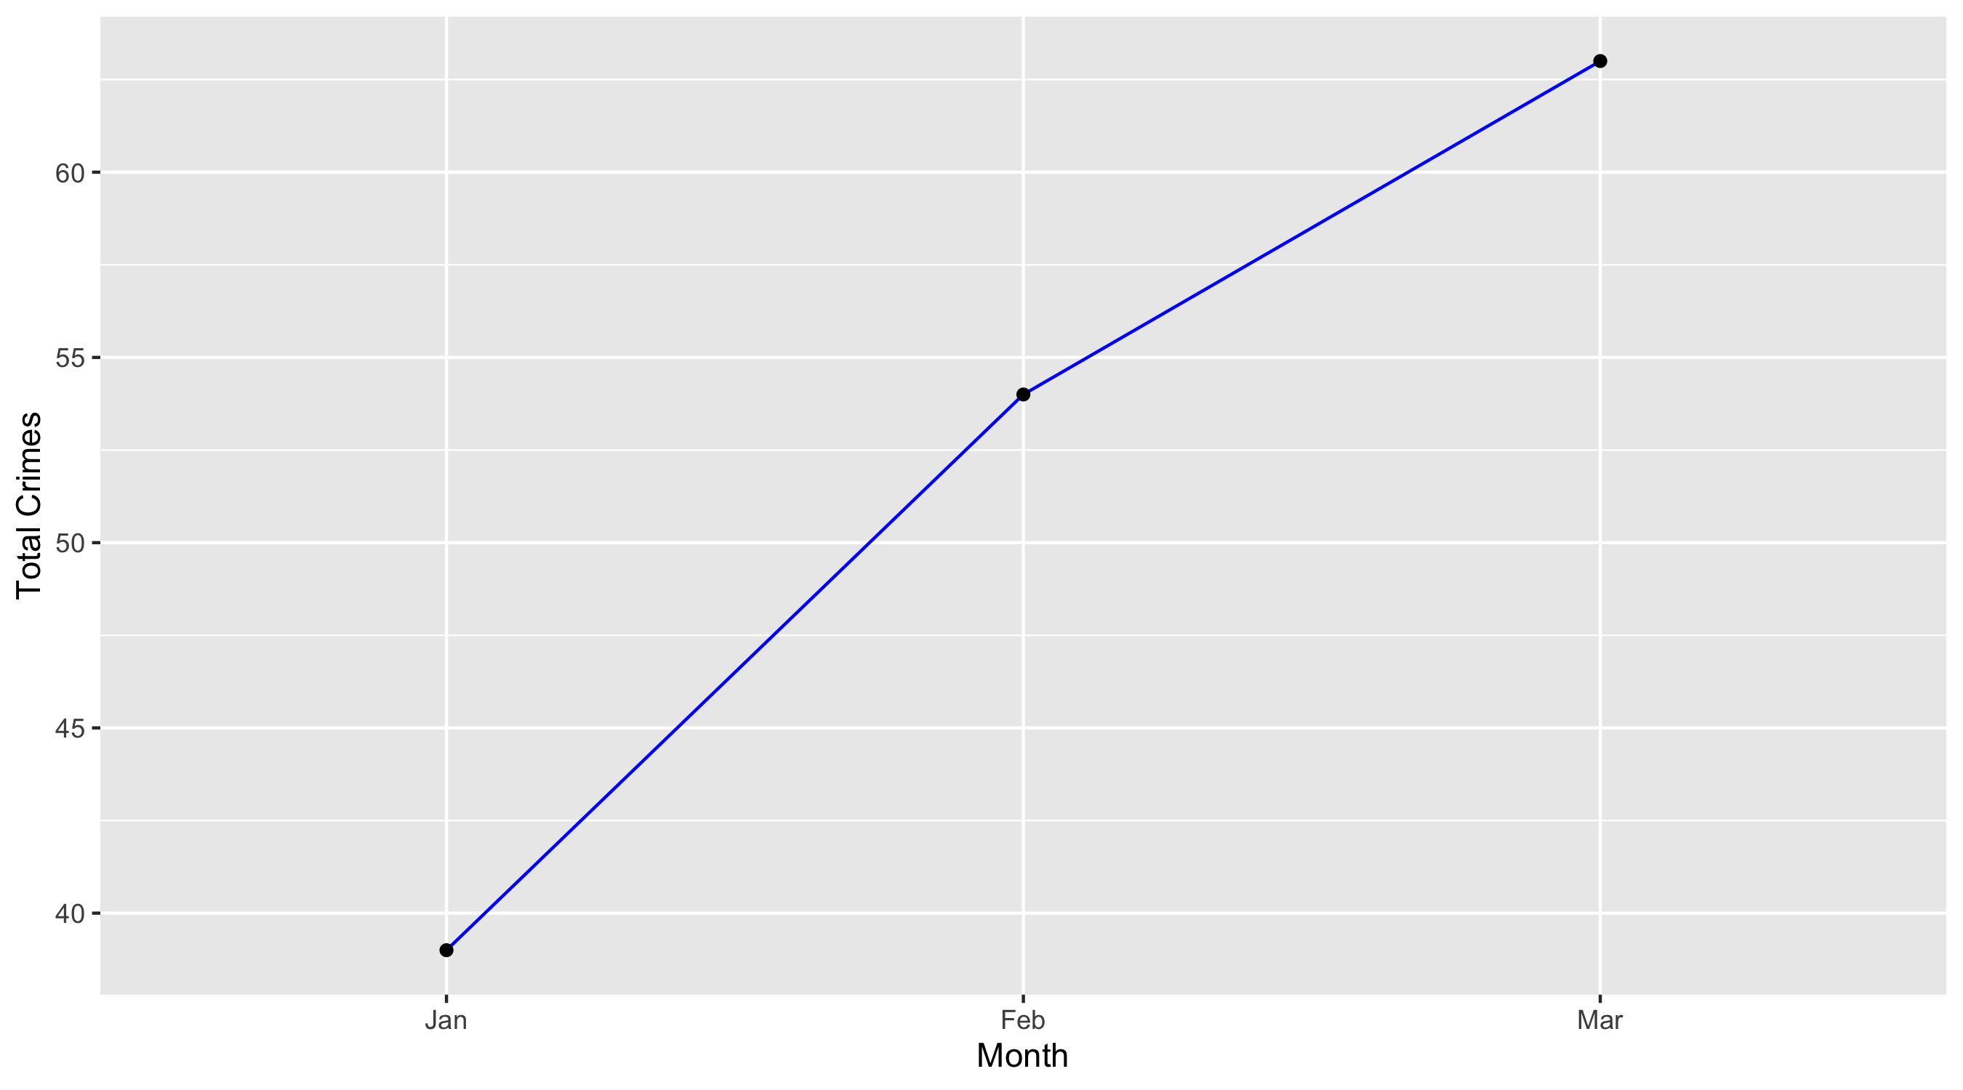
Forest Park Southeast

Slide 11
Forest Park Southeast: Property Crimes
Crime | Jan | Feb | Mar | Total
Robbery | 0 | 0 | 0 | 0
Arson | 0 | 0 | 0 | 0
Extortion/Blackmail | 0 | 0 | 0 | 0
Burglary/Breaking and Entering | 0 | 1 | 1 | 2
Pocket-picking | 0 | 0 | 0 | 0
Purse-snatching | 0 | 0 | 0 | 0
Shoplifting | 1 | 0 | 0 | 1
Theft From Building | 3 | 2 | 1 | 6
Theft From Coin-Operated Machine or Device | 0 | 0 | 0 | 0
Theft From MV | 7 | 12 | 14 | 33
Theft From MV Parts/Accessories | 2 | 2 | 3 | 7
All Other Larceny | 1 | 3 | 2 | 6
MV Theft | 4 | 3 | 1 | 8
Counterfeiting/Forgery | 0 | 0 | 0 | 0
False Pretense/Swindle/Confidence Game | 0 | 0 | 0 | 0
Credit Card/ATM Fraud | 0 | 0 | 0 | 0
Impersonation | 0 | 0 | 0 | 0
Welfare Fraud | 0 | 0 | 0 | 0
Wire Fraud | 0 | 0 | 0 | 0

Slide 12
Forest Park Southeast: Property Crimes
Crime | Jan | Feb | Mar | Total
Identity Theft | 0 | 0 | 0 | 0
Hacking/Computer Invasion | 0 | 0 | 0 | 0
Embezzlement | 0 | 0 | 0 | 0
Stolen Property Offenses | 0 | 0 | 1 | 1
Destruction/Damage/Vandalism of Property | 11 | 20 | 15 | 46
Bribery | 0 | 0 | 0 | 0
Bad Checks | 0 | 0 | 0 | 0
Total | 29 | 43 | 38 | 110

Slide 13
Forest Park Southeast: Society Crimes
Crime | Jan | Feb | Mar | Total
Drug/Narcotic Violations | 0 | 1 | 1 | 2
Drug Equipment Violations | 0 | 0 | 1 | 1
Pornography/Obscene Material | 0 | 0 | 0 | 0
Betting/Wagering | 0 | 0 | 0 | 0
Operating/Promoting/Assisting Gambling | 0 | 0 | 0 | 0
Gambling Equipment Violations | 0 | 0 | 0 | 0
Sports Tampering | 0 | 0 | 0 | 0
Prostitution | 0 | 0 | 0 | 0
Assisting or Promoting Prostitution | 0 | 0 | 0 | 0
Purchasing Prostitution | 0 | 0 | 0 | 0
Weapons Law Violations | 0 | 1 | 2 | 3
Animal Cruelty | 0 | 0 | 0 | 0
Curfew/Loitering/Vagrancy Violations | 0 | 0 | 0 | 0
Disorderly Conduct | 1 | 0 | 0 | 1
Driving Under the Influence | 0 | 0 | 0 | 0
Drunkeness | 0 | 0 | 0 | 0
Family Offenses, Nonviolent | 0 | 0 | 0 | 0
Liquor Law Violations | 0 | 0 | 0 | 0
Peeping Tom | 0 | 0 | 0 | 0
Trespass of Real Property | 0 | 0 | 1 | 1
Total | 1 | 2 | 5 | 8

Slide 14
Forest Park Southeast: Person Crimes
Crime | Jan | Feb | Mar | Total
Murder and Nonnegligent Manslaughter | 0 | 0 | 0 | 0
Negligent Manslaughter | 0 | 0 | 0 | 0
Justifiable Homicide | 0 | 0 | 0 | 0
Suicide | 0 | 0 | 0 | 0
Kidnapping/Abduction | 0 | 0 | 0 | 0
Rape | 0 | 0 | 0 | 0
Sodomy | 0 | 0 | 0 | 0
Sexual Assault with an Object | 0 | 0 | 0 | 0
Fondling | 0 | 0 | 0 | 0
Aggravated Assault | 0 | 1 | 3 | 4
*Aggravated Assault with Firearm | 0 | 0 | 3 | 3
Simple Assault | 3 | 1 | 4 | 8
Intimidation | 0 | 1 | 0 | 1
Incest | 0 | 0 | 0 | 0
Statutory Rape | 0 | 0 | 0 | 0
Human Trafficking, Commercial Sex Acts | 0 | 0 | 0 | 0
Human Trafficking, Involuntary Servitude | 0 | 0 | 0 | 0
Total | 3 | 3 | 10 | 16

Slide 15
Forest Park Southeast: Unspecified Crimes
Crime | Jan | Feb | Mar | Total
All Other Offenses | 6 | 6 | 10 | 22
Total | 6 | 6 | 10 | 22

Slide 16
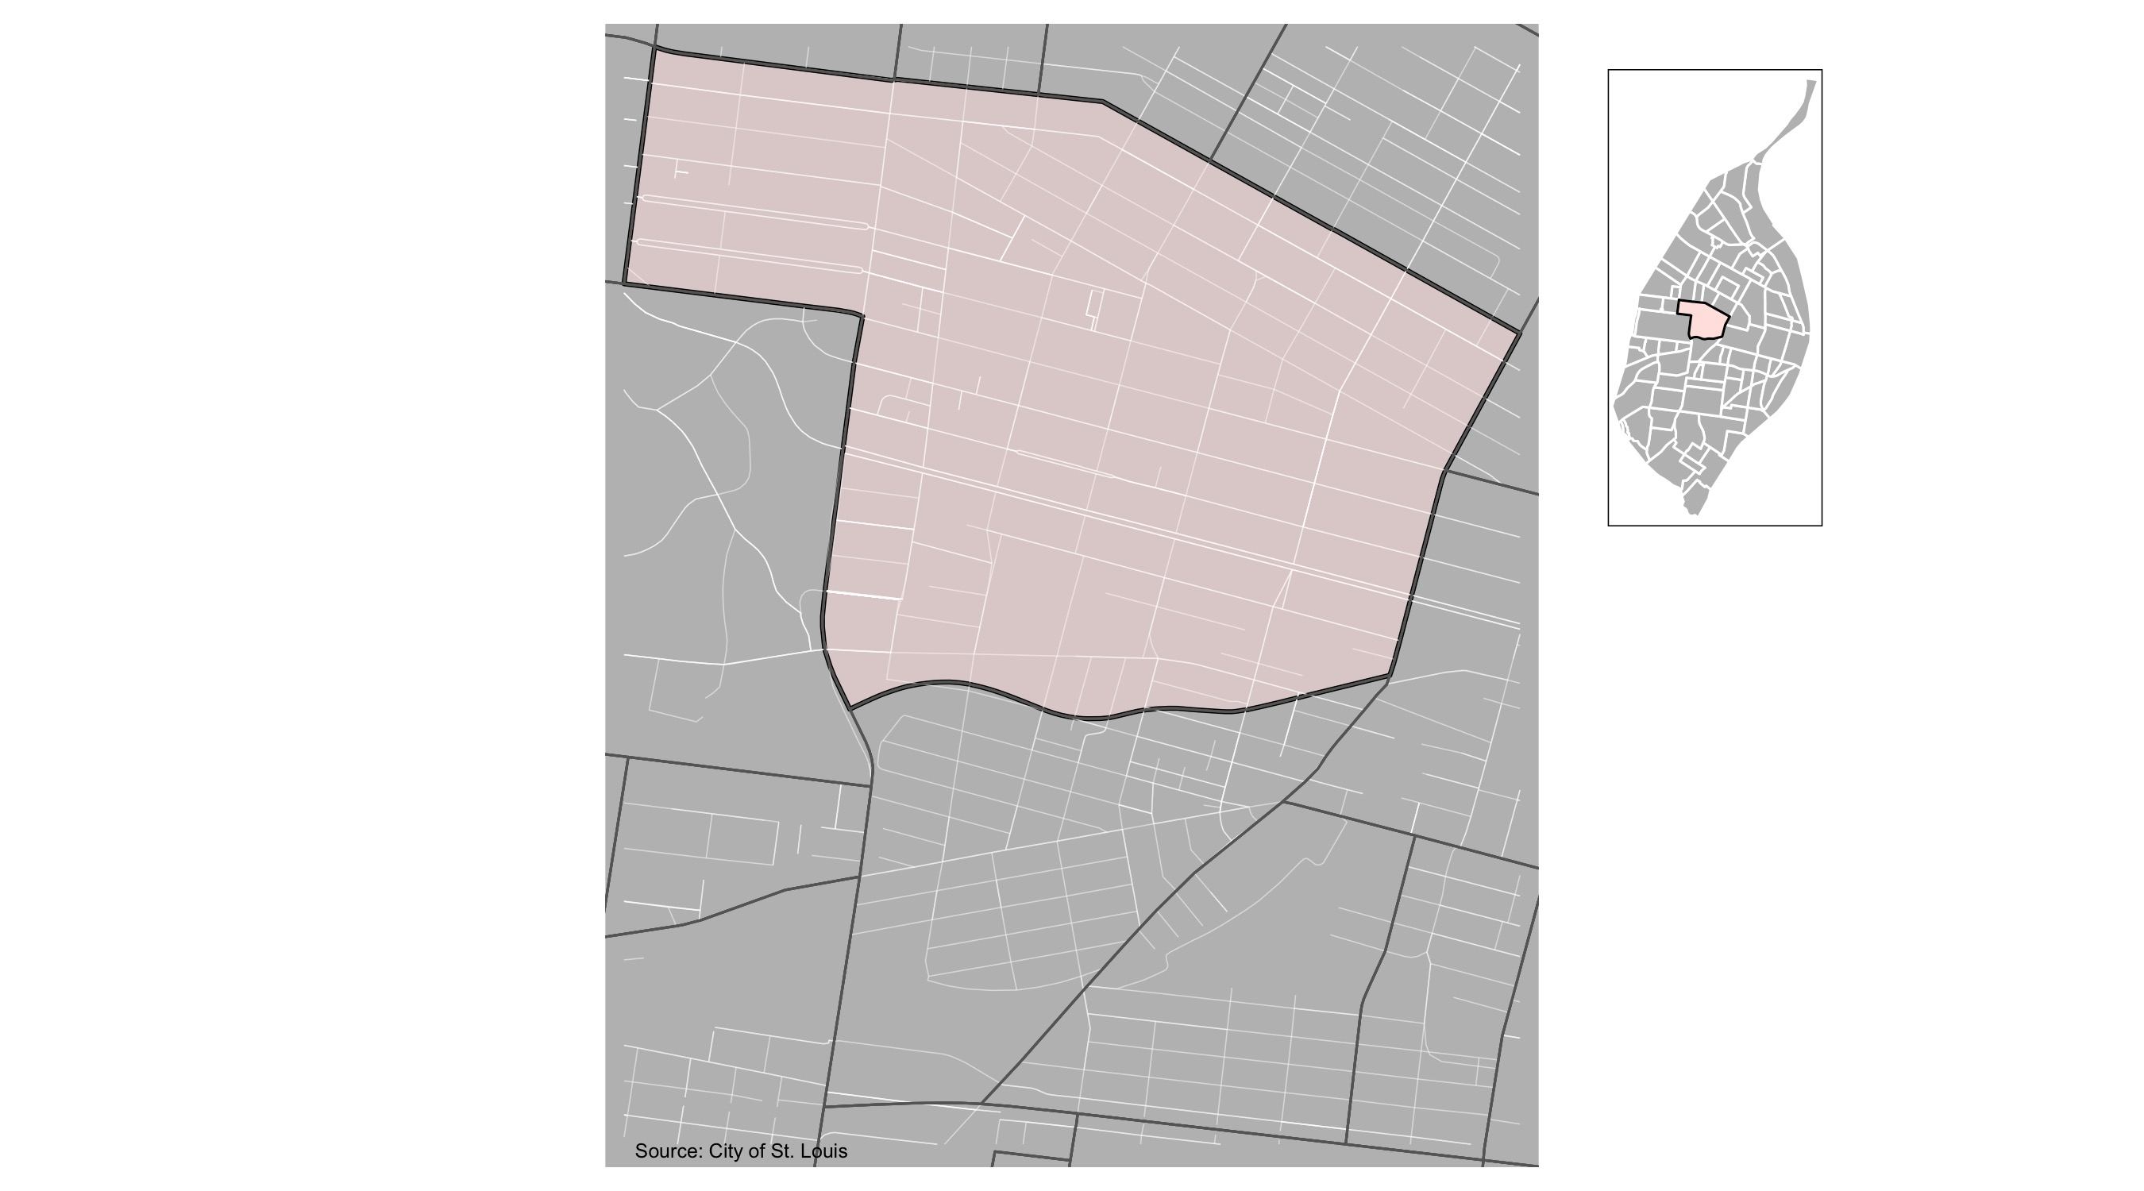
Central West End

Slide 17
Central West End: Month Summary Notes
176 total crimes in March 2022
39% change compared to March 2021 (127 total crimes)
37 crime(s) against persons in March 2022
825% change compared to March 2021 (4 crimes against persons)
17 crime(s) against society in March 2022
6% change compared to March 2021 (16 crimes against society)
96 crime(s) against propety in March 2022
16% change compared to March 2021 (83 crimes against property)
26 unspecified crime(s) in March 2022
8% change compared to March 2021 (24 unspecified crimes)

Slide 18
Central West End: Year to Date Summary Notes
142 total crimes in 2022
-11% change compared to this time in 2021 (160 total crimes)
79 crime(s) against persons in 2022
93% change compared to this time in 2021 (41 crimes against persons)
42 crime(s) against society in 2022
-34% change compared to this time in 2021 (64 crimes against society)
328 crime(s) against property in 2022
33% change compared to this time in 2021 (246 crimes against property)
59 unspecified crime(s) in 2022
11% change compared to this time in 2021 (41 unspecified crimes)

Slide 19
Central West End
2022 | 2022 | 2022 | 2022 | 2022
Type of Crime | Jan | Feb | Mar | Total
Person | 12 | 30 | 37 | 79
Property | 101 | 131 | 96 | 328
Society | 9 | 16 | 17 | 42
Unspecified | 20 | 13 | 26 | 59
Total | 142 | 190 | 176 | 508
2021 | 2021 | 2021 | 2021 | 2021
Type of Crime | Jan | Feb | Mar | Total
Person | 21 | 16 | 4 | 41
Property | 95 | 68 | 83 | 246
Society | 24 | 24 | 16 | 64
Unspecified | 20 | 9 | 24 | 53
Total | 160 | 117 | 127 | 404

Slide 20
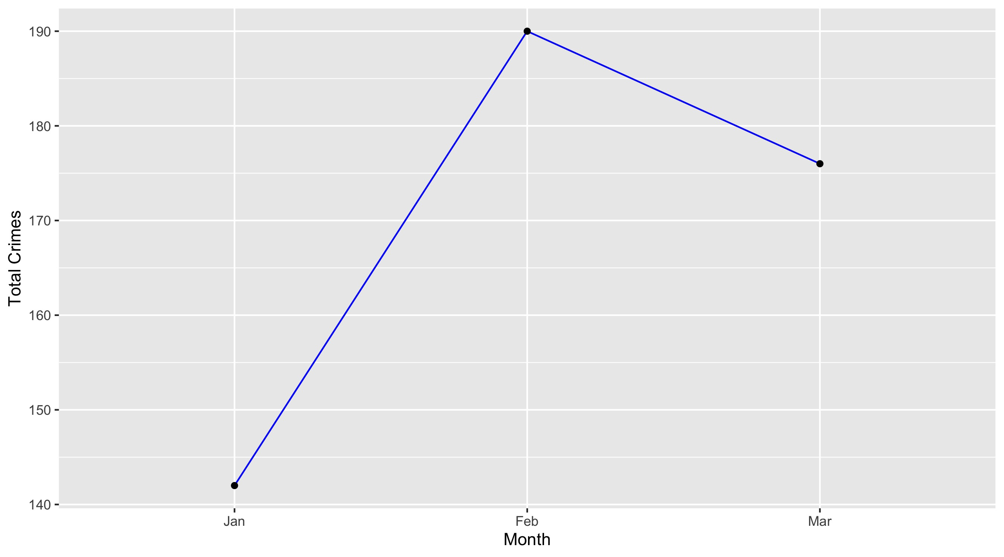
Central West End

Slide 21
Central West End: Property Crimes
Crime | Jan | Feb | Mar | Total
Robbery | 3 | 1 | 3 | 7
Arson | 0 | 0 | 0 | 0
Extortion/Blackmail | 0 | 0 | 0 | 0
Burglary/Breaking and Entering | 6 | 6 | 9 | 21
Pocket-picking | 0 | 0 | 0 | 0
Purse-snatching | 0 | 0 | 0 | 0
Shoplifting | 1 | 3 | 1 | 5
Theft From Building | 16 | 10 | 7 | 33
Theft From Coin-Operated Machine or Device | 0 | 0 | 0 | 0
Theft From MV | 24 | 27 | 25 | 76
Theft From MV Parts/Accessories | 6 | 20 | 9 | 35
All Other Larceny | 5 | 4 | 10 | 19
MV Theft | 9 | 15 | 10 | 34
Counterfeiting/Forgery | 1 | 2 | 0 | 3
False Pretense/Swindle/Confidence Game | 0 | 0 | 0 | 0
Credit Card/ATM Fraud | 2 | 0 | 2 | 4
Impersonation | 0 | 0 | 0 | 0
Welfare Fraud | 0 | 0 | 0 | 0
Wire Fraud | 0 | 0 | 0 | 0

Slide 22
Central West End: Property Crimes
Crime | Jan | Feb | Mar | Total
Identity Theft | 0 | 0 | 0 | 0
Hacking/Computer Invasion | 0 | 0 | 0 | 0
Embezzlement | 0 | 0 | 0 | 0
Stolen Property Offenses | 0 | 0 | 1 | 1
Destruction/Damage/Vandalism of Property | 28 | 43 | 19 | 90
Bribery | 0 | 0 | 0 | 0
Bad Checks | 0 | 0 | 0 | 0
Total | 101 | 131 | 96 | 328

Slide 23
Central West End: Society Crimes
Crime | Jan | Feb | Mar | Total
Drug/Narcotic Violations | 0 | 2 | 4 | 6
Drug Equipment Violations | 0 | 0 | 1 | 1
Pornography/Obscene Material | 0 | 0 | 0 | 0
Betting/Wagering | 0 | 0 | 0 | 0
Operating/Promoting/Assisting Gambling | 0 | 0 | 0 | 0
Gambling Equipment Violations | 0 | 0 | 0 | 0
Sports Tampering | 0 | 0 | 0 | 0
Prostitution | 0 | 0 | 0 | 0
Assisting or Promoting Prostitution | 0 | 0 | 0 | 0
Purchasing Prostitution | 0 | 0 | 0 | 0
Weapons Law Violations | 5 | 6 | 3 | 14
Animal Cruelty | 0 | 0 | 0 | 0
Curfew/Loitering/Vagrancy Violations | 0 | 0 | 1 | 1
Disorderly Conduct | 2 | 4 | 7 | 13
Driving Under the Influence | 0 | 1 | 0 | 1
Drunkeness | 0 | 0 | 0 | 0
Family Offenses, Nonviolent | 0 | 0 | 0 | 0
Liquor Law Violations | 0 | 0 | 0 | 0
Peeping Tom | 0 | 0 | 0 | 0
Trespass of Real Property | 2 | 3 | 1 | 6
Total | 9 | 16 | 17 | 42

Slide 24
Central West End: Person Crimes
Crime | Jan | Feb | Mar | Total
Murder and Nonnegligent Manslaughter | 0 | 0 | 2 | 2
Negligent Manslaughter | 0 | 0 | 0 | 0
Justifiable Homicide | 0 | 0 | 0 | 0
Suicide | 0 | 0 | 0 | 0
Kidnapping/Abduction | 0 | 0 | 0 | 0
Rape | 0 | 0 | 1 | 1
Sodomy | 0 | 1 | 0 | 1
Sexual Assault with an Object | 0 | 0 | 0 | 0
Fondling | 0 | 0 | 0 | 0
Aggravated Assault | 3 | 7 | 8 | 18
*Aggravated Assault with Firearm | 1 | 6 | 6 | 13
Simple Assault | 5 | 16 | 19 | 40
Intimidation | 3 | 0 | 0 | 3
Incest | 0 | 0 | 1 | 1
Statutory Rape | 0 | 0 | 0 | 0
Human Trafficking, Commercial Sex Acts | 0 | 0 | 0 | 0
Human Trafficking, Involuntary Servitude | 0 | 0 | 0 | 0
Total | 12 | 30 | 37 | 79

Slide 25
Central West End: Unspecified Crimes
Crime | Jan | Feb | Mar | Total
All Other Offenses | 20 | 13 | 26 | 59
Total | 20 | 13 | 26 | 59

Slide 26
Neighboring Geographies

Slide 27
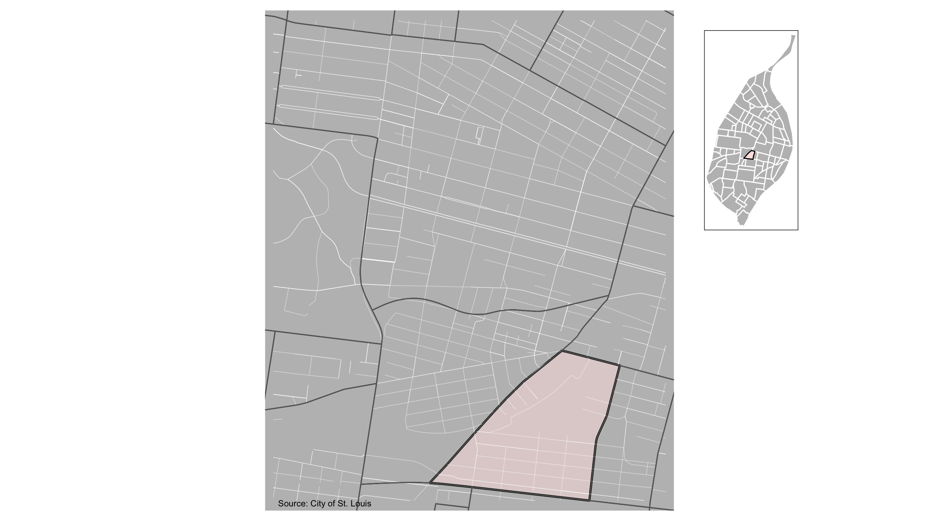
Botanical Heights

Slide 28
Botanical Heights: Month Summary Notes
22 total crimes in March 2022
100% change compared to March 2021 (11 total crimes)
5 crime(s) against persons in March 2022
Infinite change compared to March 2021 (0 crimes against persons)
1 crime(s) against society in March 2022
0% change compared to March 2021 (1 crimes against society)
15 crime(s) against propety in March 2022
67% change compared to March 2021 (9 crimes against property)
1 unspecified crime(s) in March 2022
0% change compared to March 2021 (1 unspecified crimes)

Slide 29
Botanical Heights: Year to Date Summary Notes
20 total crimes in 2022
122% change compared to this time in 2021 (9 total crimes)
10 crime(s) against persons in 2022
150% change compared to this time in 2021 (4 crimes against persons)
3 crime(s) against society in 2022
-25% change compared to this time in 2021 (4 crimes against society)
43 crime(s) against property in 2022
95% change compared to this time in 2021 (22 crimes against property)
4 unspecified crime(s) in 2022
0% change compared to this time in 2021 (4 unspecified crimes)

Slide 30
Botanical Heights
2022 | 2022 | 2022 | 2022 | 2022
Type of Crime | Jan | Feb | Mar | Total
Person | 4 | 1 | 5 | 10
Property | 14 | 14 | 15 | 43
Society | 2 | 0 | 1 | 3
Unspecified | 0 | 3 | 1 | 4
Total | 20 | 18 | 22 | 60
2021 | 2021 | 2021 | 2021 | 2021
Type of Crime | Jan | Feb | Mar | Total
Person | 1 | 3 | 0 | 4
Property | 4 | 9 | 9 | 22
Society | 1 | 2 | 1 | 4
Unspecified | 3 | 0 | 1 | 4
Total | 9 | 14 | 11 | 34

Slide 31
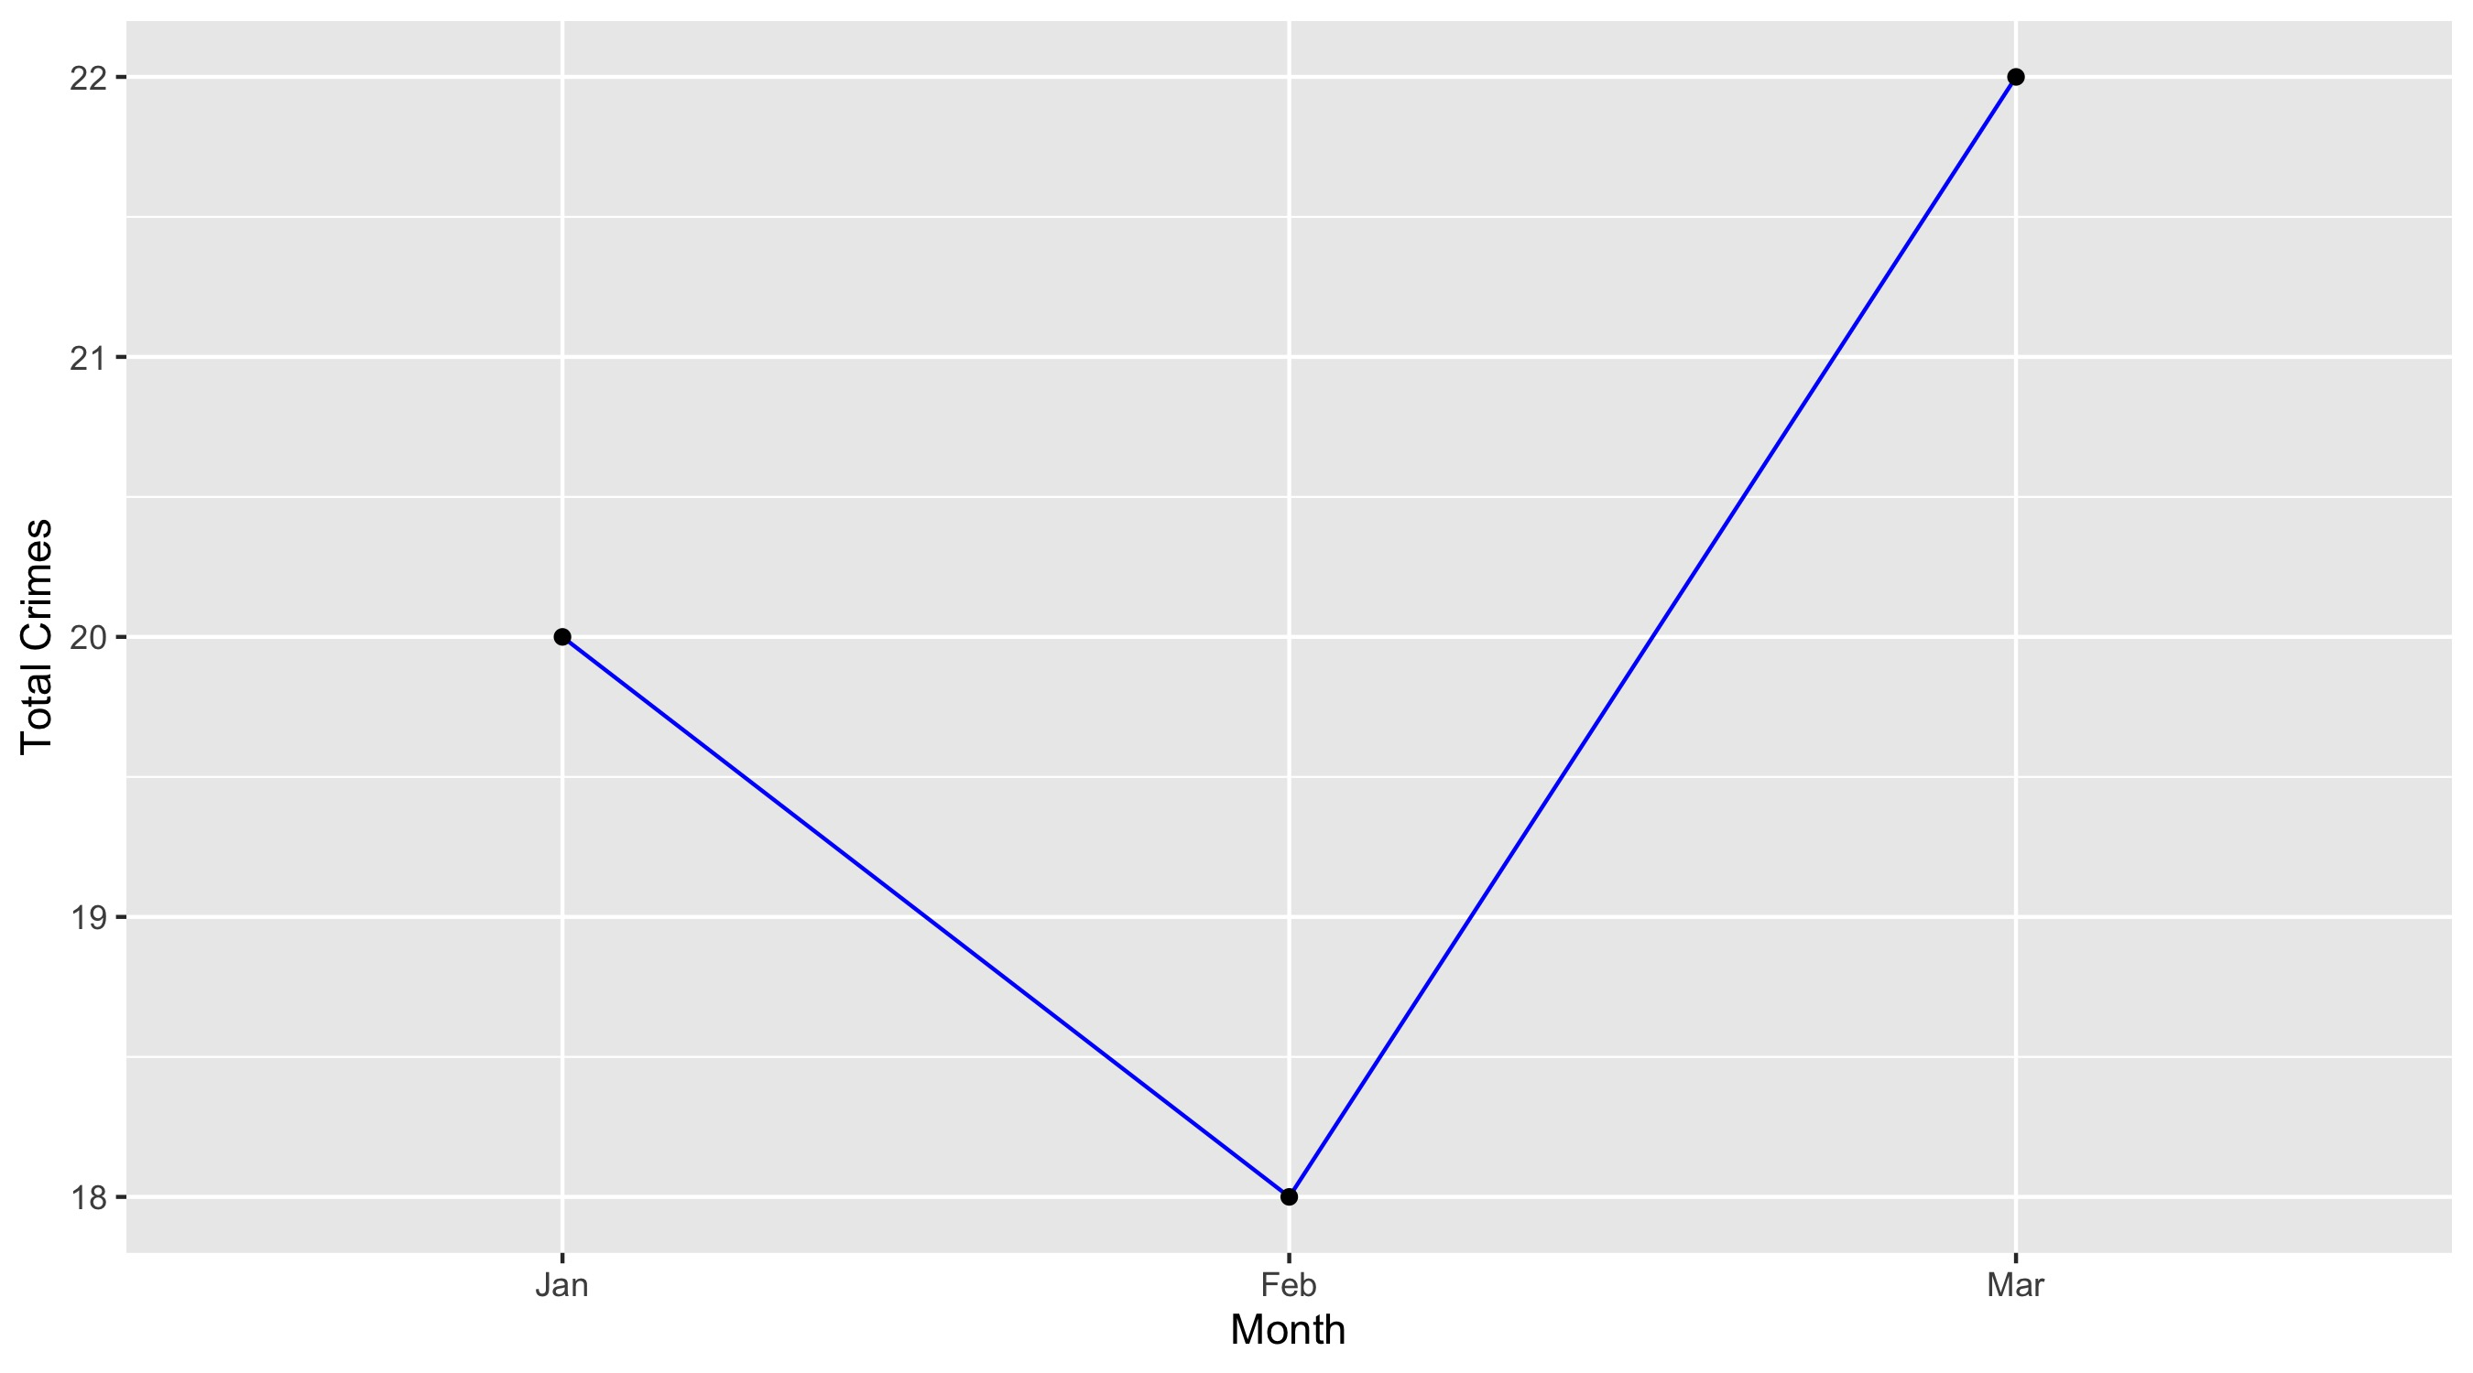
Botanical Heights

Slide 32
Botanical Heights: Property Crimes
Crime | Jan | Feb | Mar | Total
Robbery | 0 | 0 | 0 | 0
Arson | 0 | 0 | 0 | 0
Extortion/Blackmail | 0 | 0 | 0 | 0
Burglary/Breaking and Entering | 1 | 1 | 2 | 4
Pocket-picking | 0 | 0 | 0 | 0
Purse-snatching | 0 | 0 | 0 | 0
Shoplifting | 1 | 0 | 0 | 1
Theft From Building | 0 | 0 | 0 | 0
Theft From Coin-Operated Machine or Device | 0 | 0 | 0 | 0
Theft From MV | 5 | 5 | 4 | 14
Theft From MV Parts/Accessories | 1 | 1 | 1 | 3
All Other Larceny | 1 | 1 | 1 | 3
MV Theft | 1 | 2 | 0 | 3
Counterfeiting/Forgery | 0 | 0 | 0 | 0
False Pretense/Swindle/Confidence Game | 0 | 0 | 0 | 0
Credit Card/ATM Fraud | 0 | 0 | 0 | 0
Impersonation | 0 | 0 | 0 | 0
Welfare Fraud | 0 | 0 | 0 | 0
Wire Fraud | 0 | 0 | 0 | 0

Slide 33
Botanical Heights: Property Crimes
Crime | Jan | Feb | Mar | Total
Identity Theft | 0 | 0 | 0 | 0
Hacking/Computer Invasion | 0 | 0 | 0 | 0
Embezzlement | 0 | 0 | 0 | 0
Stolen Property Offenses | 0 | 0 | 0 | 0
Destruction/Damage/Vandalism of Property | 4 | 4 | 7 | 15
Bribery | 0 | 0 | 0 | 0
Bad Checks | 0 | 0 | 0 | 0
Total | 14 | 14 | 15 | 43

Slide 34
Botanical Heights: Society Crimes
Crime | Jan | Feb | Mar | Total
Drug/Narcotic Violations | 0 | 0 | 0 | 0
Drug Equipment Violations | 0 | 0 | 0 | 0
Pornography/Obscene Material | 0 | 0 | 0 | 0
Betting/Wagering | 0 | 0 | 0 | 0
Operating/Promoting/Assisting Gambling | 0 | 0 | 0 | 0
Gambling Equipment Violations | 0 | 0 | 0 | 0
Sports Tampering | 0 | 0 | 0 | 0
Prostitution | 0 | 0 | 0 | 0
Assisting or Promoting Prostitution | 0 | 0 | 0 | 0
Purchasing Prostitution | 0 | 0 | 0 | 0
Weapons Law Violations | 0 | 0 | 1 | 1
Animal Cruelty | 0 | 0 | 0 | 0
Curfew/Loitering/Vagrancy Violations | 0 | 0 | 0 | 0
Disorderly Conduct | 1 | 0 | 0 | 1
Driving Under the Influence | 0 | 0 | 0 | 0
Drunkeness | 0 | 0 | 0 | 0
Family Offenses, Nonviolent | 0 | 0 | 0 | 0
Liquor Law Violations | 0 | 0 | 0 | 0
Peeping Tom | 0 | 0 | 0 | 0
Trespass of Real Property | 1 | 0 | 0 | 1
Total | 2 | 0 | 1 | 3

Slide 35
Botanical Heights: Person Crimes
Crime | Jan | Feb | Mar | Total
Murder and Nonnegligent Manslaughter | 0 | 0 | 0 | 0
Negligent Manslaughter | 0 | 0 | 0 | 0
Justifiable Homicide | 0 | 0 | 0 | 0
Suicide | 0 | 0 | 0 | 0
Kidnapping/Abduction | 0 | 0 | 0 | 0
Rape | 0 | 0 | 0 | 0
Sodomy | 0 | 0 | 0 | 0
Sexual Assault with an Object | 0 | 0 | 0 | 0
Fondling | 0 | 0 | 0 | 0
Aggravated Assault | 2 | 0 | 2 | 4
*Aggravated Assault with Firearm | 2 | 0 | 2 | 4
Simple Assault | 0 | 1 | 1 | 2
Intimidation | 0 | 0 | 0 | 0
Incest | 0 | 0 | 0 | 0
Statutory Rape | 0 | 0 | 0 | 0
Human Trafficking, Commercial Sex Acts | 0 | 0 | 0 | 0
Human Trafficking, Involuntary Servitude | 0 | 0 | 0 | 0
Total | 4 | 1 | 5 | 10

Slide 36
Botanical Heights: Unspecified Crimes
Crime | Jan | Feb | Mar | Total
All Other Offenses | 0 | 3 | 1 | 4
Total | 0 | 3 | 1 | 4

