Slide 1
Forest Park Southeast, Central West End, Botanical Heights,
Monthly Crime Report: December 2021
Washington University Medical Center

Slide 2
History of Crime Reporting
Since the 1929 the Uniform Crime Report (UCR) has used a Summary Reporting System (SRS) to collect monthly counts of the number of crimes
In 1982 the Bureau of Justice Statistics and the FBI sponsored a study with the objective of revising the existing form of reporting crime. Through this, the National Incident Based Reporting System (NIBRS) was created
The FBI UCR Program transitioned to a NIBRS only data collection by January 1, 2021. Other states have followed suit and SLMPD has been working to make this same transition

Slide 3
NIBRS vs SRS
NIBRS captures details on each single crime incident—as well as on separate offenses within the same incident—including information on victims, known offenders, relationships between victims and offenders, arrestees, and property involved in crimes
Standardizes crime reporting across all local, state, and tribal law enforcement agencies
SRS only counted the most serious offense (i.e. if a murder and robbery occurred, only the murder is counted) while NIBRS counts up to 10 crimes per incident
Current NIBRS reporting are not directly comparable to the previous UCR “hierarchy” numbers. With this change, you will likely see increases in crime statistics. This increase does not mean that crime is necessarily increasing, but rather that crime is being reported in a non-hierarchical format, with more detail and counting each individual crime

Slide 4
NIBRS and SLMPD
Unforeseen technology delays and the incompatibility in comparing crime (NIRBS V. UCR) has caused delays in making the crime information available
The City of St Louis Information Technology Division (I.T.) has created a series of internal 2021 NIBRS reports
Because of this transition information is limited to counts of each crime by neighborhood

Slide 5
Core Neighborhoods

Slide 6
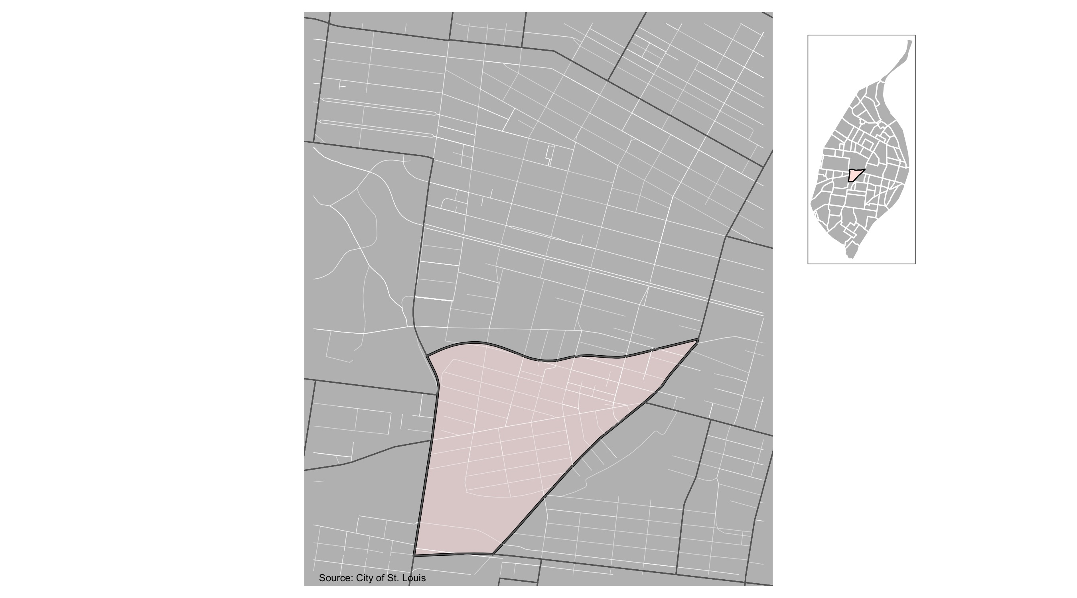
Forest Park Southeast

Slide 7
Forest Park Southeast: Summary Notes
92 total crimes in December 2021
6 crime(s) against persons
81 crime(s) against property
5 crime(s) against society
0 unspecified crimes

Slide 8
Forest Park Southeast
Type of Crime | Jan | Feb | Mar | Apr | May | Jun | Jul | Aug | Sep | Oct | Nov | Dec
Person | 3 | 1 | 1 | 2 | 3 | 8 | 11 | 4 | 4 | 6 | 6 | 4
Property | 35 | 83 | 14 | 26 | 114 | 64 | 85 | 71 | 43 | 74 | 81 | 36
Society | 5 | 0 | 1 | 2 | 0 | 5 | 7 | 2 | 3 | 3 | 5 | 2
Unspecified | 0 | 0 | 0 | 0 | 0 | 0 | 0 | 0 | 0 | 0 | 0 | 0
Total | 43 | 84 | 16 | 30 | 117 | 77 | 103 | 77 | 50 | 83 | 92 | 42

Slide 9
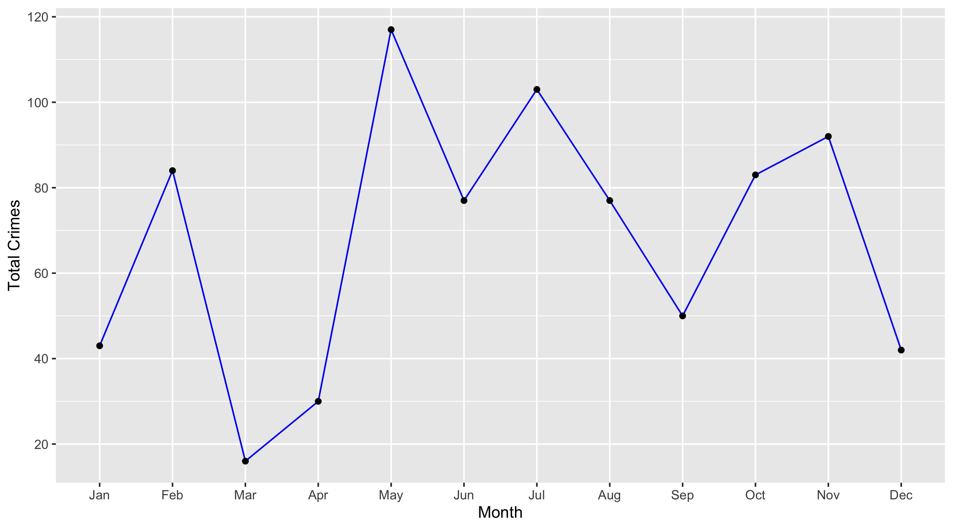
Forest Park Southeast

Slide 10
Forest Park Southeast: Property Crimes
Crime | Jan | Feb | Mar | Apr | May | Jun | Jul | Aug | Sep | Oct | Nov | Dec | Total
Robbery | 0 | 0 | 0 | 0 | 2 | 1 | 0 | 0 | 1 | 2 | 0 | 0 | 6
Arson | 0 | 1 | 0 | 0 | 0 | 0 | 0 | 0 | 0 | 0 | 0 | 0 | 1
Extortion/Blackmail | 0 | 0 | 0 | 0 | 0 | 0 | 0 | 0 | 0 | 0 | 0 | 0 | 0
Burglary/Breaking and Entering | 0 | 0 | 0 | 0 | 1 | 0 | 1 | 2 | 0 | 1 | 2 | 1 | 8
Pocket-picking | 0 | 0 | 0 | 0 | 0 | 0 | 0 | 0 | 0 | 0 | 0 | 0 | 0
Purse-snatching | 0 | 0 | 0 | 0 | 0 | 1 | 0 | 0 | 0 | 0 | 1 | 0 | 2
Shoplifting | 0 | 0 | 0 | 0 | 0 | 0 | 0 | 0 | 0 | 0 | 0 | 0 | 0
Theft From Building | 0 | 1 | 1 | 0 | 0 | 0 | 0 | 1 | 1 | 6 | 3 | 1 | 14
Theft From Coin-Operated Machine or Device | 0 | 0 | 0 | 0 | 0 | 0 | 0 | 0 | 0 | 0 | 0 | 0 | 0
Theft From MV | 9 | 31 | 5 | 7 | 45 | 22 | 29 | 24 | 18 | 27 | 31 | 11 | 259
Theft From MV Parts/Accessories | 5 | 3 | 1 | 4 | 6 | 2 | 5 | 3 | 2 | 4 | 1 | 2 | 38
All Other Larceny | 3 | 1 | 1 | 2 | 2 | 3 | 1 | 4 | 2 | 3 | 1 | 1 | 24
MV Theft | 7 | 9 | 1 | 2 | 10 | 8 | 4 | 3 | 0 | 3 | 4 | 5 | 56
Counterfeiting/Forgery | 0 | 0 | 0 | 0 | 0 | 0 | 0 | 0 | 0 | 0 | 0 | 0 | 0
False Pretense/Swindle/Confidence Game | 1 | 0 | 0 | 0 | 0 | 0 | 0 | 0 | 0 | 0 | 0 | 0 | 1
Credit Card/ATM Fraud | 0 | 0 | 0 | 0 | 0 | 0 | 1 | 0 | 0 | 0 | 0 | 0 | 1
Impersonation | 0 | 0 | 1 | 0 | 0 | 0 | 0 | 0 | 0 | 0 | 0 | 0 | 1
Welfare Fraud | 0 | 0 | 0 | 0 | 0 | 0 | 0 | 0 | 0 | 0 | 0 | 0 | 0
Wire Fraud | 0 | 0 | 0 | 0 | 0 | 0 | 0 | 0 | 0 | 0 | 0 | 0 | 0

Slide 11
Forest Park Southeast: Property Crimes
Crime | Jan | Feb | Mar | Apr | May | Jun | Jul | Aug | Sep | Oct | Nov | Dec | Total
Identity Theft | 0 | 0 | 0 | 0 | 0 | 0 | 0 | 0 | 0 | 0 | 1 | 0 | 1
Hacking/Computer Invasion | 0 | 0 | 0 | 0 | 0 | 0 | 0 | 0 | 0 | 0 | 0 | 0 | 0
Embezzlement | 0 | 0 | 0 | 0 | 0 | 0 | 0 | 0 | 0 | 0 | 0 | 0 | 0
Stolen Property Offenses | 0 | 0 | 0 | 0 | 0 | 0 | 1 | 1 | 1 | 1 | 1 | 0 | 5
Destruction/Damage/Vandalism of Property | 10 | 37 | 4 | 11 | 48 | 27 | 43 | 33 | 18 | 27 | 36 | 15 | 309
Bribery | 0 | 0 | 0 | 0 | 0 | 0 | 0 | 0 | 0 | 0 | 0 | 0 | 0
Total | 35 | 83 | 14 | 26 | 114 | 64 | 85 | 71 | 43 | 74 | 81 | 36 | 726

Slide 12
Forest Park Southeast: Society Crimes
Crime | Jan | Feb | Mar | Apr | May | Jun | Jul | Aug | Sep | Oct | Nov | Dec | Total
Drug/Narcotic Violations | 1 | 0 | 0 | 0 | 0 | 1 | 4 | 1 | 2 | 1 | 2 | 0 | 12
Drug Equipment Violations | 1 | 0 | 0 | 0 | 0 | 1 | 1 | 0 | 0 | 0 | 0 | 0 | 3
Pornography/Obscene Material | 0 | 0 | 0 | 0 | 0 | 0 | 0 | 0 | 0 | 0 | 0 | 0 | 0
Betting/Wagering | 0 | 0 | 0 | 0 | 0 | 0 | 0 | 0 | 0 | 0 | 0 | 0 | 0
Operating/Promoting/Assisting Gambling | 0 | 0 | 0 | 0 | 0 | 0 | 0 | 0 | 0 | 0 | 0 | 0 | 0
Gambling Equipment Violations | 0 | 0 | 0 | 0 | 0 | 0 | 0 | 0 | 0 | 0 | 0 | 0 | 0
Sports Tampering | 0 | 0 | 0 | 0 | 0 | 0 | 0 | 0 | 0 | 0 | 0 | 0 | 0
Prostitution | 0 | 0 | 0 | 0 | 0 | 0 | 0 | 0 | 0 | 0 | 0 | 0 | 0
Assisting or Promoting Prostitution | 0 | 0 | 0 | 0 | 0 | 0 | 0 | 0 | 0 | 0 | 0 | 0 | 0
Purchasing Prostitution | 0 | 0 | 0 | 0 | 0 | 0 | 0 | 0 | 0 | 0 | 0 | 0 | 0
Weapons Law Violations | 1 | 0 | 1 | 0 | 0 | 2 | 1 | 1 | 0 | 0 | 3 | 1 | 10
Animal Cruelty | 0 | 0 | 0 | 0 | 0 | 0 | 0 | 0 | 0 | 0 | 0 | 0 | 0
Curfew/Loitering/Vagrancy Violations | 0 | 0 | 0 | 0 | 0 | 0 | 0 | 0 | 0 | 0 | 0 | 0 | 0
Disorderly Conduct | 1 | 0 | 0 | 2 | 0 | 1 | 0 | 0 | 1 | 0 | 0 | 1 | 6
Driving Under the Influence | 1 | 0 | 0 | 0 | 0 | 0 | 1 | 0 | 0 | 1 | 0 | 0 | 3
Drunkeness | 0 | 0 | 0 | 0 | 0 | 0 | 0 | 0 | 0 | 0 | 0 | 0 | 0
Family Offenses, Nonviolent | 0 | 0 | 0 | 0 | 0 | 0 | 0 | 0 | 0 | 0 | 0 | 0 | 0
Liquor Law Violations | 0 | 0 | 0 | 0 | 0 | 0 | 0 | 0 | 0 | 1 | 0 | 0 | 1
Peeping Tom | 0 | 0 | 0 | 0 | 0 | 0 | 0 | 0 | 0 | 0 | 0 | 0 | 0
Total | 5 | 0 | 1 | 2 | 0 | 5 | 7 | 2 | 3 | 3 | 5 | 2 | 35

Slide 13
Forest Park Southeast: Person Crimes
Crime | Jan | Feb | Mar | Apr | May | Jun | Jul | Aug | Sep | Oct | Nov | Dec | Total
Murder and Nonnegligent Manslaughter | 0 | 0 | 0 | 0 | 0 | 0 | 0 | 0 | 0 | 0 | 0 | 0 | 0
Negligent Manslaughter | 0 | 0 | 0 | 0 | 0 | 0 | 0 | 0 | 0 | 0 | 0 | 0 | 0
Justifiable Homicide | 0 | 0 | 0 | 0 | 0 | 0 | 0 | 0 | 0 | 0 | 0 | 0 | 0
Suicide | 0 | 0 | 0 | 0 | 0 | 0 | 0 | 0 | 0 | 0 | 0 | 0 | 0
Kidnapping/Abduction | 0 | 0 | 0 | 0 | 0 | 0 | 0 | 0 | 0 | 0 | 1 | 0 | 1
Rape | 0 | 0 | 0 | 0 | 0 | 0 | 0 | 0 | 0 | 0 | 0 | 0 | 0
Sodomy | 0 | 0 | 0 | 0 | 0 | 0 | 0 | 0 | 0 | 0 | 0 | 0 | 0
Sexual Assault with an Object | 0 | 0 | 0 | 0 | 0 | 0 | 0 | 0 | 0 | 0 | 0 | 0 | 0
Fondling | 0 | 0 | 0 | 0 | 0 | 0 | 0 | 0 | 0 | 0 | 0 | 0 | 0
Aggravated Assault | 2 | 1 | 0 | 1 | 1 | 4 | 2 | 3 | 1 | 4 | 3 | 1 | 23
Simple Assault | 1 | 0 | 1 | 1 | 2 | 3 | 9 | 1 | 2 | 2 | 2 | 3 | 27
Intimidation | 0 | 0 | 0 | 0 | 0 | 1 | 0 | 0 | 1 | 0 | 0 | 0 | 2
Incest | 0 | 0 | 0 | 0 | 0 | 0 | 0 | 0 | 0 | 0 | 0 | 0 | 0
Statutory Rape | 0 | 0 | 0 | 0 | 0 | 0 | 0 | 0 | 0 | 0 | 0 | 0 | 0
Human Trafficking, Commercial Sex Acts | 0 | 0 | 0 | 0 | 0 | 0 | 0 | 0 | 0 | 0 | 0 | 0 | 0
Total | 3 | 1 | 1 | 2 | 3 | 8 | 11 | 4 | 4 | 6 | 6 | 4 | 53

Slide 14
Forest Park Southeast: Unspecified Crimes
Crime | Jan | Feb | Mar | Apr | May | Jun | Jul | Aug | Sep | Oct | Nov | Dec | Total
Runaway | 0 | 0 | 0 | 0 | 0 | 0 | 0 | 0 | 0 | 0 | 0 | 0 | 0
Total | 0 | 0 | 0 | 0 | 0 | 0 | 0 | 0 | 0 | 0 | 0 | 0 | 0

Slide 15
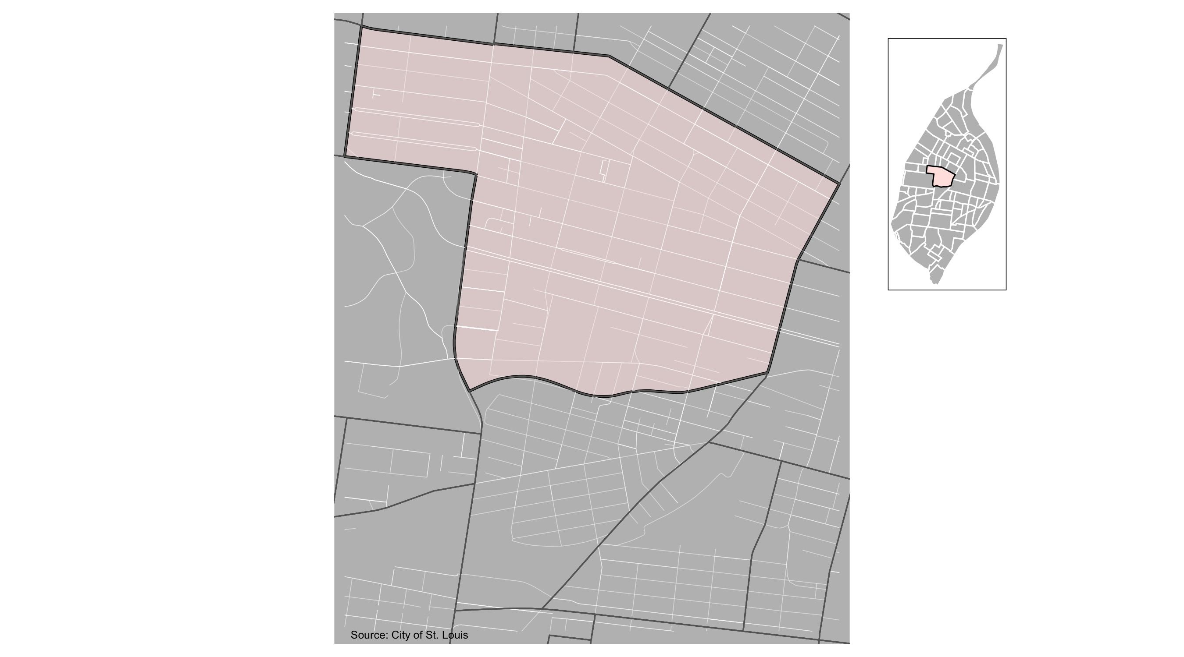
Central West End

Slide 16
Central West End: Summary Notes
170 total crimes in December 2021
18 crime(s) against persons
145 crime(s) against property
7 crime(s) against society
0 unspecified crimes

Slide 17
Central West End
Type of Crime | Jan | Feb | Mar | Apr | May | Jun | Jul | Aug | Sep | Oct | Nov | Dec
Person | 14 | 7 | 3 | 9 | 13 | 11 | 17 | 18 | 19 | 27 | 18 | 22
Property | 92 | 61 | 83 | 80 | 101 | 105 | 123 | 134 | 194 | 156 | 145 | 106
Society | 18 | 19 | 12 | 15 | 12 | 4 | 11 | 7 | 13 | 13 | 7 | 8
Unspecified | 0 | 0 | 0 | 0 | 0 | 0 | 0 | 0 | 0 | 0 | 0 | 0
Total | 124 | 87 | 98 | 104 | 126 | 120 | 151 | 159 | 226 | 196 | 170 | 136

Slide 18
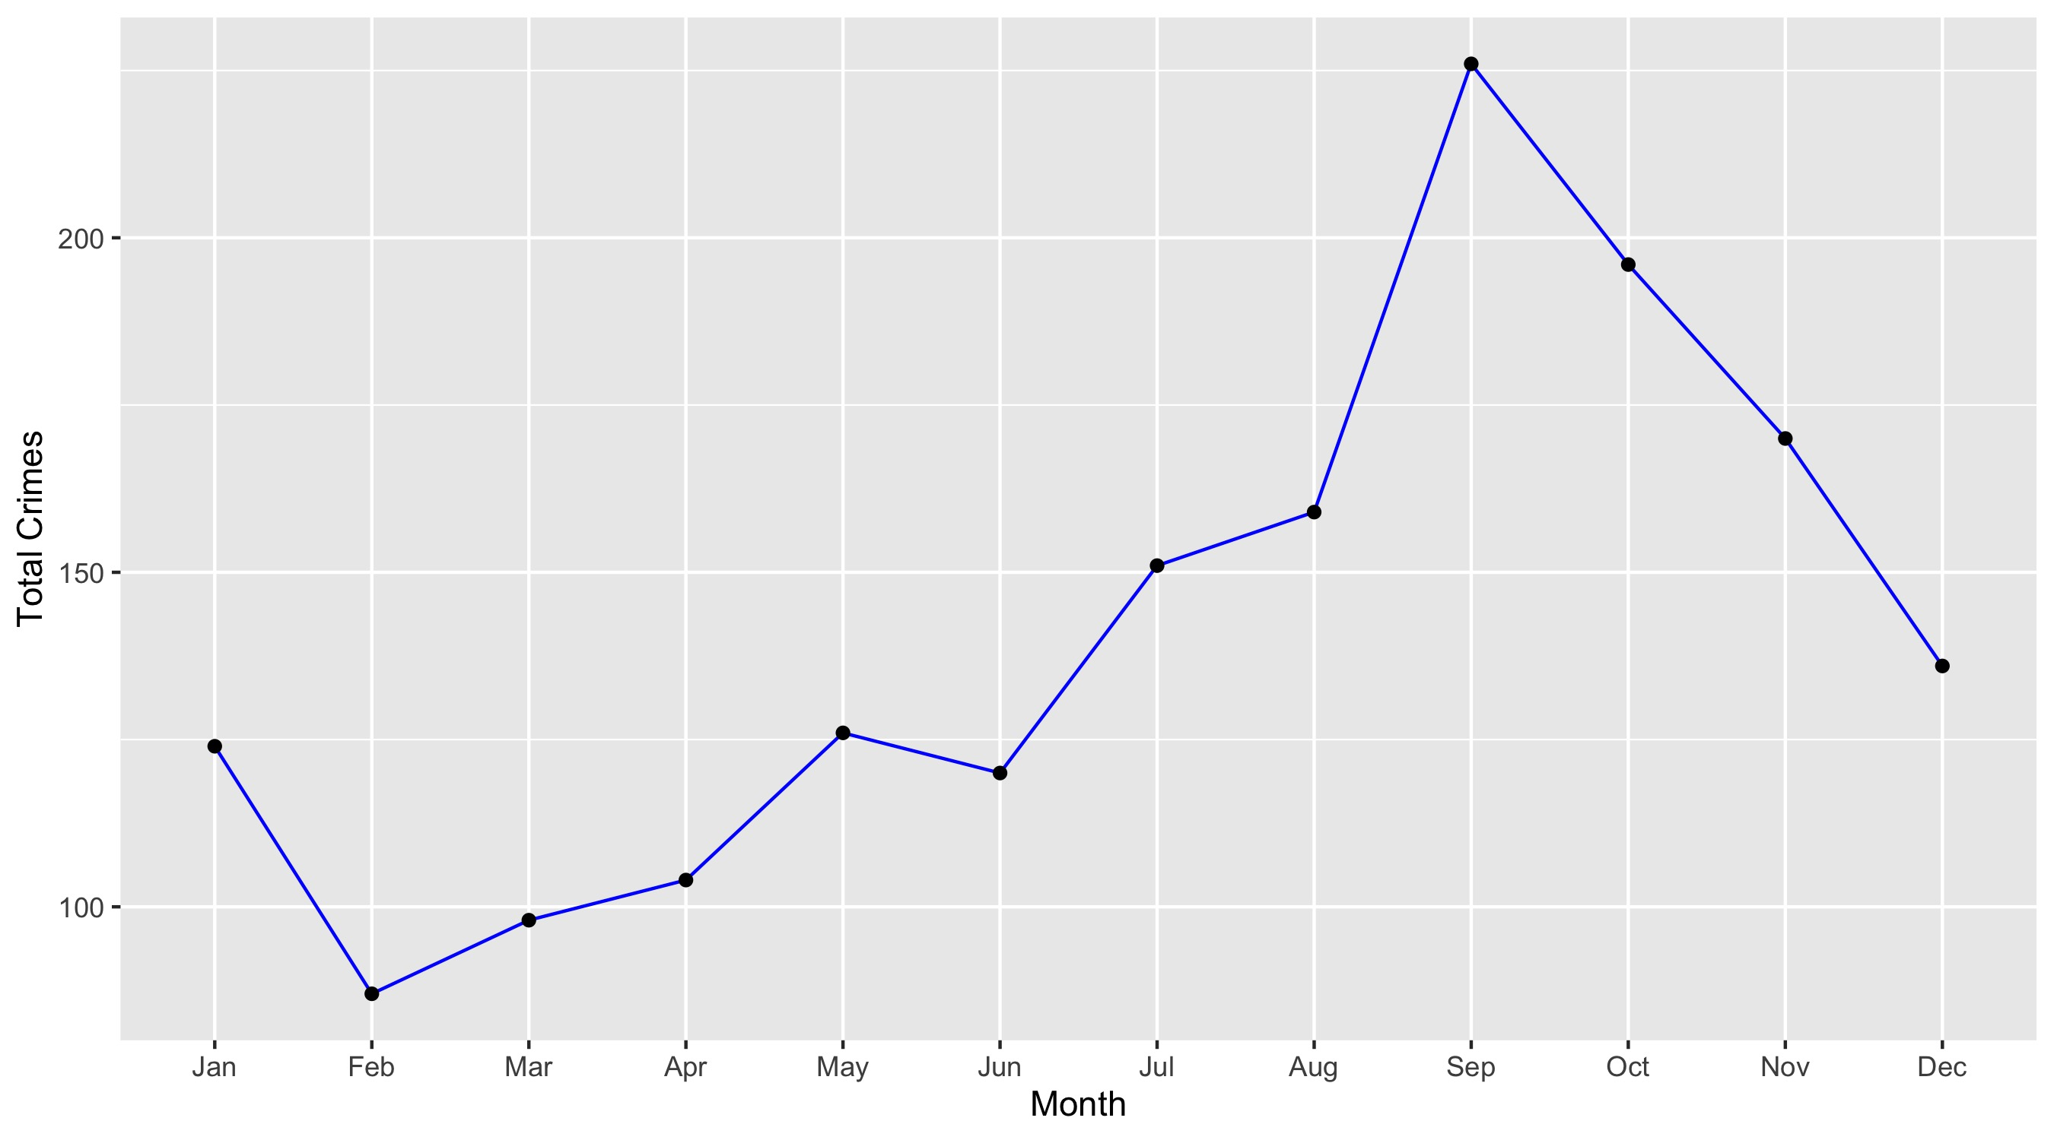
Central West End

Slide 19
Central West End: Property Crimes
Crime | Jan | Feb | Mar | Apr | May | Jun | Jul | Aug | Sep | Oct | Nov | Dec | Total
Robbery | 6 | 3 | 1 | 4 | 3 | 5 | 4 | 2 | 11 | 1 | 1 | 2 | 43
Arson | 0 | 1 | 0 | 0 | 0 | 0 | 0 | 1 | 0 | 1 | 0 | 0 | 3
Extortion/Blackmail | 0 | 0 | 0 | 0 | 0 | 0 | 0 | 0 | 0 | 0 | 0 | 0 | 0
Burglary/Breaking and Entering | 7 | 2 | 5 | 8 | 5 | 4 | 7 | 10 | 21 | 6 | 9 | 7 | 91
Pocket-picking | 1 | 0 | 0 | 0 | 2 | 0 | 0 | 2 | 0 | 0 | 0 | 0 | 5
Purse-snatching | 0 | 0 | 0 | 0 | 0 | 0 | 1 | 1 | 0 | 0 | 0 | 0 | 2
Shoplifting | 3 | 4 | 14 | 8 | 8 | 15 | 12 | 13 | 2 | 7 | 1 | 1 | 88
Theft From Building | 7 | 2 | 6 | 9 | 9 | 9 | 9 | 10 | 22 | 8 | 11 | 3 | 105
Theft From Coin-Operated Machine or Device | 0 | 0 | 1 | 0 | 0 | 0 | 0 | 0 | 0 | 0 | 0 | 0 | 1
Theft From MV | 15 | 15 | 12 | 7 | 18 | 18 | 27 | 35 | 38 | 48 | 41 | 29 | 303
Theft From MV Parts/Accessories | 18 | 8 | 6 | 10 | 13 | 11 | 13 | 10 | 23 | 19 | 13 | 11 | 155
All Other Larceny | 11 | 8 | 10 | 7 | 8 | 5 | 7 | 11 | 11 | 11 | 8 | 10 | 107
MV Theft | 4 | 8 | 9 | 4 | 5 | 6 | 6 | 9 | 20 | 11 | 5 | 6 | 93
Counterfeiting/Forgery | 0 | 0 | 1 | 0 | 0 | 0 | 0 | 0 | 0 | 0 | 1 | 2 | 4
False Pretense/Swindle/Confidence Game | 0 | 0 | 0 | 0 | 1 | 1 | 0 | 2 | 0 | 0 | 1 | 0 | 5
Credit Card/ATM Fraud | 0 | 0 | 0 | 0 | 1 | 1 | 1 | 0 | 0 | 2 | 1 | 0 | 6
Impersonation | 0 | 1 | 0 | 1 | 0 | 0 | 0 | 0 | 0 | 0 | 0 | 0 | 2
Welfare Fraud | 0 | 0 | 0 | 0 | 0 | 0 | 0 | 0 | 0 | 0 | 0 | 0 | 0
Wire Fraud | 0 | 0 | 0 | 0 | 0 | 0 | 0 | 0 | 0 | 0 | 0 | 0 | 0

Slide 20
Central West End: Property Crimes
Crime | Jan | Feb | Mar | Apr | May | Jun | Jul | Aug | Sep | Oct | Nov | Dec | Total
Identity Theft | 1 | 1 | 0 | 0 | 0 | 0 | 0 | 0 | 0 | 0 | 0 | 0 | 2
Hacking/Computer Invasion | 0 | 0 | 0 | 0 | 0 | 0 | 0 | 0 | 0 | 0 | 0 | 0 | 0
Embezzlement | 0 | 0 | 0 | 0 | 0 | 0 | 0 | 0 | 0 | 0 | 0 | 1 | 1
Stolen Property Offenses | 3 | 0 | 0 | 1 | 1 | 0 | 0 | 1 | 4 | 1 | 1 | 0 | 12
Destruction/Damage/Vandalism of Property | 16 | 8 | 18 | 21 | 27 | 30 | 36 | 27 | 42 | 41 | 52 | 34 | 352
Bribery | 0 | 0 | 0 | 0 | 0 | 0 | 0 | 0 | 0 | 0 | 0 | 0 | 0
Total | 92 | 61 | 83 | 80 | 101 | 105 | 123 | 134 | 194 | 156 | 145 | 106 | 1,380

Slide 21
Central West End: Society Crimes
Crime | Jan | Feb | Mar | Apr | May | Jun | Jul | Aug | Sep | Oct | Nov | Dec | Total
Drug/Narcotic Violations | 4 | 8 | 3 | 3 | 3 | 0 | 3 | 4 | 2 | 2 | 2 | 4 | 38
Drug Equipment Violations | 2 | 4 | 1 | 1 | 0 | 0 | 3 | 1 | 0 | 2 | 0 | 0 | 14
Pornography/Obscene Material | 0 | 0 | 1 | 0 | 0 | 0 | 0 | 0 | 0 | 1 | 0 | 0 | 2
Betting/Wagering | 0 | 0 | 0 | 0 | 0 | 0 | 0 | 0 | 0 | 0 | 0 | 0 | 0
Operating/Promoting/Assisting Gambling | 0 | 0 | 0 | 0 | 0 | 0 | 0 | 0 | 0 | 0 | 0 | 0 | 0
Gambling Equipment Violations | 0 | 0 | 0 | 0 | 0 | 0 | 0 | 0 | 0 | 0 | 0 | 0 | 0
Sports Tampering | 0 | 0 | 0 | 0 | 0 | 0 | 0 | 0 | 0 | 0 | 0 | 0 | 0
Prostitution | 0 | 0 | 0 | 0 | 0 | 0 | 0 | 0 | 0 | 0 | 0 | 0 | 0
Assisting or Promoting Prostitution | 0 | 0 | 0 | 0 | 0 | 0 | 0 | 0 | 0 | 0 | 0 | 0 | 0
Purchasing Prostitution | 0 | 0 | 0 | 0 | 0 | 0 | 0 | 0 | 0 | 0 | 0 | 0 | 0
Weapons Law Violations | 6 | 4 | 1 | 4 | 3 | 2 | 1 | 0 | 4 | 5 | 4 | 1 | 35
Animal Cruelty | 0 | 0 | 0 | 0 | 0 | 0 | 0 | 0 | 0 | 1 | 0 | 0 | 1
Curfew/Loitering/Vagrancy Violations | 0 | 0 | 0 | 0 | 1 | 0 | 0 | 0 | 0 | 0 | 0 | 0 | 1
Disorderly Conduct | 4 | 2 | 5 | 6 | 5 | 2 | 3 | 1 | 6 | 2 | 1 | 3 | 40
Driving Under the Influence | 0 | 1 | 1 | 1 | 0 | 0 | 0 | 0 | 0 | 0 | 0 | 0 | 3
Drunkeness | 0 | 0 | 0 | 0 | 0 | 0 | 0 | 0 | 0 | 0 | 0 | 0 | 0
Family Offenses, Nonviolent | 2 | 0 | 0 | 0 | 0 | 0 | 1 | 0 | 1 | 0 | 0 | 0 | 4
Liquor Law Violations | 0 | 0 | 0 | 0 | 0 | 0 | 0 | 1 | 0 | 0 | 0 | 0 | 1
Peeping Tom | 0 | 0 | 0 | 0 | 0 | 0 | 0 | 0 | 0 | 0 | 0 | 0 | 0
Total | 18 | 19 | 12 | 15 | 12 | 4 | 11 | 7 | 13 | 13 | 7 | 8 | 139

Slide 22
Central West End: Person Crimes
Crime | Jan | Feb | Mar | Apr | May | Jun | Jul | Aug | Sep | Oct | Nov | Dec | Total
Murder and Nonnegligent Manslaughter | 1 | 0 | 0 | 1 | 0 | 1 | 0 | 0 | 1 | 0 | 0 | 0 | 4
Negligent Manslaughter | 0 | 0 | 0 | 0 | 0 | 0 | 0 | 0 | 0 | 0 | 0 | 0 | 0
Justifiable Homicide | 0 | 0 | 0 | 0 | 0 | 0 | 0 | 0 | 0 | 0 | 0 | 0 | 0
Suicide | 0 | 0 | 0 | 0 | 0 | 0 | 0 | 0 | 0 | 0 | 0 | 0 | 0
Kidnapping/Abduction | 0 | 1 | 0 | 0 | 0 | 0 | 0 | 1 | 0 | 1 | 0 | 1 | 4
Rape | 0 | 0 | 0 | 0 | 0 | 0 | 1 | 0 | 0 | 0 | 0 | 0 | 1
Sodomy | 0 | 0 | 0 | 0 | 0 | 0 | 0 | 0 | 0 | 0 | 0 | 0 | 0
Sexual Assault with an Object | 0 | 0 | 0 | 0 | 0 | 0 | 0 | 0 | 0 | 0 | 0 | 0 | 0
Fondling | 0 | 0 | 0 | 0 | 1 | 0 | 0 | 0 | 0 | 0 | 1 | 0 | 2
Aggravated Assault | 7 | 2 | 3 | 5 | 4 | 1 | 6 | 9 | 9 | 10 | 6 | 5 | 67
Simple Assault | 4 | 4 | 0 | 2 | 4 | 7 | 9 | 7 | 6 | 11 | 9 | 15 | 78
Intimidation | 1 | 0 | 0 | 1 | 4 | 2 | 1 | 1 | 3 | 5 | 2 | 1 | 21
Incest | 0 | 0 | 0 | 0 | 0 | 0 | 0 | 0 | 0 | 0 | 0 | 0 | 0
Statutory Rape | 1 | 0 | 0 | 0 | 0 | 0 | 0 | 0 | 0 | 0 | 0 | 0 | 1
Human Trafficking, Commercial Sex Acts | 0 | 0 | 0 | 0 | 0 | 0 | 0 | 0 | 0 | 0 | 0 | 0 | 0
Total | 14 | 7 | 3 | 9 | 13 | 11 | 17 | 18 | 19 | 27 | 18 | 22 | 178

Slide 23
Central West End: Unspecified Crimes
Crime | Jan | Feb | Mar | Apr | May | Jun | Jul | Aug | Sep | Oct | Nov | Dec | Total
Runaway | 0 | 0 | 0 | 0 | 0 | 0 | 0 | 0 | 0 | 0 | 0 | 0 | 0
Total | 0 | 0 | 0 | 0 | 0 | 0 | 0 | 0 | 0 | 0 | 0 | 0 | 0

Slide 24
Neighboring Geographies

Slide 25
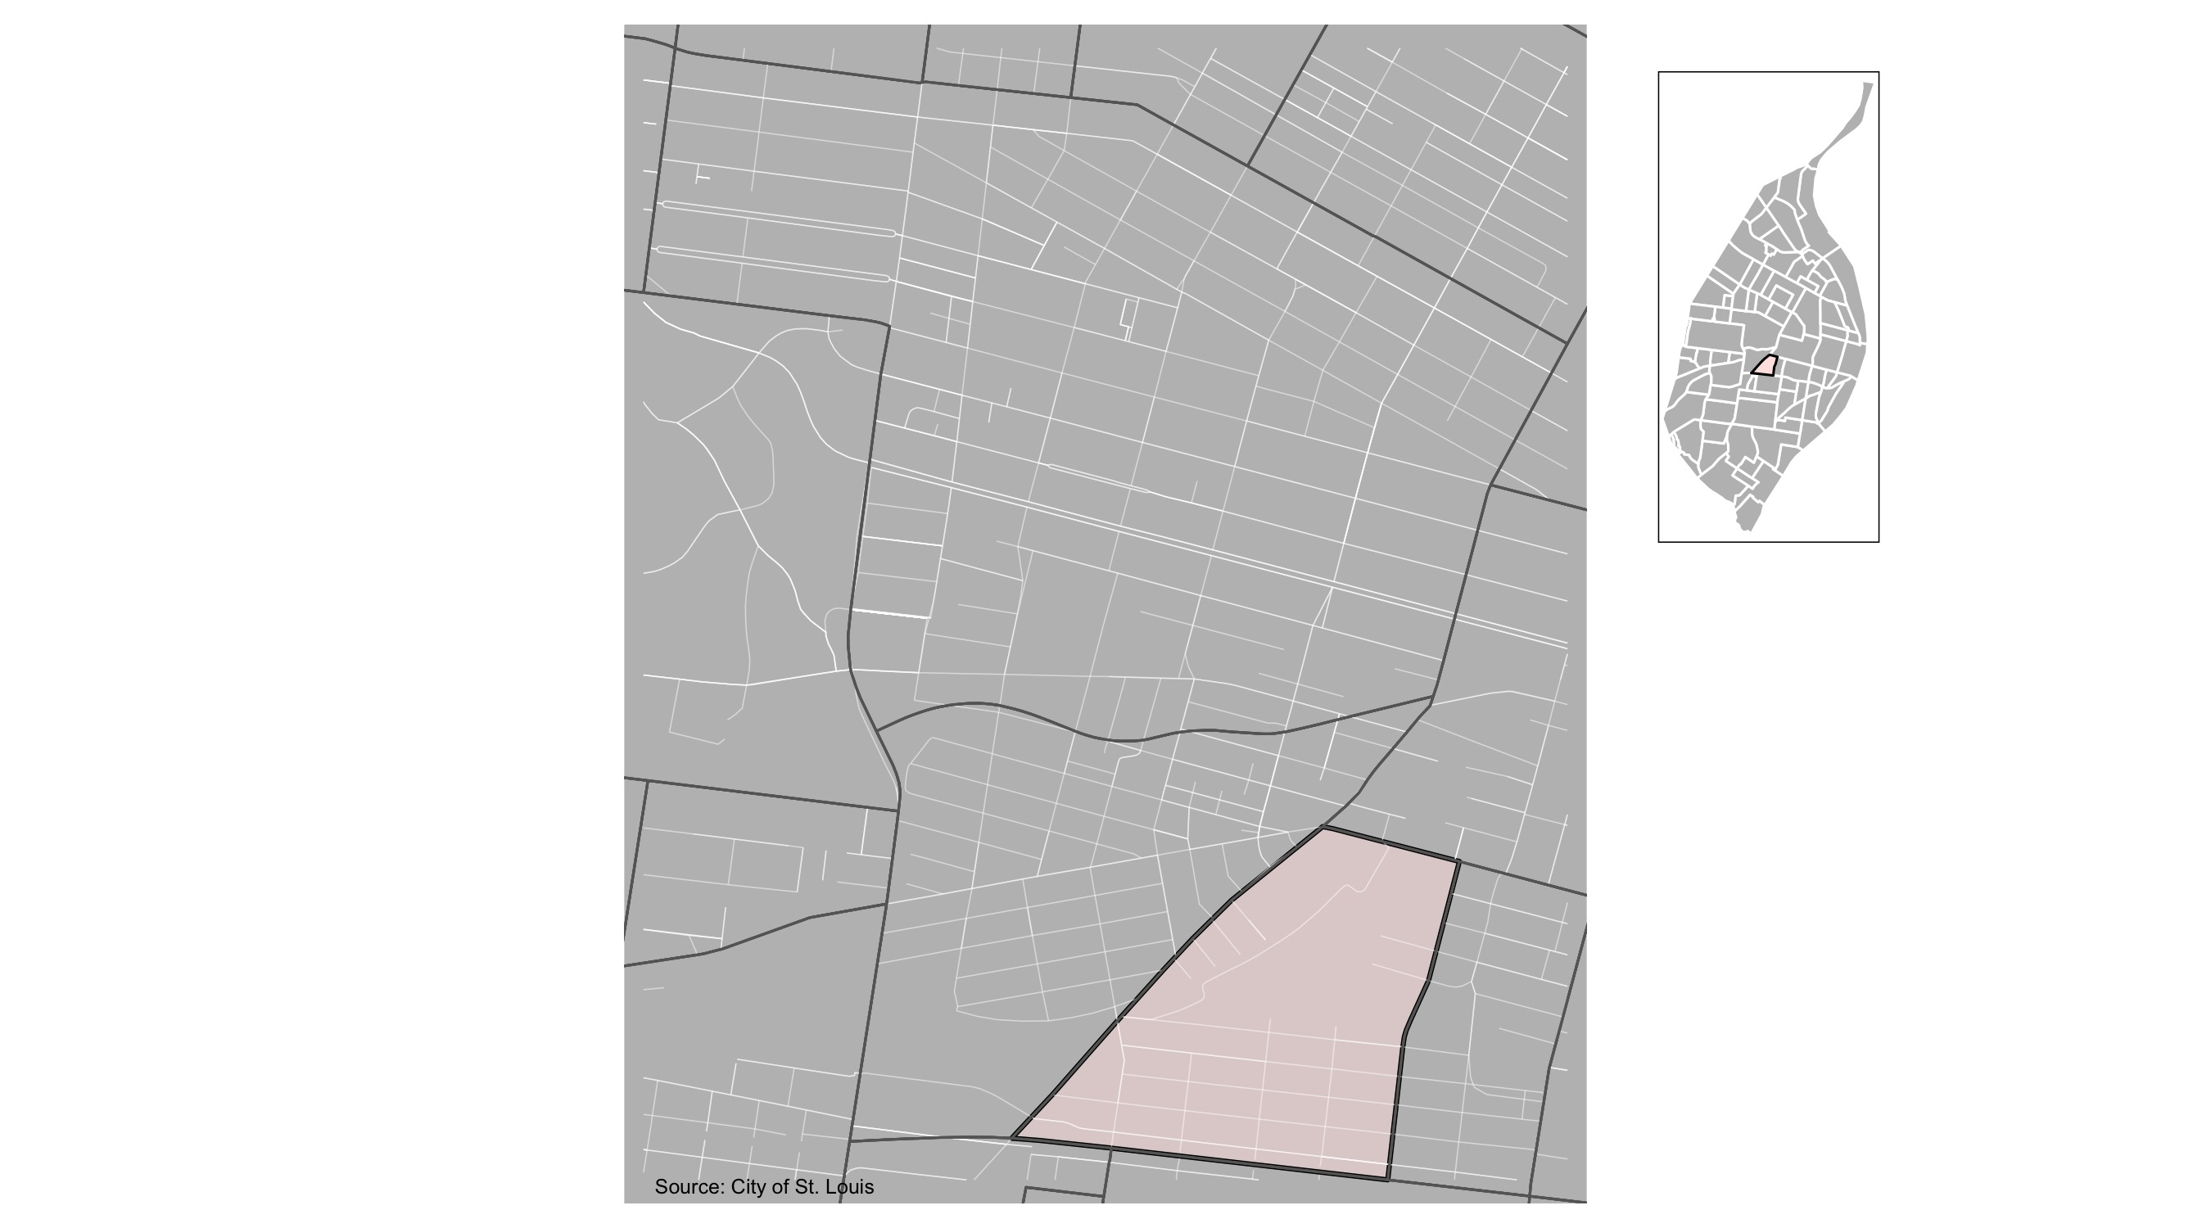
Botanical Heights

Slide 26
Botanical Heights: Summary Notes
8 total crimes in December 2021
0 crime(s) against persons
8 crime(s) against property
0 crime(s) against society
0 unspecified crimes

Slide 27
Botanical Heights
Type of Crime | Jan | Feb | Mar | Apr | May | Jun | Jul | Aug | Sep | Oct | Nov | Dec
Person | 1 | 2 | 0 | 0 | 1 | 0 | 2 | 1 | 0 | 5 | 0 | 4
Property | 4 | 9 | 8 | 7 | 13 | 15 | 19 | 12 | 22 | 6 | 8 | 2
Society | 1 | 2 | 1 | 0 | 1 | 2 | 1 | 3 | 3 | 5 | 0 | 1
Unspecified | 0 | 0 | 0 | 0 | 0 | 0 | 0 | 0 | 0 | 0 | 0 | 0
Total | 6 | 13 | 9 | 7 | 15 | 17 | 22 | 16 | 25 | 16 | 8 | 7

Slide 28
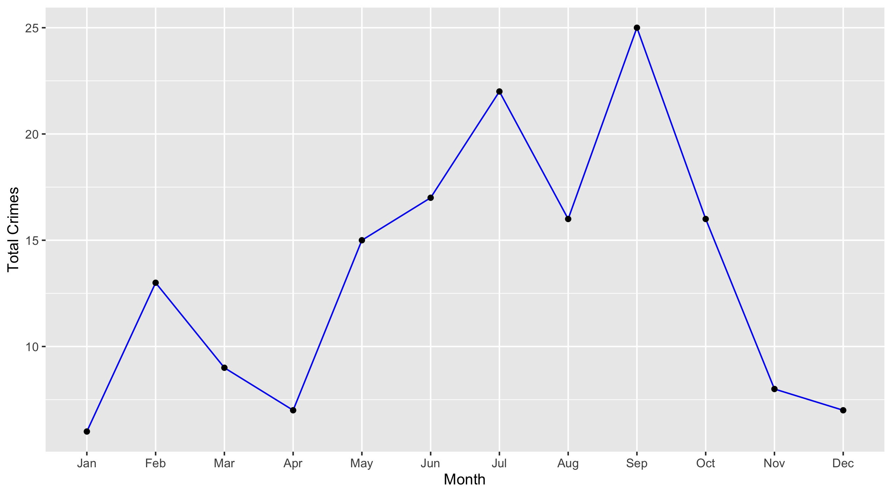
Botanical Heights

Slide 29
Botanical Heights: Property Crimes
Crime | Jan | Feb | Mar | Apr | May | Jun | Jul | Aug | Sep | Oct | Nov | Dec | Total
Robbery | 0 | 0 | 0 | 0 | 0 | 0 | 0 | 0 | 0 | 0 | 0 | 0 | 0
Arson | 0 | 0 | 0 | 0 | 0 | 0 | 0 | 0 | 0 | 0 | 0 | 0 | 0
Extortion/Blackmail | 0 | 0 | 0 | 0 | 0 | 0 | 0 | 0 | 0 | 0 | 0 | 0 | 0
Burglary/Breaking and Entering | 0 | 0 | 0 | 0 | 1 | 0 | 0 | 0 | 0 | 0 | 0 | 1 | 2
Pocket-picking | 0 | 0 | 0 | 0 | 0 | 0 | 0 | 0 | 0 | 0 | 0 | 0 | 0
Purse-snatching | 0 | 0 | 0 | 0 | 0 | 0 | 0 | 0 | 0 | 0 | 0 | 0 | 0
Shoplifting | 1 | 0 | 0 | 0 | 0 | 0 | 0 | 0 | 0 | 0 | 0 | 0 | 1
Theft From Building | 0 | 0 | 0 | 0 | 0 | 1 | 0 | 0 | 0 | 2 | 0 | 0 | 3
Theft From Coin-Operated Machine or Device | 0 | 0 | 0 | 0 | 0 | 0 | 0 | 0 | 0 | 0 | 0 | 0 | 0
Theft From MV | 0 | 3 | 3 | 2 | 5 | 5 | 6 | 5 | 8 | 1 | 3 | 0 | 41
Theft From MV Parts/Accessories | 0 | 2 | 0 | 2 | 2 | 0 | 1 | 0 | 1 | 0 | 0 | 0 | 8
All Other Larceny | 1 | 0 | 0 | 1 | 0 | 0 | 0 | 2 | 1 | 1 | 1 | 0 | 7
MV Theft | 1 | 0 | 1 | 0 | 1 | 2 | 1 | 1 | 2 | 1 | 0 | 1 | 11
Counterfeiting/Forgery | 0 | 0 | 0 | 0 | 0 | 0 | 0 | 0 | 0 | 0 | 0 | 0 | 0
False Pretense/Swindle/Confidence Game | 0 | 0 | 1 | 0 | 0 | 0 | 0 | 0 | 0 | 0 | 0 | 0 | 1
Credit Card/ATM Fraud | 0 | 0 | 0 | 0 | 0 | 0 | 0 | 0 | 0 | 0 | 0 | 0 | 0
Impersonation | 0 | 0 | 0 | 0 | 0 | 0 | 0 | 0 | 0 | 0 | 0 | 0 | 0
Welfare Fraud | 0 | 0 | 0 | 0 | 0 | 0 | 0 | 0 | 0 | 0 | 0 | 0 | 0
Wire Fraud | 0 | 0 | 0 | 0 | 0 | 0 | 0 | 0 | 0 | 0 | 0 | 0 | 0

Slide 30
Botanical Heights: Property Crimes
Crime | Jan | Feb | Mar | Apr | May | Jun | Jul | Aug | Sep | Oct | Nov | Dec | Total
Identity Theft | 0 | 0 | 0 | 0 | 0 | 0 | 0 | 0 | 0 | 0 | 0 | 0 | 0
Hacking/Computer Invasion | 0 | 0 | 0 | 0 | 0 | 0 | 0 | 0 | 0 | 0 | 0 | 0 | 0
Embezzlement | 0 | 0 | 0 | 0 | 0 | 0 | 0 | 0 | 0 | 0 | 0 | 0 | 0
Stolen Property Offenses | 0 | 0 | 0 | 0 | 0 | 0 | 0 | 0 | 0 | 0 | 0 | 0 | 0
Destruction/Damage/Vandalism of Property | 1 | 4 | 3 | 2 | 4 | 7 | 11 | 4 | 10 | 1 | 4 | 0 | 51
Bribery | 0 | 0 | 0 | 0 | 0 | 0 | 0 | 0 | 0 | 0 | 0 | 0 | 0
Total | 4 | 9 | 8 | 7 | 13 | 15 | 19 | 12 | 22 | 6 | 8 | 2 | 125

Slide 31
Botanical Heights: Society Crimes
Crime | Jan | Feb | Mar | Apr | May | Jun | Jul | Aug | Sep | Oct | Nov | Dec | Total
Drug/Narcotic Violations | 0 | 0 | 1 | 0 | 0 | 0 | 0 | 0 | 0 | 1 | 0 | 0 | 2
Drug Equipment Violations | 0 | 0 | 0 | 0 | 0 | 0 | 0 | 0 | 0 | 1 | 0 | 0 | 1
Pornography/Obscene Material | 0 | 0 | 0 | 0 | 0 | 0 | 0 | 0 | 0 | 0 | 0 | 0 | 0
Betting/Wagering | 0 | 0 | 0 | 0 | 0 | 0 | 0 | 0 | 0 | 0 | 0 | 0 | 0
Operating/Promoting/Assisting Gambling | 0 | 0 | 0 | 0 | 0 | 0 | 0 | 0 | 0 | 0 | 0 | 0 | 0
Gambling Equipment Violations | 0 | 0 | 0 | 0 | 0 | 0 | 0 | 0 | 0 | 0 | 0 | 0 | 0
Sports Tampering | 0 | 0 | 0 | 0 | 0 | 0 | 0 | 0 | 0 | 0 | 0 | 0 | 0
Prostitution | 0 | 0 | 0 | 0 | 0 | 0 | 0 | 0 | 0 | 0 | 0 | 0 | 0
Assisting or Promoting Prostitution | 0 | 0 | 0 | 0 | 0 | 0 | 0 | 0 | 0 | 0 | 0 | 0 | 0
Purchasing Prostitution | 0 | 0 | 0 | 0 | 0 | 0 | 0 | 0 | 0 | 0 | 0 | 0 | 0
Weapons Law Violations | 0 | 2 | 0 | 0 | 1 | 1 | 1 | 3 | 3 | 3 | 0 | 1 | 15
Animal Cruelty | 0 | 0 | 0 | 0 | 0 | 0 | 0 | 0 | 0 | 0 | 0 | 0 | 0
Curfew/Loitering/Vagrancy Violations | 0 | 0 | 0 | 0 | 0 | 0 | 0 | 0 | 0 | 0 | 0 | 0 | 0
Disorderly Conduct | 1 | 0 | 0 | 0 | 0 | 1 | 0 | 0 | 0 | 0 | 0 | 0 | 2
Driving Under the Influence | 0 | 0 | 0 | 0 | 0 | 0 | 0 | 0 | 0 | 0 | 0 | 0 | 0
Drunkeness | 0 | 0 | 0 | 0 | 0 | 0 | 0 | 0 | 0 | 0 | 0 | 0 | 0
Family Offenses, Nonviolent | 0 | 0 | 0 | 0 | 0 | 0 | 0 | 0 | 0 | 0 | 0 | 0 | 0
Liquor Law Violations | 0 | 0 | 0 | 0 | 0 | 0 | 0 | 0 | 0 | 0 | 0 | 0 | 0
Peeping Tom | 0 | 0 | 0 | 0 | 0 | 0 | 0 | 0 | 0 | 0 | 0 | 0 | 0
Total | 1 | 2 | 1 | 0 | 1 | 2 | 1 | 3 | 3 | 5 | 0 | 1 | 20

Slide 32
Botanical Heights: Person Crimes
Crime | Jan | Feb | Mar | Apr | May | Jun | Jul | Aug | Sep | Oct | Nov | Dec | Total
Murder and Nonnegligent Manslaughter | 0 | 0 | 0 | 0 | 0 | 0 | 0 | 0 | 0 | 0 | 0 | 0 | 0
Negligent Manslaughter | 0 | 0 | 0 | 0 | 0 | 0 | 0 | 0 | 0 | 0 | 0 | 0 | 0
Justifiable Homicide | 0 | 0 | 0 | 0 | 0 | 0 | 0 | 0 | 0 | 0 | 0 | 0 | 0
Suicide | 0 | 0 | 0 | 0 | 0 | 0 | 0 | 0 | 0 | 0 | 0 | 0 | 0
Kidnapping/Abduction | 0 | 0 | 0 | 0 | 0 | 0 | 0 | 0 | 0 | 0 | 0 | 0 | 0
Rape | 0 | 0 | 0 | 0 | 0 | 0 | 0 | 0 | 0 | 0 | 0 | 0 | 0
Sodomy | 0 | 0 | 0 | 0 | 0 | 0 | 0 | 0 | 0 | 0 | 0 | 0 | 0
Sexual Assault with an Object | 0 | 0 | 0 | 0 | 0 | 0 | 0 | 0 | 0 | 0 | 0 | 0 | 0
Fondling | 0 | 0 | 0 | 0 | 0 | 0 | 0 | 0 | 0 | 0 | 0 | 0 | 0
Aggravated Assault | 0 | 1 | 0 | 0 | 0 | 0 | 1 | 1 | 0 | 4 | 0 | 0 | 7
Simple Assault | 1 | 1 | 0 | 0 | 1 | 0 | 1 | 0 | 0 | 1 | 0 | 3 | 8
Intimidation | 0 | 0 | 0 | 0 | 0 | 0 | 0 | 0 | 0 | 0 | 0 | 1 | 1
Incest | 0 | 0 | 0 | 0 | 0 | 0 | 0 | 0 | 0 | 0 | 0 | 0 | 0
Statutory Rape | 0 | 0 | 0 | 0 | 0 | 0 | 0 | 0 | 0 | 0 | 0 | 0 | 0
Human Trafficking, Commercial Sex Acts | 0 | 0 | 0 | 0 | 0 | 0 | 0 | 0 | 0 | 0 | 0 | 0 | 0
Total | 1 | 2 | 0 | 0 | 1 | 0 | 2 | 1 | 0 | 5 | 0 | 4 | 16

Slide 33
Botanical Heights: Unspecified Crimes
Crime | Jan | Feb | Mar | Apr | May | Jun | Jul | Aug | Sep | Oct | Nov | Dec | Total
Runaway | 0 | 0 | 0 | 0 | 0 | 0 | 0 | 0 | 0 | 0 | 0 | 0 | 0
Total | 0 | 0 | 0 | 0 | 0 | 0 | 0 | 0 | 0 | 0 | 0 | 0 | 0

