Slide 1
West End, Visitation Park, Skinker DeBaliviere, DeBaliviere Place
Monthly Crime Report: December 2021
Washington University Medical Center

Slide 2
History of Crime Reporting
Since the 1929 the Uniform Crime Report (UCR) has used a Summary Reporting System (SRS) to collect monthly counts of the number of crimes
In 1982 the Bureau of Justice Statistics and the FBI sponsored a study with the objective of revising the existing form of reporting crime. Through this, the National Incident Based Reporting System (NIBRS) was created
The FBI UCR Program transitioned to a NIBRS only data collection by January 1, 2021. Other states have followed suit and SLMPD has been working to make this same transition

Slide 3
NIBRS vs SRS
NIBRS captures details on each single crime incident—as well as on separate offenses within the same incident—including information on victims, known offenders, relationships between victims and offenders, arrestees, and property involved in crimes
Standardizes crime reporting across all local, state, and tribal law enforcement agencies
SRS only counted the most serious offense (i.e. if a murder and robbery occurred, only the murder is counted) while NIBRS counts up to 10 crimes per incident
Current NIBRS reporting are not directly comparable to the previous UCR “hierarchy” numbers. With this change, you will likely see increases in crime statistics. This increase does not mean that crime is necessarily increasing, but rather that crime is being reported in a non-hierarchical format, with more detail and counting each individual crime

Slide 4
NIBRS and SLMPD
Unforeseen technology delays and the incompatibility in comparing crime (NIRBS V. UCR) has caused delays in making the crime information available
The City of St Louis Information Technology Division (I.T.) has created a series of internal 2021 NIBRS reports
Because of this transition information is limited to counts of each crime by neighborhood

Slide 5
Expanded Service Area

Slide 6
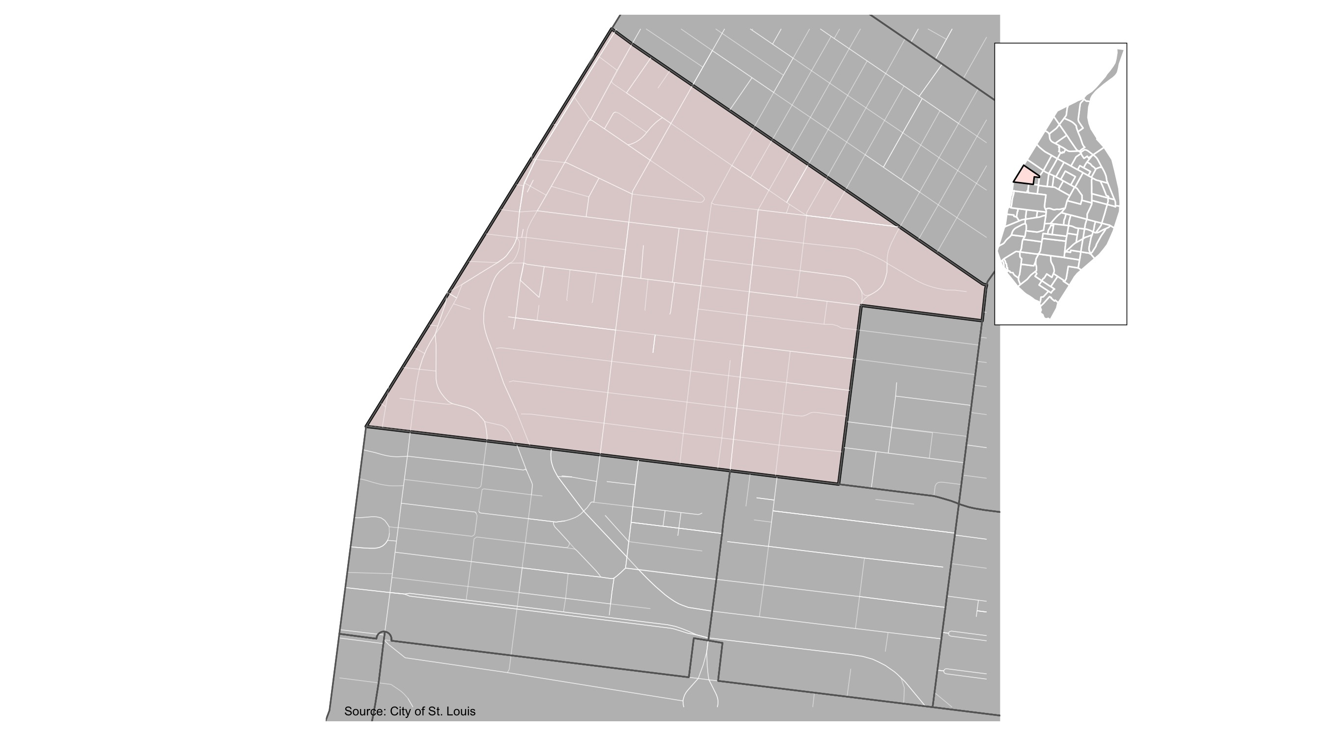
West End

Slide 7
West End: Summary Notes
75 total crimes in December 2021
17 crime(s) against persons
50 crime(s) against property
8 crime(s) against society
0 unspecified crimes

Slide 8
West End
Type of Crime | Jan | Feb | Mar | Apr | May | Jun | Jul | Aug | Sep | Oct | Nov | Dec
Person | 7 | 5 | 9 | 6 | 14 | 12 | 17 | 9 | 5 | 9 | 17 | 11
Property | 24 | 23 | 45 | 29 | 38 | 38 | 59 | 32 | 49 | 58 | 50 | 40
Society | 18 | 10 | 25 | 9 | 11 | 7 | 8 | 9 | 3 | 5 | 8 | 7
Unspecified | 0 | 0 | 0 | 0 | 0 | 0 | 0 | 0 | 0 | 0 | 0 | 0
Total | 49 | 38 | 79 | 44 | 63 | 57 | 84 | 50 | 57 | 72 | 75 | 58

Slide 9
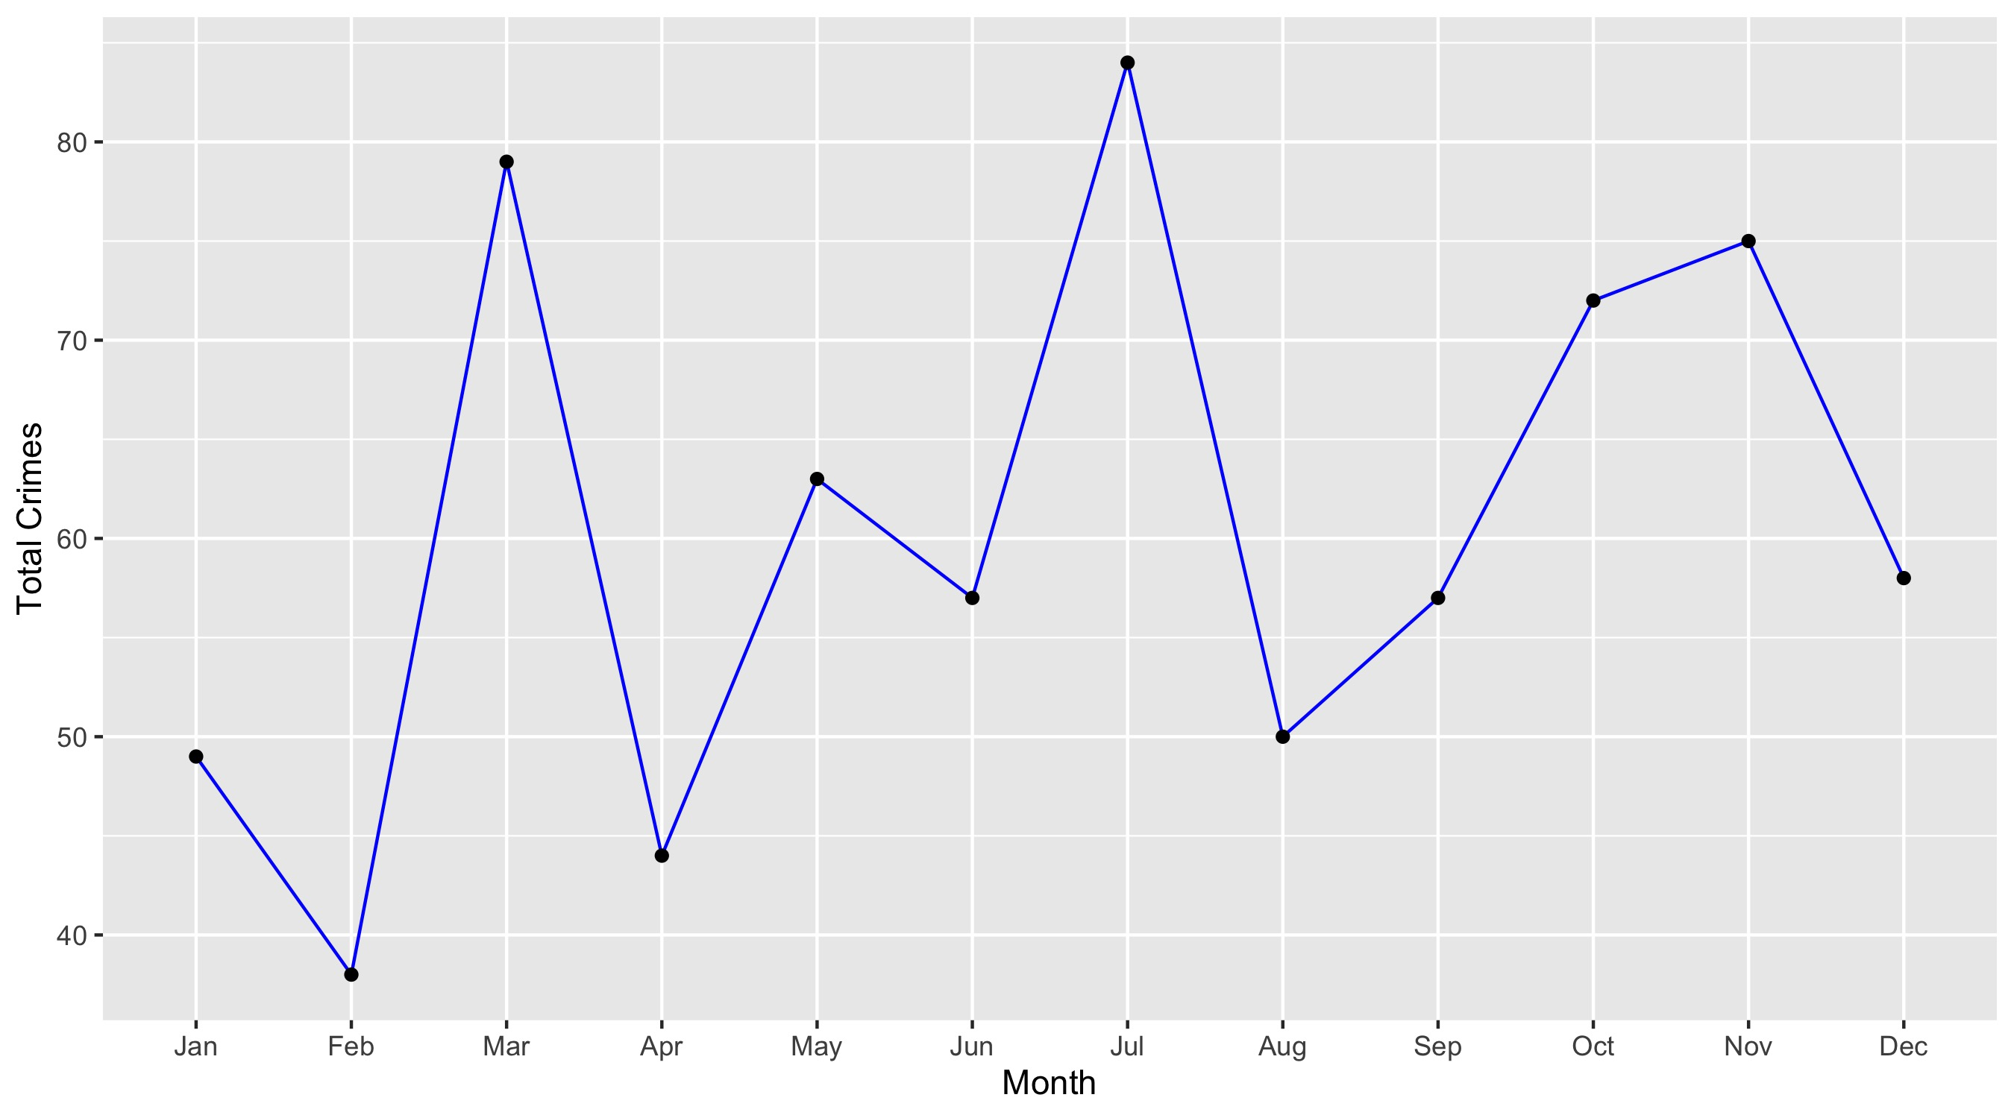
West End

Slide 10
West End: Property Crimes
Crime | Jan | Feb | Mar | Apr | May | Jun | Jul | Aug | Sep | Oct | Nov | Dec | Total
Robbery | 1 | 1 | 4 | 0 | 3 | 3 | 1 | 0 | 0 | 3 | 7 | 3 | 26
Arson | 0 | 0 | 0 | 0 | 0 | 0 | 0 | 0 | 0 | 0 | 0 | 1 | 1
Extortion/Blackmail | 0 | 0 | 0 | 0 | 0 | 0 | 0 | 0 | 0 | 0 | 0 | 0 | 0
Burglary/Breaking and Entering | 1 | 1 | 3 | 2 | 0 | 1 | 4 | 0 | 6 | 3 | 2 | 3 | 26
Pocket-picking | 0 | 0 | 0 | 0 | 0 | 0 | 1 | 0 | 0 | 0 | 0 | 0 | 1
Purse-snatching | 0 | 0 | 0 | 0 | 0 | 0 | 0 | 1 | 0 | 0 | 0 | 0 | 1
Shoplifting | 1 | 6 | 3 | 5 | 2 | 2 | 8 | 1 | 5 | 4 | 2 | 2 | 41
Theft From Building | 4 | 2 | 8 | 2 | 2 | 4 | 3 | 2 | 3 | 4 | 1 | 1 | 36
Theft From Coin-Operated Machine or Device | 0 | 0 | 0 | 0 | 0 | 0 | 0 | 0 | 0 | 0 | 0 | 0 | 0
Theft From MV | 3 | 0 | 4 | 2 | 8 | 5 | 9 | 9 | 6 | 11 | 10 | 6 | 73
Theft From MV Parts/Accessories | 1 | 2 | 3 | 3 | 0 | 0 | 1 | 0 | 5 | 5 | 1 | 2 | 23
All Other Larceny | 1 | 3 | 4 | 1 | 5 | 4 | 8 | 3 | 3 | 5 | 6 | 3 | 46
MV Theft | 2 | 3 | 7 | 4 | 6 | 6 | 7 | 3 | 4 | 5 | 4 | 4 | 55
Counterfeiting/Forgery | 0 | 0 | 0 | 0 | 0 | 0 | 0 | 1 | 0 | 0 | 0 | 0 | 1
False Pretense/Swindle/Confidence Game | 0 | 0 | 0 | 0 | 0 | 0 | 0 | 0 | 0 | 0 | 0 | 0 | 0
Credit Card/ATM Fraud | 1 | 0 | 0 | 1 | 0 | 1 | 0 | 0 | 0 | 0 | 0 | 0 | 3
Impersonation | 1 | 0 | 0 | 0 | 0 | 0 | 0 | 0 | 0 | 0 | 0 | 0 | 1
Welfare Fraud | 0 | 0 | 0 | 0 | 0 | 0 | 0 | 0 | 0 | 0 | 0 | 0 | 0
Wire Fraud | 0 | 0 | 0 | 0 | 0 | 0 | 0 | 0 | 0 | 0 | 0 | 0 | 0

Slide 11
West End: Property Crimes
Crime | Jan | Feb | Mar | Apr | May | Jun | Jul | Aug | Sep | Oct | Nov | Dec | Total
Identity Theft | 0 | 0 | 0 | 0 | 0 | 0 | 0 | 0 | 0 | 0 | 0 | 0 | 0
Hacking/Computer Invasion | 0 | 0 | 0 | 0 | 0 | 0 | 0 | 0 | 0 | 0 | 0 | 0 | 0
Embezzlement | 0 | 0 | 0 | 0 | 0 | 0 | 0 | 0 | 0 | 0 | 0 | 0 | 0
Stolen Property Offenses | 0 | 0 | 0 | 0 | 1 | 0 | 0 | 0 | 0 | 0 | 0 | 0 | 1
Destruction/Damage/Vandalism of Property | 8 | 5 | 9 | 9 | 11 | 12 | 17 | 12 | 17 | 18 | 17 | 15 | 150
Bribery | 0 | 0 | 0 | 0 | 0 | 0 | 0 | 0 | 0 | 0 | 0 | 0 | 0
Total | 24 | 23 | 45 | 29 | 38 | 38 | 59 | 32 | 49 | 58 | 50 | 40 | 485

Slide 12
West End: Society Crimes
Crime | Jan | Feb | Mar | Apr | May | Jun | Jul | Aug | Sep | Oct | Nov | Dec | Total
Drug/Narcotic Violations | 5 | 3 | 6 | 4 | 3 | 2 | 2 | 1 | 1 | 1 | 1 | 0 | 29
Drug Equipment Violations | 1 | 0 | 2 | 0 | 1 | 0 | 0 | 1 | 0 | 0 | 0 | 0 | 5
Pornography/Obscene Material | 0 | 0 | 0 | 0 | 0 | 0 | 0 | 0 | 0 | 0 | 0 | 0 | 0
Betting/Wagering | 0 | 0 | 0 | 0 | 0 | 0 | 0 | 0 | 0 | 0 | 0 | 0 | 0
Operating/Promoting/Assisting Gambling | 0 | 0 | 0 | 0 | 0 | 0 | 0 | 0 | 0 | 0 | 0 | 0 | 0
Gambling Equipment Violations | 0 | 0 | 0 | 0 | 0 | 0 | 0 | 0 | 0 | 0 | 0 | 0 | 0
Sports Tampering | 0 | 0 | 0 | 0 | 0 | 0 | 0 | 0 | 0 | 0 | 0 | 0 | 0
Prostitution | 0 | 0 | 0 | 0 | 0 | 0 | 0 | 0 | 0 | 0 | 0 | 0 | 0
Assisting or Promoting Prostitution | 0 | 0 | 0 | 0 | 0 | 0 | 0 | 0 | 0 | 0 | 0 | 0 | 0
Purchasing Prostitution | 0 | 0 | 0 | 0 | 0 | 0 | 0 | 0 | 0 | 0 | 0 | 0 | 0
Weapons Law Violations | 8 | 3 | 11 | 4 | 4 | 2 | 6 | 3 | 1 | 3 | 3 | 4 | 52
Animal Cruelty | 0 | 0 | 0 | 0 | 0 | 0 | 0 | 0 | 0 | 0 | 0 | 0 | 0
Curfew/Loitering/Vagrancy Violations | 0 | 0 | 0 | 0 | 0 | 0 | 0 | 0 | 0 | 0 | 0 | 0 | 0
Disorderly Conduct | 3 | 4 | 4 | 1 | 3 | 3 | 0 | 4 | 1 | 1 | 3 | 3 | 30
Driving Under the Influence | 0 | 0 | 1 | 0 | 0 | 0 | 0 | 0 | 0 | 0 | 0 | 0 | 1
Drunkeness | 0 | 0 | 0 | 0 | 0 | 0 | 0 | 0 | 0 | 0 | 0 | 0 | 0
Family Offenses, Nonviolent | 1 | 0 | 1 | 0 | 0 | 0 | 0 | 0 | 0 | 0 | 1 | 0 | 3
Liquor Law Violations | 0 | 0 | 0 | 0 | 0 | 0 | 0 | 0 | 0 | 0 | 0 | 0 | 0
Peeping Tom | 0 | 0 | 0 | 0 | 0 | 0 | 0 | 0 | 0 | 0 | 0 | 0 | 0
Total | 18 | 10 | 25 | 9 | 11 | 7 | 8 | 9 | 3 | 5 | 8 | 7 | 120

Slide 13
West End: Person Crimes
Crime | Jan | Feb | Mar | Apr | May | Jun | Jul | Aug | Sep | Oct | Nov | Dec | Total
Murder and Nonnegligent Manslaughter | 1 | 1 | 1 | 0 | 1 | 0 | 0 | 0 | 0 | 0 | 0 | 1 | 5
Negligent Manslaughter | 0 | 0 | 0 | 0 | 0 | 0 | 0 | 0 | 0 | 0 | 0 | 0 | 0
Justifiable Homicide | 0 | 0 | 0 | 0 | 0 | 0 | 0 | 0 | 0 | 0 | 0 | 0 | 0
Suicide | 0 | 0 | 0 | 0 | 0 | 0 | 0 | 0 | 0 | 0 | 0 | 0 | 0
Kidnapping/Abduction | 0 | 0 | 0 | 0 | 0 | 1 | 0 | 0 | 1 | 0 | 0 | 0 | 2
Rape | 0 | 0 | 0 | 0 | 0 | 0 | 0 | 0 | 0 | 0 | 0 | 0 | 0
Sodomy | 0 | 0 | 0 | 0 | 0 | 0 | 0 | 0 | 0 | 0 | 0 | 0 | 0
Sexual Assault with an Object | 0 | 0 | 0 | 0 | 0 | 0 | 0 | 0 | 0 | 0 | 0 | 0 | 0
Fondling | 0 | 0 | 0 | 0 | 0 | 0 | 0 | 0 | 0 | 0 | 0 | 0 | 0
Aggravated Assault | 5 | 3 | 5 | 4 | 7 | 5 | 4 | 6 | 0 | 4 | 3 | 8 | 54
Simple Assault | 1 | 1 | 2 | 2 | 4 | 5 | 12 | 3 | 3 | 5 | 14 | 1 | 53
Intimidation | 0 | 0 | 1 | 0 | 2 | 1 | 1 | 0 | 1 | 0 | 0 | 1 | 7
Incest | 0 | 0 | 0 | 0 | 0 | 0 | 0 | 0 | 0 | 0 | 0 | 0 | 0
Statutory Rape | 0 | 0 | 0 | 0 | 0 | 0 | 0 | 0 | 0 | 0 | 0 | 0 | 0
Human Trafficking, Commercial Sex Acts | 0 | 0 | 0 | 0 | 0 | 0 | 0 | 0 | 0 | 0 | 0 | 0 | 0
Total | 7 | 5 | 9 | 6 | 14 | 12 | 17 | 9 | 5 | 9 | 17 | 11 | 121

Slide 14
West End: Unspecified Crimes
Crime | Jan | Feb | Mar | Apr | May | Jun | Jul | Aug | Sep | Oct | Nov | Dec | Total
Runaway | 0 | 0 | 0 | 0 | 0 | 0 | 0 | 0 | 0 | 0 | 0 | 0 | 0
Total | 0 | 0 | 0 | 0 | 0 | 0 | 0 | 0 | 0 | 0 | 0 | 0 | 0

Slide 15
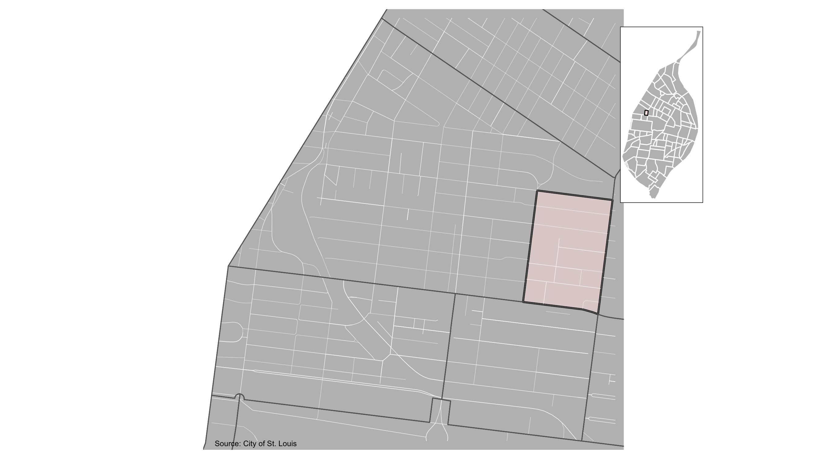
Visitation Park

Slide 16
Visitation Park: Summary Notes
12 total crimes in December 2021
7 crime(s) against persons
3 crime(s) against property
2 crime(s) against society
0 unspecified crimes

Slide 17
Visitation Park
Type of Crime | Jan | Feb | Mar | Apr | May | Jun | Jul | Aug | Sep | Oct | Nov | Dec
Person | 1 | 0 | 1 | 0 | 1 | 2 | 2 | 0 | 3 | 6 | 7 | 0
Property | 19 | 2 | 7 | 5 | 6 | 7 | 10 | 4 | 5 | 4 | 3 | 6
Society | 3 | 0 | 1 | 1 | 0 | 0 | 2 | 0 | 2 | 1 | 2 | 0
Unspecified | 0 | 0 | 0 | 0 | 0 | 0 | 0 | 0 | 0 | 0 | 0 | 0
Total | 23 | 2 | 9 | 6 | 7 | 9 | 14 | 4 | 10 | 11 | 12 | 6

Slide 18
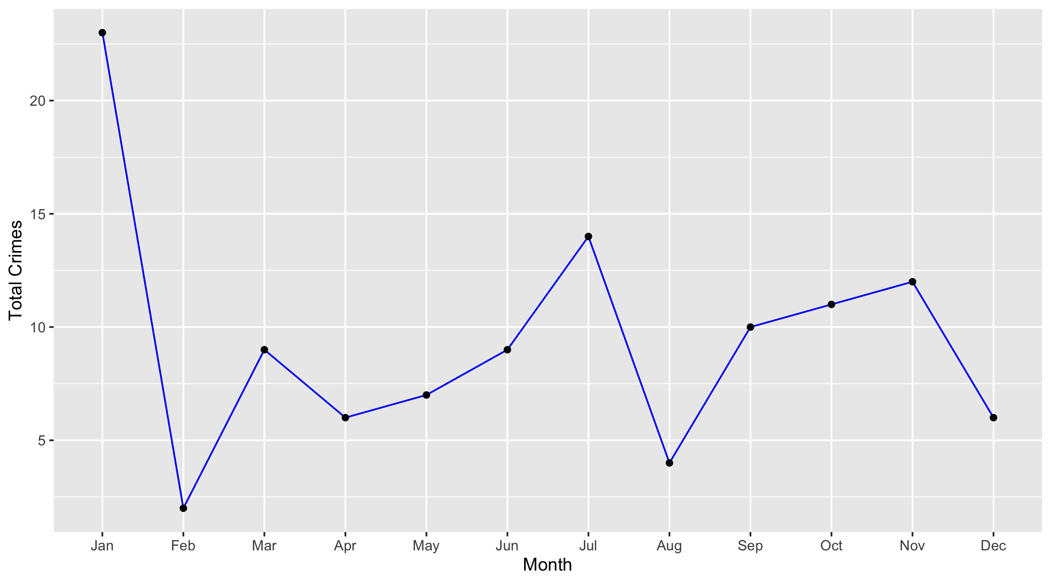
Visitation Park

Slide 19
Visitation Park: Property Crimes
Crime | Jan | Feb | Mar | Apr | May | Jun | Jul | Aug | Sep | Oct | Nov | Dec | Total
Robbery | 0 | 0 | 1 | 0 | 0 | 2 | 0 | 0 | 0 | 0 | 1 | 1 | 5
Arson | 0 | 0 | 0 | 0 | 0 | 0 | 0 | 0 | 0 | 0 | 0 | 0 | 0
Extortion/Blackmail | 0 | 0 | 0 | 0 | 0 | 0 | 0 | 0 | 0 | 0 | 0 | 0 | 0
Burglary/Breaking and Entering | 0 | 0 | 0 | 1 | 1 | 1 | 1 | 0 | 1 | 1 | 0 | 1 | 7
Pocket-picking | 0 | 0 | 0 | 0 | 1 | 0 | 0 | 0 | 0 | 0 | 0 | 1 | 2
Purse-snatching | 0 | 0 | 0 | 0 | 0 | 0 | 0 | 0 | 0 | 0 | 0 | 0 | 0
Shoplifting | 0 | 0 | 0 | 0 | 0 | 0 | 0 | 0 | 0 | 0 | 0 | 0 | 0
Theft From Building | 0 | 0 | 0 | 1 | 0 | 2 | 3 | 0 | 2 | 0 | 0 | 1 | 9
Theft From Coin-Operated Machine or Device | 0 | 0 | 0 | 0 | 0 | 0 | 0 | 0 | 0 | 0 | 0 | 0 | 0
Theft From MV | 6 | 1 | 0 | 0 | 0 | 0 | 1 | 0 | 0 | 1 | 0 | 0 | 9
Theft From MV Parts/Accessories | 1 | 0 | 0 | 1 | 0 | 0 | 1 | 0 | 1 | 0 | 0 | 0 | 4
All Other Larceny | 0 | 0 | 1 | 0 | 0 | 0 | 1 | 1 | 0 | 0 | 0 | 1 | 4
MV Theft | 1 | 1 | 3 | 1 | 2 | 0 | 0 | 3 | 0 | 0 | 0 | 0 | 11
Counterfeiting/Forgery | 0 | 0 | 0 | 0 | 0 | 0 | 0 | 0 | 0 | 0 | 0 | 0 | 0
False Pretense/Swindle/Confidence Game | 0 | 0 | 0 | 0 | 0 | 0 | 0 | 0 | 0 | 0 | 0 | 0 | 0
Credit Card/ATM Fraud | 0 | 0 | 0 | 0 | 0 | 0 | 0 | 0 | 0 | 0 | 0 | 0 | 0
Impersonation | 0 | 0 | 0 | 0 | 0 | 0 | 0 | 0 | 0 | 0 | 0 | 0 | 0
Welfare Fraud | 0 | 0 | 0 | 0 | 0 | 0 | 0 | 0 | 0 | 0 | 0 | 0 | 0
Wire Fraud | 0 | 0 | 0 | 0 | 0 | 0 | 0 | 0 | 0 | 0 | 0 | 0 | 0

Slide 20
Visitation Park: Property Crimes
Crime | Jan | Feb | Mar | Apr | May | Jun | Jul | Aug | Sep | Oct | Nov | Dec | Total
Identity Theft | 0 | 0 | 0 | 0 | 0 | 0 | 0 | 0 | 0 | 0 | 0 | 0 | 0
Hacking/Computer Invasion | 0 | 0 | 0 | 0 | 0 | 0 | 0 | 0 | 0 | 0 | 0 | 0 | 0
Embezzlement | 0 | 0 | 0 | 0 | 0 | 0 | 0 | 0 | 0 | 0 | 0 | 0 | 0
Stolen Property Offenses | 0 | 0 | 0 | 0 | 0 | 0 | 0 | 0 | 0 | 0 | 0 | 0 | 0
Destruction/Damage/Vandalism of Property | 11 | 0 | 2 | 1 | 2 | 2 | 3 | 0 | 1 | 2 | 2 | 1 | 27
Bribery | 0 | 0 | 0 | 0 | 0 | 0 | 0 | 0 | 0 | 0 | 0 | 0 | 0
Total | 19 | 2 | 7 | 5 | 6 | 7 | 10 | 4 | 5 | 4 | 3 | 6 | 78

Slide 21
Visitation Park: Society Crimes
Crime | Jan | Feb | Mar | Apr | May | Jun | Jul | Aug | Sep | Oct | Nov | Dec | Total
Drug/Narcotic Violations | 1 | 0 | 0 | 0 | 0 | 0 | 0 | 0 | 0 | 0 | 0 | 0 | 1
Drug Equipment Violations | 0 | 0 | 1 | 0 | 0 | 0 | 0 | 0 | 0 | 0 | 0 | 0 | 1
Pornography/Obscene Material | 0 | 0 | 0 | 0 | 0 | 0 | 0 | 0 | 0 | 0 | 0 | 0 | 0
Betting/Wagering | 0 | 0 | 0 | 0 | 0 | 0 | 0 | 0 | 0 | 0 | 0 | 0 | 0
Operating/Promoting/Assisting Gambling | 0 | 0 | 0 | 0 | 0 | 0 | 0 | 0 | 0 | 0 | 0 | 0 | 0
Gambling Equipment Violations | 0 | 0 | 0 | 0 | 0 | 0 | 0 | 0 | 0 | 0 | 0 | 0 | 0
Sports Tampering | 0 | 0 | 0 | 0 | 0 | 0 | 0 | 0 | 0 | 0 | 0 | 0 | 0
Prostitution | 0 | 0 | 0 | 0 | 0 | 0 | 0 | 0 | 0 | 0 | 0 | 0 | 0
Assisting or Promoting Prostitution | 0 | 0 | 0 | 0 | 0 | 0 | 0 | 0 | 0 | 0 | 0 | 0 | 0
Purchasing Prostitution | 0 | 0 | 0 | 0 | 0 | 0 | 0 | 0 | 0 | 0 | 0 | 0 | 0
Weapons Law Violations | 1 | 0 | 0 | 1 | 0 | 0 | 1 | 0 | 2 | 0 | 1 | 0 | 6
Animal Cruelty | 0 | 0 | 0 | 0 | 0 | 0 | 0 | 0 | 0 | 0 | 0 | 0 | 0
Curfew/Loitering/Vagrancy Violations | 0 | 0 | 0 | 0 | 0 | 0 | 0 | 0 | 0 | 0 | 0 | 0 | 0
Disorderly Conduct | 1 | 0 | 0 | 0 | 0 | 0 | 0 | 0 | 0 | 0 | 1 | 0 | 2
Driving Under the Influence | 0 | 0 | 0 | 0 | 0 | 0 | 0 | 0 | 0 | 0 | 0 | 0 | 0
Drunkeness | 0 | 0 | 0 | 0 | 0 | 0 | 0 | 0 | 0 | 0 | 0 | 0 | 0
Family Offenses, Nonviolent | 0 | 0 | 0 | 0 | 0 | 0 | 1 | 0 | 0 | 1 | 0 | 0 | 2
Liquor Law Violations | 0 | 0 | 0 | 0 | 0 | 0 | 0 | 0 | 0 | 0 | 0 | 0 | 0
Peeping Tom | 0 | 0 | 0 | 0 | 0 | 0 | 0 | 0 | 0 | 0 | 0 | 0 | 0
Total | 3 | 0 | 1 | 1 | 0 | 0 | 2 | 0 | 2 | 1 | 2 | 0 | 12

Slide 22
Visitation Park: Person Crimes
Crime | Jan | Feb | Mar | Apr | May | Jun | Jul | Aug | Sep | Oct | Nov | Dec | Total
Murder and Nonnegligent Manslaughter | 0 | 0 | 0 | 0 | 0 | 0 | 0 | 0 | 0 | 0 | 0 | 0 | 0
Negligent Manslaughter | 0 | 0 | 0 | 0 | 0 | 0 | 0 | 0 | 0 | 0 | 0 | 0 | 0
Justifiable Homicide | 0 | 0 | 0 | 0 | 0 | 0 | 0 | 0 | 0 | 0 | 0 | 0 | 0
Suicide | 0 | 0 | 0 | 0 | 0 | 0 | 0 | 0 | 0 | 0 | 0 | 0 | 0
Kidnapping/Abduction | 0 | 0 | 0 | 0 | 0 | 0 | 0 | 0 | 0 | 1 | 0 | 0 | 1
Rape | 0 | 0 | 0 | 0 | 0 | 0 | 0 | 0 | 1 | 0 | 0 | 0 | 1
Sodomy | 0 | 0 | 0 | 0 | 0 | 1 | 0 | 0 | 0 | 0 | 0 | 0 | 1
Sexual Assault with an Object | 0 | 0 | 0 | 0 | 0 | 0 | 0 | 0 | 0 | 0 | 0 | 0 | 0
Fondling | 0 | 0 | 0 | 0 | 0 | 0 | 0 | 0 | 0 | 0 | 0 | 0 | 0
Aggravated Assault | 0 | 0 | 0 | 0 | 0 | 0 | 1 | 0 | 0 | 1 | 2 | 0 | 4
Simple Assault | 1 | 0 | 1 | 0 | 1 | 1 | 1 | 0 | 1 | 4 | 5 | 0 | 15
Intimidation | 0 | 0 | 0 | 0 | 0 | 0 | 0 | 0 | 1 | 0 | 0 | 0 | 1
Incest | 0 | 0 | 0 | 0 | 0 | 0 | 0 | 0 | 0 | 0 | 0 | 0 | 0
Statutory Rape | 0 | 0 | 0 | 0 | 0 | 0 | 0 | 0 | 0 | 0 | 0 | 0 | 0
Human Trafficking, Commercial Sex Acts | 0 | 0 | 0 | 0 | 0 | 0 | 0 | 0 | 0 | 0 | 0 | 0 | 0
Total | 1 | 0 | 1 | 0 | 1 | 2 | 2 | 0 | 3 | 6 | 7 | 0 | 23

Slide 23
Visitation Park: Unspecified Crimes
Crime | Jan | Feb | Mar | Apr | May | Jun | Jul | Aug | Sep | Oct | Nov | Dec | Total
Runaway | 0 | 0 | 0 | 0 | 0 | 0 | 0 | 0 | 0 | 0 | 0 | 0 | 0
Total | 0 | 0 | 0 | 0 | 0 | 0 | 0 | 0 | 0 | 0 | 0 | 0 | 0

Slide 24
Neighboring Geographies

Slide 25
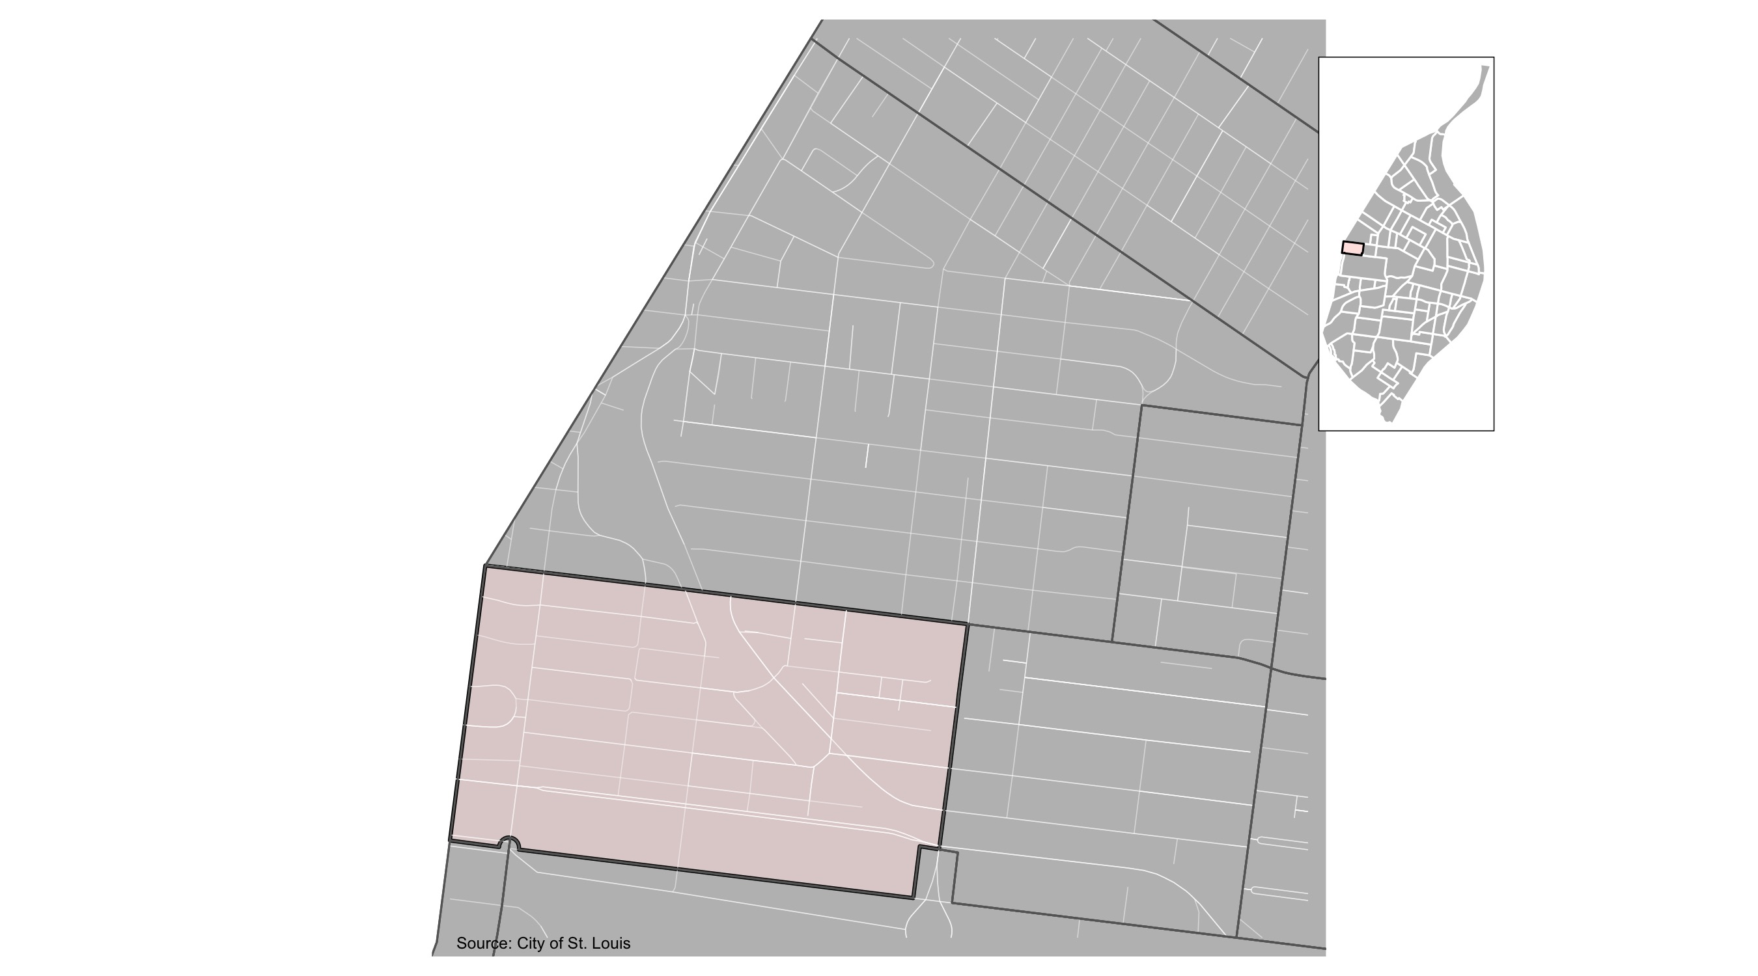
Skinker DeBaliviere

Slide 26
Skinker DeBaliviere: Summary Notes
24 total crimes in December 2021
0 crime(s) against persons
22 crime(s) against property
2 crime(s) against society
0 unspecified crimes

Slide 27
Skinker DeBaliviere
Type of Crime | Jan | Feb | Mar | Apr | May | Jun | Jul | Aug | Sep | Oct | Nov | Dec
Person | 1 | 2 | 1 | 6 | 1 | 0 | 2 | 3 | 2 | 1 | 0 | 2
Property | 16 | 12 | 13 | 13 | 4 | 26 | 42 | 24 | 42 | 22 | 22 | 19
Society | 1 | 1 | 1 | 1 | 1 | 1 | 5 | 2 | 6 | 4 | 2 | 3
Unspecified | 0 | 0 | 0 | 0 | 0 | 0 | 0 | 0 | 0 | 0 | 0 | 0
Total | 18 | 15 | 15 | 20 | 6 | 27 | 49 | 29 | 50 | 27 | 24 | 24

Slide 28
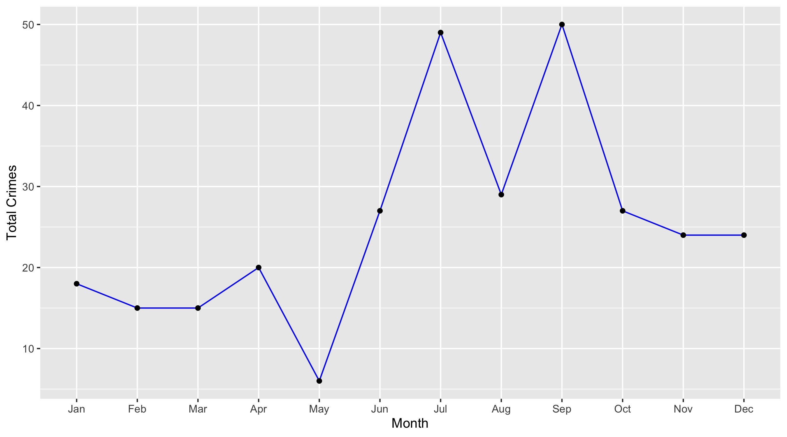
Skinker DeBaliviere

Slide 29
Skinker DeBaliviere: Property Crimes
Crime | Jan | Feb | Mar | Apr | May | Jun | Jul | Aug | Sep | Oct | Nov | Dec | Total
Robbery | 0 | 1 | 2 | 0 | 0 | 0 | 0 | 0 | 1 | 0 | 2 | 1 | 7
Arson | 0 | 0 | 1 | 1 | 0 | 0 | 0 | 0 | 0 | 0 | 0 | 0 | 2
Extortion/Blackmail | 0 | 0 | 0 | 0 | 0 | 0 | 0 | 0 | 0 | 0 | 0 | 0 | 0
Burglary/Breaking and Entering | 1 | 0 | 2 | 1 | 0 | 2 | 1 | 1 | 5 | 1 | 2 | 4 | 20
Pocket-picking | 0 | 0 | 0 | 0 | 0 | 0 | 0 | 0 | 0 | 0 | 0 | 0 | 0
Purse-snatching | 0 | 0 | 0 | 0 | 0 | 0 | 0 | 0 | 0 | 0 | 0 | 0 | 0
Shoplifting | 0 | 0 | 0 | 0 | 0 | 0 | 0 | 0 | 0 | 0 | 0 | 0 | 0
Theft From Building | 2 | 1 | 2 | 1 | 0 | 0 | 0 | 0 | 1 | 1 | 0 | 0 | 8
Theft From Coin-Operated Machine or Device | 0 | 0 | 0 | 0 | 0 | 0 | 0 | 0 | 0 | 0 | 0 | 0 | 0
Theft From MV | 3 | 4 | 2 | 0 | 1 | 10 | 19 | 11 | 8 | 5 | 7 | 3 | 73
Theft From MV Parts/Accessories | 1 | 2 | 3 | 2 | 1 | 0 | 1 | 2 | 8 | 2 | 1 | 2 | 25
All Other Larceny | 3 | 1 | 0 | 0 | 0 | 1 | 1 | 1 | 3 | 3 | 1 | 2 | 16
MV Theft | 0 | 0 | 1 | 1 | 1 | 1 | 3 | 0 | 2 | 1 | 3 | 1 | 14
Counterfeiting/Forgery | 0 | 0 | 0 | 0 | 0 | 1 | 0 | 0 | 0 | 0 | 0 | 0 | 1
False Pretense/Swindle/Confidence Game | 0 | 1 | 0 | 0 | 0 | 0 | 0 | 0 | 0 | 0 | 0 | 0 | 1
Credit Card/ATM Fraud | 0 | 0 | 0 | 0 | 0 | 0 | 0 | 0 | 0 | 0 | 0 | 0 | 0
Impersonation | 0 | 0 | 0 | 0 | 0 | 0 | 0 | 0 | 0 | 0 | 0 | 0 | 0
Welfare Fraud | 0 | 0 | 0 | 0 | 0 | 0 | 0 | 0 | 0 | 0 | 0 | 0 | 0
Wire Fraud | 0 | 0 | 0 | 0 | 0 | 0 | 0 | 0 | 0 | 0 | 0 | 0 | 0

Slide 30
Skinker DeBaliviere: Property Crimes
Crime | Jan | Feb | Mar | Apr | May | Jun | Jul | Aug | Sep | Oct | Nov | Dec | Total
Identity Theft | 0 | 0 | 0 | 0 | 0 | 0 | 0 | 0 | 0 | 0 | 0 | 0 | 0
Hacking/Computer Invasion | 0 | 0 | 0 | 0 | 0 | 0 | 0 | 0 | 0 | 0 | 0 | 0 | 0
Embezzlement | 0 | 0 | 0 | 0 | 0 | 0 | 0 | 0 | 0 | 0 | 0 | 0 | 0
Stolen Property Offenses | 0 | 0 | 0 | 0 | 0 | 0 | 0 | 0 | 3 | 2 | 1 | 0 | 6
Destruction/Damage/Vandalism of Property | 6 | 2 | 0 | 7 | 1 | 11 | 17 | 9 | 11 | 7 | 5 | 6 | 82
Bribery | 0 | 0 | 0 | 0 | 0 | 0 | 0 | 0 | 0 | 0 | 0 | 0 | 0
Total | 16 | 12 | 13 | 13 | 4 | 26 | 42 | 24 | 42 | 22 | 22 | 19 | 255

Slide 31
Skinker DeBaliviere: Society Crimes
Crime | Jan | Feb | Mar | Apr | May | Jun | Jul | Aug | Sep | Oct | Nov | Dec | Total
Drug/Narcotic Violations | 0 | 0 | 0 | 0 | 0 | 0 | 2 | 1 | 3 | 1 | 0 | 1 | 8
Drug Equipment Violations | 0 | 0 | 0 | 0 | 0 | 0 | 1 | 0 | 0 | 0 | 0 | 0 | 1
Pornography/Obscene Material | 1 | 0 | 0 | 0 | 0 | 0 | 0 | 0 | 0 | 0 | 0 | 0 | 1
Betting/Wagering | 0 | 0 | 0 | 0 | 0 | 0 | 0 | 0 | 0 | 0 | 0 | 0 | 0
Operating/Promoting/Assisting Gambling | 0 | 0 | 0 | 0 | 0 | 0 | 0 | 0 | 0 | 0 | 0 | 0 | 0
Gambling Equipment Violations | 0 | 0 | 0 | 0 | 0 | 0 | 0 | 0 | 0 | 0 | 0 | 0 | 0
Sports Tampering | 0 | 0 | 0 | 0 | 0 | 0 | 0 | 0 | 0 | 0 | 0 | 0 | 0
Prostitution | 0 | 0 | 0 | 0 | 0 | 0 | 0 | 0 | 0 | 0 | 0 | 0 | 0
Assisting or Promoting Prostitution | 0 | 0 | 0 | 0 | 0 | 0 | 0 | 0 | 0 | 0 | 0 | 0 | 0
Purchasing Prostitution | 0 | 0 | 0 | 0 | 0 | 0 | 0 | 0 | 0 | 0 | 0 | 0 | 0
Weapons Law Violations | 0 | 1 | 1 | 0 | 0 | 1 | 2 | 0 | 2 | 3 | 2 | 0 | 12
Animal Cruelty | 0 | 0 | 0 | 0 | 0 | 0 | 0 | 0 | 0 | 0 | 0 | 0 | 0
Curfew/Loitering/Vagrancy Violations | 0 | 0 | 0 | 0 | 0 | 0 | 0 | 0 | 0 | 0 | 0 | 0 | 0
Disorderly Conduct | 0 | 0 | 0 | 1 | 1 | 0 | 0 | 1 | 1 | 0 | 0 | 2 | 6
Driving Under the Influence | 0 | 0 | 0 | 0 | 0 | 0 | 0 | 0 | 0 | 0 | 0 | 0 | 0
Drunkeness | 0 | 0 | 0 | 0 | 0 | 0 | 0 | 0 | 0 | 0 | 0 | 0 | 0
Family Offenses, Nonviolent | 0 | 0 | 0 | 0 | 0 | 0 | 0 | 0 | 0 | 0 | 0 | 0 | 0
Liquor Law Violations | 0 | 0 | 0 | 0 | 0 | 0 | 0 | 0 | 0 | 0 | 0 | 0 | 0
Peeping Tom | 0 | 0 | 0 | 0 | 0 | 0 | 0 | 0 | 0 | 0 | 0 | 0 | 0
Total | 1 | 1 | 1 | 1 | 1 | 1 | 5 | 2 | 6 | 4 | 2 | 3 | 28

Slide 32
Skinker DeBaliviere: Person Crimes
Crime | Jan | Feb | Mar | Apr | May | Jun | Jul | Aug | Sep | Oct | Nov | Dec | Total
Murder and Nonnegligent Manslaughter | 0 | 0 | 0 | 0 | 0 | 0 | 0 | 0 | 1 | 0 | 0 | 0 | 1
Negligent Manslaughter | 0 | 0 | 0 | 0 | 0 | 0 | 0 | 0 | 0 | 0 | 0 | 0 | 0
Justifiable Homicide | 0 | 0 | 0 | 0 | 0 | 0 | 0 | 0 | 0 | 0 | 0 | 0 | 0
Suicide | 0 | 0 | 0 | 0 | 0 | 0 | 0 | 0 | 0 | 0 | 0 | 0 | 0
Kidnapping/Abduction | 0 | 0 | 0 | 0 | 0 | 0 | 0 | 0 | 0 | 1 | 0 | 0 | 1
Rape | 0 | 0 | 0 | 0 | 0 | 0 | 0 | 0 | 0 | 0 | 0 | 0 | 0
Sodomy | 0 | 0 | 0 | 1 | 0 | 0 | 0 | 0 | 0 | 0 | 0 | 0 | 1
Sexual Assault with an Object | 0 | 0 | 0 | 0 | 0 | 0 | 0 | 0 | 0 | 0 | 0 | 0 | 0
Fondling | 0 | 0 | 0 | 0 | 0 | 0 | 0 | 0 | 0 | 0 | 0 | 0 | 0
Aggravated Assault | 0 | 2 | 0 | 2 | 0 | 0 | 0 | 1 | 0 | 0 | 0 | 1 | 6
Simple Assault | 1 | 0 | 0 | 2 | 1 | 0 | 0 | 2 | 1 | 0 | 0 | 1 | 8
Intimidation | 0 | 0 | 1 | 1 | 0 | 0 | 2 | 0 | 0 | 0 | 0 | 0 | 4
Incest | 0 | 0 | 0 | 0 | 0 | 0 | 0 | 0 | 0 | 0 | 0 | 0 | 0
Statutory Rape | 0 | 0 | 0 | 0 | 0 | 0 | 0 | 0 | 0 | 0 | 0 | 0 | 0
Human Trafficking, Commercial Sex Acts | 0 | 0 | 0 | 0 | 0 | 0 | 0 | 0 | 0 | 0 | 0 | 0 | 0
Total | 1 | 2 | 1 | 6 | 1 | 0 | 2 | 3 | 2 | 1 | 0 | 2 | 21

Slide 33
Skinker DeBaliviere: Unspecified Crimes
Crime | Jan | Feb | Mar | Apr | May | Jun | Jul | Aug | Sep | Oct | Nov | Dec | Total
Runaway | 0 | 0 | 0 | 0 | 0 | 0 | 0 | 0 | 0 | 0 | 0 | 0 | 0
Total | 0 | 0 | 0 | 0 | 0 | 0 | 0 | 0 | 0 | 0 | 0 | 0 | 0

Slide 34
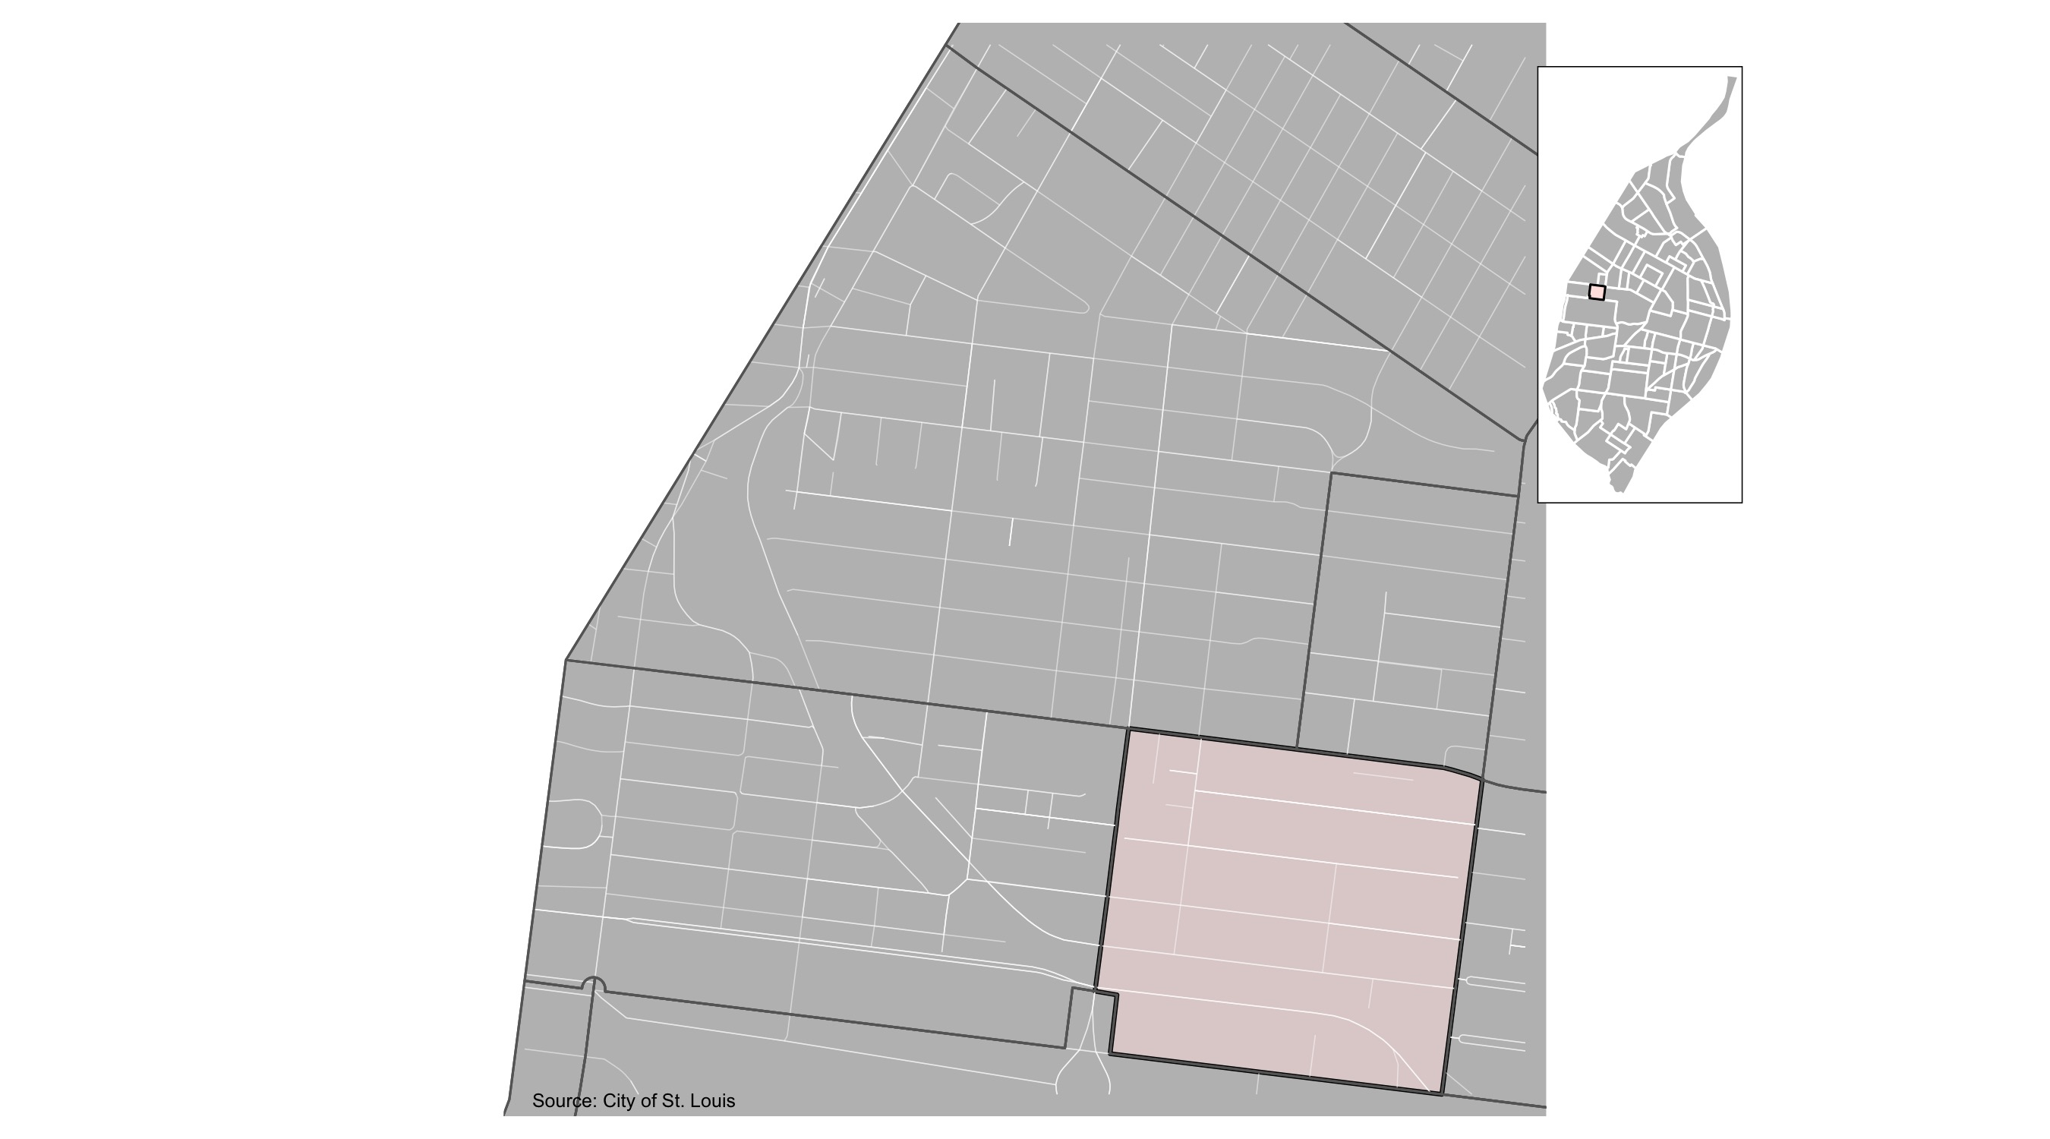
DeBaliviere Place

Slide 35
DeBaliviere Place: Summary Notes
29 total crimes in December 2021
1 crime(s) against persons
28 crime(s) against property
0 crime(s) against society
0 unspecified crimes

Slide 36
DeBaliviere Place
Type of Crime | Jan | Feb | Mar | Apr | May | Jun | Jul | Aug | Sep | Oct | Nov | Dec
Person | 2 | 1 | 2 | 5 | 0 | 7 | 0 | 1 | 1 | 2 | 1 | 3
Property | 14 | 8 | 10 | 19 | 13 | 9 | 13 | 31 | 39 | 26 | 28 | 28
Society | 0 | 4 | 3 | 3 | 1 | 1 | 2 | 3 | 8 | 3 | 0 | 0
Unspecified | 0 | 0 | 0 | 0 | 0 | 0 | 0 | 0 | 0 | 0 | 0 | 0
Total | 16 | 13 | 15 | 27 | 14 | 17 | 15 | 35 | 48 | 31 | 29 | 31

Slide 37
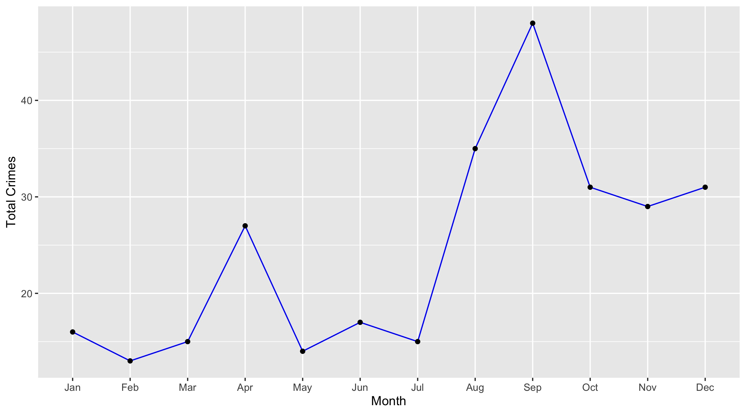
DeBaliviere Place

Slide 38
DeBaliviere Place: Property Crimes
Crime | Jan | Feb | Mar | Apr | May | Jun | Jul | Aug | Sep | Oct | Nov | Dec | Total
Robbery | 0 | 0 | 1 | 0 | 0 | 0 | 1 | 0 | 1 | 1 | 2 | 0 | 6
Arson | 0 | 0 | 0 | 0 | 0 | 0 | 0 | 0 | 0 | 0 | 0 | 0 | 0
Extortion/Blackmail | 0 | 0 | 0 | 0 | 0 | 0 | 0 | 0 | 0 | 0 | 0 | 0 | 0
Burglary/Breaking and Entering | 1 | 0 | 0 | 2 | 3 | 1 | 1 | 1 | 0 | 0 | 1 | 1 | 11
Pocket-picking | 0 | 0 | 0 | 0 | 0 | 0 | 0 | 0 | 0 | 0 | 0 | 0 | 0
Purse-snatching | 0 | 0 | 0 | 0 | 0 | 0 | 0 | 0 | 0 | 0 | 1 | 0 | 1
Shoplifting | 0 | 0 | 0 | 0 | 0 | 0 | 0 | 0 | 0 | 0 | 0 | 0 | 0
Theft From Building | 3 | 1 | 2 | 2 | 2 | 1 | 1 | 6 | 2 | 2 | 7 | 8 | 37
Theft From Coin-Operated Machine or Device | 0 | 0 | 0 | 0 | 0 | 0 | 0 | 0 | 0 | 0 | 0 | 0 | 0
Theft From MV | 2 | 4 | 1 | 1 | 1 | 1 | 4 | 9 | 15 | 4 | 4 | 5 | 51
Theft From MV Parts/Accessories | 1 | 1 | 0 | 3 | 1 | 0 | 0 | 2 | 5 | 1 | 1 | 2 | 17
All Other Larceny | 1 | 0 | 1 | 2 | 1 | 3 | 0 | 2 | 2 | 4 | 6 | 2 | 24
MV Theft | 1 | 2 | 2 | 3 | 1 | 1 | 2 | 5 | 3 | 5 | 3 | 2 | 30
Counterfeiting/Forgery | 0 | 0 | 0 | 1 | 0 | 0 | 0 | 0 | 0 | 0 | 0 | 1 | 2
False Pretense/Swindle/Confidence Game | 0 | 0 | 0 | 0 | 0 | 0 | 0 | 0 | 0 | 1 | 0 | 0 | 1
Credit Card/ATM Fraud | 0 | 0 | 0 | 0 | 0 | 0 | 1 | 0 | 0 | 1 | 0 | 0 | 2
Impersonation | 0 | 0 | 1 | 0 | 0 | 0 | 0 | 0 | 0 | 0 | 0 | 0 | 1
Welfare Fraud | 0 | 0 | 0 | 0 | 0 | 0 | 0 | 0 | 0 | 0 | 0 | 0 | 0
Wire Fraud | 0 | 0 | 0 | 0 | 0 | 0 | 0 | 0 | 0 | 0 | 0 | 0 | 0

Slide 39
DeBaliviere Place: Property Crimes
Crime | Jan | Feb | Mar | Apr | May | Jun | Jul | Aug | Sep | Oct | Nov | Dec | Total
Identity Theft | 0 | 0 | 0 | 0 | 0 | 0 | 0 | 0 | 0 | 0 | 0 | 0 | 0
Hacking/Computer Invasion | 0 | 0 | 0 | 0 | 0 | 0 | 0 | 0 | 0 | 0 | 0 | 0 | 0
Embezzlement | 0 | 0 | 0 | 0 | 0 | 0 | 0 | 0 | 0 | 0 | 0 | 0 | 0
Stolen Property Offenses | 0 | 0 | 0 | 0 | 0 | 0 | 0 | 0 | 0 | 0 | 0 | 0 | 0
Destruction/Damage/Vandalism of Property | 5 | 0 | 2 | 5 | 4 | 2 | 3 | 6 | 11 | 7 | 3 | 7 | 55
Bribery | 0 | 0 | 0 | 0 | 0 | 0 | 0 | 0 | 0 | 0 | 0 | 0 | 0
Total | 14 | 8 | 10 | 19 | 13 | 9 | 13 | 31 | 39 | 26 | 28 | 28 | 238

Slide 40
DeBaliviere Place: Society Crimes
Crime | Jan | Feb | Mar | Apr | May | Jun | Jul | Aug | Sep | Oct | Nov | Dec | Total
Drug/Narcotic Violations | 0 | 1 | 0 | 1 | 1 | 0 | 0 | 1 | 4 | 2 | 0 | 0 | 10
Drug Equipment Violations | 0 | 0 | 0 | 0 | 0 | 0 | 0 | 0 | 0 | 0 | 0 | 0 | 0
Pornography/Obscene Material | 0 | 0 | 0 | 0 | 0 | 0 | 0 | 0 | 0 | 0 | 0 | 0 | 0
Betting/Wagering | 0 | 0 | 0 | 0 | 0 | 0 | 0 | 0 | 0 | 0 | 0 | 0 | 0
Operating/Promoting/Assisting Gambling | 0 | 0 | 0 | 0 | 0 | 0 | 0 | 0 | 0 | 0 | 0 | 0 | 0
Gambling Equipment Violations | 0 | 0 | 0 | 0 | 0 | 0 | 0 | 0 | 0 | 0 | 0 | 0 | 0
Sports Tampering | 0 | 0 | 0 | 0 | 0 | 0 | 0 | 0 | 0 | 0 | 0 | 0 | 0
Prostitution | 0 | 0 | 0 | 0 | 0 | 0 | 0 | 0 | 0 | 0 | 0 | 0 | 0
Assisting or Promoting Prostitution | 0 | 0 | 0 | 0 | 0 | 0 | 0 | 0 | 0 | 0 | 0 | 0 | 0
Purchasing Prostitution | 0 | 0 | 0 | 0 | 0 | 0 | 0 | 0 | 0 | 0 | 0 | 0 | 0
Weapons Law Violations | 0 | 0 | 1 | 0 | 0 | 0 | 1 | 0 | 2 | 1 | 0 | 0 | 5
Animal Cruelty | 0 | 0 | 0 | 0 | 0 | 0 | 0 | 0 | 0 | 0 | 0 | 0 | 0
Curfew/Loitering/Vagrancy Violations | 0 | 0 | 0 | 0 | 0 | 0 | 0 | 0 | 0 | 0 | 0 | 0 | 0
Disorderly Conduct | 0 | 3 | 2 | 2 | 0 | 0 | 1 | 2 | 2 | 0 | 0 | 0 | 12
Driving Under the Influence | 0 | 0 | 0 | 0 | 0 | 0 | 0 | 0 | 0 | 0 | 0 | 0 | 0
Drunkeness | 0 | 0 | 0 | 0 | 0 | 0 | 0 | 0 | 0 | 0 | 0 | 0 | 0
Family Offenses, Nonviolent | 0 | 0 | 0 | 0 | 0 | 1 | 0 | 0 | 0 | 0 | 0 | 0 | 1
Liquor Law Violations | 0 | 0 | 0 | 0 | 0 | 0 | 0 | 0 | 0 | 0 | 0 | 0 | 0
Peeping Tom | 0 | 0 | 0 | 0 | 0 | 0 | 0 | 0 | 0 | 0 | 0 | 0 | 0
Total | 0 | 4 | 3 | 3 | 1 | 1 | 2 | 3 | 8 | 3 | 0 | 0 | 28

Slide 41
DeBaliviere Place: Person Crimes
Crime | Jan | Feb | Mar | Apr | May | Jun | Jul | Aug | Sep | Oct | Nov | Dec | Total
Murder and Nonnegligent Manslaughter | 0 | 0 | 0 | 0 | 0 | 0 | 0 | 0 | 1 | 0 | 0 | 0 | 1
Negligent Manslaughter | 0 | 0 | 0 | 0 | 0 | 0 | 0 | 0 | 0 | 0 | 0 | 0 | 0
Justifiable Homicide | 0 | 0 | 0 | 0 | 0 | 0 | 0 | 0 | 0 | 0 | 0 | 0 | 0
Suicide | 0 | 0 | 0 | 0 | 0 | 0 | 0 | 0 | 0 | 0 | 0 | 0 | 0
Kidnapping/Abduction | 0 | 0 | 0 | 0 | 0 | 0 | 0 | 0 | 0 | 0 | 0 | 0 | 0
Rape | 0 | 0 | 0 | 0 | 0 | 0 | 0 | 0 | 0 | 0 | 0 | 0 | 0
Sodomy | 0 | 0 | 0 | 0 | 0 | 0 | 0 | 0 | 0 | 0 | 0 | 0 | 0
Sexual Assault with an Object | 0 | 0 | 0 | 0 | 0 | 0 | 0 | 0 | 0 | 0 | 0 | 0 | 0
Fondling | 1 | 0 | 0 | 0 | 0 | 0 | 0 | 0 | 0 | 0 | 0 | 0 | 1
Aggravated Assault | 0 | 0 | 1 | 1 | 0 | 3 | 0 | 0 | 0 | 2 | 0 | 1 | 8
Simple Assault | 1 | 1 | 1 | 3 | 0 | 4 | 0 | 1 | 0 | 0 | 1 | 2 | 14
Intimidation | 0 | 0 | 0 | 1 | 0 | 0 | 0 | 0 | 0 | 0 | 0 | 0 | 1
Incest | 0 | 0 | 0 | 0 | 0 | 0 | 0 | 0 | 0 | 0 | 0 | 0 | 0
Statutory Rape | 0 | 0 | 0 | 0 | 0 | 0 | 0 | 0 | 0 | 0 | 0 | 0 | 0
Human Trafficking, Commercial Sex Acts | 0 | 0 | 0 | 0 | 0 | 0 | 0 | 0 | 0 | 0 | 0 | 0 | 0
Total | 2 | 1 | 2 | 5 | 0 | 7 | 0 | 1 | 1 | 2 | 1 | 3 | 25

Slide 42
DeBaliviere Place: Unspecified Crimes
Crime | Jan | Feb | Mar | Apr | May | Jun | Jul | Aug | Sep | Oct | Nov | Dec | Total
Runaway | 0 | 0 | 0 | 0 | 0 | 0 | 0 | 0 | 0 | 0 | 0 | 0 | 0
Total | 0 | 0 | 0 | 0 | 0 | 0 | 0 | 0 | 0 | 0 | 0 | 0 | 0

