Slide 1
Forest Park Southeast, Botanical Heights, Central West End
Monthly Crime Report: January 2021
Washington University Medical Center

Slide 2
Forest Park Southeast : Summary Notes
52 total crimes in January 2021
3 crime(s) against persons
35 crime(s) against property
5 crime(s) against society
9 unspecified crimes

Slide 3
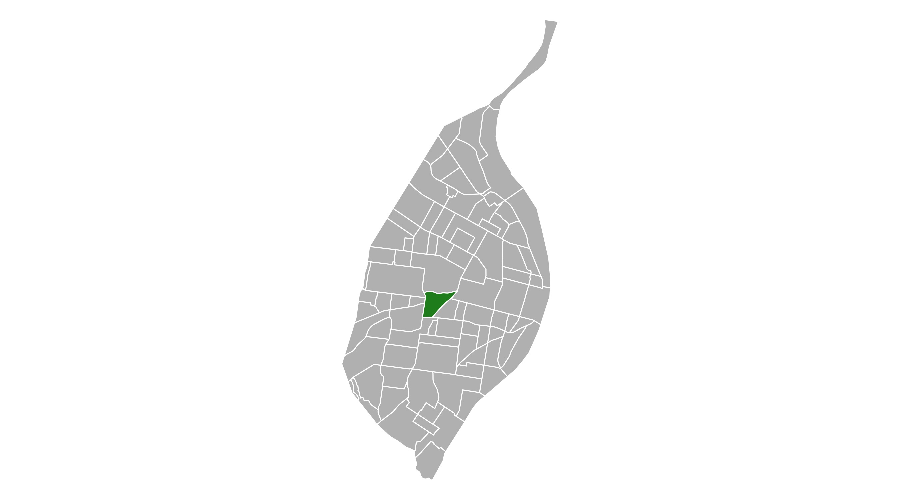
Forest Park Southeast
Type of Crime | Jan
Person | 3
Property | 35
Society | 5
Unspecified | 9
Total | 52

Slide 4
Forest Park Southeast : Property Crimes
Crime | Jan
Robbery | 0
Arson | 0
Extortion/Blackmail | 0
Burglary/Breaking and Entering | 0
Pocket-picking | 0
Purse-snatching | 0
Shoplifting | 0
Theft From Building | 0
Theft From Coin-Operated Machine or Device | 0
Theft From Motor Vehicle | 9
Theft From Motor Vehicle Parts/Accessories | 5
All Other Larceny | 3
Motor Vehicle Theft | 7
Counterfeiting/Forgery | 0
False Pretense/Swindle/Confidence Game | 1
Credit Card/Automatic Teller Machine Fraud | 0
Impersonation | 0
Welfare Fraud | 0
Wire Fraud | 0
Identity Theft | 0

Slide 5
Forest Park Southeast : Property Crimes
Crime | Jan
Hacking/Computer Invasion | 0
Embezzlement | 0
Stolen Property Offenses | 0
Destruction/Damage/Vandalism of Property | 10
Bribery | 0
Bad Checks | 0

Slide 6
Forest Park Southeast : Society Crimes
Crime | Jan
Drug/Narcotic Violations | 1
Drug Equipment Violations | 1
Pornography/Obscene Material | 0
Betting/Wagering | 0
Operating/Promoting/Assisting Gambling | 0
Gambling Equipment Violations | 0
Sports Tampering | 0
Prostitution | 0
Assisting or Promoting Prostitution | 0
Purchasing Prostitution | 0
Weapons Law Violations | 1
Animal Cruelty | 0
Curfew/Loitering/Vagrancy Violations | 0
Disorderly Conduct | 1
Driving Under the Influence | 1
Drunkeness | 0
Family Offenses, Nonviolent | 0
Liquor Law Violations | 0
Peeping Tom | 0
Trespass of Real Property | 0

Slide 7
Forest Park Southeast : Person Crimes
Crime | Jan
Murder and Nonnegligent Manslaughter | 0
Negligent Manslaughter | 0
Justifiable Homicide | 0
Suicide | 0
Kidnapping/Abduction | 0
Rape | 0
Sodomy | 0
Sexual Assault with an Object | 0
Fondling | 0
Aggravated Assault | 2
Simple Assault | 1
Intimidation | 0
Incest | 0
Statutory Rape | 0
Human Trafficking, Commercial Sex Acts | 0
Human Trafficking, Involuntary Servitude | 0

Slide 8
Forest Park Southeast : Unspecified Crimes
Crime | Jan
Runaway | 0
All Other Offenses | 9

Slide 9
Botanical Heights : Summary Notes
9 total crimes in January 2021
1 crime(s) against persons
4 crime(s) against property
1 crime(s) against society
3 unspecified crimes

Slide 10
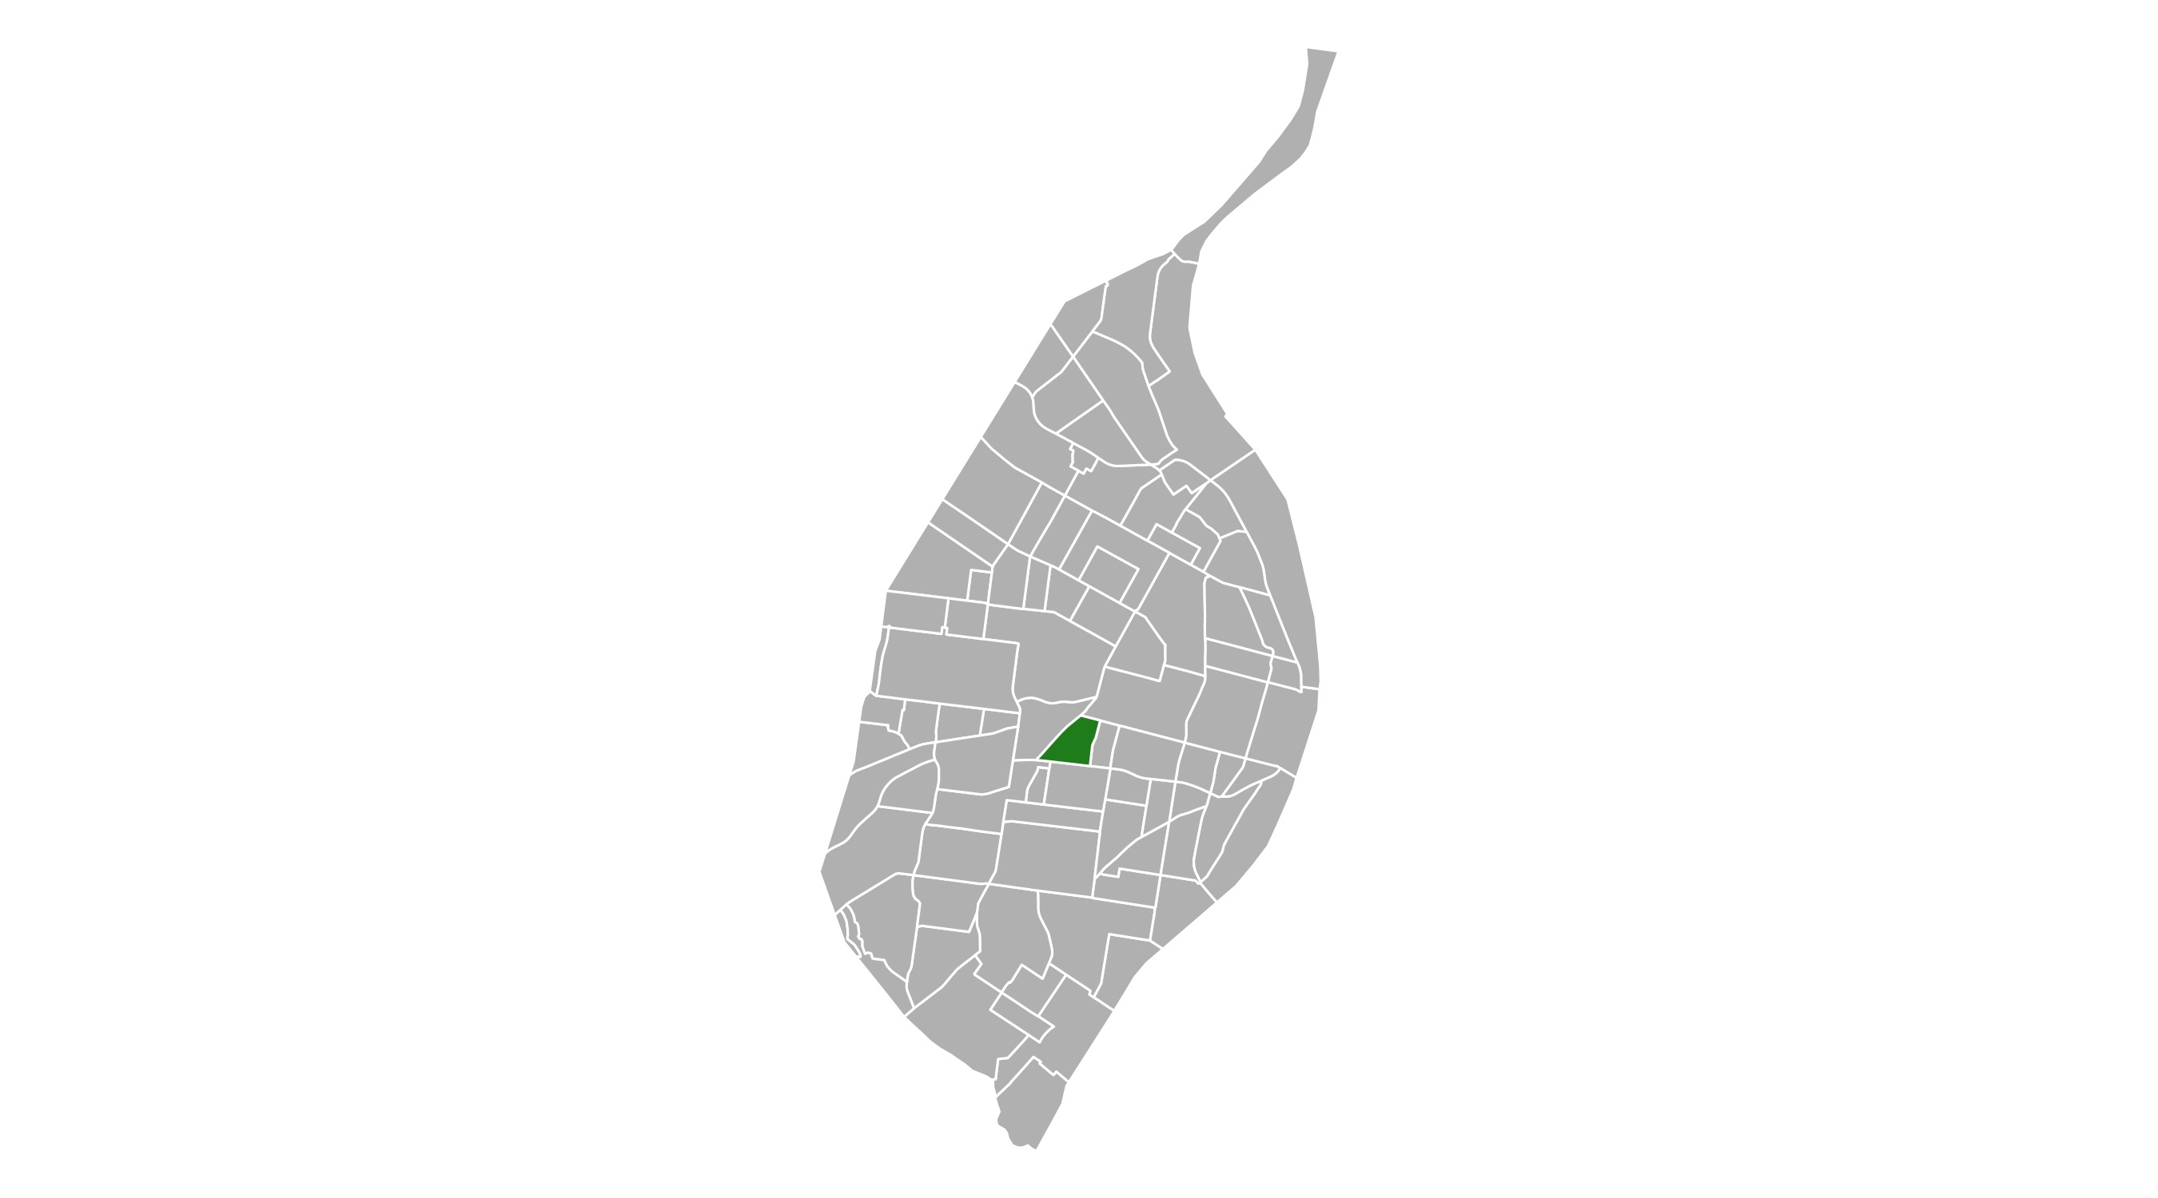
Botanical Heights
Type of Crime | Jan
Person | 1
Property | 4
Society | 1
Unspecified | 3
Total | 9

Slide 11
Botanical Heights : Property Crimes
Crime | Jan
Robbery | 0
Arson | 0
Extortion/Blackmail | 0
Burglary/Breaking and Entering | 0
Pocket-picking | 0
Purse-snatching | 0
Shoplifting | 1
Theft From Building | 0
Theft From Coin-Operated Machine or Device | 0
Theft From Motor Vehicle | 0
Theft From Motor Vehicle Parts/Accessories | 0
All Other Larceny | 1
Motor Vehicle Theft | 1
Counterfeiting/Forgery | 0
False Pretense/Swindle/Confidence Game | 0
Credit Card/Automatic Teller Machine Fraud | 0
Impersonation | 0
Welfare Fraud | 0
Wire Fraud | 0
Identity Theft | 0

Slide 12
Botanical Heights : Property Crimes
Crime | Jan
Hacking/Computer Invasion | 0
Embezzlement | 0
Stolen Property Offenses | 0
Destruction/Damage/Vandalism of Property | 1
Bribery | 0
Bad Checks | 0

Slide 13
Botanical Heights : Society Crimes
Crime | Jan
Drug/Narcotic Violations | 0
Drug Equipment Violations | 0
Pornography/Obscene Material | 0
Betting/Wagering | 0
Operating/Promoting/Assisting Gambling | 0
Gambling Equipment Violations | 0
Sports Tampering | 0
Prostitution | 0
Assisting or Promoting Prostitution | 0
Purchasing Prostitution | 0
Weapons Law Violations | 0
Animal Cruelty | 0
Curfew/Loitering/Vagrancy Violations | 0
Disorderly Conduct | 1
Driving Under the Influence | 0
Drunkeness | 0
Family Offenses, Nonviolent | 0
Liquor Law Violations | 0
Peeping Tom | 0
Trespass of Real Property | 0

Slide 14
Botanical Heights : Person Crimes
Crime | Jan
Murder and Nonnegligent Manslaughter | 0
Negligent Manslaughter | 0
Justifiable Homicide | 0
Suicide | 0
Kidnapping/Abduction | 0
Rape | 0
Sodomy | 0
Sexual Assault with an Object | 0
Fondling | 0
Aggravated Assault | 0
Simple Assault | 1
Intimidation | 0
Incest | 0
Statutory Rape | 0
Human Trafficking, Commercial Sex Acts | 0
Human Trafficking, Involuntary Servitude | 0

Slide 15
Botanical Heights : Unspecified Crimes
Crime | Jan
Runaway | 0
All Other Offenses | 3

Slide 16
Central West End : Summary Notes
149 total crimes in January 2021
14 crime(s) against persons
92 crime(s) against property
23 crime(s) against society
20 unspecified crimes

Slide 17
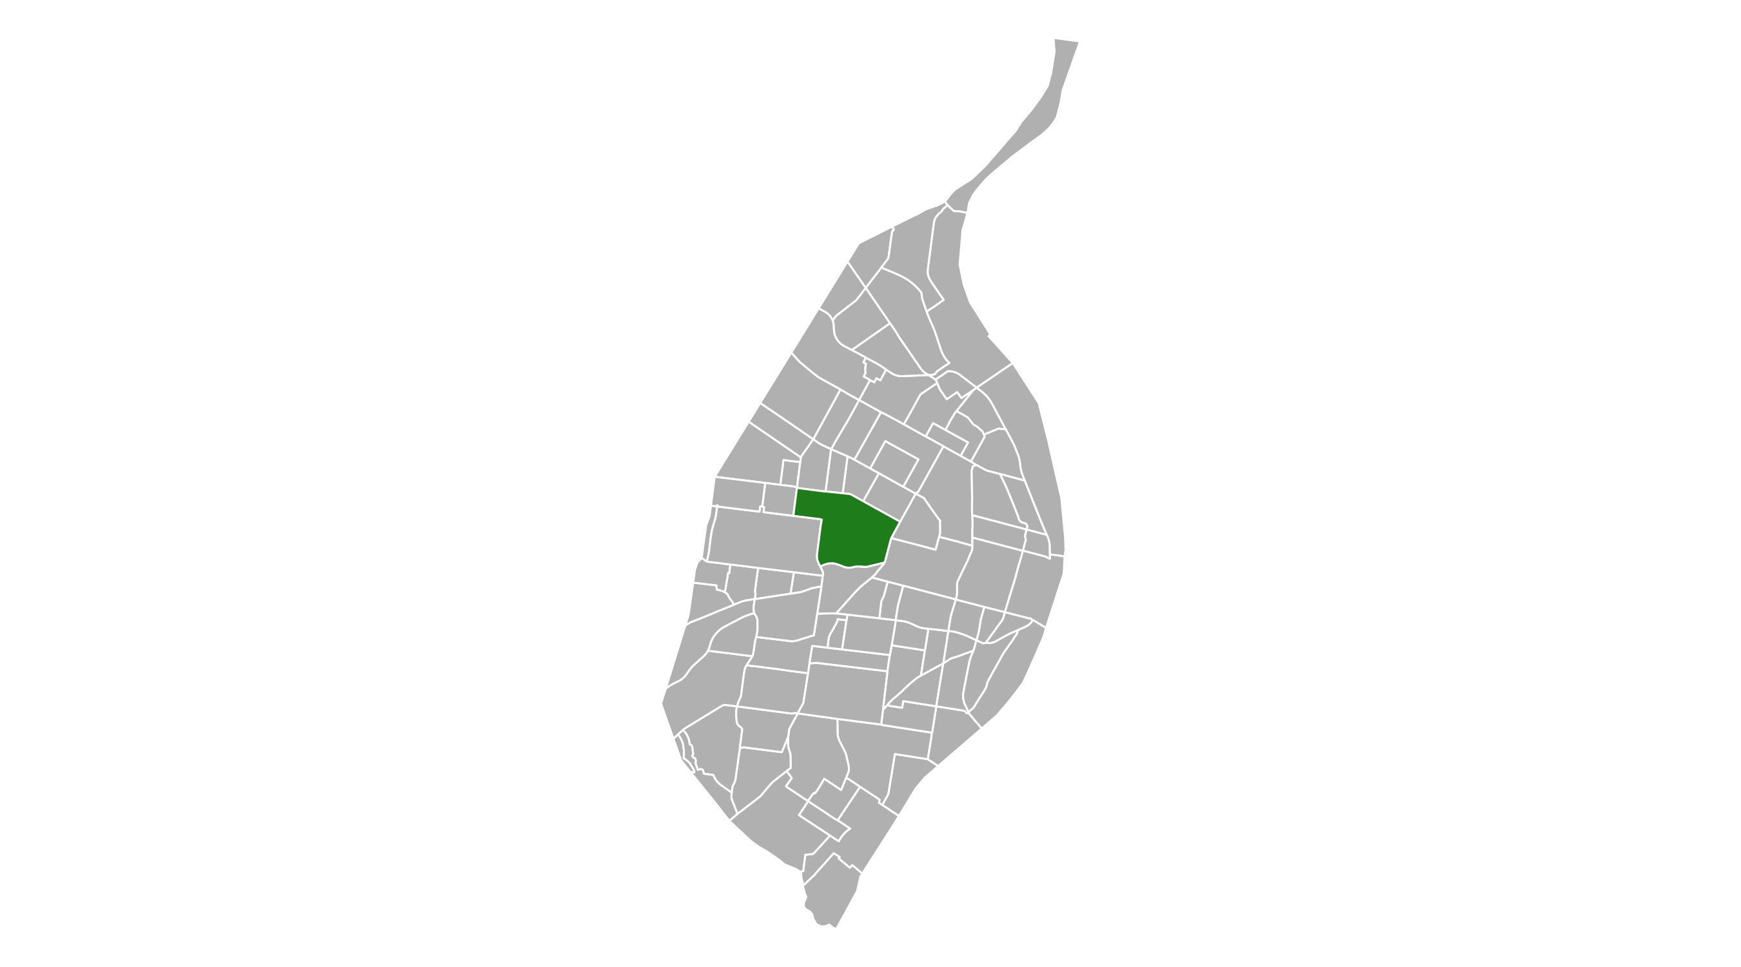
Central West End
Type of Crime | Jan
Person | 14
Property | 92
Society | 23
Unspecified | 20
Total | 149

Slide 18
Central West End : Property Crimes
Crime | Jan
Robbery | 6
Arson | 0
Extortion/Blackmail | 0
Burglary/Breaking and Entering | 7
Pocket-picking | 1
Purse-snatching | 0
Shoplifting | 3
Theft From Building | 7
Theft From Coin-Operated Machine or Device | 0
Theft From Motor Vehicle | 15
Theft From Motor Vehicle Parts/Accessories | 18
All Other Larceny | 11
Motor Vehicle Theft | 4
Counterfeiting/Forgery | 0
False Pretense/Swindle/Confidence Game | 0
Credit Card/Automatic Teller Machine Fraud | 0
Impersonation | 0
Welfare Fraud | 0
Wire Fraud | 0
Identity Theft | 1

Slide 19
Central West End : Property Crimes
Crime | Jan
Hacking/Computer Invasion | 0
Embezzlement | 0
Stolen Property Offenses | 3
Destruction/Damage/Vandalism of Property | 16
Bribery | 0
Bad Checks | 0

Slide 20
Central West End : Society Crimes
Crime | Jan
Drug/Narcotic Violations | 4
Drug Equipment Violations | 2
Pornography/Obscene Material | 0
Betting/Wagering | 0
Operating/Promoting/Assisting Gambling | 0
Gambling Equipment Violations | 0
Sports Tampering | 0
Prostitution | 0
Assisting or Promoting Prostitution | 0
Purchasing Prostitution | 0
Weapons Law Violations | 6
Animal Cruelty | 0
Curfew/Loitering/Vagrancy Violations | 0
Disorderly Conduct | 4
Driving Under the Influence | 0
Drunkeness | 0
Family Offenses, Nonviolent | 2
Liquor Law Violations | 0
Peeping Tom | 0
Trespass of Real Property | 5

Slide 21
Central West End : Person Crimes
Crime | Jan
Murder and Nonnegligent Manslaughter | 1
Negligent Manslaughter | 0
Justifiable Homicide | 0
Suicide | 0
Kidnapping/Abduction | 0
Rape | 0
Sodomy | 0
Sexual Assault with an Object | 0
Fondling | 0
Aggravated Assault | 7
Simple Assault | 4
Intimidation | 1
Incest | 0
Statutory Rape | 1
Human Trafficking, Commercial Sex Acts | 0
Human Trafficking, Involuntary Servitude | 0

Slide 22
Central West End : Unspecified Crimes
Crime | Jan
Runaway | 0
All Other Offenses | 20

