Slide 1
Forest Park Southeast, Botanical Heights, Central West End, Medical Campus
Monthly Crime report: April 2020 Washington University Medical Center

Slide 2
lay <- lay_new(matrix(1:4, nc = 2), widths = c(2,2), heights = c(2,2)) title <- lay_new(1, widths = 2, heights = 2) layout <- lay_bind_row(title, lay, heights = c(1,6)) lay_show(layout)

Slide 3
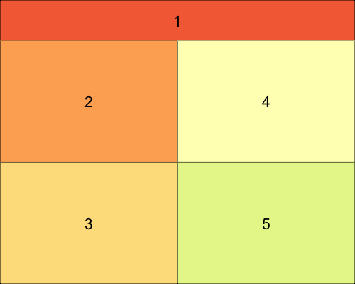

Slide 4
lay01 <- lay_new(matrix(1:2)) title01 <- lay_new(1, widths = 2, heights = 2) layout01 <- lay_bind_row(title01, lay01, heights = c(1,6)) lay_show(layout01)

Slide 5
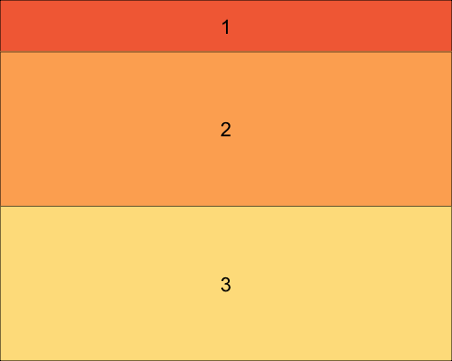

Slide 6
## create officer layouts offlayout <- phl_layout(layout, margins = c(0, 1, 1, 0), innerMargins = rep(0.15,4)) offlayout01 <- phl_layout(layout, margins = c(0.25, 0.25, 0.25, 0.25), innerMargins = rep(0.15,4))
cols <- c("Aggravated Assault" = "#e41a1c", "Arson" = "#A65628", "Burgalry" = "#377eb8", "Homicide" = "#FFFF33", "Larceny" = "#4DAF4A", "Motor Vehicle Theft" = "#984EA3", "Robbery" = "#FF7F00")
#title slide report%>% add_slide(layout = "Title Slide", master = "Office Theme")%>% ph_with(value = "Forest Park Southeast, Botanical Heights, Central West End, Medical Campus", location = ph_location_type(type = "ctrTitle"))%>% ph_with(c(paste("Monthly Crime Report:", params$month, params$year, sep = " "), "Washington University Medical Center"), location = ph_location_type(type = "subTitle")) -> report

Slide 7
Forest Park Southeast: Summary Notes

Slide 8
Forest Park Southeast: Year to Year Comparison
## Warning in phl_with_flextable(., olay = offlayout01, 2, flex): Table total width is larger than placeholder size. ## Table width: 10.5 ## Placeholder width: 4.45
## Warning in phl_with_flextable(., olay = offlayout01, 2, flex): Table total height is larger than placeholder size. ## Table height: 2.723 ## Placeholder height: 2.7
## Warning in phl_with_flextable(., olay = offlayout01, 3, flex01): Table total width is larger than placeholder size. ## Table width: 4.5 ## Placeholder width: 4.45
## Warning in phl_with_flextable(., olay = offlayout01, 3, flex01): Table total height is larger than placeholder size. ## Table height: 2.721 ## Placeholder height: 2.7

Slide 9
Forest Park Southeast: Summary Tables
## Warning in phl_with_flextable(., olay = offlayout, 2, flex02): Table total height is larger than placeholder size. ## Table height: 2.604 ## Placeholder height: 2.486

Slide 10
Forest Park Southeast: Total Crime Map

Slide 11
Botanical Heights: Summary Notes

Slide 12
Botanical Heights: Year to Year Comparison
## Warning in phl_with_flextable(., olay = offlayout01, 2, flex): Table total width is larger than placeholder size. ## Table width: 10.5 ## Placeholder width: 4.45
## Warning in phl_with_flextable(., olay = offlayout01, 2, flex): Table total height is larger than placeholder size. ## Table height: 2.723 ## Placeholder height: 2.7
## Warning in phl_with_flextable(., olay = offlayout01, 3, flex01): Table total width is larger than placeholder size. ## Table width: 4.5 ## Placeholder width: 4.45
## Warning in phl_with_flextable(., olay = offlayout01, 3, flex01): Table total height is larger than placeholder size. ## Table height: 2.721 ## Placeholder height: 2.7

Slide 13
Botanical Heights: Summary Tables
## Warning in phl_with_flextable(., olay = offlayout, 2, flex02): Table total height is larger than placeholder size. ## Table height: 2.604 ## Placeholder height: 2.486

Slide 14
Botanical Heights: Total Crime Map

Slide 15
Botanical Heights: Crime by Days of the Week

Slide 16
District 2: Crime Rates Map

Slide 17
District 2: Density Map Explanation

Slide 18
Summary Notes: Central West End

Slide 19
Central West End: Year to Year Comparison
## Warning in phl_with_flextable(., olay = offlayout01, 2, flex): Table total width is larger than placeholder size. ## Table width: 10.5 ## Placeholder width: 4.45
## Warning in phl_with_flextable(., olay = offlayout01, 2, flex): Table total height is larger than placeholder size. ## Table height: 2.742 ## Placeholder height: 2.7
## Warning in phl_with_flextable(., olay = offlayout01, 3, flex01): Table total width is larger than placeholder size. ## Table width: 4.5 ## Placeholder width: 4.45
## Warning in phl_with_flextable(., olay = offlayout01, 3, flex01): Table total height is larger than placeholder size. ## Table height: 2.721 ## Placeholder height: 2.7

Slide 20
Central West End: Summary Tables
## Warning in phl_with_flextable(., olay = offlayout, 2, flex02): Table total height is larger than placeholder size. ## Table height: 2.606 ## Placeholder height: 2.486

Slide 21
Central West End: Total Crime Map

Slide 22
Washington University Medical Campus: Summary Notes

Slide 23
Washington University Medical Campus: Year to Year Comparison
## Warning in phl_with_flextable(., olay = offlayout01, 2, flex): Table total width is larger than placeholder size. ## Table width: 10.5 ## Placeholder width: 4.45
## Warning in phl_with_flextable(., olay = offlayout01, 2, flex): Table total height is larger than placeholder size. ## Table height: 2.723 ## Placeholder height: 2.7
## Warning in phl_with_flextable(., olay = offlayout01, 3, flex01): Table total width is larger than placeholder size. ## Table width: 4.5 ## Placeholder width: 4.45
## Warning in phl_with_flextable(., olay = offlayout01, 3, flex01): Table total height is larger than placeholder size. ## Table height: 2.721 ## Placeholder height: 2.7

Slide 24
Washington University Medical Campus: Summary Tables

Slide 25
Washington University Medical Center: Total Crime Map

Slide 26
Cortex: Total Crime Map

Slide 27
District 5: Crime Rates Map

Slide 28
District 5: Density Map Explanation

Slide 29
Forest Park Southeast: Neighborhood Detail
Appendix 1
report%>% add_slide(layout = "Title Slide", master = "Office Theme")%>% ph_with(value = "Forest Park Southeast: Neighborhood Detail", location = ph_location_type(type = "ctrTitle"))%>% ph_with("Appendix 1", location = ph_location_type(type = "subTitle")) -> report

Slide 30
Forest Park Southeast: Time of Crimes Map

Slide 31
Forest Park Southeast: Violent Crime Map

Slide 32
Forest Park Southeast: Crime Density Map

Slide 33
Grove Community Improvement District: Total Crime Map

Slide 34
Forest Park Southeast: Larceny Breakdown
## Warning in phl_with_flextable(., olay = offlayout, 2, flex01): Table total height is larger than placeholder size. ## Table height: 2.604 ## Placeholder height: 2.486

Slide 35
Forest Park Southeast: Total Crimes by Days of the Week

Slide 36
Forest Park Southeast: Crimes by Time of Day

Slide 37
Forest Park Southeast: Crimes by Day & Category

Slide 38
Central West End: Neighborhood Detail
Appendix 2
report%>% add_slide(layout = "Title Slide", master = "Office Theme")%>% ph_with(value = "Central West End: Neighborhood Detail", location = ph_location_type(type = "ctrTitle"))%>% ph_with("Appendix 2", location = ph_location_type(type = "subTitle")) -> report

Slide 39
Central West End: Time of Crimes Map

Slide 40
Central West End: Violent Crime Map

Slide 41
Central West End: Crime Density Map

Slide 42
Central West End: Larceny Breakdown
## Warning in phl_with_flextable(., olay = offlayout, 2, flex01): Table total height is larger than placeholder size. ## Table height: 2.607 ## Placeholder height: 2.486
## Warning in phl_with_flextable(., olay = offlayout, 4, flex03): Table total height is larger than placeholder size. ## Table height: 2.698 ## Placeholder height: 2.486

Slide 43
Central West End: Total Crimes by Days of the Week

Slide 44
Central West End: Crimes by Time of Day

Slide 45
Central West End: Crimes by Day & Category
# save powerpoint report print(report, target = here::here("results", "presentations", params$year, params$month, "fpse-bot-cwe-mc-presentation.pptx"))

