Slide 1
Forest Park Southeast, Botanical Heights, Central West End, Medical Campus
Washington University Medical Center

Slide 2
Summary Notes: FPSE August 2019
## [1] "20 total crimes in August 2019"
## [1] "11.1% change compared to August 2018 (18 total crimes)"
## [1] "1 crime(s) against persons in August 2019"
## [1] "-75.0% change compared to August 2018 (4 crimes against persons)"
## [1] "165 total crimes in 2019"
## [1] "25.0% change compared to this time in 2018 (132 total crimes)"
## [1] "27 crime(s) against persons in 2019"
## [1] "-20.6% change compared to this time in 2018 (34 crimes against persons)"

Slide 3
Comparing 2018 to 2019: Forest Park Southeast
Part 1 Crimes | Jan | Feb | Mar | Apr | May | Jun | Jul | Aug | Sep | Oct | Nov | Dec | Total
Aggravated Assault | 1 | 2 | 0 | 3 | 7 | 4 | 4 | 3 | 1 | 7 | 0 | 3 | 35
Arson | 0 | 0 | 1 | 0 | 0 | 0 | 0 | 0 | 0 | 0 | 0 | 0 | 1
Burgalry | 0 | 1 | 1 | 3 | 0 | 1 | 1 | 1 | 0 | 1 | 0 | 0 | 9
Homicide | 1 | 0 | 0 | 0 | 0 | 0 | 0 | 0 | 0 | 0 | 0 | 0 | 1
Larceny | 5 | 5 | 5 | 8 | 20 | 4 | 14 | 11 | 15 | 7 | 10 | 3 | 107
Motor Vehicle Theft | 2 | 1 | 2 | 0 | 3 | 3 | 3 | 2 | 2 | 2 | 2 | 2 | 24
Robbery | 0 | 0 | 1 | 1 | 1 | 4 | 2 | 1 | 0 | 2 | 1 | 2 | 15
Total | 9 | 9 | 10 | 15 | 31 | 16 | 24 | 18 | 18 | 19 | 13 | 10 | 192
Part 1 Crimes | Jan | Feb | Mar | Apr | May | Jun | Jul | Aug | Total
Aggravated Assault | 0 | 3 | 1 | 2 | 2 | 4 | 2 | 0 | 14
Arson | 0 | 0 | 1 | 0 | 0 | 1 | 0 | 0 | 2
Burgalry | 0 | 0 | 1 | 1 | 0 | 0 | 3 | 1 | 6
Larceny | 7 | 10 | 15 | 12 | 9 | 21 | 16 | 17 | 107
Motor Vehicle Theft | 3 | 6 | 1 | 2 | 0 | 4 | 6 | 1 | 23
Robbery | 1 | 0 | 1 | 1 | 2 | 5 | 2 | 1 | 13
Total | 11 | 19 | 20 | 18 | 13 | 35 | 29 | 20 | 165

Slide 4
Forest Park Southeast: August 2019
Part 1 Crimes | Number of Crimes
Burgalry | 1
Larceny | 17
Motor Vehicle Theft | 1
Robbery | 1
Total | 20
Day of the Week | Number of Crimes
Sun | 1
Mon | 1
Tue | 4
Wed | 3
Thu | 6
Fri | 2
Sat | 3
Total | 20
Crimes Against Persons | Number of Crimes
FALSE | 19
TRUE | 1
Total | 20
Time of Day | Number of Crimes
Day | 15
Night | 5
Total | 20

Slide 5
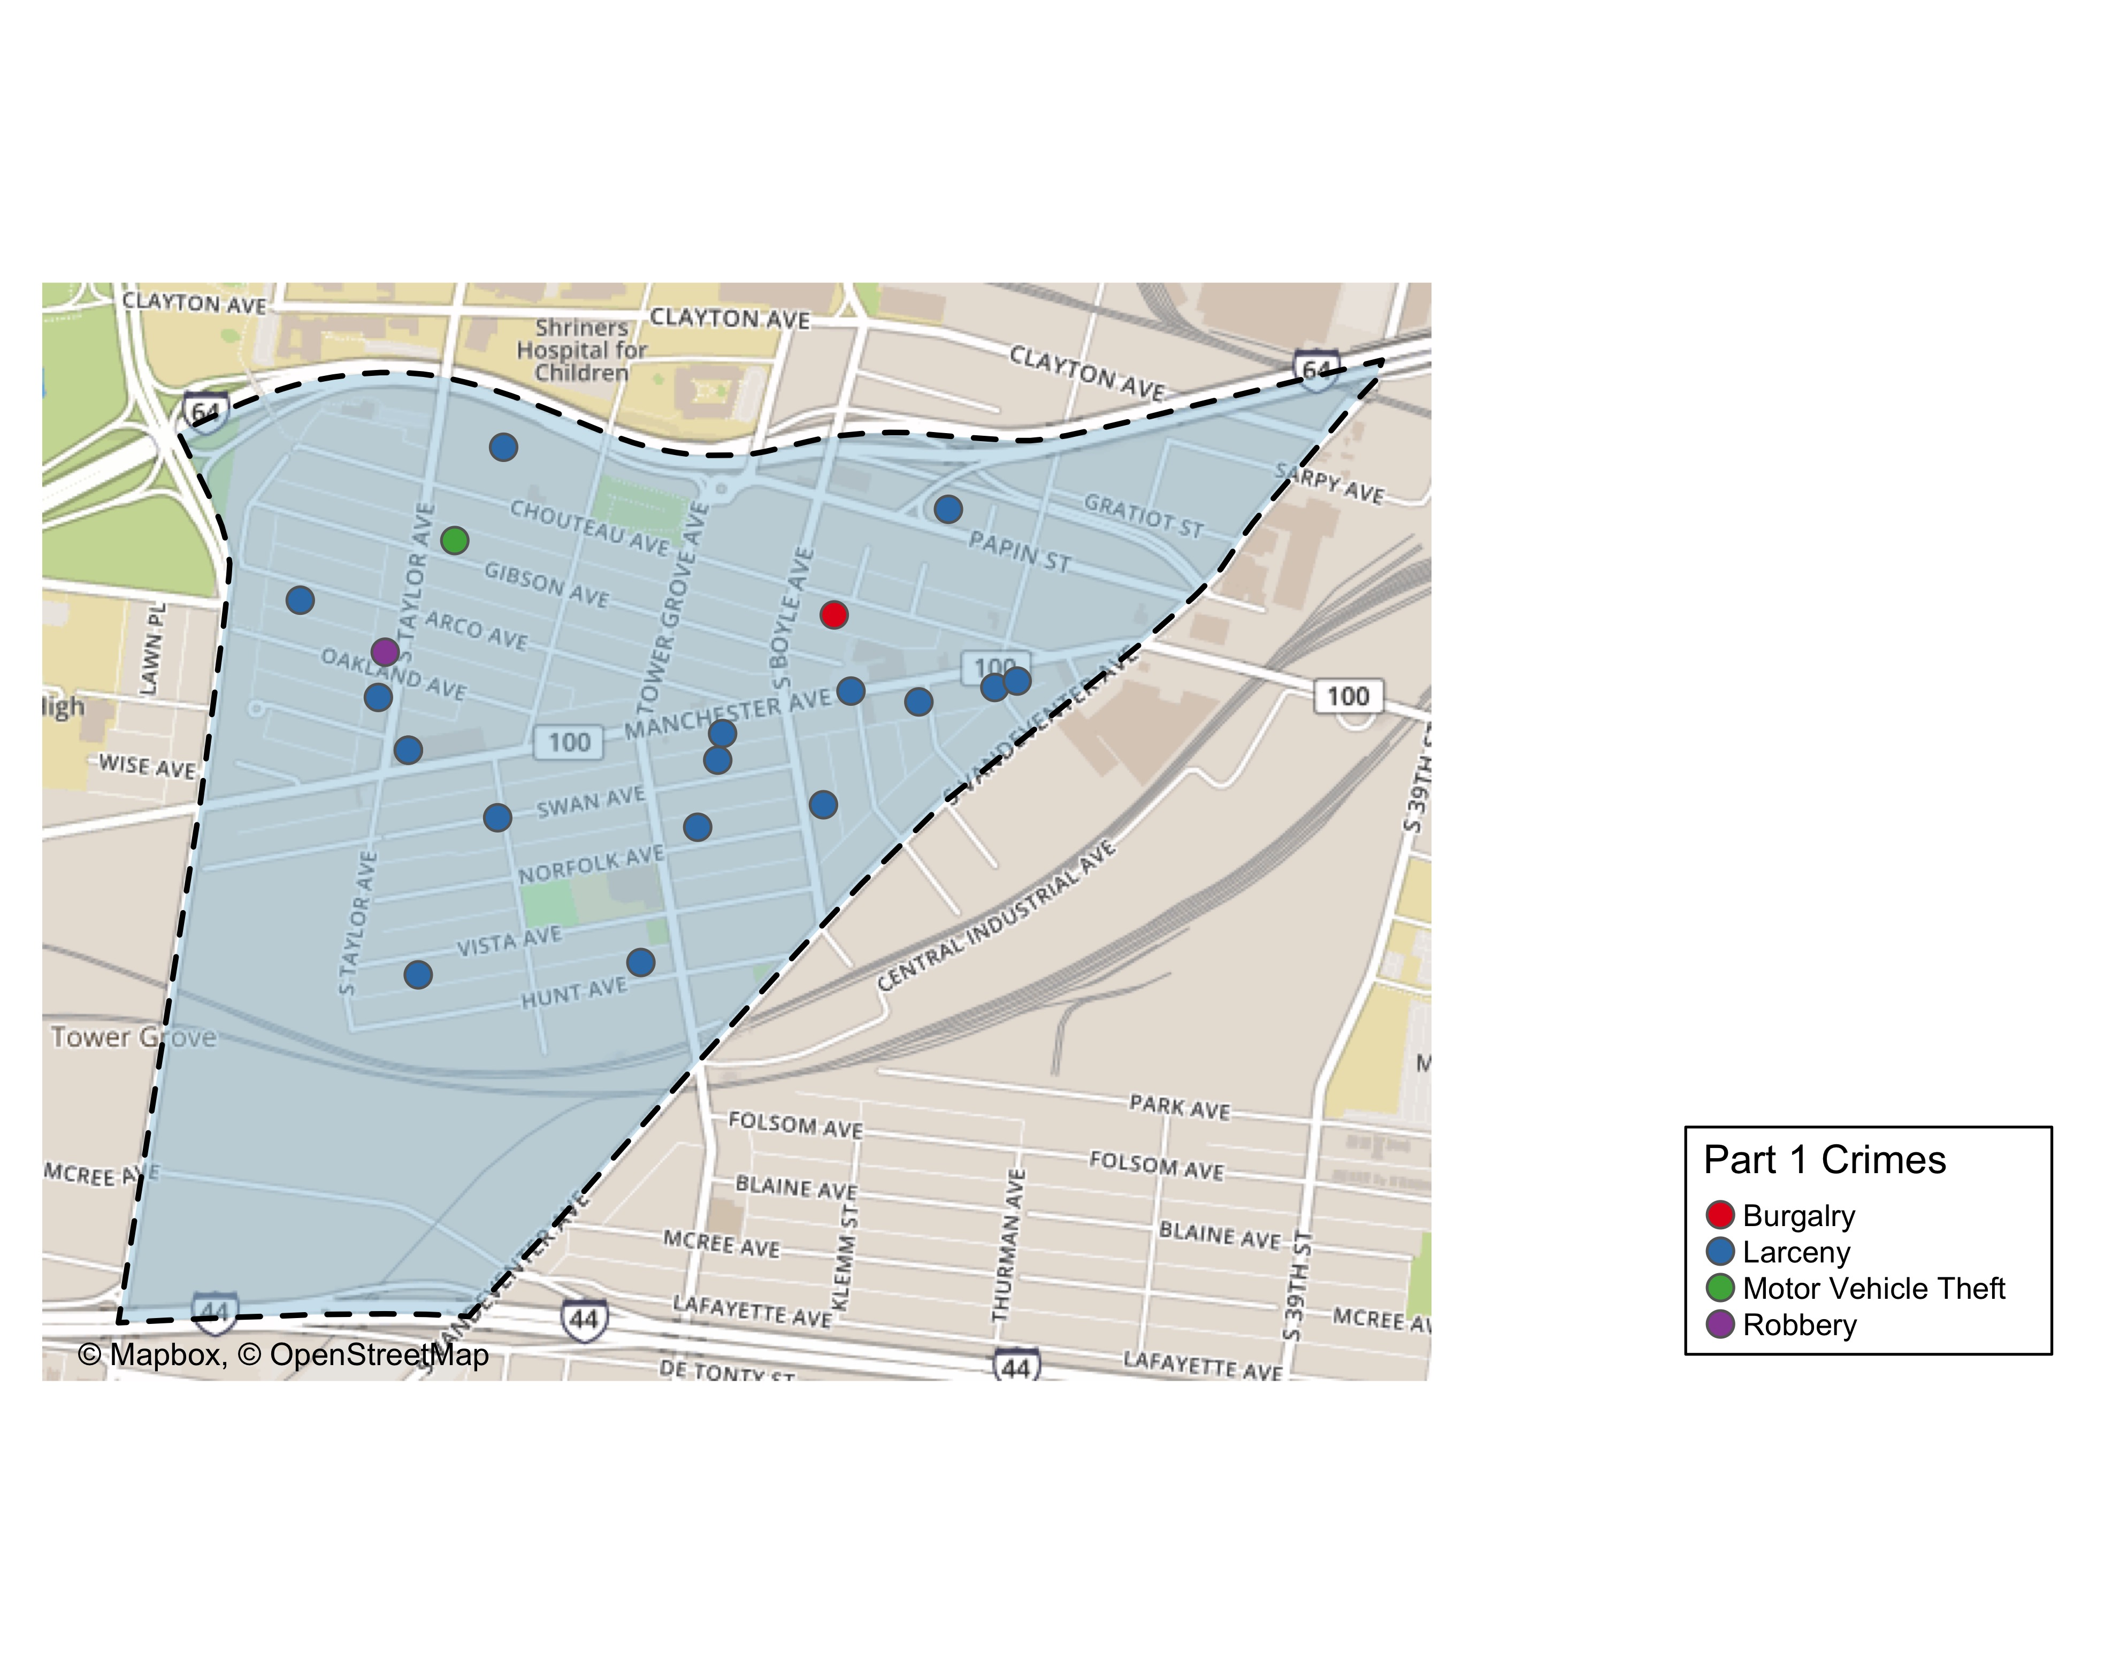
Forest Park Southeast Total Crime

