Slide 1
Forest Park Southeast, Botanical Heights, Central West End, Medical Campus
Washington University Medical Center

Slide 2
Summary Notes: FPSE August 2019
## [1] "20 total crimes in August 2019"
## [1] "11.1% change compared to August 2018 (18 total crimes)"
## [1] "1 crime(s) against persons in August 2019"
## [1] "-75.0% change compared to August 2018 (4 crimes against persons)"
## [1] "166 total crimes in 2019"
## [1] "25.8% change compared to this time in 2018 (132 total crimes)"
## [1] "27 crime(s) against persons in 2019"
## [1] "-20.6% change compared to this time in 2018 (34 crimes against persons)"

Slide 3
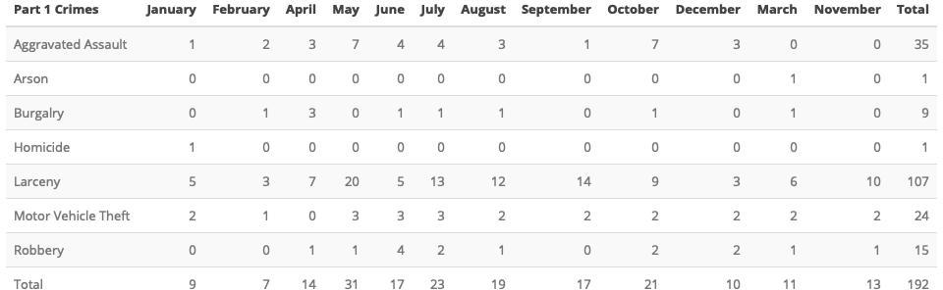
Comparing 2018 to 2019: Forest Park Southeast

Slide 4
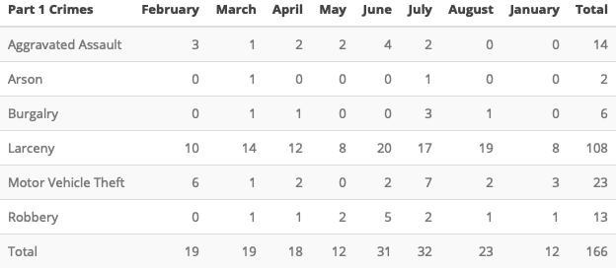

Slide 5
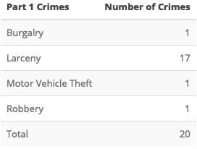
Forest Park Southeast August 2019

Slide 6
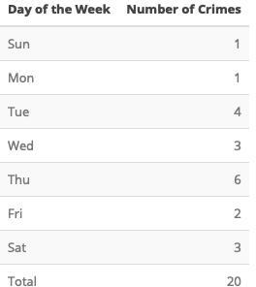

Slide 7
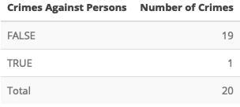

Slide 8
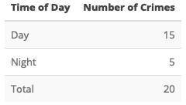

Slide 9
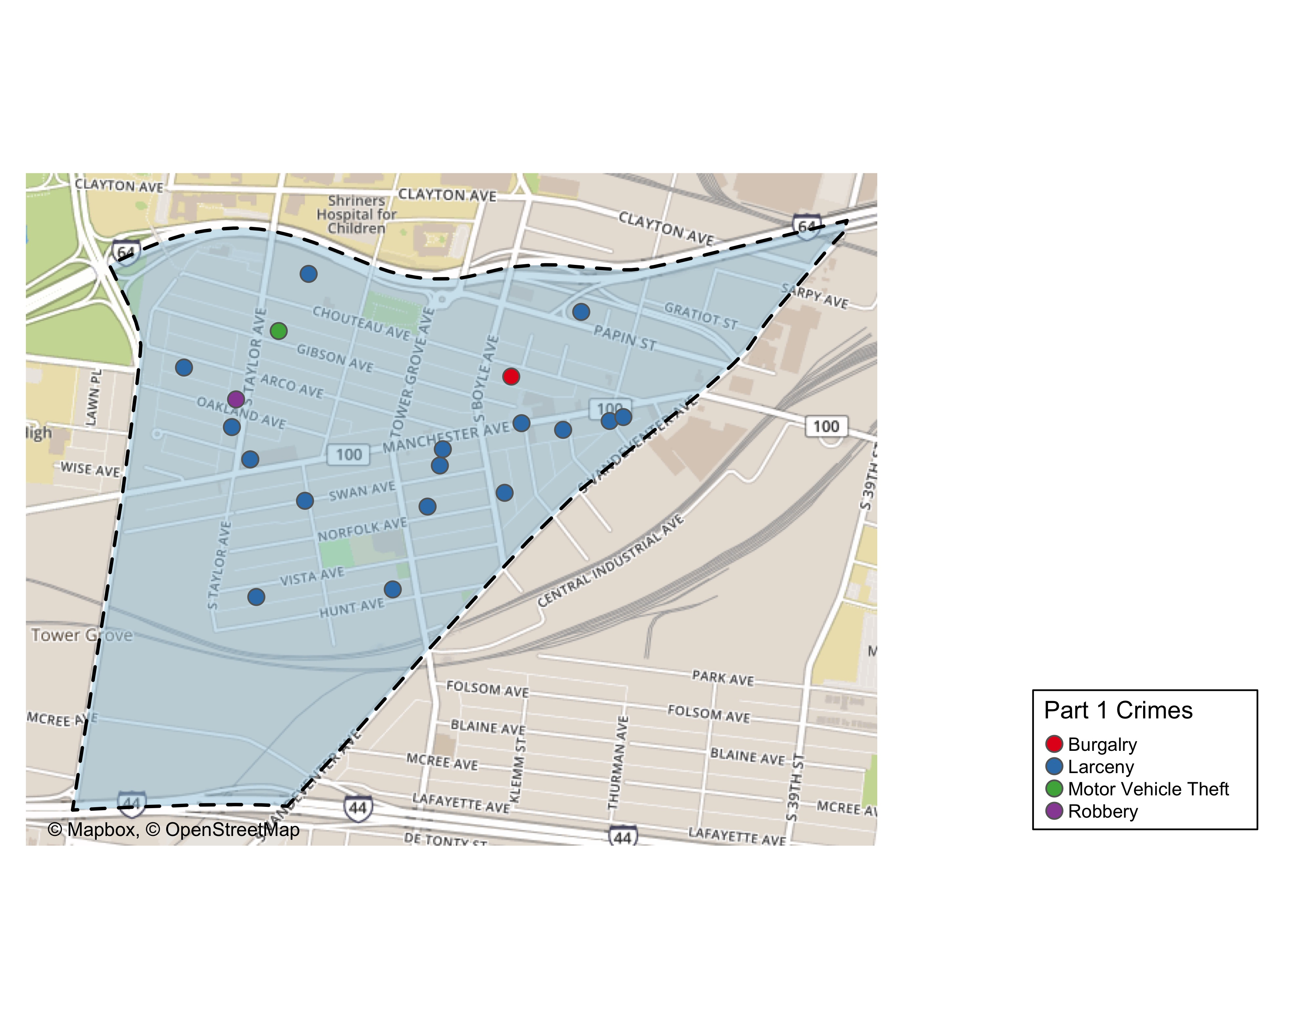
Forest Park Southeast Total Crime

Slide 10
Summary Notes: Botanical Heights
## [1] "4 total crimes in August 2019"
## [1] "-77.8% change compared to August 2018 (18 total crimes)"
## [1] "1 crime(s) against persons in August 2019"
## [1] "0% change compared to August 2018 (1 crimes against persons)"
## [1] "53 total crimes in 2019"
## [1] "-32.1% change compared to this time in 2018 (78 total crimes)"
## [1] "9 crime(s) against persons in 2019"
## [1] "28.6% change compared to this time in 2018 (7 crimes against persons)"

Slide 11
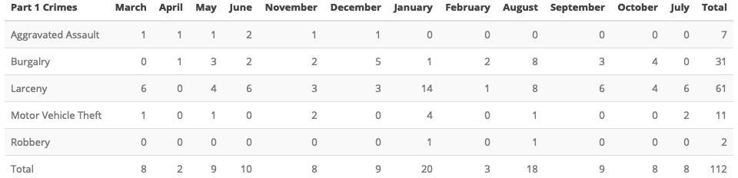
Comparing 2018 to 2019: Botanical Heights

Slide 12
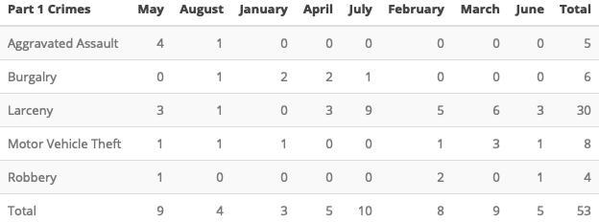

Slide 13
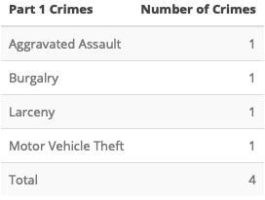

Slide 14
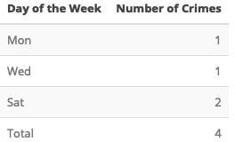

Slide 15
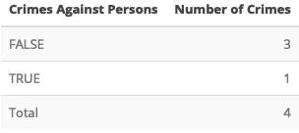

Slide 16


Slide 17
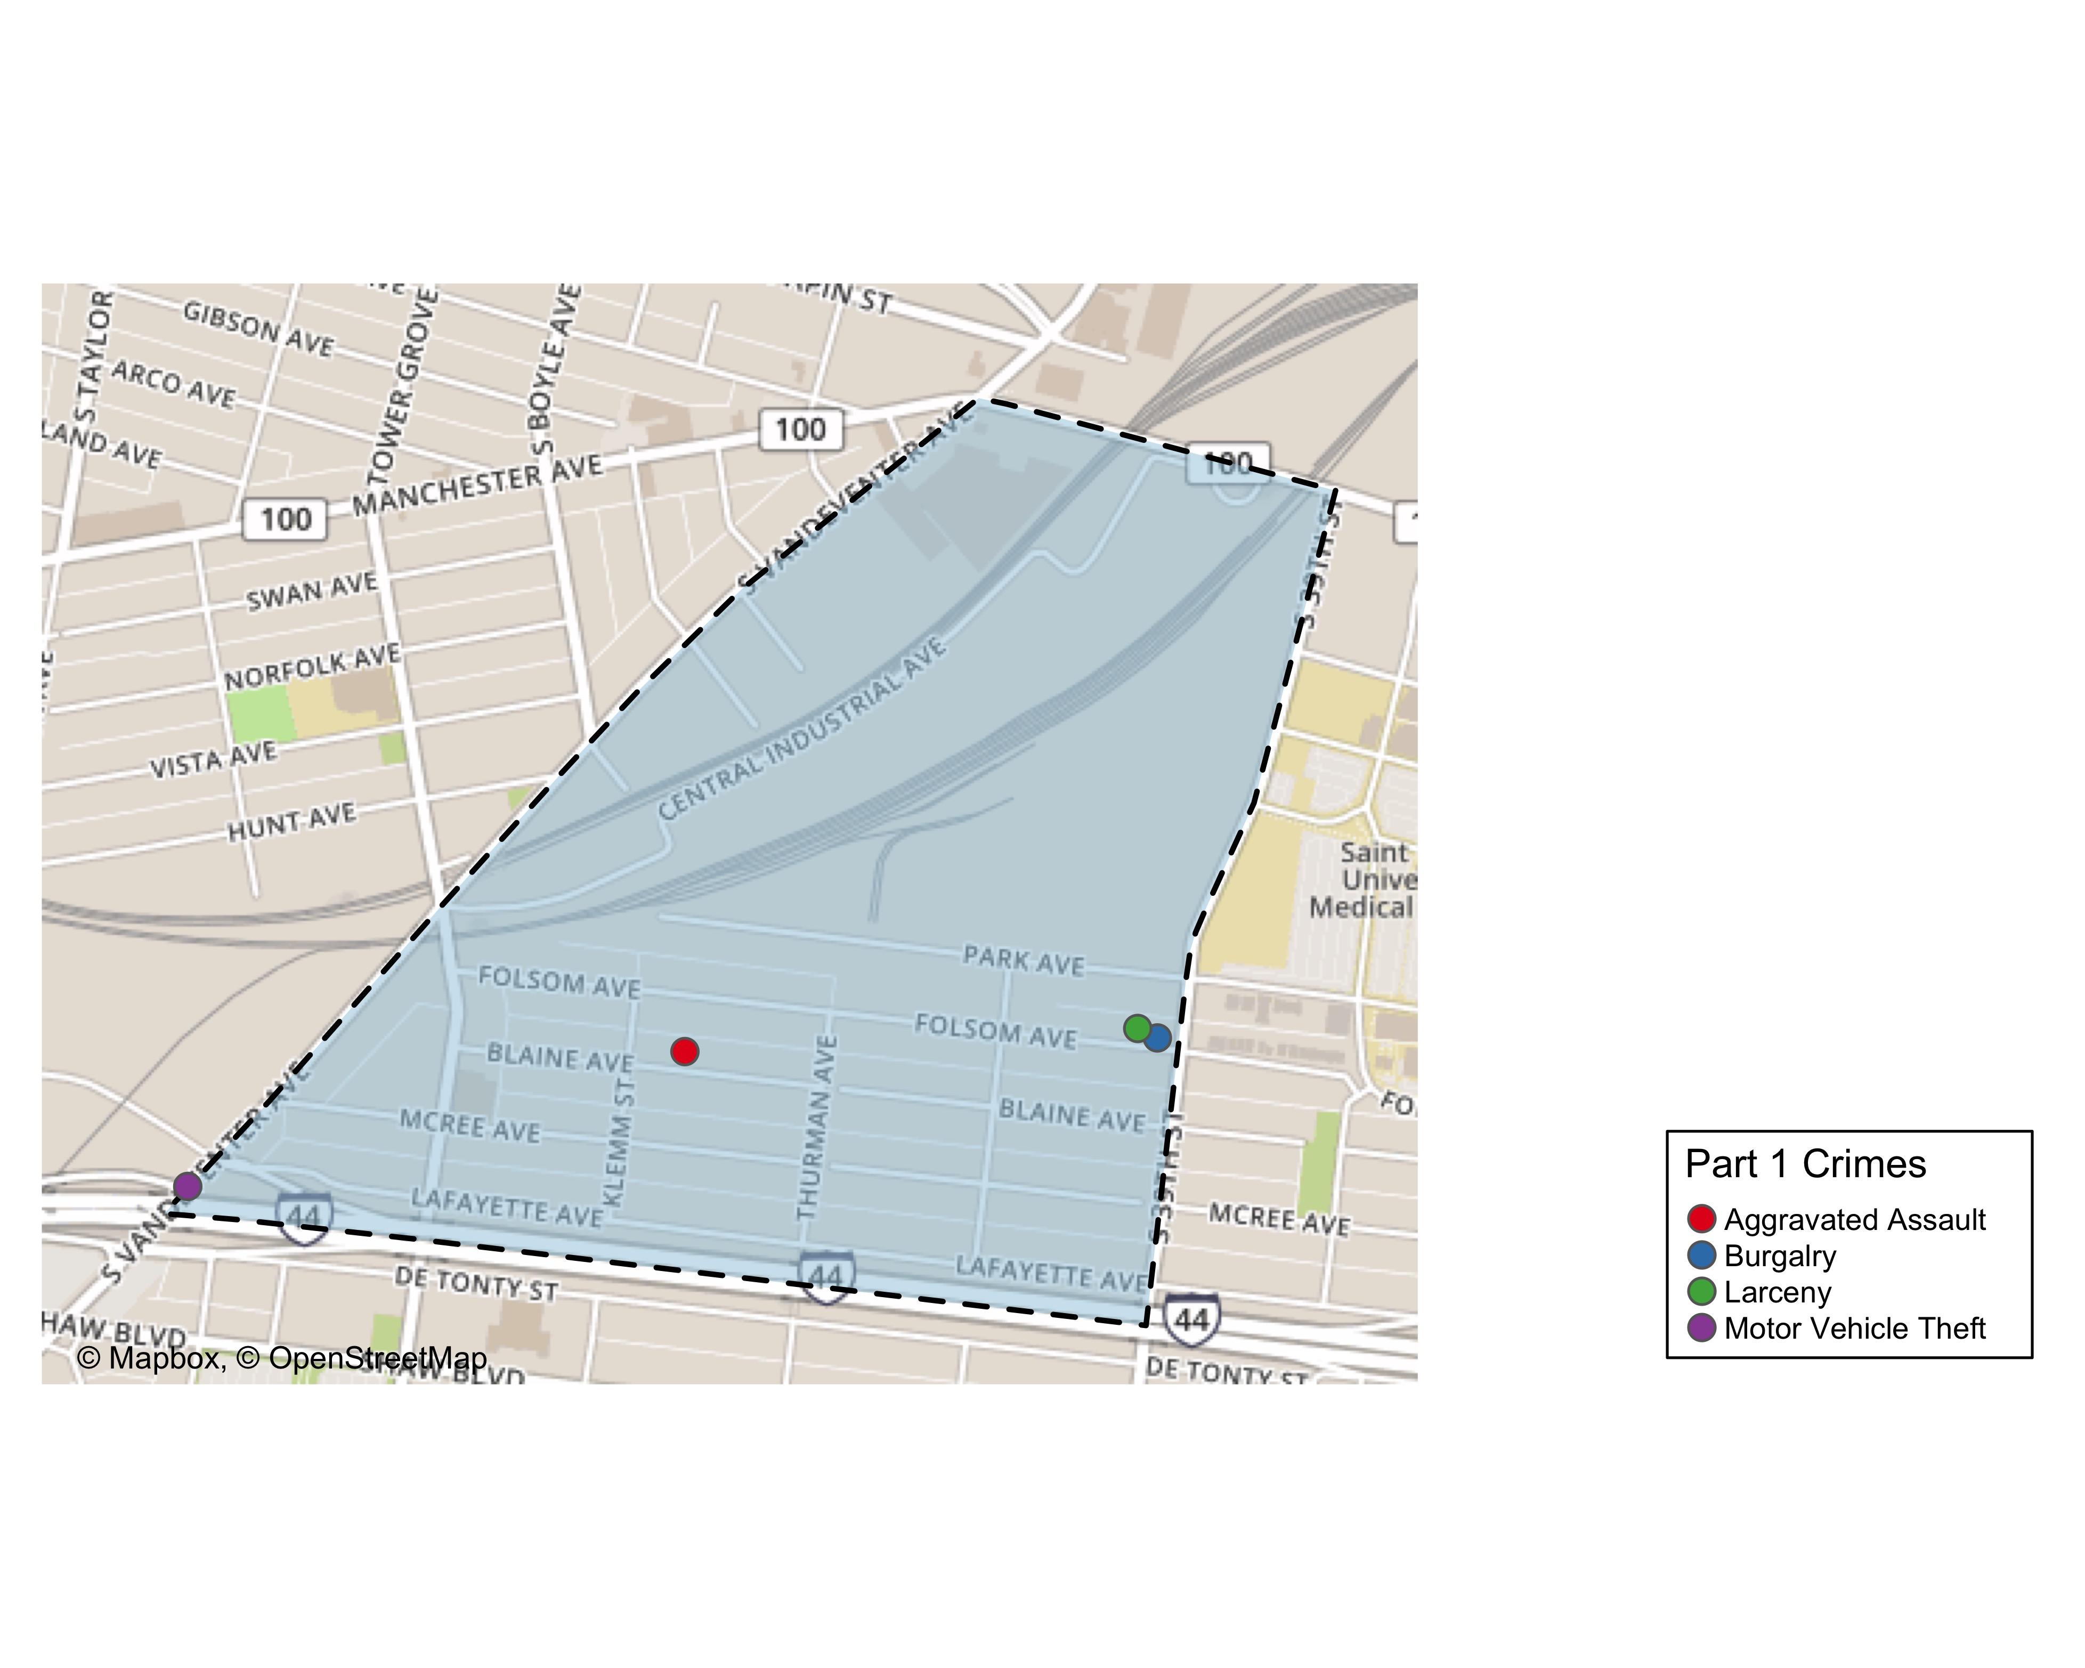
Botanical Heights Total Crime

Slide 18
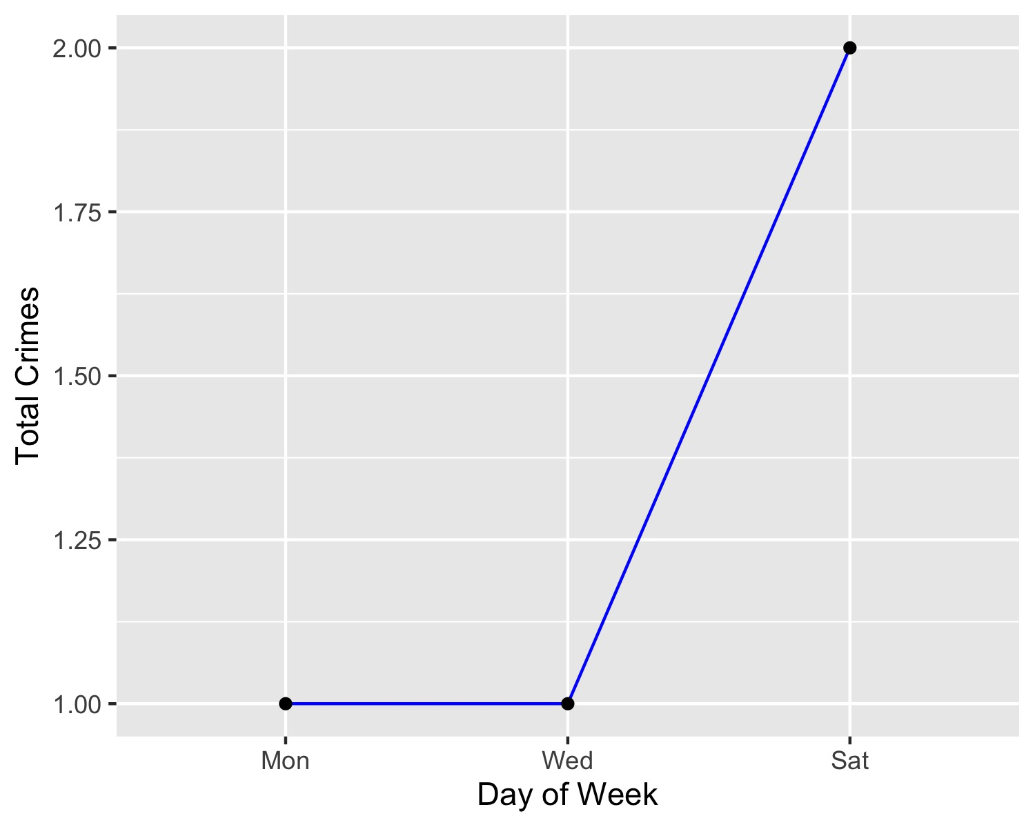
Botanical Heights Crime by Days of the Week

Slide 19
FPSE Larceny

