Slide 1
Forest Park Southeast, Botanical Heights, Central West End, Medical Campus
Washington University Medical Center

Slide 2
Summary Notes: FPSE August 2019
## [1] "20 total crimes in August 2019"
## [1] "11.1% change compared to August 2018 (18 total crimes)"
## [1] "1 crime(s) against persons in August 2019"
## [1] "-75.0% change compared to August 2018 (4 crimes against persons)"
## [1] "166 total crimes in 2019"
## [1] "25.8% change compared to this time in 2018 (132 total crimes)"
## [1] "27 crime(s) against persons in 2019"
## [1] "-20.6% change compared to this time in 2018 (34 crimes against persons)"

Slide 3
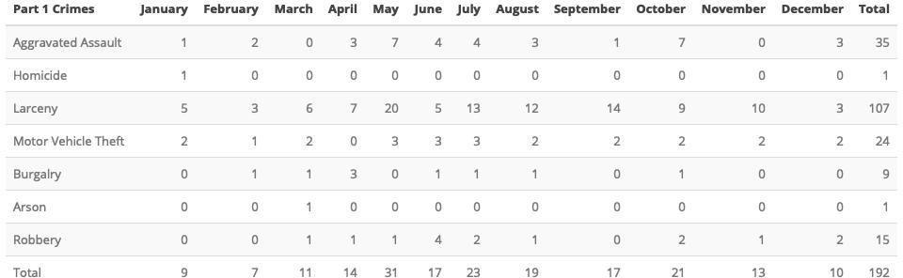
Comparing 2018 to 2019

Slide 4
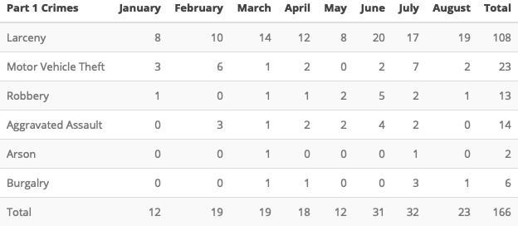

Slide 5
Forest Park Southeast 2019

