Slide 1
Washington University Central Corridor Neighborhoods
3 Year Rolling Averages for Part 1 Crimes
2011-2018

Slide 2
Total Crime
3 Year Rolling Averages
2011-2018

Slide 3
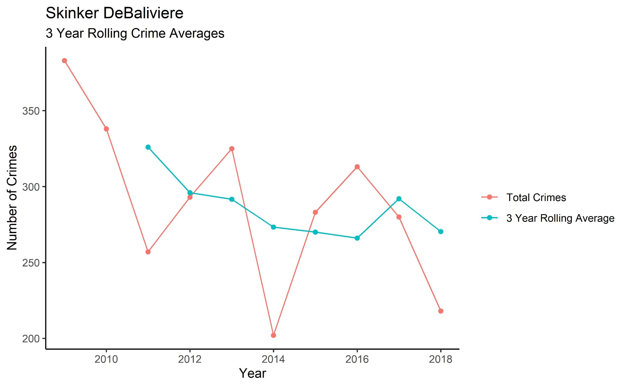
Skinker-DeBaliviere – Total Crime

Slide 4
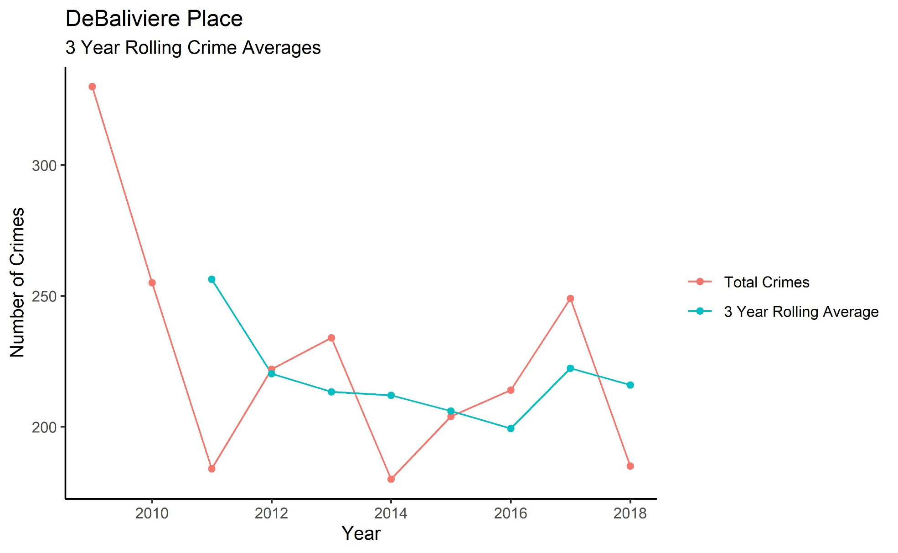
DeBaliviere Place – Total Crime

Slide 5
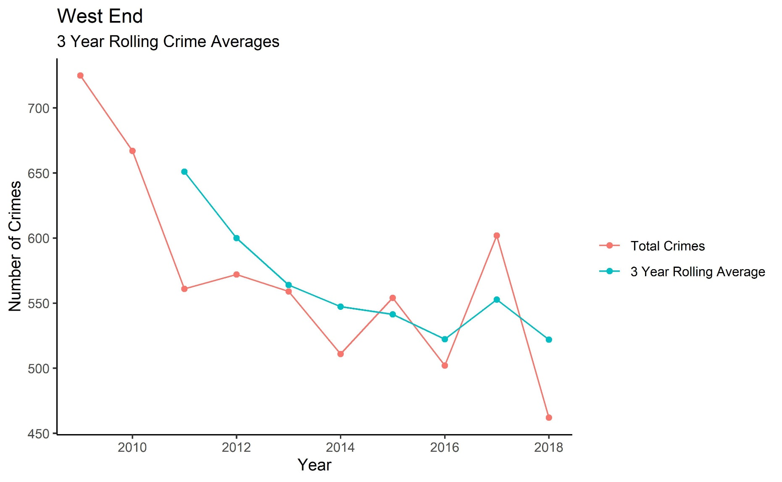
West End – Total Crime

Slide 6
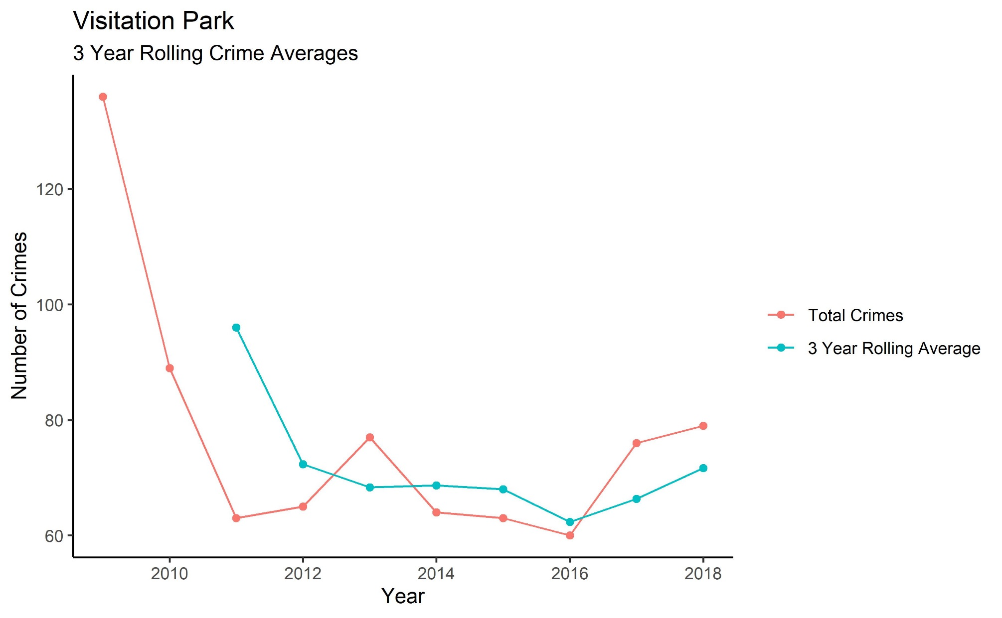
Visitation Park – Total Crime

Slide 7
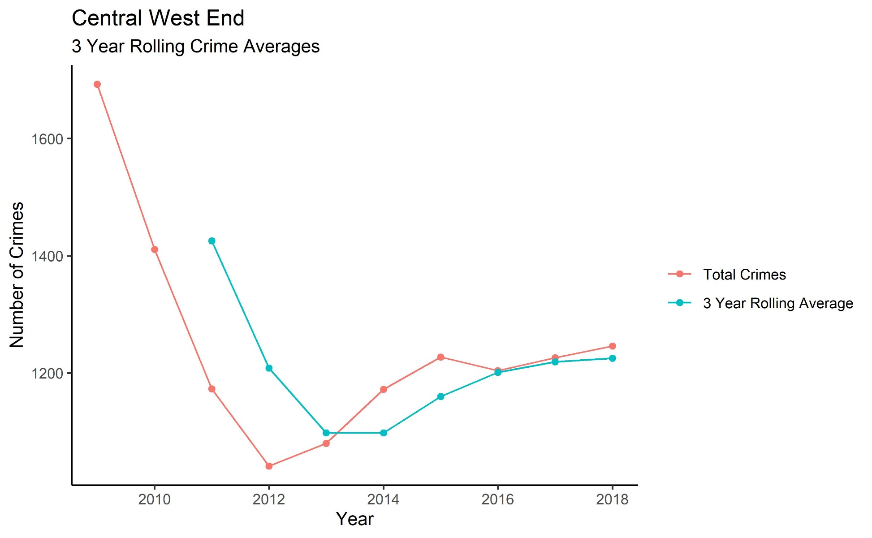
Central West End – Total Crime

Slide 8
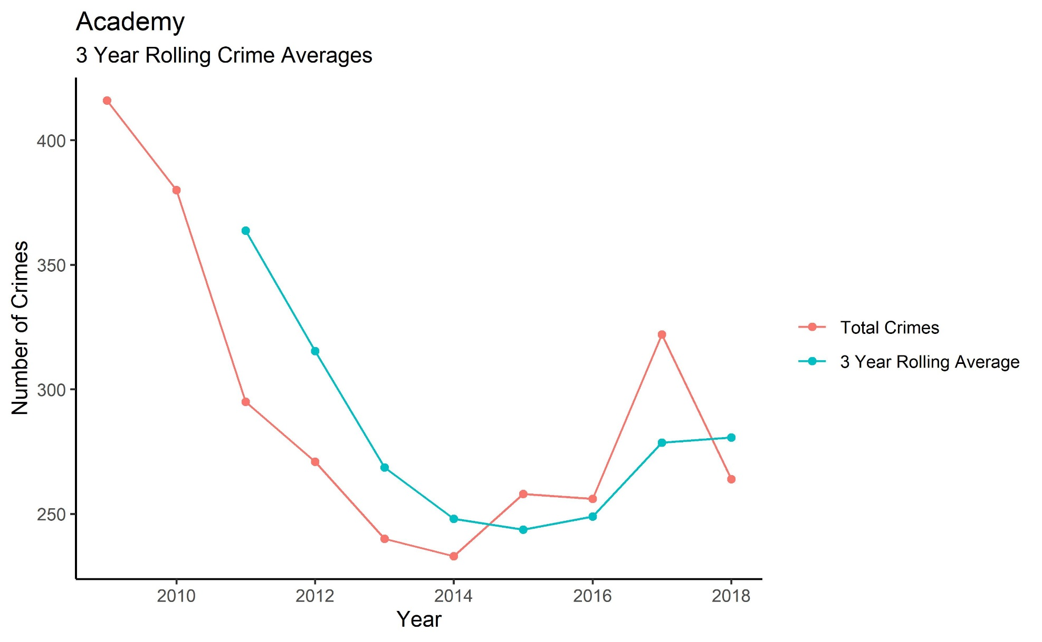
Academy-Sherman Park – Total Crime

Slide 9
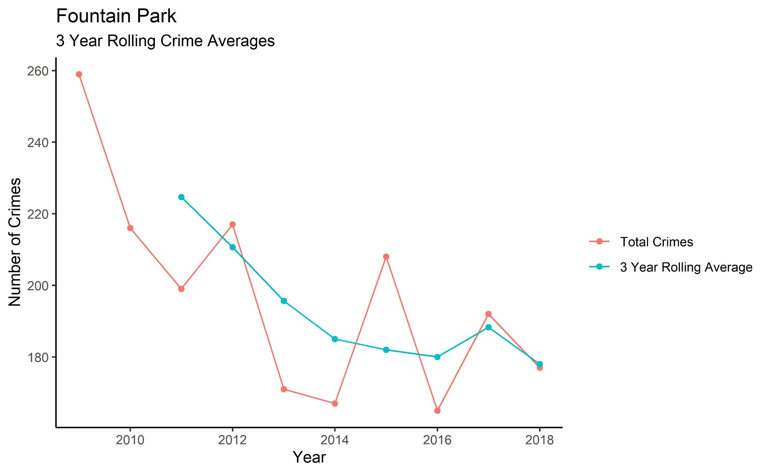
Fountain Park – Total Crime

Slide 10
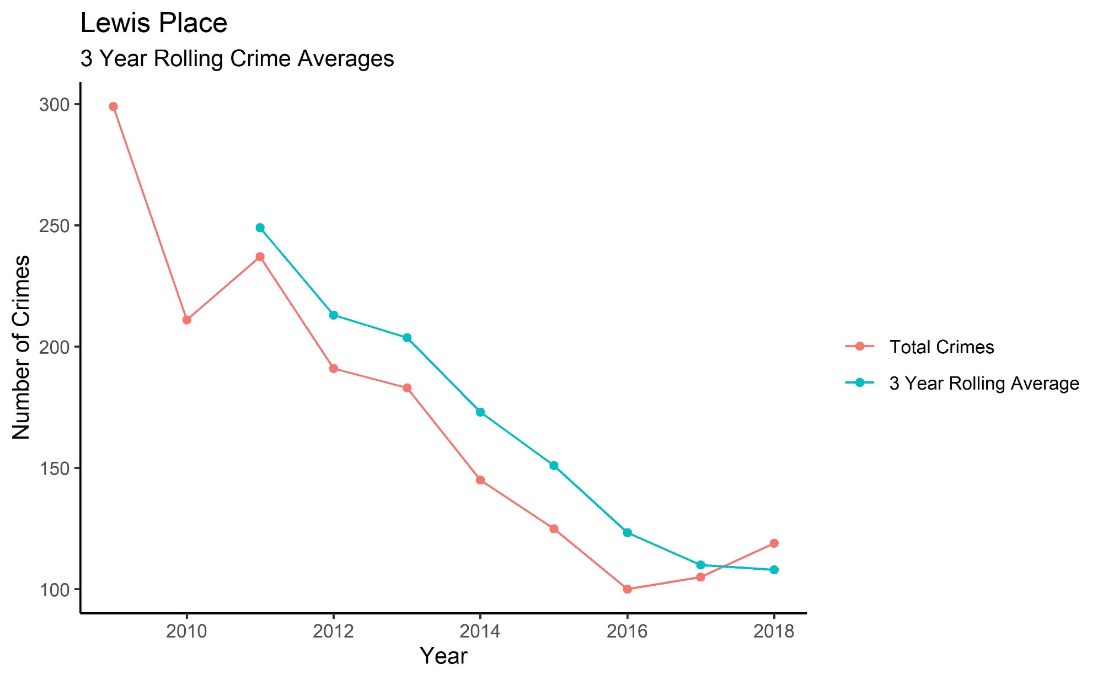
Lewis Place – Total Crime

Slide 11
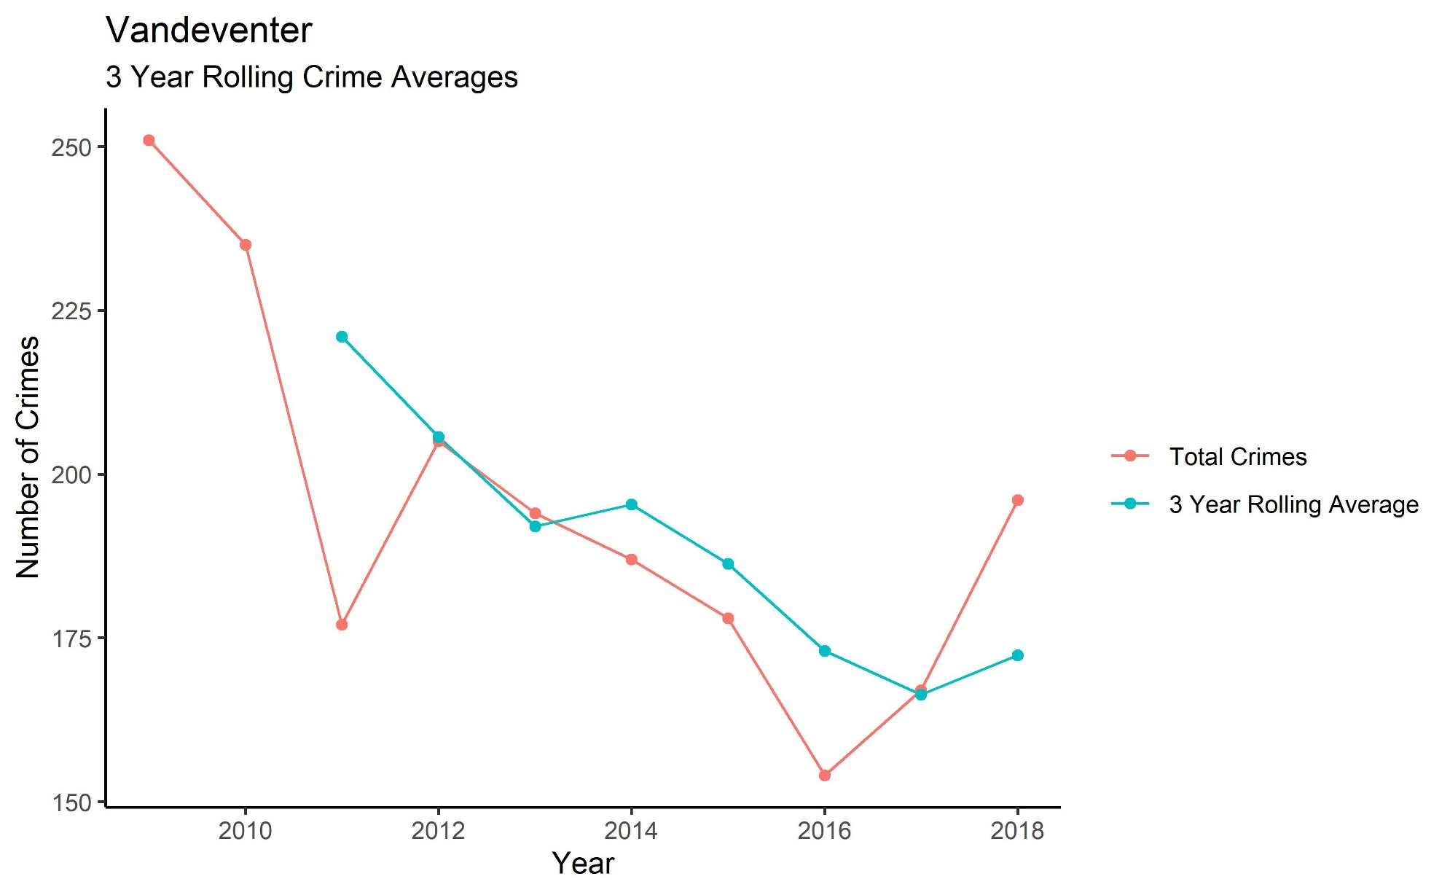
Vandeventer – Total Crime

Slide 12
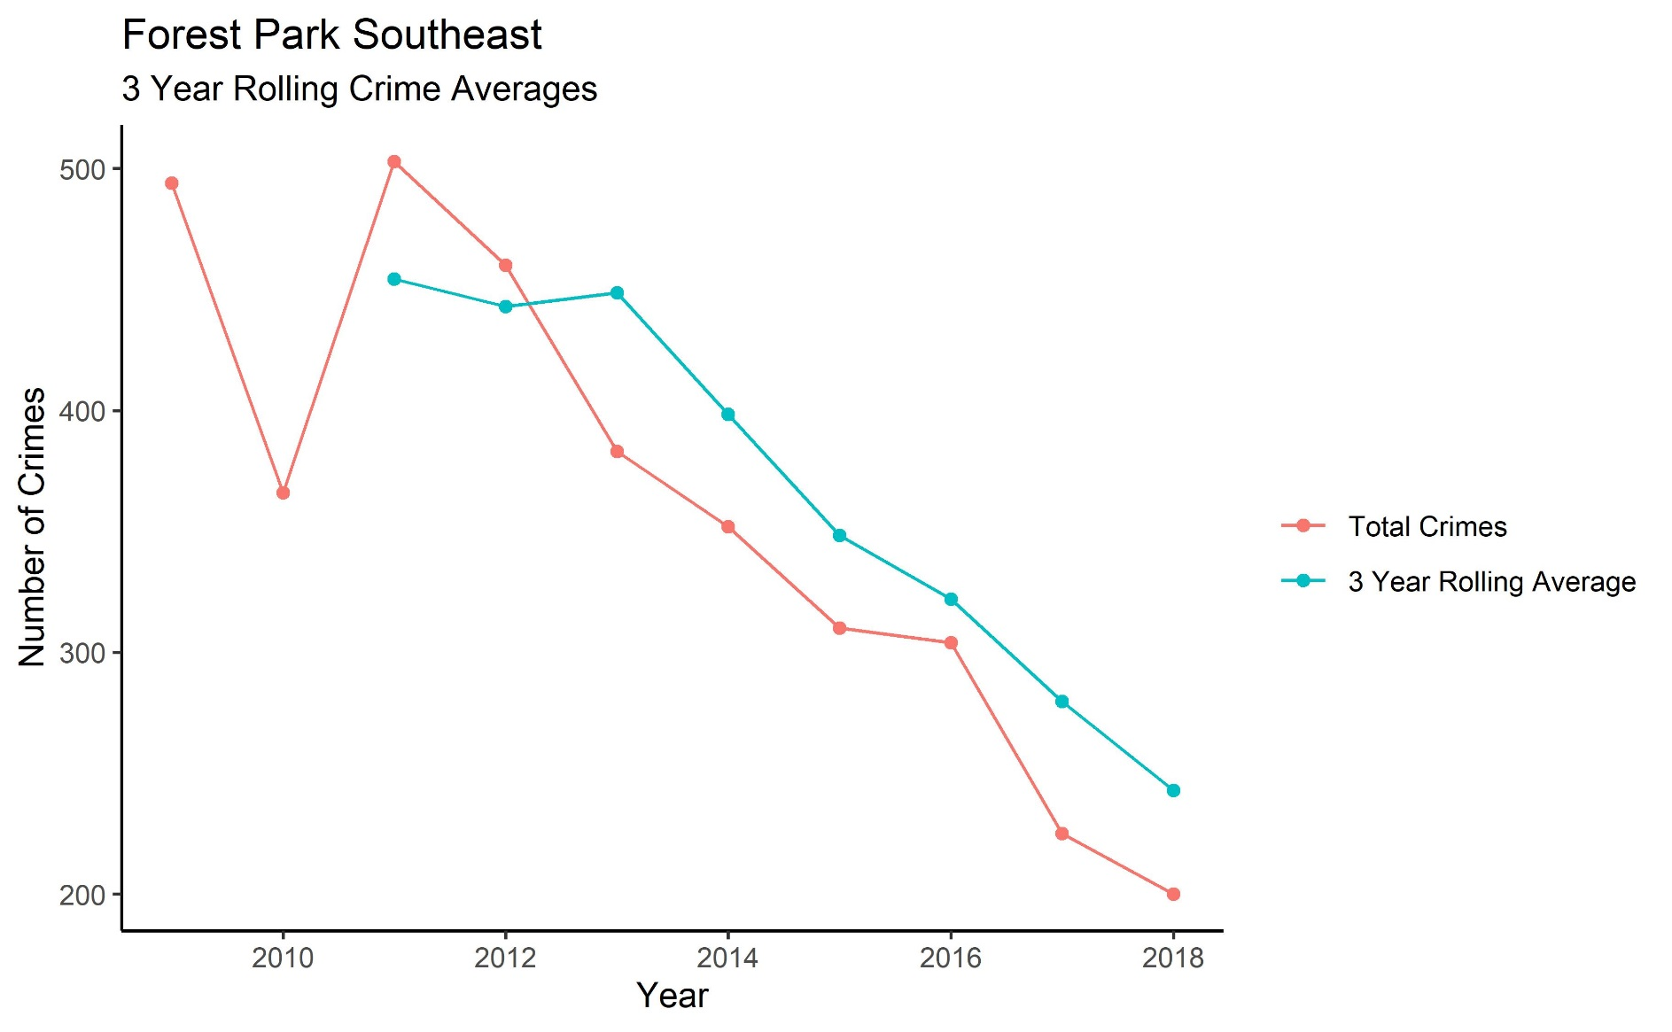
Forest Park Southeast – Total Crime

Slide 13
Violent Crime
3 Year Rolling Averages
2011-2018

Slide 14
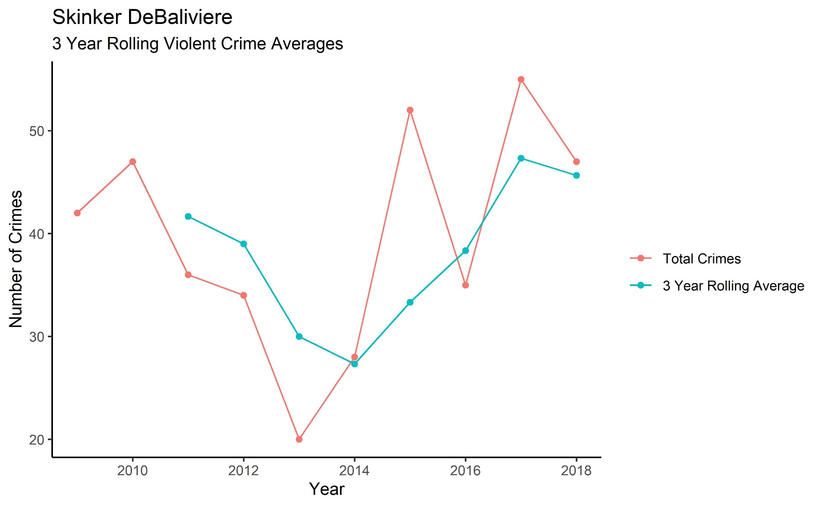
Skinker-DeBaliviere – Violent Crime

Slide 15
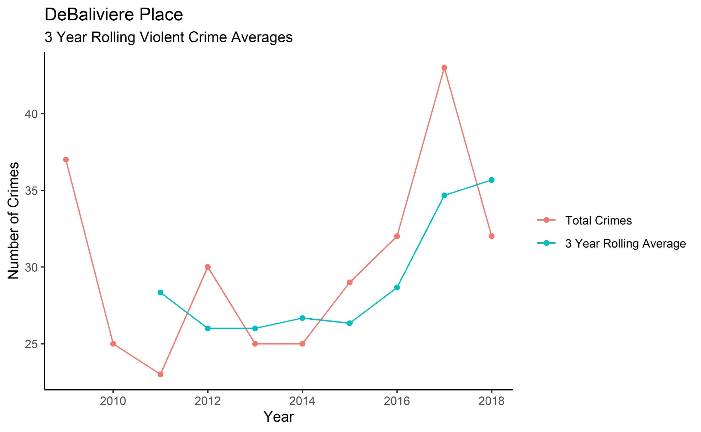
DeBaliviere Place – Violent Crime

Slide 16
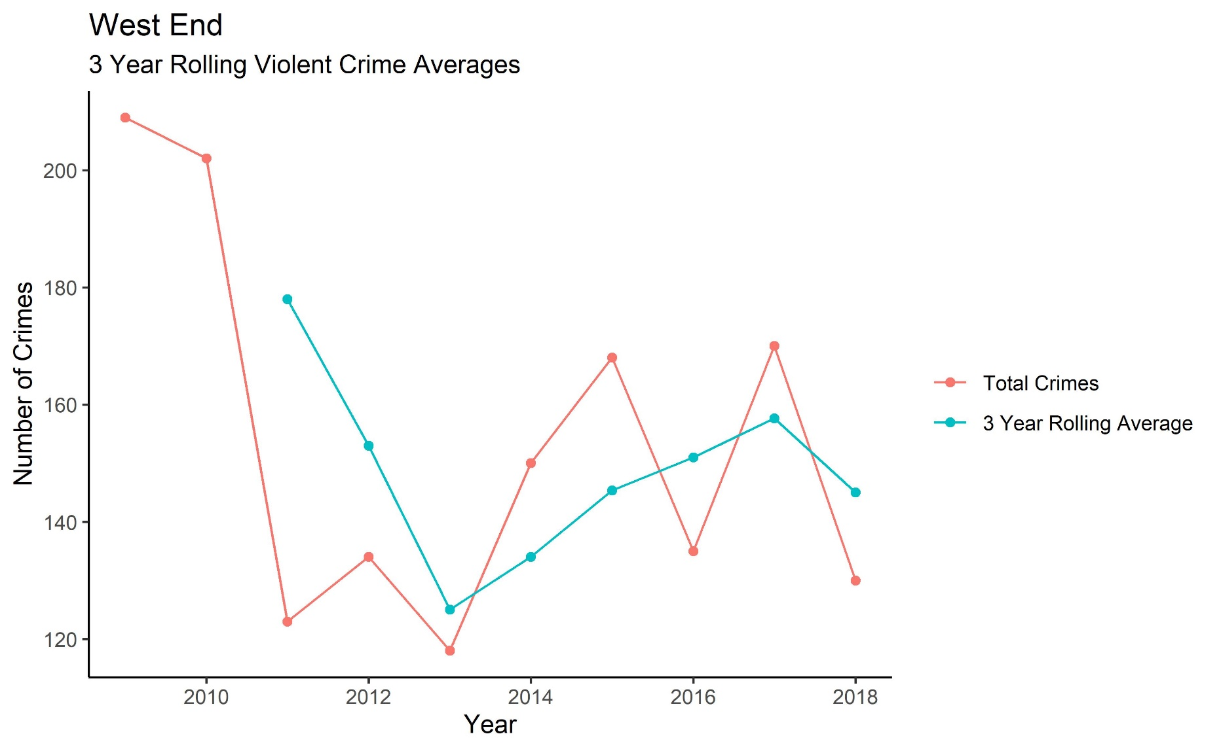
West End – Violent Crime

Slide 17
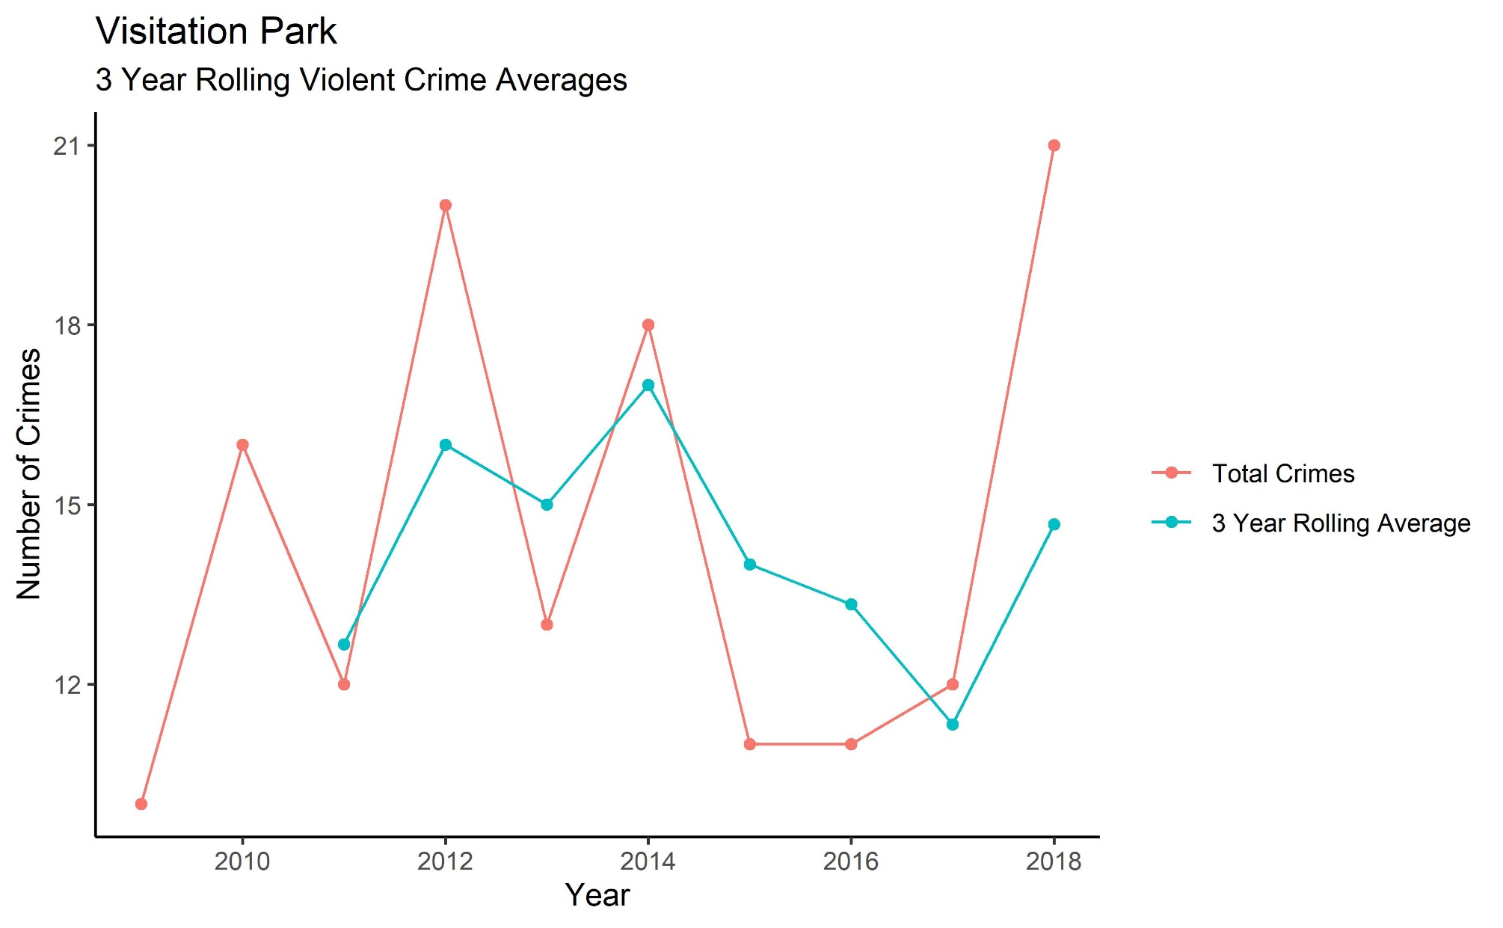
Visitation Park – Violent Crime

Slide 18
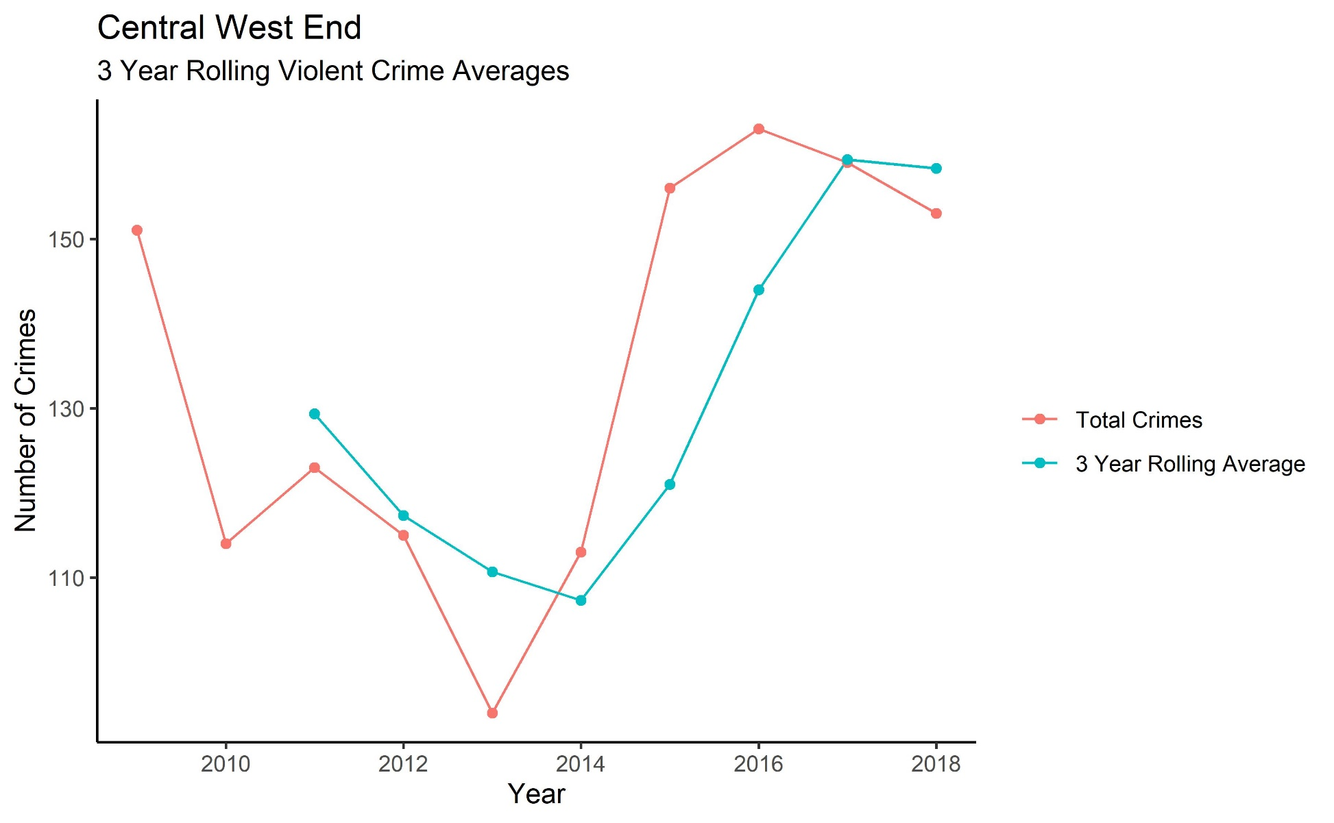
Central West End – Violent Crime

Slide 19
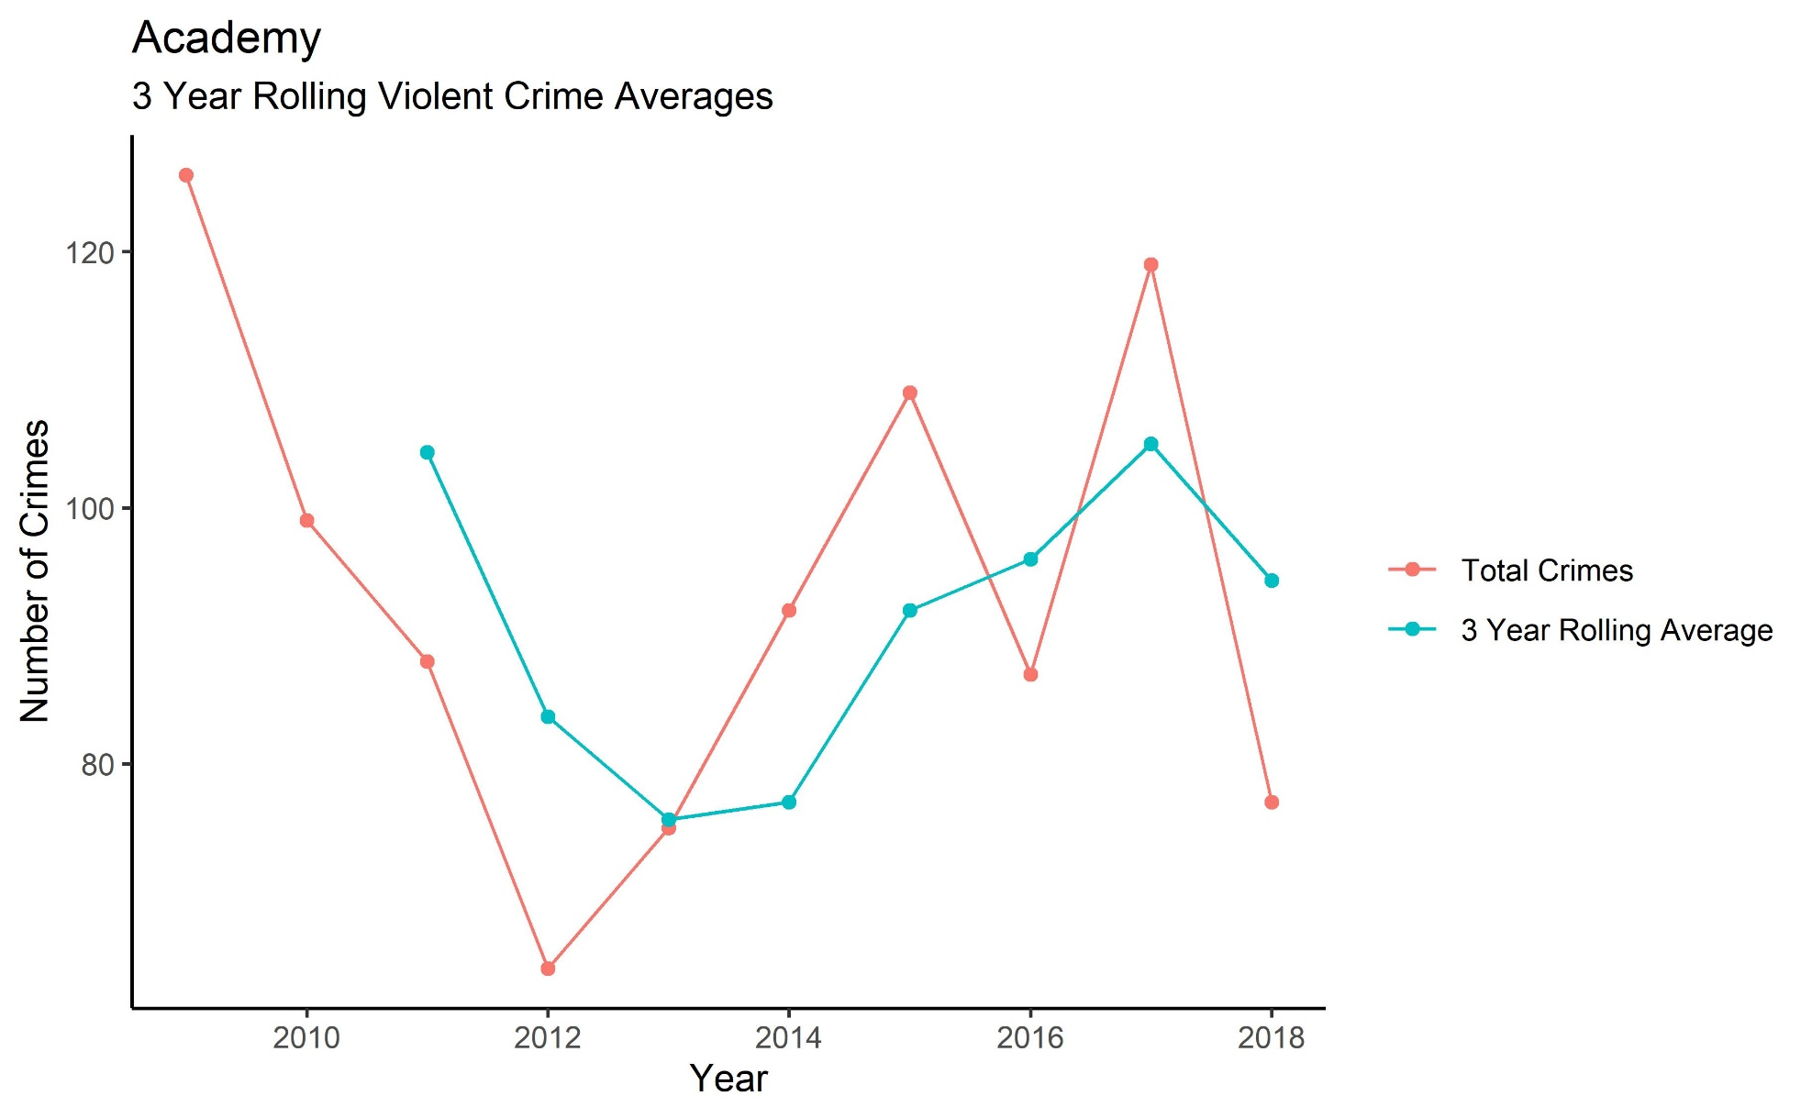
Academy-Sherman Park – Violent Crime

Slide 20
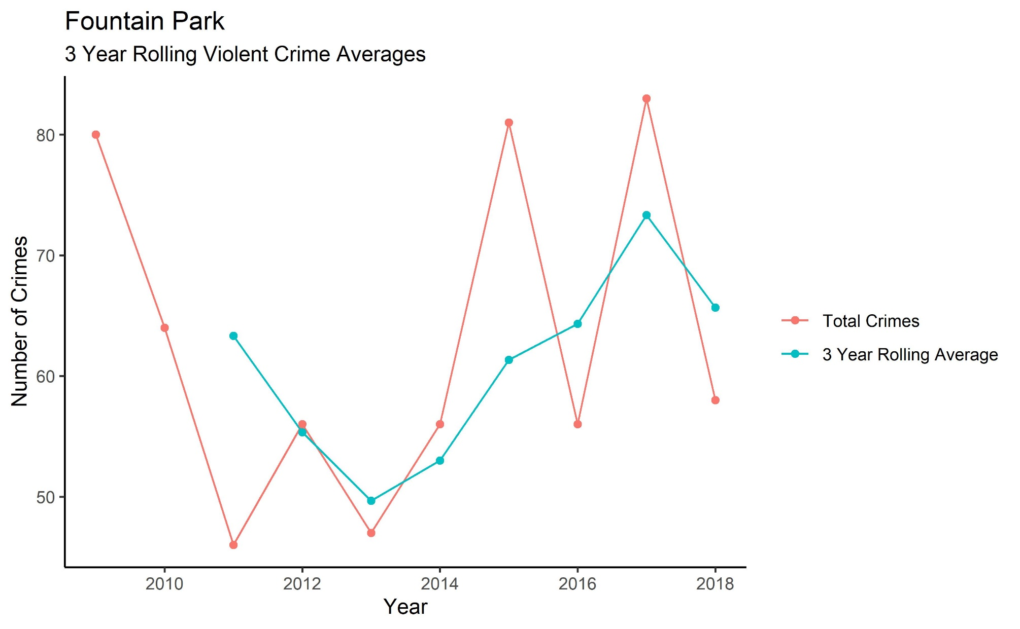
Fountain Park – Violent Crime

Slide 21
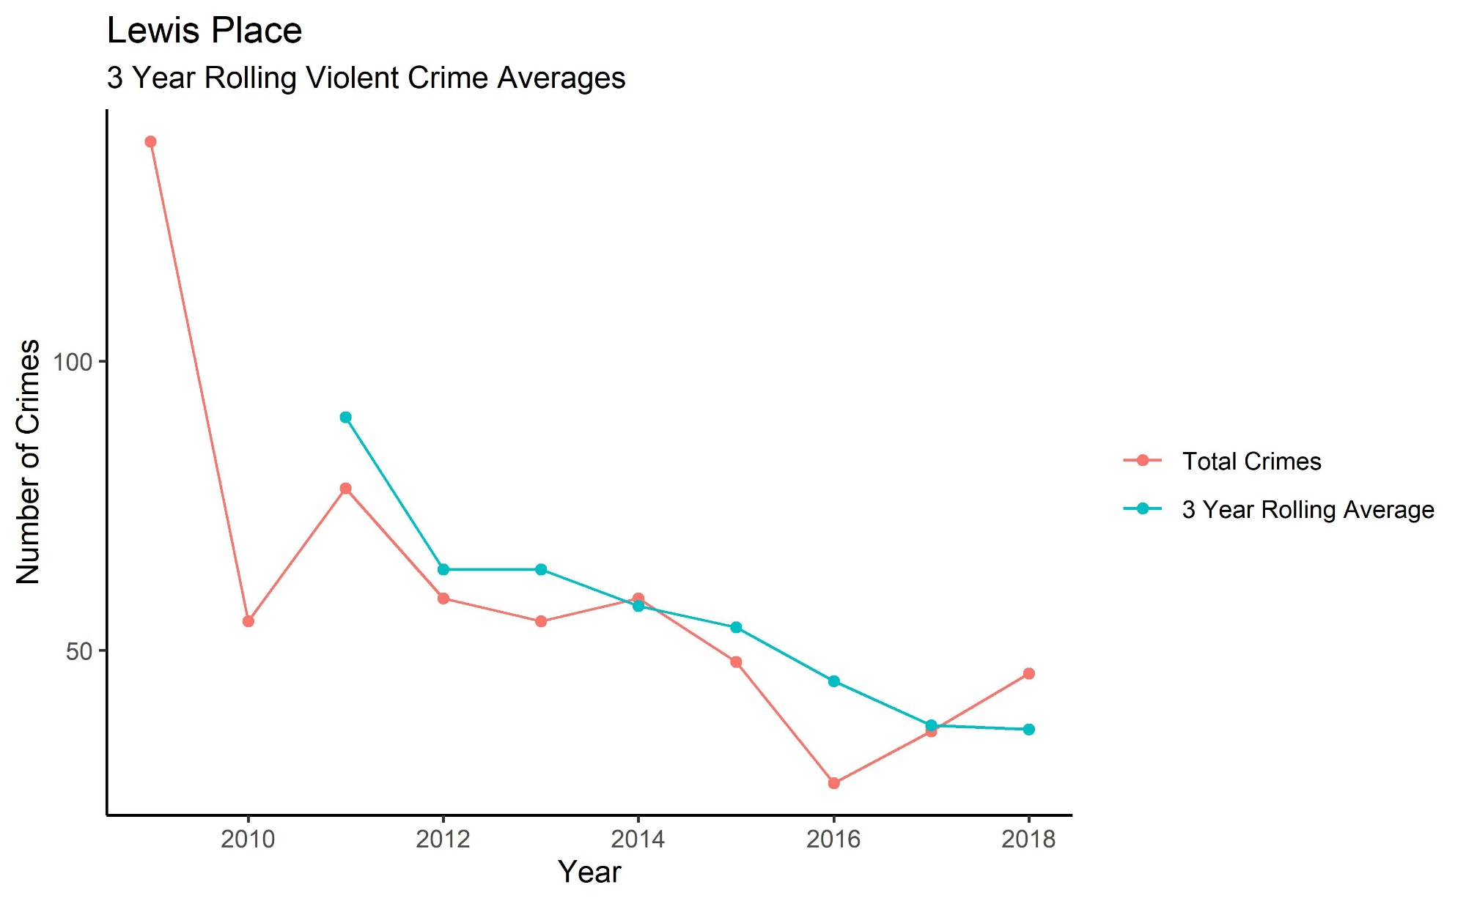
Lewis Place – Violent Crime

Slide 22
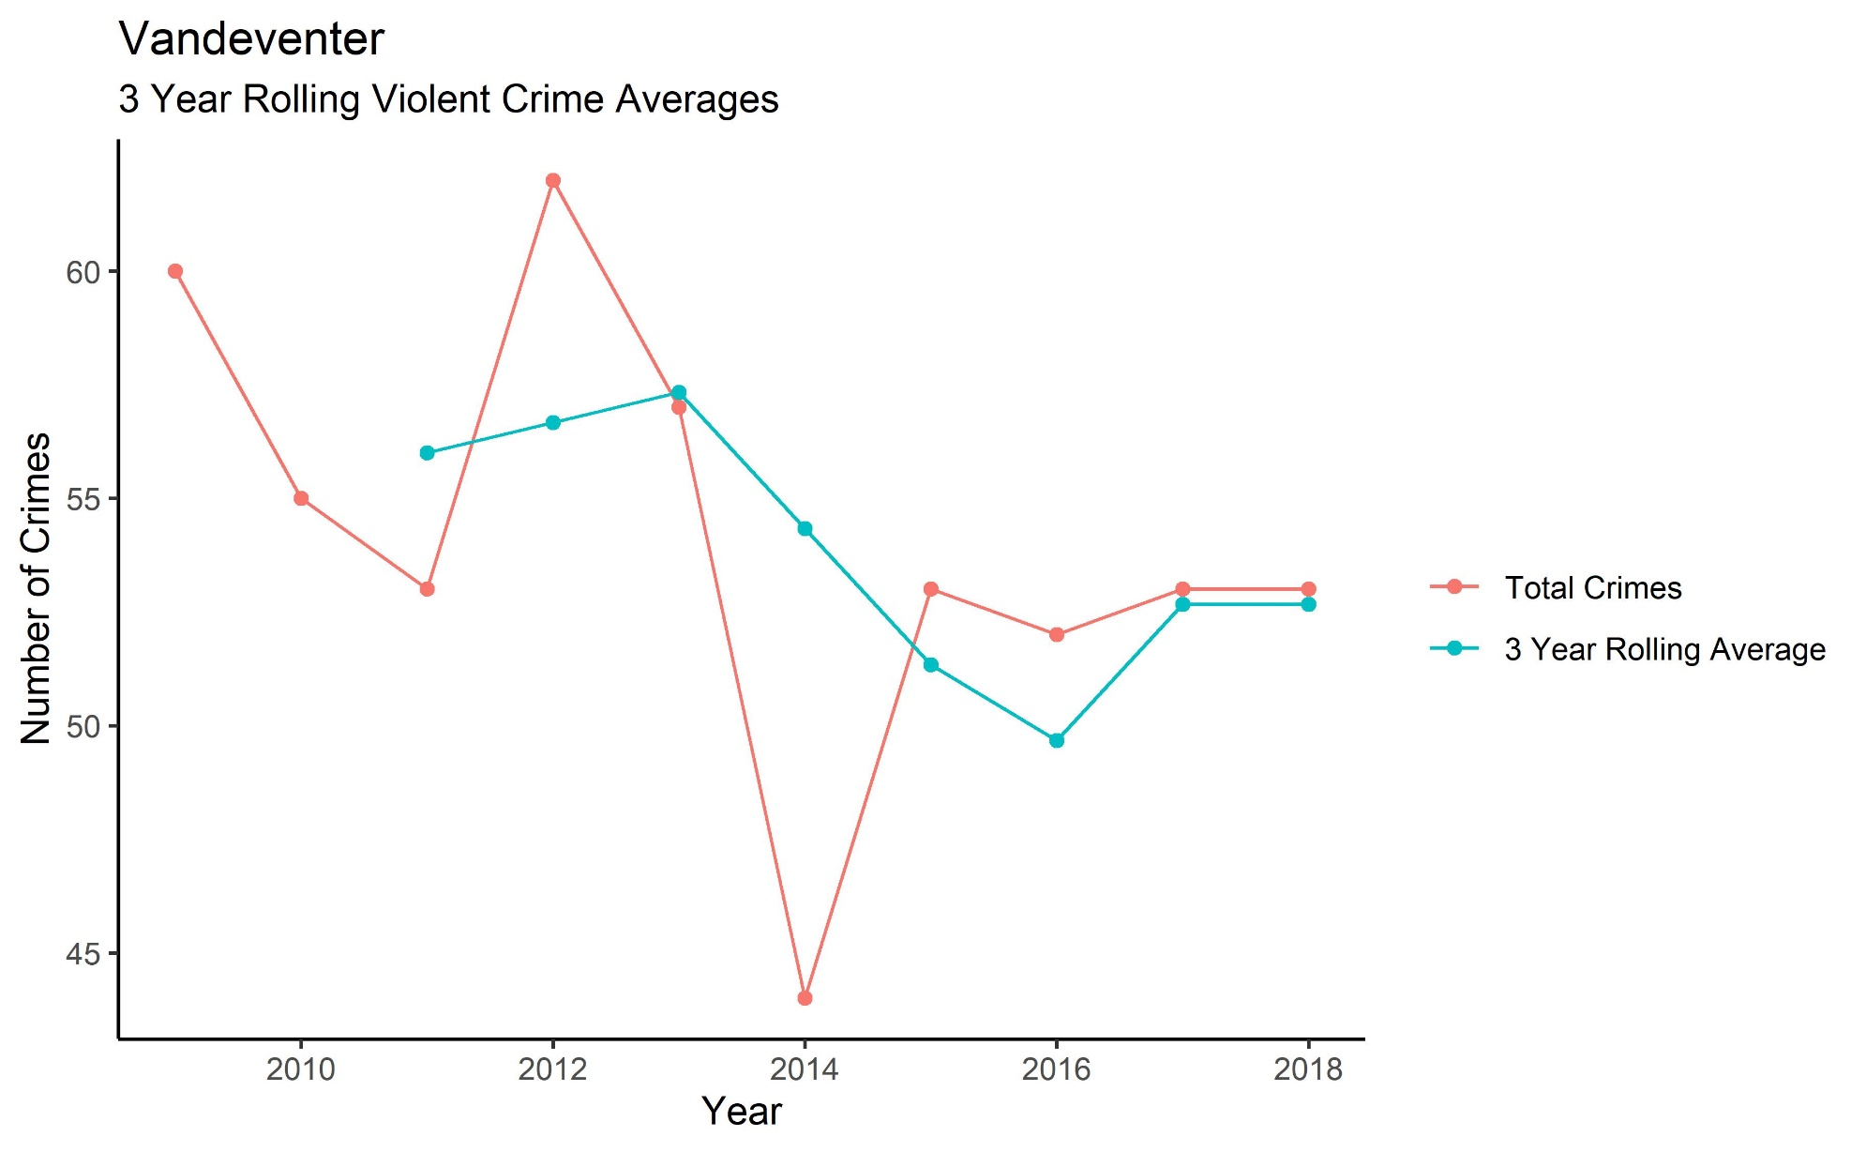
Vandeventer – Violent Crime

Slide 23
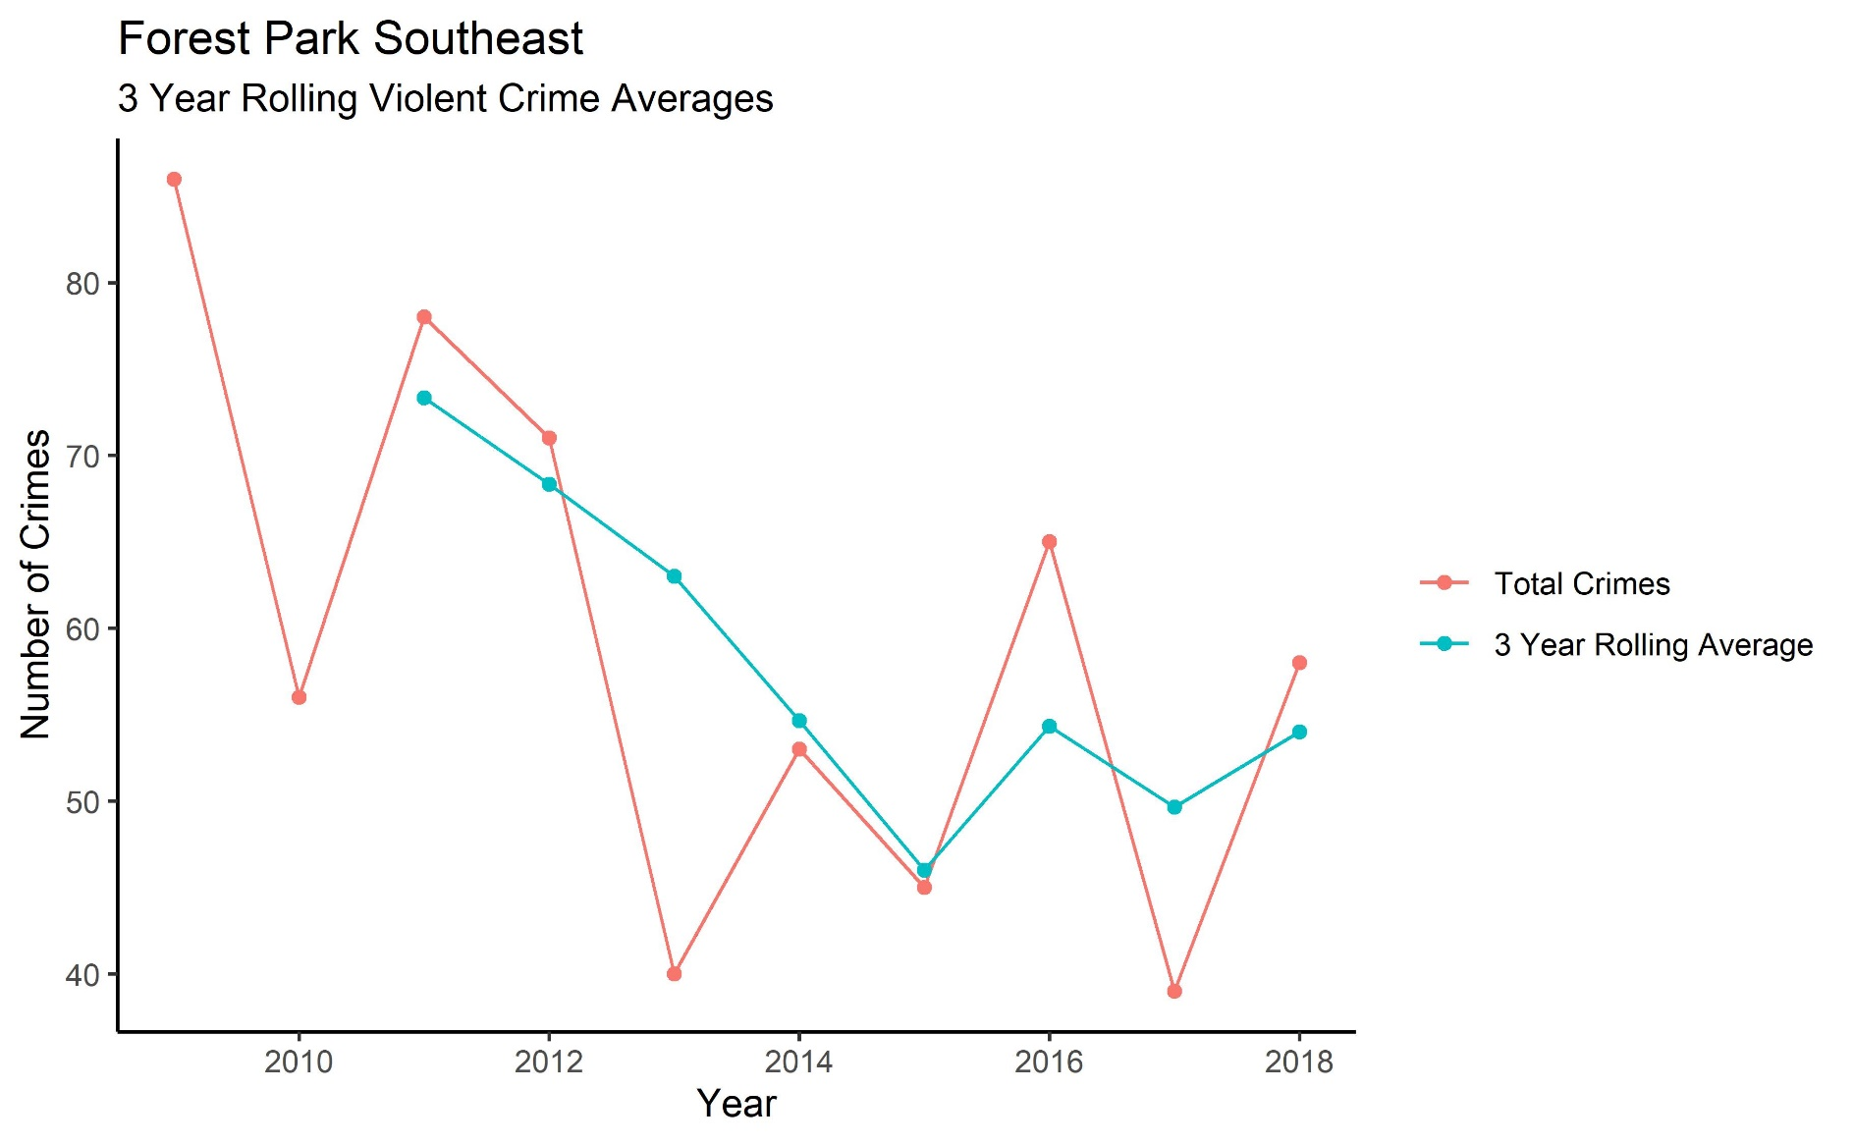
Forest Park Southeast – Violent Crime

