Slide 1
How to implement a syscall?

Slide 2
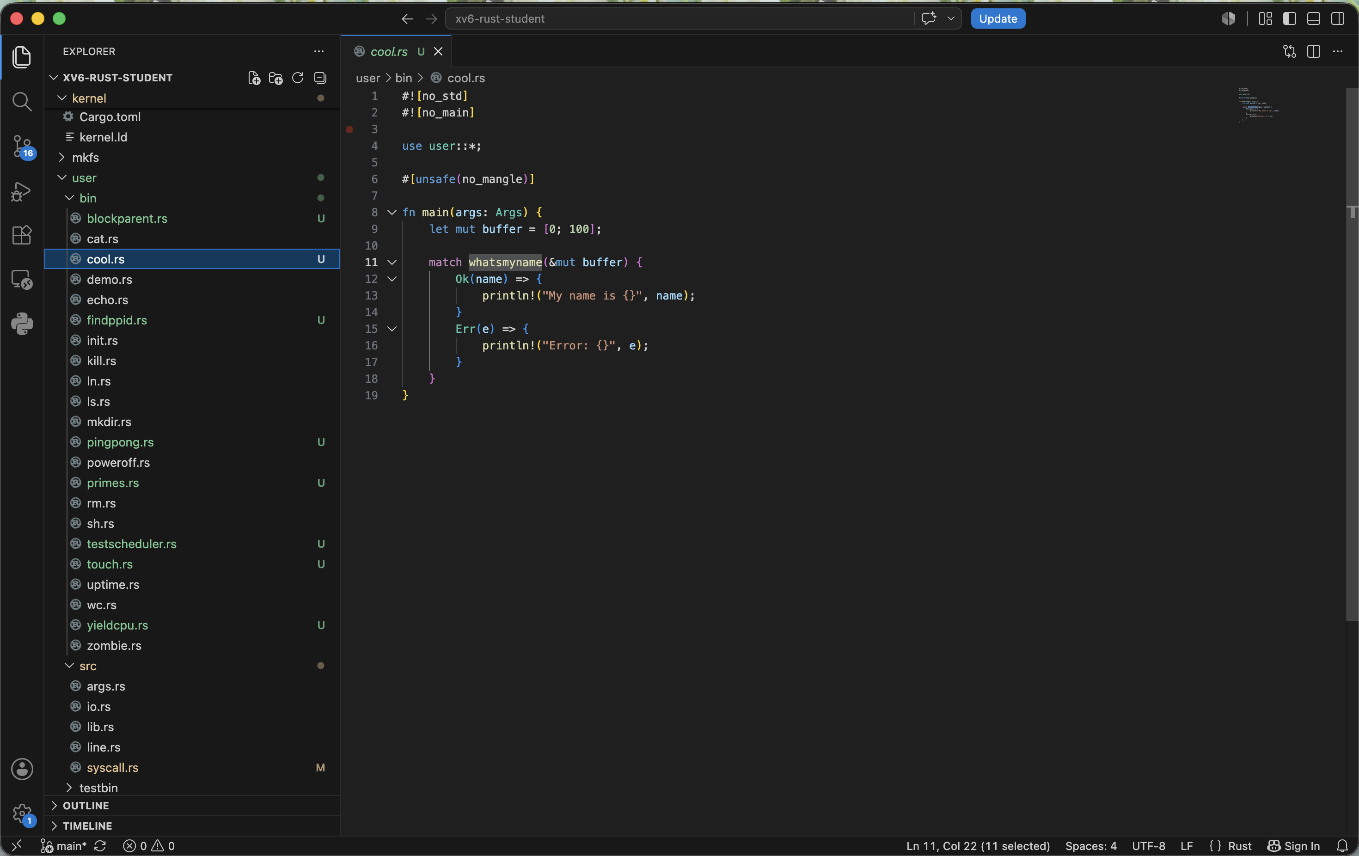
Example cool
This program prints one’s name, but not from args, but instead ask the kernel to tell its name.
We are going to implement whatsmyname
Add this program to user/bin

Slide 3
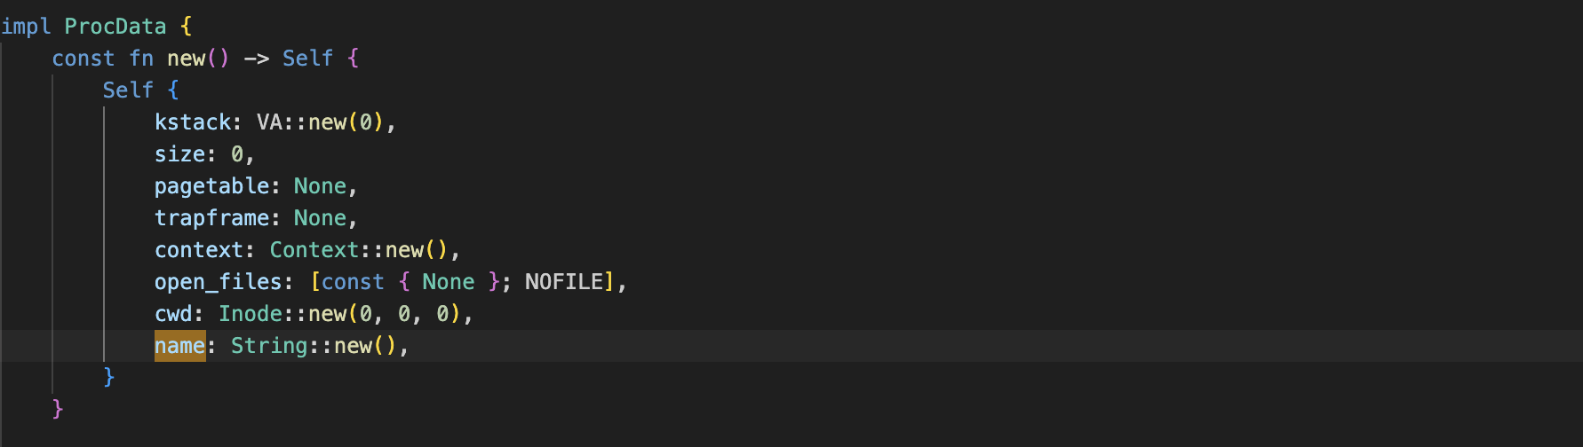
Where is name stored?
In kernel/src/proc.rs, ProcData defines the data a process will carry. Each process has a private field ProcData. This field is what we are looking for.

Slide 4
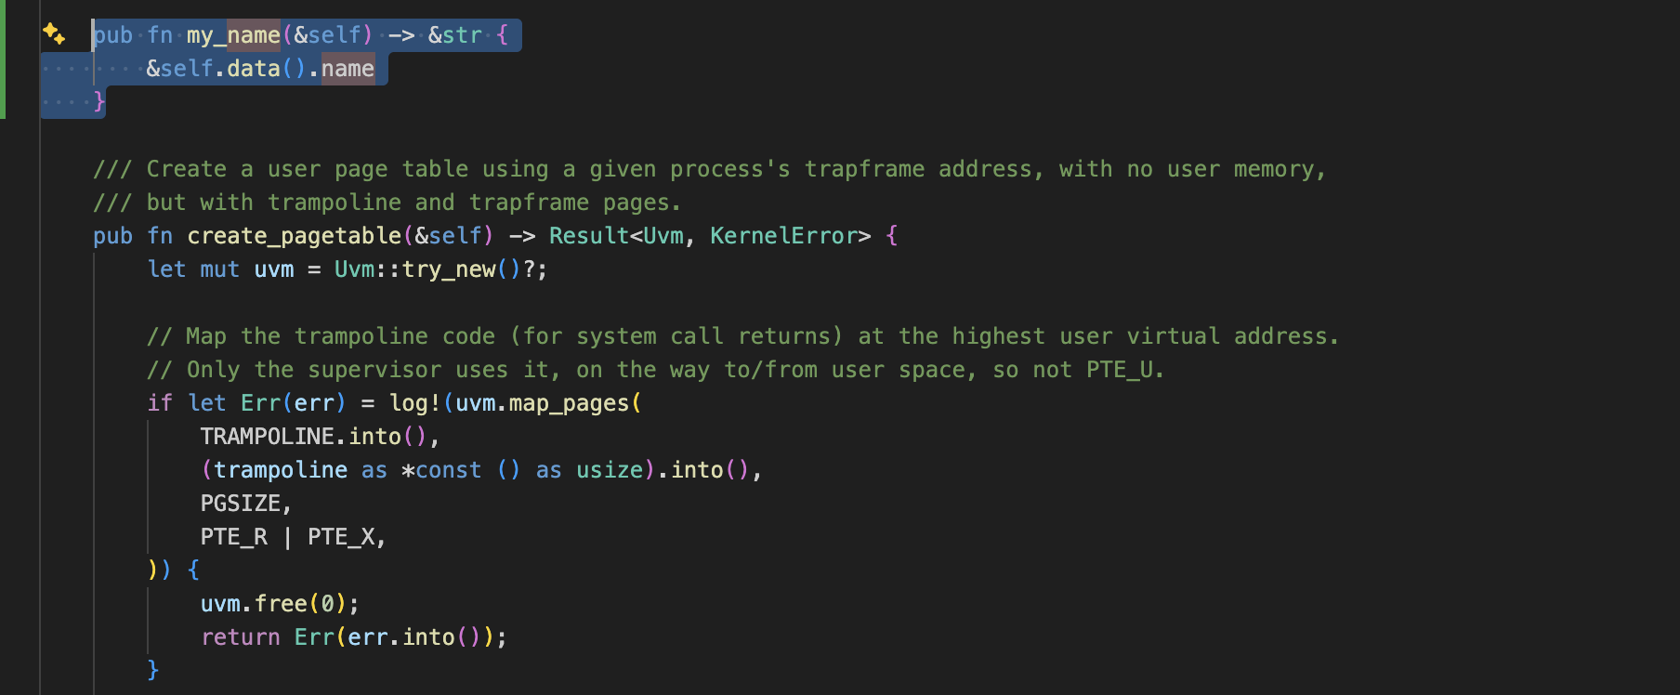
Add this method under the Proc
data() returns the process’s ProcData, extract the name then return this name.
We are still in in kernel/src/proc.rs

Slide 5
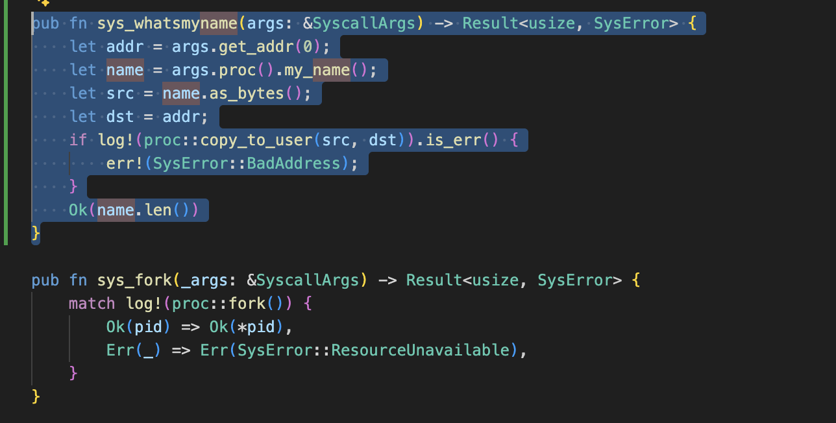
Kernel writes to memory
The kernel can’t return a string, we need to pass it a pointer(address) to write.
This is why we defined a buf in cool.rs and pass it to whatsmyname.
The kernel receives this pointer and write directly to this pointer.
This is in kernel/src/sysproc.rs

Slide 6
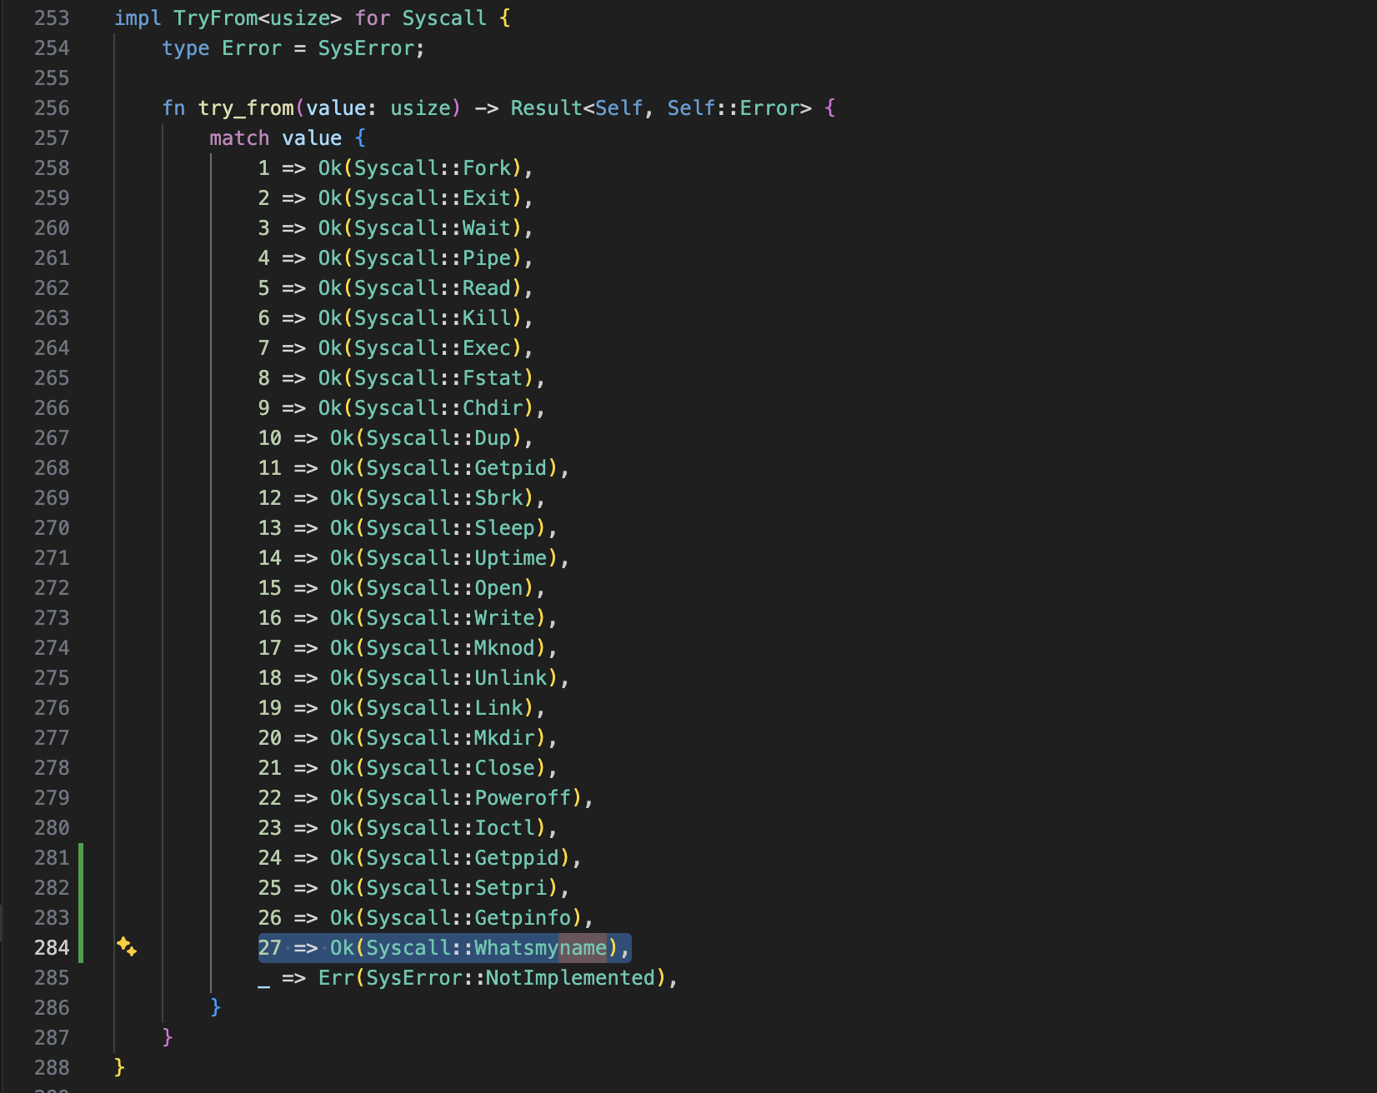
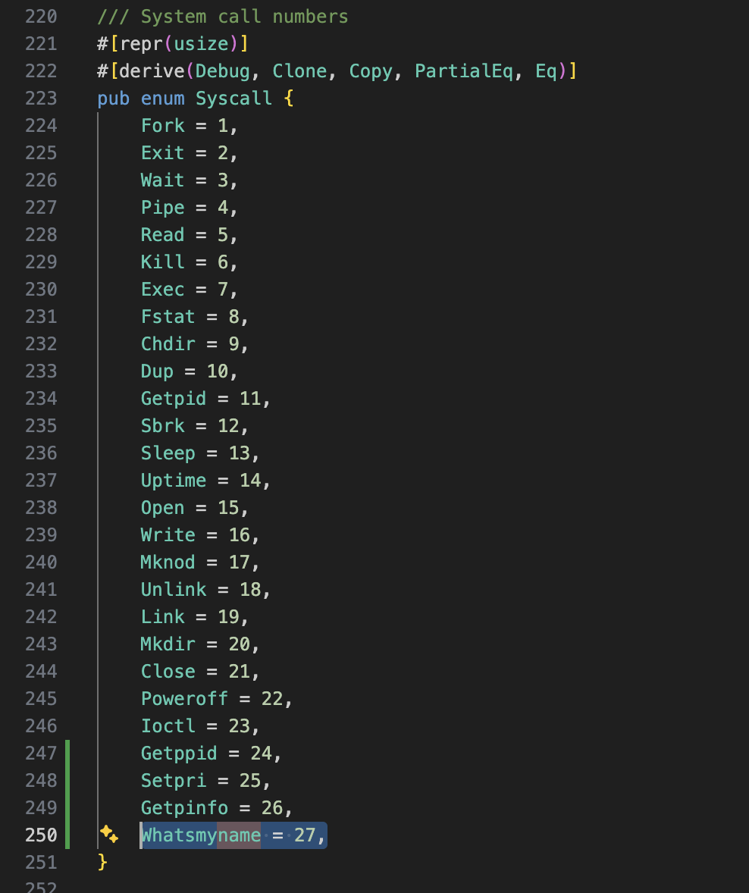
Create a syscall that uses this function
This is in kernel/src/syscall.rs

Slide 7
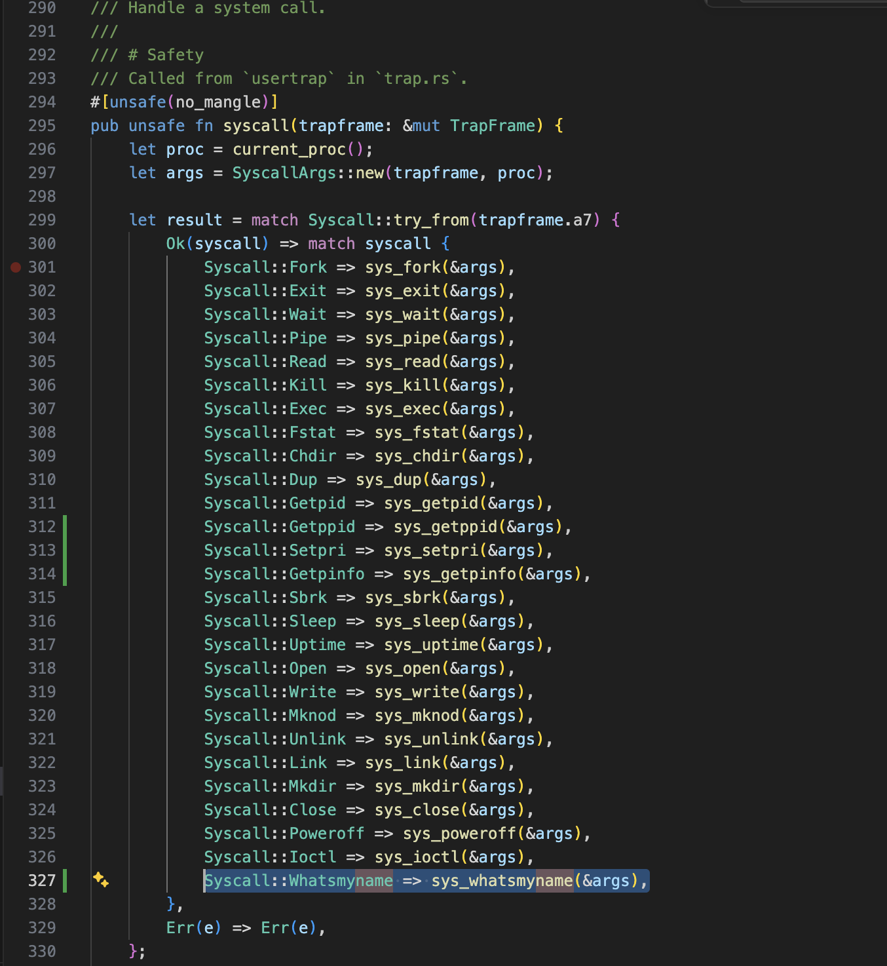
Create a syscall that uses this function
This is still in kernel/src/syscall.rs

Slide 8
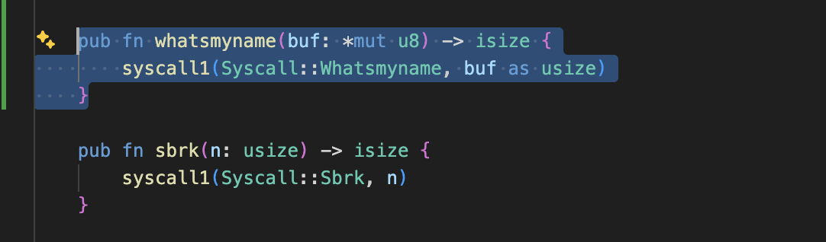
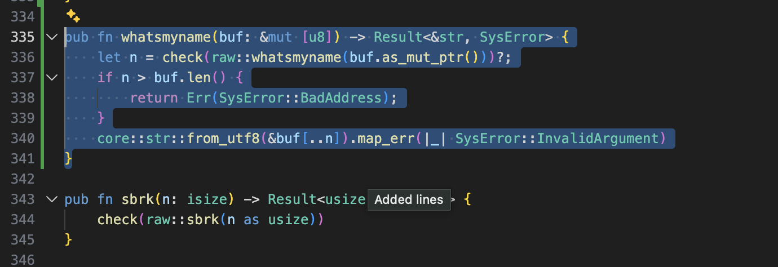
Wrap the system call in user side
We are now in user/src.syscall.rs !
This is a raw function that’s wired to syscall
Let’s wrap this function to a more user friendly way

Slide 9
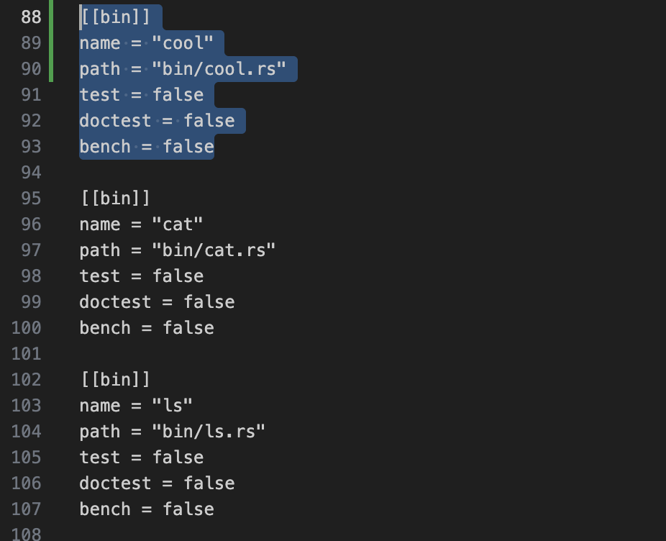
Reminder
Don’t forget to put cool in user/Cargo.toml!

Slide 10
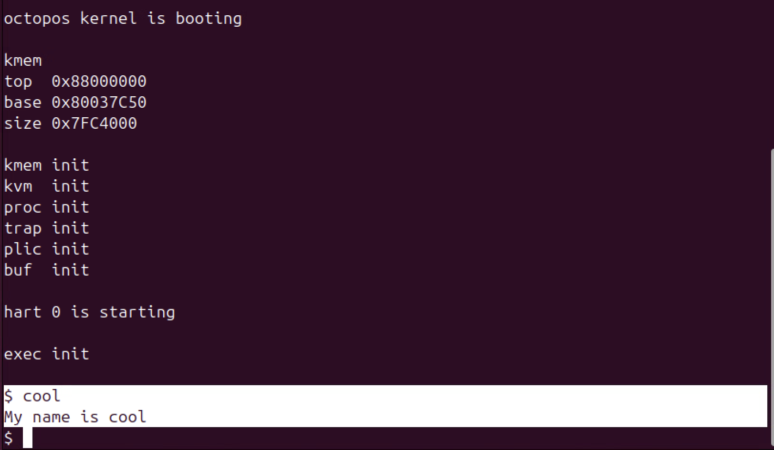
Succeed!

