Slide 1






Empowering $A^{∗}$Search Algorithms with Neural Networks for Personalized Route Recommendation
Jingyuan Wang, Ning Wu, ${\text{Wayne} \text{Xin} \text{Zhao}}^{∗}$, Fanzhang Peng, Xin Lin
School of Computer Science and Engineering, Beihang University ${\text{School} \text{of} \text{Information}\text{, }\text{Renmin} \text{University} \text{of} \text{China}}^{∗}$
Notes:
Hello, everyone. Welcome to this oral presentation. I'm Yang Zhang from Beihang University. Actually you can see that I'm not the author of this paper. It's a great pity that the authors are all absent because of visa issue. So I'm here on behalf of my advisor to present this work. Now, let's get started. The title is Empowering A-Star search algorithms with neural networks for personalized route recommendation.

Slide 2
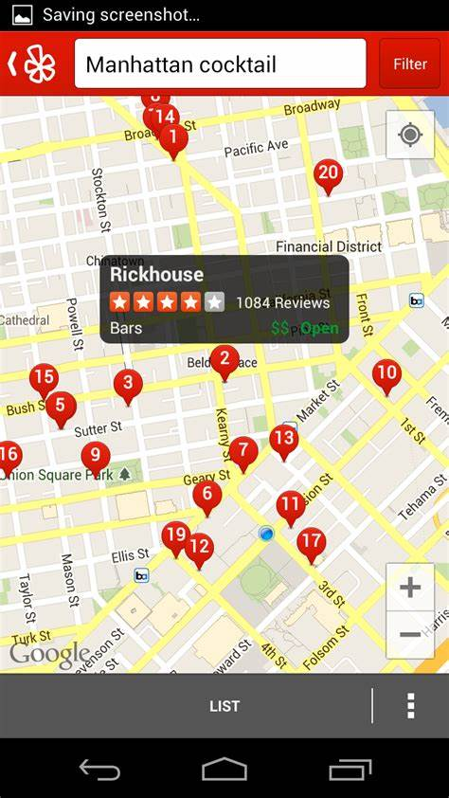
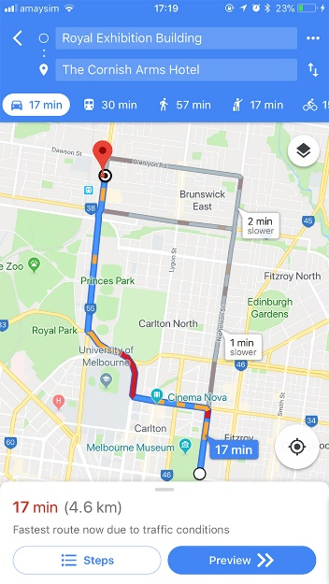
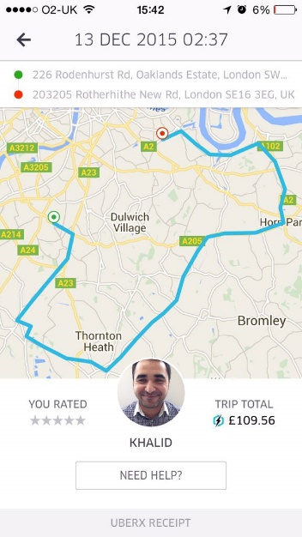



Background: Personalized Route Recommendation
Personalized Route Recommendation System has became one of the most core functions in many online applications, e.g., online map.
Personalized Route Recommendation aims to generate user-specific route suggestions on instant queries about the path planning from a source to a destination.
Notes:
Personalized route recommendation is an important problem, and has became one of the most core functions in many online applications.(翻页)
Given time, source and destination, it aims to offer user-specific route suggestions

Slide 3
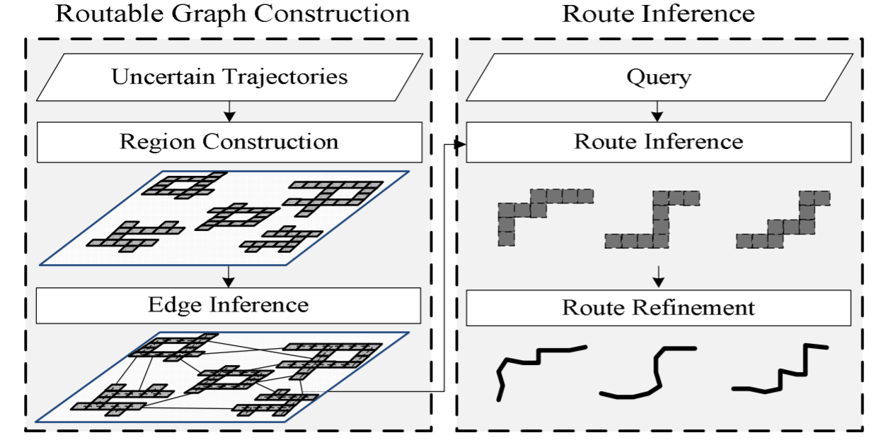
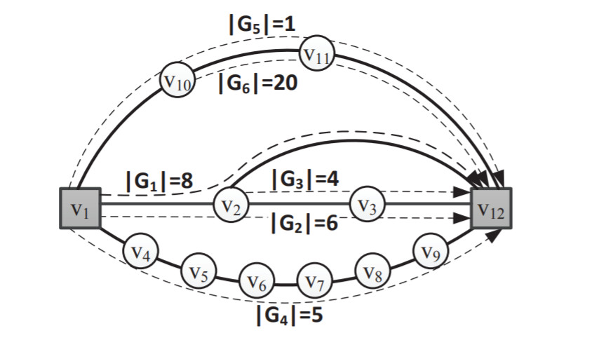
Background: Recommendation Methods
Heuristic Search: a basic recommendation method
Design cost function manually, and search an optimal path according to it.
Difficult to utilize various kinds of context information in the search process.
[Wei, 2012, KDD]
[Luo, 2013, SIGMOD]
Search-based Method
Notes:
Over past years, heuristic search has been a basic solution to route recommendation. Such algorithms search an optimal path according to mannually designed cost functions.
However, it’s difficult for such methods to utilize complex context information in the search process.

Slide 4
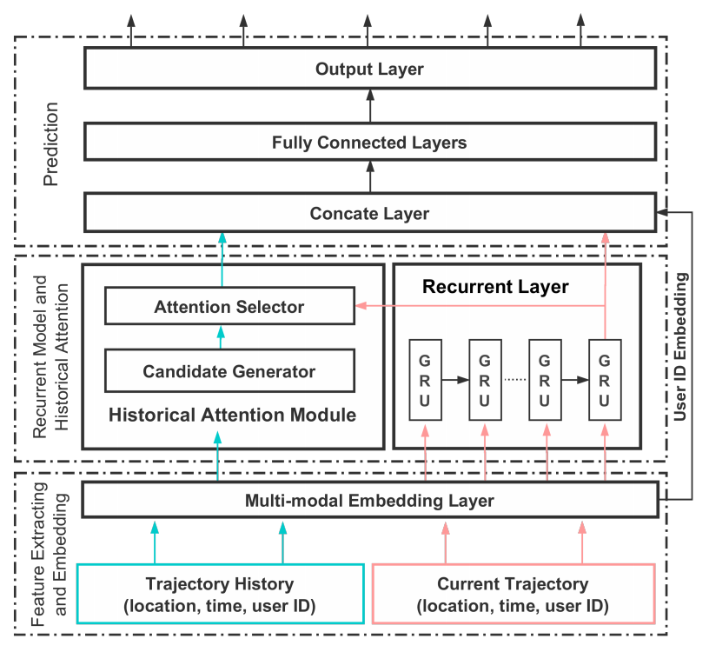
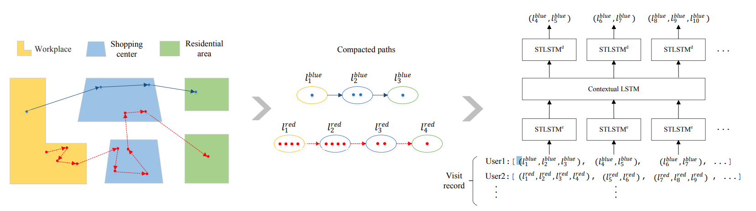
Background: Recommendation Methods
Neural Network: a rising recommendation method
Focus on one-step or short-term location prediction.
Sequential neural models have been widely used for modeling sequential trajectory data.
[Feng, 2018, WWW]
[Kong, 2018, IJCAI]
Neural Network Based Method
Neural network is a promising way to capture complex pattern in auxiliary data.
Notes:
Recently, neural network has been a rising method in the route recommendation filed. Many papers utilize recurrent neural networks to predict one-step or short-term locations.(翻页)
From these work, we can see that neural network is a promising way to capture complex patterns.

Slide 5
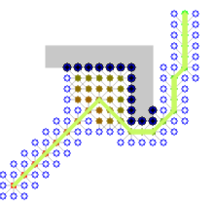

Background: Motivation
Our idea
Heuristic search is able to generate high-quality approximate solutions using proper cost functions.
Deep learning methods are effective to capture the complex data characteristics using learnable neural networks.
Our idea is to learn cost functions of the A* search algorithm by neural networks.
A* search algorithm
Deep Learning
+
=
OUR IDEA
Notes:
Since heuristic search is a great framework for route recommendation and deep learning methods are effective to capture complex data characteristics, we propose to learn the cost functions of A* search algorithm by neural networks.

Slide 6



Background: Key Research Problems
Define a suitable form for the cost in the PRR task.
Minimize negative logarithmic probability.
Design effective models for implementing cost functions with
different purposes.
Observable cost and estimated cost.
Utilize rich context and constraint information for improving the task performance.
Context
Constraint
User History
Time
Road Network
Neuralized A-Star based personalized Route recommendation
Notes:
To solve this problem with the combination of A* search and neural networks, there are three key points. Firstly, we need to define a suitable form of the cost. What's more, effective models should be designed to learn the cost functions of A* algorithm. Last but not least, it will be of great help if we can fully utilize rich context and contraint information. Focusing on the three problems above, we propose the Neuralized A-Star based personalized Route recommendation Model.

Slide 7
Background: Problem Definition
Node：location
Edge: road segment
Road Network
Route
Location Sequence
8:00
10:00
Trajectory
9:00
Location Sequence and Arrived Time
8:00
Query
Departure Time, Source Location and Destination Location
8:00
Personalized Route Recommendation
Given departure time, source location and destination location, infer the most possible route for user.
Notes:
We shall first give the formula definition of personalized route recommendation. A road network consists of node and edge, node is location and edge is road segment. A route is a location sequence and a trajectory is a route with arrived time of every location. A query consists of departure time, source location and destination location. Our goal is to infer the most possible route given a user's query.

Slide 8
Background: Review of A* Algorithm
A* Search Algorithm
f(a) = g(a) + h(a)
Find the shortest path on graph
Candidate:
a
Flexible to adapt different task
Effective and efficient
Current:
Cost Function
b
Choose location with least cost
Find the path with least cost
c
Consist of two part: observable cost g and estimated cost h
f(b) < f(a) < f(c)
Notes:
Before introducing our model, I want to do a review of the A-Star algorithm. Originally, A-Star algorithm is designed to find the shortest path on graph, and it can be flexibly adapted to different tasks. Compared with other search algorithms such as Dijkstra and deep first search, it’s effective and efficient.
The core of A-Star Algorithm is the cost functions. The search procedure in A-Star algorithm is to find the path with least cost. The cost consists of two parts, in this paper, we call them observable cost g and estimated cost h. In this picture, you can see that the A-Star algorithm will choose the location with least cost at every expansion until it arrives the destination.

Slide 9
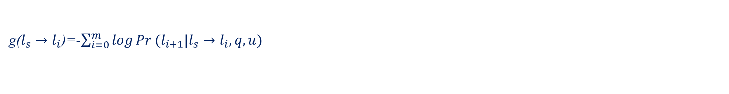
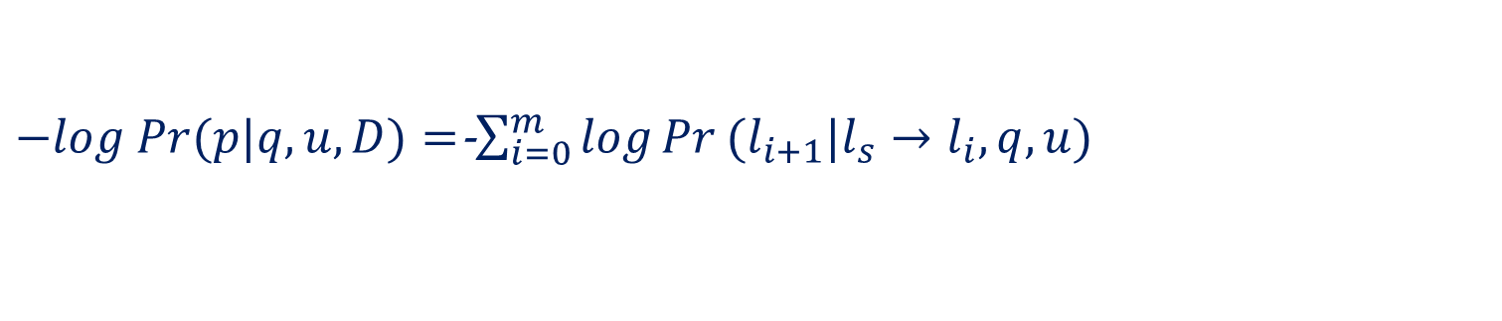
Background: A Simple A*-based Approach for PRR
Our Target
Minimize its negative log: $−log Pr(p|q,u,D)$
Given a possible path $p: l_{s}→l_{1}→l_{2}\text{…}→l_{m} →l_{d}$
It can be rewritten as:
$−log Pr(p|q,u,D)=$-$\sum_{i=0}^{m}{\log{Pr}(l_{i+1}|l_{s}→l_{i}, q,u)}$
Design Cost Function
g($l_{s}→l_{i}$)=-$\sum_{i=0}^{m}{\log{Pr}(l_{i+1}|l_{s}→l_{i}, q,u)}$
$Pr$ can be calculated by shallow model.
h($l_{i}→l_{d}$)= Euclid($l_{i},l_{d}$) or ?
h($l_{i}→l_{d}$) can be designed manually.
Notes:
So, a A-star based approach can be summarized as follow, our target is to minimize the negative log likelihood. Given a path consisting of m locations, we can factorize the path to compute its cost according to the chain rule .
We can compute the observable cost of a candidate location i as this foluma, and Pr can be calculated by shallow models.
Actually, the computation of the estimated cost is much more difficult, since the optimal sub-route for location i to location d is unknown. People usually design it manually under certain rules.

Slide 10

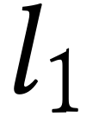
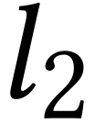

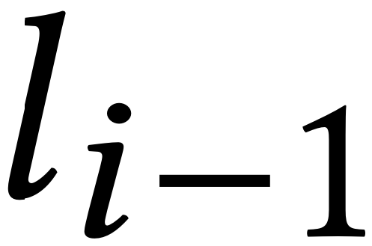

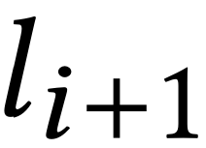
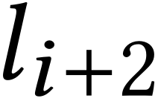
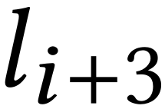
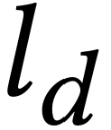
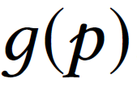

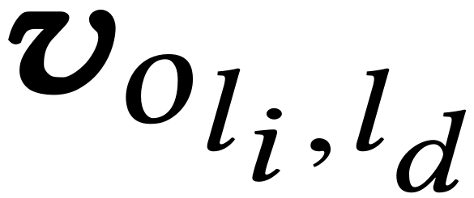
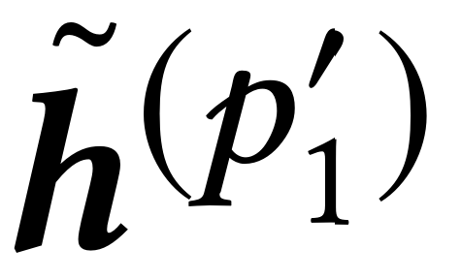
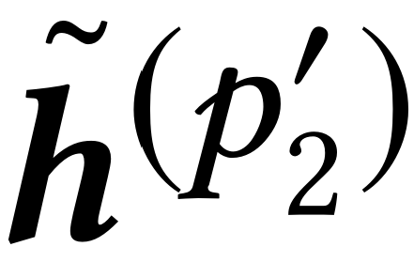
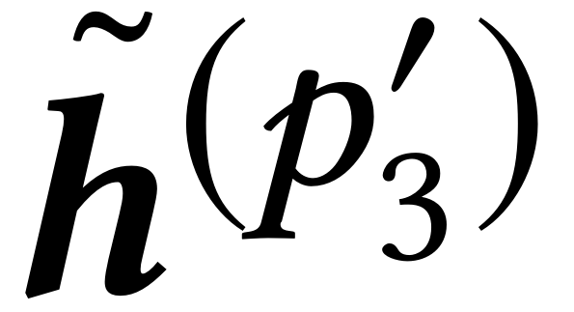
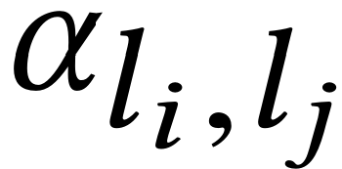

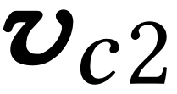

NASR: Overall
Observed Sub-Trajectory
Next Location
Unobserved Sub-Trajectory
Source
Destination
…………
……
Inter-trajectory ATT
Moving
State
MLP
Intra-trajectory ATT
n_{li}
Distance from l_{i} to l_{d}
n_{ld}
GRU
GRU
GRU
GRU
……
……
User History Trajectories
Current Sub-Trajectory
Road Network
Notes:
This is the overall architecture of our model - NASR. On the left, it's the observable cost network, and it consists of intra-trajectory attention and inter-trajectory attention. On the right, it's the estimated cost network, and it consists of a context-aware graph attention network and a MLP.

Slide 11

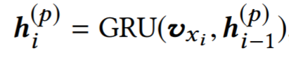
NASR: Observed Cost
Embedding Rich Context Information
Inter-trajectory ATT
day
hour
user
location
temporal
Intra-trajectory ATT
Extracting Sequential Feature by GRU
GRU
GRU
GRU
GRU
We employ the widely used GRU network to encode it into a vector.
……
……
User History Trajectories
Current Sub-Trajectory
Notes:
Now let's dive into the observable cost network. First, we consider to combine several information together. The user, location and temporal representation are concatenated into a new vector. Then, GRU is employed to extract sequential dependence.

Slide 12
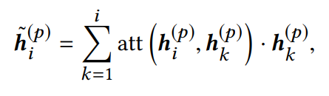
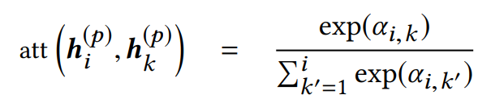
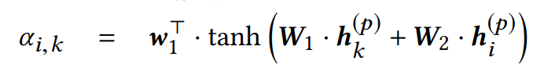
NASR: Observed Cost
Intra-Trajectory Attention
Inter-trajectory ATT
Intra-trajectory ATT
GRU
GRU
GRU
GRU
……
……
With intra-trajectory attention, we can discover more important characteristics by considering the entire trajectory.
User History Trajectories
Current Sub-Trajectory
Notes:
Based on sequential hidden states extracted by GRU, we propose intra-trajectory attention to capture important characteristics of the entire trajectory.

Slide 13
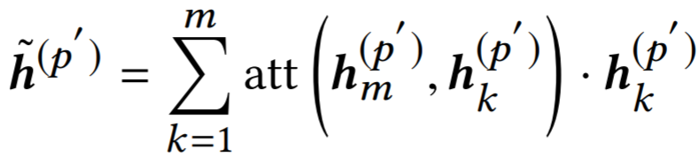
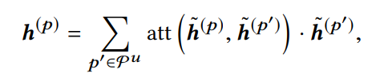


NASR: Observed Cost
User History Trajectories
For every historical trajectory $p^{′}$ of a user, we have:
Inter-trajectory ATT
Inter-Trajectory Attention
Intra-trajectory ATT
Given the current trajectory p, we attend it to each of the other historical trajectories as
GRU
GRU
GRU
GRU
……
……
User History Trajectories
where $p^{u}$ denotes the set of historical trajectories generated by $u$.
Current Sub-Trajectory
Notes:
Furthermore, the historical trajectories of the same user is also important to model user-preference, hence, we introduce inter-trajectory attention mechanism to take the user's historical trajectories into account.

Slide 14
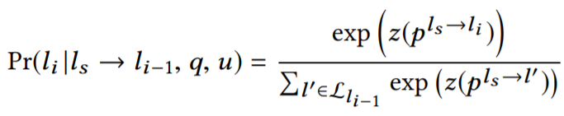

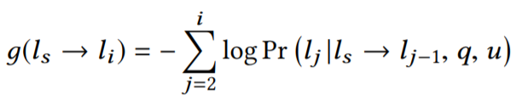
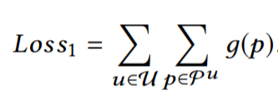
NASR: Observed Cost
Road Network Constraints
We are able to compute the probability of the next location using a softmax function with road network constraint.
Inter-trajectory ATT
Intra-trajectory ATT
GRU
GRU
GRU
GRU
Observable Cost Computation
……
……
Loss
User History Trajectories
Current Sub-Trajectory
Notes:
Once we have learned the finnal representaion of the trajectory, we are able to compute the probability of the next location using a softmax function with road network constraint. (翻页)
Finanly the observable cost g can be calculated as this formula we have mentioned before.
and the observable cost network can be optimized by this loss function(翻页)

Slide 15

NASR: Estimated Cost
Moving
State
Graph Neural Network
MLP
Learning effective structural representations for summarizing graph nodes. The update of graph neural networks can be given as
n_{li}
Distance from l_{i} to l_{d}
n_{ld}
Here, we adopt the recently proposed Graph ATTention network (GAT) for a good balance between capacity and efficiency. In GAT, the key part is to compute the attention importance of a node on another.
Road Network
Notes:
To model the estimated cost h , we introduce graph neural network in our model. We choose graph attention network to model road network since it’s effective and efficient in previous studies. In graph attention network, the key point is to compute the attention weights.

Slide 16
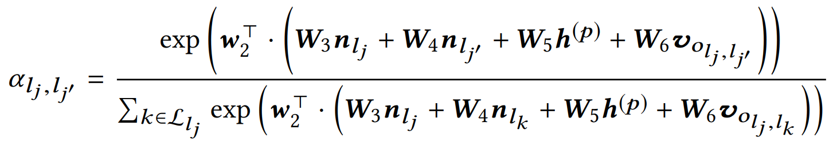
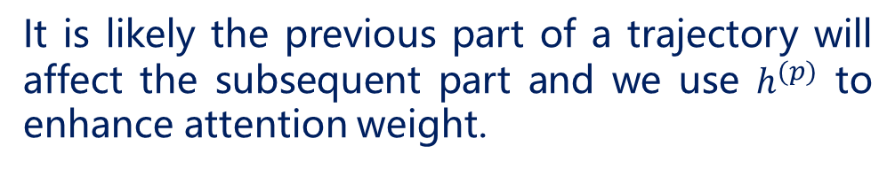
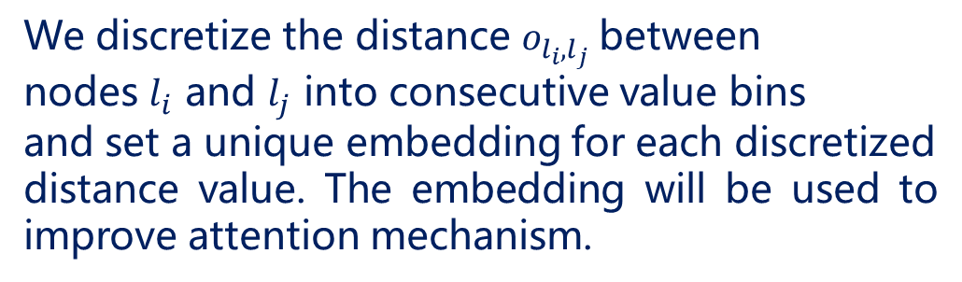
NASR: Estimated Cost
Context-aware Graph Attention
Moving
State
MLP
We discretize the distance $o_{l_{i},l_{j}}$between
nodes $l_{i}$ and $l_{j}$ into consecutive value bins
and set a unique embedding for each discretized
distance value. The embedding will be used to improve attention mechanism.
n_{li}
Distance from l_{i} to l_{d}
n_{ld}
It is likely the previous part of a trajectory will affect the subsequent part and we use $h^{(p)}$ to enhance attention weight.
Road Network
Notes:
Based on graph attention network, we propose context-aware graph attention mechanism. Besides node and edge, we alse take geographical distance and user preference into consideration. The distance between location i and j is discretized into token, and these tokens will be embedded into vector. Moving state h^p comes from observable cost network, which is the output of Inter-Trajectory Attention. The distance vector and moving state will be used to compute the attention weights, so as to improve the performance of graph attention network.

Slide 17
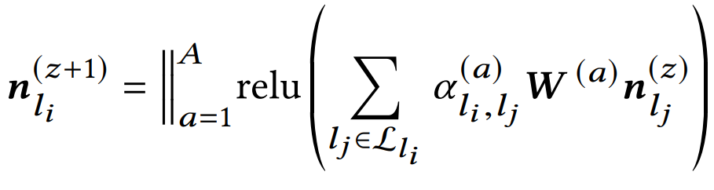
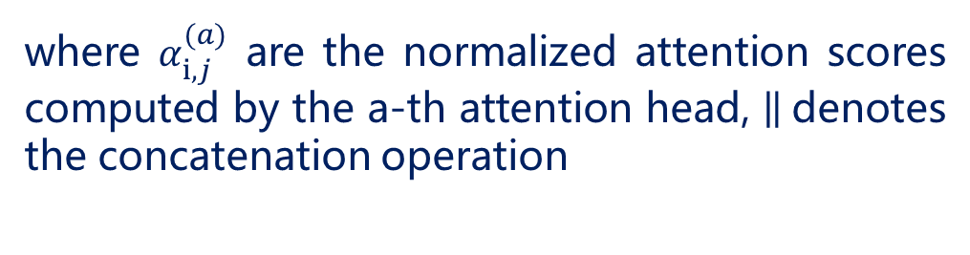
NASR: Estimated Cost
Multi-head Attention
Moving
State
MLP
Since our attention mechanism involves many kinds of information, we use the multi-head attention for stabilizing the learning process.
n_{li}
Distance from l_{i} to l_{d}
n_{ld}
where $α_{i,j}^{(a)}$ are the normalized attention scores computed by the a-th attention head, denotes the concatenation operation
Road Network
Notes:
Similar to the transformer, we also use multi-head attention mechanism to stabilizing the learning process

Slide 18

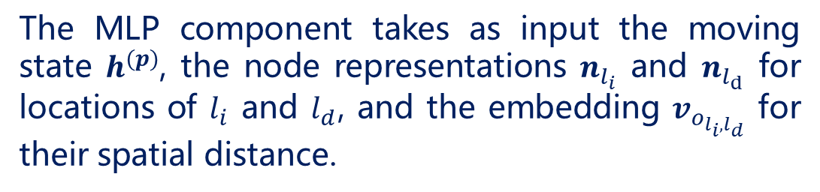
NASR: Estimated Cost
Predicting the Estimated Cost with A MLP Component
Moving
State
MLP
Fuse context vector, node representation
and distance information.
n_{li}
Distance from l_{i} to l_{d}
n_{ld}
The MLP component takes as input the moving state $h^{(p)}$, the node representations $n_{l_{i}}$ and $n_{l_{d}}$ for locations of $l_{i}$ and $l_{d}$, and the embedding $v_{o_{l_{i},l_{d}}}$ for their spatial distance.
Road Network
Notes:
After several iterations of graph attention network, we use a MLP to fuse context vector, node representation and distance information. The MLP finally output the estimated cost.

Slide 19

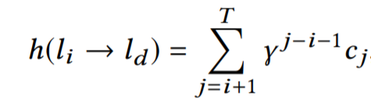
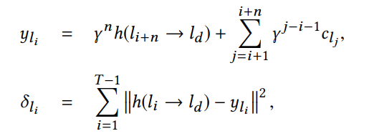


NASR: Estimated Cost
Estimated Cost Network Training
When a location $l_{i}$ is selected, an immediate cost $c_{i}$ will be yielded according to:
Moving
State
MLP
n_{li}
Distance from l_{i} to l_{d}
n_{ld}
Estimated cost:
Temporal difference learning:
Road Network
Loss:
Notes:
Next, I will talk about the training method of the estimated cost network. （翻页）
When a location i is selected, an immediate cost c_i will be yielded according to this formula. （翻页）
改公式
So, the real estimated cost between location i and d can be modeled as this formula. （翻页）
We use temporal difference learning to optimize this network, since the computation of estimated cost is a multi-step decision process and is difficult to be optimized directly.

Slide 20
NASR: Model Training
Load data
Pretrain
Pretrain observable cost network
Pre-train the observable cost network component.
Yes
Model
converged
No
Joint Learning
Perform gradient descent on observable cost network
End
Train the two components jointly using alternative optimization
Perform TD learning on estimated cost network
Notes:
This is the training procedure of our model. （翻页）
We first pre-train the GRU based observable cost network. （翻页）
Then, we train the two components jointly using alternative optimization by iterating the trajectories in training set.

Slide 21
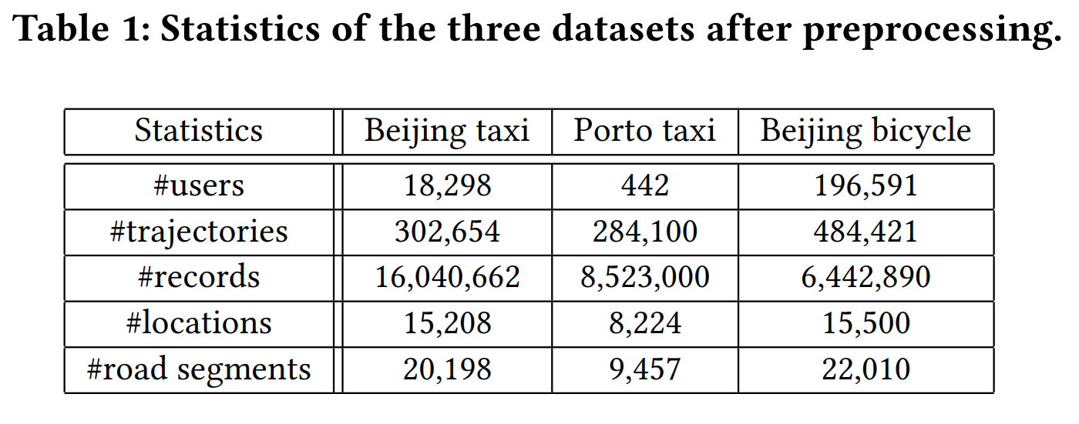


Experiments: Data Description
Remove stay points and noisy points
Processed Trajectories
Map Matching
Raw Trajectories
Final Datasets
Road network from OpenStreetMap
Notes:
Next, we are going to talk about the experiments. We collected three datasets, named Beijing taxi, porto taxi and Beijing bicycle. These data are processed by removing stay points and noisy points. Meanwhile, we collected road network of Beijing and Porto from OpenStreetMap. Processed trajectories are matched to road network by an open-source map-matching algorithm. Finally, we got three processed datasets. Statistics of the three datasets can be seen in table 1.

Slide 22
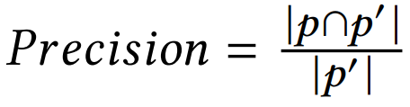
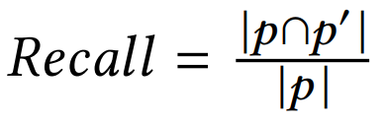
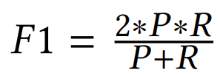
Experiments: Metric and Baselines
Benchmarks
Evaluation Metrics
RICK [KDD 2012]: Search-based method
MPR [KDD 2011]: Search-based method
CTRR [IJDE 2018]: Collaborative filtering
STRNN [AAAI 2016]: RNN with spatial-temporal
contexts
DeepMove [WWW 2018]: RNN with attention
Notes:
On the left, it’s the evaluation metrics, precision, recall and F1. They can be used to evaluate the difference between the inferred route and the groudtruth.
On the right is our five benchmarks, RICK and MPR are search-based methods while STRNN and DeepMove are deep learning methods. CTRR is a collaborative filtering based method.

Slide 23
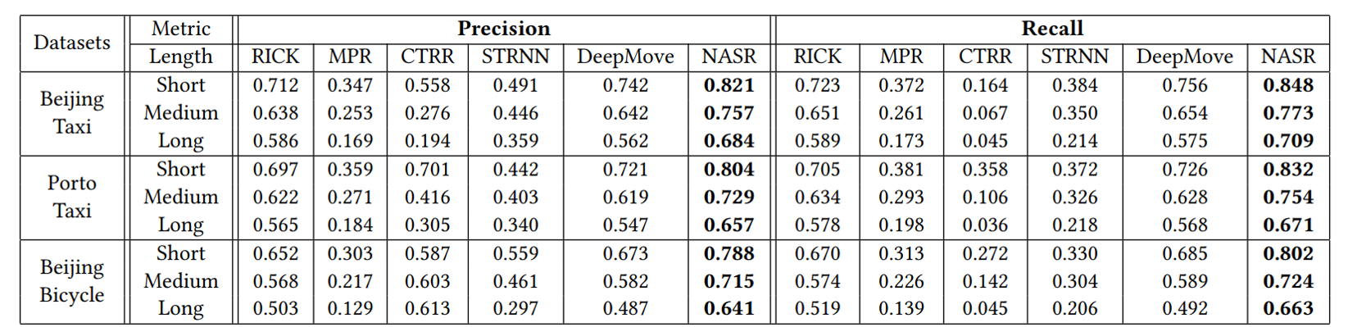
Experiments: Effectiveness
We discuss three types of query：
Short (10 to 20 locations),
Medium (20 to 30 locations),
Long (more than 30 locations).
Notes:
To evaluate different conditions, we consider short, medium and long query. Short query ranges from ten to twenty locations, medium query ranges from twenty to thirty locations, and long query is more than thirty locations.
Here is the precision and recall of our model on three datasets.

Slide 24
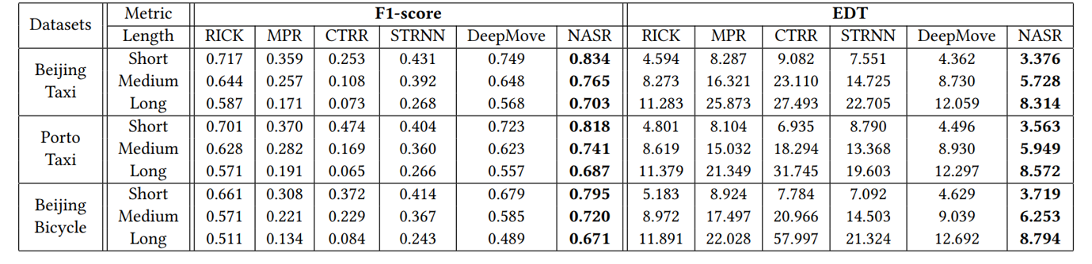
Experiments: Effectiveness
Our proposed model NASR performs best among all the methods. Because it combines both the benefits of heuristic search and neural networks.
Notes:
Here is the result of F1 score. From the two columns, you can see that our proposed model NASR performs best among all the methods. Because it combines both the benefits of heuristic search and neural networks.

Slide 25
Experiments: Effectiveness
Heuristic search methods perform very well, especially the RICK method. RICK fully characterizes the road network information and adopts the informed A ∗ algorithm.
Notes:
As for the heuristic search methods, i.e., RICK and MPR, they perform very well, especially the RICK. RICK fully utilize the road network information and adopts the informed A-star algorithm.

Slide 26
Experiments: Effectiveness
The matrix factorization based method CTRR does not perform better than RICK and MPR. A possible reason is that CTRR can not fully utilize the road network information.
Notes:
Next, the matrix factorization based method CTRR does not perform better than RICK and MPR. A possible reason is that CTRR can not fully utilize the road network information. Besides, it has limited capacities in learning complex trajectory features

Slide 27
Experiments: Effectiveness
Deep learning method DeepMove performs very well. Compared with STRNN, DeepMove considers more kinds of context information and designs more advanced sequential neural networks.
Notes:
Also, deep learning method DeepMove performs very well among all the baselines, while STRNN gives a worse performance. Compared with STRNN, DeepMove considers more kinds of context information and designs more advanced sequential neural networks.

Slide 28
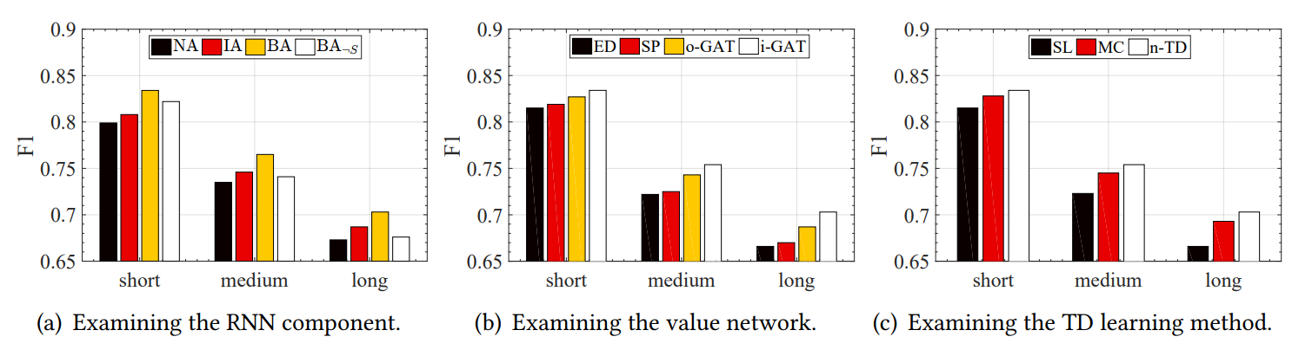
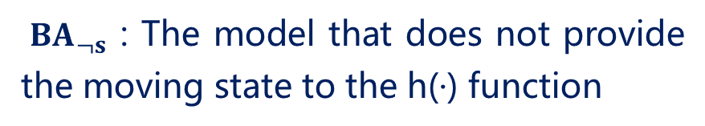
Experiments: Detailed Analysis
NA : Without attention.
IA : Using only intra-trajectory attention.
BA : Using both intra- and inter-trajectory
attention.
${BA}_{¬s}$ : The model that does not provide the moving state to the h(·) function
NA < IA < BA and ${BA}_{¬s}$ < BA
Conclusion: Inter-trajectory attention and
Intra-trajectory attention are both effective.
Notes:
Here comes the ablation study, we consider three variants of the attention mechanism for implementing observable cost function: without attention (NA), using only intra-trajectory attention (IA) and using both intra- and inter-trajectory attention (BA).
Recall our GRU component is also able to learn a vectorized representation for the moving state of users. We further prepare a variant for verifying the effect of the learned moving state in the value network, namely the model that does not provide the moving state to the estimated cost function.
It shows that both intra- and inter-trajectory attention are important to improve the performance of the PRR task. Especially, the learned moving state from the GRU component is useful for the value network. When the moving state is incorporated, the performance has been greatly improved.

Slide 29
Experiments: Detailed Analysis
ED : Using Euclid distance.
SL : Using supervised learning.
SP : Using scalar product between the embeddings
of the candidate and destination locations.
MC : Using Monte Carlo method.
o-GAT : Using the original implementation of graph
attention networks.
n-TD: Using temporal difference
learning.
i-GAT: Using our improved GAT by incorporating
context information.
Notes:
On the left, we present four variants of the estimated cost function. We can see that the simplest spatial distance baseline ED gives the worst performance, which indicates simple heuristics may not work well in our task. Graph attention networks are more effective to capture structural features from a graph. When incorporating context information, our value network is able to outperform the variant using original implementation.
On the right, we present the performance of three training methods. We can see that the simplest supervised learning method performs worst. Since the prediction involves multi-step search process, it is not easy to directly fit the distance using traditional supervised learning methods. Compared with all the methods, we can see that the TD learning method is the most effective way for the estimated cost.

Slide 30
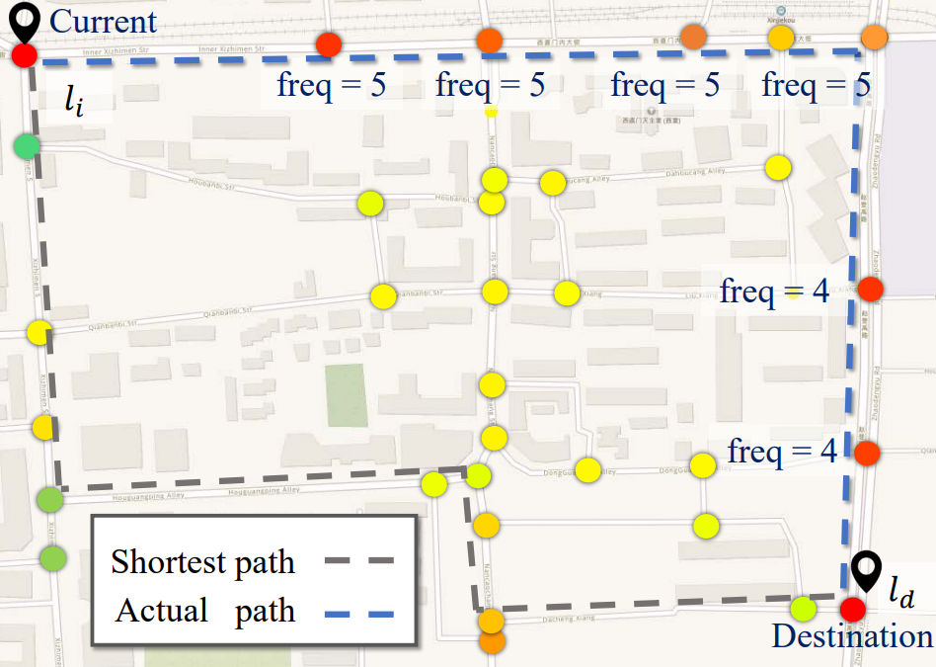


Experiments: Qualitative Analysis(1)
Visualization of the learned association scores using improved graph attention networks. The colored circles denote locations in the road network. A darker color indicates a larger importance degree w.r.t. current location $l_{i}$ and destination $l_{d}.$ “$freq "$ denotes the visit frequency by the user in historical trajectories.
Notes:
For a candidate location j , we compute its importance by a simple formula on the right, where n(·) is the location representations learned after training.
It can be seen that locations with larger importance have larger visit frequency, which means our graph attention mechanism is effective.

Slide 31

Experiments: Qualitative Analysis(2)
By comparing (a) (the original search space) and (b) (the reduced search space by NASR)，it can be seen that our model is able to effectively reduce the search space.
Notes:
By comparing the two figures, one is the original search space and the other one is the reduced search space by NASR，it can be seen that our model is able to effectively reduce the search space.

Slide 32

Experiments: Qualitative Analysis(3)
Visualization of the search procedure with the estimated costs by the NASR model. In (c), red points have been already explored and green points are candidate locations to extend in $A^{∗}$search algorithm.
Notes:
When zooming into a subsequence of this route, we further compare the estimated cost values for two candidate locations (which are the green points)
Although the location on the right has a longer distance than the left one, it is located on the main road that is much more likely to lead a better traffic condition. Our model is able to predict a lower cost for such location by effectively learning from road network constraint and historical data.

Slide 33
Conclusion
We first presented a simple A ∗ solution for solving the PRR task, and formally defined the suitable form of the cost.
We set up two components to learn the two cost respectively, i.e., the GRU component for g(·) and the value network for h(·).
Currently, we focus on the PRR task. We will also study whether our solution can be generalized to solve other complex search tasks.

Slide 34
Question?
Email to the authors:
jywang@buaa.edu.cn
wuning@buaa.edu.cn

