Slide 1





Learning To Effectively Estimate the Travel Time for Fastest Route Recommendation
Ning Wu, Jingyuan Wang, ${\text{Wayne} \text{Xin} \text{Zhao}}^{∗}$, Yang Jin
School of Computer Science and Engineering, Beihang University ${\text{School} \text{of} \text{Information}\text{, }\text{Renmin} \text{University} \text{of} \text{China}}^{∗}$
Notes:
Hello, everyone. Welcome to this oral presentation. I'm Ning Wu from Beihang University. Now, let's get started. The title is Learning To Effectively Estimate the Travel Time for Fastest Route Recommendation.

Slide 2
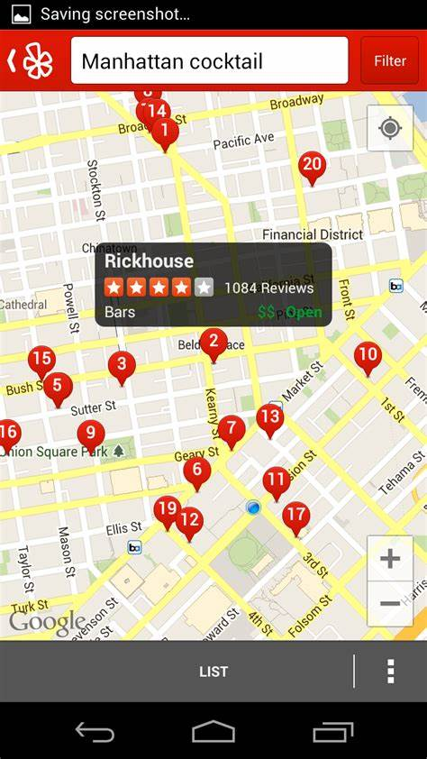
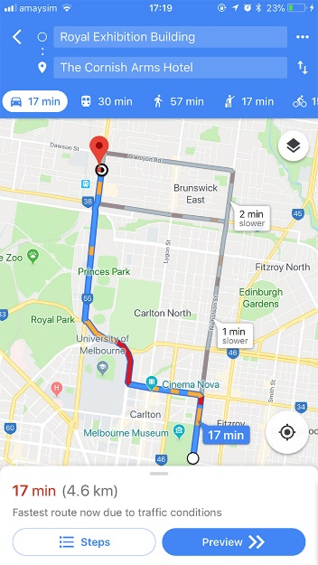
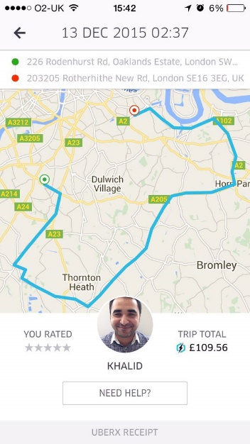



Background: Fastest Route Recommendation
Fastest Route Recommendation System has became one of the most core functions in many online applications, e.g., online map.
Fastest Route Recommendation aims to find the fastest path in response to user‘s queries in a large complex road network.
Notes:
Fastest route recommendation is an important problem, and has became one of the most core functions in many online applications.(翻页)
Given time, source and destination, it aims to offer a fastest route suggestions

Slide 3
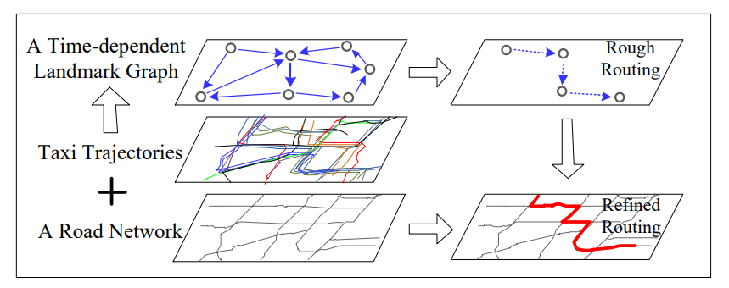
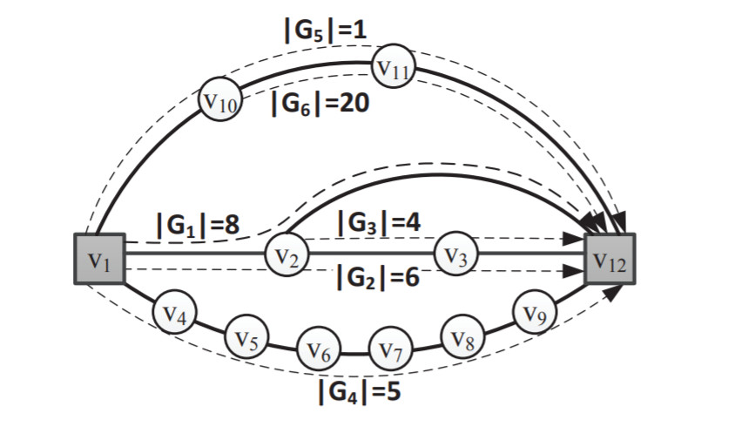
Background: Recommendation Methods
Heuristic Search: a basic recommendation method
Design cost function manually, and search an optimal path according to it.
Difficult to utilize various kinds of context information in the search process.
[Yuan, 2010, SIGSPATIAL]
[Luo, 2013, SIGMOD]
Search-based Method
Notes:
Over past years, heuristic search has been a basic solution to route recommendation. Such algorithms search an optimal path according to mannually designed cost functions.
However, it’s difficult for such methods to utilize complex context information in the search process, such as real time traffic condition.

Slide 4
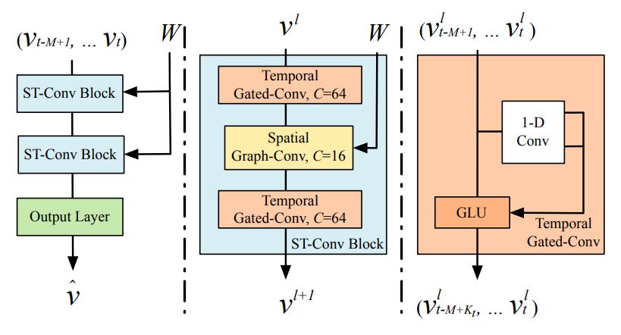
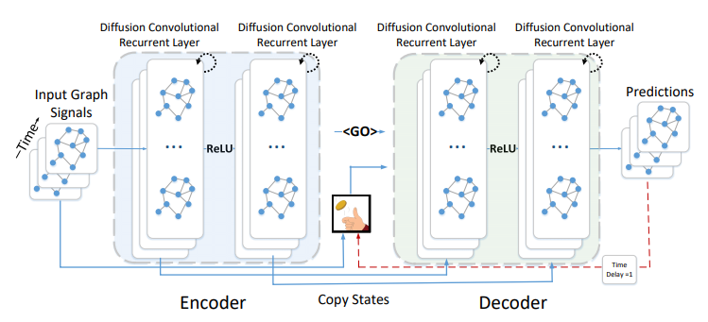
Background: Traffic Prediction
Neural Network: a rising traffic prediction method
Capture spatial-temporal dependency in data.
Neural network has been widely used for modeling traffic speed variation.
[Yu, 2018, IJCAI]
[Li, 2018, ICLR]
Neural Network Based Method
Neural network is a promising way to predict traffic condition.
Notes:
Recently, neural network has been a rising method in the traffic prediction field. Many papers utilize convolutional neural network and recurrent neural network to capture spatial-temporal dependency in data.(翻页)
From these work, we can see that neural network is a promising way to predict traffic condition.

Slide 5
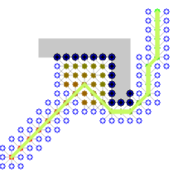

Background: Motivation
Our idea
Heuristic search is able to generate high-quality approximate solutions using proper cost functions.
Deep learning methods are effective to predict travel time using learnable neural networks.
Our idea is to learn cost functions of the A* search algorithm by neural networks.
A* search algorithm
Deep Learning
+
=
OUR IDEA
Notes:
Since heuristic search is a great framework for route recommendation and deep learning methods are effective to predict traffic condition, we propose to find the fastest route by traffic prediction in the framework of A* search algorithm.

Slide 6



Background: Key Research Problems
Define a suitable form for the cost in the FRR task.
Minimize travel time.
Design effective models for estimating travel time with
different purposes.
Observable cost and estimated cost.
Utilize rich context and constraint information for improving the task performance.
Context
Constraint
Spatial
Temporal
Road Network
Neuralized A-Star based Fastest route recommendation
Notes:
To solve this problem with the combination of A* search and neural networks, there are three key points. Firstly, we need to define a suitable form of the cost. (翻页*2)
What‘s more, effective models should be designed to learn the cost functions of A* algorithm. (翻页*3)
Last but not least, it will be of great help if we can fully utilize rich context and contraint information. (翻页)
Focusing on the three problems above, we propose the Neuralized A-Star based fastest Route recommendation Model.

Slide 7
Background: Problem Definition
Node：location
Edge: road segment
Road Network
Route
Location Sequence
Road Speed
8:30
Average Travel Speed between two Locations at Sometime
8:00
Query
Departure Time, Source Location, Destination Location and
Traffic Condition
8:00
Fastest Route Recommendation
Given departure time, source location, destination location and traffic condition, infer the fastest route for user.
Notes:
We shall first give the formula definition of fastest route recommendation. A road network consists of node and edge, node is location and edge is road segment. (翻页*2)
A route is a location sequence and road speed is the average travel speed between two locations at sometime. (翻页)
A query consists of departure time, source location and destination location. (翻页)
Our goal is to infer the fastest route given a user's query and traffic condition of departure time.

Slide 8
Background: Review of A* Algorithm
A* Search Algorithm
f(a) = g(a) + h(a)
Find the shortest path on graph
Candidate:
a
Flexible to adapt different task
Effective and efficient
Current:
Cost Function
b
Choose location with least cost
Find the path with least cost
c
Consist of two part: observable cost g and estimated cost h
f(b) < f(a) < f(c)
Notes:
Before introducing our model, I want to do a review of the A-Star algorithm. Originally, A-Star algorithm is designed to find the shortest path on graph, and it can be flexibly adapted to different tasks. Compared with other search algorithms such as Dijkstra and deep first search, it’s effective and efficient. (翻页)
The core of A-Star Algorithm is the cost functions. The search procedure in A-Star algorithm is to find the path with least cost. The cost consists of two parts, in this paper, we call them observable cost g and estimated cost h. (翻页)
In this picture, you can see that the A-Star algorithm will choose the location with least cost at every expansion until it arrives the destination.

Slide 9
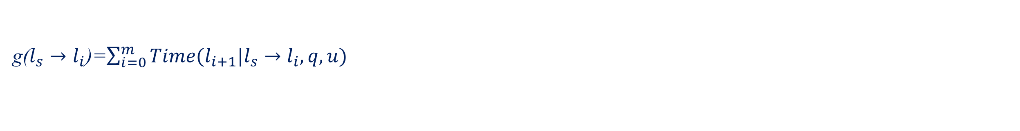

Background: A Simple A*-based Approach for FRR
Our Target
Minimize its travel time: $Time(p|q,u,D)$
Given a possible path $p: l_{s}→l_{1}→l_{2}\text{…}→l_{m} →l_{d}$
It can be rewritten as:
$$Time(p|q,u,D)=\sum_{i=0}^{m}{Time(l_{i+1}|l_{s}→l_{i}, q,u)}$$
Design Cost Function
g($l_{s}→l_{i}$)=$\sum_{i=0}^{m}{Time(l_{i+1}|l_{s}→l_{i}, q,u)}$
$Time$ can be calculated based on current road speed.
h($l_{i}→l_{d}$)= Euclid($l_{i},l_{d}$) or ?
h($l_{i}→l_{d}$) can be designed manually.
Notes:
So, an A-star based approach can be summarized as follow, our target is to minimize the travel time. Given a path consisting of m locations, we can factorize the path to compute its cost.(翻页)
We can compute the observable cost of a candidate location i as this foluma, and Time can be calculated by shallow models.
Actually, the computation of the estimated cost is much more difficult, since the optimal sub-route for location i to location d is unknown. People usually design it manually under certain rules.

Slide 10
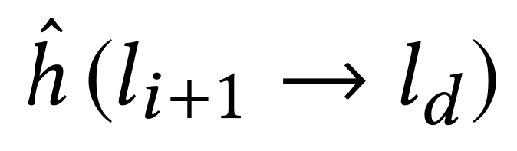
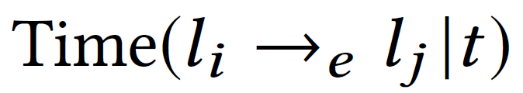
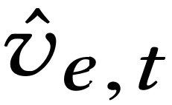
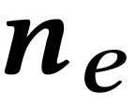
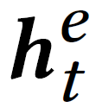
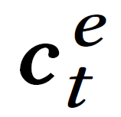

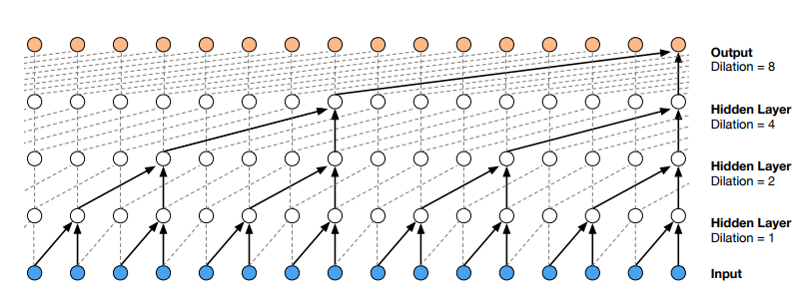





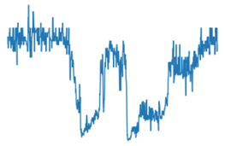


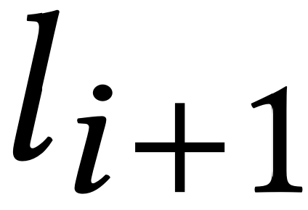
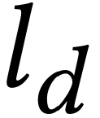


NASF: Overall
A* search framework
Min Selector
MLP
MLP
MLP
MLP
GAT
GAT
GAT
GRU
GRU
GRU
GRU
GRU
GRU
GRU
ReLU
GRU
GRU
GRU
…
Dilated Causal CNN
…
…
1st shortest
route
2nd shortest
route
kth shortest
route
…
Short-term history speed
Long-term history speed
Road Network
…
Notes:
That’s the overall framework. It consists of two network that are used to model the observed cost and estimated cost separately.

Slide 11

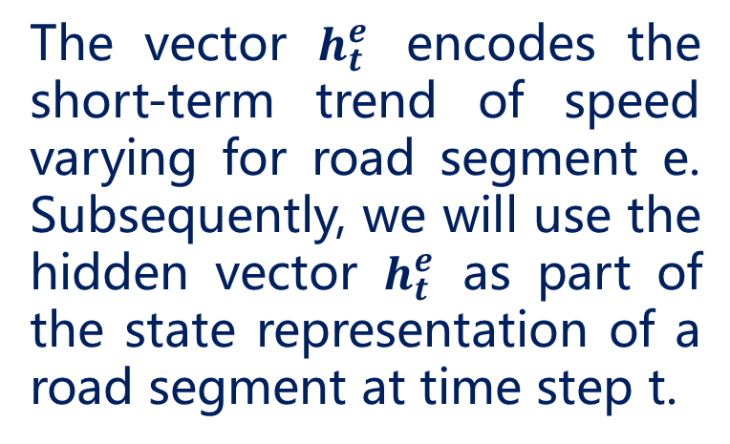
NASF: Observed Cost
Extracting Short-term Feature by GRU
We employ the widely used GRU network to encode it into a vector.
MLP
GAT
GAT
GAT
GRU
GRU
GRU
GRU
ReLU
The vector $h_{t}^{e}$ encodes the short-term trend of speed varying for road segment e. Subsequently, we will use the hidden vector $h_{t}^{e}$ as part of the state representation of a road segment at time step t.
…
Dilated Causal CNN
…
…
…
Short-term history speed
Long-term history speed
Road Network
…
Notes:
Now let's dive into the observable cost network. First, we consider short term traffic information. The traffic speed information is encoded into a vector. Then, GRU is employed to extract sequential dependence.

Slide 12


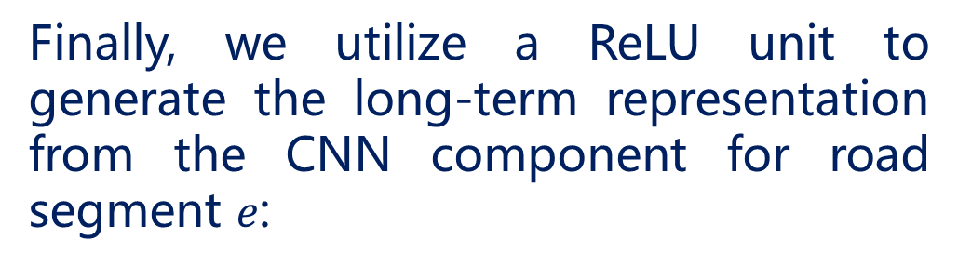
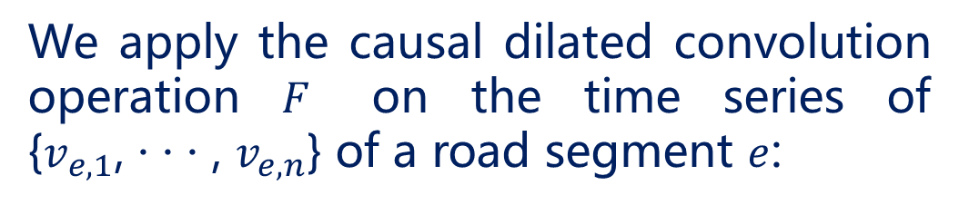
NASF: Observed Cost
Dilated Causal CNN
We apply the causal dilated convolution operation $F$ on the time series of {$v_{e,1}$, · · · , $v_{e,n}$} of a road segment $e$:
MLP
GAT
GAT
GAT
GRU
GRU
GRU
GRU
ReLU
…
Finally, we utilize a ReLU unit to generate the long-term representation from the CNN component for road segment $e\text{:}$
Dilated Causal CNN
…
…
…
Short-term history speed
Long-term history speed
Road Network
…
Notes:
Furthermore, the long term dependency in traffic information is also important to model traffic condition, hence, we introduce dilated causal convolution to take the long term information into account.

Slide 13

NASF: Observed Cost
Graph Neural Network
Learning effective structural representations for summarizing graph nodes. The update of graph neural networks can be given as
MLP
GAT
GAT
GAT
GRU
GRU
GRU
GRU
ReLU
…
Here, we adopt the recently proposed Graph ATTention network (GAT) for a good balance between capacity and efficiency. In GAT, the key part is to compute the attention importance of a node on another.
Dilated Causal CNN
…
…
…
Short-term history speed
Long-term history speed
Road Network
…
Notes:
the spatial relation between roads is also important to model traffic condition, hence, we introduce graph neural network to take the spatial dependency into account.

Slide 14


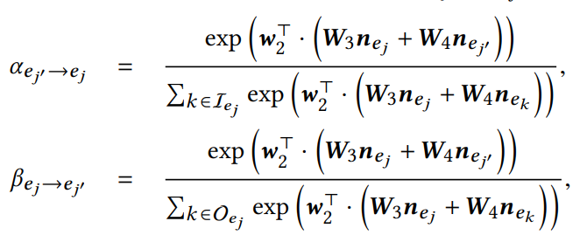
NASF: Observed Cost
Direction-Sensitive Graph Attention Network
The update of GAT can be given as
MLP
GAT
GAT
GAT
We concatenate the learned representations
GRU
GRU
GRU
GRU
ReLU
…
Dilated Causal CNN
…
…
We set two kinds of attention weights between
two road segments
…
Short-term history speed
Long-term history speed
Road Network
…
Notes:
the direction of road is also important, hence, we introduce direction-sensitive graph attention network to take the direction of road into account.

Slide 15


NASF: Observed Cost
Observable Cost Computation
We can divide the road length by the predicted traffic speed as the travel time through the road segment as follows:
MLP
GAT
GAT
GAT
GRU
GRU
GRU
GRU
ReLU
…
Dilated Causal CNN
…
Loss
…
…
Short-term history speed
Long-term history speed
We can compute the mean squared error loss as:
Road Network
…
Notes:
Once we have learned the final representation of the road segment at timestamp i, we are able to compute the speed of the road segment at timestamp i.
Finally the observable cost g can be calculated as the two formula
and the observable cost network can be optimized by this loss function

Slide 16
NASF: Estimated Cost
Generation of Shortest Route
Min Selector
Given a candidate location, we can efficient generate the
top-K shortest routes from it to the destination.
MLP
MLP
MLP
GRU
GRU
GRU
Modeling by Bi-GRU
GRU
GRU
GRU
Given a candidate route, we build an arrival time predictor on top of bi-directional GRU (BiGRU)
…
1st shortest
route
2nd shortest
route
kth shortest
route
Road Network
…
Notes:
To model the estimated cost h , we generate several candidate shortest route by shortest path algorithm.
Then, GRU is employed to extract sequential dependency.

Slide 17
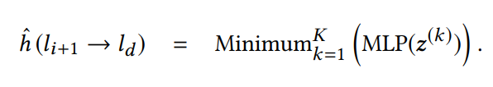
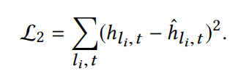
NASF: Estimated Cost
Estimation of the Fastest Arrival Time
Min Selector
We choose the minimum one of the K values:
MLP
MLP
MLP
GRU
GRU
GRU
GRU
GRU
GRU
…
We further define the loss for the h(·) function:
1st shortest
route
2nd shortest
route
kth shortest
route
Road Network
…
Notes:
To guarantee the admissibility of A* algorithm, we choose the minimum one of the several mlp output.
To train the estimated cost network, we employ the time-dependent algorithm to find the duration of the real fastest path as ground truth.

Slide 18
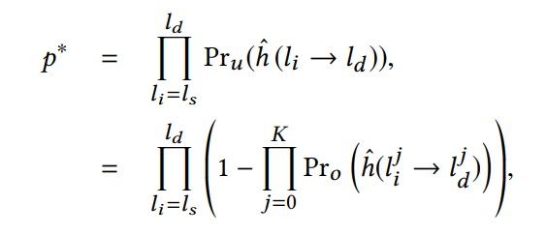

NASF: Estimated Cost
Admissibility Analysis
Formally, the probability that our model has found
the optimal path can be defined as:
Min Selector
MLP
MLP
MLP
GRU
GRU
GRU
GRU
GRU
GRU
…
1st shortest
route
2nd shortest
route
kth shortest
route
We derive an estimate of K:
Road Network
…
Notes:
In heuristic search, a heuristic function is said to be admissible if it never overestimates the cost of reaching the goal, i.e., the cost it estimates to reach the goal is not higher than the lowest possible cost from the current point in the path. If an admissible heuristic is adapted in an algorithm, then this algorithm would eventually find an optimal solution to the goal. Here, we present a simplified admissibility analysis of our method.
Formally, the probability that our model has found the optimal path can be defined as 翻页
We can derive an estimate of K as 翻页
Which means we can guarantee a large probability for P* with a small K value.

Slide 19
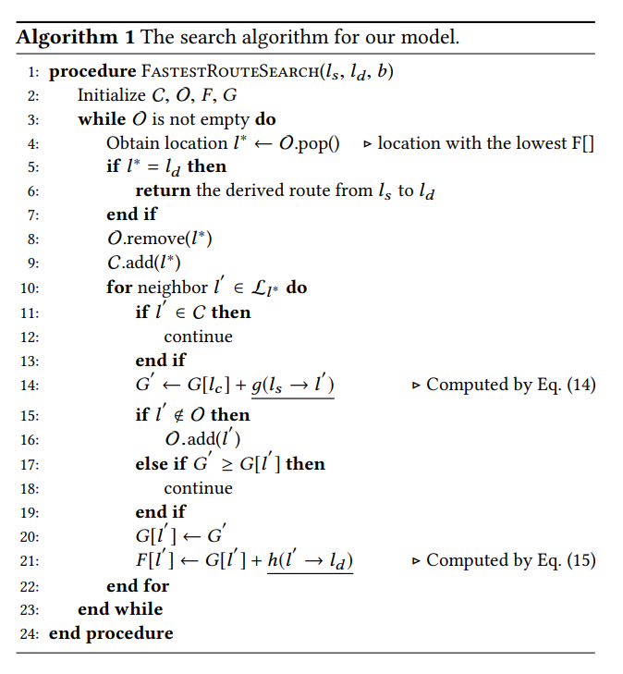
The Fastest Route Recommendation Algorithm
Notes:
This is the searching procedure of our model.
Specially, we maintain two sets, called closed set and open set. At each step, a node l* with the minimum cost is excluded from the open set for expansion and added into the closed set. Given a candidate location, we utilize Equation 14(fourteen) to compute the value for g function and utilize Equation 15(fifteen) to compute the value for h function. Finally, the two cost values are summed as the final evaluation cost of a candidate location.

Slide 20
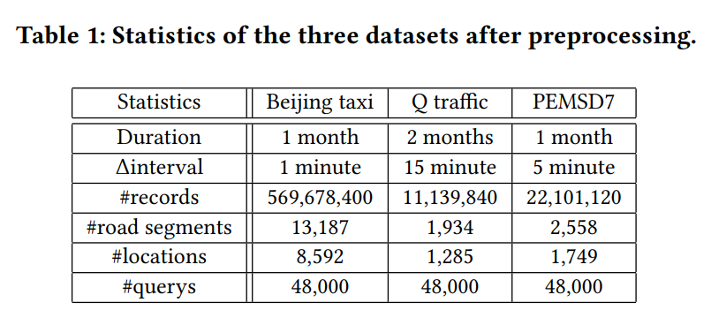
Experiments: Data Description
Remove stay points and noisy points
Processed Trajectories
Map Matching
Raw Trajectories
Average Speed
Road Network
Notes:
Next, we are going to talk about the experiments. We collected three datasets, named Beijing taxi, Q traffic and PEMSD7.

Slide 21


Experiments: Metric and Baselines
Evaluation Metrics
Benchmarks
T-drive [SIGSPATIAL 2010]: This baseline mines smart driving behaviors from the historical GPS trajectories
IAFP [ICDE 2006]: This baseline adopts a novel extension of the A* algorithm with historical traffic speed data of road networks
STGCN [IJCAI 2018]: Predicting traffic condition with spatial-temporal graph convolution neural network.
ETC..
Notes:
it’s the evaluation metrics FR1 and FR2. They can be used to evaluate the difference between the inferred route and the groudtruth. 翻页
Here is our benchmarks, T-drive and IAFP are history-based methods while STGCN and others are real time based methods.

Slide 22
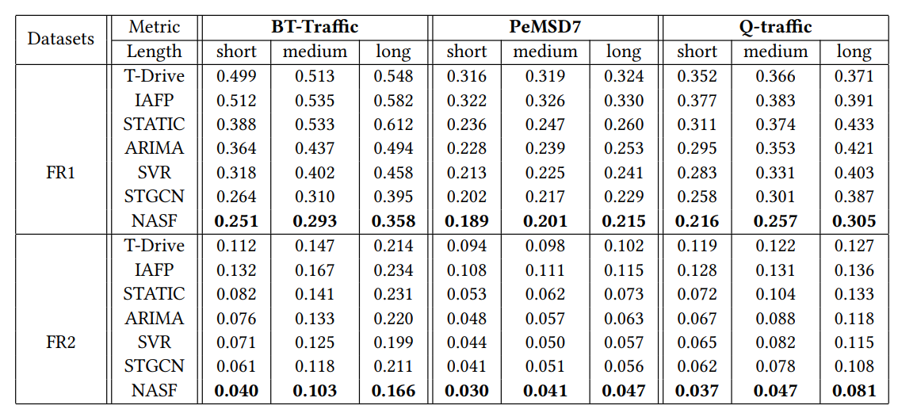
Experiments: Effectiveness
We discuss three types of query：
BT-Traffic: Short (<5km), Medium (5-10km), Long (>10km).
Notes:
To evaluate different conditions, we consider short, medium and long query. Their range depends on the dataset.
Here is the performance of our model on three datasets.

Slide 23
Experiments: Effectiveness
Our proposed model NASF performs best among all the methods. Because it combines both the benefits of heuristic search and neural networks.
Notes:
From the two columns, you can see that our proposed model NASF performs best among all the methods. Because it combines both the benefits of heuristic search and neural networks.

Slide 24
Experiments: Effectiveness
Historical data based methods perform not very well, especially the T-Drive method. T-Drive fully characterizes the road network information and adopts the informed A ∗ algorithm.
Notes:
As for the history based methods, i.e., T-Drive and IAFP, they perform not very well, because historical traffic information is not enough to predict future.

Slide 25
Experiments: Effectiveness
The real time based method perform better than T-drive and IAFP. A possible reason is that real time data is more useful than history data.
Notes:
Next, the real time based methods perform better than T-drive and IAFP. A possible reason is that real time data is more useful than history data.

Slide 26
Experiments: Effectiveness
Deep learning method STGCN performs very well. Compared with others, it considers more kinds of context information and designs more advanced sequential neural networks.
Notes:
Also, deep learning method STGCN performs very well among all the baselines. Compared with others, it considers more kinds of context information and designs more advanced sequential neural networks.

Slide 27
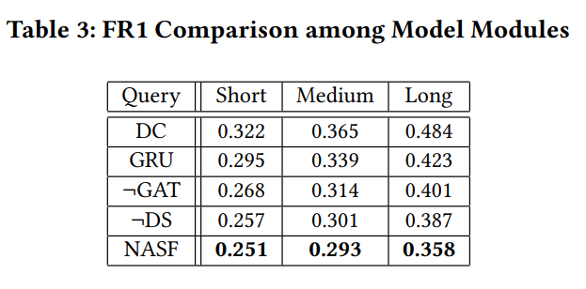
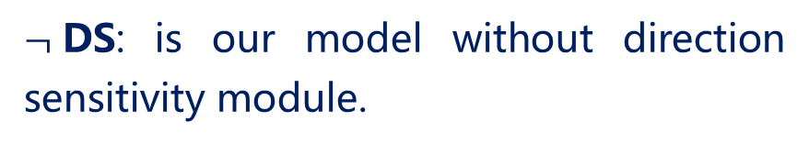

Experiments: Detailed Analysis
DC: is our model without graph attention network and GRU for short-term trend modeling.
GRU: is our model without graph attention network and dilated convolution modules.
$¬$GAT: is our model without the graph attention
network module.
$¬$DS: is our model without direction sensitivity module.
NASF: The whole model.
DC>GRU>$¬$GAT>$¬$DS>NASF
Conclusion: The model performances are improved by graph attention network and direction sensitivity modules, which verified the effectiveness of the two modules.
Notes:
Here comes the ablation study, we consider four variants of the attention mechanism(ˈmekənɪzəm
) for implementing observable cost function.
Only dilated convolution, only GRU, our model without graph attention, our model without direction sensitivity module.
It shows that the model performances are improved by graph attention network and direction sensitivity modules, which verified the effectiveness of the two modules.

Slide 28
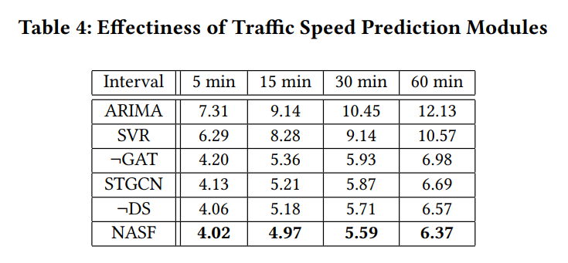



Experiments: Detailed Analysis
ARIMA : Using ARIMA model to predict future speed.
$STGCN$: Using spatio-temporal graph convolution neural network.
SVR : Using support vector regression to predict future speed.
$¬$DS : Using our traffic speed prediction model without the DS module
$¬$GAT : Using our traffic speed prediction model without the GAT and DS modules.
$NASF$ : Using all modules.
Notes:
Here, we compare our model with other model on the task of traffic prediction. It can be seen that our model has best performance compared with others

Slide 29
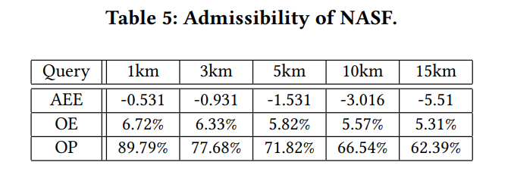
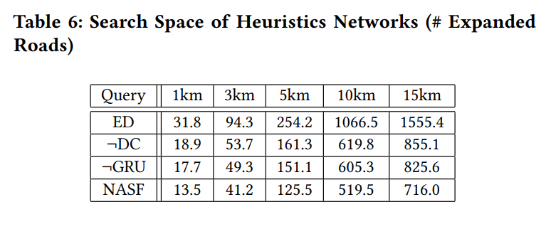
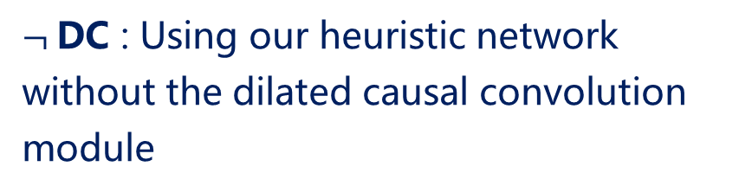
Experiments: Detailed Analysis
AEE : Average Estimation Error for all future travel time estimations.
ED : Using Euclid distance.
$¬$DC : Using our heuristic network without the dilated causal convolution module
OE : The percentage of estimations that overestimate the fastest arrival time.
OP : The percentage of queries that can find the optimal path.
¬GRU : Using our heuristic network without the GRU module.
NASF : Using our whole model
Notes:
On the left, we present three metrics to evaluate the admissibility of our model. They are AEE, OE, and OP. Table five means that our model is admissible at most time.
On the right, we present four variants of the estimated cost function. We can see that the simplest spatial distance baseline ED gives the worst performance, which indicates simple heuristics may not work well in our task and dilated causal convolution and GRU are both effective to model the estimated cost function.

Slide 30
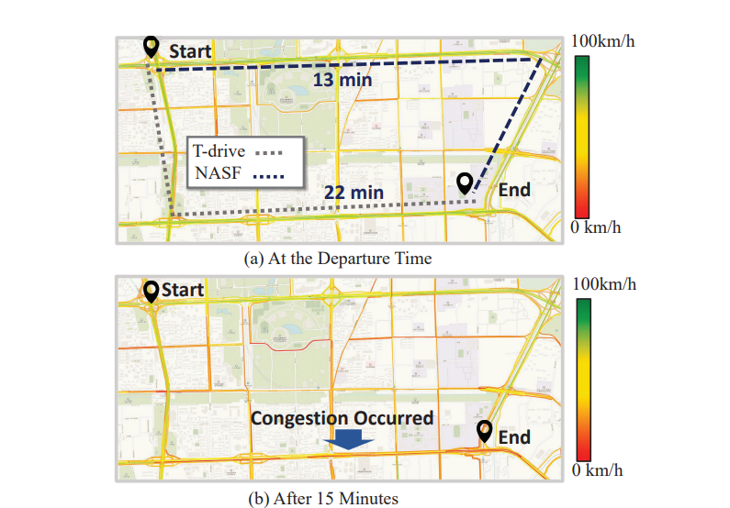
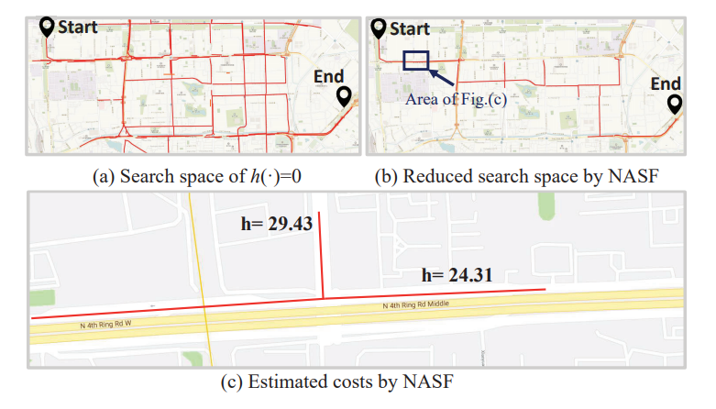
Experiments: Qualitative Analysis(1)
Visualization of traffic speed information in road networks. A darker color indicates a lower traffic speed.
Visualization of the search procedure with the estimated costs by the NASF model.
Notes:
On the left, It’s the visualization of traffic speed information in road network. It means our model can avoid future congestion for driver.
On the right, it’s the search space of NASF， It means our model can reduce search space significantly.

Slide 31
Conclusion
We first presented a simple A ∗ solution for solving the FRR task, and formally defined the suitable form of the cost.
We set up two components to learn the two cost respectively, i.e., the GRU component for g(·) and the value network for h(·).
Currently, we focus on the FRR task. We will also study whether our solution can be generalized to solve other complex search tasks.

Slide 32
Question?
Email to the authors:
jywang@buaa.edu.cn
wuning@buaa.edu.cn
https://www.bigscity.com/
Our website:

Slide 33



Authors

