Slide 2
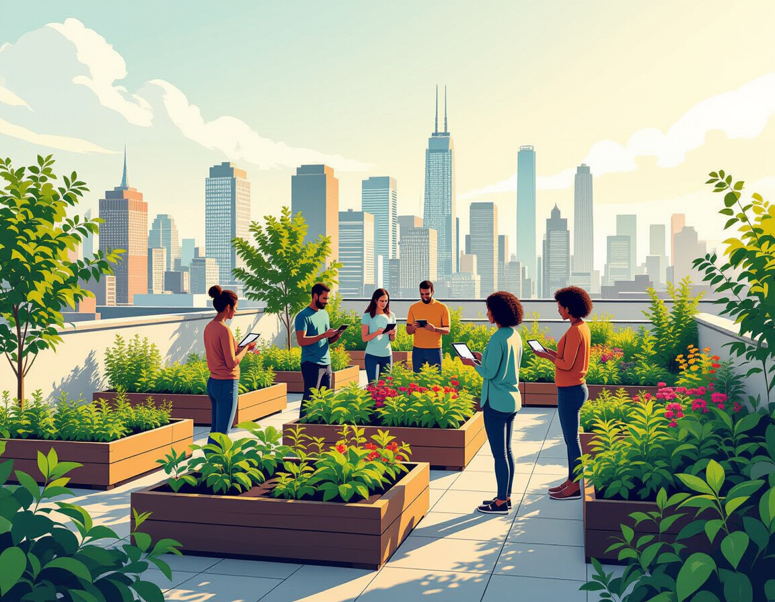
Introduction to Our Innovative Software Product
Our mission is to revolutionize urban gardening! We provide an innovative platform to promote balcony and rooftop gardening, addressing hunger and fostering sustainability.

Slide 3
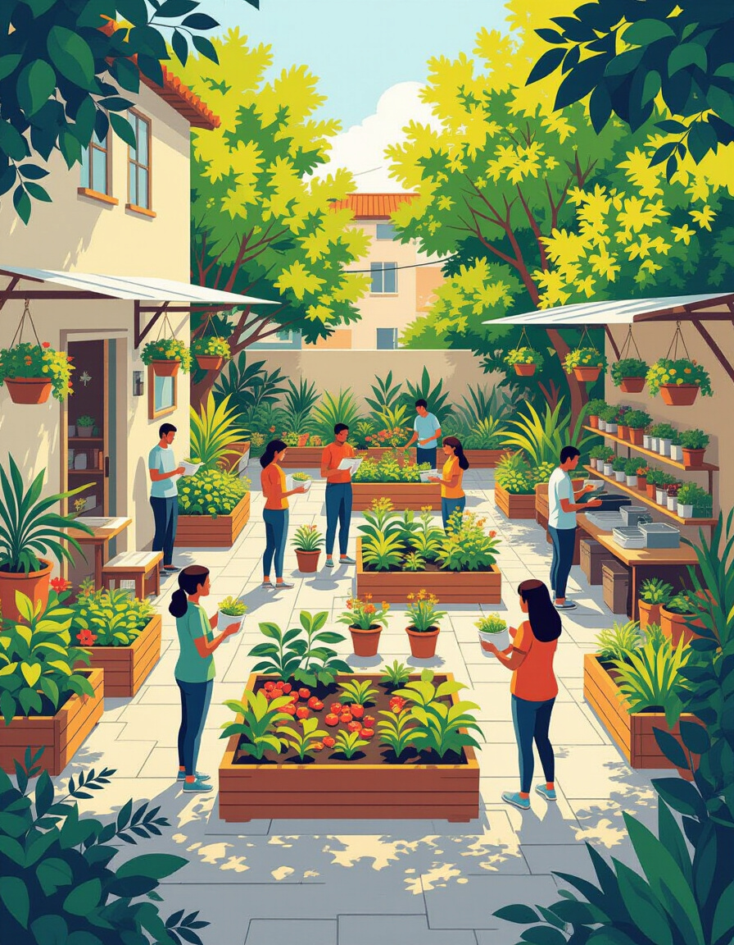
The Vision: Alleviating Hunger through Gardening
Our initiative directly aligns with the United Nations Sustainable Development Goals (SDGs) by promoting sustainable agriculture and combating hunger. Gardening transforms underutilized spaces into food-producing ecosystems, enhancing food security and community resilience.
Why is this important?:
Fosters sustainability.
Directly addresses hunger.
Supports the UN SDGs.

Slide 4

Features of the Website: Plant Suggestions
Our plant suggestion page provides tailored advice on what to plant and how to care for your plants. Users receive guidance specific to their location and growing conditions, maximizing their gardening success.
Key Benefits:
Personalized advice.
Easy-to-follow instructions.
Promotes successful gardening.

Slide 5

Interactive Tool: Start My Balcony
Our "Start My Balcony" feature uses AI to provide personalized plant recommendations. Users input data such as sunlight exposure, balcony coverage, and soil type, and the AI suggests suitable plants for their unique environment.
How it works:
User inputs balcony details.
AI analyzes environmental factors.
Generates personalized plant recommendations.

Slide 6

E-commerce Integration: Buy from Us
The "Buy from Us" page offers a convenient way for users to purchase essential gardening supplies. We sell pots, seeds, seedlings, and manure, ensuring a seamless gardening experience from start to finish.
High-quality pots and seeds.
Healthy seedlings.
Nutrient-rich manure.

Slide 7

Future Enhancements: Expanding Functionality
We are committed to continuously improving our platform. Future enhancements include user login features, advanced plant care guides, and community forums to foster collaboration and knowledge sharing.
User login functionality.
Advanced plant care guides.
Community forums.

Slide 8
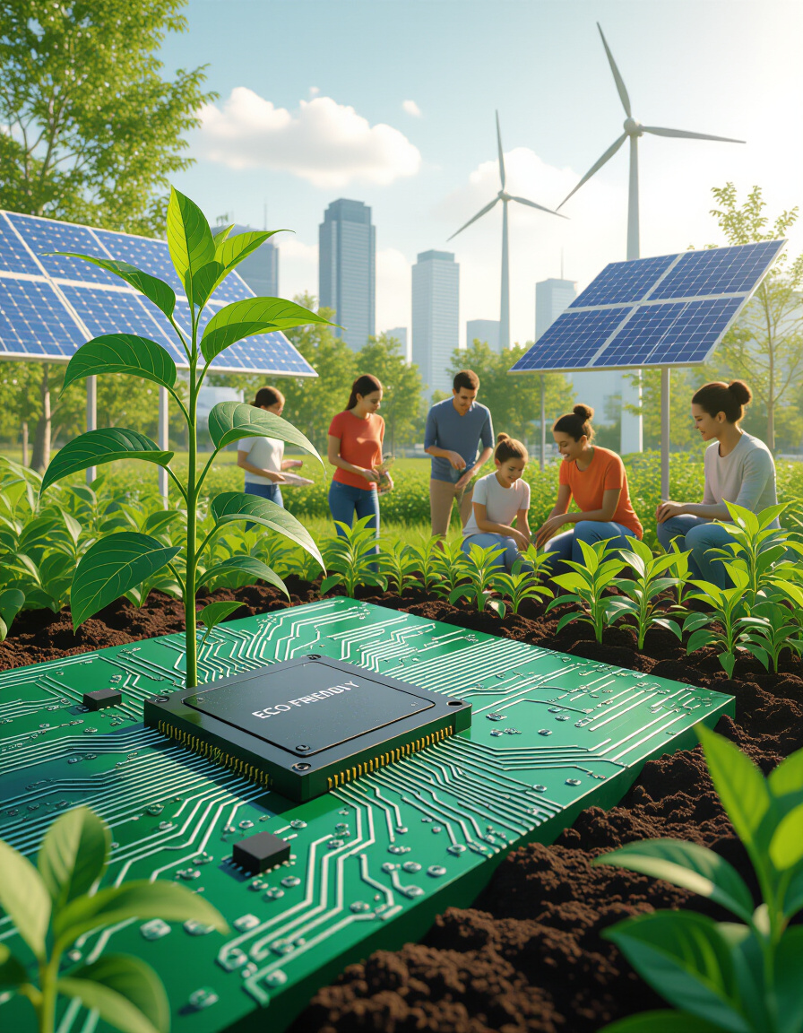
Impact: Increasing Eco-Friendliness and Reducing Hunger
Our website promotes eco-friendliness by encouraging local food production and reducing the carbon footprint associated with transporting produce. By empowering individuals to grow their own food, we contribute to reducing hunger and building more sustainable communities.
Increased eco-friendliness.
Reduced carbon footprint.
Alleviation of hunger.

Slide 9

Call to Action: Join Us in This Green Revolution
We invite you to join us in this green revolution! Whether through partnerships, support, or by using our website to start your own gardening journey, your involvement can make a significant impact. Let’s cultivate a more sustainable and nourished future together.

