Slide 1


Enterprise Messaging With
ActiveMQ and Spring JMS
Bruce Snyder
bruce.snyder@springsource.com
SpringOne
29 Apr 2009
Amsterdam, The Netherlands
1

Slide 2
Agenda
•
•
•
•
Installing ActiveMQ
Configuring ActiveMQ
Using Spring JMS with ActiveMQ
Some ActiveMQ Features
2

Slide 3

What is ActiveMQ?
• Open source
• Message-oriented middleware
• Apache project
– http://activemq.apache.org/
• Apache licensed
• JMS 1.1 compliant
• Goal:
– To achieve standards-based, message-oriented
application integration across many languages and
platforms
3

Slide 4
Installing ActiveMQ
• Download it
• Unzip it
• Run it
• It’s really that simple!
4

Slide 5

Configuring ActiveMQ
(conf/activemq.xml)
5

Slide 6
Configuring ActiveMQ
• XML configuration
<amq:broker id="broker" persistent="false" useJmx="true">
<amq:transportConnectors>
<amq:transportConnector name="openwire" uri="tcp://localhost:0" />
</amq:transportConnectors>
</amq:broker>
6

Slide 7
Configuring ActiveMQ
• Pure Java configuration
– Used to embed ActiveMQ in a Java app
BrokerService broker = new BrokerService();
broker.setPersistence(false);
TransportConnector connector = broker.addConnector("tcp://localhost:61616");
broker.start();
...
connector.stop();
broker.stop();
7

Slide 8
ActiveMQ Uses URIs
For Transport Configuration
<protocol>://<host>:<port>?<transport-options>
vm://embedded?broker.persistent=false
tcp://localhost:61616?jms.useAsyncSend=true
stomp://localhost:61613
failover:(tcp://host1:61616,tcp://host2:61616)?
initialReconnectDelay=100
8

Slide 9
Wire Formats
• OpenWire
– The default in ActiveMQ; a binary protocol
– Clients for C++, Java and .NET
• STOMP
– Simple Text Oriented Messaging Protocol; a text based protocol
– Clients for C, Javascript, Perl, PHP, Python, Ruby and more
• XMPP
– The Jabber XML protocol
• REST
– HTTP POST and GET
9

Slide 10
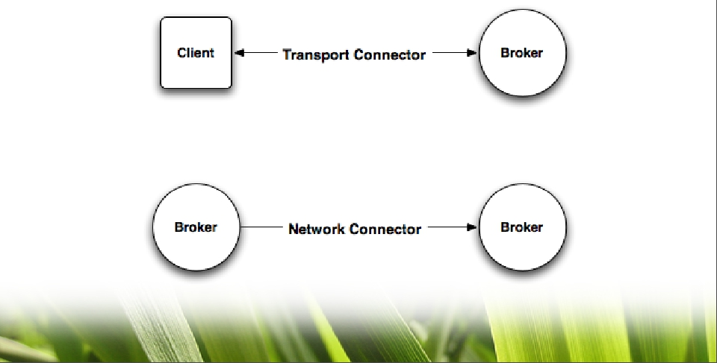
Two Types of Transports
• Client-to-broker communications
• Broker-to-broker communications
10

Slide 11
Transport Connectors
• Client-to-broker connections
– Similar to JDBC connections to a database
• Protocols are supported:
–
–
–
–
–
–
–
TCP
UDP
NIO
SSL
HTTP/S
VM
XMPP
11

Slide 12
Network Connectors
• Broker-to-broker connections
– A cluster of ActiveMQ instances
– Known as a network of brokers
• Protocols supported:
–
–
–
–
–
–
–
Static
Failover
Multicast
Zeroconf
Peer
Fanout
Discovery
12

Slide 13

Message Persistence
• AMQ Store
• JDBC
• Journaled JDBC
13

Slide 14
AMQ Message Store
• Transactional message storage solution
• Fast and reliable
• Composed of two parts:
– Data Store - holds messages in a transactional
journal
– Reference store - stores message locations for fast
retrieval
• The default message store in ActiveMQ 5
14

Slide 15
Non-Journaled JDBC
• Transactional message storage solution
• Reliable but not fast
– JDBC connection overhead is prohibitively slow
15

Slide 16
Journaled JDBC
• Transactional message storage solution
• Reliable and faster than non-journaled
• Two-piece store
– Journal - A high-performance, transactional journal
– Database - A relational database of your choice
• Default database in ActiveMQ 4.x was Apache
Derby
16

Slide 17

Master/Slave Configurations
• Pure master/slave
• Shared filesystem master/slave
• JDBC master/slave
17

Slide 18
Pure Master/Slave
• Shared nothing, fully replicated topology
– Does not depend on shared filesystem or database
• A Slave broker consumes all commands from
the master broker (messages, acks, tx states)
• Slave does not start any networking or
transport connectors
• Master broker will only respond to client after a
message exchange has been successfully
replicated to the slave broker
18

Slide 19
Pure Master/Slave
• If the master fails, the slave optionally has two
modes of operation:
– Start up all it’s network and transport connectors
• All clients connected to failed Master resume on Slave
– Close down completely
• Slave is simply used to duplicate state from Master
19

Slide 20
Shared Filesystem
Master/Slave
•
•
•
•
Utilizes a directory on a shared filesystem
No restriction on number of brokers
Simple configuration (point to the data dir)
One master selected at random
20

Slide 21
JDBC Master/Slave
•
•
•
•
Recommended when using a shared database
No restriction on the number of brokers
Simple configuration
Clustered database negates single point of
failure
• One master selected at random
21

Slide 22
Client Connectivity With
Master/Slave
• Clients should use the failover transport
for automatic reconnect to the
broker:
failover:(tcp://broker1:61616,\
tcp://broker2:61616, \
tcp://broker3:61616)?\
initialReconnectDelay=100
22

Slide 23

Broker Security
• Authentication
– I.e., are you allowed to connect to ActiveMQ?
– File based implementation
– JAAS based implementation
• Authorization
– I.e., do you have permission to use that ActiveMQ
resource?
– Destination level
– Message level via custom plugin
23

Slide 24
Networks of Brokers
• Many brokers acting together in a cluster
• Provides large scalability
• ActiveMQ store-and-forward allows messages
to traverse brokers in the network
– Demand-based forwarding
– Some people call this distributed queues
• Many possible configurations or topologies are
supported
24

Slide 25
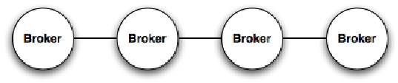
Topology Example
25

Slide 26
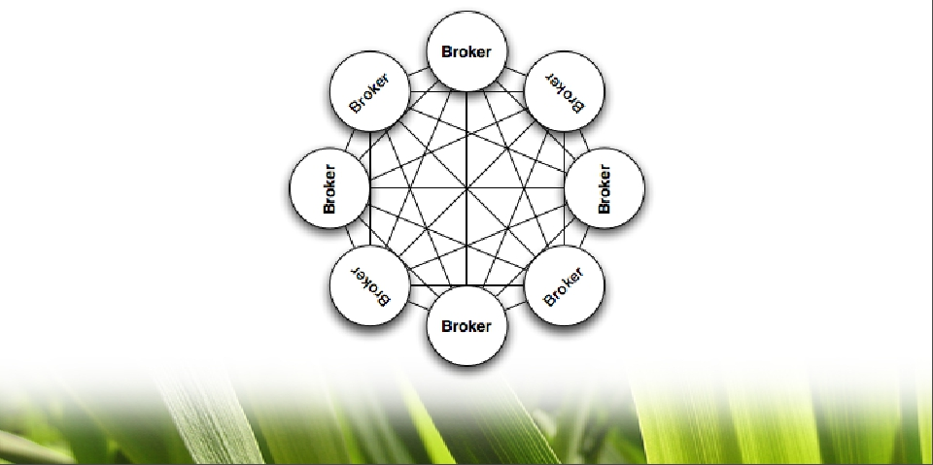
Topology Example
26

Slide 27
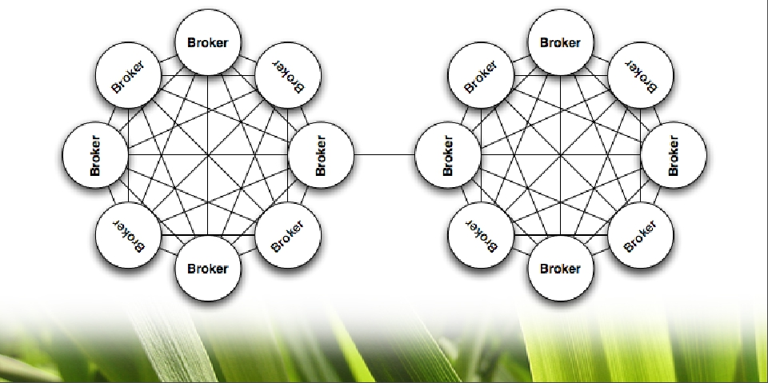
Topology Example
27

Slide 28
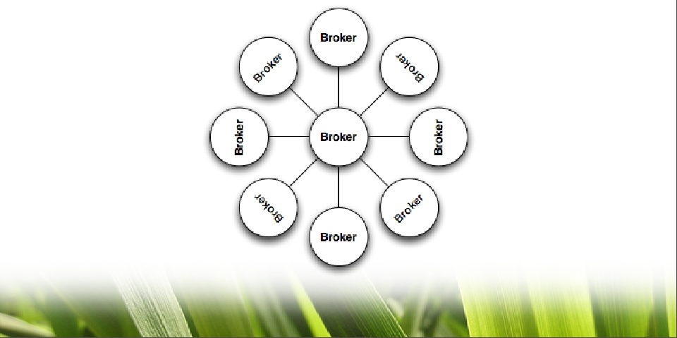
Topology Example
28

Slide 29
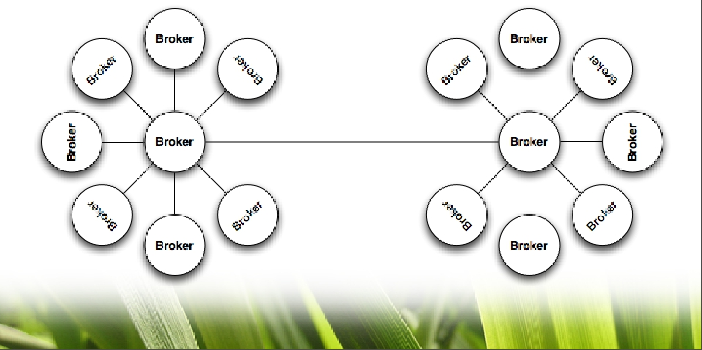
Topology Example
29

Slide 30


Using ActiveMQ
In Your Applications
EJB
1
2
3
JMS
DIY
30

Slide 31
DIY/Roll Your Own
• Advantages
– Do whatever you want - it’s a green field!
• Disadvantages
– Manual creation of MessageProducers and
MessageConsumers
– Manual concurrency management
– Manual thread management
– Manual transaction management
– Manual resource management
• ConnectionFactory, Connections, Destinations
31

Slide 32
EJB:Message Driven Beans
• Advantages
– Automatic Transaction management
– Automatic Concurrency
– Automatic resource management
• ConnectionFactory, Connections, Destinations
• Disadvantages
– Requires EJB container and therefore a JEE server
• Exception: Apache OpenEJB (http://openejb.apache.org/ )
– Increased overhead
32

Slide 33
Spring JMS
• Advantages
– No EJB container required (no JEE container)
– Simplified resource management
• ConnectionFactory, Connections, Destinations
– Simplified concurrency management
– Simplified transaction management
• Disadvantages
– Are there any? ;-)
33

Slide 34
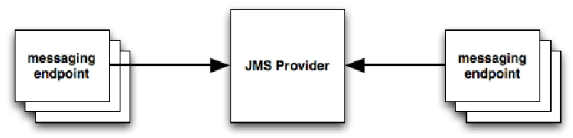
Typical JMS Applications
34

Slide 35
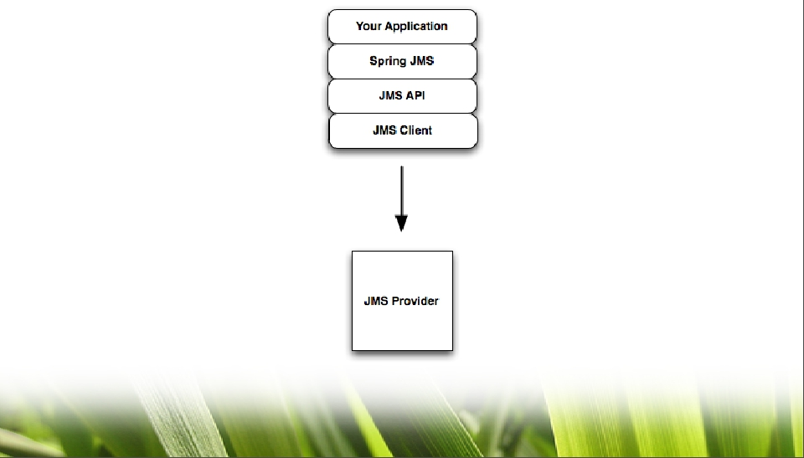
JMS With Spring
35

Slide 36
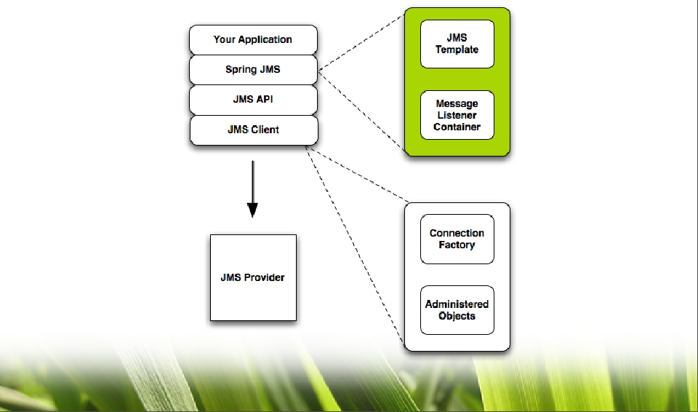
JMS With Spring
36

Slide 37
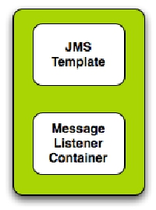
Spring JMS
• JMS Template
– Send and receive messages
synchronously
• Message Listener Container
– Receive messages asynchronously
– Message-Driven POJOs (MDPs)
37

Slide 38
JmsTemplate
Synchronous
• browse()
– Browse messages in a queue
• convertAndSend()
– Send messages synchronously
– Convert a Java object to a JMS message
• execute()
– Provides access to callbacks for more complex scenarios
• receive() and receiveAndConvert()
– Receive messages synchronously
• receiveSelected() and receiveSelectedAndConvert()
– Receive filtered messages synchronously
• send()
– Send a message synchronously using a MessageCreator
38

Slide 39

The Spring JmsTemplate
Synchronous
• Send using convertAndSend()
– Converts an object to a JMS message with a
configured MessageConverter
@Autowired
Destination destination;
@Autowired
JmsTemplate jmsTemplate;
jmsTemplate.convertAndSend("Hello World!");
39

Slide 40

The Spring JmsTemplate
Synchronous
• Using send() with a MessageCreator
– Provides access to Session for more complex
message creation
@Autowired
Destination destination;
@Autowired
JmsTemplate jmsTemplate;
jmsTemplate.send(destination, new MessageCreator() {
public Message createMessage(Session session)
throws JMSException {
return session.createTextMessage("Hello World!");
}
});
40

Slide 41

The Spring JmsTemplate
Synchronous
• Using execute() and the SessionCallback
– Provides access to the Session for flexibility
@Autowired
Destination destination;
@Autowired
JmsTemplate jmsTemplate;
jmsTemplate.execute(new SessionCallback() {
public Object doInJms(Session session) throws JMSException {
Queue queue = session.createQueue("MY.TEST.QUEUE");
MessageProducer producer = session.createProducer(queue);
TextMessage message = session.createTextMessage("Hello World!");
producer.send(message);
}
});
41

Slide 42

The Spring JmsTemplate
Synchronous
• Using execute() with the ProducerCallback
– Provides access to the Session and the
MessageProducer for more complex scenarios
@Autowired
Destination destination;
@Autowired
JmsTemplate jmsTemplate;
jmsTemplate.execute(new ProducerCallback() {
public Object doInJms(Session session, MessageProducer producer)
throws JMSException {
TextMessage message = session.createTextMessage("Hello World!");
producer.send(destination, message);
}
return null;
}
42

Slide 43
The Spring JmsTemplate
Synchronous
• Using receive()
– Very straightforward
– Accepts a destination object or the destination name
as a String
@Autowired
Destination destination;
@Autowired
JmsTemplate jmsTemplate;
jmsTemplate.receive(destination);
43

Slide 44

The Spring JmsTemplate
Synchronous
• Using receiveAndConvert()
– Converts an object to a JMS message with a
configured MessageConverter
@Autowired
Destination destination;
@Autowired
JmsTemplate jmsTemplate;
jmsTemplate.receiveAndConvert(destination, new MessageCreator() {
public Message createMessage(Session session)
throws JMSException {
return session.createTextMessage("Hello World!");
}
});
44

Slide 45
The Spring JmsTemplate
Synchronous
• Using receiveSelected()
– Makes use of a JMS selector expression
@Autowired
Destination destination;
@Autowired
JmsTemplate jmsTemplate;
String selectorExpression = “ Timestamp BETWEEN 1218048453251 AND
1218048484330”;
jmsTemplate.receiveSelected(destination, selectorExpression);
45

Slide 46
Message-Driven POJOs
Asynchronous
• Message Listener Container
– SimpleMessageListenerContainer
• Very basic
• Static configuration
• No external transaction support
– DefaultMessageListenerContainer
• Most commonly used container
• Allows for dynamic scaling of queue consumers
• Participates in external transactions
– ServerSessionMessageListenerContainer
• Requires provider support of the ServerSessionPool SPI
• Most powerful (dynamic session management)
46

Slide 47
Message-Driven POJOs
Asynchronous
• Three types of listeners:
– javax.jms.MessageListener interface
• Standard JEE interface
• Threading is up to you
– SessionAwareMessageListener interface
• Spring-specific interface
• Provides access to the Session object
– Useful for request-response messaging
• Client must handle exceptions
– MessageListenerAdapter interface
• Spring-specific interface
• Allows for type-specific message handling
• No JMS dependencies whatsoever
47

Slide 48

MessageListener
Asynchronous
• Standard JMS MessageListener
• Uses an onMessage() method
public class MyMessageListener implements MessageListener {
private static Logger LOG = Logger.getLogger(MyMessageListener.class);
public void onMessage(Message message) throws JMSException {
try {
LOG.info("Consumed message: “ + message);
// Do some processing here
} catch (JMSException e) {
LOG.error(e.getMessage(), e);
}
}
48

Slide 49

SessionAwareMessageListener
Asynchronous
• Provides access to the session
• Uses an onMessage() method
public class MySessionAwareMessageListener implements SessionAwareMessageListener {
private static Logger LOG = Logger.getLogger(MySessionAwareMessageListener.class);
public void onMessage(Message message, Session session) throws JMSException {
try {
LOG.info("Consumed message: “ + message);
TextMessage newMessage = session.createTextMessage(“This is a test”);
MessageProducer producer = session.createProducer(message.getJMSReplyTo());
LOG.info("Sending reply message: " + messageCount);
producer.send(newMessage);
} catch (JMSException e) {
LOG.error(e.getMessage(), e);
}
}
49

Slide 50
MessageListenerAdapter
Asynchronous
• Handles all message contents
• No reply message is sent (void return)
public interface MyMessageListenerAdapter {
void handleMessage(String text);
void handleMessage(Map map);
void handleMessage(byte[] bytes);
void handleMessage(Serializable obj);
}
50

Slide 51
MessageListenerAdapter
Asynchronous
• Handles all raw JMS message types
• No reply message is sent (void return)
public interface MyMessageListenerAdapter {
void handleMessage(TextMessage message);
void handleMessage(MapMessage message);
void handleMessage(BytesMessage message);
void handleMessage(ObjectMessage message);
}
51

Slide 52

MessageListenerAdapter
Asynchronous
• Handles String content
• No reply message is sent (void return)
• Method name must be explicitly configured
public interface MyMessageListenerAdapter {
void processMessage(String message);
}
---------------------------------------------------------
<jms:listener-container
container-type="default"
connection-factory="consumerConnectionFactory"
acknowledge="auto">
<jms:listener destination="SPRING.ONE" ref="myMessageListenerAdapter"
method="processMessage" />
</jms:listener-container>
52

Slide 53
MessageListenerAdapter
Asynchronous
• Handles String content
• A TextMessage reply message is sent (String
return)
public interface MyMessageListenerAdapter {
String handleMessage(String message);
}
---------------------------------------------------------
<jms:listener-container
container-type="default"
connection-factory="consumerConnectionFactory"
acknowledge="auto">
<jms:listener destination="SPRING.ONE" ref="myMessageListenerAdapter"
method="processMessage" />
</jms:listener-container>
53

Slide 54
ActiveMQ Consumer Options
•
•
•
•
•
•
•
Message prefetch
Exclusive consumer
Consumer priority
Message groups
Redelivery policies
Retroactive consumer
Selectors
54

Slide 55
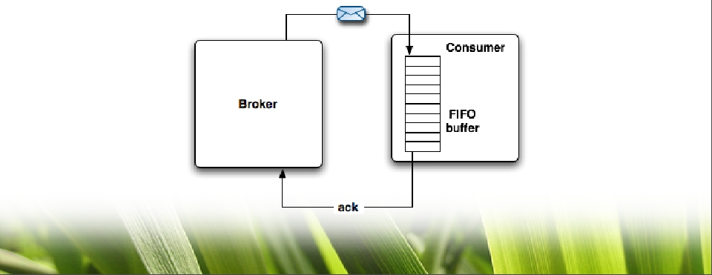
Message Prefetch
• Used for slow consumer situations
– Prevents flooding the consumer
• FIFO buffer on the consumer side
55

Slide 56
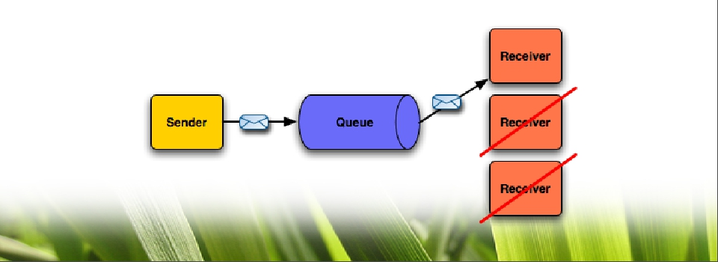
Exclusive Consumer
• Anytime more than one consumer is consuming
from a queue, message order is lost
• Allows a single consumer to consume all messages
on a queue to maintain message ordering
56

Slide 57
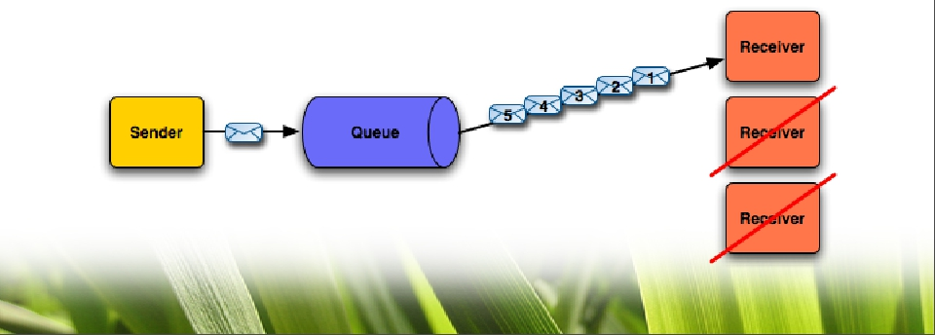
Consumer Priority
• Gives a consumer preference for message delivery
• Allows for the weighting of consumers to optimize
network traversal for message delivery
57

Slide 58

Message Groups
• Uses the JMSXGroupID property to mark messages
• One consumer receives all messages in the group
until JMSXGroupID is reset
• Allows one consumer to handle all messages in a
group
58

Slide 59
Redelivery Policy
• Messages are redelivered to a client when:
– A transacted session is rolled back
– A transacted session is closed before commit
– A session is using CLIENT_ACKNOWLEDGE and
Session.recover() is explicitly called
• Clients can override the redelivery policy
– Must be configured on the
ActiveMQConnectionFactory or the
ActiveMQConnection
• max redeliveries, initial redelivery delay, exponential
backoff, backoff multiplier, etc.
• Dead Letter Strategy can be configured using a
destination policy in the activemq.xml
59

Slide 60
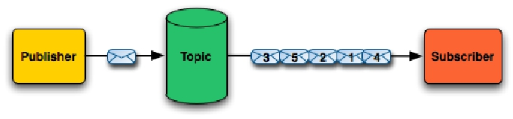
Retroactive Consumer
• Message replay at start of a subscription
– At the start of every subscription, send any
old messages that the consumer may have
missed
– Configurable via policies
60

Slide 61
Message Selectors
• Used to attach a filter to a subscription
• Defined using a subset SQL 92 syntax
• JMS selectors
– Filters only message properties
• JMSType = ‘stock’ and trader = ‘bob’ and price < ‘105’
• XPath selectors
– Filters message bodies that contain XML
• ‘/message/cheese/text() = 'swiss'’
61

Slide 62
Other Handy Features
•
•
•
•
Destination Policies
Virtual Destinations
Total Ordering of Messages
Mirrored Queues
62

Slide 63

Wildcards and
Destination Policies
...
<destinationPolicy>
<policyMap>
<policyEntries>
<policyEntry topic="Price.Stock.>"
memoryLimit="128mb">
</policyEntries>
</policyMap>
</destinationPolicy>
...
•
Price.>
•
•
•
Price.Stock.>
Price.Stock.NASDAQ.*
Price.Stock.*.IBM
> - Everything recursively
* - Everything at that level
63

Slide 64
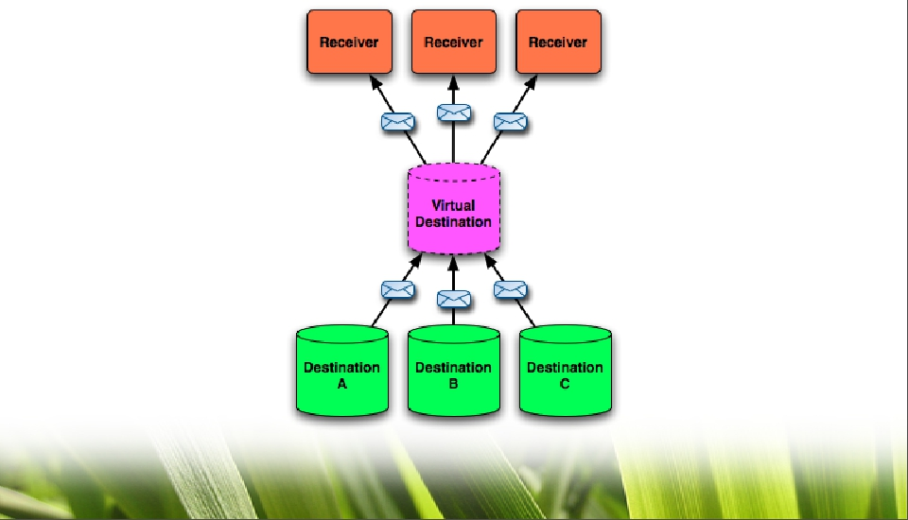
Virtual Destinations
64

Slide 65
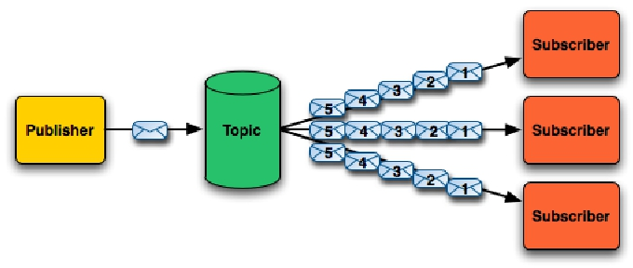
Total Ordering
• A guaranteed order of messages for each
consumer
65

Slide 66
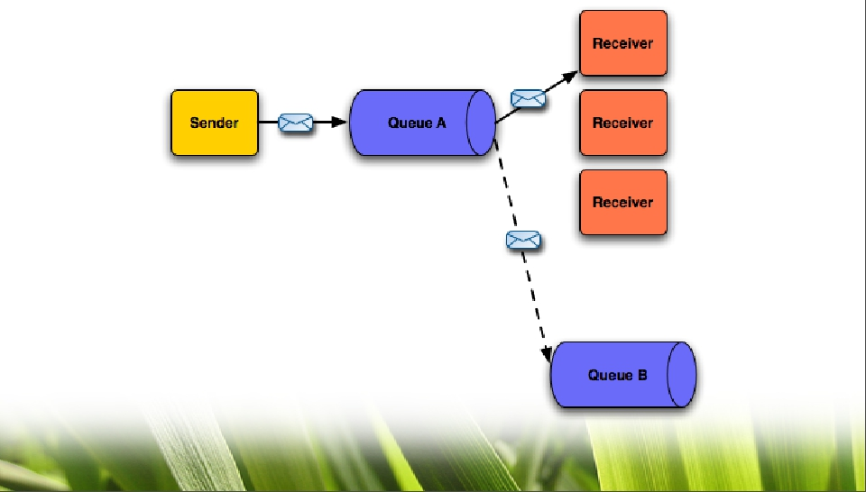
Mirrored Queues
66

Slide 67

What is Apache Camel?
=>
67

Slide 68
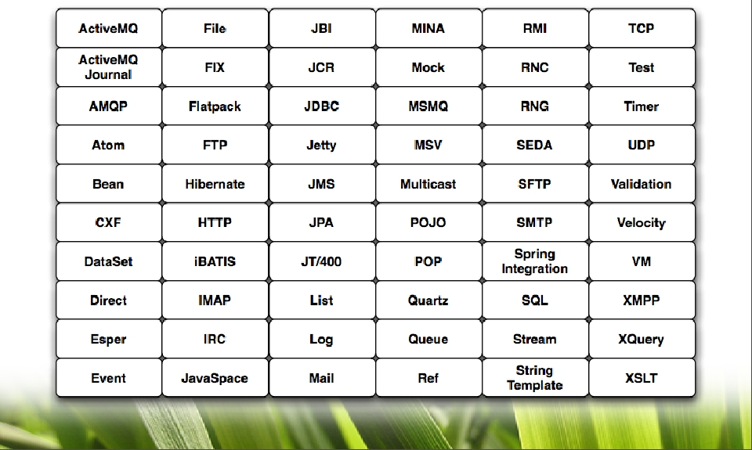
Camel Components
68

Slide 69

Message Routing Made Easy
• Java API for message routing
package com.mycompany.routes ;
public class MyRoute extends RouteBuilder {
public void conﬁgure() {
from("activemq:TEST.QUEUE").
to("ﬁle:///opt/inbox/text.txt").
to("log:MyLog?showProperties=true");
}
};
}
69

Slide 70
Message Routing Made Easy
• XML flavor as well
<camelContext id="camel"
xmlns=" http://activemq.apache.org/camel/schema/spring ">
<package>com.mycompany</package>
<route>
<from uri="activemq:example.A" />
<to uri="ﬁle:///opt/inbox/text.txt" />
<to uri=”log:MyLog?showProperties=true” />
</route>
</camelContext>
70

Slide 71
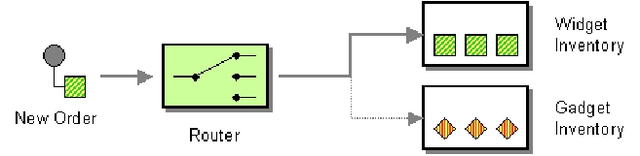

Content Based Router -
Java DSL
RouteBuilder simpleChoiceRoute = new RouteBuilder() {
public void conﬁgure() {
from("ﬁle:/opt/inbox").choice().
when(header("foo").isEqualTo("bar")).
to("activemq:QUEUE.A").
when(header("foo").isEqualTo("cheese")).
to("jbi:service:http://com/mycompany/MyService").
otherwise().
to("ﬁle:/opt/outbox-foo");
}
};
71

Slide 72

Content Based Router -
Spring DSL
<camelContext id="simpleChoiceRoute">
<route>
<from uri=" ﬁle:/opt/inbox " />
<choice>
<when>
<predicate>
<header name="foo" />
<isEqualTo value="bar" />
</predicate>
<to uri=" activemq:QUEUE.A " />
</when>
<when>
<predicate>
<header name="foo" />
<isEqualTo value="cheese" />
</predicate>
<to uri="jbi:service:http://com/mycompany/MyService" />
</when>
<otherwise>
<to uri=" ﬁle:/opt/outbox-foo " />
</otherwise>
</choice>
</route>
</camelContext>
72

Slide 73

Thank You For Attending!
• Questions and answers
Coming soon:
ActiveMQ in Action ===>
73

