Slide 1
TERA
A Movie Recommendation System

Slide 2

WHAT ?
Recommendation systems are widely used on the Web for recommending products and services for customers.

Slide 3
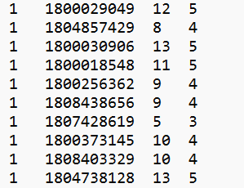
Data Used In TERA Project
User ID
Rate within 1~13
Rate within 1~5
Movie ID

Slide 4
HOW?
K-NN
Weighted slop one
SVD

Slide 5

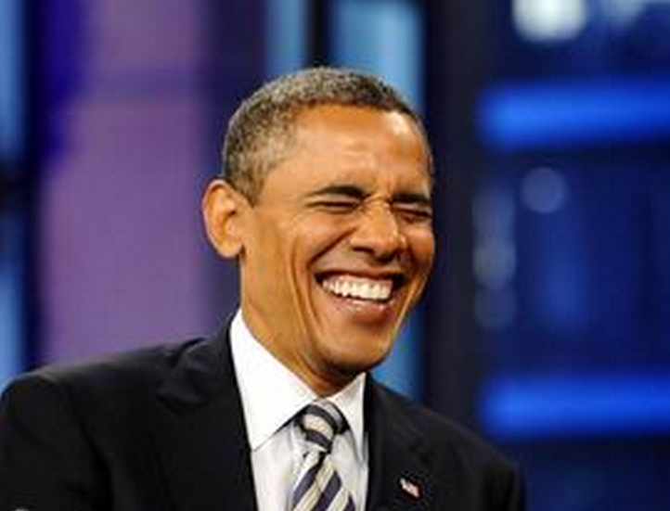
K -NN
I rate Harry Potter 10 points.
I rate Star War 10 points.
I rate The Lord of the Rings 12 points.
I also rate Harry Potter 10 points.
I also rate Star War 10 points.
Will I like the Lord of the Rings ???

Slide 6
K -NN
A 10
B 12
A 4
A 3
B 4
U2
B 5
U1
U3
C 7
recommend
C ?

Slide 7
How to measure similarity?

Slide 8
kNN (K nearest neighbor)
The idea is to use kNN model to find the users with similar tastes and preferences with the given user.
Let the record (or profile) of the target user be u (represented as a vector), and the record of another user be v (v in T).
The similarity between the 2 users are:

Slide 9
kNN (K nearest neighbor) Con’d
The similarity value was calculated by Euclidean distances and Cosine.
A Simple case:
User 1 rated movies m1 and m2 as (r1, r2)
User 2 rated the same movies m1 and m2 as (r3, r4)
The similarity can be calculated by the Euclidean formula:

Slide 10

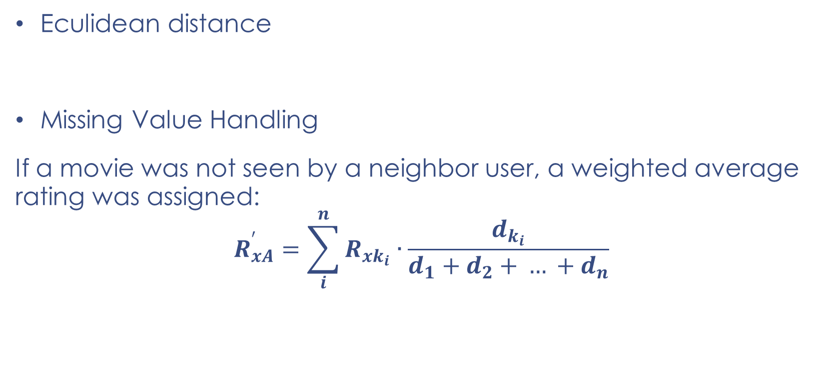
kNN (K nearest neighbor) Con’d
Eculidean distance
Missing Value Handling
If a movie was not seen by a neighbor user, a weighted average rating was assigned:
$$R_{xA}^{′}=\sum_{i}^{n}{R_{xk_{i}}∙\frac{d_{k_{i}}}{d_{1}+d_{2}{+ … +d}_{n}}}$$

Slide 11
kNN (K nearest neighbor) Con’d
Distance Function(Eculidean vs. Cosine)
Cosine distance function performs better than Eculidean distance function.
Because the dataset is really sparse. For example, suppose 2 users, say x1 and x2, they have not watched even one movie in common. So we don’t know the similarity of the two. Faced this situation, we used Cosine distance function as our Similarity measure. Actually it performs much better in our evolution.

Slide 12
Slope One (Con’d)
Introduction:
Slope One algorithms work on the intuitive principle of a “popularity differential” between movies for users. In a pairwise fashion, we determine how much better one movie is liked than another. One way to measure this differential is simply to subtract the average rating of the two movies. In turn, this difference can be used to predict another user’s rating of one of those movies, given their rating of the other.

Slide 13
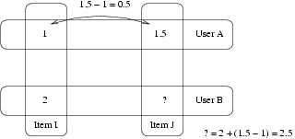
Slope One (Con’d)
An Example:

Slide 14
Slope One
Example:
User A gave a 1 to Item I and an 1.5 to Item J.
User B gave a 2 to Item I.
How do you think User B rated Item J?
The Slope One answer is to say 2.5 (1.5-1+2=2.5).

Slide 15
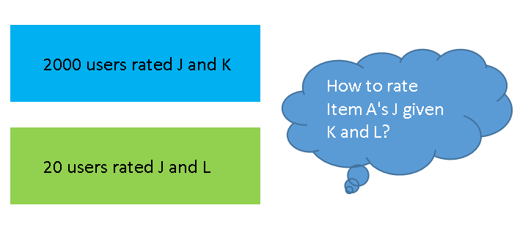
Slope One (Con’d)
Why use weighted?

Slide 16

Slope One (Con’d)
The WEIGHTED SLOPE ONE Scheme

Slide 17
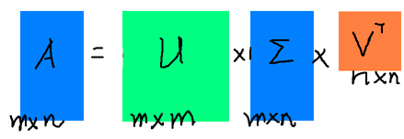
SVD (Singular Value Decomposition)
A singular value decomposition provides a convenient way for breaking a matrix, which perhaps contains some data we are interested in, into simpler, meaningful pieces.
How it works?

Slide 18
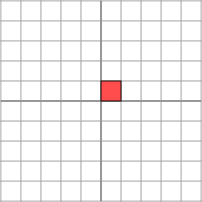
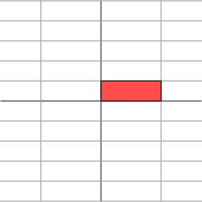

SVD (Singular Value Decomposition)
Geometrically, we may think of a matrix like this as taking a point (x, y) in the plane and transforming it into another point using matrix multiplication:

Slide 19
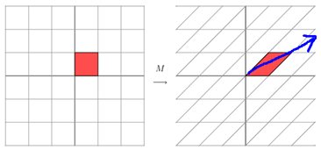
SVD (Singular Value Decomposition)
If the Matrix is not symmetric:

Slide 20
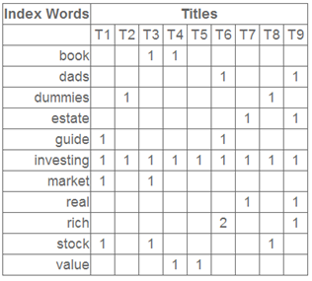
SVD (Singular Value Decomposition)
A Concrete example:

Slide 21
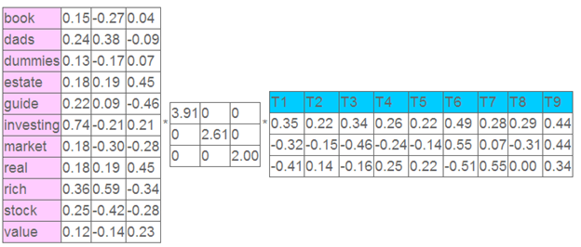
SVD (Singular Value Decomposition)
After SVD:

Slide 22
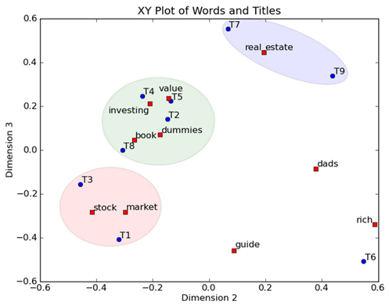
SVD (Singular Value Decomposition)

Slide 23
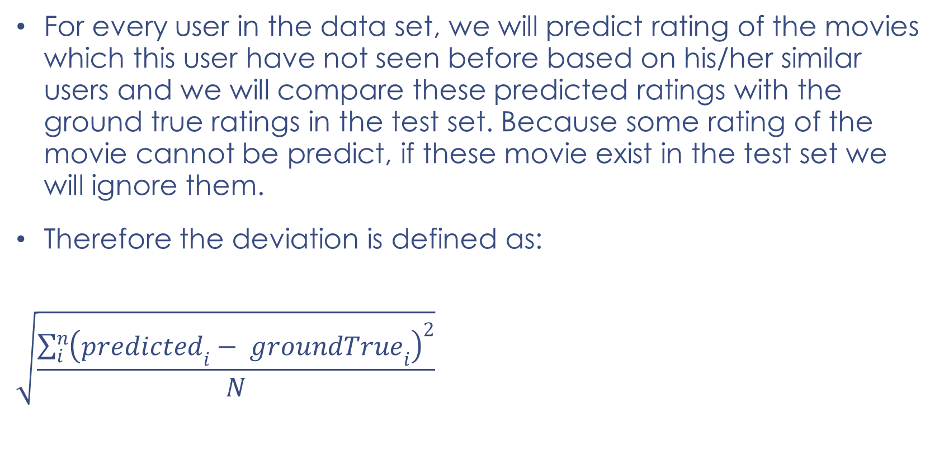
Evaluation
For every user in the data set, we will predict rating of the movies which this user have not seen before based on his/her similar users and we will compare these predicted ratings with the ground true ratings in the test set. Because some rating of the movie cannot be predict, if these movie exist in the test set we will ignore them.
Therefore the deviation is defined as:
$$\sqrt{\frac{\sum_{i}^{n}{{\left({predicted}_{i}− {groundTrue}_{i}\right)}^{2}}}{N}}$$

Slide 24
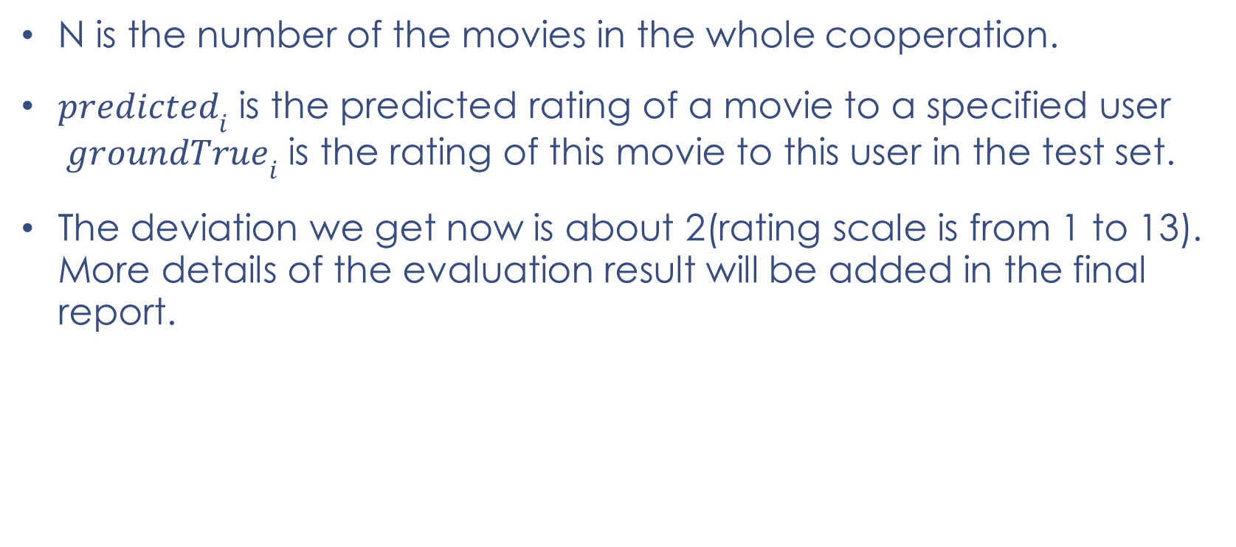
Evaluation Con’d
N is the number of the movies in the whole cooperation.
${predicted}_{i}$ is the predicted rating of a movie to a specified user ${groundTrue}_{i}$ is the rating of this movie to this user in the test set.
The deviation we get now is about 2(rating scale is from 1 to 13). More details of the evaluation result will be added in the final report.

Slide 25
References
Ron Zacharski, http://guidetodatamining.com
Eyrun A. Eyjolfsdottir, Gaurangi Tilak, NanLi, “MovieGEN: A Movie Recommendation System”
Daniel Lemire, Anna Maclachlan, “Slope One Predictors for Online Rating-Based Collaborative Filtering”
JONATHAN L. HERLOCKER, JOSEPH A.KONSTAN, LOREN G. TERVEEN, JOHNT. RIEDL, “Evaluating Collaborative Filtering Recommender Systems”
Kaggle Wiki, Root Mean Squared Error (RMSE)

Slide 26

Any questions?

Slide 27
Thank you!
The End

