Slide 1
Two predictions for every Olist order
GROUP 11
A baseline pipeline (A) for every order, then an improved pipeline (B) built from A’s limits and adopted inside the seven largest states.
Regression · delivery lead time · test MAE in days
Classification · detractor alert · test AP
3.30 B vs 4.03 A
0.197 B vs 0.178 A
ZHANG HANG · YU SUMIN · WU QIANZONG · SII TOH SIM
NUS · IT5006
Notes:
0:20. Good evening, we are Team 11. For every Olist order we make two predictions: how many days delivery will take, and whether the customer will leave a one- or two-star review. We built a baseline, Pipeline A, found its limits in its own evidence, and built Pipeline B to answer them.

Slide 2
Each prediction is made when the business can act
PROBLEM AND METRICS
 | Regression · delivery lead time | Classification · detractor alert
Target | Days from purchase to delivery, on the log scale | Lowest valid review score is 1 or 2
Moment | At checkout | A: at checkout · B: at carrier handover
User | Fulfilment shows a delivery range | Customer service contacts customers at risk
Metric | MAE in days; RMSE, R², share within 3 days | Average precision; ROC-AUC, Brier, precision, recall
Error cost | A late promise breaks expectations | One missed detractor = five false alerts (assumed), so alert above 1/6
Yardstick | Dummy (median): test MAE 4.38 days | Detractor share: 9.9% on the test, 14.8% in development
Team 11 · IT5006 · 2/16 · Report section 1
Notes:
0:35. Each prediction is made when someone can act on it. Lead time is predicted at checkout, when fulfilment shows the customer a delivery range, and we judge it by mean absolute error in days. The review alert is for customer service. Detractors are a minority, 9.9% of test orders, so accuracy would mislead and we use average precision. We weight a missed detractor as five false alerts, which puts the alert threshold at one in six.

Slide 3
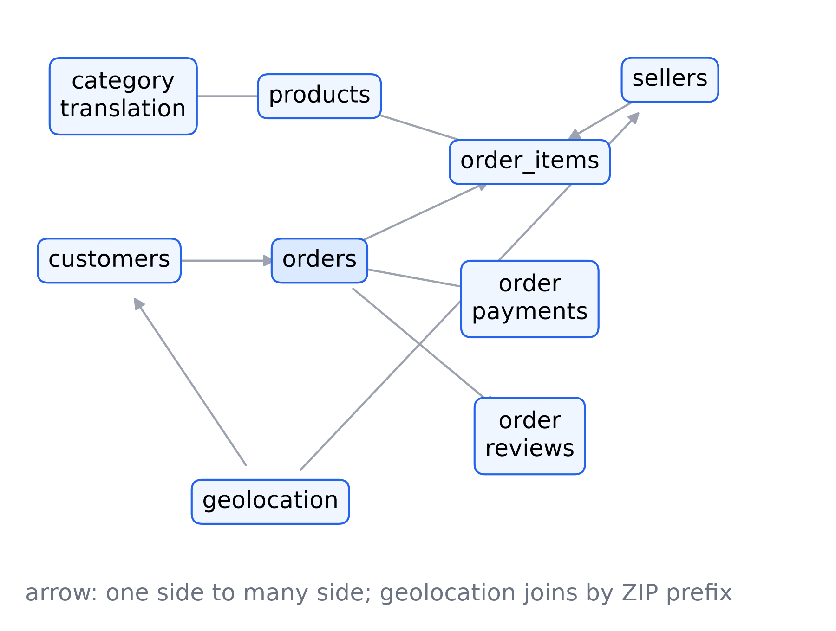
Nine tables become one row per order
DATA, JOINS AND LEAKAGE
Aggregate first
Items, payments and reviews are reduced to one row per order, then joined one to one
Primary item
The highest-priced item gives the category and the seller
Customers
Matched on customer_unique_id: one customer stays on one side of every split
Leakage rule
A predictor must exist at the prediction moment; Olist’s estimated date is never used
Team 11 · IT5006 · 3/16 · Report section 3 · join diagram from Pipeline A’s data stage (B-G-13)
Notes:
0:35. Olist ships nine tables. Items, payments and reviews have several rows per order, so each is reduced to one row per order before the join, and the join stays one to one. Customers are matched on customer_unique_id, so the same person never sits on both sides of a split. The leakage rule: a column is a predictor only if it exists at the prediction moment. Delivery, carrier and review fields never are.

Slide 4
Every learned step is fitted on the training fold only
PREPROCESSING
Step | Rule | Why
Missing numbers | Training-fold median plus a missing indicator | Tells a filled value from a real one
Missing categories | Their own “Unknown” level | No row dropped
Skew | log(1 + x): money, size, distance, days | Long right tails
Late tail | Kept; predict log(1 + lead time) | Very late orders are real
Encoding | One-hot; linear models drop one level | Full-rank design matrix
Scaling | Standardised, linear and logistic only | Comparable coefficients
Test period | Newest 20%, held out first, read once | Unbiased final score
Pipeline A development orders
One pipeline per fold
76,925 lead time · 77,736 alert
All steps sit inside one scikit-learn pipeline, cloned for each model
Team 11 · IT5006 · 4/16 · Report section 3
Notes:
0:35. Every learned step, imputation, encoding and scaling, sits inside one scikit-learn pipeline fitted on the training fold only and cloned for each model, so no validation or test statistic reaches a model. Missing numbers get the fold median and an indicator; skewed amounts get a log. We keep the late tail, because very late orders are real customers, and model the log of lead time instead. The newest 20% of orders were held out first and read once.

Slide 5
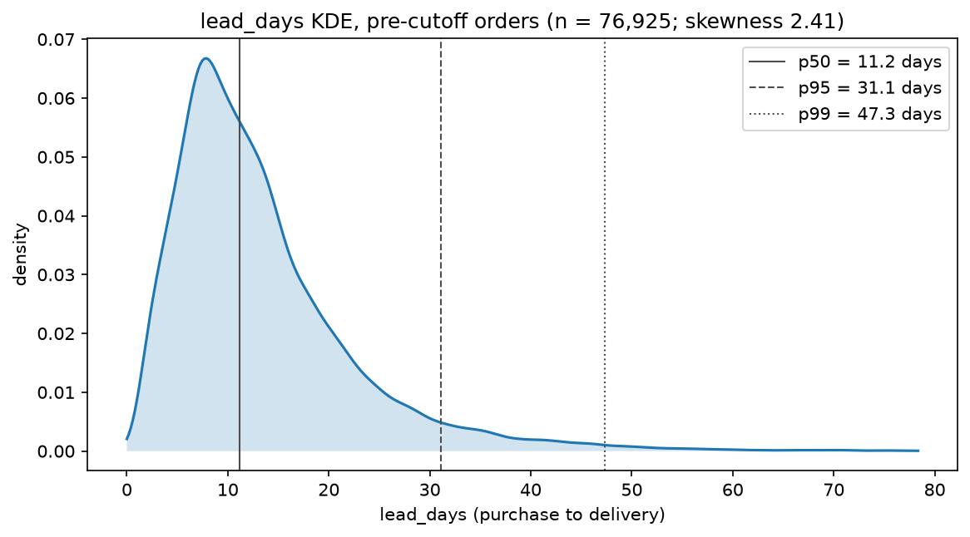
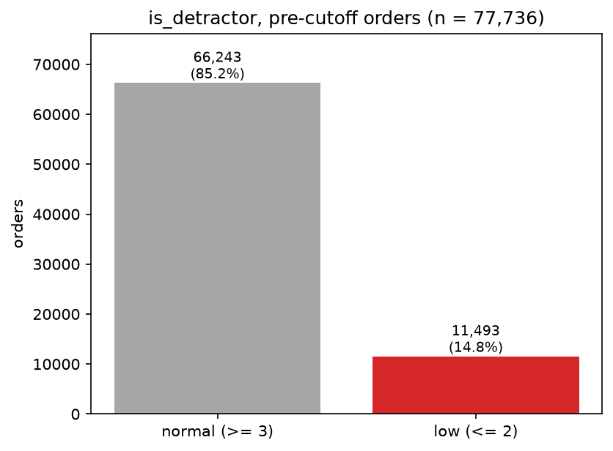
Lead time is skewed; detractors are a minority
EXPLORATION · BOTH TARGETS
Regression · lead time, development orders
Classification · detractor share
Regression
Classification
Both
Median 11.2 days, skewness 2.41: log target, judged by MAE
14.8% are detractors: judged by AP, not accuracy
Development orders only; the test period was never explored
Team 11 · IT5006 · 5/16 · Report section 4 · Pipeline A EDA (stage 3)
Notes:
0:35. Two findings shaped the models. Lead time is skewed: median 11.2 days, skewness 2.41, hence the log target and MAE. And 14.8% of development orders are detractors, hence average precision, not accuracy. All exploration used development orders only; the test period was never looked at.

Slide 6
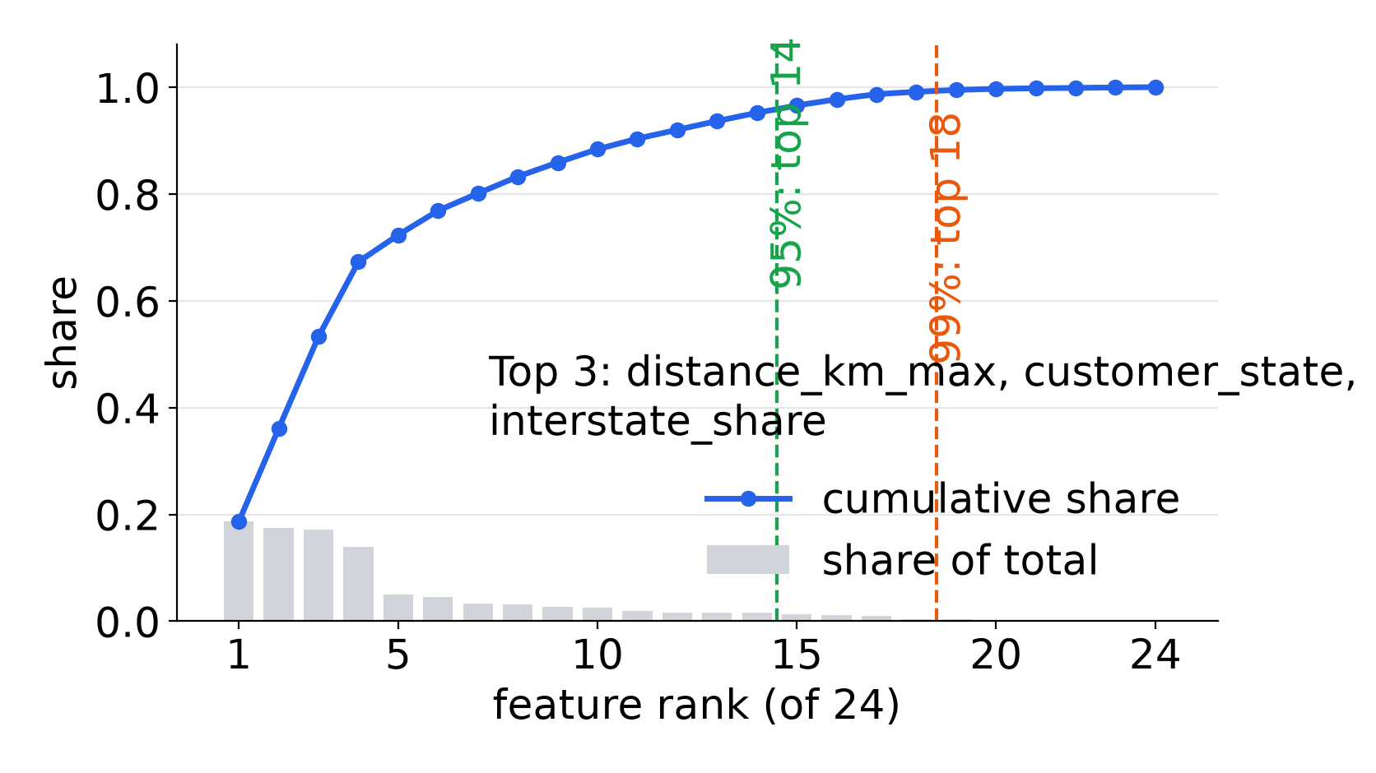
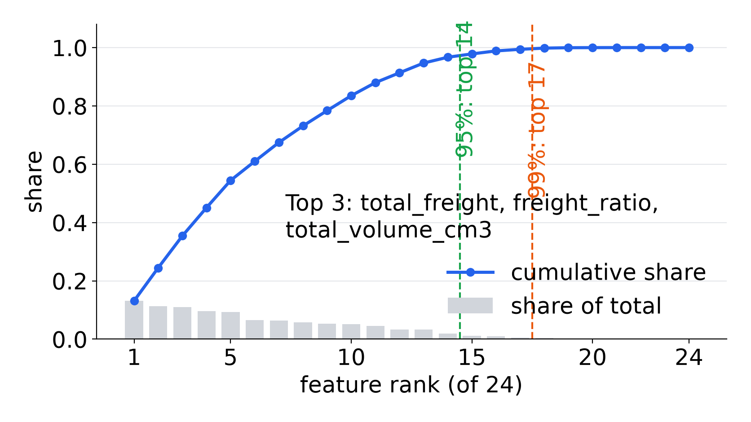
24 checkout predictors, screened and ranked
PIPELINE A · BASELINE FEATURES
Basket · price and freight · size and product · geography (states, distance, interstate share) · calendar and payment · alert only: photos, description length, seller’s earlier score
Regression · lead time: ranking and cumulative share
Classification · alert: ranking and cumulative share
Team 11 · IT5006 · 6/16 · Report section 5.1 · Pipeline A EDA screening (stage 3)
Notes:
0:30. Pipeline A, the baseline, uses 24 predictors known at checkout: basket, price and freight, size, product, geography, calendar and payment. Each candidate was ranked by its association with the target. Notice what is missing: nothing about how this seller or this route has delivered recently.

Slide 7
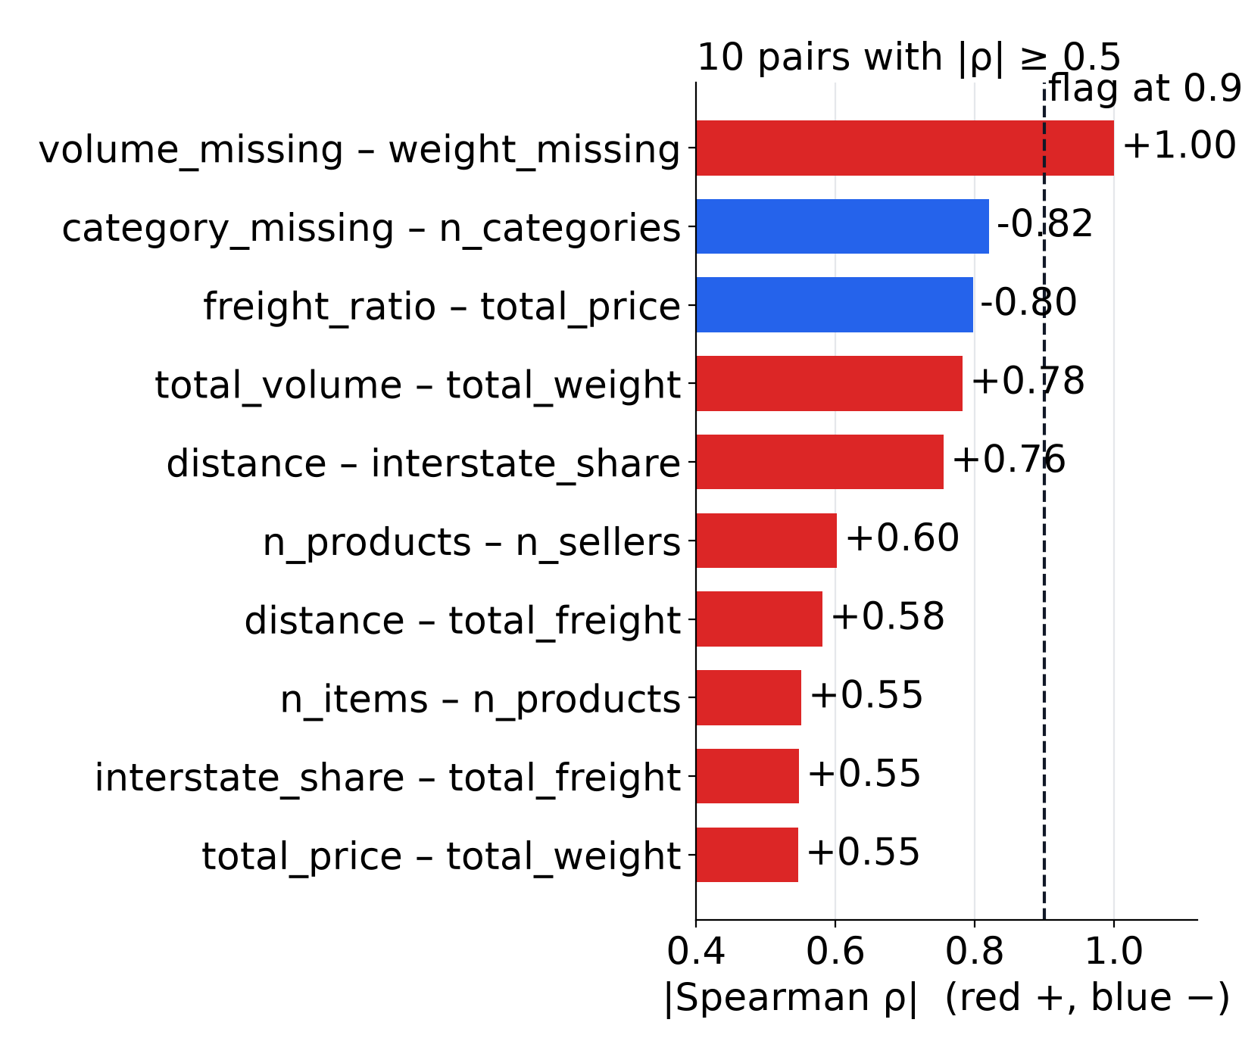
Correlated features go first, then a 99% rule
PIPELINE A · MULTICOLLINEARITY AND SELECTION
Multicollinearity
Flag |r| above 0.9 or VIF above 10. No VIF reached the cut. One identical pair, missing weight and missing volume shares: the lower-ranked one is dropped.
Selection
Rank by association (Spearman for lead time, mutual information for the alert); keep features until 99% of the cumulative score.
Team 11 · IT5006 · 7/16 · Report sections 5.2, 5.3, appendix J · heatmap: Pipeline A EDA (stage 3)
Notes:
0:35. Before selection we check multicollinearity. We flag pairs above 0.9 correlation and features with a variance inflation factor above 10. No feature reached the VIF cut; one pair was identical, missing weight and missing volume, and we dropped one of them. Then a simple rule keeps the smallest set of features that carries 99% of the ranked signal.

Slide 8
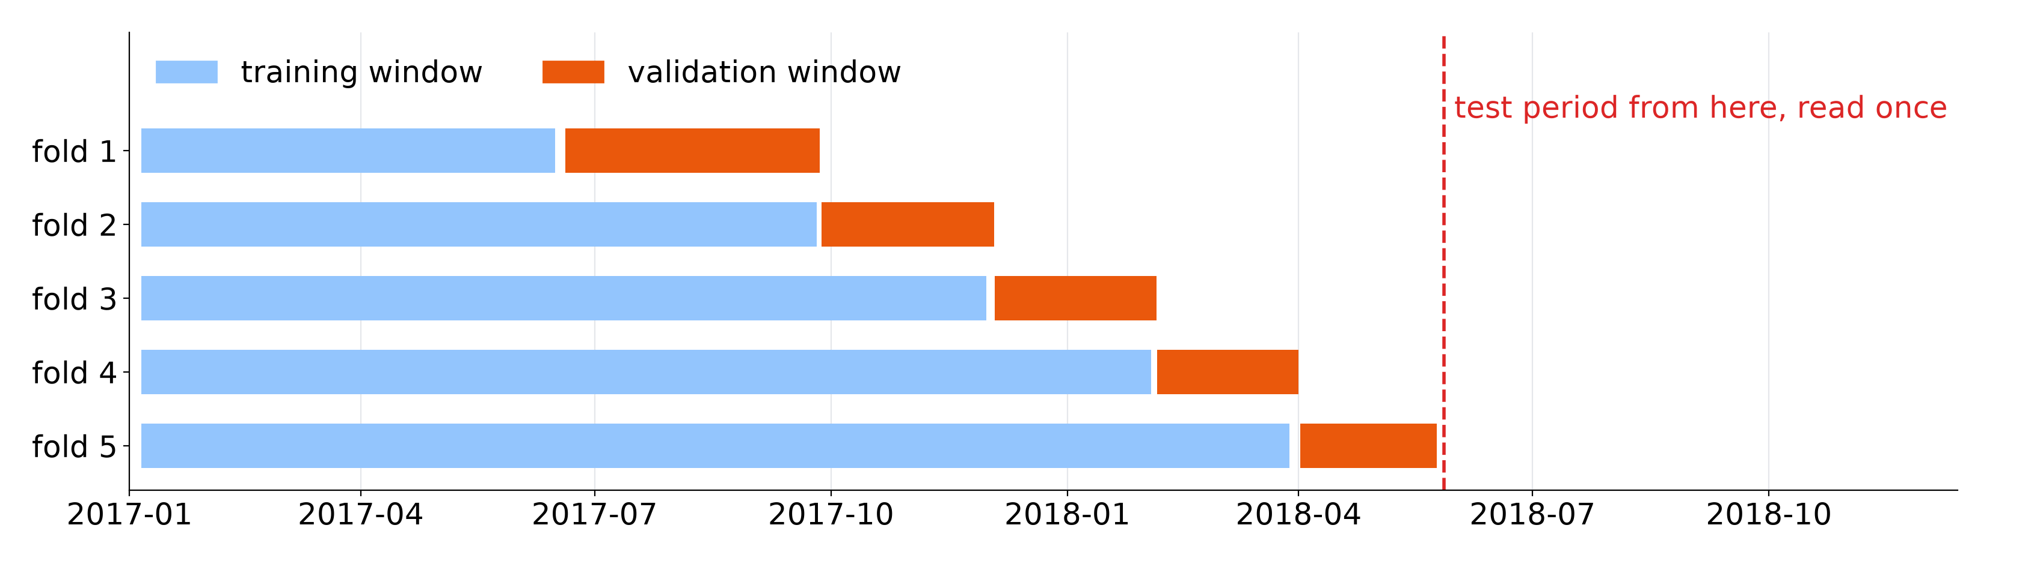
Time-ordered folds; simple models first
PIPELINE A · VALIDATION AND MODEL LADDER
Folds
Ladder
Regression · val. MAE
Classification · val. AP
Five expanding folds; customers purged; labels known before each window
Dummy, linear or logistic, tree, forest; simplest within one SE
5.47 days vs 6.49 dummy
0.232 vs 0.148 dummy
Team 11 · IT5006 · 8/16 · Report sections 6.1–6.4 · fold chart: regression, A’s boundaries · validation scores are selection scores
Notes:
0:35. Validation uses five time-ordered folds: train on the past, validate on the following weeks, with returning customers removed from training. A random split would train on the future. Models climb a ladder from a dummy to linear or logistic, a tree and a forest, and we keep the simplest within one standard error. The baseline clearly beats its dummy: MAE 5.47 against 6.49 days, AP 0.232 against 0.148.

Slide 9
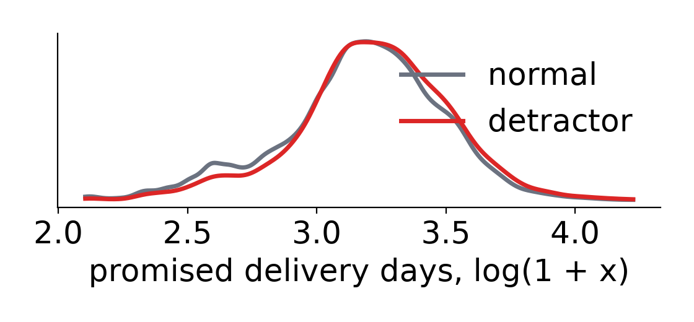
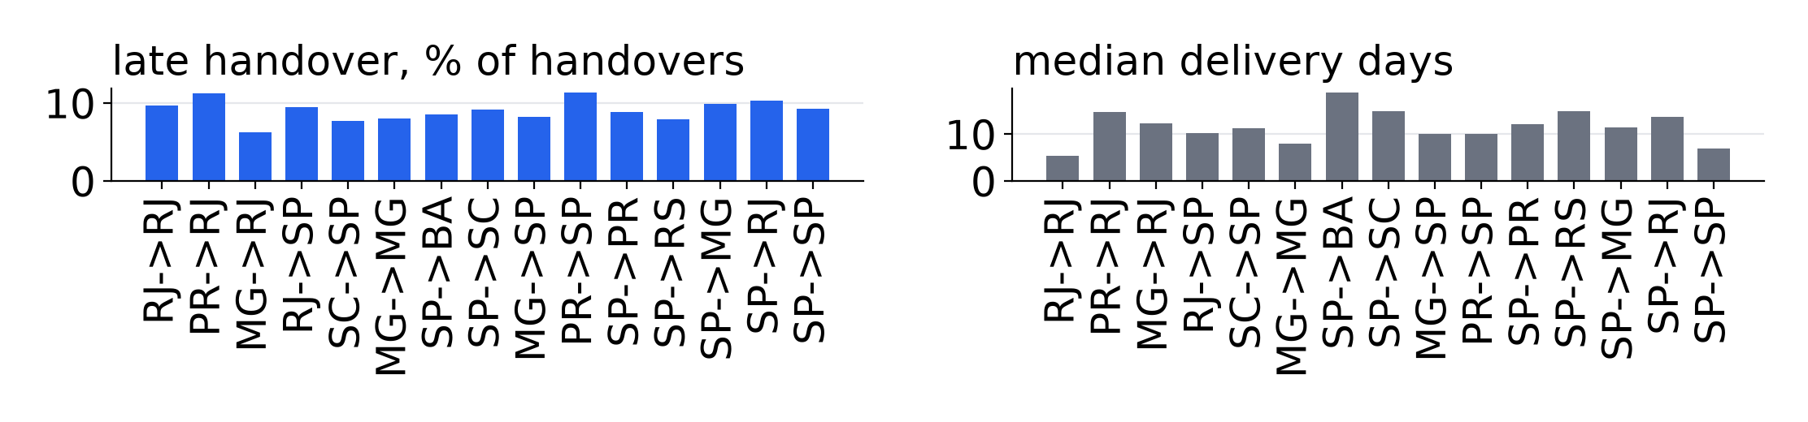
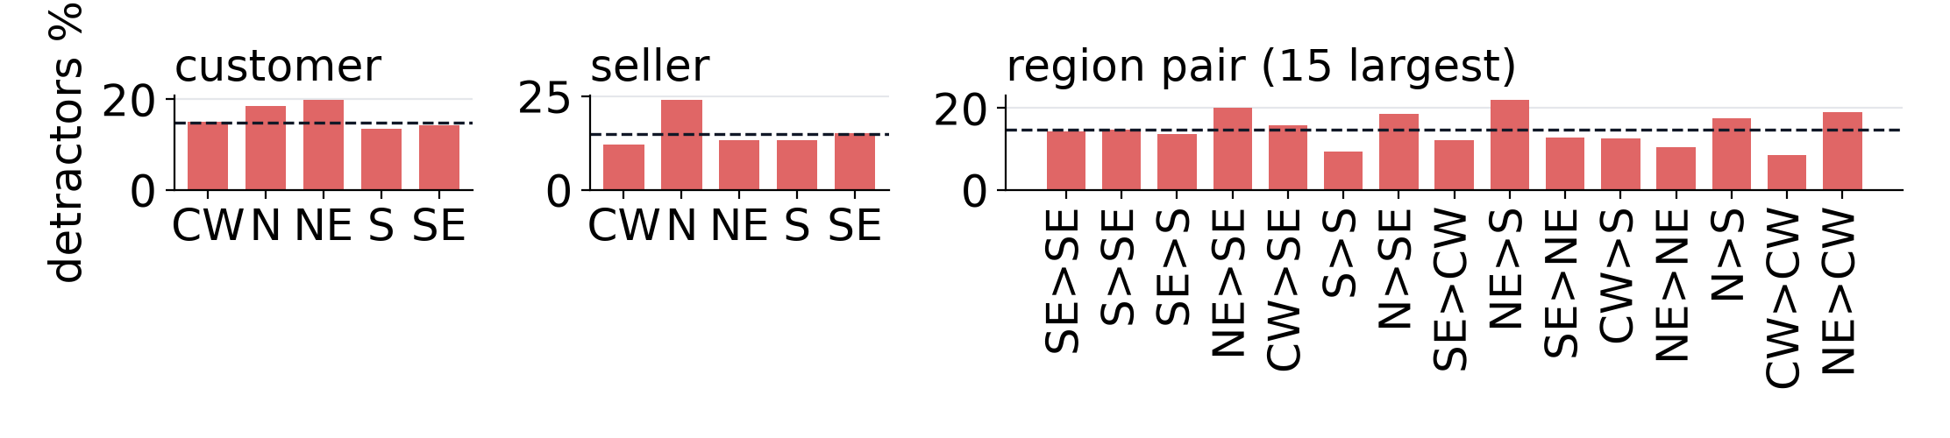
What the baseline cannot see at checkout
PIPELINE A · THREE LIMITS, FROM EXPLORATION
1 · Lateness unknown
2 · Speed depends on route and time
57.2% detractors if late vs 9.5% on time
Median 7.8 days to SP vs 27.1 to AM; orders 4,478 to 7,284, Oct to Nov 2017
3 · Distant regions are noisier
Detractor rates swing most on thin, long routes
Team 11 · IT5006 · 9/16 · Report sections 1.1 and 4 · charts 1 and 3: Pipeline A EDA screens 3.11, 3.12; chart 2: B’s data stage
Notes:
0:45. But A's own evidence showed three limits. One: late delivery goes with bad reviews, 57.2% detractors when late against 9.5% on time, yet at checkout lateness is unknown. Two: speed depends on the route and changes over time, from a median of 7.8 days to Sao Paulo to 27.1 to Amazonas, and checkout features carry no recent behaviour. Three: thin, distant routes are noisy and one model fits them poorly. Each limit points to one change in Pipeline B.

Slide 10
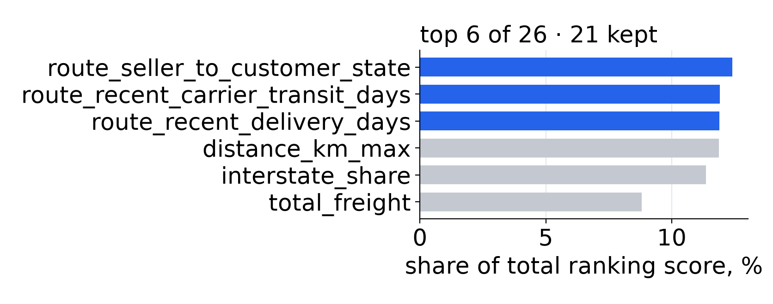
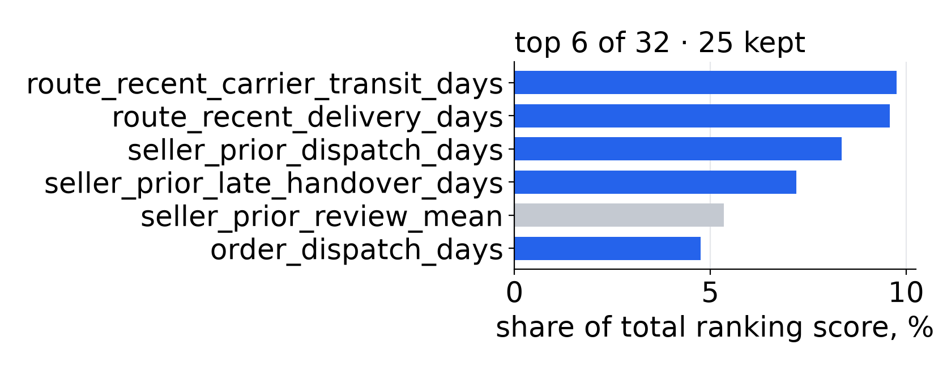
Recent seller and route history rank at the top
PIPELINE B · NEW FEATURES
New feature | What it measures | Answers A’s limit
Route | Seller state to customer state | 2 · speed depends on route and time
Seller history | Prior late-handover rate and days, dispatch days | 2 · speed depends on route and time
Route history | Delivery and transit days, last 3 weeks (0.5/0.3/0.2) | 2 · speed depends on route and time
Alert at handover | This order’s handover lateness and dispatch days | 1 · lateness unknown at checkout
Regression · lead time (blue bars: B’s new features)
Classification · alert (blue bars: B’s new features)
Team 11 · IT5006 · 10/16 · Report sections 5.1, 5.3 · history uses only other orders, never this order’s outcome
Notes:
0:40. Pipeline B answers the first two limits. New features describe the route and the recent history of the seller and the route: late handovers, dispatch days, recent delivery and transit times, computed only from other orders completed in earlier weeks. For the alert, B moves to carrier handover, where this order's own dispatch delay is known. In both tasks the new features rank at the top.

Slide 11
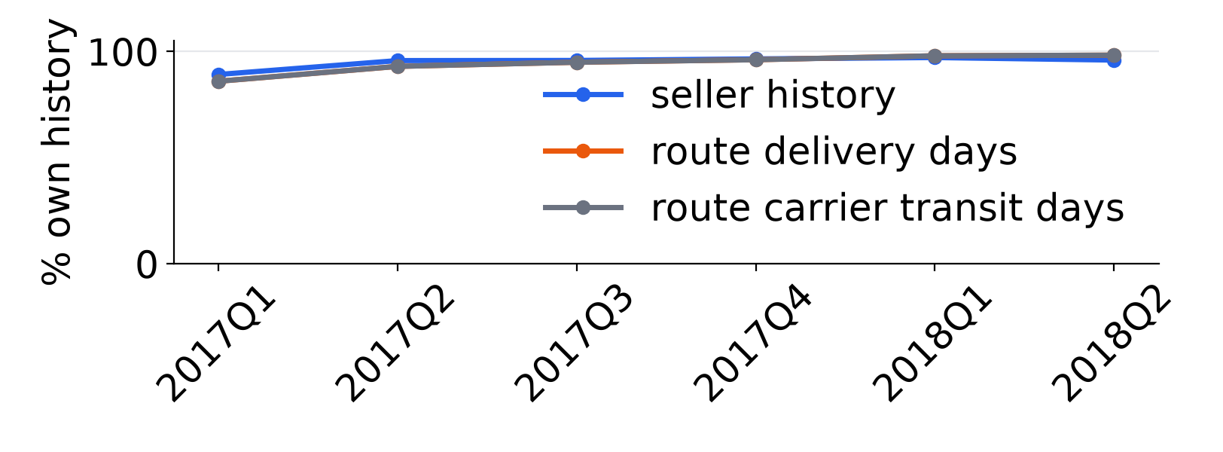
Seven states, nested states removed, plain models kept
PIPELINE B · SCOPE, MULTICOLLINEARITY AND MODEL
B’s orders | Lead time | Alert
A’s development orders | 76,925 | 77,736
Outside the seven states | − 13,777 | − 13,983
Distance unknown | − 606 | − 618
Above B’s lead-time cap | − 45 | —
Never handed over | — | − 461
Reviewed before handover | — | − 146
History warm-up, six weeks | − 1,264 | − 1,270
B’s development orders | 61,233 | 61,258
Test orders | 15,422 | 15,492
Multicollinearity
The route fixes both states, so the state columns go; the constant missing-distance share too. Full rank in every fold.
Model
Same folds and ladder as A; the forest is within one SE, so plain linear and logistic are kept.
Team 11 · IT5006 · 11/16 · Report sections 3, 5.1, 5.2, 6.2–6.4 · A’s frozen model serves every order outside the seven states
Notes:
0:35. The third limit is answered by scope: B serves the seven largest states with a known distance, 61,233 development orders for lead time, and A's frozen model serves every other order. Inside the scope, the route fixes both states, so the state columns are dropped to keep the design matrix full rank. The same ladder and one-standard-error rule again keep the plain linear and logistic models.

Slide 12
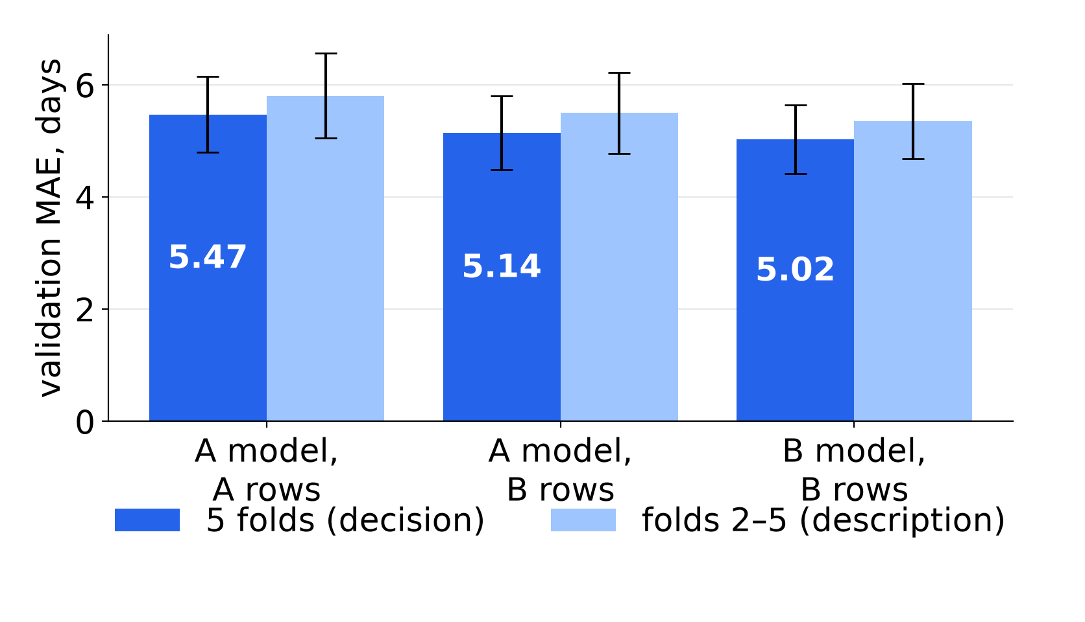
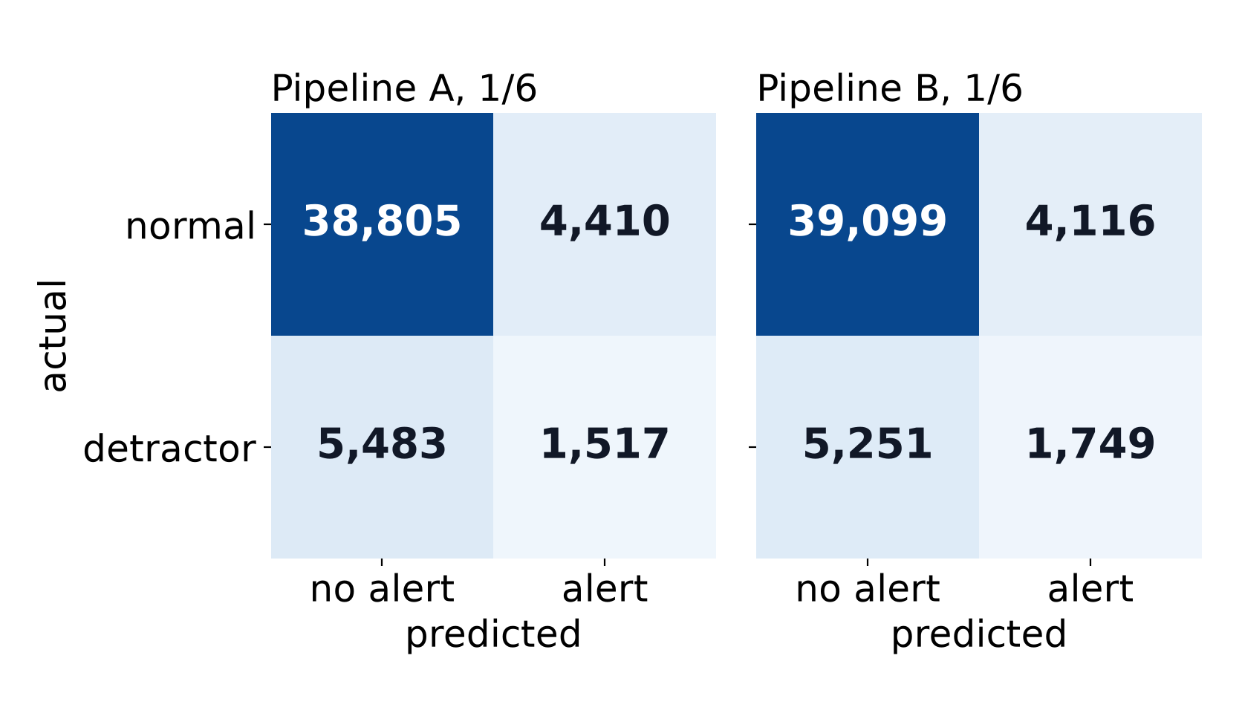
B beats A on the folds; scope and features split the gain
VALIDATION · A VS B ON B’S ROWS
Regression · lead time · validation MAE in days
Classification · detractor alert · confusion matrices at 1/6
A all states 5.470 · A on B’s rows 5.142 · B 5.025: most of the gain is scope
A all states 0.232 · A on B’s rows 0.230 · B 0.248: the gain is features and timing
Team 11 · IT5006 · 12/16 · Report sections 6.5, 7.3 · validation scores are selection scores; adoption rule fixed before the test
Notes:
0:40. Before touching the test, we fixed the adoption rule: B must beat A on the same folds. It did, in every fold of both tasks. For lead time most of the gain is scope: A improves from 5.470 to 5.142 days on B's rows, and B reaches 5.025. For the alert, scope changes almost nothing; the gain comes from the new features and the later moment.

Slide 13
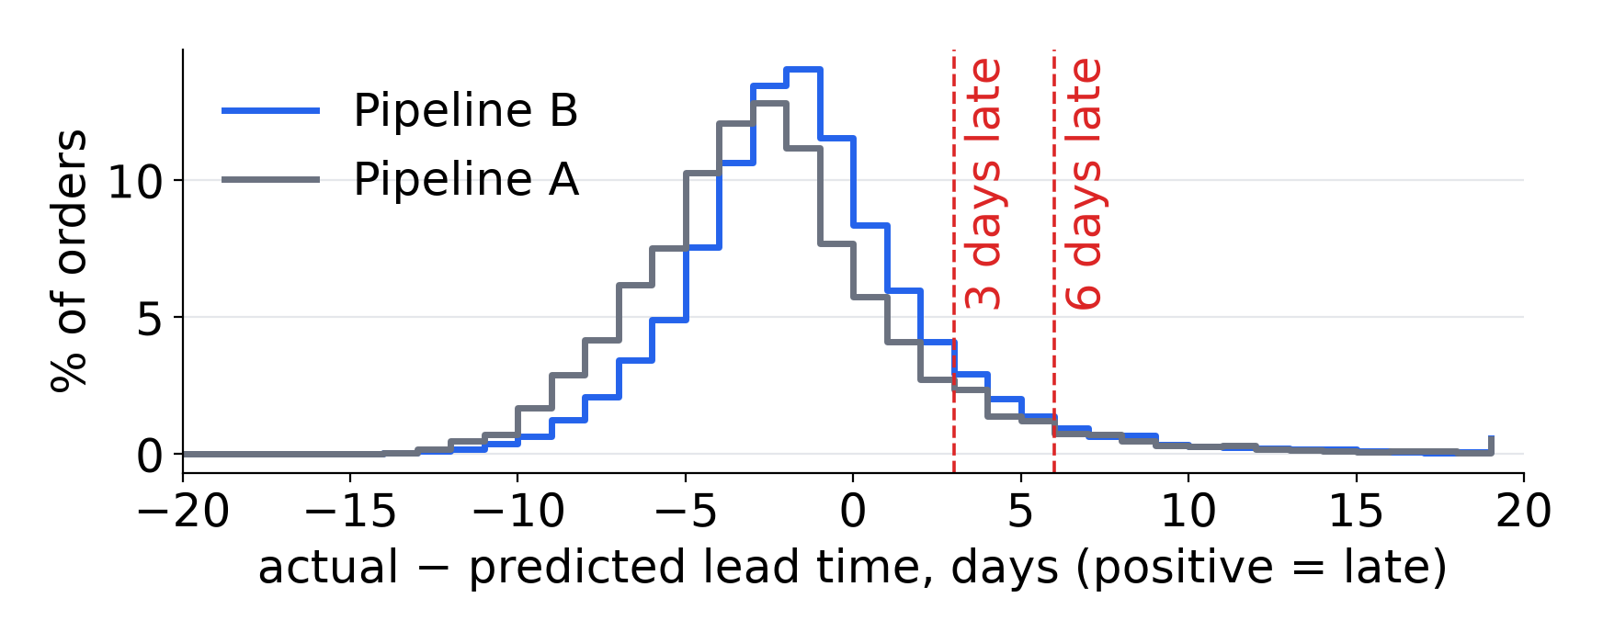
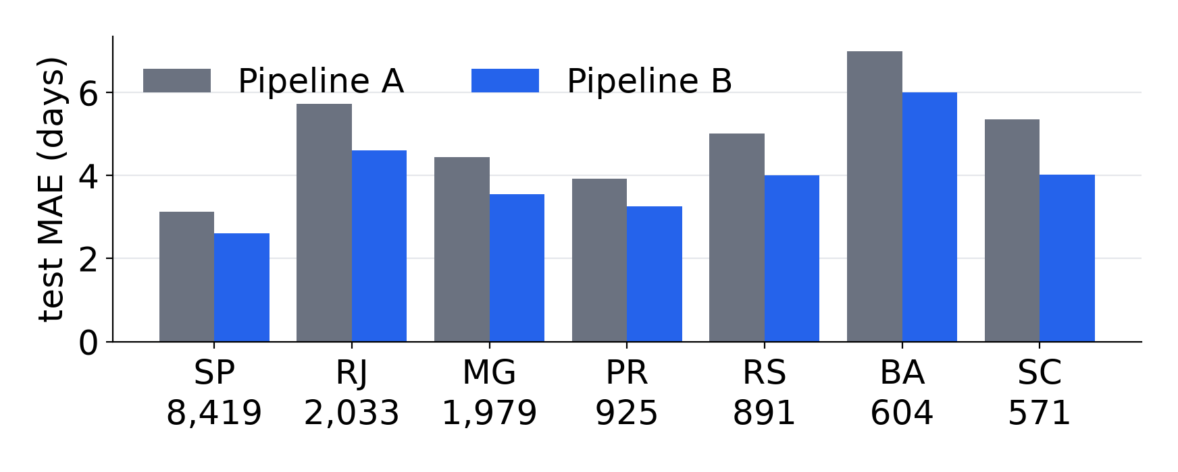
B’s promise errors are smaller on the same orders
TEST · REGRESSION · DELIVERY LEAD TIME
Test, read once | B | A
MAE, days | 3.30 | 4.03
MAE 95% interval | 3.24–3.35 | —
B − A | -0.729 [-0.754, -0.703]
Within 3 days | 57.6% | 44.3%
More than 3 days late | 11.1% | 9.3%
More than 6 days late | 4.7% | —
Mean residual, val → test | +2.9 → -1.1 | —
Dummy MAE | 4.38
Routes where B is better | 20 of 20
Team 11 · IT5006 · 13/16 · Report section 7.1 · 15,422 test orders, read once
Notes:
0:40. Then the test, read once. On the same orders B's error is 3.30 days against 4.03 for A; the difference, -0.729 days, has a 95% interval that excludes zero, and B is better on all 20 routes judged. 57.6% of orders land within three days. One caveat: B leaves slightly more orders more than three days late, so the promise needs a buffer.

Slide 14
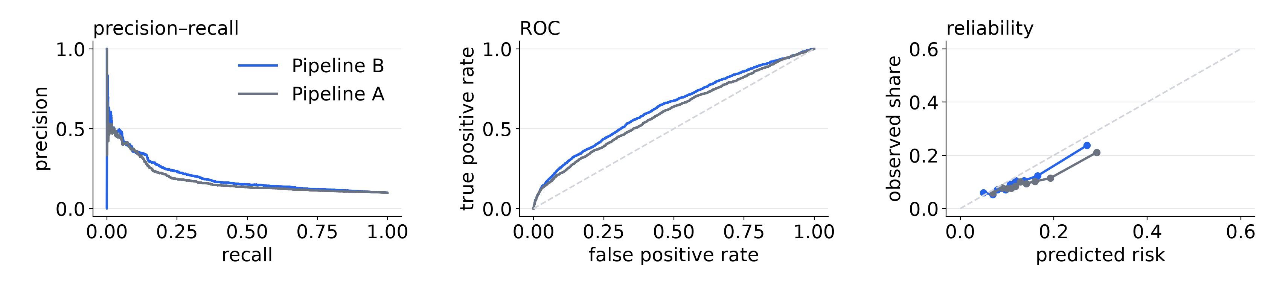
B ranks likely detractors better on the same orders
TEST · CLASSIFICATION · DETRACTOR ALERT
Ranking | B, handover | A, checkout
Average precision | 0.197 | 0.178
AP 95% interval | 0.181–0.218 | —
B − A | +0.0187 [+0.0089, +0.0291]
ROC-AUC | 0.636 | 0.604
Brier (lower is better) | 0.0867 | 0.0893
B at a threshold | Alerts a day | Precision | Recall
Frozen 1/6 | 23.2 | 0.208 | 0.300
Operating 4/15 | 5.6 | 0.346 | 0.121
1,541 detractors among 15,492 test orders (9.9%)
Team 11 · IT5006 · 14/16 · Report section 7.2 · 4/15 chosen after the test; the frozen 1/6 is the unbiased result
Notes:
0:40. For the alert, B's average precision is 0.197 against 0.178, with an interval above zero, and ROC-AUC and Brier agree. Part of the gain is the later moment: B scores at handover, A at checkout. The frozen threshold of one in six is the unbiased result. After the test, the business chose four in fifteen to cut false alarms: 5.6 alerts a day at precision 0.346.

Slide 15
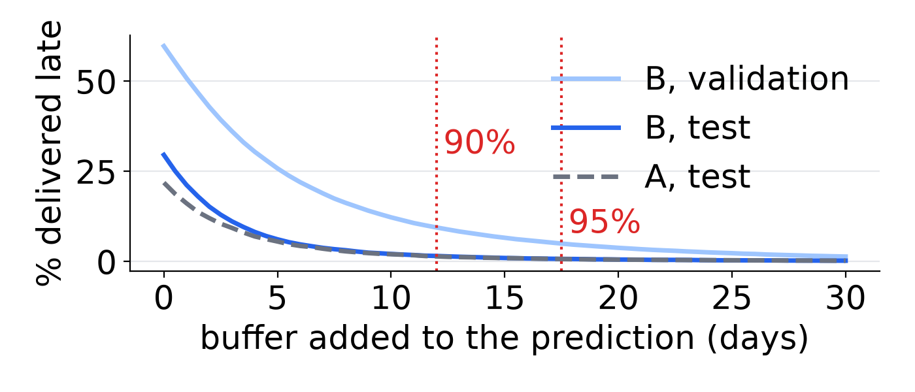
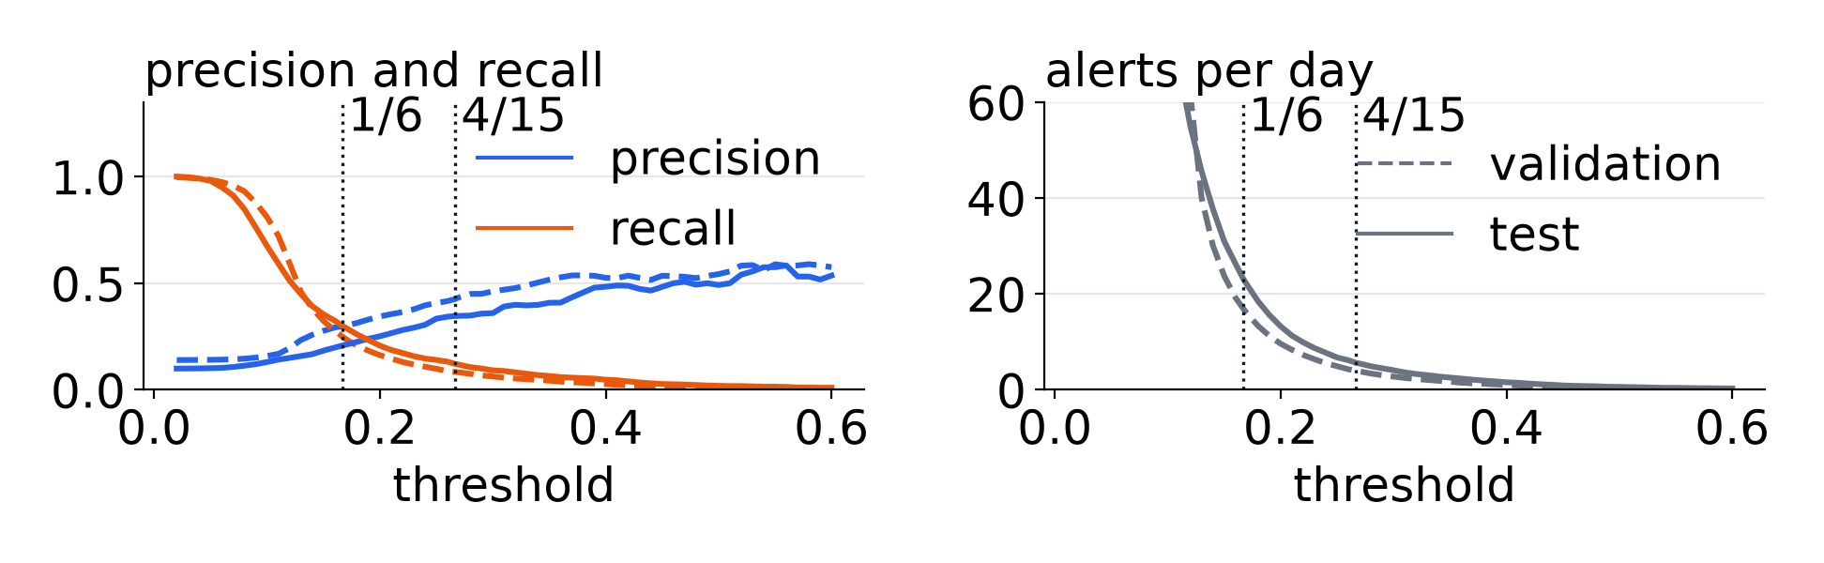
What operations can do now, shown live next
USE, DEPLOYMENT AND LIMITS
Regression · promise buffer
Classification · alert threshold
Promise a range
Alert at handover
A 12.0-day buffer leaves 1.5% late on the test; 17.5 days leaves 0.7%
B at 4/15: 5.6 a day, precision 0.346; with A’s fallback: 20.5 a day, 0.192
Flag missed dispatch
Limits
Precision 21.2%; catches 16.8% of all detractors
4/15 set after the test; faster test period; seven states; associations, not causes
Team 11 · IT5006 · 15/16 · Report sections 8–10 · each prediction carries a badge naming its model
Notes:
0:40. What can operations do now? Promise a range: a 12.0-day buffer, chosen on validation, left 1.5% of test orders late. Alert at handover: with A's fallback outside the seven states, about 20.5 alerts a day; the 6-a-day review cap applies to B alone, and the team accepted the higher combined volume. Flag missed dispatch with a simple rule. Limits: four in fifteen was chosen after the test, the test period was faster than development, and these are associations, not causes. Let me show you the app.

Slide 16
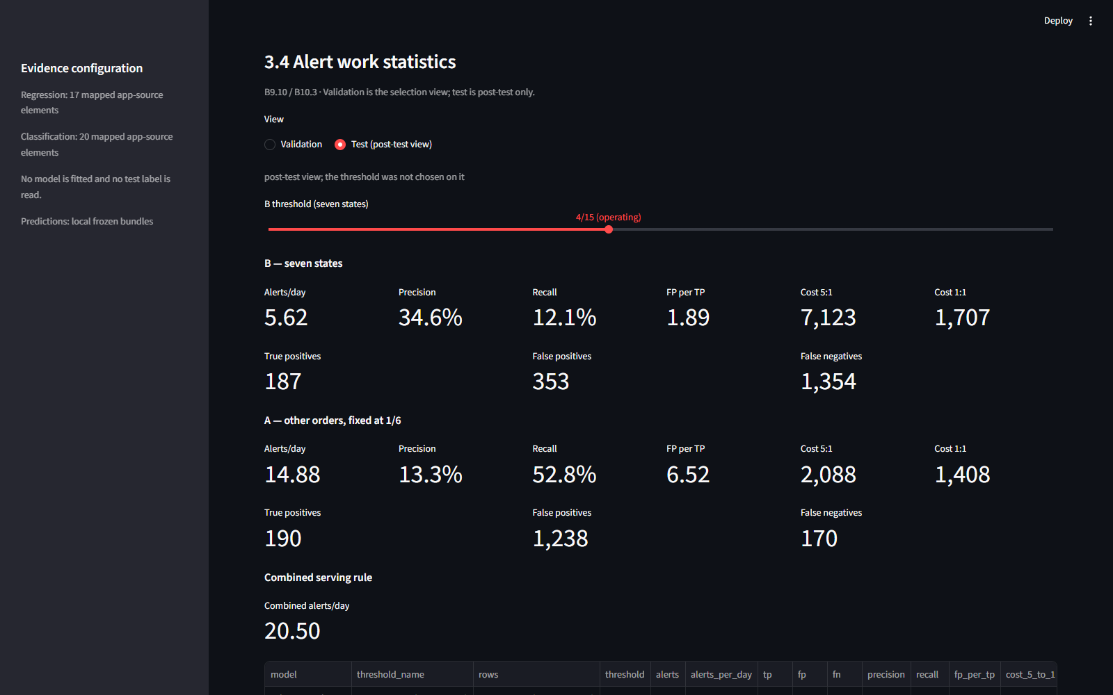
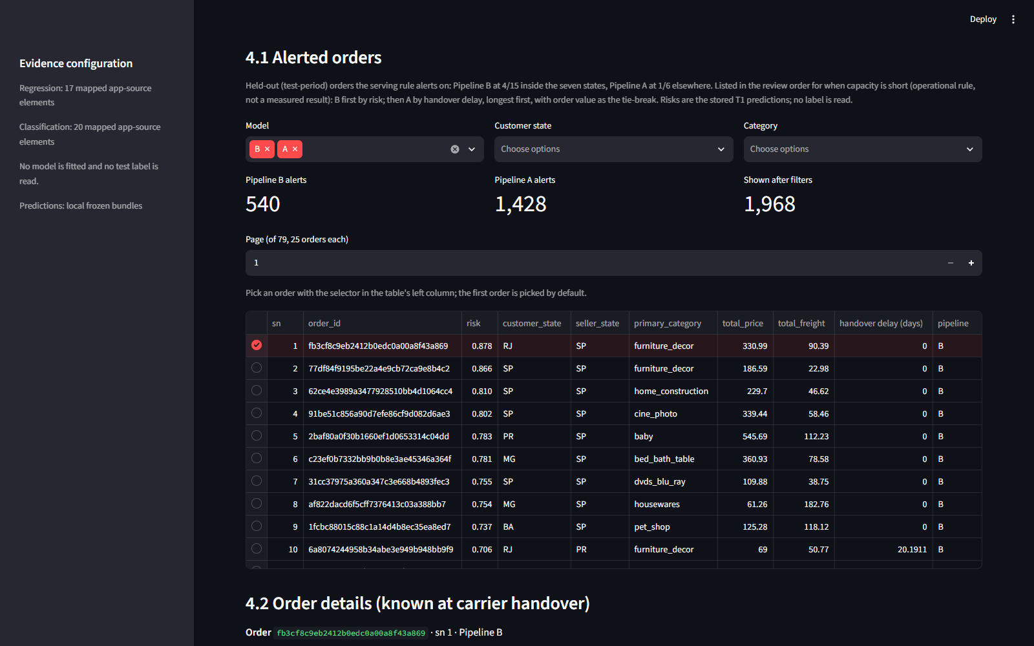
The same frozen models, live for operations
DEPLOYED APP · STREAMLIT
Detractor tab · alert statistics on the test period at 4/15
ML deployment tab · alerted held-out orders
App https://it5006grp11ecommerce.streamlit.app/
Code https://github.com/wuqianzong/Team11_IT5006_Ecommerce_Analytics_AY2627Sem1
Team 11 · IT5006 · 16/16 · Report section 8 and appendix L · scores held-out orders only; no test label is read
Notes:
0:20. This is the app we just showed, in case the live demo is slow. The detractor tab gives the alert statistics on the test period at the operating threshold, and the ML deployment tab lists the alerted held-out orders in review order. It runs the same frozen models as the report; the link and the code are on this slide.

