Slide 1
Two predictions for every Olist order
GROUP 11
A baseline pipeline (A) for every order, then an improved pipeline (B) built from A’s limits and adopted inside the seven largest states.
Regression · delivery lead time · test MAE in days
Classification · detractor alert · test AP
3.30 B vs 4.03 A
0.197 B vs 0.178 A
Olist’s own estimate: 12.62
ZHANG HANG · YU SUMIN · WU QIANZONG · SII TOH SIM
NUS · IT5006
Notes:
0:15. Good evening, we are Team 11. For every Olist order we predict how many days delivery will take, and whether the customer will leave a one- or two-star review. Our delivered model is off by 3.30 days on average; Olist's own estimate is off by 12.62.

Slide 2
Growth stalled when delivery broke; two models act before the damage
BUSINESS PROBLEM
Growth stalled
Service broke
Retention low
Revenue 2.5× from Mar 2017 to Apr 2018, but no month since topped Nov 2017 (R$ 1,010,016)
Late deliveries 5.3% in Oct 2017, 21.4% in Mar 2018; detractors 11.9% to 22.5%
Over 14 months only 2.9% of customers ordered more than once; within a month at most 2.3%
Goal: restart sales growth and lift retention. Problem: promise a delivery date Olist can keep, and reach unhappy customers before they write the review.
Observation: 57.2% of late orders got a 1–2 star review, against 9.5% of orders on time.
Lead-time model, at checkout → sales
Detractor alert, at handover → retention
A shorter promise the operation keeps. Shorter promises raised sales in an experiment and a simulation (Cui et al., 2024; Salari et al., 2022): a literature-supported hypothesis for Olist.
Customer service reaches at-risk customers before the review. That contact improves reviews or repeat orders is an unmeasured mechanism, to be tested in a pilot.
Team 11 · IT5006 · 2/18 · Report section 1 · revenue and repeat rate: dashboard Business overview data, Mar 2017–Apr 2018
Notes:
0:30. Why does this matter? Olist's revenue grew 2.5 times, then stalled after the November 2017 peak. At the same time delivery broke: late deliveries rose to 21.4% in March 2018 and detractors to 22.5%, and late orders get bad reviews far more often. Over fourteen months only 2.9% of customers ordered more than once, so one bad delivery is often the whole relationship. So the goal is to restart sales growth and lift retention, and our problem is to promise a date Olist can keep and reach unhappy customers before they review. The lead-time model serves the promise, the alert serves customer service.

Slide 3
Each prediction is made when the business can act
PROBLEM AND METRICS
 | Regression · delivery lead time | Classification · detractor alert
Target | Days from purchase to delivery, on the log scale | Lowest valid review score is 1 or 2
Moment | At checkout | A: at checkout · B: at carrier handover
User | Fulfilment shows a delivery range | Customer service contacts customers at risk
Metric | MAE in days; RMSE, R², share within 3 days | Average precision; ROC-AUC, Brier, precision, recall
Error cost | A late promise breaks expectations | One missed detractor = five false alerts (assumed), so alert above 1/6
Yardstick | Dummy (median): test MAE 4.38 days | Detractor share: 9.9% on the test, 14.8% in development
Team 11 · IT5006 · 3/18 · Report section 1
Notes:
0:35. Each prediction is made when someone can act on it. Lead time is predicted at checkout, when fulfilment shows the customer a delivery range, and we judge it by mean absolute error in days. The review alert is for customer service. Detractors are a minority, 9.9% of test orders, so accuracy would mislead and we use average precision. We weight a missed detractor as five false alerts, which puts the alert threshold at one in six.

Slide 4
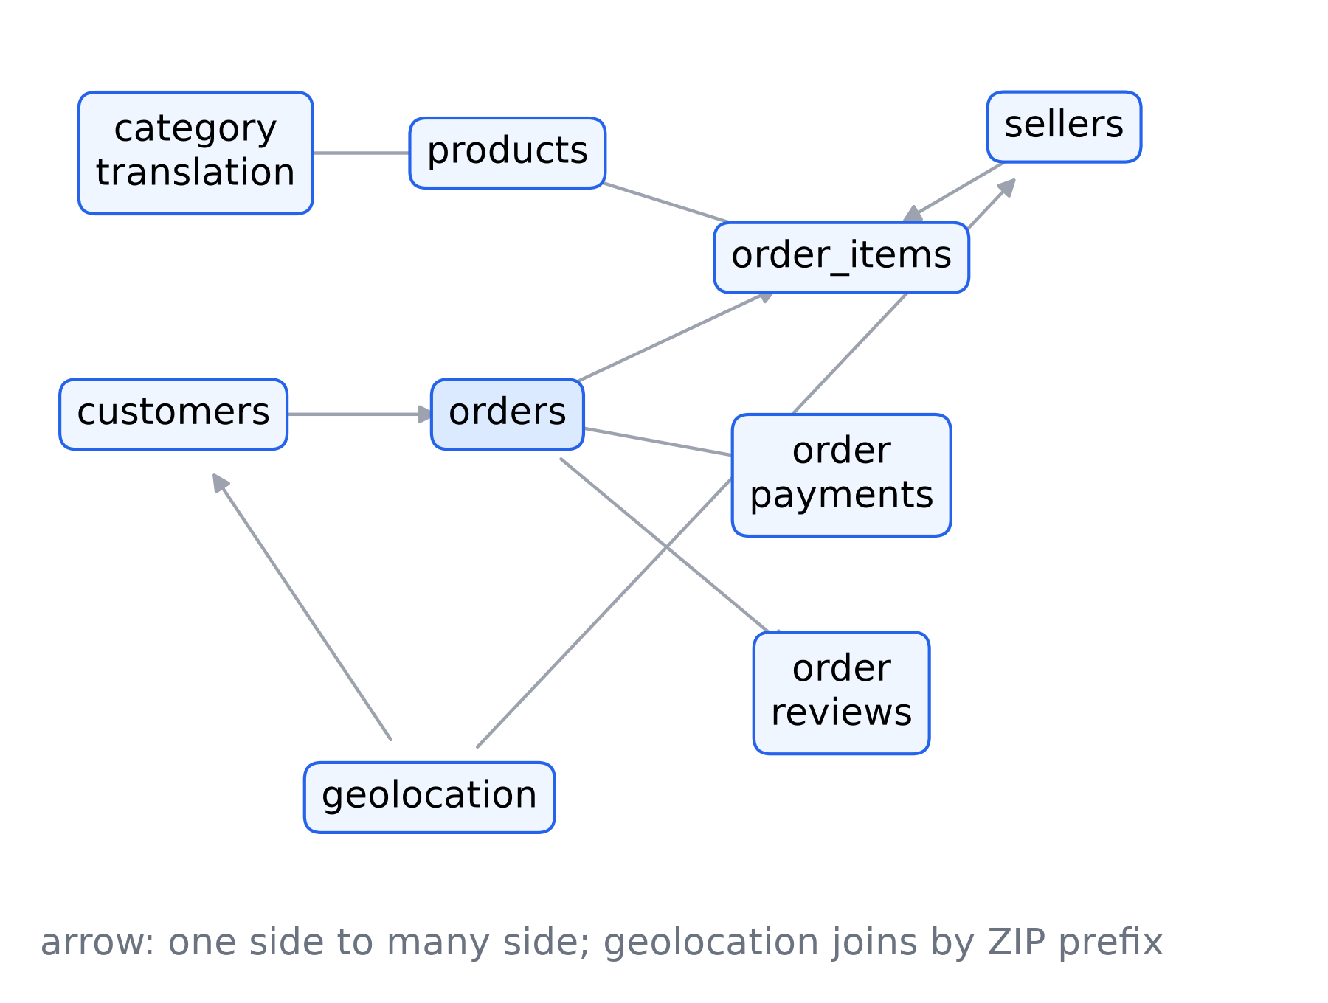
Nine tables become one row per order
DATA, JOINS AND LEAKAGE
Aggregate first
Items, payments and reviews are reduced to one row per order, then joined one to one
Primary item
The highest-priced item gives the category and the seller
Customers
Matched on customer_unique_id: one customer stays on one side of every split
Leakage rule
A predictor must exist at the prediction moment; Olist’s estimated date is never used
Team 11 · IT5006 · 4/18 · Report section 3 · join diagram from Pipeline A’s data stage (B-G-13)
Notes:
0:35. Olist ships nine tables. Items, payments and reviews have several rows per order, so each is reduced to one row per order before the join, and the join stays one to one. Customers are matched on customer_unique_id, so the same person never sits on both sides of a split. The leakage rule: a column is a predictor only if it exists at the prediction moment. Delivery, carrier and review fields never are.

Slide 5
Every learned step is fitted on the training fold only
PREPROCESSING
Step | Rule | Why
Missing numbers | Training-fold median plus a missing indicator | Tells a filled value from a real one
Missing categories | Their own “Unknown” level | No row dropped
Skew | log(1 + x): money, size, distance, days | Long right tails
Late tail | Kept; predict log(1 + lead time) | Very late orders are real
Encoding | One-hot; linear models drop one level | Full-rank design matrix
Scaling | Standardised, linear and logistic only | Comparable coefficients
Test period | Newest 20%, held out first, read once | Unbiased final score
Pipeline A development orders
One pipeline per fold
76,925 lead time · 77,736 alert
All steps sit inside one scikit-learn pipeline, cloned for each model
Team 11 · IT5006 · 5/18 · Report section 3
Notes:
0:35. Every learned step, imputation, encoding and scaling, sits inside one scikit-learn pipeline fitted on the training fold only and cloned for each model, so no validation or test statistic reaches a model. Missing numbers get the fold median and an indicator; skewed amounts get a log. We keep the late tail, because very late orders are real customers, and model the log of lead time instead. The newest 20% of orders were held out first and read once.

Slide 6
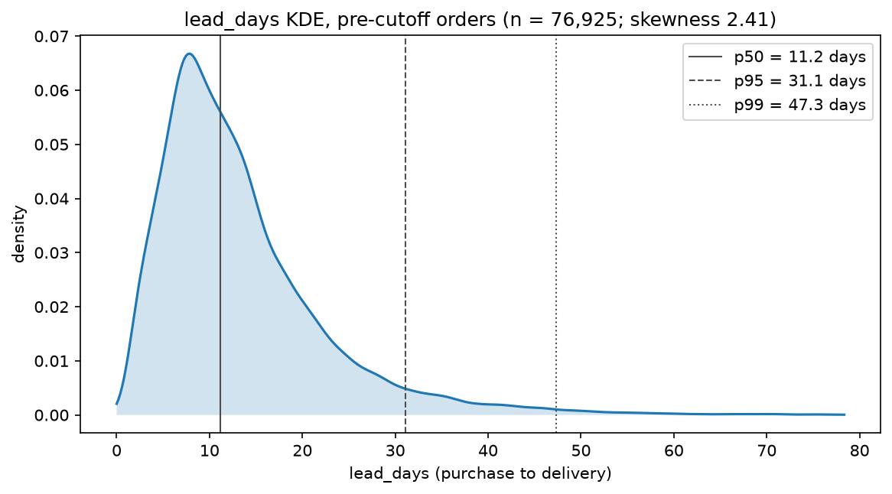
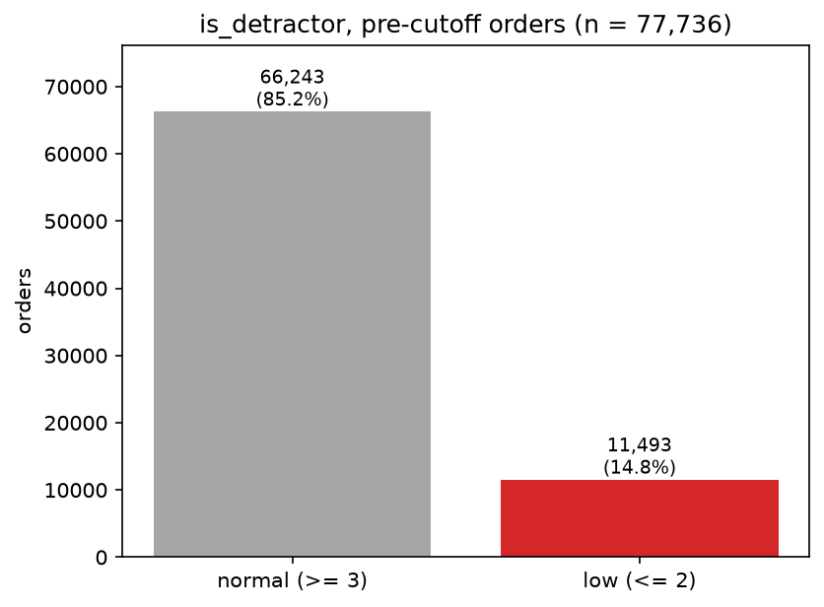
Lead time is skewed; detractors are a minority
EXPLORATION · BOTH TARGETS
Regression · lead time, development orders
Classification · detractor share
Regression
Classification
Both
Median 11.2 days, skewness 2.41: log target, judged by MAE
14.8% are detractors: judged by AP, not accuracy
Development orders only; the test period was never explored
Team 11 · IT5006 · 6/18 · Report section 4 · Pipeline A EDA (stage 3)
Notes:
0:35. Two findings shaped the models. Lead time is skewed: median 11.2 days, skewness 2.41, hence the log target and MAE. And 14.8% of development orders are detractors, hence average precision, not accuracy. All exploration used development orders only; the test period was never looked at.

Slide 7
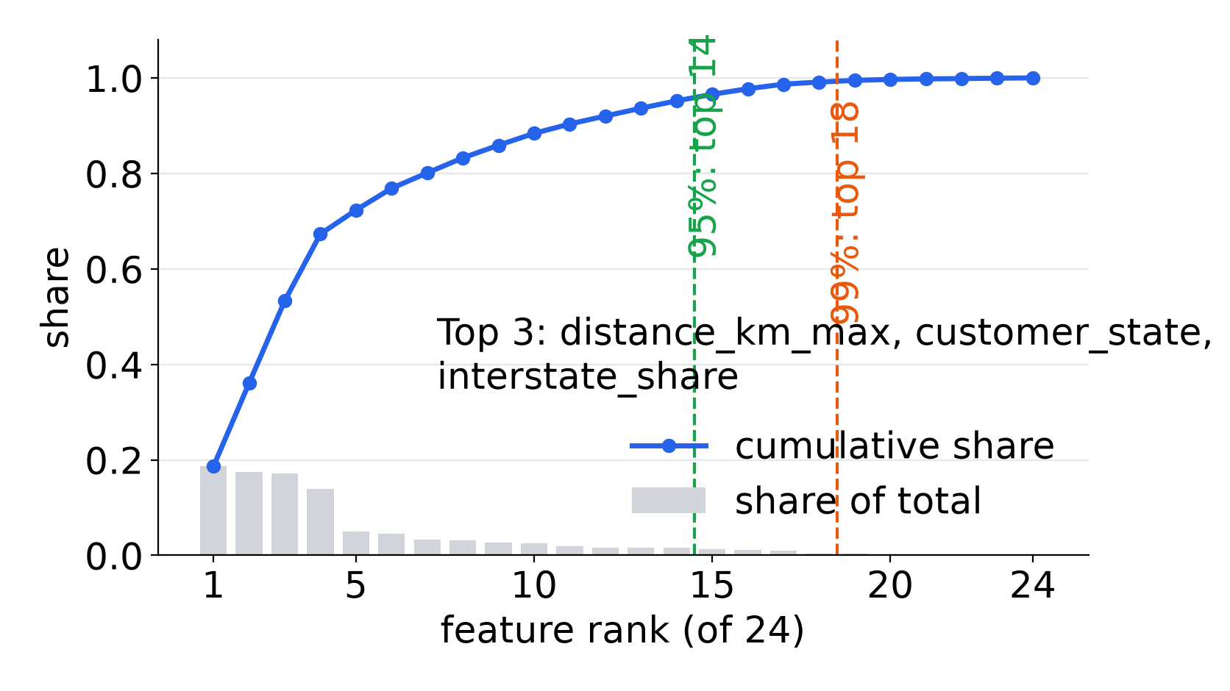
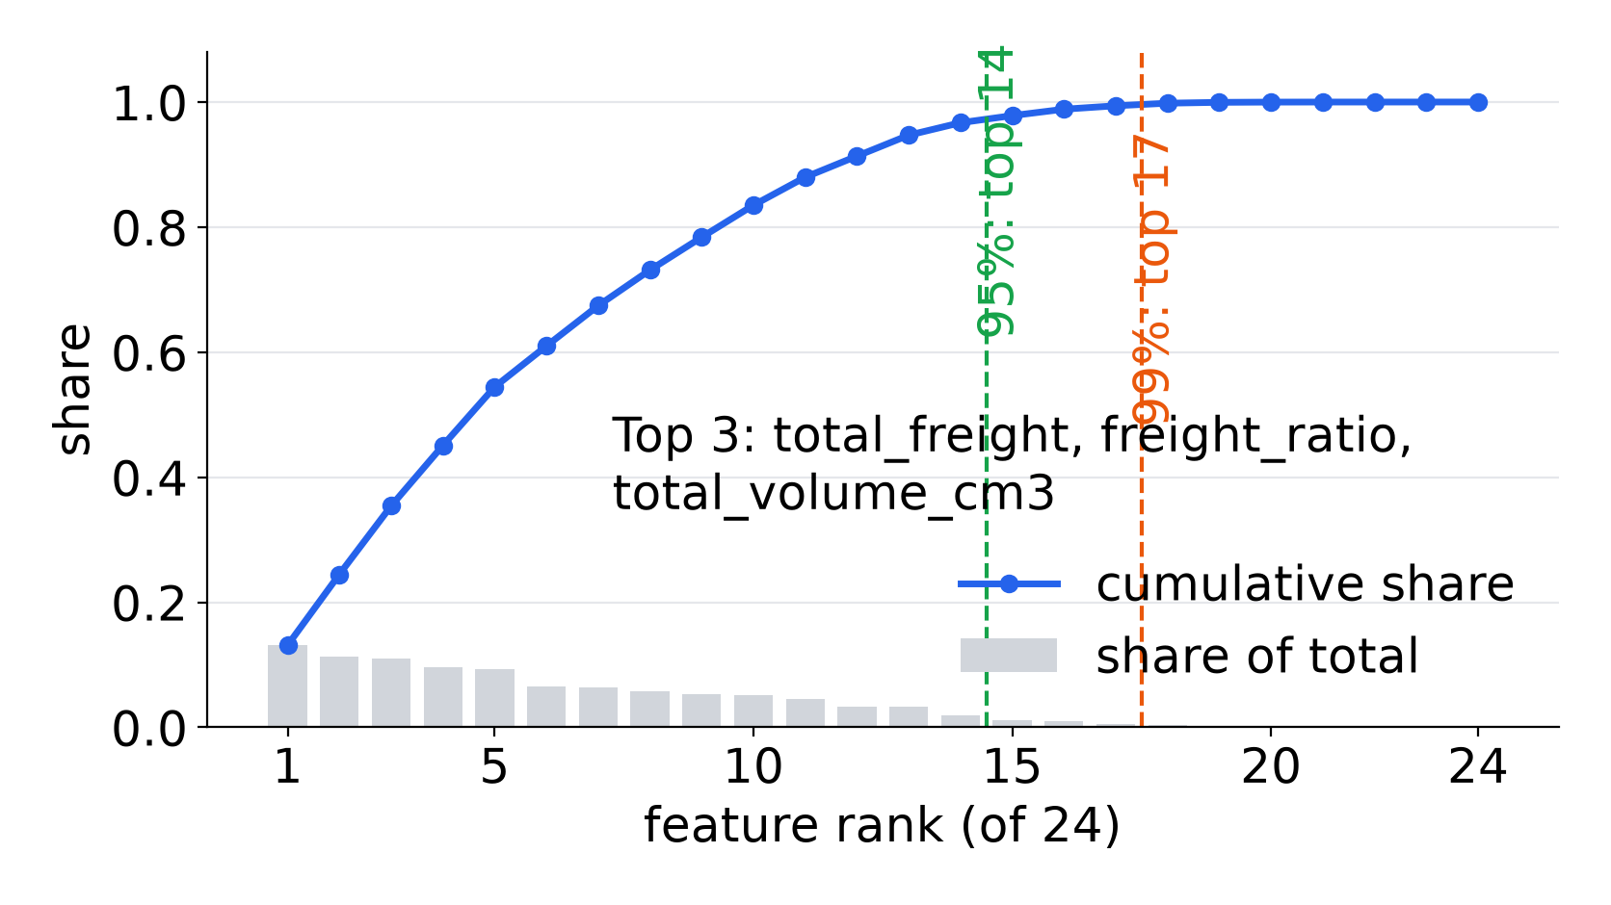
24 checkout predictors, screened and ranked
PIPELINE A · BASELINE FEATURES
Basket: more items and sellers, more picking and parcels · Price and freight: freight reflects distance and service · Size: heavy parcels travel slower · Geography: route and its reliability · Calendar and payment: weekends, late hours and boleto delay dispatch · alert only: photos and description set expectations; the seller’s earlier score sums up past service (hypotheses, tested by the ranking)
Regression · lead time: ranking and cumulative share
Classification · alert: ranking and cumulative share
Team 11 · IT5006 · 7/18 · Report section 5.1 · Pipeline A EDA screening (stage 3)
Notes:
0:30. Pipeline A, the baseline, uses 24 predictors known at checkout, each with a reason: bigger baskets mean more picking and separate parcels, freight reflects distance and service, heavy parcels travel slower, the route sets reliability, and weekends, late orders and boleto payments delay dispatch. These are hypotheses; each candidate was ranked by its association with the target. Notice what is missing: nothing about how this seller or this route has delivered recently.

Slide 8
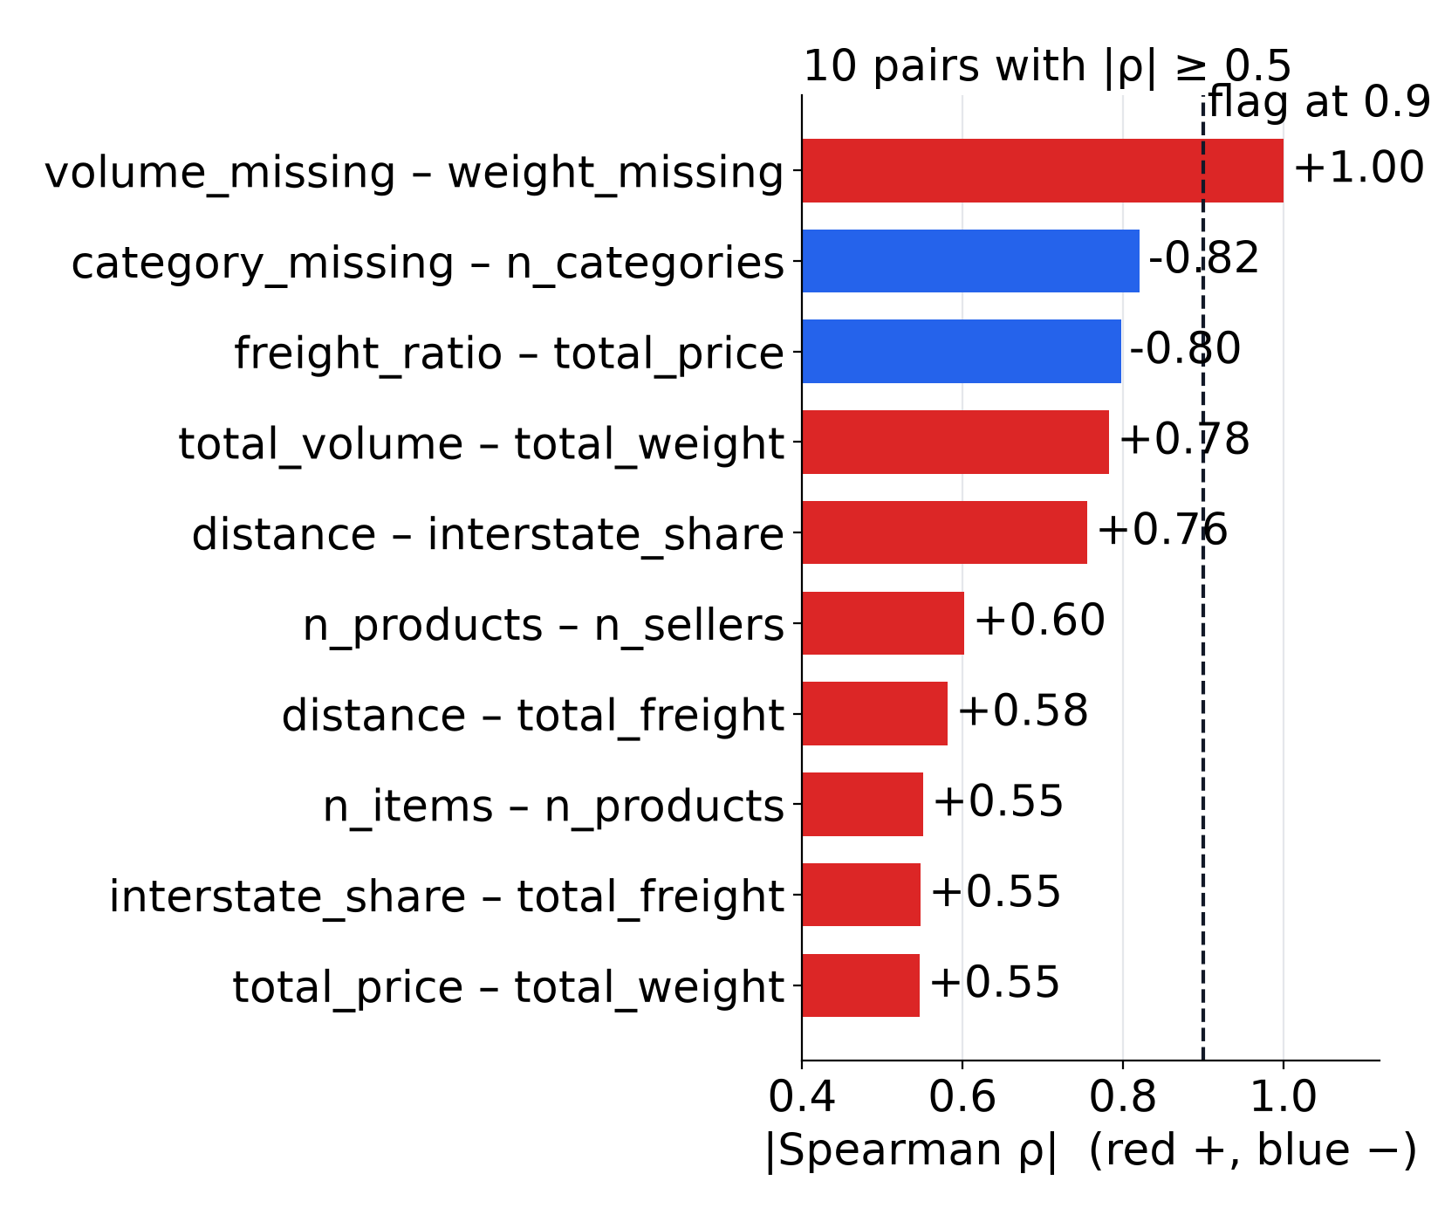
Correlated features go first, then a 99% rule
PIPELINE A · MULTICOLLINEARITY AND SELECTION
Multicollinearity
Flag |r| above 0.9 or VIF above 10. No VIF reached the cut. One identical pair, missing weight and missing volume shares: the lower-ranked one is dropped.
Selection
Rank by association (Spearman for lead time, mutual information for the alert); keep features until 99% of the cumulative score.
Team 11 · IT5006 · 8/18 · Report sections 5.2, 5.3, appendix J · heatmap: Pipeline A EDA (stage 3)
Notes:
0:35. Before selection we check multicollinearity. We flag pairs above 0.9 correlation and features with a variance inflation factor above 10. No feature reached the VIF cut; one pair was identical, missing weight and missing volume, and we dropped one of them. Then a simple rule keeps the smallest set of features that carries 99% of the ranked signal.

Slide 9
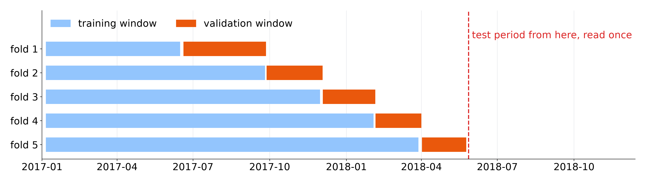
Time-ordered folds; simple models first
PIPELINE A · VALIDATION AND MODEL LADDER
Folds
Ladder
Regression · val. MAE
Classification · val. AP
Five expanding folds; customers purged; labels known before each window
Dummy, linear or logistic, tree, forest; simplest within one SE
5.47 days vs 6.49 dummy
0.232 vs 0.148 dummy
Team 11 · IT5006 · 9/18 · Report sections 6.1–6.4 · fold chart: regression, A’s boundaries · validation scores are selection scores
Notes:
0:35. Validation uses five time-ordered folds: train on the past, validate on the following weeks, with returning customers removed from training. A random split would train on the future. Models climb a ladder from a dummy to linear or logistic, a tree and a forest, and we keep the simplest within one standard error. The baseline clearly beats its dummy: MAE 5.47 against 6.49 days, AP 0.232 against 0.148.

Slide 10
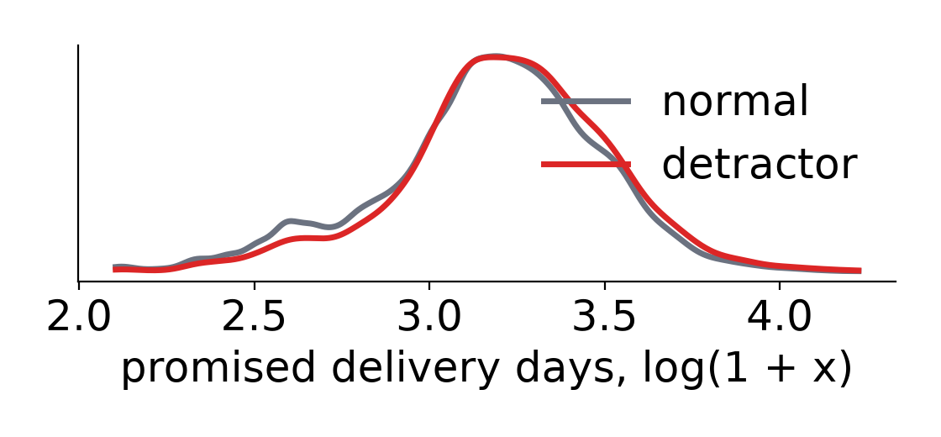
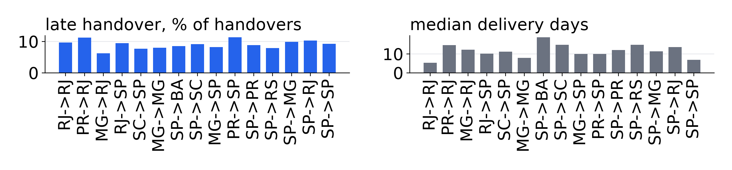
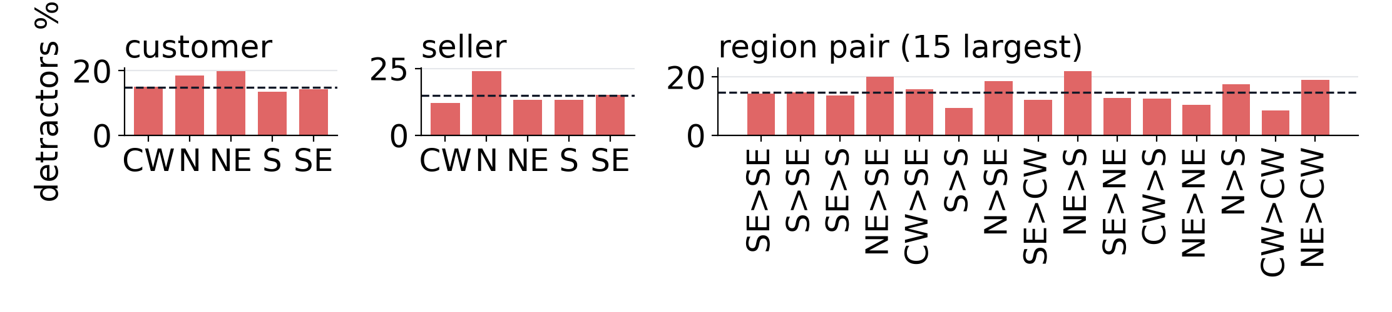
What the baseline cannot see at checkout
PIPELINE A · THREE LIMITS, FROM EXPLORATION
1 · Lateness unknown
2 · Speed depends on route and time
57.2% detractors if late vs 9.5% on time
Median 7.8 days to SP vs 27.1 to AM; orders 4,478 to 7,284, Oct to Nov 2017
3 · Distant regions are noisier
Detractor rates swing most on thin, long routes
Team 11 · IT5006 · 10/18 · Report sections 1.1 and 4 · charts 1 and 3: Pipeline A EDA screens 3.11, 3.12; chart 2: B’s data stage
Notes:
0:45. But A's own evidence showed three limits. One: late delivery goes with bad reviews, 57.2% detractors when late against 9.5% on time, yet at checkout lateness is unknown. Two: speed depends on the route and changes over time, from a median of 7.8 days to Sao Paulo to 27.1 to Amazonas, and checkout features carry no recent behaviour. Three: thin, distant routes are noisy and one model fits them poorly. Each limit points to one change in Pipeline B.

Slide 11
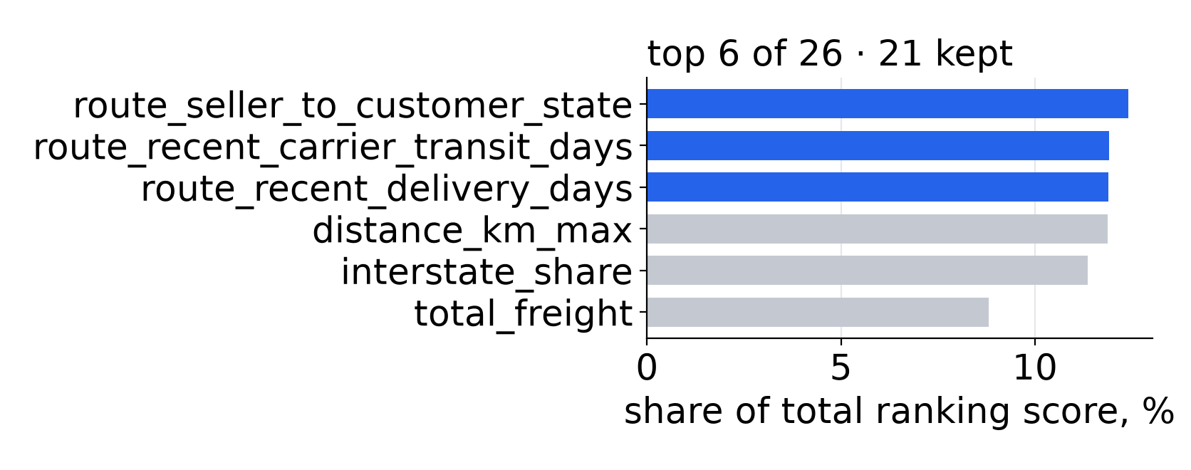
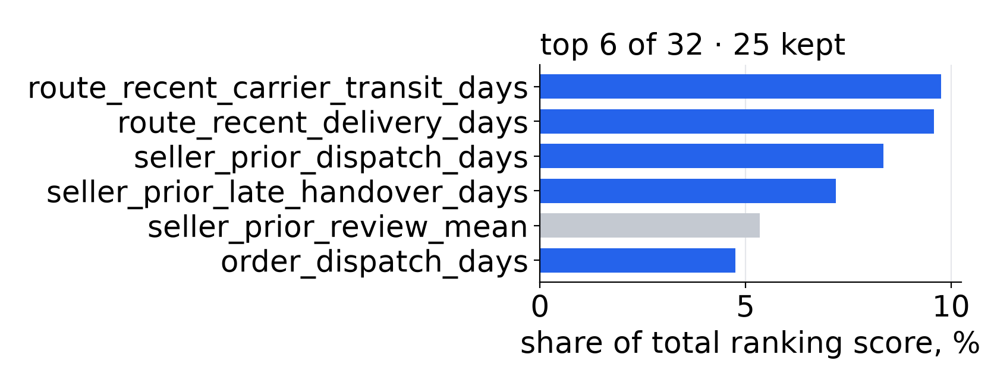
Recent seller and route history rank at the top
PIPELINE B · NEW FEATURES
New feature | What it measures | Answers A’s limit
Route | Seller state to customer state | 2 · speed depends on route and time
Seller history | Prior late-handover rate and days, dispatch days | 2 · speed depends on route and time
Route history | Delivery and transit days, last 3 weeks (0.5/0.3/0.2) | 2 · speed depends on route and time
Alert at handover | This order’s handover lateness and dispatch days | 1 · lateness unknown at checkout
Regression · lead time (blue bars: B’s new features)
Classification · alert (blue bars: B’s new features)
Team 11 · IT5006 · 11/18 · Report sections 5.1, 5.3 · history uses only other orders, never this order’s outcome
Notes:
0:40. Pipeline B answers the first two limits. New features describe the route and the recent history of the seller and the route: late handovers, dispatch days, recent delivery and transit times, computed only from other orders completed in earlier weeks. For the alert, B moves to carrier handover, where this order's own dispatch delay is known. In both tasks the new features rank at the top.

Slide 12
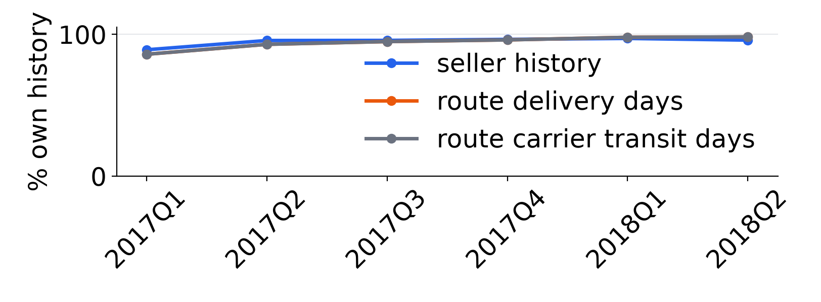
Seven states, nested states removed, plain models kept
PIPELINE B · SCOPE, MULTICOLLINEARITY AND MODEL
B’s orders | Lead time | Alert
A’s development orders | 76,925 | 77,736
Outside the seven states | − 13,777 | − 13,983
Distance unknown | − 606 | − 618
Above B’s lead-time cap | − 45 | —
Never handed over | — | − 461
Reviewed before handover | — | − 146
History warm-up, six weeks | − 1,264 | − 1,270
B’s development orders | 61,233 | 61,258
Test orders | 15,422 | 15,492
Multicollinearity
The route fixes both states, so the state columns go; the constant missing-distance share too. Full rank in every fold.
Model
Same folds and ladder as A; the forest is within one SE, so plain linear and logistic are kept.
Team 11 · IT5006 · 12/18 · Report sections 3, 5.1, 5.2, 6.2–6.4 · A’s frozen model serves every order outside the seven states
Notes:
0:35. The third limit is answered by scope: B serves the seven largest states with a known distance, 61,233 development orders for lead time, and A's frozen model serves every other order. Inside the scope, the route fixes both states, so the state columns are dropped to keep the design matrix full rank. The same ladder and one-standard-error rule again keep the plain linear and logistic models.

Slide 13
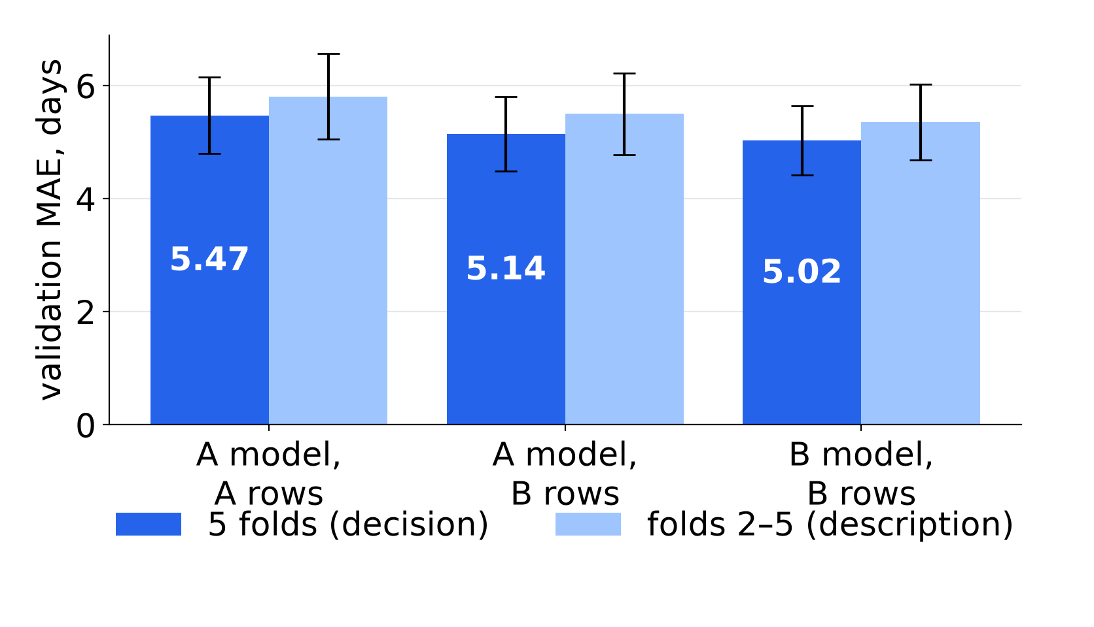
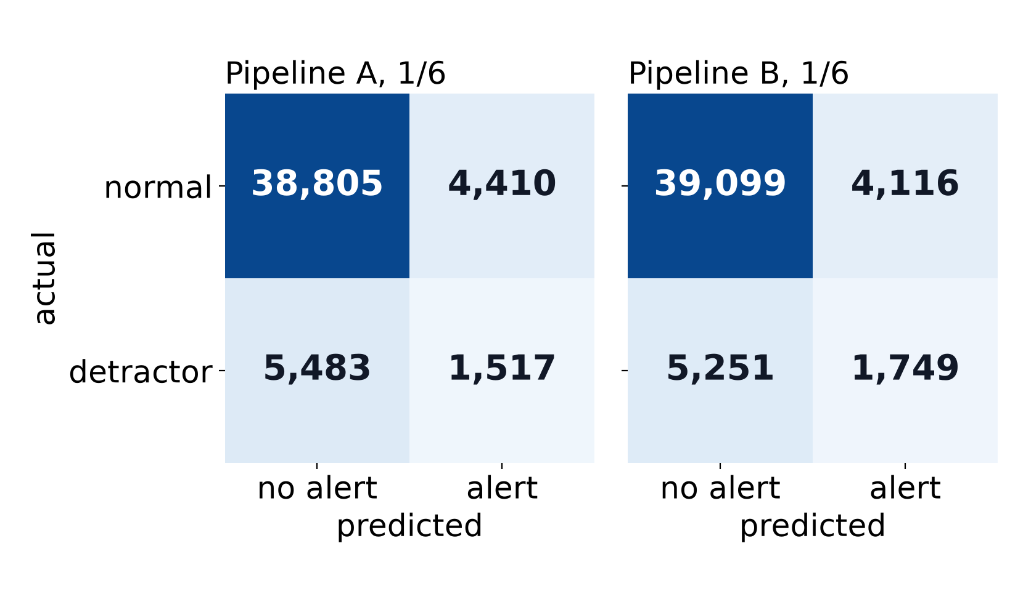
B beats A on the folds; scope and features split the gain
VALIDATION · A VS B ON B’S ROWS
Regression · lead time · validation MAE in days
Classification · detractor alert · confusion matrices at 1/6
A all states 5.470 · A on B’s rows 5.142 · B 5.025: most of the gain is scope
A all states 0.232 · A on B’s rows 0.230 · B 0.248: the gain is features and timing
Team 11 · IT5006 · 13/18 · Report sections 6.5, 7.3 · validation scores are selection scores; adoption rule fixed before the test
Notes:
0:40. Before touching the test, we fixed the adoption rule: B must beat A on the same folds. It did, in every fold of both tasks. For lead time most of the gain is scope: A improves from 5.470 to 5.142 days on B's rows, and B reaches 5.025. For the alert, scope changes almost nothing; the gain comes from the new features and the later moment.

Slide 14
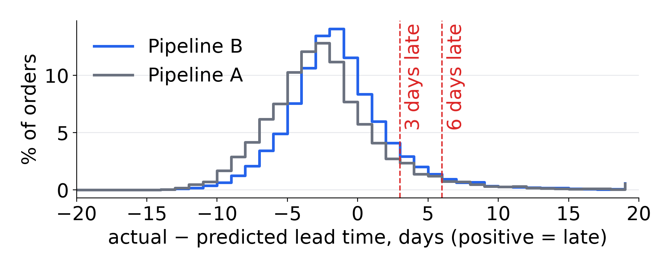
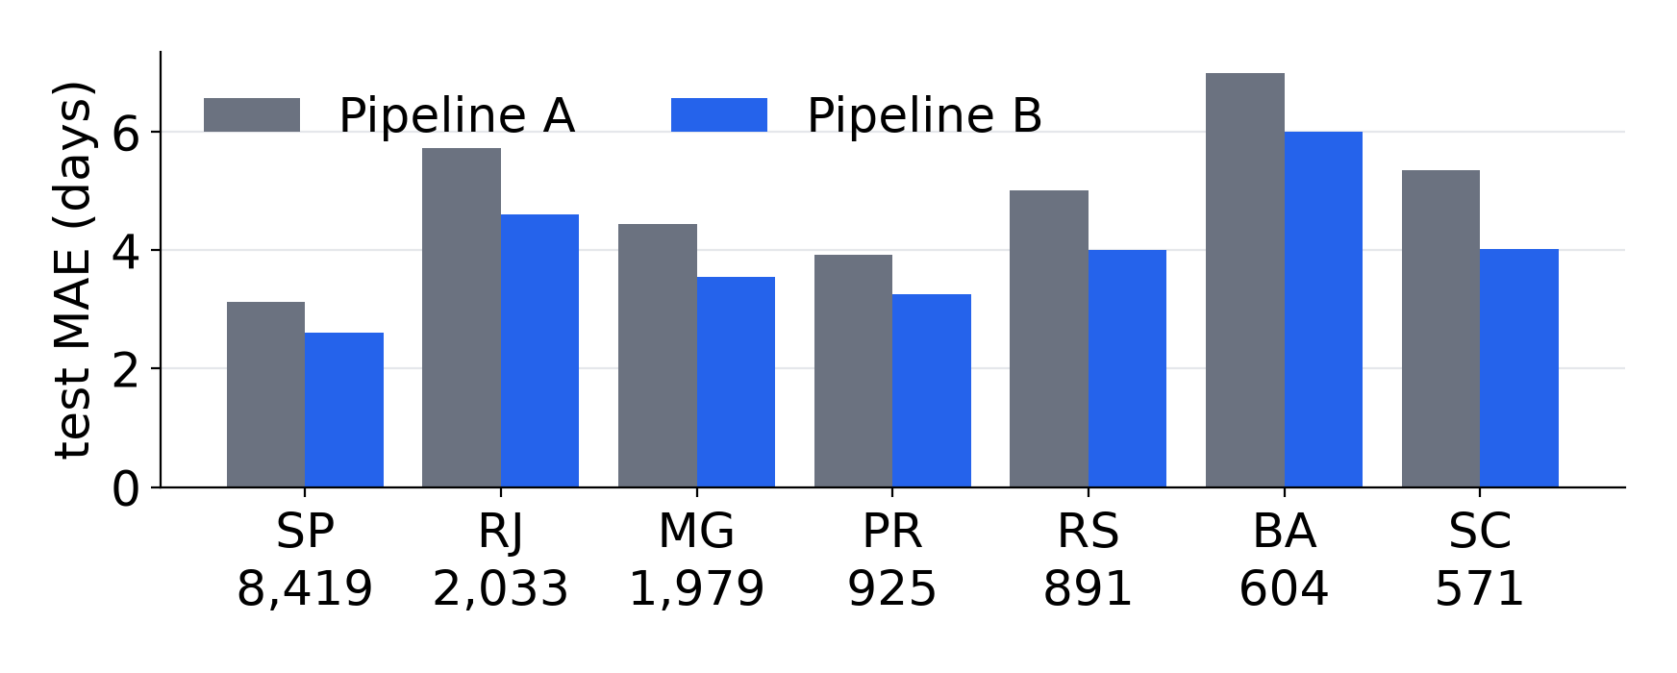
B’s promise errors are smaller on the same orders
TEST · REGRESSION · DELIVERY LEAD TIME
Test, read once | B | A
MAE, days | 3.30 | 4.03
MAE 95% interval | 3.24–3.35 | —
B − A | -0.729 [-0.754, -0.703]
Within 3 days | 57.6% | 44.3%
More than 3 days late | 11.1% | 9.3%
More than 6 days late | 4.7% | —
Mean residual, val → test | +2.9 → -1.1 | —
Training → validation MAE (dummy 4.79 → 5.97) | 3.86 → 5.02 | —
Dummy MAE | 4.38
Routes where B is better | 20 of 20
Team 11 · IT5006 · 14/18 · Report section 7.1 · 15,422 test orders, read once
Notes:
0:40. Then the test, read once. On the same orders B's error is 3.30 days against 4.03 for A; the difference, -0.729 days, has a 95% interval that excludes zero, and B is better on all 20 routes judged. 57.6% of orders land within three days. Training error is below validation for a model with no features too, so the gap comes from the periods, not overfitting. One caveat: B leaves slightly more orders more than three days late, so the promise needs a buffer.

Slide 15
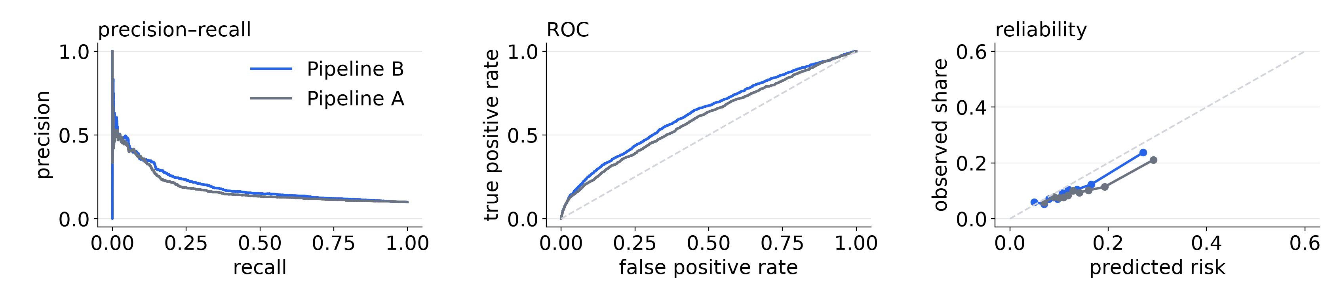
B ranks likely detractors better on the same orders
TEST · CLASSIFICATION · DETRACTOR ALERT
Ranking | B, handover | A, checkout
Average precision | 0.197 | 0.178
AP 95% interval | 0.181–0.218 | —
B − A | +0.0187 [+0.0089, +0.0291]
ROC-AUC | 0.636 | 0.604
Brier (lower is better) | 0.0867 | 0.0893
B at a threshold | Alerts a day | Precision | Recall
Frozen 1/6 | 23.2 | 0.208 | 0.300
Operating 4/15 | 5.6 | 0.346 | 0.121
1,541 detractors among 15,492 test orders (9.9%)
Errors at 1/6: 1,078 detractors missed; only 13% of them arrived after Olist’s estimate, so their reason is not in the data. False alerts: 23% late handovers, 5% late deliveries
Team 11 · IT5006 · 15/18 · Report section 7.2 · 4/15 chosen after the test; the frozen 1/6 is the unbiased result
Notes:
0:40. For the alert, B's average precision is 0.197 against 0.178, with an interval above zero, and ROC-AUC and Brier agree. Part of the gain is the later moment: B scores at handover, A at checkout. The frozen threshold of one in six is the unbiased result. After the test, the business chose four in fifteen to cut false alarms: 5.6 alerts a day at precision 0.346. Most missed detractors had a delivery that went to plan, so the reason for their review is not in our data; many false alerts were late handovers that still arrived on time.

Slide 16
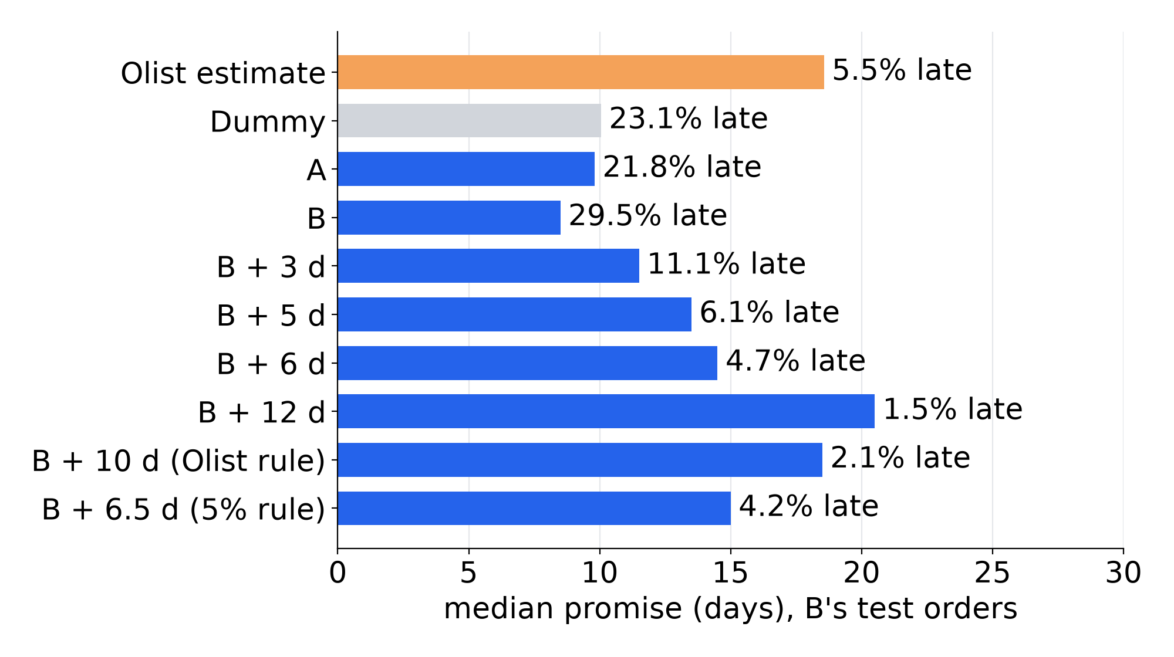
The buffer is a dial: a shorter promise than Olist’s, late less often
BUSINESS USE · REGRESSION · THE PROMISE
Median promise and late share, B’s test orders (post-test view)
Today: Olist’s estimate
18.6 days, 5.5% late, MAE 12.6
Candidate rule: at most 5% late on recent weeks
Set on the last validation weeks (Apr–May 2018): B + 6.5 days. On the test: median 15.0 days, 4.2% late
Matching Olist’s recent late share (2.1%)
Needs B + 10.0 days: 18.5 days, as long as Olist’s
Why recent weeks
Dispatch is the lever
b12’s 12.0 days was set on all folds, late-2017 crisis included: B late on 59.7% there, 29.5% on the test
37% of late orders left the seller late; 10% faster transit puts 3.1% of late orders on time (scenario)
Team 11 · IT5006 · 16/18 · Report section 9 · test numbers are a post-test view; the frozen 12.0-day buffer is the unbiased result; the rule needs a rolling backtest
Notes:
0:30. How fulfilment uses the lead-time model. Olist's own estimate promised a median of 18.6 days and was late 5.5% of the time. B plus a buffer is a dial. Set it on recent weeks at 5% late: 6.5 days, which promised 15.0 days with 4.2% late on the test, shorter than Olist's and late less often. Matching Olist's late share on those weeks, 2.1%, would need 10.0 days. The rule needs a rolling backtest. Expediting transit after a late handover saves few orders, so dispatch is the lever.

Slide 17
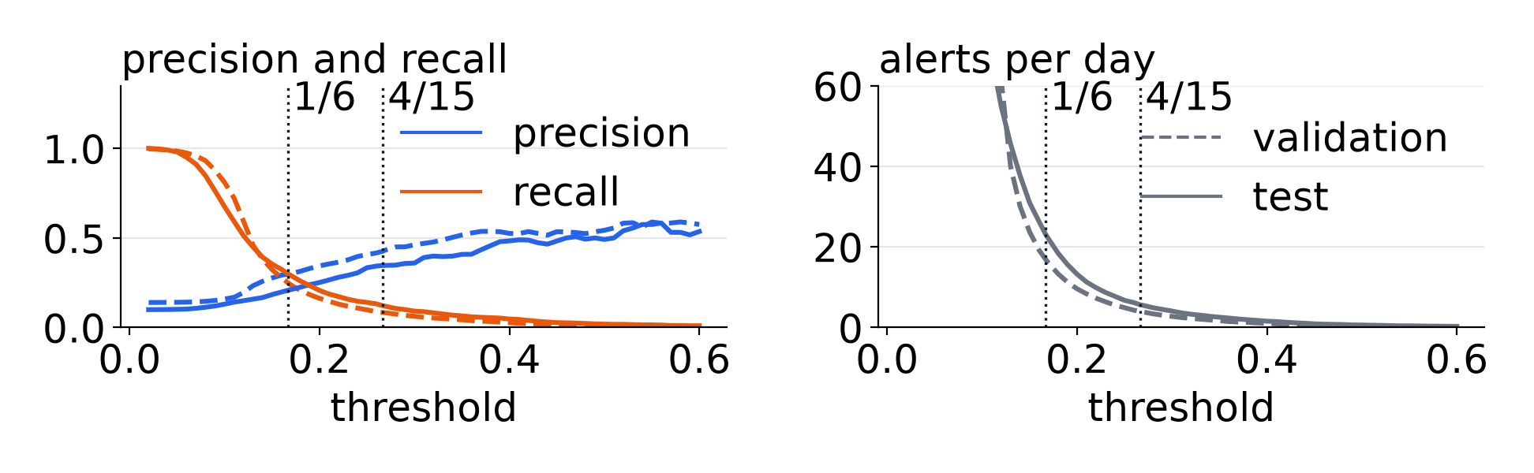
A daily queue that reaches about two detractors a day before they review
BUSINESS USE · CLASSIFICATION · SERVICE RECOVERY
Option (test) | Alerts/day | Precision | Reached/day
B at 4/15, seven states | 5.6 | 0.346 | 1.9
A fallback at 1/6, other states | 14.9 | 0.133 | 2.0
A fallback at 4/15, other states (option) | 2.4 | 0.226 | 0.6
Missed-dispatch rule, seven states (overlaps B) | 13.3 | 0.212 | 2.8
Tab 3 · threshold
4.1 · daily queue
4.2 · case file
4.3 · weekly
4/15 fits review capacity; 1/6 was the cost threshold set on validation
B by risk, then A by handover delay; missed dispatch is a separate rule (3.5)
The reason picks the action: late dispatch → new date and apology; slow route → expedite; high freight → refund or voucher; contact outside the app
Scenario list and priorities to seller management (association); no action log yet
Freight discount (association, not an effect)
Next: a hold-back pilot
Of 95 still-late orders B flags, −30% freight stops 15 alerts; free shipping stops 75, all beyond the model’s freight range
Test cost at 5:1: 9,211 against 9,505 with no alerts. A contact pays if precision × value kept exceeds its cost (values unknown); randomise who is contacted
Team 11 · IT5006 · 17/18 · Report section 9 · reached/day = precision × alerts/day · proposed workflow (operational rule; report Table K22): the app covers the queue, not the contact
Notes:
0:30. How customer service uses the alert. Pipeline B at four in fifteen sends 5.6 alerts a day and about 1.9 of them are real detractors. A's fallback adds 14.9 a day at lower precision, and on the test those alerts cost more than none, so a higher fallback threshold is an option to test. The missed-dispatch rule works inside the seven states, beside B. In the proposed workflow, customer service sets the threshold, works the daily queue and reads the case file in the app, and the reason picks the action: a new date and an apology after a late dispatch, expediting on a slow route, a refund or voucher when freight is high. The contact happens outside the app, and each week the list goes to seller management. Freight discounts move few alerts, and that is an association. The next step is a randomised pilot.

Slide 18
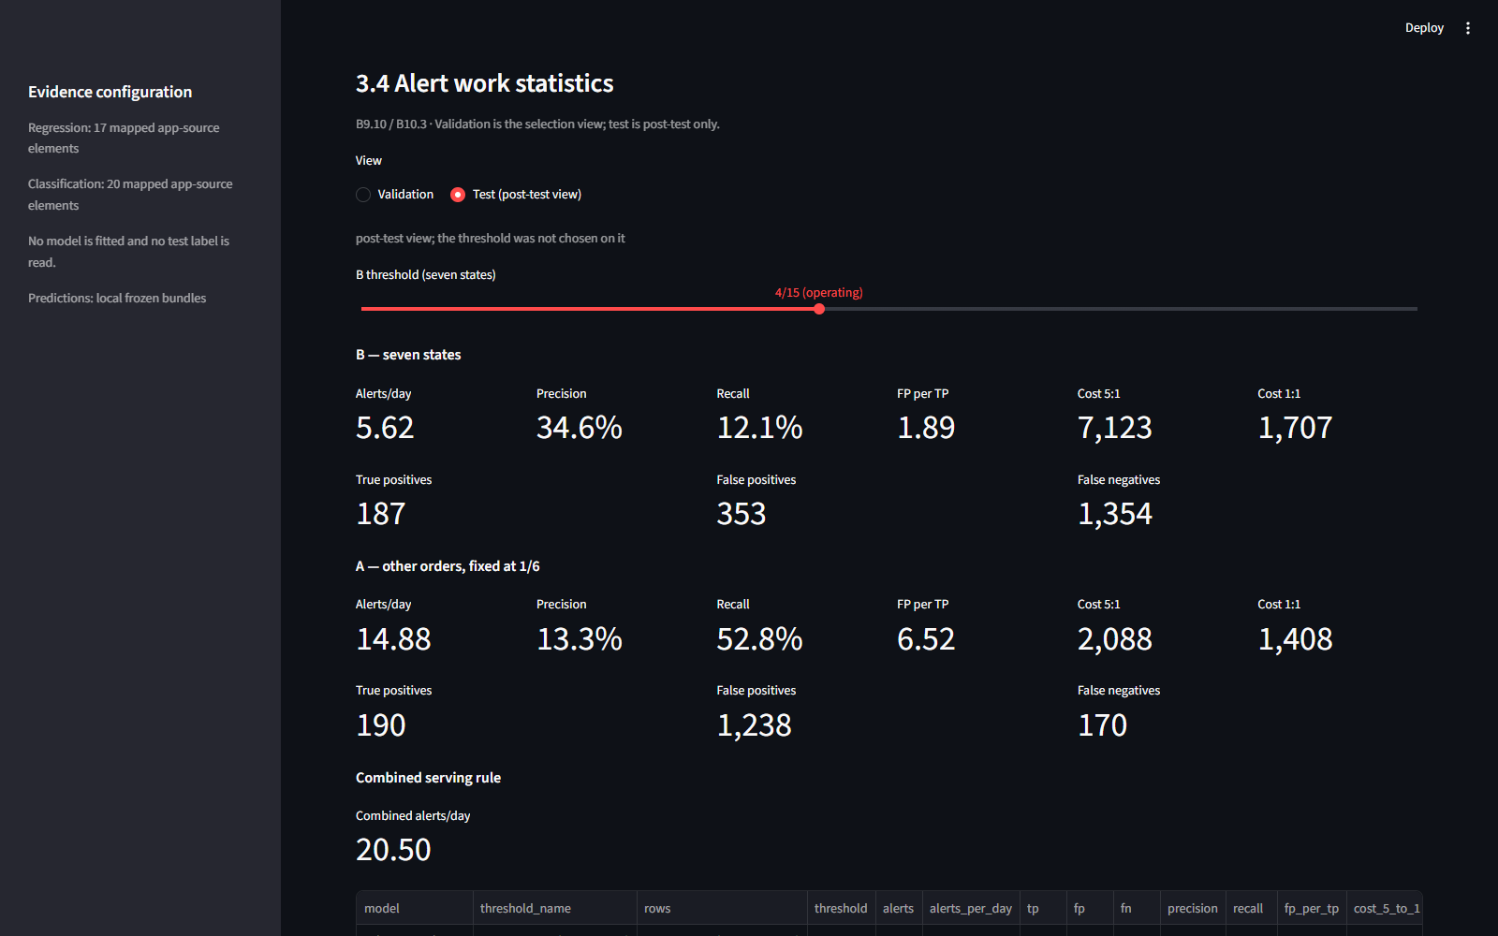
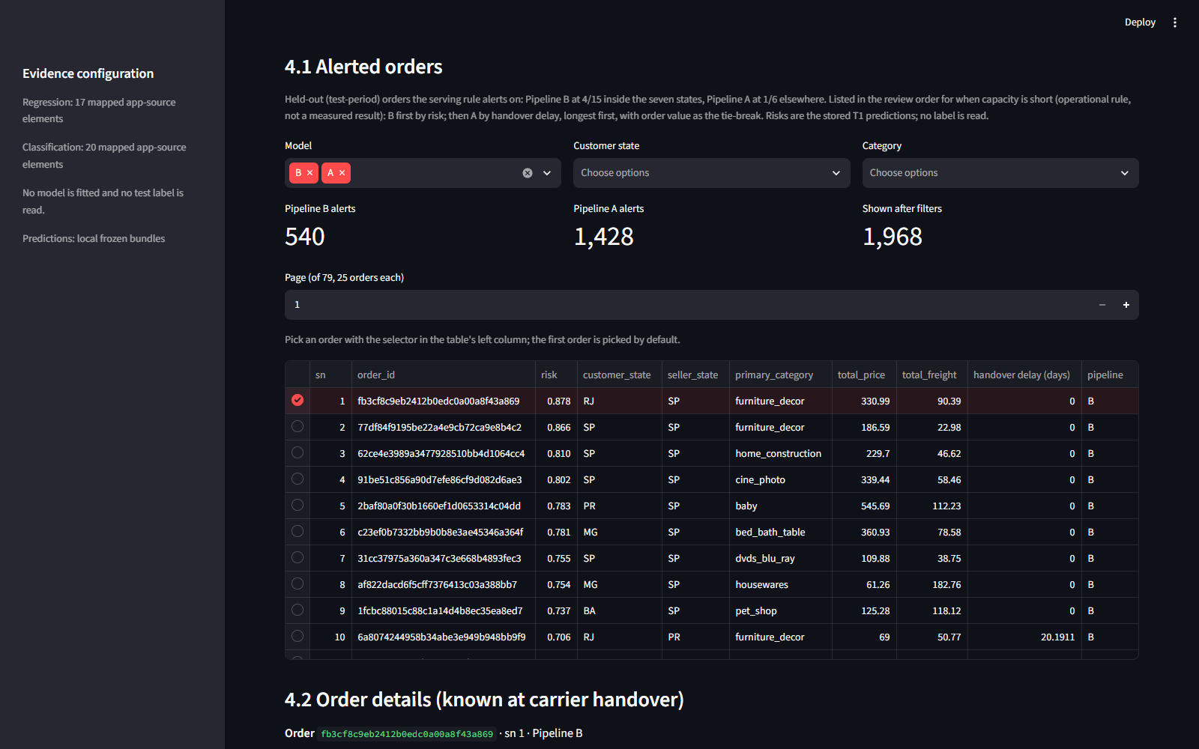
The same frozen models, live for operations
DEPLOYED APP · STREAMLIT
Detractor tab · alert statistics on the test period at 4/15
ML deployment tab · alerted held-out orders
App https://it5006grp11ecommerce.streamlit.app/
Code https://github.com/wuqianzong/Team11_IT5006_Ecommerce_Analytics_AY2627Sem1
Team 11 · IT5006 · 18/18 · Report section 8 and appendix L · scores held-out orders only; no test label is read
Notes:
0:10. The app runs the same frozen models as the report; the detractor tab and the ML deployment tab are shown here in case the live demo is slow, with the link and the code.

