Slide 1
Exoplanet Transit Depth: Theory and Distribution
Steven Wu

Slide 2
Theory

Slide 3
Transit depth

Slide 4
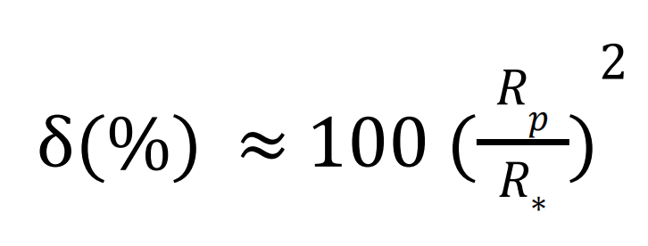

where
$δ$ is transit depth in percent (%)
$R_{p}$ is the planet radius
$R_{∗}$ is the stellar radius

Slide 5
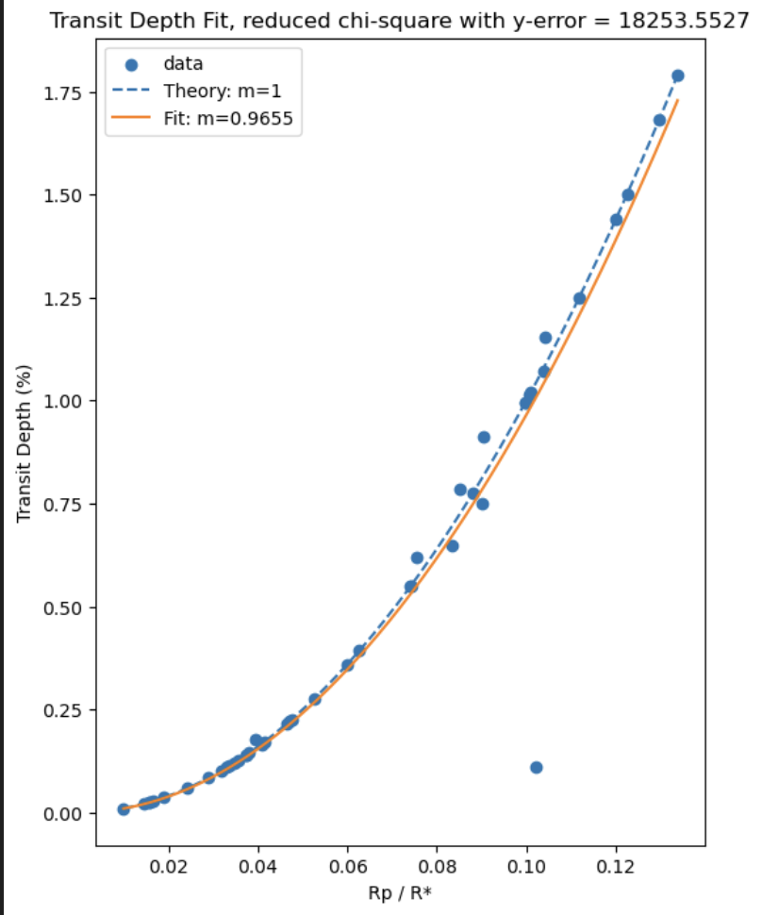
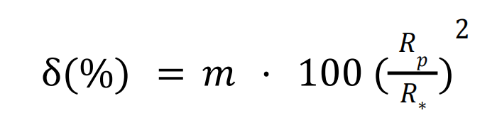
m = 0.9655 ≈ 1
Reduced chi-square = 18253.5527 >> 1
Errors too small
Real data is more complicated than the ideal model
outlier
One outlier
Unexpected small transit depth ?!

Slide 6
Normal transit
Grazing transit

Slide 7
Distribution

Slide 10
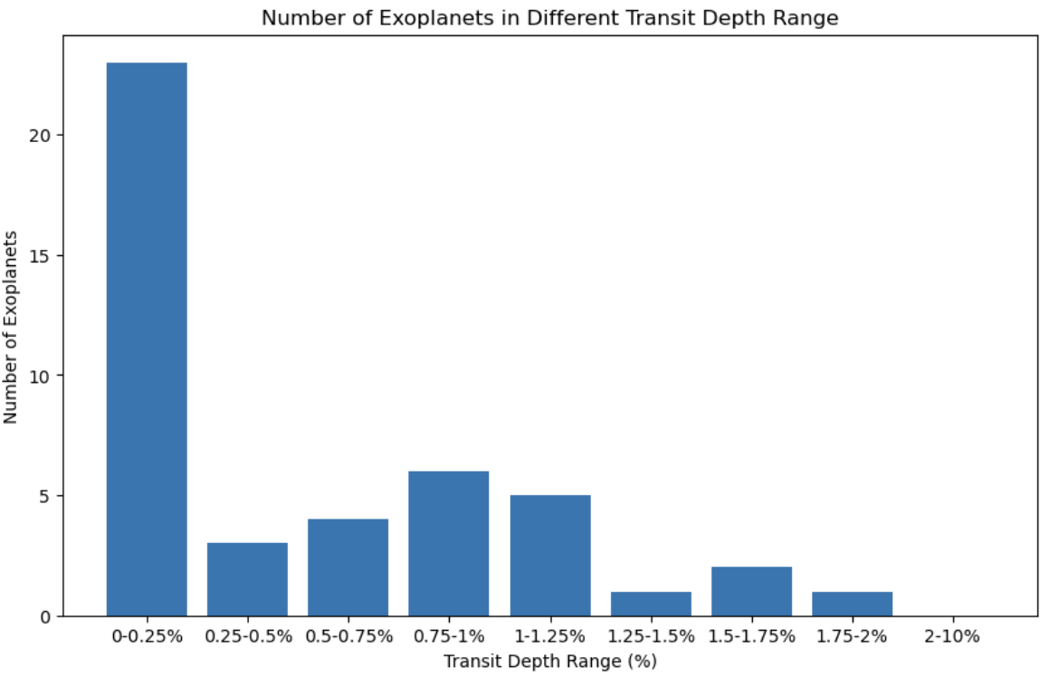
Most planets have small transit depths
Generally decreased as transit depth became larger
Deeper transits -> a large planet with a small host star
Rare

Slide 11
THANK YOU
Steven Wu

