Slide 1

Sector Level Mappinng #1
Oh Gihwan, Han Gyuhwa , Hong Gyeonghwan
Computer engineering , Sungkyunkwan Univ.
Sector Level Mapping FTL
- Static and Dynamic mapping

Slide 2
Index
Sector Level Mapping Table
Read module for sector level mapping
Write module for sector level mapping
Considerations
Experiments
Next work

Slide 3
Sector Level Mapping Table

Slide 4
Read module for sector level mapping

Slide 5
Write module for sector level mapping

Slide 6
Considerations
Dynamic 과 static 비교
다른 실험은 안한 이유.
약간의 최적화 트릭 ( loop 없애고 most bit 이용해서 dram search 하는거 )

Slide 7
Experiments
Environment
Application : Iometer
Description
Random Write
Sequential Read
Transfer size
512 Bytes, 1 KB , 2KB , 4KB
FTL
Tutorial
Greedy
Static Sector mapping
Dynamic Sector mapping
Notes:
Experiments results are average of three.

Slide 8
Experiments results
Random Write test ( Average of three tests )
Sequential Read test ( Average of three tests )

Slide 9
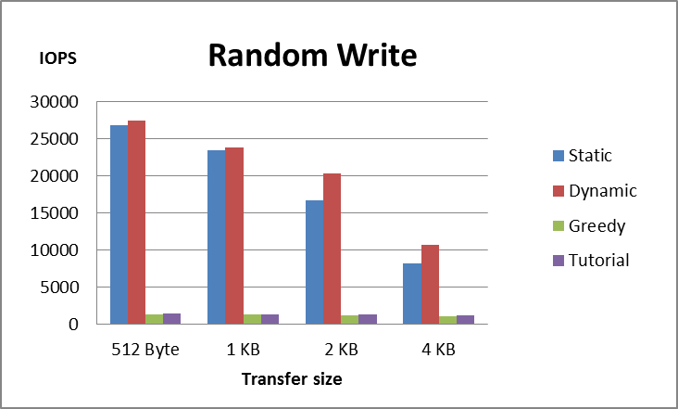
Experiments results

Slide 10
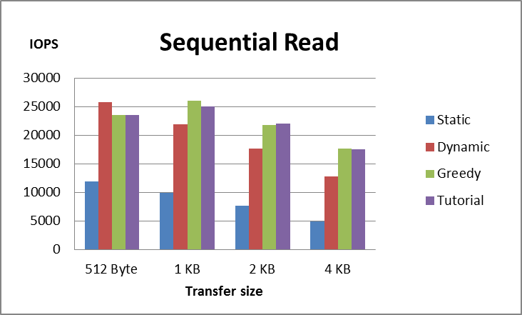
Experiments results

Slide 11
Experiments results
실험 분석
실험 결과가 저렇게 나온 이유

Slide 12
Next work
개선 사항
앞으로 할 일

