Slide 1
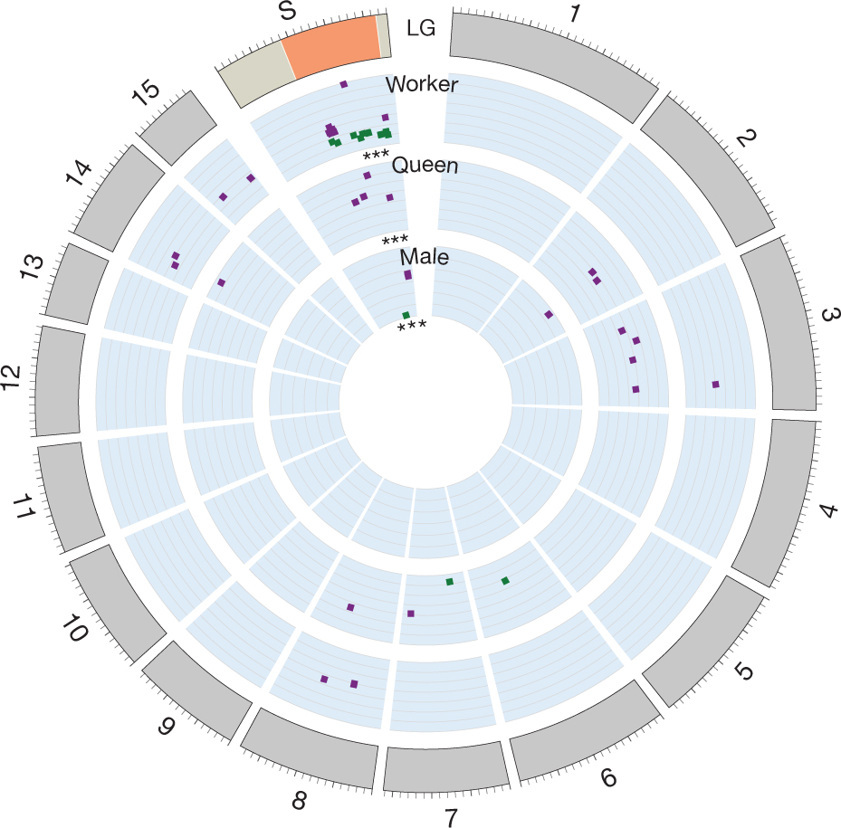

Expression of genes associated with Gp-9 genotype are
overrepresented on the social chromosome.
J Wang et al. Nature 000, 1-5 (2013) doi:10.1038/nature11832

