Slide 1
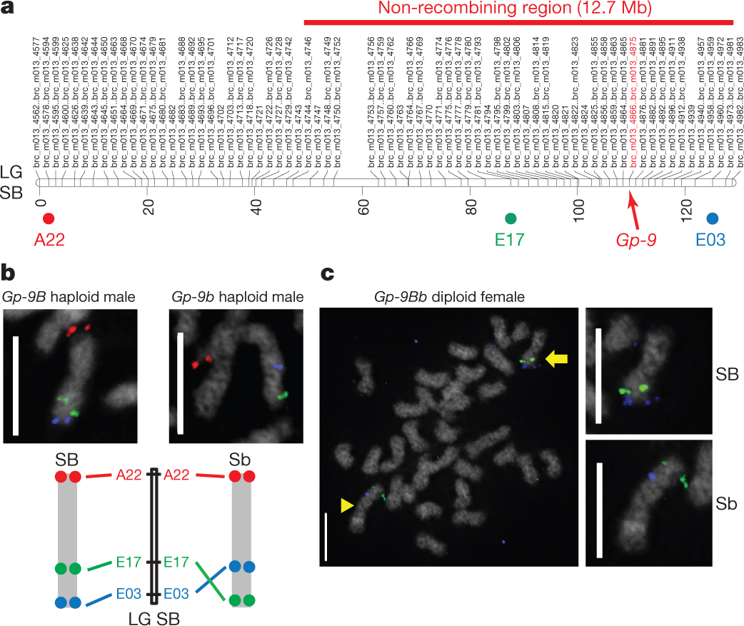

Fine-scale mapping and BAC-FISH analysis of the social chromosome.
J Wang et al. Nature 000, 1-5 (2013) doi:10.1038/nature11832

